Slide 1
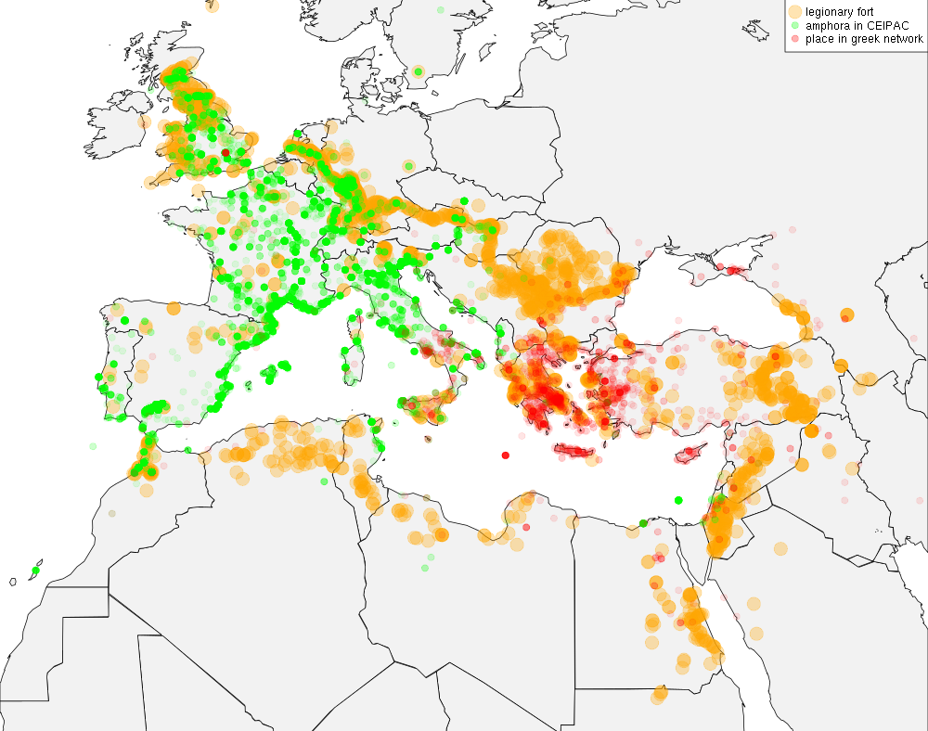
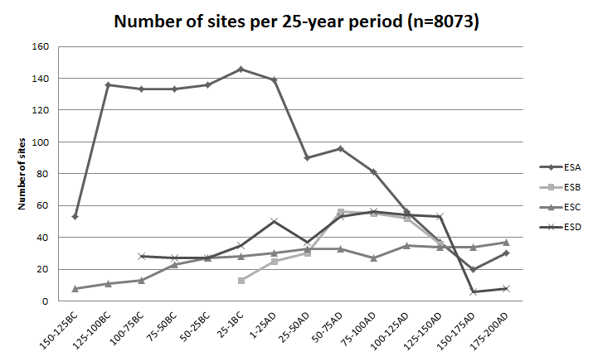
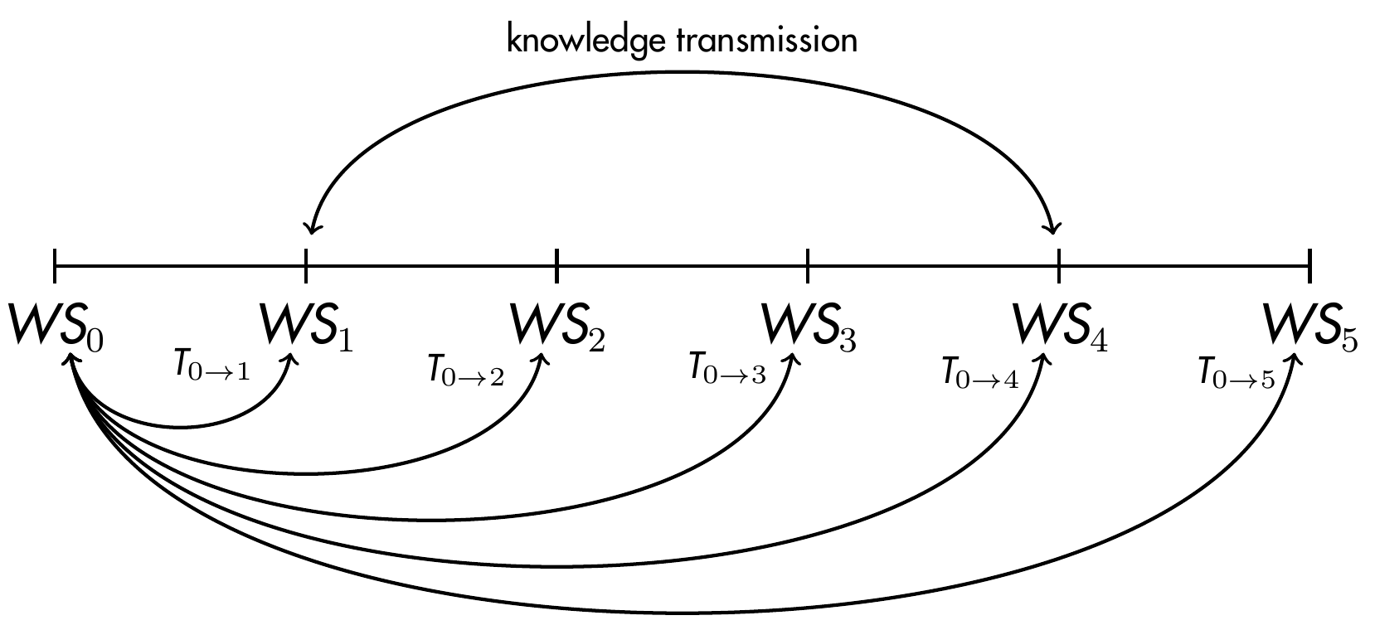
Archaeology
History
Data Analysis
Formal Model
DATA
PATTERN
PROCESS
Computer Model

Slide 2




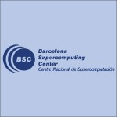
Archaeology
History
Data Analysis
Formal Model
DATA
PATTERN
PROCESS
Computer Model

