Slide 1
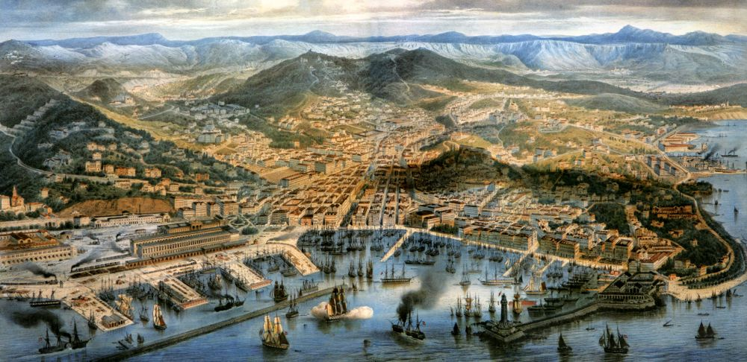
Patterns In Globalization
Viewed through the lens of Trieste
Gaetano Dato, Ben Zhu, Simon Carrignon, Anjali Tarun, Evelyn Strombom, Rudi Minxha, Brian Ferguson, Tucker Ely, Philip Pika

Slide 2

Import and Export from 1859 to 1910

Slide 3
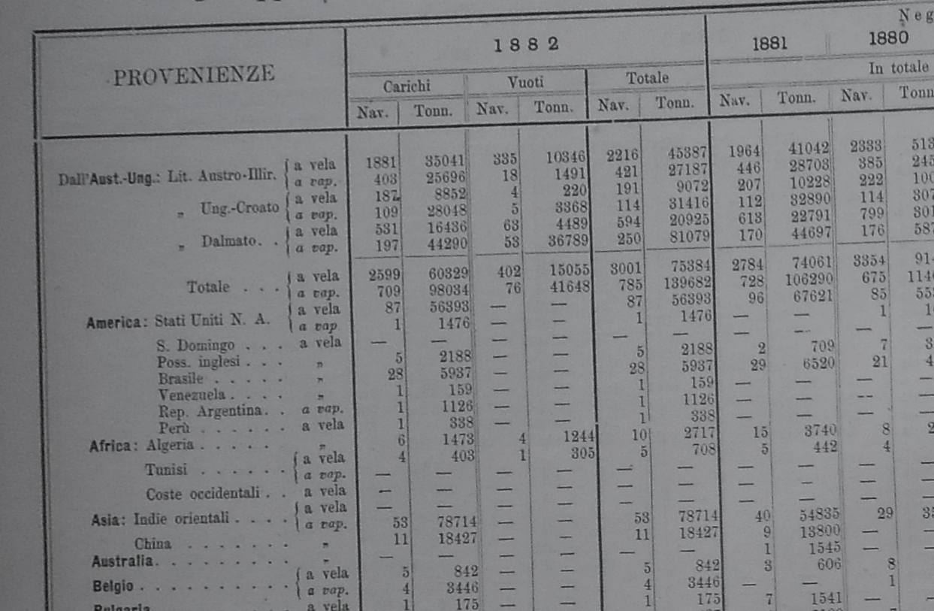

Slide 4
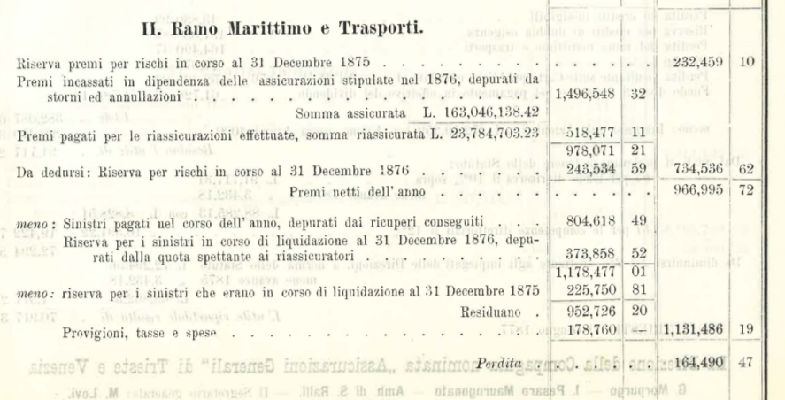
Insurance Data

Slide 5
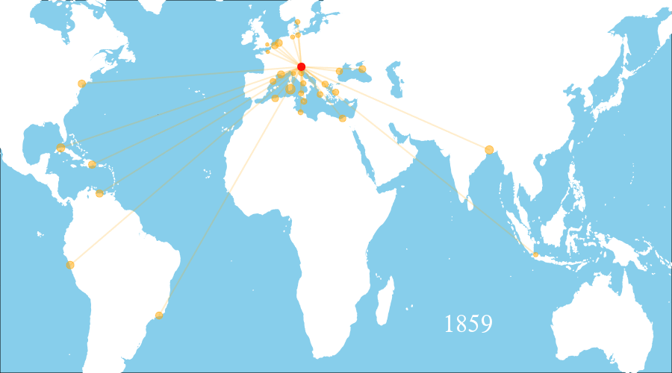
Import volume in Trieste from 1859 to 1910

Slide 6
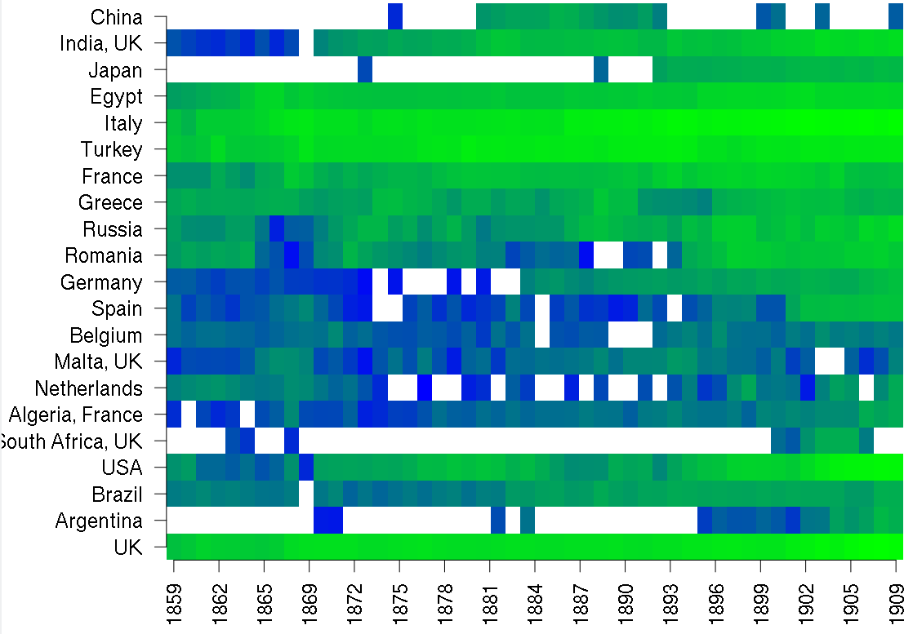
Japanese boom
Pacific
Opening of Suez Canal
Mediterranean
US Civil War
Atlantic

Slide 7
Economic Changes

Slide 8
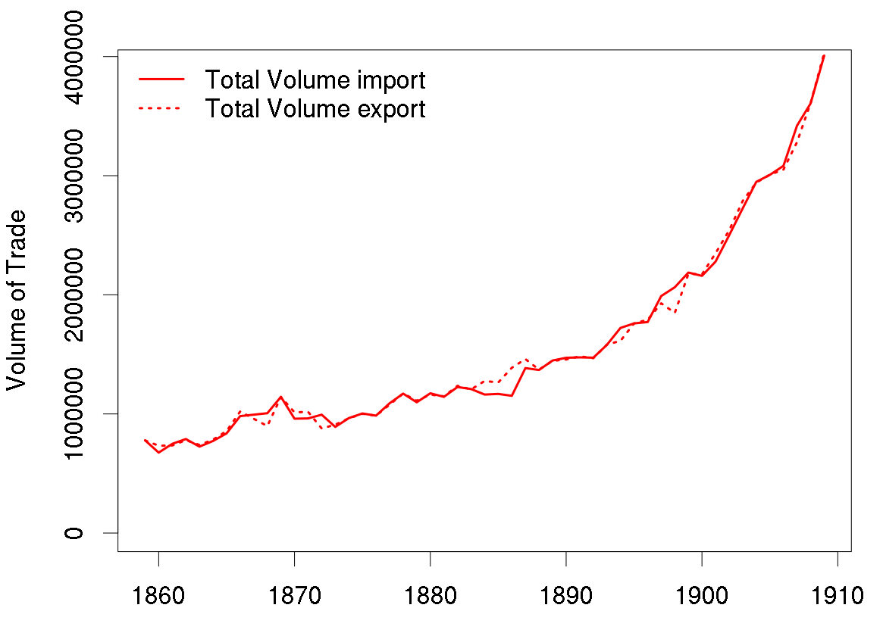

Slide 9
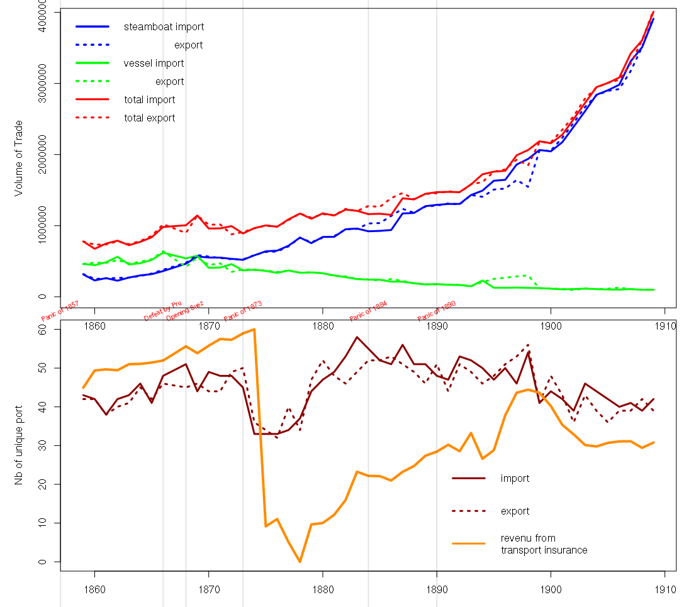

Slide 10
Insurance data
(hedge risk)
The Theoretical Landscape
What we think we are looking at
Import-Export strategy related to economic growth ideal
Real Data
(actual import and export behavior)
Math
Fingerprint of Globalization
Diversification over time
Volume over time
How do significant global events affect the evolution of these strategies.
Look for disconnection among world parters leading to war.
Decrease in variance, increase in KL.
Noise
(world event data)
Natural disasters
Disease
War
Trade agreements
Treaties
Embargos
Recessions
Government collapse
Technological innovation
Notes:
(1) The Austrians had some economic growth goal.
(2) We have raw data related to one of the major

Slide 11
The Theoretical Landscape
What we think we are looking at
Shipping data
Insurance data
World event data
Noise
(World event data)
Insurance data
(Hedge risk)
KL-divergence
Fingerprint of Globalization
Diversification over time
Volume over time
How do significant global events affect the evolution of these strategies.
Look for disconnection among world parters leading to war.
Decrease in variance, increase in KL.
Noise
(World event data)
Notes:
(1) The Austrians had some economic growth goal.
(2) We have raw data related to one of the major

Slide 12
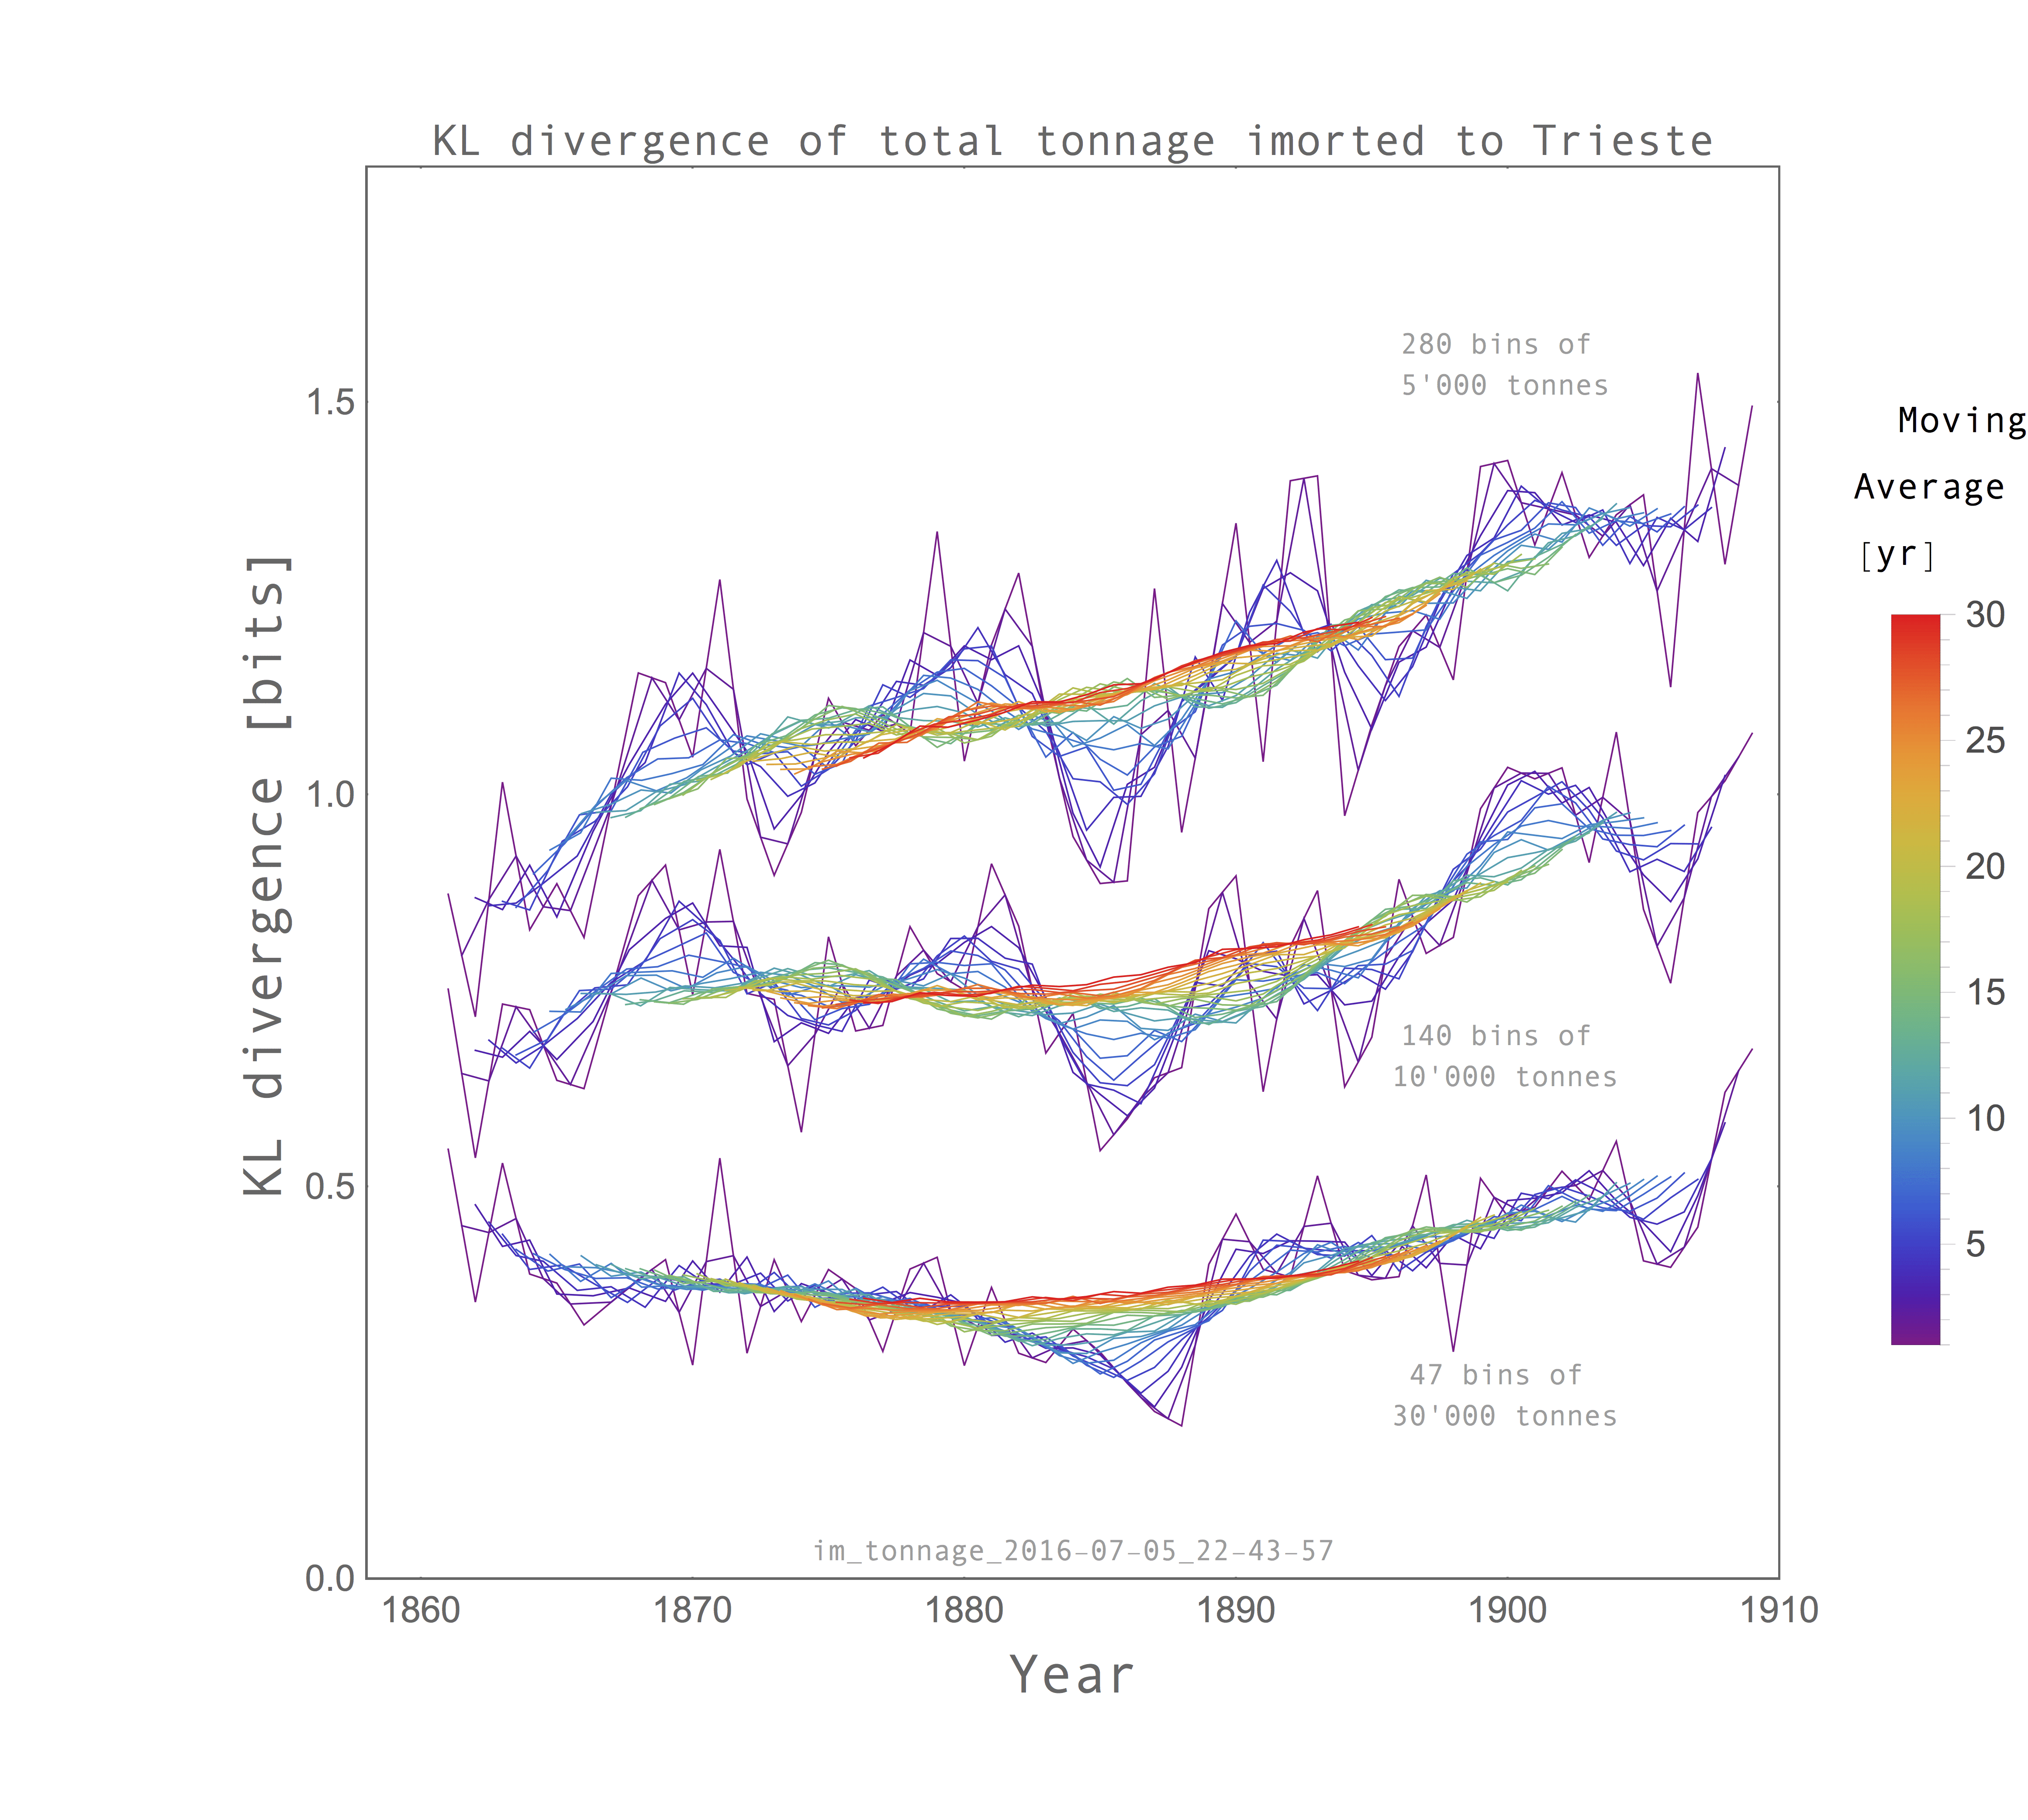
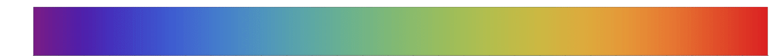
Kullback–Leibler Divergence - Import Data
1.5
More bins
(Fine grained)
[bits]
1.0
Fewer bins
(Coarse grained)
0.5
Year
Moving
Average [yr]
1 5 10 15 20 25 30

Slide 13
Technologic Changes

Slide 15
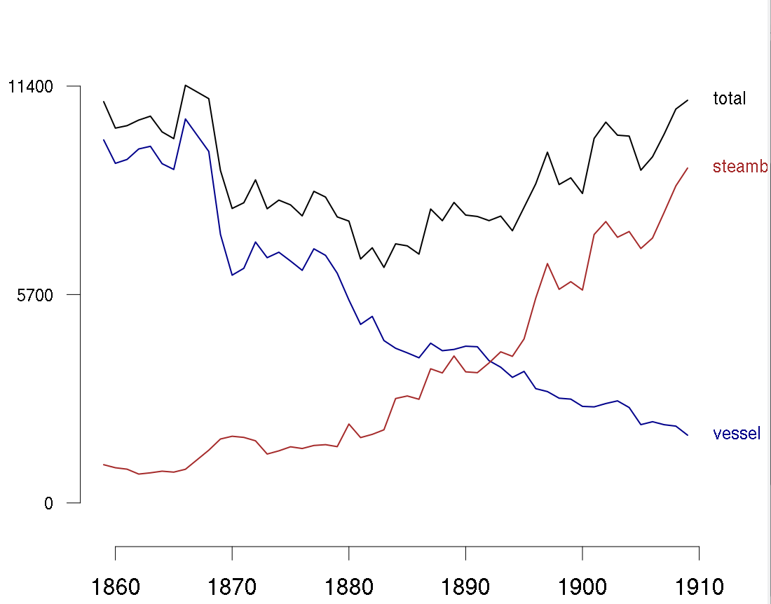
Number and type of boats

Slide 16
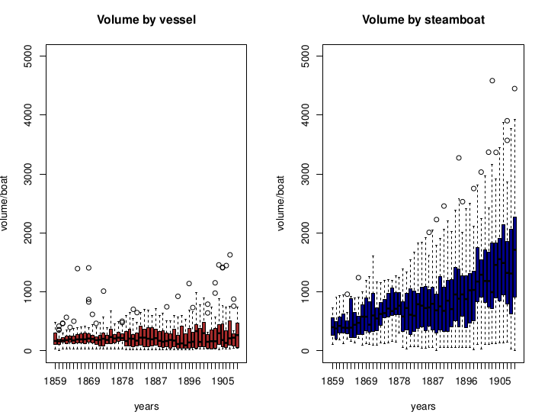

Slide 17
Number of boats
+

Slide 18
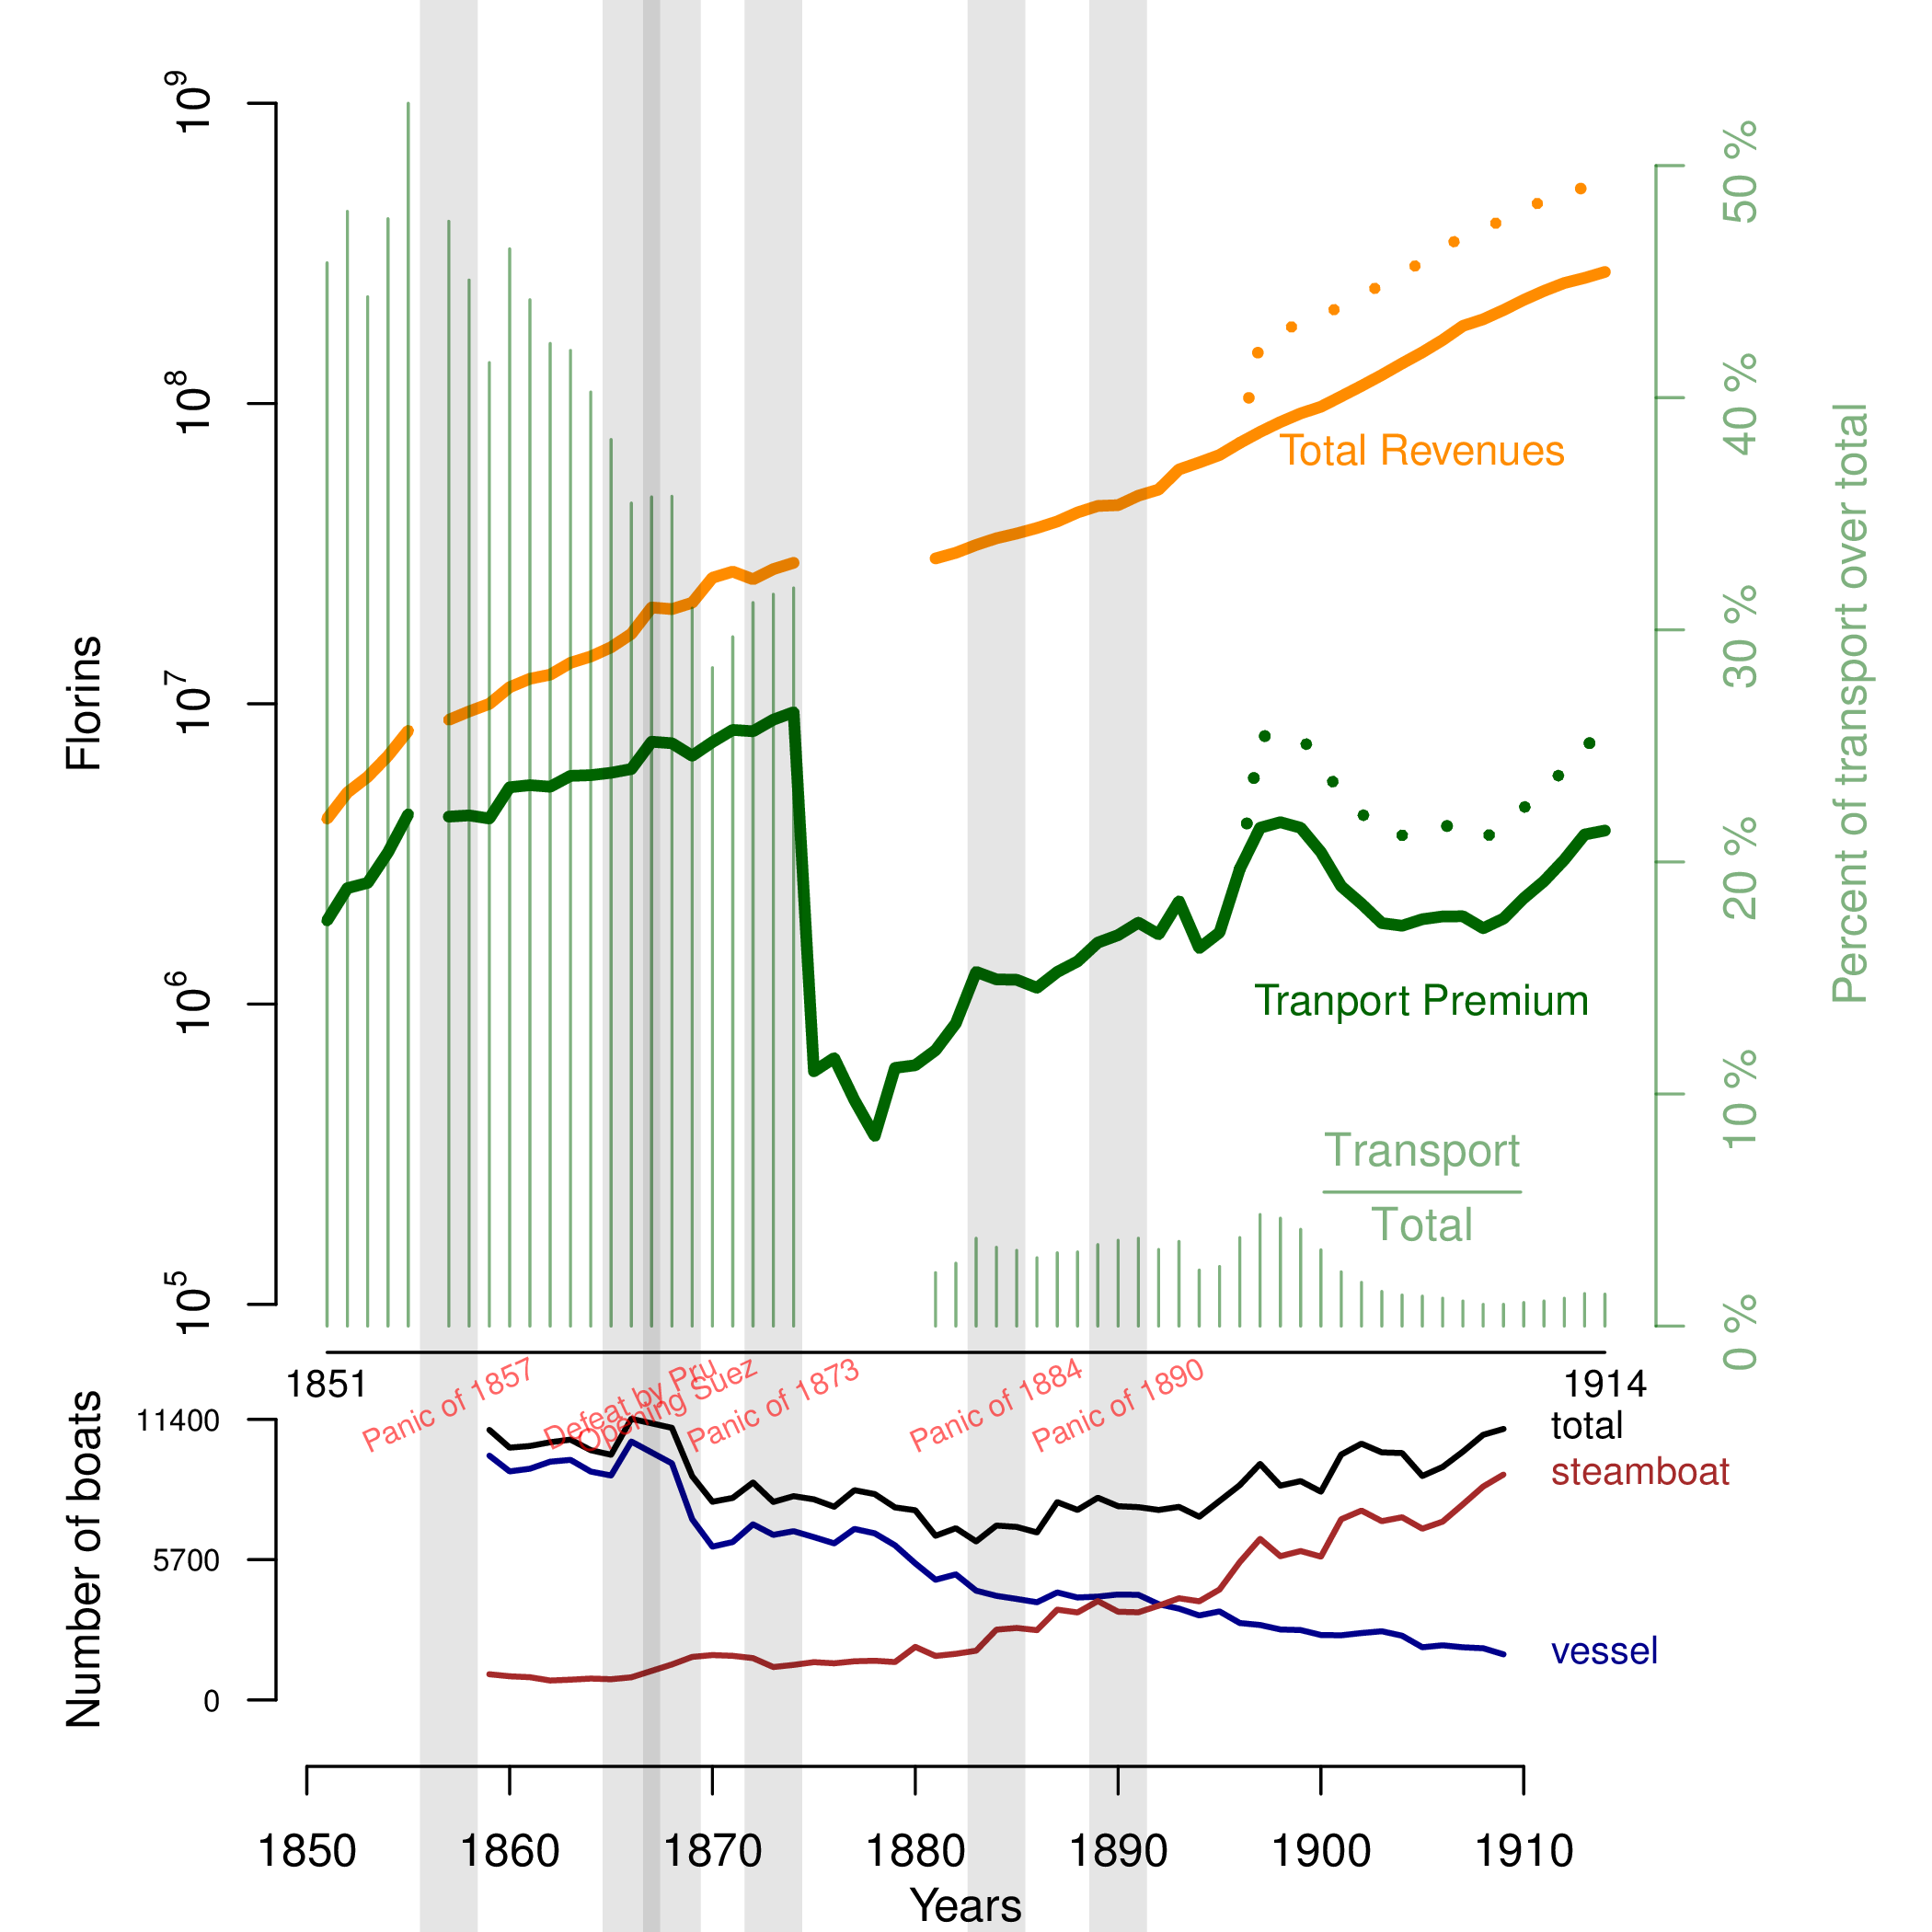

Notes:
When an insurer collects premiums they put that money into an investment pool. They use the premiums collected to fund investments (generally in low risk investments). Ideally, the company wants to have enough premium coming in to keep the investment pool fully funded but the profit itself comes from the return on investment rather than a surplus in the premiums charged vs. claims and expenses paid.

Slide 19
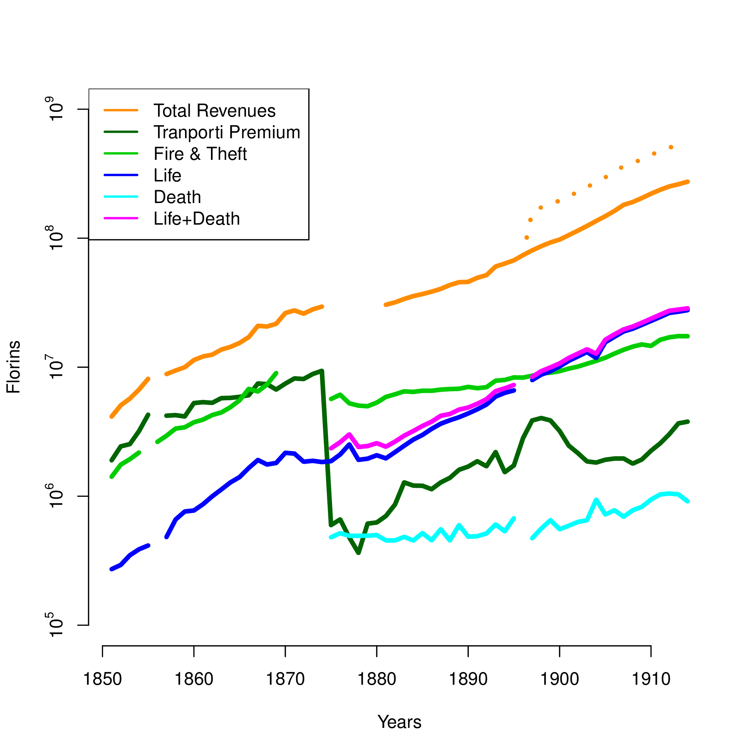

Slide 20
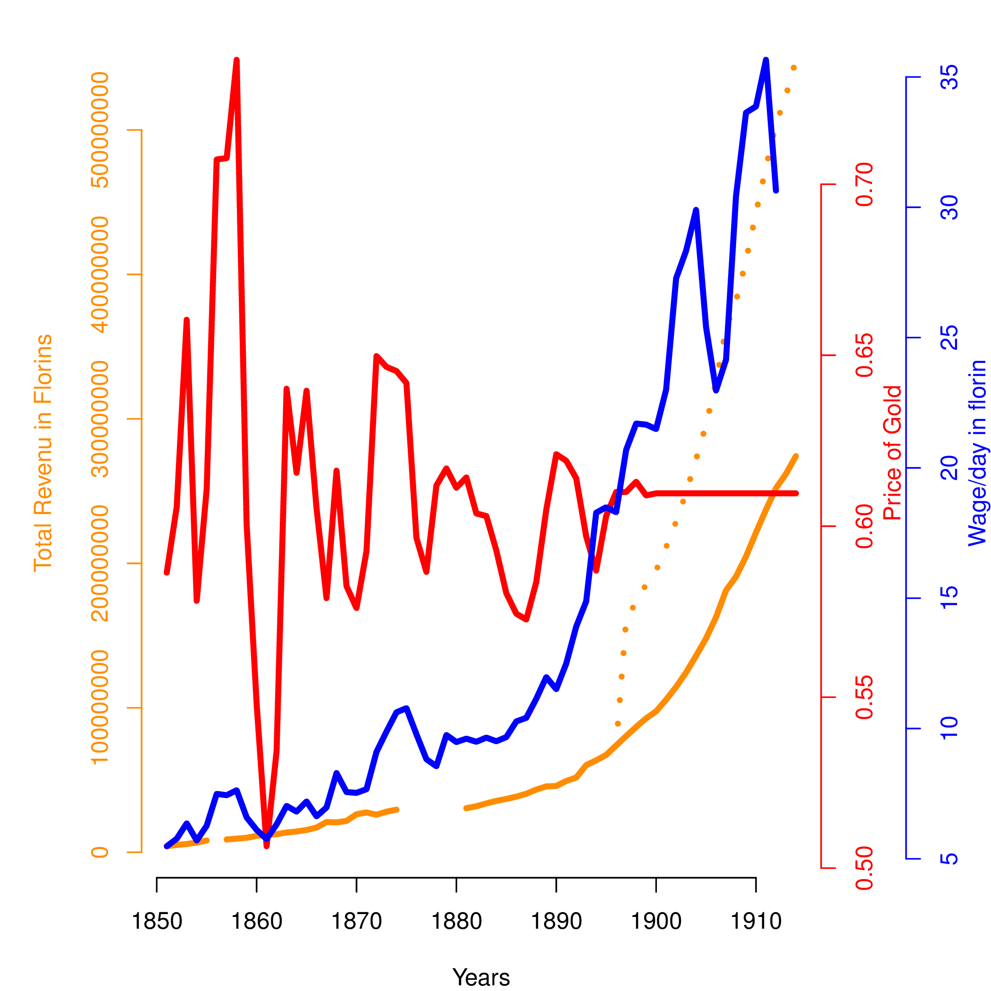

Slide 21
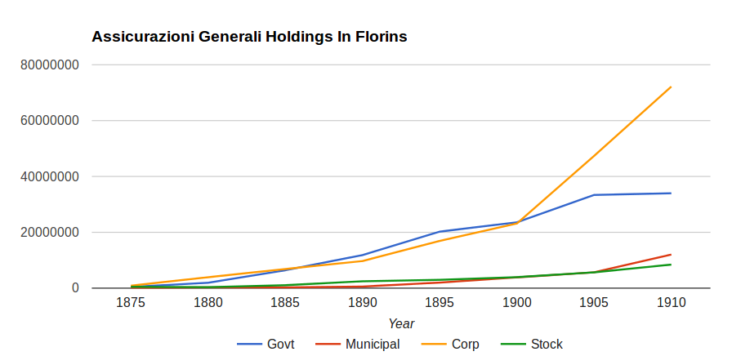
Generali Balance Sheet
2. Investment Strategy
Notes:
When an insurer collects premiums they put that money into an investment pool. They use the premiums collected to fund investments (generally in low risk investments). Ideally, the company wants to have enough premium coming in to keep the investment pool fully funded but the profit itself comes from the return on investment rather than a surplus in the premiums charged vs. claims and expenses paid.

Slide 22
Behind the Patterns

Slide 23

Global Network

Slide 24
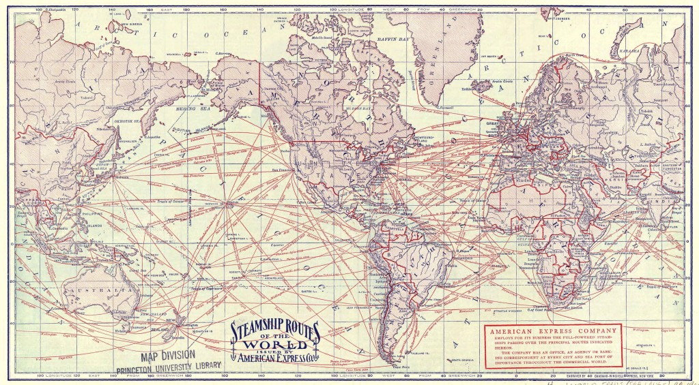
Global Network

Slide 25
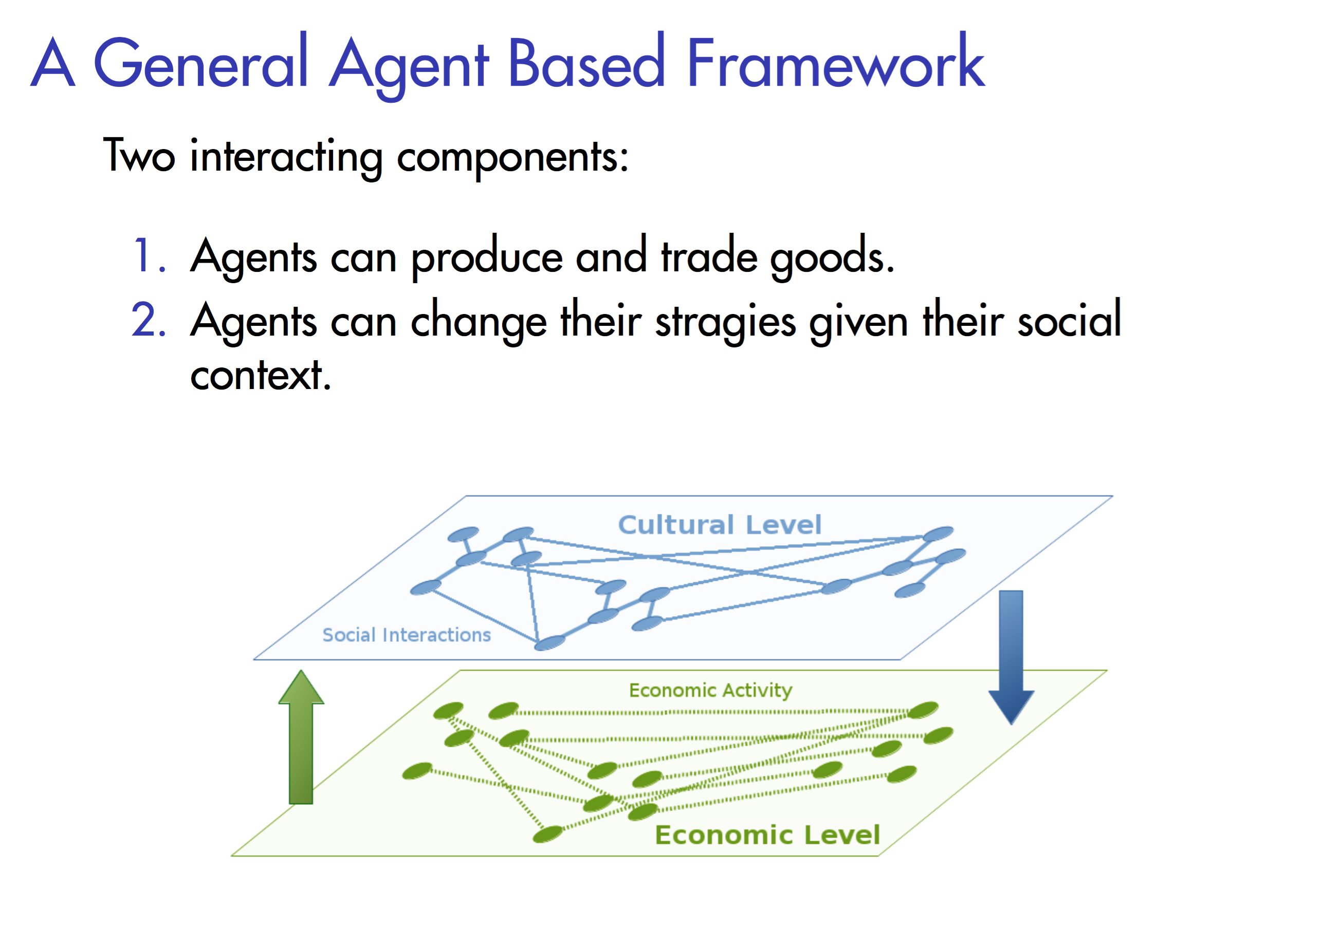
Notes:
In ongoing studies we want to compare the results of our analysis with the result of a model has been developped to study similar dynamics in past economies.
In this model agents (that in our case will be countries), can produce goods and trade those good with their economics partners. After a certain time, and given the result of the trade and the cultural links of every country, the agents can modify and copy the trading strageies of other countries. We hope with this simple model to test some hypothesis about the process leading the change in economics strategies that could explain the changes in trade flow.

Slide 26
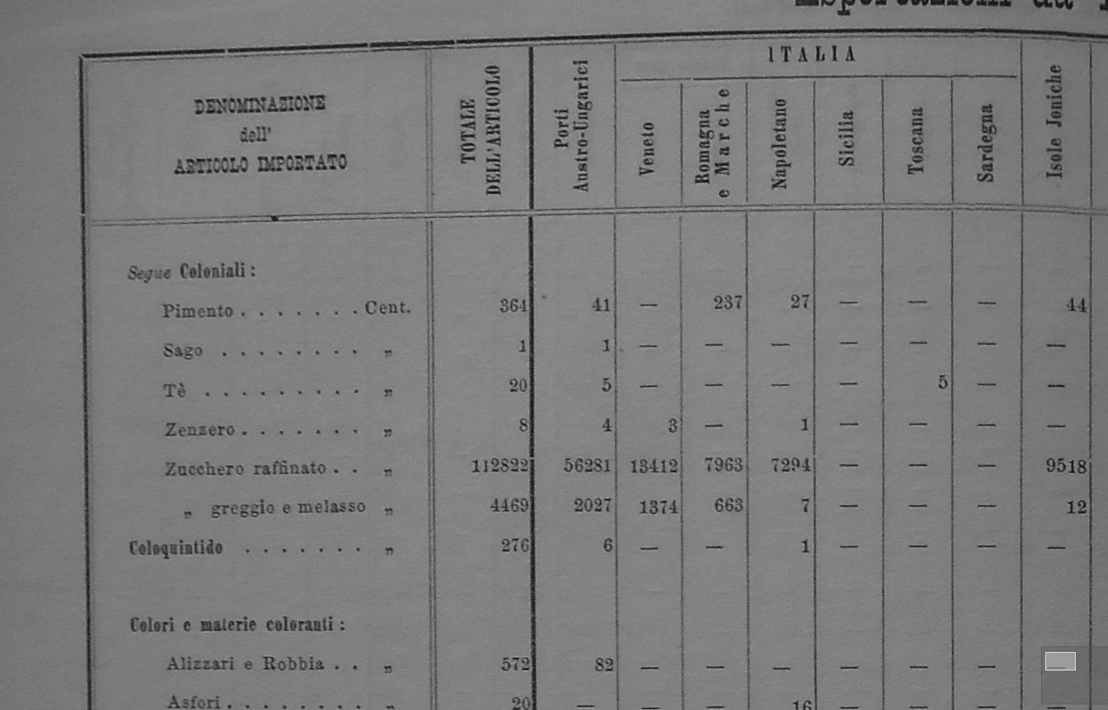

Slide 27
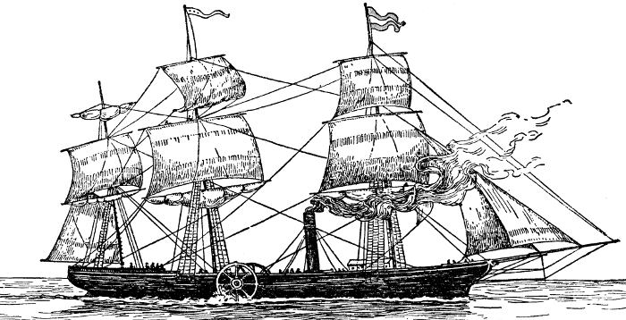
Going Forward
Digitize goods data (Hausmann-type analysis)
Time series analysis in import/export correlation: Granger causality/entropy
Analyze shipping insurance premiums
Correlate global events to trade data

