Slide 1
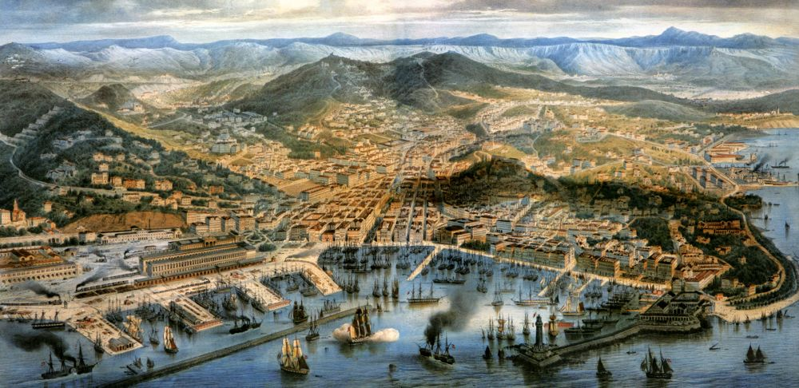
Patterns In Globalization
Viewed through the lens of Trieste
Gaetano Dato, Ben Zhu, Simon Carrignon, Anjali Tarun, Evelyn Strombom, Rudi Minxha, Brian Ferguson, Tucker Ely, Philip Pika

Slide 2
The Theoretical Landscape
What we think we are looking at
Insurance data
(hedge risk)
Import-Export strategy related to economic growth ideal
Real Data
(actual import and export behavior)
Math
Fingerprint of Globalization
Diversification over time
Volume over time
How do significant global events affect the evolution of these strategies.
Look for disconnection among world parters leading to war.
Decrease in variance, increase in KL.
Noise
(world event data)
Natural disasters
Disease
War
Trade agreements
Treaties
Embargos
Recessions
Government collapse
Technological innovation
Notes:
(1) The Austrians had some economic growth goal.
(2) We have raw data related to one of the major
<numéro>

Slide 3
The Theoretical Landscape
What we think we are looking at
Shipping data
Insurance data
World event data
Noise
(World event data)
Insurance data
(Hedge risk)
KL-divergence
Fingerprint of Globalization
Diversification over time
Volume over time
How do significant global events affect the evolution of these strategies.
Look for disconnection among world parters leading to war.
Decrease in variance, increase in KL.
Noise
(World event data)
Notes:
(1) The Austrians had some economic growth goal.
(2) We have raw data related to one of the major
<numéro>

Slide 4
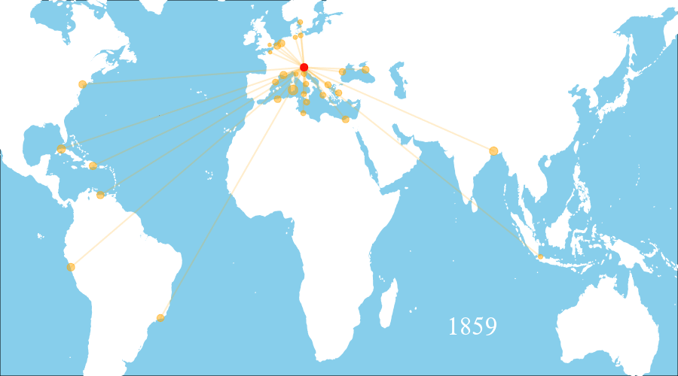

Slide 5
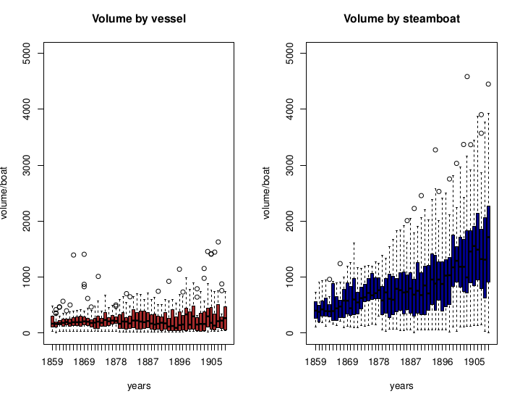

Slide 6
Imports
US Civil War
Atlantic
Mediterranean
Opening of Suez Canal
Japanese boom
Pacific

Slide 7
Exports
US Civil War
Atlantic
Mediterranean
Japanese boom
Opening of Suez Canal
Pacific

Slide 8
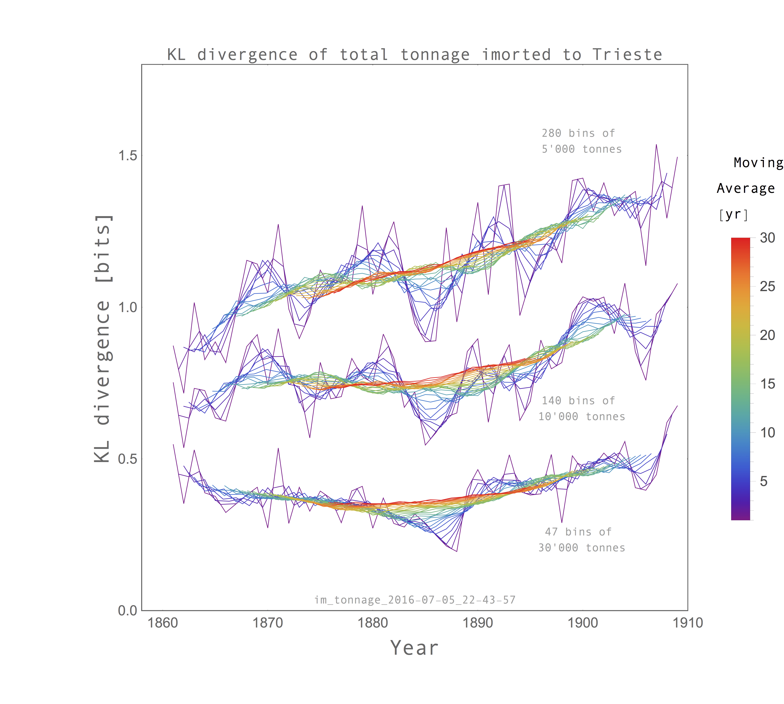
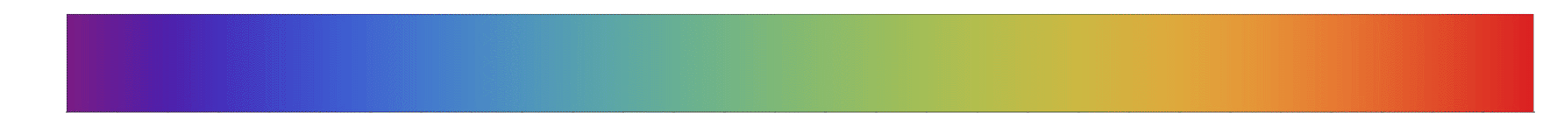
Kullback–Leibler Divergence - Import Data
1.5
More bins
(Fine grained)
[bits]
1.0
Fewer bins
(Coarse grained)
0.5
Year
Moving
Average [yr]
1 5 10 15 20 25 30

Slide 9
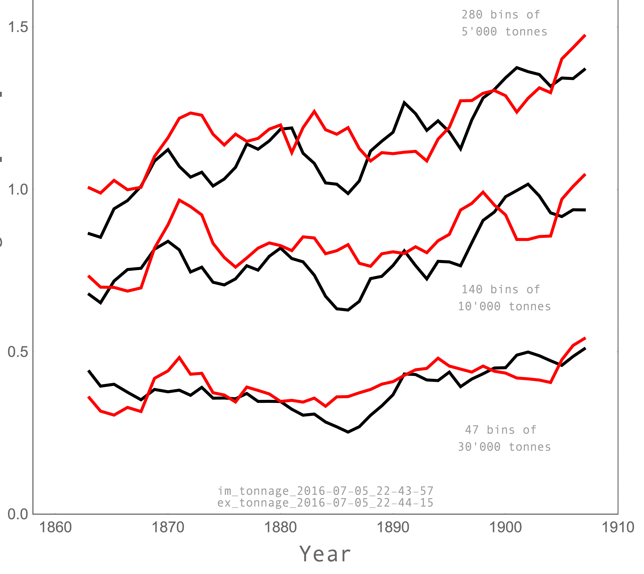
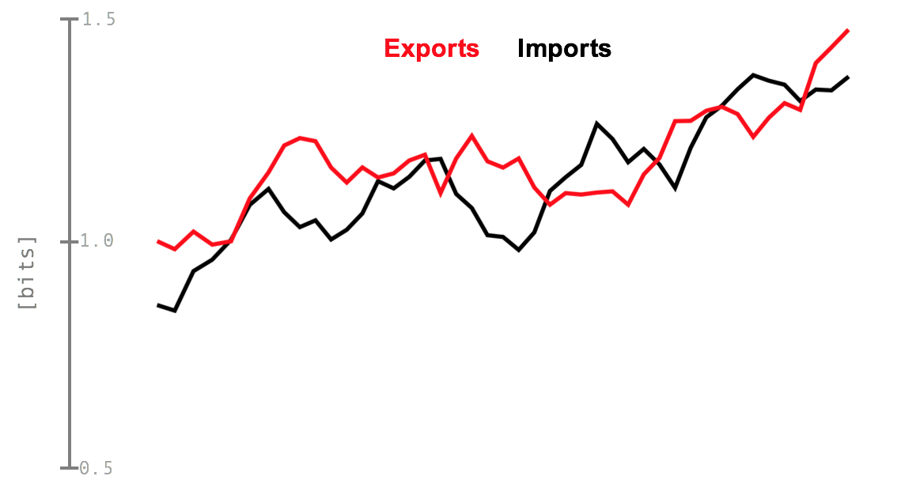
KL Divergence - 5 year moving averages
1.5
Exports
Imports
1.0
[bits]
0.5

Slide 10
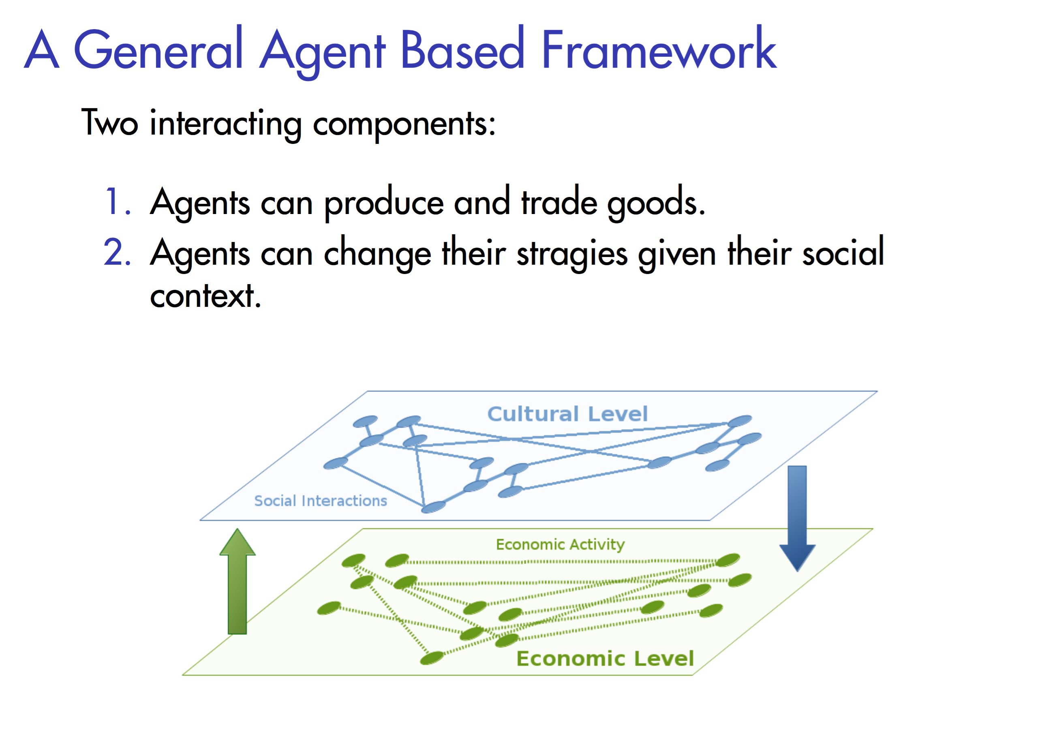
Notes:
In ongoing studies we want to compare the results of our analysis with the result of a model has been developped to study similar dynamics in past economies.
In this model agents (that in our case will be countries), can produce goods and trade those good with their economics partners. After a certain time, and given the result of the trade and the cultural links of every country, the agents can modify and copy the trading strageies of other countries. We hope with this simple model to test some hypothesis about the process leading the change in economics strategies that could explain the changes in trade flow.

Slide 11
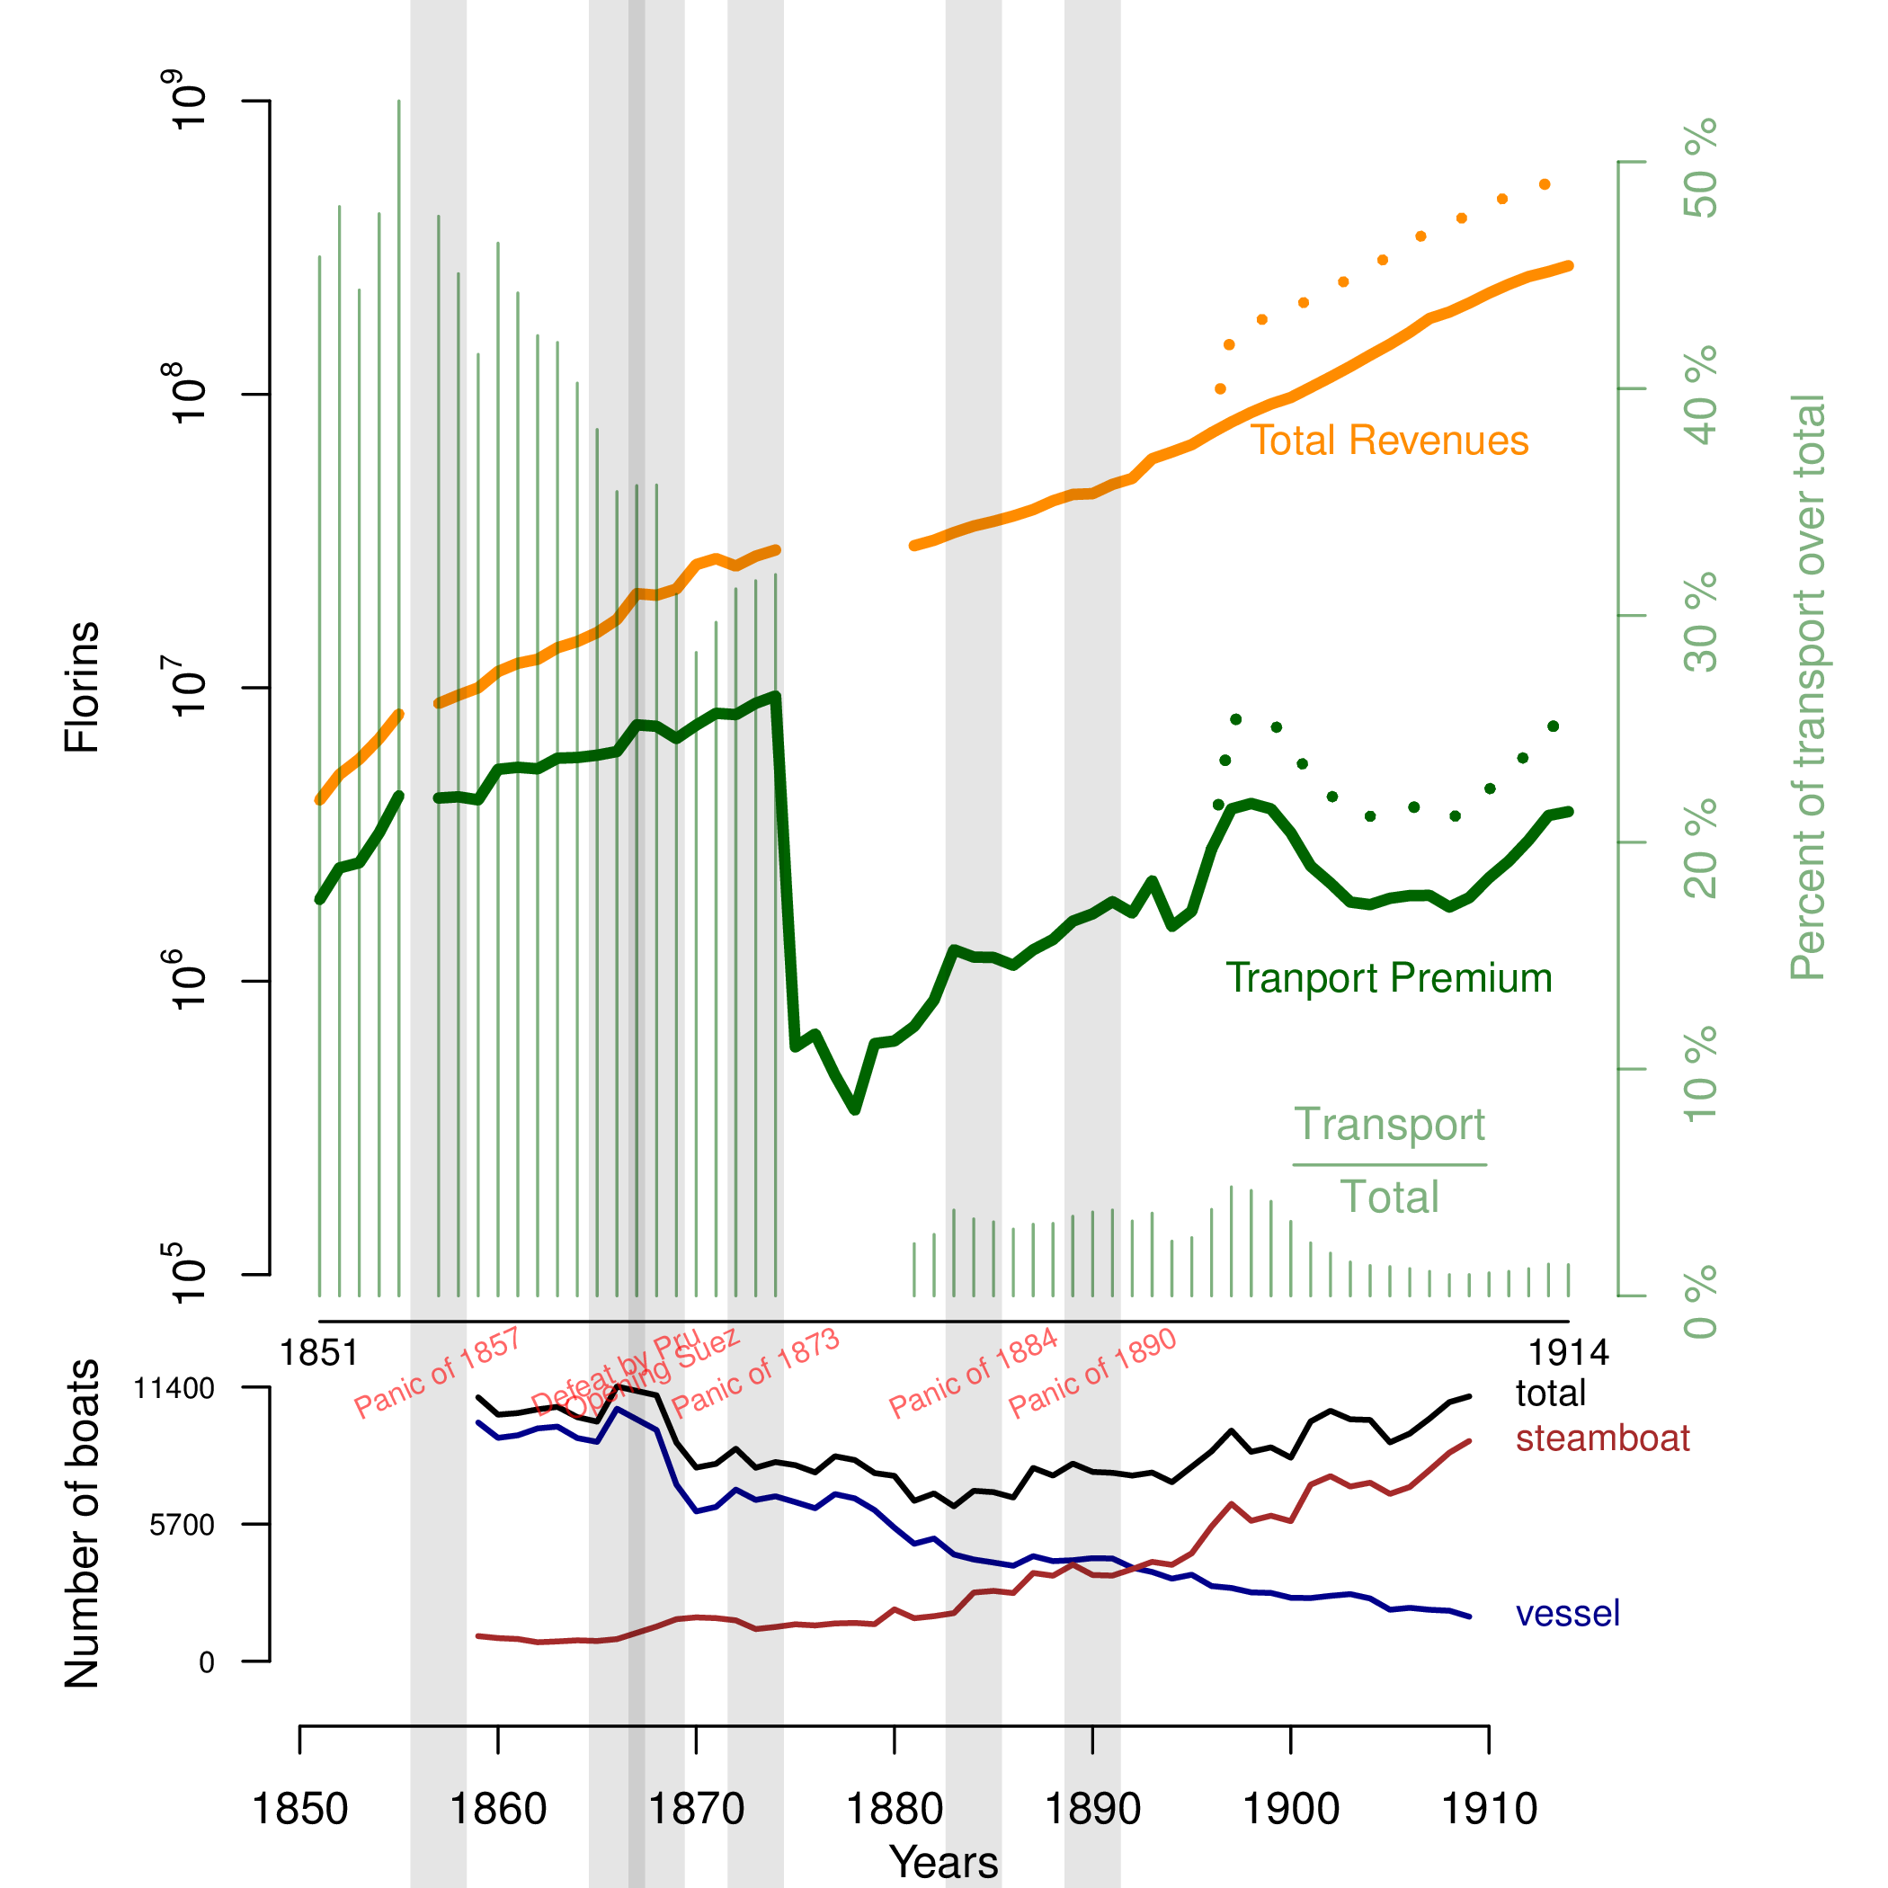

Notes:
<numéro>
When an insurer collects premiums they put that money into an investment pool. They use the premiums collected to fund investments (generally in low risk investments). Ideally, the company wants to have enough premium coming in to keep the investment pool fully funded but the profit itself comes from the return on investment rather than a surplus in the premiums charged vs. claims and expenses paid.

Slide 12
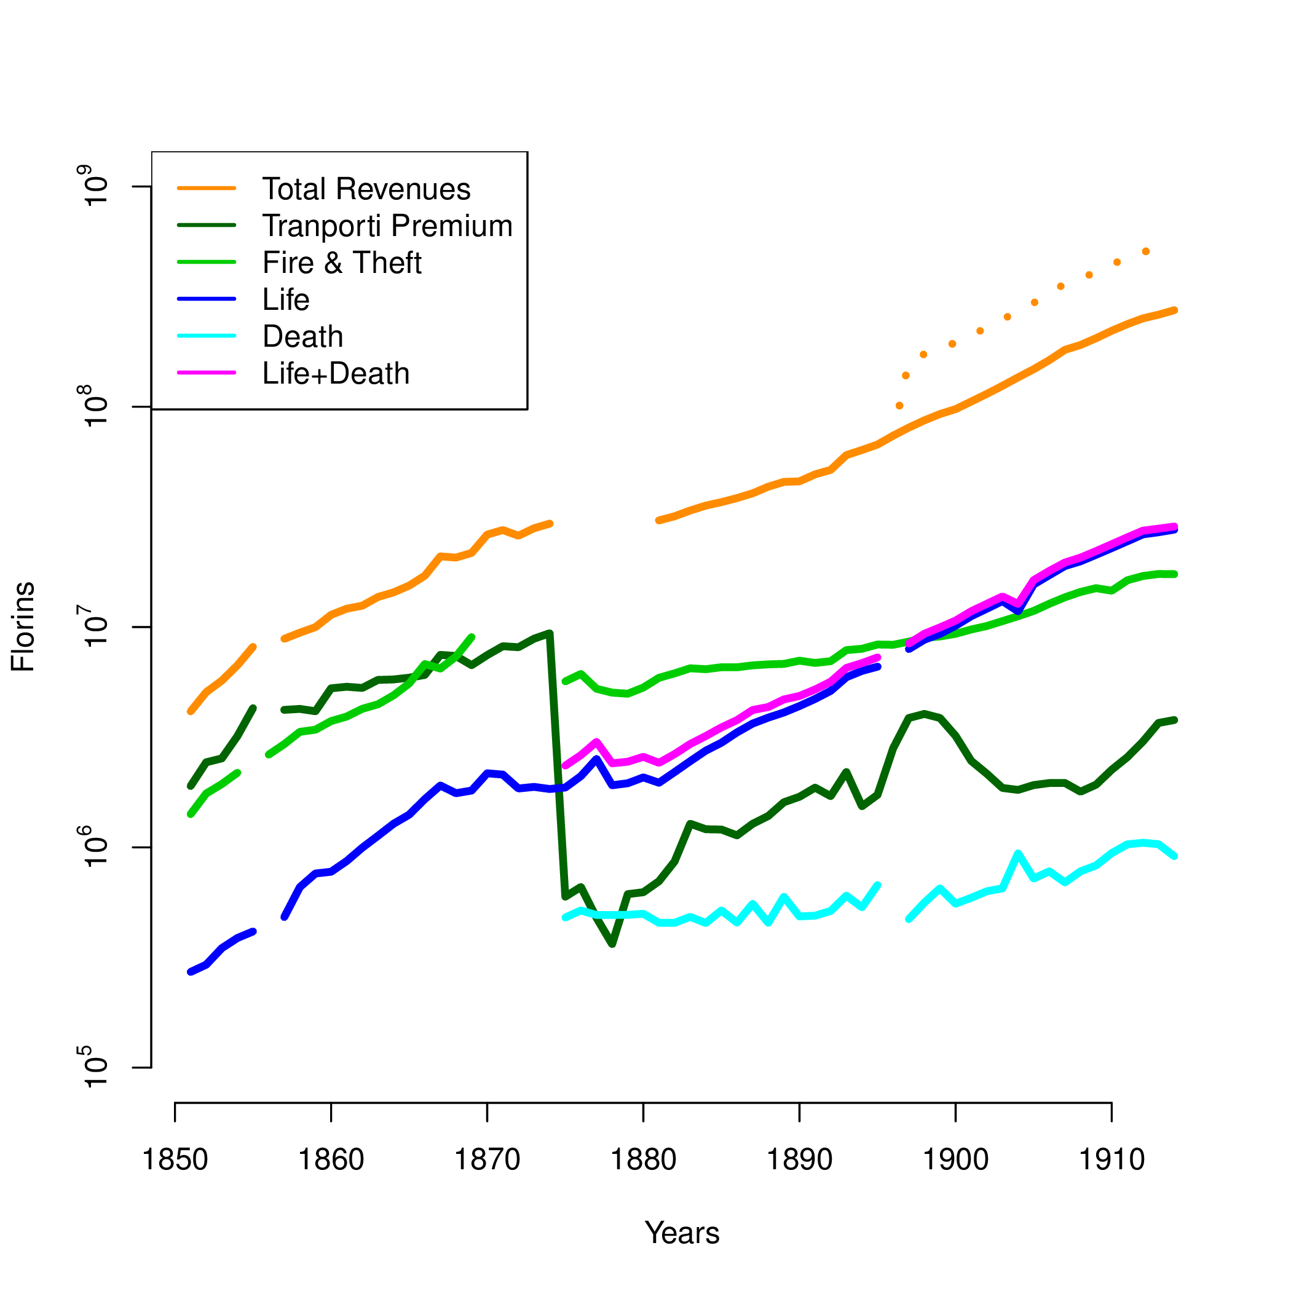

Slide 13
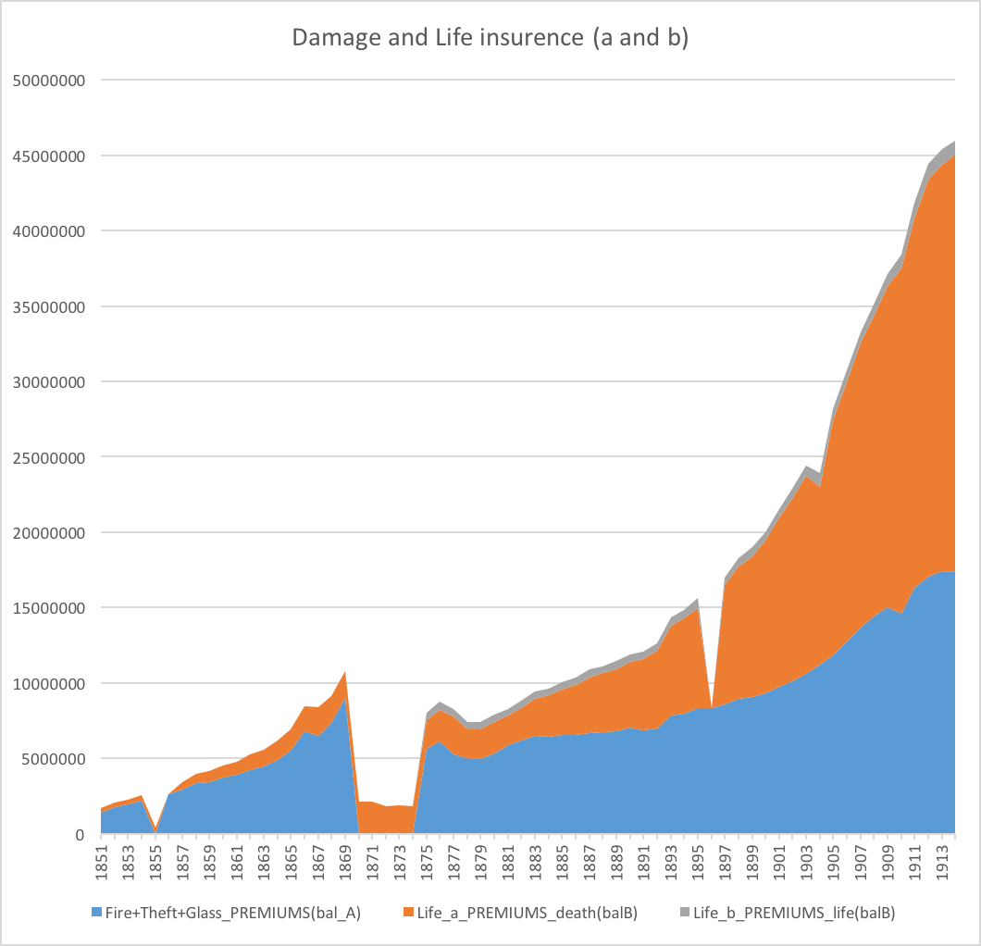

Slide 14
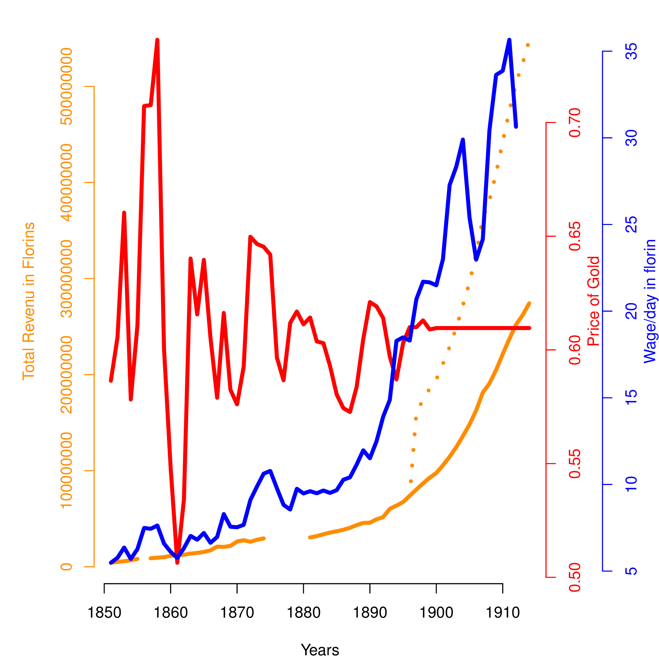

Slide 15
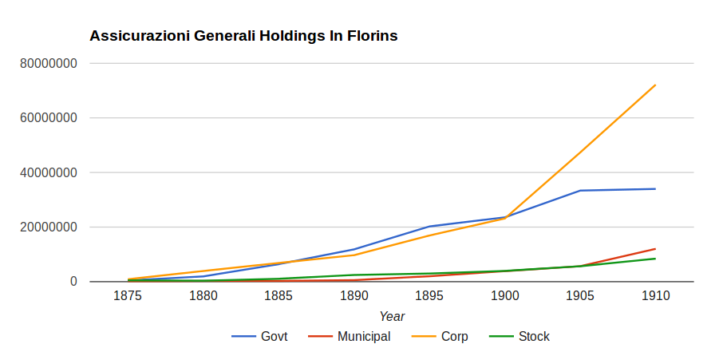
Generali Balance Sheet
2. Investment Strategy
Notes:
<numéro>
When an insurer collects premiums they put that money into an investment pool. They use the premiums collected to fund investments (generally in low risk investments). Ideally, the company wants to have enough premium coming in to keep the investment pool fully funded but the profit itself comes from the return on investment rather than a surplus in the premiums charged vs. claims and expenses paid.

Slide 16
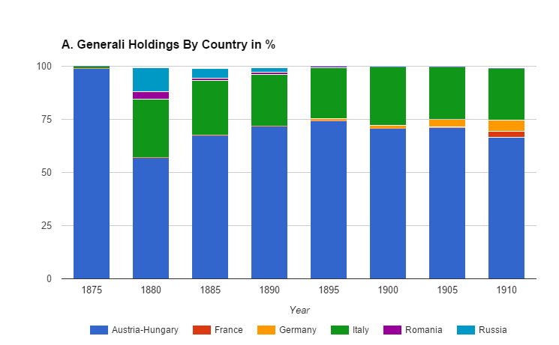
Investment Strategy - How is risk diversified?
Notes:
Sector exposure is limited to Railroads and Banks (and Insurance Companies for stocks although stocks were not a big portion of the portfolio).

Slide 17
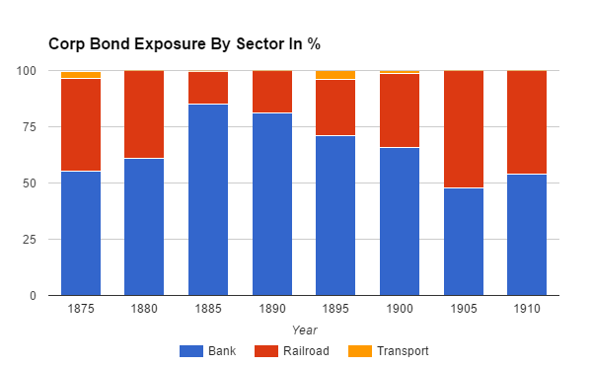
Notes:
Sector exposure is limited to Railroads and Banks (and Insurance Companies for stocks although stocks were not a big portion of the portfolio).

Slide 18
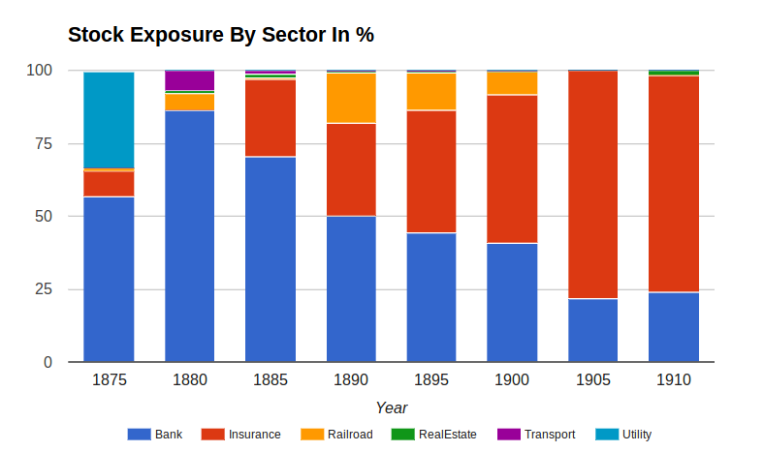

Slide 19
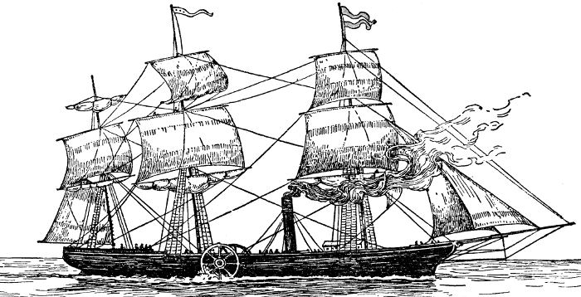
Going Forward
Digitize goods data (Hausmann-type analysis)
Time series analysis in import/export correlation: Granger causality/entropy
Analyze shipping insurance premiums
Correlate global events to trade data

