Slide 1
CIFS Administration on Data ONTAP 7.3
Version 5.0
Course#: STRSW-ED-ILT-CIFSAD-REV03

Slide 2
Safety
Alarm signal
Evacuation route
Assembly area
Electrical safety

Slide 3
Information Sources
NOWTM (NetApp on the Web) Site
  http://NOW.NetApp.com
NetApp Training Schedules
  http://www.netapp.com/us/services/university/
NetApp University Support
  http://netappusupport.custhelp.com

Slide 4
Overview
CIFS Administration on
Data ONTAP 7.3
Notes:
1-<number>

Slide 5

CIFS Features
Notes:
1-<number>

Slide 6
CIFS Definition
What is Common Internet File System (CIFS)?
  A Microsoft network file-sharing protocol that evolved from the Server Message Block (SMB) protocol
How does CIFS work?
  Access and manipulate files and folders on remote servers as if they are on a local machine
NetApp Confidential - Internal Use only
Notes:
1-<number>
The Common Internet File System (CIFS) is a Microsoft network file-sharing protocol that evolved from the Server Message Block (SMB) protocol.
When using CIFS, any application that processes network I/O can access and manipulate files and folders (directories) on remote servers in a similar way that it accesses and manipulates files and folders on the local system.

Slide 7
CIFS: Basic Functions
Network browsing to locate:
  Machines within an environment (provided by a browse list)
  Shared resources that are available on a given machine (provided by that machine)
User authentication
Authorization
  Shared Resource Access
  Folder and File Access
NetApp Confidential - Internal Use only
Notes:
1-<number>
The following are some CIFS features available in a Windows workgroup and domain:
Network browsing to locate machines within a domain or workgroup (provided by a
browse list) and shares that are available on each machine (provided by that machine).
User authentication.
Authorization at the share and folder/file level.

Slide 8
CIFS: Basic Functions (Cont.)
Basic file attributes
  Read-only
  Archive
  System
  Hidden
Extended NTFS file attributes of indexing, compression, and encryption
Unicode support
File locking (opportunistic locks)
Dialect negotiation
NetApp Confidential - Internal Use only
Notes:
1-<number>
Extended Attributes
Extended NTFS file attributes generally are not supported on a storage system. However, Encrypted File Systems (EFS) is supported with Open Systems SnapVault®.
Unicode support
Universal character encoding standard provides a unique number for every character, no matter what the platform, program, or language.
Characters represented by more than eight bits.
Opportunistic locks (oplocks for domains only)
Guarantee to the client that file content is not allowed to be changed by the server or, if some change is imminent, the client is notified before the change proceeds.
Oplocks are used to synchronize data and enhance performance.
Dialect negotiation
Each protocol version is referred to as a “dialect” and assigned a unique string identifier.

Slide 9
CIFS Environments
Notes:
1-<number>

Slide 10
Network Environments
Storage systems can participate in:
Workgroups
  Windows workgroup
  Non-Windows workgroup
Domains
  Windows NT 4.0
  Windows Active Directory
Notes:
1-<number>

Slide 11
Client Requirements
Each client in a CIFS environment must:
Locate other computers
Request resources from a server
  Requires user authentication
  Requires resource authorization
    Share permissions
    File-level permissions
NOTE: Implementation differs depending on the CIFS environment.
Notes:
1-<number>
In a network, a Windows client user requires the ability to:
Find other machines (computers)
Request resources from a server meaning any machine in the role of a server.
Requesting resources requires user authentication (verification of a user’s identity) to establish a session with a server and user authorization (permission) to access a share and resources (folders and files) in a share.

Slide 12
Windows Workgroups
Notes:
1-<number>

Slide 13
Windows Workgroup
A Windows workgroup:
  Logical grouping of networked machines
  Shares resources, such as folders and files
Each machine in the workgroup authenticates and authorizes users via a local security database
NOTE: Users must have an account on the machine they wish to
access.
Notes:
1-<number>
A Windows workgroup is a simple, logical group of networked machines (computers) that share resources, such as folders and files.
Each machine has its own Security Accounts Manager database (for Windows NT) or a local security database (for Windows 2000 or later) that is used to perform user authentication and user authorization.
Each user that wants to access resources on a machine must have a user account on that machine.

Slide 14


Storage System Joins a Workgroup
For a storage system to “join” a Windows workgroup…
It must broadcast its “name” to the network
The master browser must update the master browse list
It must broadcasts the browse list to all members of the domain
  15-minute delay possible
NOTE: Storage systems do not pull the master browse list
I’m a storage system,
and I’m new!
List
List
List
Master
Browser
Machine
B
Storage
System
Notes:
1-<number>
When workgroup machines normally pull the updated master browse list to their local machine, the storage system does not. The browse list is a mechanism for members of the workgroup to find other members. The storage system always acts in a server role. Therefore, there is no need to discovery other members in the workgroup.

Slide 15
Name Resolution in a Workgroup
Machine name to IP resolution:
A user broadcasts a name query on the network
The requested machine responds to the name query by returning its IP address
Storage system’s IP
What is the IP address
of the storage system?
List
List
List
Machine
A
Machine
B
Storage
System
Notes:
1-<number>
How does workgroup machine-name resolution work?
A machine broadcasts a name query to other machines are the network. For example, Machine A may broadcast a query for the IP address of the storage system. The storage system responds to the name query by broadcasting it IP address back to Machine A.

Slide 16


Storage System User Authentication
Storage system user authentication is performed
locally:
Users are added to a storage system
Authentication is performed locally
Authenticated users are provided with a session
Machine B requests user
session authentication
Authenticates
Machine B
User Info
username
password
group info
user rights
List
List
List
Local User
Accounts
Session with
Machine B
Master
Browser
User
Info
Machine
B
User
Info
Storage
System
User
Info
Machine Accounts
Notes:
1-<number>
How does user authentication work on a storage system in a workgroup?
Users (local-user accounts) are added to a storage system and user authentication is performed locally on the storage system. User session authentication with a user name and password, enables a user to establish a session with the storage system.
Data access on a storage system requires a network logon to the storage system. A user can administer a storage system through the network (for example, a Telnet session) using a local account on the storage system; however, a user cannot logon locally to a storage system to access data.
Machine-B user requests user session authentication with the storage system. The storage system authenticates Machine-B user by using his user name and password found in the storage system local-user account. After Machine-B user successfully authenticates, a session is established with Machine-B user and the storage system.
Authenticated users can browse a storage system for available resources, but must be authorized to access a share and resources in a share.

Slide 17
Non-Windows Workgroups
Notes:
1-<number>

Slide 18
Non-Windows Workgroups
A non-Windows workgroup:
  Support for Windows client machines when there is no Windows workgroup or domain
  Share resources with Windows client users
This environment is also referred to as:
  UNIX password workgroup
  /etc/passwd-style workgroup
Notes:
1-<number>
A non-Windows workgroup is a logical group of networked machines that share resources with Windows client users; the networked machines are members of neither a Windows workgroup nor a Windows domain.
This network environment also is called:
UNIX password workgroup
/etc/passwd-style workgroup

Slide 19
Non-Windows Workgroup Storage System
Provides user authentication by one or more of the following:
  Storage system local /etc/passwd file
  Network Information Services (NIS) server
  Lightweight Directory Access Protocol (LDAP) server
Provides name to IP resolution by one or more of the following:
  Storage system local /etc/hosts file
  NIS server
  Domain Name System (DNS) server
NOTE: /etc/nsswitch.conf sets the order of precedence for the
mechanism used
Notes:
1-<number>
When a storage system becomes a non-Windows workgroup server, it provides services to clients. An example is an all-UNIX work environment with many UNIX workstations and a few Windows clients with users that need CIFS resources. Note that any UNX reference also includes LINUX.
Servers functioning in the role of a directory store for user information (user names, passwords, and group information):
Storage system’s local /etc/passwd file
Network Information Services (NIS) server
Lightweight Directory Access Protocol (LDAP) server
Servers that can provide machine (host) name resolution:
Storage system’s local /etc/hosts file
NIS server
Domain Name System (DNS) server

Slide 20
Windows Workgroup Advantages
Does not require running Windows Domain Controller
  Advantageous for small organizations
Simple to design and implement
Convenient for a limited number of machines in close proximity
  Limited to 96 local clients
Notes:
1-<number>

Slide 21
Non-Windows Workgroup Advantages
In a mostly UNIX environment, CIFS shares made available to the few Windows client users
User authentication performed by existing:
  NIS
  LDAP server
  /etc/passwd file
Name to IP resolution performed by existing:
  NIS
  DNS server
  /etc/hosts
Notes:
1-<number>

Slide 22
Workgroup Disadvantages
Administrative overhead in maintaining a list of user accounts on multiple machines
  Any changes to a user account (for example, passwords) could be made on each machine
Joining or leaving a workgroup must be replicated by the master browse list
  Delay up to 15 minutes
Generally, a browse list cannot span subnets
  Workgroup depends on subnet broadcasting
Notes:
1-<number>

Slide 23
Workgroups
CIFS Administration on
Data ONTAP 7.3
Notes:
2-<number>

Slide 24
Terminating/Restarting CIFS
Notes:
2-<number>

Slide 25
Stopping and Restarting CIFS
To terminate CIFS service (a complete shutdown) where all CIFS sessions are ended:
  cifs terminate [-t minutes]
To restart CIFS service after terminating:
  cifs restart
Notes:
2-<number>

Slide 26
CLI: Stopping and Restarting CIFS
As an example, stop and restart CIFS services on the storage system called “system”.
  system> cifs terminate
  CIFS local server is shutting down...
  CIFS local server has shut down...
  system> cifs restart
  CIFS local server is running.
  system> Tue Aug 1 19:07:26
  GMT[nbt.nbns.registrationComplete:info]: NBT:
  All CIFS name registrations have completed for
  the local server.
Notes:
2-<number>

Slide 27
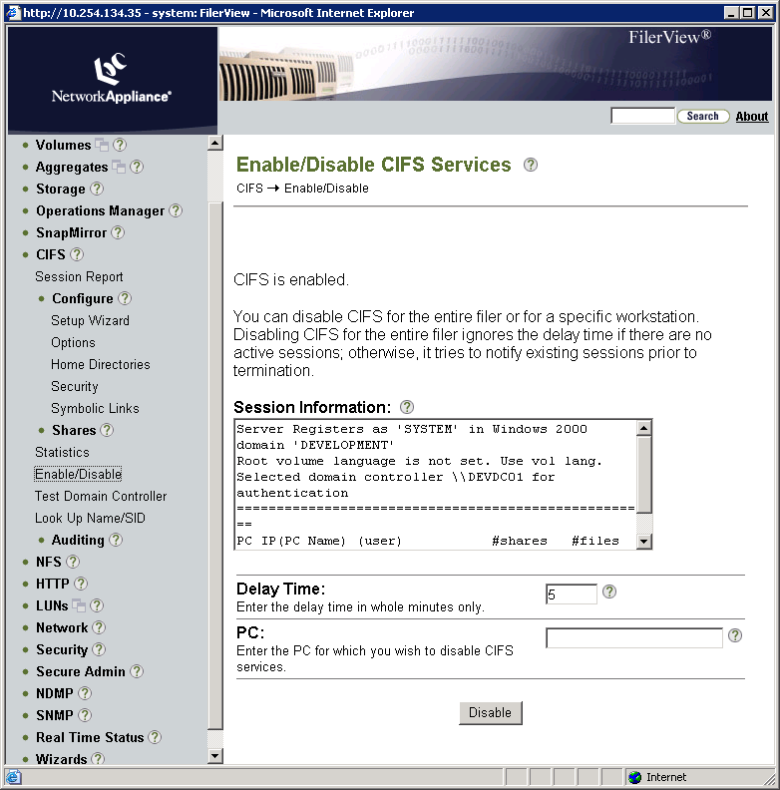
FilerView: Stopping CIFS Services
Notes:
2-<number>
You can disable CIFS for the entire storage system or for a specific workstation. Disabling CIFS for the entire storage system ignores the delay time if there are no active sessions. Otherwise, it tries to notify existing sessions prior to termination.
As an example with FilerView, stop CIFS services on the storage system by performing the following steps:
Go to FilerView→CIFS→Enable/Disable.
There are no active sessions for the storage system, so the Delay Time is ignored.
Click the Disable button.
Note: You also can enter the name of a specific PC (Windows workstation) to disable CIFS services.

Slide 28
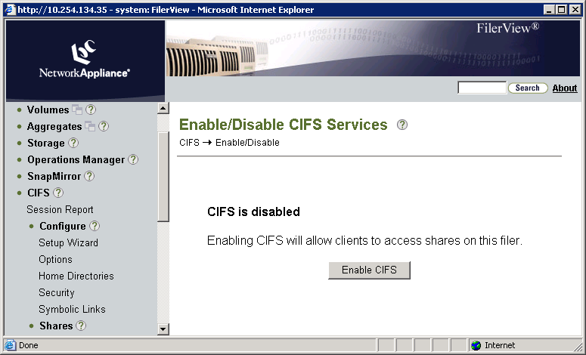
FilerView: Restarting CIFS Services
Notes:
2-<number>
As an example with FilerView, restart the CIFS services on the storage system by performing the following steps:
Go to FilerView→CIFS→Enable/Disable.
Click the Enable CIFS button.
Enabling CIFS will allow clients to access shares on this storage system.

Slide 29
FilerView: Restarting CIFS Services
Notes:
2-<number>
As an example with FilerView, restart the CIFS services on the storage system by performing the following steps:
Go to FilerView→CIFS→Enable/Disable.
Click the Enable CIFS button.
Enabling CIFS will allow clients to access shares on this storage system.

Slide 30
Shares and Sessions
CIFS Administration on
Data ONTAP 7.3
Notes:
3-<number>

Slide 31
Share Administration
Shares may be managed via:
  CLI
  FilerView®
  Microsoft Management Console (MMC)
    Computer Management
Share administration includes:
  Display shares
  Add shares
  Provide access to shares
  Remove shares
Notes:
3-<number>

Slide 32
Displaying Shares
Notes:
3-<number>

Slide 33
CLI: Displaying CIFS Shares
As a result of setting up the CIFS service, default shares are created
To display all shares: cifs shares
Example:
system> cifs shares
Name Mount Point Description
---- ----------- -----------
ETC$ /etc Remote Administration
BUILTIN\ Administrators / Full Control
HOME /vol/vol0/home Default Share
everyone / Full Control
C$ / Remote Administration
BUILTIN\ Administrators / Full Control
Notes:
3-<number>

Slide 34
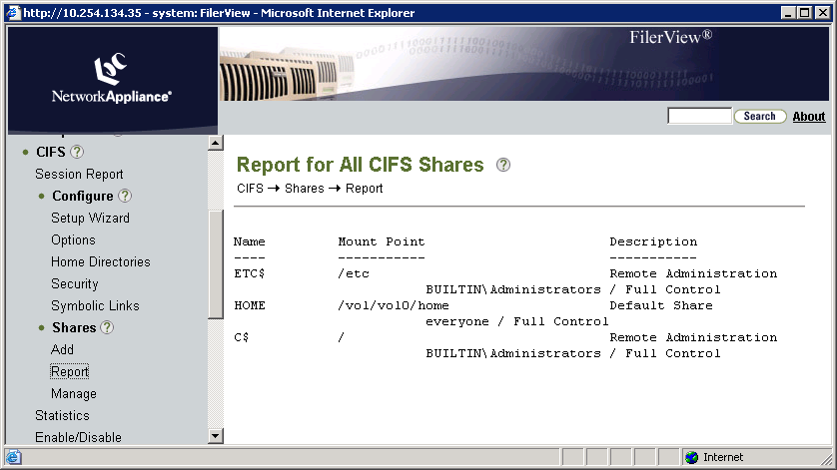
FilerView: Displaying CIFS Shares
Display CIFS shares with FilerView
Notes:
3-<number>
You can go to FilerView→CIFS→Shares→Report to display CIFS shares.
In this example, the three default shares―C$, ETC$, and HOME―display with their mount points (paths) and descriptions.

Slide 35
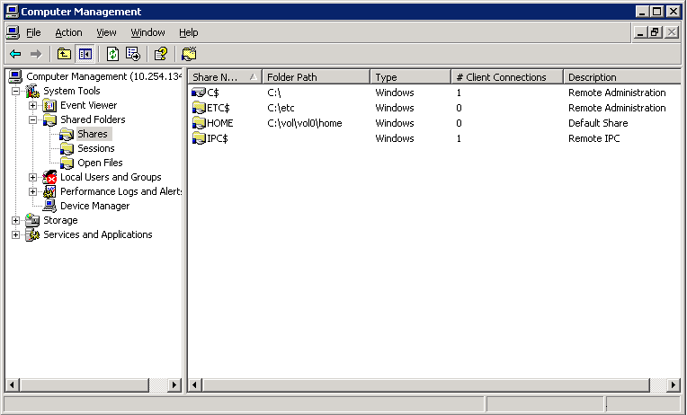
MMC: Displaying Storage System Shares
Connect to the storage system with a right-click and selecting “Connect to another computer…”
You are now interacting with the storage system
Users and Groups is disabled
in workgroup authentication
NOTE: You must login with a user account that is defined in the BUILTIN\Administrations group
Notes:
3-<number>
To display storage system shares, click the Shares folder in the console tree. The three default shares―C$, ETC$, and HOME―display, as does the hidden IPC$ share.
The IPC$ share is an interprocess communications mechanism for temporary connections between clients and servers. It is primarily used to administer network servers remotely. This share enables the communication between the Windows Computer Management GUI and the storage system.

Slide 36
Accessing Shares
Notes:
3-<number>

Slide 37
Accessing a Share
Once the share has been created, it may be
accessed from Windows by
The Microsoft’s net use command
  net use e: \\toaster\jdoe /user:marketing\jdoe
Using the Run Dialog
Mapping a Drive
Notes:
3-<number>

Slide 38
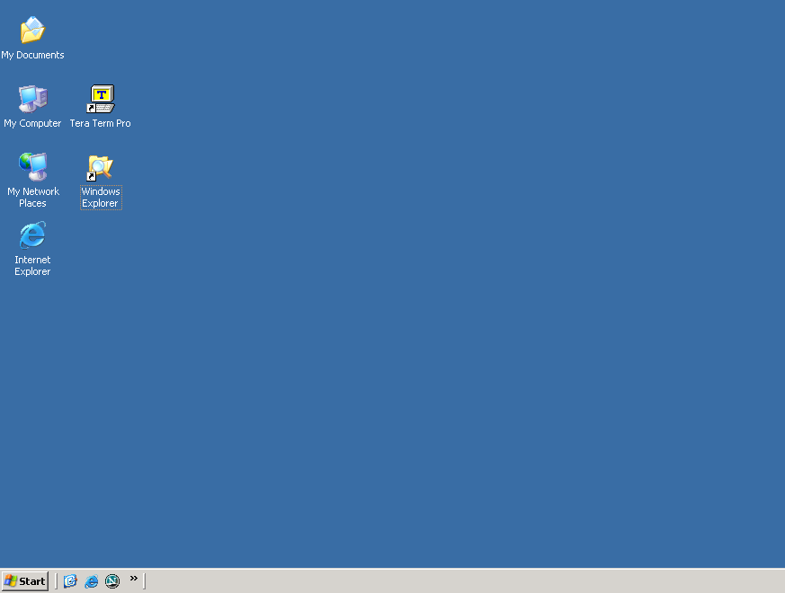
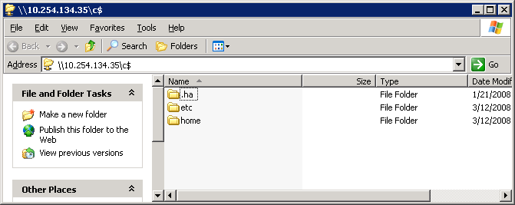
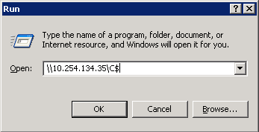
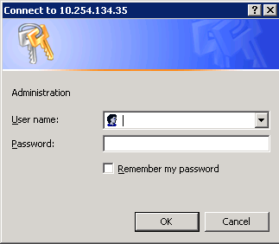
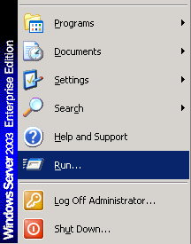
Run Dialog
Notes:
3-<number>
On a Windows workstation using the Windows “run line,” access the C$ share on the storage system “system” by performing the following steps:
On the Windows desktop, click the Start menu and choose Run. The Run window
appears.
In the Open text box, type \\storage_system_name\C$ (\\system\C$).
Note: The storage system name can be the name or IP address. Click the OK button and the Connect To window appears.
In the Connect To window, type the user name administrator and the password,
and click the OK button. The \\system\C$ window appears with the share access to
C$ that displays the “etc” and “home” folders.

Slide 39
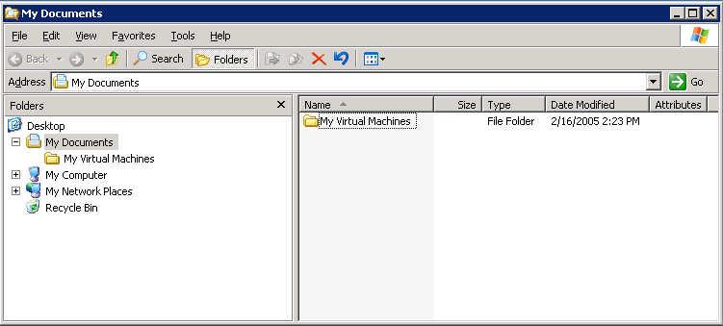

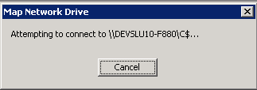
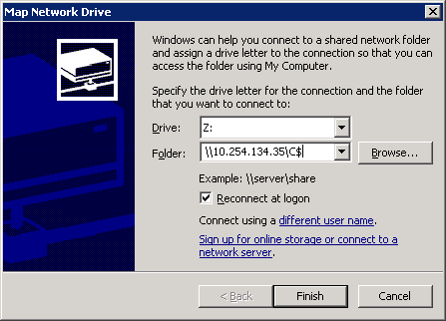
Mapping a Drive to a Share
\\10.254.134.35\C$...
Notes:
3-<number>
On a Windows workstation, map a network drive letter to a share by performing the following steps:
Open Windows Explorer and to go Tools→Map Network Drive. The Map Network Drive window appears.
In the Drive list box, select any unused letter. In the example, the letter K is selected.
In the Folder list box, type \\storage_system\C$.
Note: The storage system name can be the name or IP address.
Click the Finish button. The Map Network Drive attempts to connect to the storage system and share.
When the Connect to window appears, in the User name text box, type administrator and in the Password text box, type the administrator’s password.
Click the OK button.

Slide 40
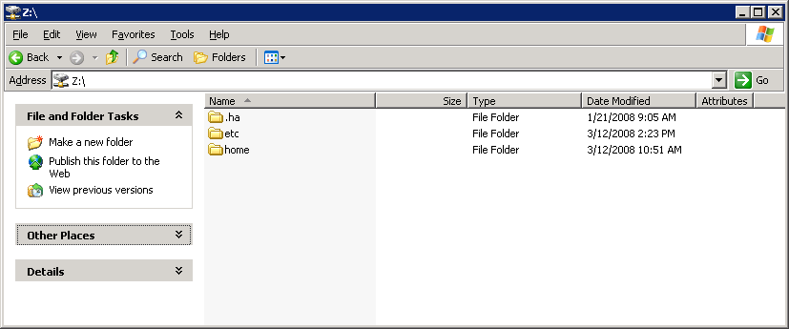
Mapping a Drive to a Share (Cont.)
Notes:
3-<number>
(The following continues the mapping of a network drive letter to a share.)
The mapped network drive letter (K is shown in this example) displays the mapping to the C$ share. Both the etc and home folders are in the C$ share.

Slide 41
Encoding
CIFS uses Unicode for its encoding.
If a volume is exclusively being accessed by CIFS, consider:
  vol options <vol> create_ucode on
  vol options <vol> convert_ucode on
If the ucode options are not set, Data ONTAP® will transparently convert a non-Unicode directory when first accessed by CIFS.
  Time consuming
  If read-only (i.e., snapshot copy), then access is refused
Notes:
3-<number>
The CIFS protocol requires the UNICODE encoding method. Unicode is an industry standard allowing computers to consistently represent text in most of the world’s writing systems. Unicode provides a unique number for every character regardless of the language. See http://www.unicode.org for more information.
If a volume is exclusively begin accessed by CIFS or Network File System (NFS) version 4.0 or later, then consider setting the create_ucode and convert_ucode volume options. Create_ucode option forces newly created directories to be unicode directories for both NFS and CIFS. By default it is set to off, in which case all directories are created in a non-Unicode format and the first CIFS access will convert it to the Unicode format. The convert_ucode on option forces all directories to be converted to the Unicode format when accessed from both NFS and CIFS. By default, this option is set to off.
Unicode is not defaulted on a storage system because Unicode directories take up more space and are slower on some workloads.

Slide 42
Sparse Files
Notes:
3-<number>

Slide 43
Sparse Files
Now that we have access to a share, users can create and read files from that location.
When creating files, normally Data ONTAP allocates space for the complete size of the file regardless if the file contains data.
Sparse files are files in which much of the data are zeros.
Data ONTAP 7.3 and later can store sparse files more efficiently.
Notes:
3-<number>
In the Windows environment, a sparse file is a file in which many of the data blocks contain zeros. The blocks in the sparse files that contain zeros are known as sparse data sets.
Files like these are typically very large. Some examples of sparse files are files containing disk image, a matrix within a high-speed database or log files. The problem with files containing sparse data sets is that they use disk space inefficiently.
Support for sparse files was introduced in the NTFS filesystem as another way to make the disk space usage more efficient. The NTFS filesystem used compression as a partial solution to the problem. File compression compacts ranges of data blocks containing zeros. However, a drawback of file compression is that access time may increase due to data compression and decompression.
When the sparse file functionality is enabled, Data ONTAP only allocates hard drive space to a file for regions that contain nonzero data. When a write operation is attempted where a large amount of the data in the buffer is zeros, the zeros are not written to the file. Instead, the file system creates an internal list containing the locations of the zeros in the file. This list is consulted during all read operations. When a read operation is performed in areas of the file where zeros were located, the filesystem returns the appropriate number of zeros in the buffer allocated for the read operation. In this way, maintenance of the sparse file is transparent to all processes that access it.

Slide 44
Sparse Files and Data ONTAP Features
To configure, use the fsutil tool from Microsoft.
Setting sparse attribute:
  Deletes space reservations for the file
  All of the operations to set the space reservations on the sparse files fail
The sparse bit is preserved during the qtree SnapMirror® process.
The sparse bit is preserved during the backup (dump) and restore processes.
Notes:
3-<number>
To set the sparse attribute, the client administrator uses the fsutil tool from Microsoft.
fsutil: sparse
Syntax
fsutil sparse [queryflag] PathName
fsutil sparse [queryrange] PathName
fsutil sparse [setflag] PathName
fsutil sparse [setrange] PathName BeginningOffset length
Example: To mark a file as sparse, type:
fsutil sparse setflag C:\Temp\sample.txt
When Windows client administrators set the sparse attribute on a file, then the space reservations for that file are deleted. Any reserved space is returned to the available space. Any attempts to set space reservations on a sparse file will fail. When administrators turn the sparse attribute off, space reservations will remain off as well until intentionally set by the administrator.

Slide 45
Quotas with Sparse File Attribute
Data ONTAP 7.2 and lower – physical file size
Data ONTAP 7.3 and higher – logical file size
Without sparse file attribute set
With sparse file attribute set
sparse data sets (zeros)
Allocated
10 Gigabytes
10 Megabytes
Notes:
3-<number>
Using Data ONTAP 7.2 and lower, the number of blocks charged to the user's quota for a file is equal to the number of blocks actually allocated. Data ONTAP 7.3 has modified quota accounting in WAFL so that the full logical size of a file is accounted for by quotas. This simplifies quota management and matches the way quotas are implemented by Microsoft for Windows Server 2008.

Slide 46
Sessions
Notes:
3-<number>

Slide 47
CIFS Sessions
A client establishes a session with a storage system upon the first share access
  Access is based on user authentication and share access rules
Display a CIFS session status by using these methods:
  CLI: cifs sessions command
  FilerView: FilerView -> CIFS -> Session Report
  Windows Computer Management: GUI-> System Tools -> Shared Folders->Sessions
Notes:
3-<number>
A client user establishes a session with a storage system upon the first share access. Access is based on user authentication and share access rules. The authentication method is defined by the environment into which the storage system is added.
You can display a CIFS session status by using these methods:
CLI cifs sessions command
FilerView→CIFS→Session Report
Windows Computer Management GUI→System Tools→Shared Folders→Sessions

Slide 48
cifs sessions Command
With the cifs sessions command, you can
display the following types of session
information:
A summary of session information, including the number of open shares and files opened by user
  cifs sessions
Share and file information about a specified connected user or all connected users, including shares and files opened
  cifs sessions username | IPaddress | host
  cifs sessions * [all connected users]
Security information
  cifs sessions -s
Notes:
3-<number>
With the cifs sessions command, you can display the following types of session information:
A summary of session information, including storage system information and the number of open shares and files opened by each connected user
cifs sessions
Share and file information about a specified connected user or all connected users, including:
The names of shares opened by a specified connected user or all connected users
The access levels of opened files
cifs sessions user_name | IP_address |workstation_name
cifs sessions * [all connected users]
Security information

Slide 49
cifs sessions Example
The following example of the cifs sessions command shows a session with a storage system in a Windows domain.
system> cifs sessions
Server Registers as ‘system' in workgroup ‘WORKGROUP'
Root volume language is not set. Use vol lang.
Using Local Users authentication
====================================================
PC IP(PC Name) (user) #shares #files
10.254.134.40() (system\administrator - root)
1 0
Notes:
3-<number>
The following example of the cifs sessions command shows a session with a storage system in a Windows workgroup.
The PC IP address 10.254.134.40 is the Windows workstation WIN.
The system\administrator user is the local administrator account on the storage system.
The user mapping for this account is root.
One share is currently being accessed.

Slide 50
CLI: cifs sessions Security Information
system> cifs sessions -s
users
Security Information
10.254.134.40() (system\administrator - root)
***************
UNIX uid = 0
user is a member of group daemon (1)
user is a member of group daemon (1)
NT membership
system\administrator
BUILTIN\Administrators
User is also a member of Everyone, Network Users,
Authenticated Users
***************
Notes:
3-<number>
The following example of cifs sessions -s command shows security information for a user with a session with a storage system in a Windows workgroup.

Slide 51
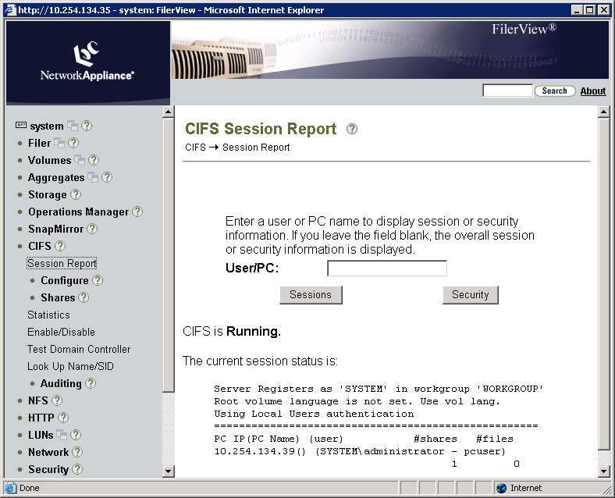
FilerView: CIFS Sessions
Notes:
3-<number>
Go to FilerView→CIFS→Session Report and click the Sessions button to display session information.
In this example, CIFS is running, and the storage system is in a Windows workgroup.

Slide 52
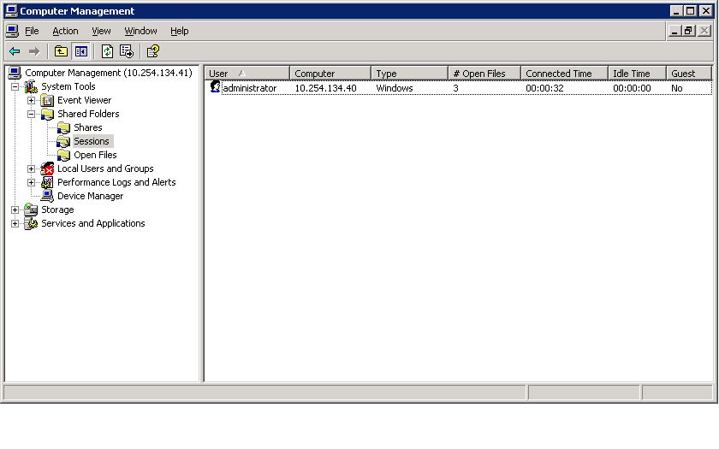
MMC: CIFS Sessions
GUI connected to the storage system
List and terminate all the current sessions except
the session that Computer Management uses
Notes:
3-<number>
With the Computer Management GUI, click the System Tools→Shared Folders→Sessions folders to display the CIFS sessions.
In this example, the local administrator has a session with the storage system DEV270-1 which is in a Windows workgroup.
The name of the administrator’s computer is 10.254.134.40
The number of Open Files is 3.
This account is not a Guest account.

Slide 53
Broadcasting a Message
To display a message on Windows users’ sessions:
  cifs broadcast {workstation | -v volname} “message”
  You can inform users about pending terminations or other important events.
The Messenger service on the Windows workstation must be enabled.
  On your Windows workstation, go to Start→Programs→Administrative Tools→ Services→Messenger.
  If the Messenger service is disabled, start the service.
Notes:
3-<number>
To display a message on Windows users’ workstations, use the following command:
cifs broadcast {workstation | -v volname} “message”
You can inform users about pending terminations or other important events.
The Messenger service on the Windows workstation must be enabled.
To enable the Messenger service on your Windows workstation:
Go to Start→Programs→Administrative Tools→ Services→Messenger.
If the Messenger service is disabled, start the service. (The default is disabled.)

Slide 54
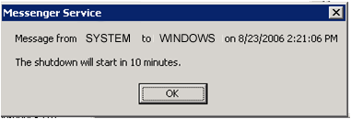
Broadcasting a Message Example
Example of broadcasting a message from a storage system:
system> cifs broadcast -v flexvol1 "The shutdown will start in 10 minutes."
The following message displays on the Windows workstation:
Notes:
3-<number>
The following is an example of broadcasting a message using the volume option from a storage system:
DEVSLU10-F1> cifs broadcast -v flexvol1 "The shutdown will start in 10 minutes."
The message “The shutdown will start in 10 minutes” will be broadcasted to all users that have sessions on the volume named flexvol1.

Slide 55
Terminating Sessions
cifs terminate Host1
Host1
cifs terminate [-t time] host
Host2
cifs terminate
Host3
Host4
Notes:
3-<number>
The cifs terminate command stops CIFS service. If a single host is named, all CIFS sessions opened by that host are terminated. If a host is not specified, all the CIFS sessions are terminated and the CIFS service is shut down.
If you run cifs terminate without specifying a time before shutdown and users have open files, you are prompted to enter the number of minutes to delay before terminating. If CIFS service is terminated immediately for a host that has one or more files open, the user will not be able to save changes. You can use the -t option to warn of an impending shutdown of service. If you execute cifs terminate from rsh, you need to supply the -t option.

Slide 56
Creating / Deleting Shares
Notes:
3-<number>

Slide 57
Default Shares
As you recall, three default share definitions are created upon completion of cifs setup:
  C$
  ETC$
  HOME
But you can create new shares…
Notes:
3-<number>

Slide 58
Creating a Share
When you create a share, you must provide:
  Complete path name
  Name of the share
  Optionally, a description of the share
Data ONTAP CLI also allows:
  Group membership for files in the share
  Support for wide symbolic links
  Disabling/enabling of virus scanning when files in the share are first opened
MMC also allows permissions for the share
Notes:
3-<number>
When you create a share, you must provide these items:
The complete path name of an existing volume or directory to be shared
The name of the share entered by users when they connect to the share
Optionally, a description of the share
When creating a share from the Data ONTAP CLI, you can specify a variety of share properties, including group membership for files in the share, support for wide symbolic links, and disabling of virus scanning when files in the share are first opened. Virus scanning occurs when files are opened, renamed, and closed after being modified.
Microsoft interfaces allow additionally the administrator to set permissions as you create the share.

Slide 59
Creating a Share (Cont.)
Additional properties can be set/modified after
creating a share:
Maximum number of users who can simultaneously access the share
  If not specified, the limit is defined by the storage system’s memory
Share-level access control list (ACL)
Notes:
3-<number>
After you have created a share, you can specify these share properties:
Maximum number of users who can simultaneously access the share
If you do not specify a number, the number of users is limited by storage system memory.
Share-level Access Control List (ACL)

Slide 60
CLI: Preparing to Create a Share
You can create shares for folders, qtrees, or volumes
For example:
  To prepare for creating a share on a qtree, first create the following resources:
    An aggregate (aggr1)
    A flexible volume (flexvol1) on aggr1
    A qtree (datatree1) on flexvol1
  NOTE: This path example will be used throughout this module
Notes:
3-<number>
You can create shares for volumes or directories including qtrees.
For example, to prepare for creating a share on a qtree, first create the following resources:
An aggregate (aggr1)
A flexible volume (flexvol1) on aggr1
A qtree (datatree1) on flexvol1
CLI: Creating an Aggregate
For example, create on a storage system an aggregate aggr1 with RAID type raid4 and with 3 disks.
DEVSLU10-F1> aggr create aggr1 -t raid4 -r 3
Fri Jun 30 08:59:18 GMT [raid.vol.disk.add.done:notice]: Addition of Disk /aggr1/plex0/rg0/0b.27 She
lf 1 Bay 11 [NETAPP X272_HJURE073F10 NA14] S/N [41519624] to aggregate aggr1 has completed successfully
Fri Jun 30 08:59:18 GMT [raid.vol.disk.add.done:notice]: Addition of Disk /aggr1/plex0/rg0/0b.25 She
lf 1 Bay 9 [NETAPP X272_HJURE073F10 NA14] S/N [414Y7808] to aggregate aggr1 has completed successfully

Slide 61
CLI: Adding a CIFS Share
As an example, add a share called datatree1 (for the qtree datatree1).
system> cifs shares -add datatree1 /vol/flexvol1/datatree1
-comment "Qtree for Windows Users"
The share name 'datatree1' will not be accessible by some MS-DOS workstations
Are you sure you want to use this share name? [n]:y
Name ---- | Mount Point ----------- | Description -----------
datatree1 | /vol/flexvol1/datatree1 everyone / Full control | Qtree for Windows Users
Default access control (discussed later)
Notes:
3-<number>
For example, add a share on a storage system called datatree1 (for the qtree datatree1).
system> cifs shares -add datatree1 /vol/flexvol1/datatree1
-comment "Qtree for Windows Users"
The share name 'datatree1' will not be accessible by some MS-DOS workstations
Are you sure you want to use this share name? [n]:y
system> cifs shares datatree1
Name Mount Point Description
---- ----------- -----------
datatree1 /vol/flexvol1/datatree1 Qtree for Windows Users
everyone / Full Control
The default access control is full control for everyone.

Slide 62
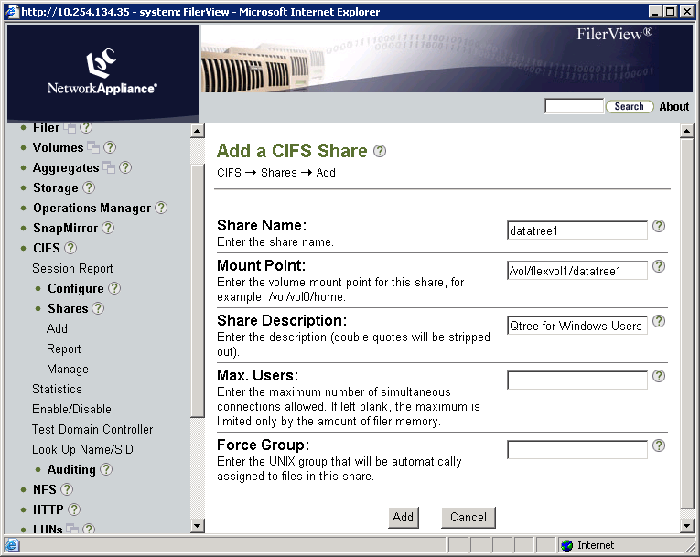
FilerView: Adding a CIFS Share
Notes:
3-<number>
As an example with FilerView, add a new share called datatree1 (for the qtree datatree1) on volume flexvol1 by performing the following steps:
Go to FilerView→CIFS→Shares→Add.
For Share Name, type datatree1.
For Mount Point, type /vol/flexvol1/ datatree1.
For Share Description, type Qtree for Windows Users.
Click the Add button.
You receive a caution message that the share name “datatree1” will not be accessible by some MS-DOS workstations (because the length of the name is more than eight characters).

Slide 63
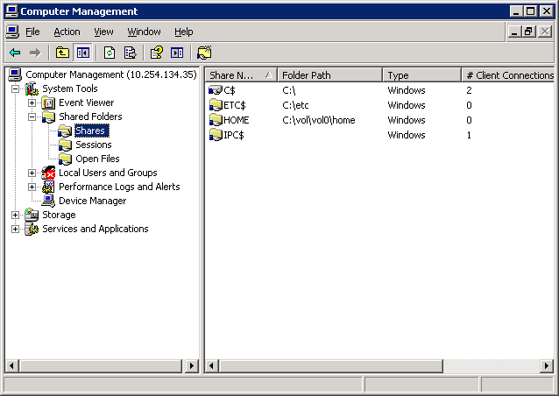
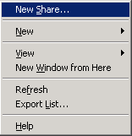
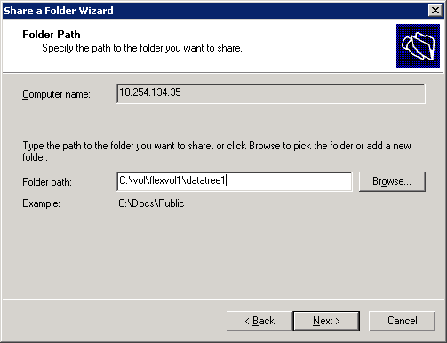
MMC: Adding a CIFS Share
Right-click Shares.
Choose New Share...
Notes:
3-<number>
As an example with the Windows Computer Management GUI, add a new share called datatree1 (for the qtree datatree1) on volume flexvol1 by performing the following steps:
In the console tree, right-click the Shares folder and choose New Share…. The Welcome to the Share a Folder Wizard appears.
Click the Next button to start the wizard, and the Folder path page displays with the Computer name text box showing your storage system name or IP address.
In the Folder path text box, type the path C:\vol\flexvol1\datatree1 for the datatree1 share, and click the Next button.

Slide 64
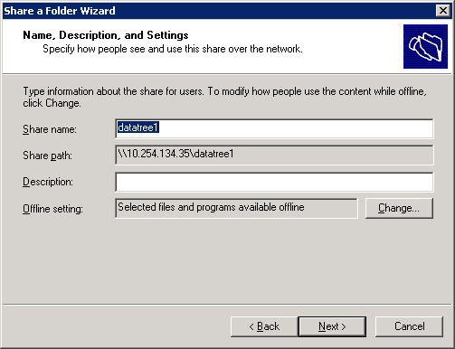
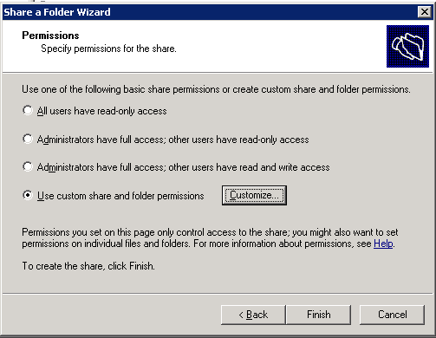

MMC: Adding a CIFS Share (Cont.)
Click the Customize button.
Notes:
3-<number>
(The following continues the adding of a CIFS share.)
In the “Name, Description, and Settings” page, in the Share name text box enter datatree1.
In the Description text box, type Qtree for Windows Users and click the Next button.
In the “Permissions” page, mark the Use custom share and folder permissions radio button, and then click the Customize button.

Slide 65
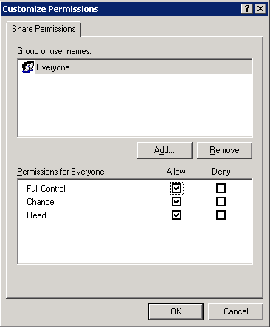
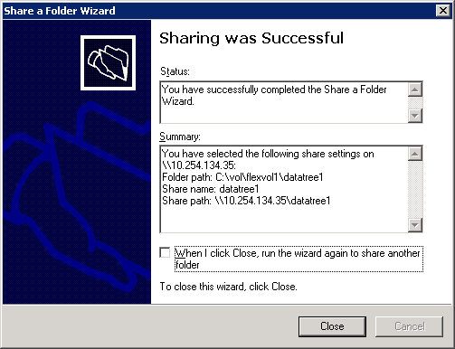
MMC: Adding a CIFS Share (Cont.)
Click the OK button.
Notes:
3-<number>
(The following continues the adding of a CIFS share.)
In the Customize Permissions window, mark the check boxes for Full Control, Change, and Read, and click the OK button.
In the Permissions page, click the Finish button.
You receive the message that sharing was successful.
Click the Close button to close the wizard.

Slide 66
CLI: Deleting a Share
As an example, delete the share called datatree1.
system> cifs shares -delete datatree1
system> cifs shares
Name Mount Point Description
---- ----------- -----------
ETC$ /etc Remote Administration
BUILTIN\ Administrators / Full Control
HOME /vol/vol0/home Default Share
everyone / Full Control
C$ / Remote Administration
BUILTIN\ Administrators / Full Control
NOTE: The share datatree1 is deleted
Notes:
3-<number>
For example, delete the share called datatree1.
system> cifs shares -delete datatree1
system> cifs shares
Name Mount Point Description
---- ----------- -----------
ETC$ /etc Remote Administration
BUILTIN\Administrators / Full Control
HOME /vol/vol0/home Default Share
everyone / Full Control
C$ / Remote Administration
BUILTIN\Administrators / Full Control
Note: The share datatree1 is deleted.

Slide 67
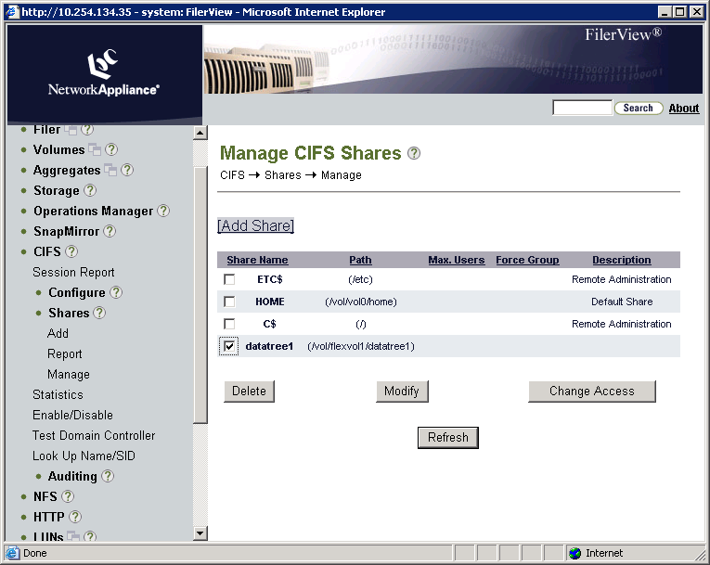
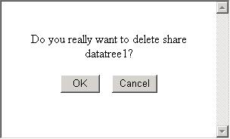
FilerView: Deleting a Share
Click the OK button.
Click the operation Delete.
Notes:
3-<number>
As an example with FilerView, delete the share called datatree1 by performing the following steps:
Go to FilerView→CIFS→Shares→Manage.
For datatree1 share, click the operation Delete.
When the confirmation dialog box asks if you really want to delete the share datatree1, click the OK button.

Slide 68
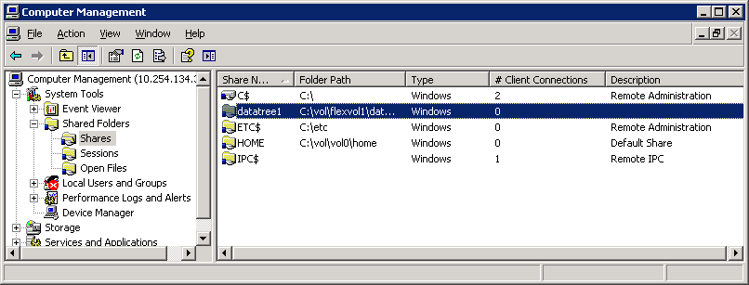
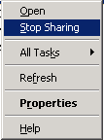
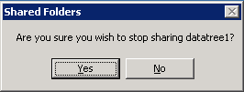
MMC: Deleting a Share
Right-click datatree1 share.
Choose Stop Sharing.
Click the Yes button to confirm stop sharing datatree1.
Notes:
3-<number>
As an example with the Windows Computer Management GUI, delete the share called datatree1 by performing the following steps:
In the Computer Management window, right-click the datatree1 share and choose Stop Sharing.
In the Shared Folders window, when it asks if you are sure that you wish to stop sharing datatree1, click the Yes button.

Slide 69
Access Control
CIFS Administration on
Data ONTAP 7.3
Notes:
3-<number>

Slide 70
Local Users
Notes:
3-<number>

Slide 71
Local Users
Local users are:
Accounts that are authenticated locally
Associated with Groups on the storage system
Created and managed using useradmin command or a text editor
Saved in the /etc/registry or /etc/passwd
Notes:
3-<number>
On the storage system, the domain administrators group and the local administrator account are part of the BUILTIN\Administrators group. They can do the following:
Provide a text editor to edit configuration files. Data ONTAP does not include an editor.
Provide the ability to administer a storage system and hence have access to the root file system (C$ and ETC$).
Modify the share access for C$ and ETC$ to grant additional users access.
The local administrator can setup local users on the storage system with the useradmin user add command.

Slide 72
Purpose of Local Users
Two main reasons for local user authentication:
Provides local administrators the ability to configure the storage system
  Discussed in Data ONTAP Fundamentals Course
Provides local client users access to the resources on the storage system for all environments
  Windows workgroup
  Non-Windows workgroup
  Windows domain
NOTE: You can create a maximum of 96 local user accounts.
Notes:
3-<number>
Reasons for local user accounts include the following:
Windows workgroup
You must create local user accounts so that the storage system can authenticate local users.
Non-Windows workgroup (UNIX mode)
Do not create local user accounts because the storage system authenticates users with the UNIX password (/etc/passwd) database.
Windows domain
The storage system can authenticate users (with the local user accounts) who try to connect to the storage system from an untrusted domain.
Local users can access the storage system when the domain controller is down or not available for domain authentication.
Note: You can create a maximum of 96 local user accounts.

Slide 73
Purpose of Local Users (Cont.)
When the CIFS server is configured for:
Windows workgroup
  You must create local user accounts so that the storage system can authenticate users
  Use the useradmin command
  User accounts are stored in /etc/registry
Non-Windows workgroup (UNIX mode)
  You must create local UNIX users
  Use the passwd command
  User accounts are stored in /etc/passwd and /etc/shadow
Notes:
3-<number>

Slide 74
Purpose of Local Users (Cont.)
When the CIFS server is configured for:
Windows domain
  Storage system can authenticate users (with the local user accounts) who try to connect to the storage system from an untrusted domain
  Local users can access the storage system when the domain controller is down or not available for domain authentication
  Use the useradmin command
  User accounts are stored in /etc/registry
Notes:
3-<number>

Slide 75
Local Administrator
As you recall, during cifs setup, the local
administrator account may be created.
It is highly recommended that you create the local
administrator account: (system\administrator) for
this filer. This account allows access to CIFS
from Windows when domain controllers are not
accessible.
Do you want to create the system\administrator
account? [y]:
Enter the new password for system\administrator:
Retype the password:
Notes:
3-<number>

Slide 76
Local User Definitions
List the local users on the storage system.
system> useradmin user list
Name: root
Info: Default system administrator.
Rid: 0
Groups:
Name: administrator
Info: Built-in account for administering the filer
Rid: 500
Groups: Administrators
A local administrator is added to the user list if the response during
cifs setup was to create a local administrator account for the
storage system. Be sure to set an appropriate password for the
administrator account.
This is the storage system root user account.
Notes:
3-<number>
A local administrator is added to the user list if the response during cifs setup was to create a local administrator account for the storage system. Be sure to set an appropriate password for the administrator account.

Slide 77
Administrating Local Users
Local Users
Must provide a unique name
Associate user to a group
Created only via CLI’s useradmin command when the storage system is set to CIFS workgroup authentication
Notes:
3-<number>
With FilerView, you cannot create local user accounts.
Microsoft Management Console (MMC) tools have some capabilities that are discussed in the next module because they only are available when the storage system is using CIFS domain authentication.

Slide 78
Local User Management
Manage local users fully by using the CLI
useradmin command.
To add a new local user:
useradmin user add user_name –g group_name
To modify a local user :
useradmin user modify user_name –g group_name
To list user information:
useradmin user list user_name
To delete a local user:
useradmin user delete user_name
Notes:
3-<number>

Slide 79
CLI: Adding a New Local User
As an example, add a local user called Jane to
the predefined Guests group.
Note: User names are not case sensitive.
system> useradmin user add jane -g Guests
New password:
Retype new password:
user <jane> added.
system> Mon Jul 31 01:13:18 GMT
[useradmin.added.deleted:info]:
The user 'jane' has been added.
Password is typed but not displayed.
Notes:
3-<number>
As an example, add a local user called Jane to the predefined Guests group.
Note: User names are not case sensitive.
system> useradmin user add jane -g Guests
New password:
Retype new password:
User <jane> added.
system> Mon Jul 31 01:13:18 GMT [useradmin.added.deleted:info]: The user 'jane' has been added.
Note: The password is typed but not displayed.

Slide 80
CLI: Adding a New Local User (Cont.)
In the example, verify that the local user Jane
has been added to the predefined Guests group.
system> useradmin user list jane
Name: jane
Info:
Rid: 131075
Groups: Guests
Full Name:
Allowed Capabilities:
Password min/max age in days: 0/4294967295
Status: enabled
Notes:
3-<number>
In the example, verify that the local user Jane has been added to the predefined Guests group.
system> useradmin user list jane
Name: jane
Info:
Rid: 131075
Groups: Guests
Full Name:
Allowed Capabilities:
Password min/max age in days: 0/4294967295
Status: enabled
Note: Jane has no allowed capabilities in the Guests group, but she can log in and be authenticated.

Slide 81
Local Groups
Notes:
3-<number>

Slide 82
Local Groups
Local Groups
Contain local and domain users
Created only via CLI’s useradmin command when the storage system is set to CIFS workgroup authentication
Notes:
3-<number>
With FilerView, you cannot create local group accounts.
Microsoft Management Console (MMC) tools have some capabilities that are discussed in the next module because they only are available when the storage system is using CIFS domain authentication.

Slide 83
CLI: Group Management
Manage local groups by using the CLI useradmin.
To add a new group:
  useradmin group add group_name –r role
To modify an existing group:
  useradmin group modify group_name –g
  new_group_name
To list group information:
  useradmin group list group_name
To delete a group:
  useradmin group delete group_name
To add an existing Windows domain user to a group:
  useradmin domainuser add username –g
  group_name
To list Windows domain users in a group:
  useradmin domainuser list –g group_name
Notes:
3-<number>

Slide 84
CLI: Local Groups
As an example, add a local group called Helpers
with the predefined admin role and verify the
Results.
system> useradmin group add Helpers -r admin
Group <Helpers> added.
system > Mon Jul 31 02:02:43 GMT
[useradmin.added.deleted:info]: The group
'Helpers' has been added.
system > useradmin group list Helpers
Name: Helpers
Info:
Rid: 131076
Roles: admin
Allowed Capabilities: login-*,cli-*,api
*,security-*
Notes:
3-<number>
As an example, add a local group called Helpers with the predefined admin role and verify the results.
system> useradmin group add Helpers -r admin
Group <Helpers> added.
system> Mon Jul 31 02:02:43 GMT [useradmin.added.deleted:info]: The group 'Helpers' has been added.
system> useradmin group list Helpers
Name: Helpers
Info:
Rid: 131076
Roles: admin
Allowed Capabilities: login-*,cli-*,api-*,security-*
Note: The admin role has full capabilities.
When groups are created, they are placed in the lclgroups.cfg file. Normally, this file is for administrative reference only; it is not used to reload groups into the system memory. However, sometimes you need Data ONTAP to reload this file―for example, when you migrate a storage system. Do not edit this file without direction from support.

Slide 85
Share Permissions
Notes:
3-<number>

Slide 86
Permissions
Permissions can be set at:
  Share level
  Folder/File level
Both permission levels must be satisfied to gain access to the resource
Notes:
3-<number>

Slide 87
Share Permissions
Share permissions can be managed by:
  CLI: cifs access command
  FilerView
  MMC such as Computer Management
Windows share permissions are the following:
  Read-only
  Full control
  Change
If all the permissions are denied, then there is no access.
Notes:
3-<number>

Slide 88
cifs access Command
CLI cifs access command sets or modifies the share-level ACL to share definitions
  To modify a share access:
  cifs access <share> [-g] [user_rights]
  To delete an ACL entry for a user on a share:
  cifs access -delete <share> [-g] [user]
The –g option specifies that the user is the name of a UNIX group. Use this command when you have:
  A UNIX group and a UNIX user or an NT user or group with the same name
Notes:
3-<number>
The CLI cifs access command sets or modifies the share-level access control list (ACL) to share definitions.
To modify a share access:
cifs access <sharename> [-g] [user_rights]
To delete an ACL entry for a user on a share:
cifs access -delete <sharename> [-g] [user]
The -g option specifies that the user is the name of a UNIX group. Use this command when you have
A UNIX group and a UNIX user or an NT user or group with the same name.

Slide 89
CLI: Setting and Deleting Share Access
As an example, on the datatree1 share, set the share
access for the administrator to Full Control and delete
the Everyone access
system> cifs access datatree1 administrator Full Control
1 share(s) have been successfully modified
system> cifs access -delete datatree1 everyone
1 share(s) have been successfully modified
system> cifs shares datatree1
Name Mount Point Description
---- ----------- -----------
datatree1 /vol/flexvol1/datatree1 Windows Qtree
  system\administrator / Full Control
NOTE: This is the storage system local administrator
Notes:
3-<number>
For example, on the datatree1 share, set the share access for the administrator to Full Control and delete the Everyone access.
system> cifs access datatree1 administrator Full Control
1 share(s) have been successfully modified
system> cifs access -delete datatree1 everyone
1 share(s) have been successfully modified
system> cifs shares datatree1
Name Mount Point Description
---- ----------- -----------
datatree1 /vol/flexvol1/datatree1 Windows Qtree
system\administrator / Full Control
Note: The system\administrator is the storage-system local administrator.

Slide 90
FilerView: Managing Share Access
Notes:
3-<number>
As an example with FilerView, on the datatree1 share, set the share access for the administrator to Full Control and delete the Everyone access by performing the following steps:
Go to FilerView→CIFS→Shares→Manage.
For datatree1 share, click operation Change Access.

Slide 91
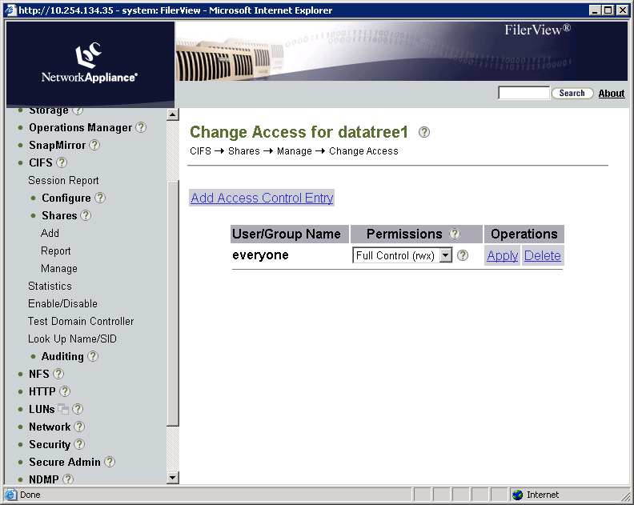
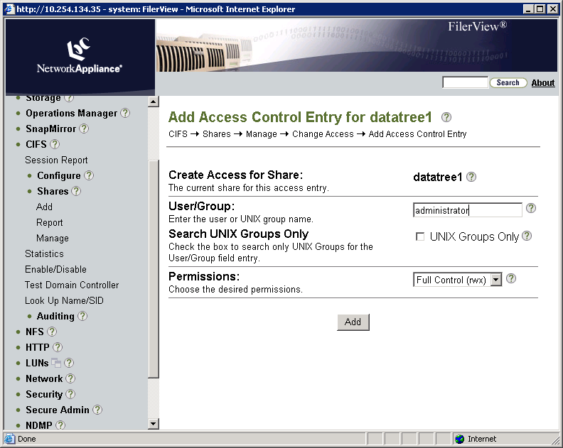
FilerView: Managing Share Access (Cont.)
Notes:
3-<number>
(The following continues the setting and deleting of share access.)
In the Change Access for datatree1 page, click Add Access Control Entry.
In the Add access Control Entry for datatree1 page, perform these steps:
In the User/Group text box, type administrator.
In the Permissions list box, select Full Control (rwx).
Click the Add button.

Slide 92
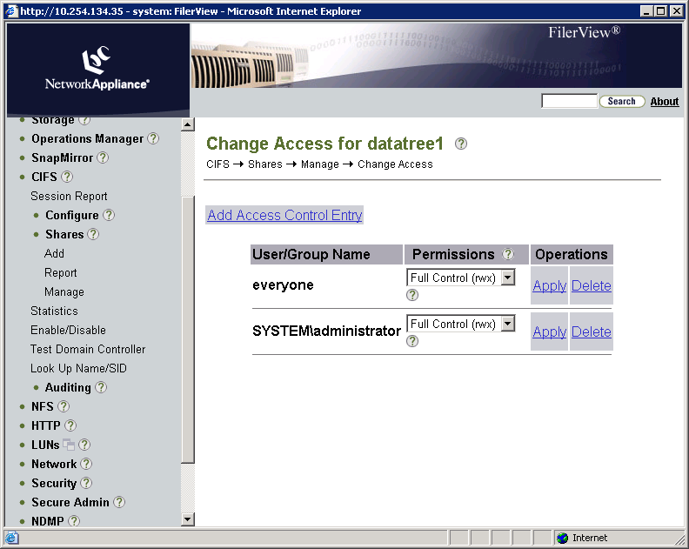
FilerView: Managing Share Access (Cont.)
Click the operation
Delete.
Notes:
3-<number>
(The following continues the setting and deleting of share access.)
In the Change Access for datatree1 page, view the newly added administrator with Full-Control share access.
In the everyone row, click the operation Delete to remove the share access.

Slide 93
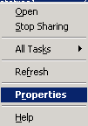
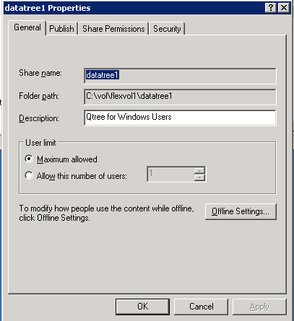
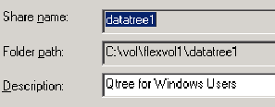
MMC: Setting and Deleting Share Access
Right-click datatree1 share.
Choose Properties.
Click the Share Permissions tab.
Notes:
3-<number>
As an example with Windows Computer Management GUI, on the datatree1 share, set the share access for the administrator to Full Control and delete the Everyone access by performing the following steps:
Right-click the datatree1 share and choose Properties.
In the datatree1 Properties window, the General tab appears displaying the share name, folder path, and description for the datatree1 share. Click the Share Permissions tab.

Slide 94
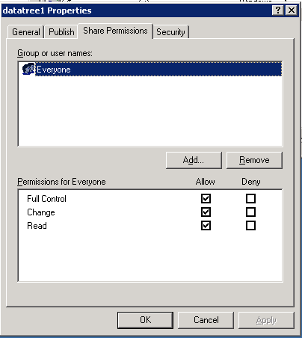
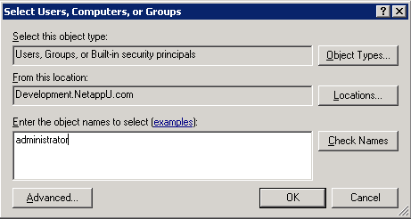
MMC: Managing Share Access (Cont.)
Location of users or groups.
Click the Add button.
Type administrator.
Notes:
3-<number>
(The following continues the setting and deleting of share access.)
In the Share Permissions tab, click the Add button. The Select Users, Computers, or Groups window appears.
In the Enter the object names to select text box, type administrator and click the OK button. The datatree1 Properties window appears, displaying the new share access for the administrator.

Slide 95
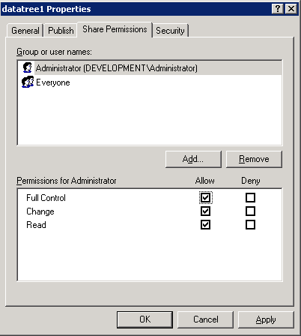
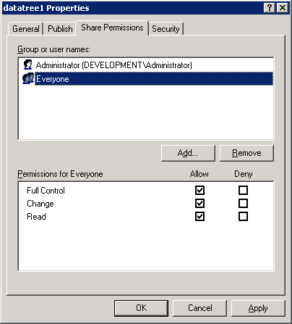
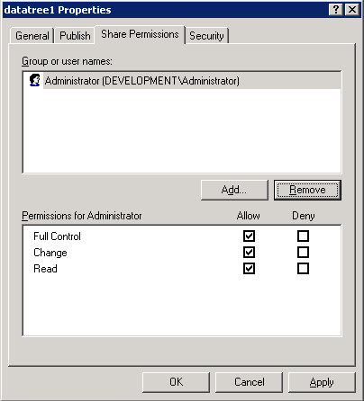
MMC: Managing Share Access (Cont.)
Select Everyone.
Click the Remove button.
Notes:
3-<number>
(The following continues the setting and deleting of share access.)
In the dataree1 Properties window, select Everyone and click the Remove button to delete share access for Everyone.
The datatree1 Properties window displays that the Everyone share access is deleted.

Slide 96
File Permissions
Notes:
3-<number>

Slide 97
Folder/File Permissions
A storage system stores the NTFS file-level permissions for folders and files.
  Managed only from a Windows client or GPOs
Standard Windows GUI tools display and set permissions.
Manage permissions as you would an NTFS file system on a Windows workstation or server.
Notes:
3-<number>
A storage system stores the NTFS file-level permissions for folders and files. They can be managed from a Windows client only or Group Policy Objects (GPOs).
Standard Windows GUI tools display and set permissions. Manage permissions as you would an NTFS file system on a Windows workstation or server.

Slide 98
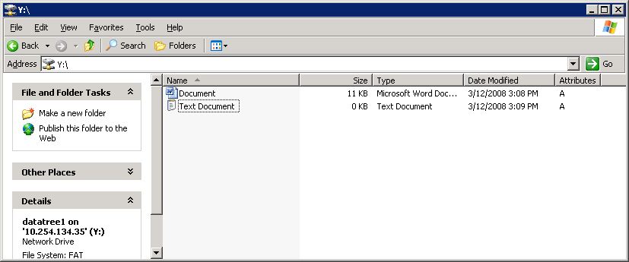
File Permissions of a Mapped Drive
Right-click the file, and choose Properties.
Right-click and choose Properties.
Notes:
3-<number>
To display the file permissions, perform the following steps:
From a mapped network drive, right-click the file.
Choose Properties from the shortcut menu.

Slide 99
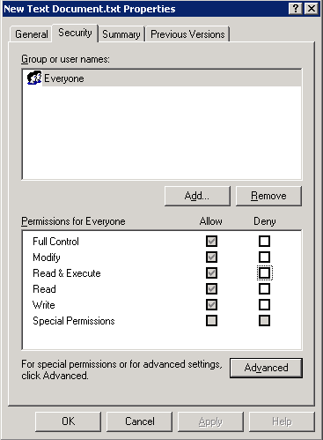
Security Tab
Click the Security tab
The Everyone system group
has full control for permissions,
including Modify, Read & Execute,
Read, Write, and Special Permissions
Notes:
3-<number>
In the file Properties window, click the Security tab.
Note the group and user names and the permissions for the group or user.
Click the OK button.
In this example, the Everyone system group has full control for permissions including Modify, Read and Execute, Read, Write, and Special Permissions.

Slide 100
ABE
Notes:
3-<number>

Slide 101
Access-based Enumeration
Share permissions conventionally allow users to view shared folders or files regardless of whether the users have access to them
  Causes security risk
Administrators can protect sensitive information using Access-based Enumeration (ABE) option
  cifs shares -change <sharename>
  [-accessbasedenum | -noaccessbasedenum]
  May be set with -add switch when creating shares
  No ABE is the default
Notes:
3-<number>
Conventional share properties allow you to specify which users (individually or in groups) have permission to view or modify shared resources. However, they do not allow you to control whether shared folders or files are visible to users who do not have permission to access them. This could pose problems, if the names of shared folders or files describe sensitive information, such as the names of customers or new products under development.
Access-based Enumeration (ABE) extends share properties to include the enumeration of shared resources. When ABE is enabled on a CIFS share, users who do not have permission to access a shared folder or file underneath it (whether through individual or group permission restrictions) do not see that shared resource displayed in their environment. ABE therefore enables you to filter the display of shared resources based on user access rights.
ABE for a CIFS share on a NetApp storage system can be managed by the CIFS shares option [–accessbasedenum | -noaccessbasedenum].

Slide 102
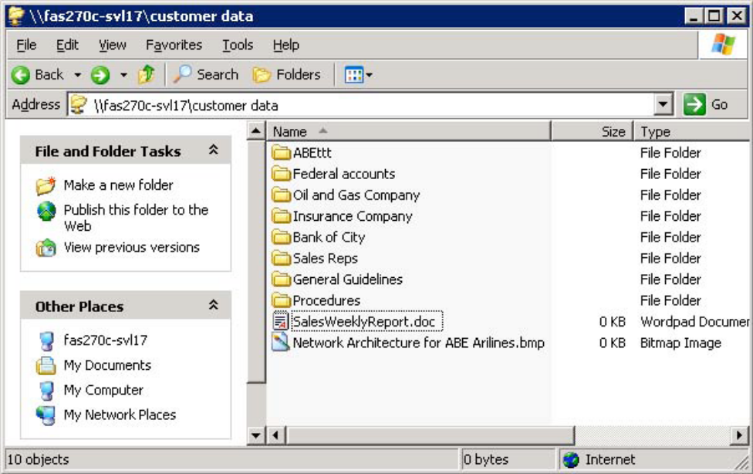
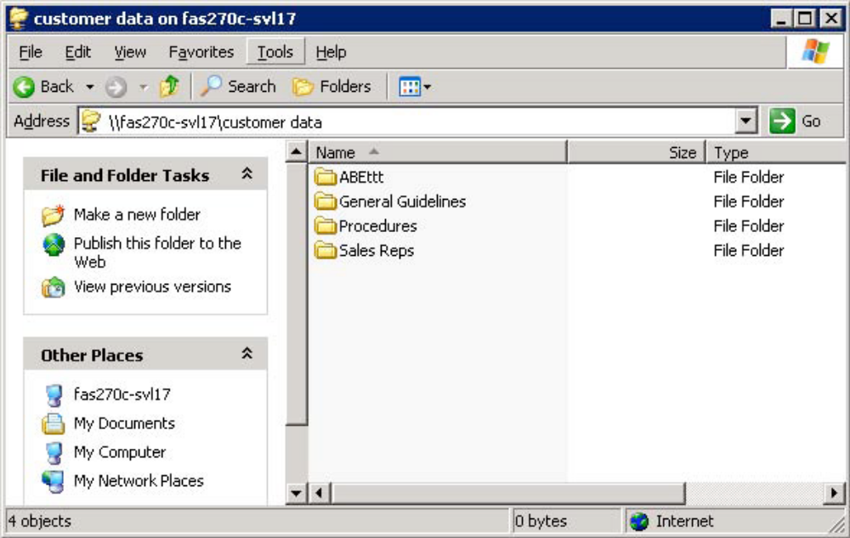
Access-based Enumeration (Cont.)
Without ABE
With ABE
Notes:
3-<number>
The two figures illustrate how ABE affects Data ONTAP directory listing. In the first figure, all the folders under the share “customer data” are visible to the user, even though he or she does not have access to some of the folders containing sensitive information. In the bottom figure, after enabling Access-based Enumeration on this share, users can see only the folders to which they have access.

Slide 103
Multiprotocol
Notes:
3-<number>

Slide 104
Multiprotocol
But CIFS users don’t necessarily have to access only NTFS volumes or qtrees
Volumes and qtrees can have either:
  NTFS style ACL permissions
  UNIX style permissions
Having UNIX style permissions does not prevent Windows (CIFS) users from accessing a volume or qtree if Multiprotocol is correctly configured
Notes:
3-<number>

Slide 105

Security Style Interaction
For a Windows user to
access:
A NTFS style volume or qtree
  Windows user is tested against NTFS style ACLs
A UNIX style volume or qtree
  Windows user must be mapped to a UNIX UID and GID
Windows HOST
Windows
User and
Group ID
UNIX
User and
Group ID
NTFS
UNIX
Notes:
3-<number>
Note: There is always a user mapping (UNIX user ⬄NTFS user) whether the chosen security style is NTFS or multiprotocol. Even when a Windows client user is accessing data through an NTFS qtree on a storage system with NTFS security style, a user mapping occurs for the Windows client user. Both NTFS and UNIX users are always mapped.

Slide 106

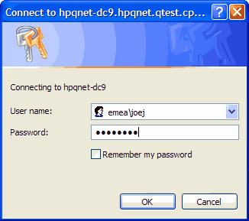

Windows to UNIX User Resolution
Domain
Authenticated
Windows
authenticated
Unauthenticated
Windows
Domain
Controller
Workgroup Authentication
Authenticated by
/etc/registry
Windows
authenticated
Unauthenticated
Storage System
Notes:
3-<number>
When a CIFS user attempts to access a volume or qtree that has UNIX permissions, the user is authenticated with the method by which the CIFS server has previously been configured. If the storage system has been configured for domain authentication, the storage system passes the credentials to the domain controller for proper authentication. The credentials are either authenticated or not. If the storage system has been configured for workgroup authentication, then the storage will authenticate the user via the /etc/registry.

Slide 107
Windows to UNIX User Resolution (Cont.)
If not verified
Check
wafl.default_unix_user
Windows
authenticated
Check mapping
/etc/usermap.cfg
Domain/user => UNIX
If mapping exists,
try mapped user
Verify UNIX user by /etc/passwd,
NIS, or domain
If no mapping,
try Windows user
If mapped to ‘ ‘
Invalid user
User accepted
Notes:
3-<number>
A Windows authenticated user then is looked up in the /etc/usermap.cfg file. Three possibilities are available. The user maybe mapped to a UNIX user, not mapped at all, or mapped to an empty string. If the user is mapped, then the mapped UNIX user is passed to verification. If the user is not mapped, then the authenticated CIFS users name is tried for UNIX verification with all letter lowercased. If the user is mapped to an empty string “ ”, then the user is invalid.
Verification
The storage system will attempt to verify a UNIX user by employing the mechanism as stated in the /etc/nsswitch.conf file. These mechanisms are using /etc/passwd, NIS, and/or LDAP. If verification is unsuccessful, then the option wafl.default_unix_user is tried as a generic user account. A typical default UNIX user is “pcuser” with UID =65534 and GID=65534, which is stored in /etc/passwd file by default. If verification is successful, the CIFS user is properly associated with a UNIX account. If verification is unsuccessful, the CIFS user is invalid.
Window Administrator
The Windows Administrator user is a special case. The administrator is mapped to the UNIX user name “root” with UID=0 and GID= if the wafl.nt_admin_priv_map_to_root option is set “on”.

Slide 108
Windows to UNIX User Resolution (Cont.)
Unauthenticated
or Invalid user
Guest account configured
options
cifs.guest_account
Try
guest
user
Verify
UNIX user by
/etc/passwd,
NIS, or LDAP
Guest user
accepted
Yes
No
Unauthenticated
or Invalid user
rejected
Guest user
rejected
Notes:
3-<number>
Unauthenticated or invalid users still may be allowed access to the resource if options cifs.guest_account is configured. The guest account then is passed to the storage system for UNIX verification that are specified by the /etc/nsswitch.conf file.

Slide 109
Verify Mappings
A Windows-to-UNIX user mapping is kept as part of the CIFS session credential.
  A fresh Windows-to-UNIX user mapping is required only when a new CIFS session is established for a user.
  Use cifs session -s command to verify mapping.
Notes:
3-<number>

Slide 110
Multiprotocol Options
A CIFS user can access the file without disrupting UNIX permissions.
A CIFS user might then attempt to set security restrictions on a file or folder.
  Prior to Data ONTAP 7.2, the CIFS user must have an add-on from the NOW™ site called SecureShare®.
  Data ONTAP 7.2 and later, the CIFS user can manage security directly with cifs.preserve_unix_security
Notes:
3-<number>

Slide 111
Preserving UNIX Permissions
cifs.preserve_unix_security option preserves UNIX permissions as files are edited and saved by Windows applications that perform the following steps:
    Read the security properties of the file
    Create a new temporary file
    Apply those properties to the temporary file
    Rename temporary file with original file name
Windows clients that perform a security query receive a constructed ACL that exactly represents the UNIX permissions
Notes:
3-<number>
Enabling the cifs.preserve_unix_security option preserves UNIX permissions as files are edited and saved by Windows applications that perform the following steps:
Read the security properties of the file.
Create a new temporary file.
Apply those properties to the temporary file.
Then give the temporary file the original file name.
Windows clients that perform a security query receive a constructed ACL that exactly represents the UNIX permissions.

Slide 112
Preserving UNIX Permissions (Cont.)
cifs.preserve_unix_security option
allows manipulation of UNIX permissions by
using the Security tab on a Windows client
  When enabled, UNIX qtrees appear as NTFS volumes
  The default for this option is “off”
NOTE: You cannot change the owner and group from the Windows
Security tab.
Notes:
3-<number>
Enabling the cifs.preserve_unix_security option also allows you to manipulate the UNIX permissions by using the Security tab on a Windows client, or using any application that can query and set Windows ACLs.
When enabled, UNIX qtrees appear as NTFS volumes. The default for this option is off.
Note: You cannot change the owner and group from the Windows Security tab.

Slide 113
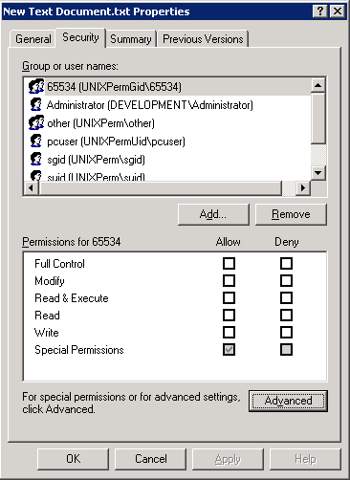
File Permissions with Mapped UNIX User
UNIX credentials are used
when evaluating access
requests by comparing
Windows credentials against
the file or folder’s permissions.
Notes:
3-<number>
In this example, a Windows user is accessing a UNIX file. The Security tab in the file Properties window displays the user’s mapped UNIX credentials.
The UNIX credentials are used when evaluating the user’s access requests by comparing the user’s credentials against the file or folder’s UNIX access permissions.

Slide 114
Reconfiguring CIFS
Notes:
4-<number>

Slide 115
Reconfiguring CIFS
To reconfigure CIFS on a storage system:
  Disconnect users and stop CIFS service:
    cifs terminate
  Reconfigure CIFS service:
    cifs setup
CIFS server restarts with the new configuration
Next we will investigate reconfiguring a storage system for an Active Directory domain
Notes:
4-<number>
To reconfigure CIFS on a storage system:
Disconnect users and stop CIFS service:
cifs terminate
Reconfigure CIFS service:
cifs setup
The storage system automatically attempts to restart the CIFS service with the new CIFS configuration.

Slide 116
CLI cifs setup: AD
cifs setup Windows 2000 (Active Directory)
domain completion
(1) Active Directory domain authentication
(Active Directory domains only)
(2) Windows NT 4 domain authentication
(Windows NT or Active Directory domains)
(3) Windows Workgroup authentication using
the filer's local user accounts
(4) /etc/passwd and/or NIS/LDAP
authentication
Selection (1-4)? [1]:
Notes:
4-<number>
This is an example of the administrator configuring the storage system for a Active Directory (AD) domain.

Slide 117
CLI cifs setup: AD (Cont.)
Windows 2000 completion continued
What is the name of the Active Directory
domain? [development.netappu.com]:
In Active Directory-based domains, it is essential that the filer's time match the domain's internal time so that the Kerberos-based authentication system works correctly.
If the time difference between the filer and the domain controllers is more than 5 minutes, CIFS authentication will fail. Time services currently are not configured on this filer.
Would you like to configure time services? [y]:
Notes:
4-<number>
Active Directory uses a time-based key mechanism. It is important for the domain controller and the storage system to be in sync by five (5) minutes or less.

Slide 118
CLI cifs setup: AD (Cont.)
Windows 2000 completion continued
CIFS Setup will configure basic time services. To continue, you
must specify one or more time servers. Specify values as a
comma or space separated list of server names or IPv4
addresses. In Active Directory-based domains, you can also
specify the fully qualified domain name of the domain being
joined (for example:(“DEVELOPMENT.NETAPPU.COM") and time
services will use those domain controllers as time servers.
Enter the time server host(s) and/or address(es)
[DEVELOPMENT.NETAPPU.COM]:10.254.134.2
[The IP address is for the domain controller or a time server.
It is best to enter the IP address of the main (root) domain
controller for the domain.]
Would you like to specify additional time servers? [n]:
Wed Jun 21 16:28:22 GMT [rc:ALERT]: timed: time daemon started
Notes:
4-<number>
The IP address is for the domain controller or a time server. It is best to enter the IP address of the main (root) domain controller for the domain.
The timed daemon allows the storage system to synchronize its time with external resources.
You need to configure the following:
options timed.max_skew 30m
options timed.proto ntp
options timed.sched hourly
options timed.servers [server_ip_or_name,…]
For a list of available time servers, see http://www.eecis.udel.edu/~mills/ntp/servers.htm
options timed.enable on
options timed.log on

Slide 119
CLI cifs setup: AD (Cont.)
Windows 2000 completion continued
In order to create an Active Directory machine account for the filer, you must supply the name and password of a Windows
account with sufficient privileges to add computers to the DEVELOPMENT.NETAPPU.COM domain.
Enter the name of the Windows user
[Administrator@DEVELOPMENT.NETAPPU.COM]:
[This Windows user is the domain account administrator
that has privileges to join (add) the storage system to the
domain controller.]
Password for Administrator@DEVELOPMENT.NETAPPU.COM:
CIFS -Logged in as Administrator@DEVELOPMENT.NETAPPU.COM.
The user that you specified has permission to create the filer's machine account in several (4) containers. Please choose where you would like this account to be created.
Notes:
4-<number>
This Windows user is the domain account administrator that has privileges to join (add) the storage system to the domain controller.

Slide 120
CLI cifs setup: AD (Cont.)
[The container list displays OUs (Organizational
Units) in which you have permission to create
computer accounts. The list reflects your Active
Directory domain and may contain customized OUs.]
CN=computers
NOTE: CN means Common Name. The storage system is joining as a member server.
(2) OU=Domain Controllers
(3) OU=Additional_OU
(4) OU=sub_Additional_OU,OU=Additional_OU
(5) None of the above
Selection (1-5)? [1]:
Notes:
4-<number>
The container list displays Organizational Units (OUs) in which you have permission to create computer accounts. The list reflects your Active Directory domain structure and may contain customized OUs.

Slide 121
CLI cifs setup: AD (Cont.)
Windows 2000 completion continued
Wed Jun 21 16:29:23 GMT [wafl.quota.sec.change:notice]: security style for /vol/vol0/ changed from unix to ntfs
CIFS - Starting SMB protocol...
It is highly recommended that you create the local administrator account (system\administrator) for this filer. This account allows access to CIFS from Windows when domain controllers are not accessible.
Do you want to create the system\administrator account? [y]:
Enter the new password for system\administrator:
Retype the password:
Notes:
4-<number>
The local administrator account has privileges to administer CIFS on the storage system even if the domain controller is down. The local administration can set up local users on the storage system with the useradmin user add command.

Slide 122
CLI cifs setup: AD (Cont.)
Windows 2000 completion continued
Currently, the user “system\administrator" and members of the group “DEVELOPMENT\Domain Admins" have permission to administer CIFS on this filer. You may specify an additional user or group to be added to the filer's "BUILTIN\Administrators" group, thus giving them administrative privileges as well.
Would you like to specify a user or group that can administer CIFS? [n]:
Wed Jun 21 16:30:18 GMT [nbt.nbns.registrationComplete:info]: NBT: All CIFS name registrations have completed for the local server.
Welcome to the DEVELOPMENT.NETAPPU.COM (DEVELOPMENT) Active Directory(R) domain.
CIFS local server is running.
Notes:
4-<number>

Slide 123
FilerView Setup
Notes:
4-<number>

Slide 124
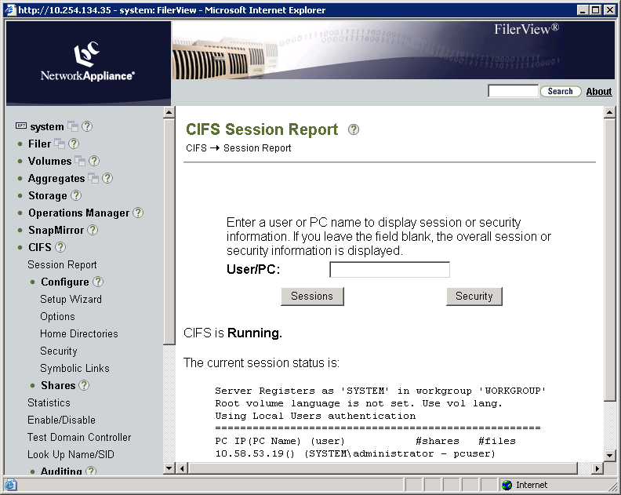
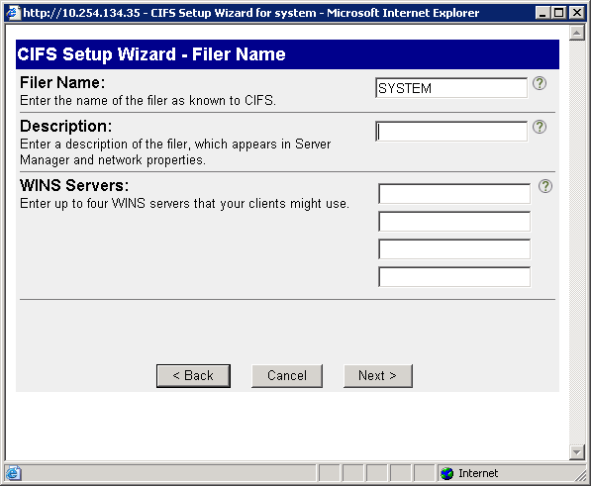
CIFS Setup Wizard
This description is available
from the CLI: cifs comment
Notes:
4-<number>
To start the CIFS Setup Wizard, choose CIFS→Configure→Setup Wizard.
The CIFS Setup Wizard helps you through configuration of your storage system for CIFS access. You may run the wizard at any time to change the settings. CIFS is stopped and restarted upon completion of the wizard.
In the CIFS Setup Wizard – Filer Name window, the name of the storage system appears. You can add a description of the storage system. This description is available from the CLI by typing cifs comment.

Slide 125
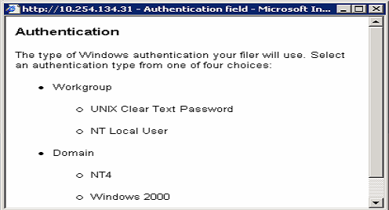
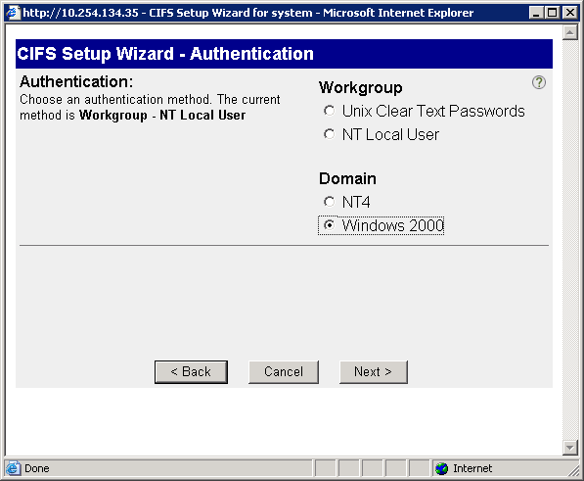

CIFS Setup Wizard (Cont.)
Help (?)
Domain user must have authority to join the storage system to the domain.
Notes:
4-<number>
In the CIFS Setup Wizard – Authentication window, choose an authentication method. You can click ? for help. The Authentication help window shows the four choices for authentication methods:
Workgroup
UNIX Clear Text Password (Non-Windows workgroup)
NT Local User (Windows workgroup)
Domain
NT4 (Windows NT4 domain)
Windows 2000 (Windows Active Directory domain)
For workgroup authentication, enter the name of the workgroup.
For the NT domain authentication, a domain administrator must precreate a machine account for the storage system on the domain controller (Primary Domain Controller) before the storage system joins the domain. Enter the NT4 domain name.
The domain user (administrator) added to the Windows 2000 domain must have the authority (privileges) to join the storage system to the domain. Enter the Windows 2000 (Active Directory) domain name, administrator name, and administrator password.

Slide 126


CIFS Setup Wizard (Cont.)
Notes:
4-<number>
In the CIFS Setup Wizard – Security Style window, choose the type of security style to be used as the default on the storage system. The choices are multiprotocol or NTFS-only.
The default security style is NTFS-only if CIFS only is licensed. If both CIFS and NFS are licensed, the default is multiprotocol. Note that changing the default security style does not change existing files and directories, but only the newly created files and directories.

Slide 127
Advanced Administration
CIFS Administration on
Data ONTAP 7.3
Notes:
5-<number>

Slide 128
Event Auditing
Notes:
5-<number>

Slide 129
Auditing CIFS Events
Enable auditing of:
  Logon and logoff events
  File access events
    NTFS volumes/qtrees
    MIXED volumes/qtrees
    UNIX volumes/qtrees
      cifs.audit.nfs.enable on
Audit records are recorded in an internal format and then are saved off into an external format for viewing
Notes:
5-<number>
You can enable auditing for the following categories of events:
Logon and logoff events
File access events
These are the prerequisites for auditing file access events:
The file or directory can be audited in a mixed or NTFS volume or qtree
If the cifs.audit.nfs.enable option is on, you can audit events for files in UNIX security-style qtrees
You must activate auditing for individual files and directories according to your Windows documentation
For more information about configuring NFS auditing, please see technical report #3595 at http://www.netapp.com/library/tr/3595.pdf.

Slide 130
Configuring Auditing
To set up CIFS auditing:
  Determine what you are going to audit
  Configure any System ACLs (SACLs) needed
  Set options for CIFS auditing and turn it on
  Save off audit record into .evt file
  Use Microsoft Event Viewer to access the audit record
When you configure Data ONTAP for CIFS auditing, the event log file and settings for all options persist across a reboot or if CIFS is terminated or restarted.
Notes:
5-<number>

Slide 131
Determining What to Audit
To enable auditing for file access events:
  options
  cifs.audit.file_access_events.enable
  on
To enable auditing for logon and logoff events:
  options
  cifs.audit.logon_events.enable on
Notes:
5-<number>
To enable auditing specifically for file access events:
options cifs.audit.file_access_events.enable on
The auditing of file access events is turned on by default and requires that the cifs.audit.enable option is on.
To enable auditing specifically for logon and logoff events:
options cifs.audit.logon_events.enable on
The auditing of logon and logoff events is turned on by default and requires that the cifs.audit.enable option is on.
Note: Auditing settings applies to the entire storage system, not just an individual share or volume.

Slide 132
Setting an SACL for Event Logging
If you desire file access events auditing, you must set a SACL on a file and specify the groups/users/events to monitor.
To set a SACL
  For a volume or qtree:
    Use Storage-Level Access Guard security
  For individual files and directories:
    Use the Windows Properties/Security tab to set the ACL
      Security tab >Advanced > Auditing
    Use Storage-Level Access Guard security
Notes:
5-<number>
System access control lists (SACLs) can be used to enable auditing access on files and directories.
There are three ways to set SACLs for auditing access:
If you want to audit access events on all files and directories within a volume or qtree, it is recommended that you set SACLs by applying Storage-Level Access Guard security. For more information about Storage-Level Access Guard, see the Data ONTAP Fundamentals, Release 7.3 course.
If you want to audit access events on individual files and directories, you can set SACLs in two ways:
Using your Windows Explorer GUI.
Using Storage-Level Access Guard security
Note: Make sure that you select only the events you need to audit, because selecting too many audit options might impact system performance.

Slide 133
Auditing Configuration
Set the location of the saved log file
  options cifs.audit.saveas <path>
Set the log file size
  options cifs.audit.logsize <value>
To enable CIFS auditing on the storage system:
  options cifs.audit.enable on
  The default is CIFS auditing disabled (off)
Notes:
5-<number>

Slide 134
Saving the Audit Record
The audit record is recorded in an internal format.
  /etc/log/auditlog.alf
  Can wrap, resulting in event loss, if not written to external file
The audit record can be saved to an external file
2 ways:
  Manually
    cifs audit save [-f]
  Automatically, on the occurrence of
    File size threshold
      cifs.audit.autosave.onsize.enable
      cifs.audit.autosave.onsize.threshold
    Time interval
      cifs.audit.autosave.ontime.enable
      cifs.audit.autosave.ontime.threshold
    File size threshold and time interval
Notes:
5-<number>

Slide 135
Options for Autosaving
The saved files are automatically named.
Each time the internal log file is saved, an extension is added to the base name of the
  .evt file.
  Counter
    options cifs.audit.autosave.file.extension counter
      Example: If the base file name is evtlog, when an automatic save occurs, the newest evtlog.evt is renamed to evtlog1.evt, the former evtlog1.evt is then renamed to evtlog2.evt, and so on.
  Timestamp
    options cifs.audit.autosave.file.extension timestamp
      basename.YYYYMMDDHHMMSS.evt
Notes:
5-<number>

Slide 136
Options for Autosaving (Cont.)
This option limits the number of files
automatically saved.
The administrator can specify how many files can be saved by the autosave feature; when saved, event files are much larger than the internal .alf files.
To specify the maximum number of .evt files that can be automatically stored (1 to 999):
  options cifs.audit.autosave.limit value
  options cifs.audit.autosave.limit 20
Notes:
5-<number>

Slide 137
View the External Audit File
From a Windows client, you can view audit
events with Microsoft Event Viewer with the
following displays:
Real-time display using Live View (Windows 2000 or later)
  options cifs.audit.liveview.enable
Static display of the event log file
Notes:
5-<number>
Live View
To enable or disable Live View on your storage system, set options cifs.audit.liveview.enable on | off.
From a Windows client, start Event Viewer from Administrative Tools or from MMC.
From the Action menu, select Connect to Another Computer. Enter the name of the storage system you
want to audit and click OK.
On the left side of the application, select the Security entry.
The right side of the application is populated with the latest audit events captured on the storage system (up to
5,000 events).

Slide 138
Auto Home Shares
Notes:
5-<number>

Slide 139
Auto Home Shares
Auto Home Shares
  Match users by “name” and provide a home directory share automatically
  Save administrators from manually creating home shares for their users
When user logs in, user’s “name” is matched to a home directory path and share becomes available
  Each user can connect to the user’s home directory only, not to the home directories of other users.
  Exception: BUILTIN\Administrators group can access others shares by setting options cifs.homedirs_public_for_admin on
Notes:
5-<number>
You can create user home directories on the storage system and configure Data ONTAP to offer each user a home directory share automatically. Each user can connect to the user’s home directory only, not to the home directories of other users.
The cifs share command does not display the home directories.
To specify the naming style used for matching home directories to users:
options cifs.home_dir_namestyle {ntname | hidden | domain | mapped | “”}
To specify whether members of the storage system BUILTIN\Administrators group can connect to the CIFS home directories of other users:
options cifs.homedirs_public_for_admin on
When you create a user’s folder for the user’s home directory, Data ONTAP automatically searches the paths in the cifs_homedir.cfg file for the user name that matches the login name and dynamically creates the share for that user.

Slide 140
Creating Auto Home Shares
To set up an auto home share:
Configure the parent location of the users’ home directories
Specify the naming style of the home directories
Create individual directories in a home directory path
Access the auto home share
NOTE: The cifs share command does not
display the home directories.
Notes:
5-<number>

Slide 141
Creating Home Directories
Create a parent directory or qtree for the users’ home directories
  Example: /vol/vol1/mktghome
Specify the parent home directory paths by editing the /etc/cifs_homedir.cfg file
  Changes to this file are processed automatically whenever CIFS starts.
  You can also process changes immediately to this file by using the cifs homedir load command.
  The cifs homedir command displays the current list of home directory paths.
Notes:
5-<number>
The /etc/cifs_homedir.cfg configuration file contains the configured home directory paths for users that access the storage system using the CIFS network protocol. For changes to take effect after editing the file, you must run the cifs homedir load command.

Slide 142
Specify Naming Style
Naming Style
  Determines how Data ONTAP will attempt to match the user to the directory
To specify the naming style used for matching home directories to users:
  options cifs.home_dir_namestyle {ntname | hidden | domain | mapped | “”}
    ntname or “” = \\toaster\jdoe
    hidden = \\toaster\jdoe$
    domain = \\toaster\~marketing~jdoe
    mapped = \\toaster\~jdoe
Notes:
5-<number>
The cifs homedir command displays the current list of home directory paths. The options cifs.home_dir_namestyle command enables you to specify the naming style used for matching home directories to users.
Use ntname if the home directories have the same names as the Window user names.
Use hidden if you want to use a Windows user name with a dollar sign ($) appended to it to initiate a search for a home directory with the same name as the Windows user name.
Use domain if you want to use the domain name in addition to the Windows user name to search for the home directory.
Use mapped if the home directories have the UNIX user names as specified in the usermap.cfg file.
Use “” if you do not want to specify a namestyle and want Data ONTAP to match home directories to users the same way it did before Data ONTAP 6.0
Note: By default, the cifs.home_dir_namestyle option is “”.

Slide 143
Create Users’ Directories
If the namestyle is set to ntname, hidden, mapped or “”, create users’ directories under the home directory path.
  Example: /vol/vol1/mktghome/jdoe
If the namestyle is set to domain, create a domain directory under the home directory path before the user directory.
  Example: /vol/vol1/mktghome/marketing/jdoe
Notes:
5-<number>

Slide 144
Access the Home Directory
Log in as the user
Access the home share by
  Run dialog box from the Start menu
  Map a drive to the share
NOTE: A user may have logins in two domains
  If jdoe is logged in as engineering/jdoe, jdoe sees only the engineering home directory
  To access the marketing domain’s home share, use
    net use * \\toaster\jdoe /user:marketing\jdoe
Notes:
5-<number>

Slide 145
Group Policy Objects
Notes:
5-<number>

Slide 146
Group Policy Objects
Group Policy Objects (GPOs) are a set of rules that apply to computers in an Active Directory environment.
  While not all GPOs are applicable to your storage system, the storage system recognizes and processes relevant GPOs.
When CIFS and GPOs are enabled on your storage system, Data ONTAP sends LDAP queries to the Active Directory server and requests GPO information.
  If the GPO definitions are applicable to the storage system, the Active Directory server returns the GPO information.
Notes:
5-<number>
Group Policy Objects (GPOs) are a set of rules that apply to computers in an Active Directory environment. While not all GPOs are applicable to your storage system, the storage system recognizes and processes relevant GPOs.
When CIFS and GPOs are enabled on your storage system, Data ONTAP sends Lightweight Directory Access Protocol (LDAP) queries to the Active Directory server and requests GPO information. If the GPO definitions are applicable to the storage system, the Active Directory server returns the GPO information.

Slide 147
Relevant GPOs
The following GPOs are currently supported on
your storage system:
Startup and shutdown scripts
Group Policy refresh interval for computers
File System security policy
Restricted Groups security policy
Event Log
Auditing
Notes:
5-<number>
The following GPOs are currently supported on your storage system:
Startup and shutdown scripts
Group Policy refresh interval for computers
File System security policy
Restricted Groups security policy
Event Log
Auditing

Slide 148
Example of Using GPOs
GPO File System security settings can be
applied directly to Data ONTAP file system
objects (directories or files).
The settings are propagated down the directory hierarchy.
The File System security settings can be applied to mixed or NTFS volumes or qtrees only.
  Cannot be applied UNIX security style
The File System security ACL propagation is limited to about 280 levels of directory hierarchy.
Notes:
5-<number>
You can specify GPO File System security settings directly on Data ONTAP file system objects (directories or files). The settings are propagated down the directory hierarchy, so that when you set a GPO security setting on a directory, the settings are applied to objects within that directory.
The File System security settings can be applied to mixed or NTFS volumes or qtrees only. They cannot be applied to a file or a directory in a UNIX volume or a qtree.
The File System security ACL propagation is limited to about 280 levels of directory hierarchy.

Slide 149
Configuring GPOs
To use GPOs on your storage system:
CIFS is licensed and enabled on the storage system.
CIFS is configured using cifs setup, and the storage system joins a Windows 2000 (or later) domain environment.
GPOs are configured on a Windows Active Directory server by associating a GPO to an Organizational Unit (OU), and then placing the storage system within that OU.
GPO support is enabled on the storage system with options cifs.gpo.enable on.
  When support is enabled the first time, the /etc/ad directory is created as an information repository.
Notes:
5-<number>
To use GPOs on your storage system:
CIFS is licensed and enabled on the storage system.
CIFS is configured using cifs setup, and the storage system joins a Windows 2000 (or later) domain environment.
GPOs are configured on a Windows Active Directory server by associating a GPO to an Organizational Unit (OU), and then placing the storage system within that OU.
GPO support is enabled on the storage system with
options cifs.gpo.enable on.
When support is enabled the first time, the /etc/ad directory is created as an information repository.

Slide 150
CLI GPO Commands
cifs gpresult
  Displays GPOs currently in effect for the storage system and the results of those GPOs
cifs gpupdate
  Updates GPOs on the storage system immediately with the most current Group Policy settings available in the Active Directory domain
Notes:
5-<number>
To display GPOs currently in effect for the storage system and the results of those GPOs, use the cifs gpresult command.
To update GPOs on the storage system immediately with the most current Group Policy settings available in the Active Directory domain, use the cifs gpupdate command.

Slide 151
GPO: Mapping User Home Folders
A “login” GPO in Active Directory can be configured to automatically map the user’s auto home share.
The basic steps are:
  Create an OU
  Create the GPO within the OU
  Create a script and associate it with the GPO
  Test the configuration
Notes:
5-<number>
The corresponding labs provide detail instructions on how to create a GPO to automatically map the user’s auto home share to a network drive. The next several slides are only intended for high-level discussion.

Slide 152

GPO: Mapping User Home Folders (Cont.)
Create an OU
This user has been added to the OU.
This is the new OU.
Notes:
5-<number>

Slide 153


GPO: Mapping User Home Folders (Cont.)
Create the GPO within the OU
Right-click
Select
Notes:
5-<number>
Right-click User_Logon_GPO and select the Properties tab, then select the Create and Link a GPO here… option.
In this example, the Login_Homespace_Mapping GPO has already been created. To edit an existing GPO, right-click the GPO and select Edit to open the Group Policy Object Editor.

Slide 154

GPO: Mapping User Home Folders (Cont.)
Create a script and associate it with the GPO
Right-click
Notes:
5-<number>

Slide 155
GPO: Mapping User Home Folders (Cont.)
Create the script:
  net use m: \\<storagesystem>\%username%
  NOTE: This assumes ntname or “” namestyle
Place the script in the GPO logon scripts default location.
  C:\Windows\SYSVOL\<domain>\policies\<SID>\user\scripts\logon
Test the configuration.
  Log in as a user and there should be an auto home share mapped to the “m” drive.
Notes:
5-<number>

Slide 156
Oplocks
Notes:
5-<number>

Slide 157
CIFS Oplocks
CIFS opportunistic locks (oplocks) enable the redirector on a CIFS client in certain file-sharing scenarios to perform client-side caching of read-ahead, write-behind, and lock information.
  A client can then work with a file (read or write it) without regularly reminding the server that it needs access to the file in question.
  This improves performance by reducing network traffic.
CIFS oplocks on the storage system are on by default.
Notes:
5-<number>
CIFS opportunistic locks (oplocks) enable the redirector on a CIFS client in certain file-sharing scenarios to perform client-side caching of read-ahead, write-behind, and lock information.
A client can then work with a file (read or write it) without regularly reminding the server that it needs access to the file in question. This improves performance by reducing network traffic.
CIFS oplocks on the storage system are on by default.

Slide 158
CIFS Oplocks (Cont.)
To set the CIFS protocol oplock setting:
  options cifs.oplocks.enable [on|off]
Setting the cifs.oplocks.enable option:
  OFF
    Disables oplocks on the storage system regardless of the volumes’ or qtrees’ setting
  ON
    Enables oplocks on the storage system if enabled on the volume or qtree
Notes:
5-<number>
To set the systemwide oplock setting:
options cifs.oplocks.enable [on|off]
Setting the cifs.oplocks.enable option has the following effects:
If you set the cifs.oplock.enable option to off, then oplocks are disable on the storage system.
If you set the cifs.oplock.enable option back to on, then CIFS oplocks are enabled if enabled at the volume or qtree level. See qtree status to verify whether oplocks is enabled or disabled for particular volumes or qtrees.

Slide 159
CIFS Oplocks (Cont.)
You might turn oplocks off for one of the following reasons:
  You are using a database application with documentation that recommends oplocks be
  turned off.
  The CIFS clients are on an unreliable network.
  You are handling critical data, and you cannot afford even the slightest data loss.
Otherwise, leave CIFS oplocks on.
To change CIFS oplocks use:
  qtree oplocks [path] {enable|disable}
Notes:
5-<number>
You might turn oplocks off for one of the following reasons:
You are using a database application whose documentation recommends oplocks be turned off.
The CIFS clients are on an unreliable network.
You are handling critical data, and you cannot afford even the slightest data loss.
Otherwise, leave CIFS oplocks on.

Slide 160
Virus Scanning
Notes:
5-<number>

Slide 161
CIFS Virus Protection
CIFS virus protection:
Provides on-access virus scanning of files on a storage system
Requires a virus-scanning Windows server running compliant antivirus applications
May require a file to be scanned before a CIFS client can open it
Notes:
5-<number>
CIFS virus protection is a Data ONTAP feature that enables a virus-scanning Windows server running compliant antivirus applications to provide on-access virus scanning of files on a storage system.
On-access virus scanning means that a file is scanned before a CIFS client is allowed to open it.

Slide 162
CIFS Virus Scanning
The following steps describe how virus scanning
works:
The scanner (Windows server) registers with the storage system, so no storage system configuration is required.
At the storage system prompt, type the vscan on command to enable scanning.
The scanner waits for requests to come from the storage system.
  Several scanners can register with the storage system. This is recommended for performance and reliability.
  A single scanner can scan multiple storage systems.
The scanner pings the storage system from time to time to detect and recover from reboots and takeovers.
Notes:
5-<number>
The following steps describe how virus scanning works:
The scanner (Windows server) registers with the storage system, so no storage system configuration is required.
At the storage system prompt, type the vscan on command to enable scanning.
The scanner waits for requests to come from the storage system.
Several scanners can register with the storage system. This is recommended for performance and reliability.
A single scanner can scan multiple storage systems.
The scanner pings the storage system from time to time to detect and recover from reboots and takeovers.

Slide 163


Virus-Scanning Process
Client requests a file
Storage system requests scanner to scan file
Scanner returns a go or no-go reply
  If file is go, the storage system allows access.
  If file is no-go, storage system denies access.
Scanner
Storage System
Ethernet
Client
Notes:
5-<number>
The client requests a file.
The storage system requests the scanner to scan the file.
The scanner returns a go or no-go reply
If a file is go, the storage system allows access.
If a file is no-go, the storage system denies access.

Slide 164
vscan Commands
vscan help | List of virus-scanning commands
vscan extensions | Specify files to check or ignore for viruses
vscan off | Disable virus scanning
vscan on | Enable virus scanning
vscan options | Set timeout value, mandatory scan, and Client MsgBox
vscan reset | Reset cache of already-scanned files
vscan scanners | Manage scanning clients
Notes:
5-<number>
The following is a list of vscan commands and their meanings:
vscan help List virus-scanning commands
vscan extensions Specify files to check or ignore for viruses.
vscan off Disable virus scanning.
vscan on Enable virus scanning.
vscan options Set timeout value, mandatory scan, and Client MsgBox.
vscan reset Reset cache of already-scanned files.
vscan scanners Manage scanning clients.

Slide 165
Client MsgBox
There are three “styles” of MsgBox:
“Attempt to scan modified file failed.”
  Your machine is probably the source of the virus.
“Attempt to scan file failed.”
  Your Windows workstation is probably innocent, but it has attempted to open an infected file.
“Could not scan file and storage system is configured to deny access.”
  vscan “mandatory_scan” is set, and no scanners are available to scan files.
Notes:
5-<number>
There are three “styles” of MsgBox:
“Attempt to scan modified file failed.”
Your machine is probably the source of the virus.
“Attempt to scan file failed.”
Your Windows workstation is probably innocent, but it has attempted to open an infected file.
“Could not scan file and storage system is configured to deny access.”
The vscan “mandatory_scan” is set, and no scanners are available to scan files.

Slide 166
Secondary Scanners
Actual virus scanning is done by an attached antivirus scanner, running on a Windows server.
All scanners are primary scanners unless explicitly made a secondary.
The secondary scanner’s main purpose is to act as a hot standby in case the primary goes down.
Storage system will not use the secondary scanner unless there are no primary scanners available.
To turn on secondary scanners:
  system> vscan scanners secondary_scanners IP1[,IP2…]
  system> vscan scanners secondary_scanners 10.1.2.3,10.2.3.4
Notes:
5-<number>
Actual virus scanning is done by an attached antivirus scanner, running on a Windows server. All scanners are primary scanners unless explicitly made secondary.
The secondary scanner’s main purpose is to act as a hot standby in case the primary goes down. The storage system will not use the secondary scanner unless there are no primary scanners available.
To turn on secondary scanners:
storage_sys> vscan scanners secondary_scanners IP1[,IP2…]
storage_sys > vscan scanners secondary_scanners 10.1.2.3,10.2.3.4

Slide 167
Setting Up Virus Scanning
Turn on vscan
  vscan on
Set vscan extension
  vscan extensions include
  vscan extensions exclude
Set vscan options
  vscan options timeout [seconds]
  vscan mandatory_scan [on | off]
  vscan client_msgbox [on | off]
Set up secondary scanners
  vscan scanners secondary_scanners [IP,…]
Notes:
5-<number>
NOTE: Primary scanners “attach” to the storage system automatically and will appear in the list of available scanners by using the vscan scanners command. Administrators may designate primary scanners as secondary or designate a secondary back to a primary scanner.

Slide 168
vscan Options for CIFS Shares
cifs shares -add <sharename> <path>
  [novscan]
  [novscanread]
  Example: cifs shares –add engineering /vol/vol0 –novscan
cifs shares –change <sharename> <path>
  [novscanread|vscanread]
  [vscan|novscan]
  Example: cifs shares –change engineering /vol/vol0 -novscanread
Notes:
5-<number>

Slide 169
File Scanning
File Policies (FPolicy)
  Allows administrators to create file policies that specify file operation permissions according to file type
  Example: Restrict .jpg and .mpg files from being stored on a storage system
FPolicy is enabled two ways:
  Using third-party file screening software
    Can be located at www.netapp.com/partners
  Using native file blocking
Notes:
5-<number>
You use file screening to specify files or directories with restrictions to be placed on them.
Upon receiving a file operation request (such as open, write, create, or rename), Data ONTAP checks its file screening policies before permitting the operation.
A file screening policy determines how the storage system handles requests from individual client systems for operations such as open, rename, create, and delete.

Slide 170
Triggering Operations
Operations that can trigger a file policy:
create
open
write
rename
delete
close
create_dir
getattr
link
lookup
read
rename_dir
setattr
symlink
Notes:
5-<number>

Slide 171
Third-Party File-Screening Process
Client requests a file.
Storage system consults the screen server.
Screen server responds as follows:
  If file is OK, storage system allows access.
  If a file is denied, storage system denies access.
File Screen Server
Storage System
Ethernet
Possible operations controlled by file screening are creation of a new file, opening an existing file, and renaming a file.
Client
Notes:
5-<number>

Slide 172
Configuring FPolicy
To enable FPolicy:
Turn the feature on
  options fpolicy.enable on
Create a file policy
  fpolicy create <PolicyName> screen
    Screen is the only supported policy type
Add/remove extensions and options to the file policy
Set up a file policy monitor
Enable the file policy
  fpolicy enable <PolicyName>
Notes:
5-<number>

Slide 173
Blocking MP3s Example
To block MP3s on a storage system:
  fpolicy create mp3blocker screen
    Creates the FPolicy
  fpolicy ext inc set mp3blocker mp3
    Adds the extension mp3 to the FPolicy
  fpolicy options mp3blocker required on
    Requires FPolicy to be implemented
  fpolicy monitor set mp3blocker -p cifs,nfs create,rename
    Assigns FPolicy to create and rename operation over CIFS and NFS traffic
  fpolicy enable mp3blocker -f
    Turns it on
Notes:
5-<number>
This is intended as a high-level discussion. The corresponding labs have detailed instructions on how to implement this example.

Slide 174
Security
Notes:
5-<number>

Slide 175
Security
Security is always a concern.
NetApp® provides several mechanisms to increase security within the CIFS protocol:
  Disable share caching
  Enable SMB signing
  Set minimum security level
Notes:
5-<number>

Slide 176
Share Caching
Administrators can configure caching by using a share property:
  Enable manual caching (default)
    cifs shares -change sharename
    -manual_caching
  Enable automatic caching of documents
    cifs shares -change sharename
      -auto_document_caching
  Enable automatic caching of programs
    cifs shares -change sharename
      -auto_program_caching
To increase security:
  Disable caching
    cifs shares -change sharename -nocaching
Notes:
5-<number>
Client-side caching enables Windows clients to cache files on a share so that the files are available for offline use. Client-side caching can be specified from the storage system or from a Windows 2000, XP, 2003, Vista, or 2008 client. A shared folder caching policy can be set to the following options:
Manual caching is enabled by default for new shares.

Slide 177
SMB Signing
SMB Signing helps to ensure secure network traffic between clients and storage system.
If enabled, the storage system will sign if client requires it.
Client SMB policies are set through Security Settings using MMC.
The two SMB policies are:
  Microsoft Network client: Digitally sign communications (if server agrees)
  Microsoft Network client: Digitally sign communications (always)
Notes:
5-<number>
Data ONTAP supports Server Message Block (SMB) signing when requested by the client. SMB signing helps to ensure that network traffic between the storage system and the client has not been compromised by preventing replay attacks (also known as “man in the middle” attacks).
[Continues on next page.]
When SMB signing is enabled on the storage system, it is the equivalent of the Microsoft Network server policy "Digitally sign communications (if client agrees)". It is not possible to configure the storage system to require SMB signing communications from all clients, which is the equivalent of the Microsoft Network server policy "Digitally sign communications (always)." SMB signing is disabled by default on the storage system for performance reasons.
A client SMB signing policy is set through Security Settings using a Microsoft Management Console (MMC). The two SMB signing Policies are:
Microsoft Network client: Digitally sign communications (if server agrees). This setting controls whether or not the client’s SMB signing capability is enabled. It is enabled by default. When this setting is disabled on the client, the client communicates normally with the storage system without SMB signing, regardless of the SMB signing setting on the storage system. When this setting is enabled on the client
If SMB signing is enabled on the storage system, all communications between client and storage system use SMB signing.
If SMB signing is not enabled on the storage system, communications proceed normally without SMB signing.

Slide 178
SMB Signing Configuration
Configuring SMB Signing
  options cifs.signing.enable [on|off]
  Off by default
NOTE: Enabling SMB signing will significantly impact performance.
Most Windows clients will negotiate SMB signing by default if enabled on the server.
Notes:
5-<number>

Slide 179
Minimum Security Level
Administrators can require a certain level to be negotiated between client and a storage system.
  options cifs.LMCompatibilityLevel
  This option takes values from 1-5:
    LM, NTLM, NTLMv2 session security, NTLMv2, Kerberos (Default)
    NTLM, NTLMv2 session security, NTLMv2, Kerberos
    NTLMv2 session security, NTLMv2, Kerberos
    NTLMv2, Kerberos
    Kerberos only
Clients not willing to communicate at the required level are denied.
Notes:
5-<number>
Windows servers can set policies to define the minimum level of security that they support when clients connect. Data ONTAP administrators can configure the storage system to deny requests from clients that are attempting to use a security level lower than the defined minimum.
Data ONTAP 7.3 provides an option that sets the minimum security level similar to the way Microsoft’s registry variable provides this setting:
LMCompatibilityLevel:
level 0 - accept anything (default)
level 1 - LM, NTLM, NTLMv2, Kerberos
level 2 - NTLM, NTLMv2, Kerberos
level 3 - NTLMv2, Kerberos
level 4 - Kerberos only
When Data ONTAP is processing an NTLM authentication token or a Kerberos ticket from a client, the value of this option will determine if the client request will be allowed or denied.
When option cifs.LMCompatibilityLevel is enabled, the following EMS message will be displayed when Data ONTAP rejects an authentication request:
Login rejected, This type of LM/NTLM response is not accepted with current value of cifs.LMCompatibilityLevel.

Slide 180
Performance
CIFS Administration on
Data ONTAP 7.3
Notes:
6-<number>

Slide 181
Factors
Notes:
6-<number>

Slide 182
Performance Management
What is performance management?
Three broad functional categories: monitoring, controlling, and capacity planning
  Monitoring tracks activities on the network
  Controlling enables performance management to make adjustments to improve network performance
  Capacity planning ensures a healthy network that can grow to meet future needs
Notes:
6-<number>
As storage networks become more complex, the role of the system administrator becomes more challenging. Performance management enables the administrator to proactively identify problem areas before they occur. Performance data can be used to baseline, plan, and determine how critical resources of the system will be utilized. The system resources include memory, central processing unit, disk, network bandwidth, and so on.
Performance management includes the monitoring and control of system resources so that the system and network can perform at peak efficiency.
With performance monitoring, you keep track of system or network traffic based on predetermined settings (baseline). You can monitor events, analyze them, and set thresholds.
Storage capacity planning tools assist administrators in planning ahead for migration of data or acquisition of new storage hardware.

Slide 183
Steps in Resolving Performance Problems
Identify perceived performance problem
Gather data to prove or disprove the existence of the problem
If the problem exists, identify and implement configurations that might resolve the issue
Test to validate performance with new configurations
Repeat as necessary
Notes:
6-<number>
Before analyzing performance data, collect the data based on predefined metrics. Depending on the baseline of your data, set thresholds. Thresholds are limits beyond which error or warning messages are reported to the system administrator.
Performance monitoring involves knowing what is expected based on the requirements, i.e., identifying the desired metric, checking what is actually in place by collecting current network device and link utilization data, analyzing the relevant data, and finally based on the differential, conducting the necessary workload analysis per prior capacity planning documentation.

Slide 184



Factors Affecting CIFS Performance
Network Bandwidth, Latency, and Reliability
CPU
Memory
Network
Network interface
System bus
Non-volatile random access memory (NVRAM)
I/O devices
  Disk controllers
  Disks
Multiple CPUs
Memory
System Bus
NICs
NVRAM
Disk Controllers
Disk
Drives
Notes:
6-<number>
The following factors affect the performance of your Network File System (NFS) environment:
System CPU
The CPU speed directly affects the rate at which the system can process NFS requests and responses.
Memory
Since memory can be used to cache file attributes and file data, slow performance may be attributed to the amount of memory.
System bus
Since all traffic among the CPU, interface cards, memory, and disk goes through the system bus, no amount of memory increase or disk increase will compensate for slow system bus performance. Systems are usually configured to match the system bus.
Network
Current IP network technology has several speed alternatives. Common choices are 100Mb (megabit), 1000Mbit/1Gb, and 10Gb. Deploying gigabit networks requires upgrading to high-speed network interface cards (NICs) and gigabit-capable switching infrastructures. Gigabit deployment continues to become cheaper and easier as the required components become commodities. Gigabit Ethernet typically provides the physical transport and datalink layer. The Gigabit Ethernet driver can play an important role in network performance; therefore the latest version of the Ethernet driver is always recommended for highest performance.
The first step in configuring Gigabit Ethernet for any type of deployment is to isolate the NFS data network for a specific workload from the general purpose network. This reduces network congestion and provides better data security.

Slide 185
Data Collection
Notes:
6-<number>

Slide 186
Data Collection
Data ONTAP commands
  sysstat
  netstat
  ifstat
  stats
  statit
  netdiag
  cifs stat
  cifs top
  pktt
External tools
  perfstat
  sio
Covered in Data ONTAP Fundamentals course
Notes:
6-<number>
The following Data ONTAP tools can be used to collect performance data:
The sysstat, nfsstat, netstat, ifstat, cifs stat, cifs top, stats, statit, and netdiag commands are bundled with Data ONTAP for collecting and/or performance data.
The packet trace (pktt) utility is also used to gather network traffic information for further analysis by NetApp support personnel.
The external tools are available to download at the NOW (NetApp on the Web) site.

Slide 187
cifs stat Command Overview
cifs stat has two main forms
  If interval is specified, command continues displaying a summary of CIFS activity until interrupted
    Information is for the preceding interval (in seconds), with header line repeated periodically
    The interval must be >= 1
  If interval is not specified, command displays counts and percentages of all CIFS operations as well as a number of internal statistics that may be of use when diagnosing performance and other problems
Statistics displayed are cumulative for all clients by default.
  If the cifs.per_client_stats.enable option is on, a subset of clients may be selected using the -u option, the -h option, or both
Notes:
6-<number>
The cifs stat command has two main forms. If you specify the interval, the command continues displaying a summary of CIFS activity until interrupted. The information is for the preceding interval seconds. (The header line is repeated periodically.) The interval must be >= 1.
If you do not specify the interval, the command displays counts and percentages of all CIFS operations as well as a number of internal statistics that may be of use when diagnosing performance and other problems.
By default, the statistics displayed are cumulative for all clients. However, if the cifs.per_client_stats.enable option is on, a subset of the clients may be selected using the -u and/or -h options.

Slide 188
cifs stat Options
-u <user>
  If per-client stats are being gathered, selects a user account to match for stats reporting
-h <host>
  If per-client stats are being gathered, specifies a host to match for stats reporting
-v [v]
  If per-client stats are being reported using the -u or -h options, the -v option shows the count of the number of matching clients prior to the stats themselves
-c
  Displays counts and percentages for non_blocking CIFS operations as well as block_ing, which is the default
-z
  Zeroes all CIFS operation counters, including per-client counters, if any
Notes:
6-<number>
-u <user> If per-client stats are being gathered, selects a user account to match for stats reporting. More than one -u <user> option may be supplied. If more than one client matches the user, the values reported are the sum of all matching clients.
The user specified may have a domain, which restricts matching to that domain, or the domain may be "*" or left blank to match any domain. The user account may be specified, or may be "*" to match any user.
-h <host> If per-client stats are being gathered, specifies a host to match for stats reporting. More than one -h <host> option may be supplied. If more than one client matches the host, the values reported are the sum of all matching clients.
The host may be an IP address in dot notation, or it may be any hostname found using Domain Name System (DNS), if that is enabled on the storage system.
-v[v] If per-client stats are being reported using the -u or -h options, it may be desirable to know which clients contributed to the total stats being reported. If -v is given, the count of the number of matching clients is printed prior to the stats themselves. If -vv is given, the actual matching clients are also printed prior to printing the stats themselves.
-c Displays counts and percentages for non_blocking CIFS operations as well as block_ing, which is the default. This option is not available in combination with the perclient options.

Slide 189
cifs top Command Overview
Displays CIFS client activity based on different criteria
  Can display clients that are generating large amounts of load, as well as identify clients that are behaving suspiciously
  Default output—a sorted list of clients, number of I/Os, "suspicious" events, number and size of READ and WRITE requests, IP address, and client user account.
    Statistics normalized to values per second
Syntax: cifs top [-s <sort>] [-n <maxclients>] [-a <avg>] [-v]
Notes:
6-<number>
The cifs top command is used to display CIFS client activity based on a number of different criteria. It can display which clients are generating large amounts of load, as well as help identify clients that may be behaving suspiciously.
The default output is a sorted list of clients, one per line, showing the number of I/Os, number and size of READ and WRITE requests, the number of "suspicious" events, and the IP address and user account of the client. The statistics are normalized to values per second. A single client may have more than one entry if it is multiplexing multiple users on a single connection, as is frequently the case when a Windows Terminal Server connects to the storage system.
This command relies on data collected when the cifs.per_client_stats.enable option is "on" so it must be used in conjunction with that option. Administrators should be aware that there is overhead associated with collecting the per-client stats. This overhead may noticeably affect the storage system performance.
OPTIONS
-s <sort> Specifies how the client stats are to be sorted. Possible values of <sort> are ops, reads, writes, ios, and suspicious.
These values may be abbreviated to the first character, and the default is ops. They are interpreted as follows:
ops Sort by number of operations per second of any type.
Reads Sort by kilobytes per second of data sent in response to read requests.

Slide 190
pktt Overview
Overview
  Data ONTAP utility for packet capture
  Captures data for further analysis by support personnel
Syntax
  pktt start <if>|all [-d dir] [-m pklen] [-b bsize] [-i ipaddr –i ….]
    Starts packet tracing
  pktt dump [<if>|all [-d dir]] | [<if> [-f file]]
    Writes data from memory to file (disk)
  pktt stop <if>|all
    Stops packet tracing
Optional commands
  pktt pause <if>|all
  pktt status [<if>|all] [-v]
  pktt delete [filename.trc]+
  pktt list
Notes:
6-<number>
The start subcommand is used to start tracing (or to restart if it has been paused). The packet trace data is stored in “tcpdump” format in a circular buffer in memory. The flags that can optionally be supplied are as follows:
-d dir
Specifies the path to an existing directory in which the trace data file will be written. The file will always have the name “.trc” where “” is the interface name (e.g., e4, fa3, etc.). If this option is missing, the trace data will only be collected in memory, and after the buffer fills, new packets will replace existing packets. However, it is always possible to dump the contents of the buffer at any time using the pktt dump command. Note that when writing trace data to disk, if the file system cannot keep up with the network traffic, you may not log all packets. This will show up in the “dropped” counts when looking at status. Also remember that logging all traffic may generate a heavy write load on the storage system, which may bog it down. If possible, use the IP filter to reduce the amount of data to log. Note that the default value of the -b flag is too small when logging to disk if there is much traffic. You should set -b 128 KB or larger.
-s size
Allows setting a maximum size of the trace file. If not specified, the file can grow to 32 GB, so set it to a reasonable value if you think there is a chance you might forget you have left the trace going. This parameter is only useful in conjunction with the -d option. After the maximum size has been reached, packets continue to be logged to the buffer, but not to the disk.

Slide 191
External Tools
Notes:
6-<number>

Slide 192
Capturing CIFS Packets
pktt trace saved in tcpdump format
  Reference www.tcpdump.org
Use a tcpdump-compliant program to review the packet trace
  Such as Ethereal - see www.ethereal.com
Alternatively, convert pktt trace to Netmon- compliant format using
  Capconv utility – see http://now.netapp.com/NOW/download/tools/capconv/
  Netmon-compliant packet analyzers such as Windows Netmon
Notes:
6-<number>
In addition to pktt utility, the above tools enable the CIFS packets to be captured, formatted, and sent out for analysis and troubleshooting.

Slide 193
perfstat Overview
Data collection tool with several key properties:
  Captures all needed performance information with one command
  Captures information from host(s) and storage system(s)
  Captures all information simultaneously for cross-correlation
  Operates on all host platforms and storage system platforms
perfstat comes in exactly two flavors:
  Unix/Linux version (perfstat.sh)
  Windows version (perfstat.exe)
Supported platforms:
  Unix: AIX, HP-UX, Linux, OSF1, Solaris, FreeBSD
  Windows: 2000/XP/2003 /2008
Notes:
6-<number>
The perfstat tool is the following version:
A command line .exe version for Windows® platforms
The tool is used for isolating performance bottlenecks. It is the preferred method for collecting performance statistics on NetApp storage systems. Using a single command, the system administrator is able to gather all data needed to isolate performance problems on both the storage system and host data.
Since it is constantly updated, the latest version of the perfstat script can be obtained from the NOW site, on the “Tools and Utilities” page at http://now.netapp.com/NOW/download/tools/perfstat
Before using perfstat, you must have:
root access to the system
rsh access to the system from the host running perfstat
rsh access to any host systems to be monitored

Slide 194
perfstat Options
Options
    -f system_name Name of system under test
    -c Configuration data recorded only
    -h Comma-separated list of hostnames
    -t time Time to collect histogram data
    -a appname –o options Optional application to test
    -p Capture performance data only
    -l login[:password] User name and password to use
    -F Storage system only; don’t capture host data
    -v Print version info only
    -r rootcommand Run a root command on the host
    -q Quiet mode; no console output
    -x Print commands
    -b Begin capture
    -e End capture
Syntax: perfstat options > output_file
Notes:
6-<number>
The format of the basic perfstat command is as follows:
perfstat [-b|e|c] [-f filername] [-h time]
Following is a list of some of the perstat options. For the complete list, refer to the NOW site on the “Tools and Utilities” page.

Slide 195
sio Utility
Overview
  Acronym for simulated I/O
  General-purpose load generator
  Allows for different block size read and write ops
  Performs synchronous I/Os to the specified file(s)
  Collects basic statistics
Syntax
  sio Read% Rand% Blk_Size File_Size
  Seconds Thread Filename [Filename]
Notes:
6-<number>
Simulated I/O ( sio)is a general purpose I/O load generator. It performs synchronous I/Os to the specified file(s). The main purpose is to generate various I/O loads while collecting some basic statistics. In general, sio allows the user to control:
Read/write mix
Random or sequential I/O patterns
Access in various block sizes
Access over a variable amount of file space (starting at offset 0)
Adjustable run time (in seconds)
Single or multiple concurrent threads performing I/O
Access to one or more files or devices (e.g., raw devices)
After completing the specified workload, sio generates several basic statistics:
I/Os completed per second
KBps transferred
Total I/Os completed over the measured interval
sio is meant to enable I/O performance testing without having to create large application structures (such as databases). For example, sio can “approximate” a TPC-C- like workload by specifying (for instance) a 2 to 1 read/write ratio, of 4kB transfer sizes, with the appropriate number of threads. While the emulation is not exact, the approximation provides valuable insight into I/O subsystem performance.

Slide 196
Resources
Notes:
6-<number>

Slide 197
CIFS References
Education
  Fundamentals of Performance Analysis
Data ONTAP Manual page reference under http://now.netapp.com/NOW/main/tatools.shtml
NetApp library at http://www.netapp.com/library/
Tech Talk online events at http://www.netapp.com/news/techtalk/
Notes:
6-<number>

Slide 198
Troubleshooting
CIFS Administration on
Data ONTAP 7.3
Notes:
7-<number>

Slide 199
NTLM
Notes:
7-<number>

Slide 200
NTLM Communication
Windows generally authenticates users using
  NT LAN Manager (NTLM), or
  Kerberos
NTLM is a challenge-response authentication protocol.
  Three-way handshake
  Then set to DC for approval
1. Negotiate
4. Request
2. Challenge
5. Accepted/Denied
3. Response
Client
Storage System
Domain Controller
Notes:
7-<number>
In this module, we will discuss the NT LAN Manager (NTLM) and Kerberos authentication protocols. NTLM provides a basic mechanism for authenticating a client to a server based on a three-way handshake used primarily to provide compatibility with versions of Windows earlier than Windows 2000.
The attempts to start a NTLM communication by negotiating with the storage system. This is a request to begin the authentication handshake. At this point the receiver of the negotiate message doesn't know who the request is coming from—only that a response needs to be generated to complete the handshake.
The response is a challenge by the storage system. The challenge is a NONCE — essentially a 64 bit number generated by the server and guaranteed only to be used once. The client will use this to identify itself without sending its clear text credentials.
The client now needs to send a response to the challenge. T o form this response, her password is used as a cryptographic key to encrypt the NONCE. This is sent back to the storage system.
The NTLM challenge from step 2 and the response from step 3 along with the username is then set to domain controller for authentication.
If the domain controller calculates the same NTLM Challenge Response as sent by the storage based upon the domain controller’s copy of the clients hashed password, then a successful response will be sent to back to storage system. Otherwise, the challenge response is denied.

Slide 201
Kerberos
Notes:
7-<number>

Slide 202
Kerberos Security Protocol
In Windows 2000 (or later) Active Directory domains, everyone (if at all possible) should use Kerberos-based authentication because it is more secure.
  Kerberos V5 is an Internet standard security protocol for handling authentication of a user or system identity.
The following slides describe in detail how Kerberos-based authentication works to create secure communications.
Notes:
7-<number>
In Windows 2000 (or later) Active Directory domains, everyone (if at all possible) wants to use Kerberos-based authentication because it is more secure. Kerberos V5 is an Internet standard security protocol for handling authentication of a user or system identity.
The following slides describe in detail how Kerberos-based authentication works to create secure communications.

Slide 203

How Kerberos Works
Sharing a Secret: How Kerberos Works
1. Authentication exchange
The client asks the authentication server for a ticket to the ticket-granting server (TGS). The authentication server looks up the client in its database, then generates a session key (SK1) for use between the client and the TGS. Kerberos encrypts the SK1 using the client’s secret key. The authentication server also uses the TGS’s secret key (known only to the authentication server and the TGS) to create and send the user a ticket-granting ticket. (TGT).
Requests ticket to TGS
Auth
SK1
Creates session key1, ticket-granting ticket
TGT
Server authenticates client
Client
Kerberos
authentication
server
Notes:
7-<number>
1. Authentication exchange
The client asks the authentication server for a ticket to the ticket-granting server (TGS).
The authentication server looks up the client in its database, authenticates the client, and then generates a session key (SK1) for use between the client and the TGS.
Kerberos encrypts the SK1 using the client’s secret key.
The authentication server also uses the TGS’s secret key (known only to the authentication server and the TGS) to create and send the user a ticket-granting ticket (TGT).
Note: In the slide, Auth is the authenticator, SK1 is the session key, and TGT is the ticket.

Slide 204
How Kerberos Works (Cont.)
How Kerberos Works
Sharing a Secret: How Kerberos Works
2. Ticket-granting service exchange
The client decrypts the message and recovers the session key, then uses it to create an authenticator containing the user’s name, IP address and a time stamp. The client sends this authenticator (Auth), along with the TGT, to the TGS, requesting access to the target server. The TGS decrypts the TGT, then uses the SK1 inside the TGT to decrypt the authenticator. It verifies information in the authenticator, the ticket, the client’s network address, and the time stamp. If everything matches, it lets the request proceed. Then the TGS creates a new session key (SK2) for the client and target server to use, encrypts it using SK1 and send it to the client. The TGS also sends a new ticket containing the client’s name, network address, a time stamp, and an expiration time for the ticket–all encrypted with the target server’s secret key–and the name of the server.
Requests ticket to target server: Target server name, TGT and authenticator
Auth
TGT
SK2
Creates session key2, issues session ticket
for target server
TK-TS
Server authenticates client
Client
Ticket-
granting
server
Notes:
7-<number>
2. Ticket-granting service exchange
The client decrypts the message and recovers the session key and then uses it to create an authenticator containing the user’s name, IP address, and a time stamp.
The client sends this authenticator (Auth), along with the TGT, to the TGS and requests access to the target server.
The TGS decrypts the TGT and then uses the SK1 inside the TGT to decrypt the authenticator.
It verifies information in the authenticator, the ticket, the client’s network address, and the time stamp.
If everything matches, it lets the request proceed, and the server authenticates the client.
Then the TGS creates a new session key (SK2) for the client and target server to use, encrypts it using SK1 and sends it to the client.
The TGS also sends a new ticket containing the client’s name, network address, a time stamp, and an expiration time for the ticket—all encrypted with the target server’s secret key—and the name of the server.

Slide 205
How Kerberos Works (Cont.)
Sharing a Secret: How Kerberos Works
3. Client and target server exchange
The client decrypts the message and gets the SK2. Finally ready to approach the target server, the client creates a new authenticator encrypted with SK2. The client sends the session ticket (already encrypted with the target server’s secret key) and the encrypted authenticator. Because the authenticator contains plaintext encrypted with SK2, it proves that the client knows the key. The encrypted time stamp prevents an eavesdropper from recording both the ticket and authenticator and replaying them later. The target server decrypts and checks the ticket, authenticator, client address, and time stamp. For applications that require two-way authentication, the target server returns a message consisting of the time stamp plus 1, encrypted with SK2. This proves to the client that the server actually knew its own secret key and thus could decrypt the ticket and the authenticator.
Requests access; sends session ticket from TGS
Auth
TK-TS
SK2
Returns message with the time stamp plus 1, encrypted with SK2, thereby authenticating the target server to the client
Auth
Server authenticates client
Client
Target
server
Notes:
7-<number>
3. Client and target server exchange
The client decrypts the message and gets the SK2.
Finally ready to approach the target server, the client creates a new authenticator encrypted with SK2.
The client requests access to the target server and sends the session ticket (already encrypted with the target server’s secret key) and the encrypted authenticator.
Because the authenticator contains plaintext encrypted with SK2, it proves that the client knows the key.
The encrypted time stamp (TS) prevents an eavesdropper from recording both the ticket and authenticator and replaying them later.
The target server decrypts and checks the ticket, authenticator, client address, and time stamp. The target server authenticates the client.
For applications that require two-way authentication, the target server returns a message consisting of the time stamp plus 1, encrypted with SK2.
This proves to the client that the server actually knows its own secret key and thus could decrypt the ticket and the authenticator.

Slide 206
How Kerberos Works (Cont.)
Sharing a Secret: How Kerberos Works
4. Secure communications
The target server knows that the client is who he claims to be, and the two now share an encryption key for secure communications. Because only the client and target server share this key, they can assume that a recent message encrypted in that key originated with the other party.
KEY: Authenticator Session Key Ticket
SK2
SK2
Client
Target
server
Auth
SK1
TGT
Notes:
7-<number>
4. Secure communications
The target server knows that the client is who the client claims to be, and the two now share an encryption key for secure communications.
Because only the client and target server share this key, they can assume that a recent message encrypted in that key originated with the other party.

Slide 207
Authentication Scenario
Notes:
7-<number>

Slide 208
Authentication Scenario
1. In a domain environment, a Windows client user requests user session authentication with a storage system.
3. The domain controller (DC) authenticates user or indicates user not exist.
2. The storage system goes to the domain controller to authenticate the user.
5. Storage system maps NT (user) account to a UNIX user name.
4. If the DC indicates guest access, the storage system cannot allow guest access unless cifs.guest_account is set.
6. The storage system
compares NT account
info with the share ACL.
7. The storage system compares the NT account info with the file ACL or the mapped UNIX account with UNIX file permissions.
8. If the user has access to both the share and the file, then the storage system grants access.
Notes:
7-<number>
The following slides show the steps for a multiprotocol security troubleshooting scenario where a Windows client user requests access to data on a storage system in a domain environment. Each step is then examined separately to look at the potential points of failure (issues) and the tools or steps that are useful to resolve the failure.
1. In a domain environment, a Windows client user requests user session authentication with a storage system.
2. The storage system goes to the domain controller to authenticate the user.
3. The domain controller authenticates user or indicates user does not exist.
4. If the domain controller indicates user does not exist, the storage system cannot allow guest access unless cifs.guest_account is set.
5. The storage system maps the NT (user) account to a UNIX user name.
6. The storage system compares the NT account information with share Access Control List (ACL).
7. The storage system compares the NT account information with file ACL or the mapped UNIX account with the UNIX file permissions.
8. If the user has access to both share and file, then the storage system grants access.

Slide 209
Issue: Client Communication
In a domain environment, a Windows client user requests user session authentication with the storage system.
Potential Issue: “Network failed or is slow.”
    Check the following:
      system> ifstat
      system> netdiag
      system> ping
      C:\> tracert
Notes:
7-<number>
1. In a domain environment, a Windows client user requests user session authentication with the storage system.
Potential Issue: “Network failed or is slow.”
Check the following:
system > ifstat
The ifstat command displays statistics about packets received and sent on all or a specified network interface.
system > netdiag
The netdiag command analyzes the statistics continuously gathered by the network protocol code, performs various tests (if required), displays the results of analysis, and suggests remedial actions if problems are encountered.
system > ping
The ping command sends ICMP ECHO_REQUEST packets to a network hosts to elicit an ICMP ECHO_RESPONSE from the specified host or gateway.
C:\ > tracert
The Windows tracert command visually displays a network packet being sent and received and the number of hops required for the packed to reach its destination.

Slide 210
Issue: Client Communication (Cont.)
Potential Issue: “Domain controller does not authenticate the user.”
  Check the access to other servers in the domain.
Potential Issue: “Windows client cannot ‘find’ the storage system.”
  If using DNS, try pinging the storage system by name.
  C:\> ping system_name
Notes:
7-<number>
Potential Issue: “Domain controller does not authenticate the user.”
Check the access to other servers in the domain.
Potential Issue: “Windows client cannot ‘find’ the storage system.”
If using Domain Name System (DNS), try pinging the storage system by name.
C:\> ping systemtem_name
**NEED TO CONFIRM WITH DEVELOPER COMMAND IS CORRECT**

Slide 211
Issue: Client Communication (Cont.)
If using WINS, run the nbtstat command.
system> nbtstat
  The nbtstat command displays information about the NetBIOS over TCP connection.
NOTE: If you change the domain controller IP address
in DNS, be sure to change the domain controller IP
address in WINS.
Notes:
7-<number>
If using Windows Internet Naming Service (WINS), run the nbtstat command.
system> nbtstat
The nbtstat command displays information about the NetBIOS over TCP connection.
Note: If you change the domain controller IP address in DNS, be sure to change the DC IP address in WINS.

Slide 212
Issue: DC Authentication
Storage system goes to the domain controller to authenticate the Windows client user
Potential Issue: Firewall prevents communications between storage system and DC
  If using SMB over TCP/IP
    Windows 2000 and later
      Requires TCP port 445
  If using SMB over NetBIOS over TCP/IP
      Pre-Windows 2000
      Requires:
      UDP port 137 & 138
      TCP port 139
Notes:
7-<number>
2. Storage system goes to the domain controller to authenticate the Windows client user.
Potential Issue: The firewall prevents storage system and DC communications.
SMB directly over TCP/IP which is available in Windows 2000 and later requires only TCP port 445.
SMB over NetBIOS over TCP/IP which is required in all pre-Windows 2000 servers and clients, requires UDP port 137 and 138 along with TCP port 139.
See http://support.microsoft.com/kb/832017 for more information about the appropriate communication ports. Note: It is not possible to remap these ports on the storage system. If you have a firewall that only accepts traffic from certain ports, you will need to set up port forwarding to adequate establish communication.

Slide 213
Issue: DC Authentication (Cont.)
Potential Issue: “Communication from storage system to domain controller fails or trust across multiple domains fails.”
  Perform the following steps:
    system> cifs domaininfo
      This provides information about domain and known domain controllers.
      If you receive an error and want more verbose output, then go to step b.
Notes:
7-<number>
Potential Issue: “Communication from storage system to domain controller fails or trust across multiple domains fails.”
Perform the following steps:
a) system> cifs domaininfo
This provides information about domain and known domain controllers.
If you receive an error and want more verbose output, then go to step b.

Slide 214
Issue: DC Authentication (Cont.)
Set the following option on:
system> options cifs.trace_dc_connection on
  When this option is on, the storage system logs all DC address discovery and connection activities.
system> cifs resetdc
  This command tells the storage system to disconnect from the domain controller and then establish a new CIFS connection with the DC.
  (The steps are being logged with the cifs_trace_dc_connection option.)
Check the trace output on the console or logged output in /etc/messages file to find the problem.
Notes:
7-<number>
b) Set the following option on:
system> options cifs.trace_dc_connection on
When this option is on, the storage system logs all DC address discovery and connection activities.
c) system> cifs resetdc
This command tells the storage system to disconnect from the domain controller and then establish a new CIFS connection with the DC.
(The steps are being logged with the
cifs_trace_dc_connection option.)
d) Check the trace output on the console or logged output in /etc/messages file to find the problem.
The following is sample output from running the cifs resetdc command with the cifs.trace_dc_connection option set on.
system> options cifs.trace_dc_connection on
system> cifs resetdc

Slide 215
Issue: DC Authentication (Cont.)
Domain controller authenticates Windows client user or indicates user does not exist
Potential Issue: “Authentication result is not what was expected.” Check the details of the mapping.
  system> options cifs.trace_login on
    This option gives verbose output in mapping the user to its ultimate user identity.
  system> cifs sessions –s winname
    The cifs sessions –s winname command where winname can be a Windows user name or SID, displays the current user mappings for the Windows account.
Notes:
7-<number>
3. Domain controller authenticates Windows client user or indicates user does not exist.
Potential Issue: “Authentication result is not what was expected.” Check the details of the mapping.
system> options cifs.trace_login on
This option gives verbose output in mapping the user to its ultimate user identity.
system> cifs sessions –s winname
The cifs sessions –s winname command where winname can be a Windows user name or SID, displays the current user mappings (credentials) for the Windows account.
The following are cifs.trace_login examples.
A trace login for a login attempt by a user from a non-trusted domain and there is no guest account:
system> Tue Jul 11 08:35:11 CEST [auth.trace.authenticateUser.loginAccepted:info]:
AUTH: Login by NULL user from 10.10.10.22 accepted.

Slide 216
Issue: If User Does Not Exist…
If the domain controller indicates the user does not exist, the storage system cannot allow guest access unless the cifs.guest_account is set.
  Potential Issue: “Guest access is denied.”
    Set the guest account to a desired account name (user_name):
    system> options cifs.guest_account user_name
  The configured user name (account) specifies the UNIX user ID, group ID, and group set. An example of a user name is “pcuser” The cifs.guest_ account is for an unauthenticated Windows user.
  Note: The default mapping for a UNIX user that specifies an NT user account (user_name) can be set with:
  system> options wafl_default_nt_user user_name
Notes:
7-<number>
4. If the domain controller indicates the user does not exist, the storage system cannot allow guest access unless the cifs.guest_account is set.
Potential Issue: “Guest access is denied.”
Set the guest account to a desired account name (user_name):
system> options cifs.guest_account <user>
The configured user name (account) specifies the UNIX user ID (UID), group ID (GID), and group set. An example of a user name is “pcuser.” The cifs.guest account is for an unauthenticated Windows user (for example, from an untrusted domain). The user name for this account must also be in the /etc/passwd file.
If an unauthenticated Windows user is given the cifs.guest_account, then it is mapped to a UNIX user name with a UID and GID. If the unauthenticated Windows user wants to access an NTFS file, the user does not have any group rights (because the user is unauthenticated), so the user’s authorization is limited to accessing files that are available to “everyone.” If the user wants to access a UNIX file, then the UID and GID of the cifs.guest_account are used.
The option cifs.guest_account enables a user to get access to a storage system provided that either the storage system:
Uses a domain controller for authentication and the user is not in a trusted domain.
Uses the /etc/passwd file or the NIS password database for authentication and the user has no entry in the /etc/passwd file or the NIS password database.
Note: The default mapping for a UNIX user that specifies an NT user account (user_name) can be set with:
system > options wafl_default_nt_user user

Slide 217
Issue: Map NT User to UNIX User
Storage system maps NT (user) account to a UNIX user name
Potential Issue: “The NT account does not map or the UNIX user name does not exist.”
  Check for the existence of the UNIX user name in the /etc/passwd file
    system> rdfile /etc/passwd
    Edit the /etc/passwd file when necessary.
    If using an NIS server:
      system> nis info
      Check the status of NIS
      system> options nis.group_update_schedule
Notes:
7-<number>
5. Storage system maps NT (user) account to a UNIX user name.
Potential Issue: “The NT account does not map or the UNIX user name does not exist.” Check for the existence of the UNIX user name in the /etc/passwd file.
system > rdfile /etc/passwd
Edit the /etc/passwd file when necessary.
If using an NIS server:
system > nis info
The nis info command displays the status of the NIS client and slave services along with the domain name and the last time the local group cache was updated.
Check the status of NIS.
system > options nis.group_update_schedule
Make sure NIS updates are available.
The options nis.group_update_schedule command specifies the hours of the day when the local NIS group cache has to be updated. If you do not cache the NIS group, then performance is impacted.

Slide 218
Issue: Map NT User to UNIX User (Cont.)
Potential Issue: “The NT account does not map
or the UNIX user name does not exist.” (Cont.)
  Check the user mapping for NT account and UNIX user name
    system> rdfile /etc/usermap.cfg
    Edit the /etc/usermap.cfg file when necessary and be sure to use the proper syntax
    system> wcc -S <ntname> and wwc -u <unixname>
    Verify mappings with the wcc command
Notes:
7-<number>
Potential Issue: “The NT account does not map or the UNIX user name does not exist.” (Cont.)
Check the user mapping for NT account and UNIX user name.
system > rdfile /etc/usermap.cfg
Edit the /etc/usermap.cfg file when necessary and be sure to use the proper syntax.
system> wcc -S <ntname> and wwc -u <unixname>
Verify mappings with the wcc command.

Slide 219
Issue: Checking Share Permissions
Storage system compares NT account
information with the share ACL
Potential Issue: “User does not have access to the share.”
  Check the share-level ACL.
  system> cifs shares
  The CLI is the best way to check the ACLs.
  C:\>
  Use the Computer Management GUI (Windows 2000 or later) to view the shares.
    The Windows client user must have rights to connect to the storage system.
Notes:
7-<number>
6. Storage system compares NT account information with the share ACL.
Potential Issue: “User does not have access to the share.” Check the share level ACL.
system> cifs shares
C:\>
Use the Computer Management GUI (Windows 2000 or later) to view the shares. The Windows client user must have rights to connect to the storage system.
The cifs shares command displays one or more shares, edits one or more shares, creates a share, deletes a share, or displays a total summary of the shares.

Slide 220
Issue: Checking File Permissions
Storage system compares NT account info with file ACL or mapped UNIX account with UNIX file permissions
Potential Issue: “User does not have access to a file.”
  Check the security style.
    system> qtree status
    If the qtree has the wrong security style, use:
      system> qtree security <qtree> [ntfs|unix|mixed]
Check the NT ACL information.
  Right click Properties -> Security tab
  Use fsecurity command
Check the UNIX file permissions.
  unix_client> ls –l
  Use only if qtree status is “UNIX” or “mixed”
Notes:
7-<number>
7. The storage system compares NT account info with file ACL or mapped UNIX account with UNIX file permissions.
Potential Issue: “User does not have access to a file.”
Check the security style.
system> qtree status
Check the NT ACL information.
Right click Properties -> Security tab
Use fsecurity command
Check the UNIX file permissions.
unix_client> ls –l
Use only if qtree status is “UNIX” or “mixed”

Slide 221
Issue: Checking File Permissions (Cont.)
Resolving denial or unexpected accepted file access can be difficult
  Usually only a general “Access Denied” error occurs
  Error could be a result of many problems
Two tools to help resolve the problem:
  Data ONTAP® sectrace command
  Microsoft’s cacls.exe command
Notes:
7-<number>
In the past, when administrators suspected permission problems, they relied solely on NetApp Support to help them trace the source of the problem. The new Data ONTAP sectrace command allows administrators to quickly find the source of access problems.
Administrators use the sectrace command with a filter to trace access and incoming requests. The filter is based on a path, an IP address of the client, or the UNIX or Windows username. The access decisions to grant or deny the request are recorded in an EMS message.

Slide 222
sectrace Command
Administrators can set a storage system to display file access denials or acceptances.
  Traces appear on the console.
To configure:
  sectrace add -ip 10.0.0.2 -a
    -ip filters the report to only traffic coming from this client.
    -a adds acceptance information, default is only denial information.
    Other possible filters:
      -ntuser
      -unixuser
      -path
Notes:
7-<number>
To configure sectrace, use the add method along with the optional switches:
-ip switch filters the report to only network traffic coming from a particular client machine.
-a switch includes not just denial information but adds file access granted information
-ntuser switch limits the information in the trace report to a particular Window user
-unixuser switch limits the information in the trace report to a particular unix user. You can provide a uid or user name.
-path switch limits the information in the trace report to a particular path.

Slide 223
sectrace Command (Cont.)
To display configured traces:
  sectrace show [filter_index]
    Displays all or a single trace report
  Example:
  system> sectrace show
  Sectrace filter: 1
  Hits: 338
  IP Addr: 10.0.0.2
  Trace DENY and ALLOW events
Number of trace reports since added
Notes:
7-<number>

Slide 224
sectrace Command (Cont.)
Trace Report example:
  Access allowed because 'Execute' permission (0x20)
  is granted on requested path
  (Access allowed because the user is root)
  - Status: 1:8796095119360:0:0 - 10.254.134.39 -
  NT user name: DEVELOPMENT\user_jdoe - UNIX user name: root(0)
  - - Path: /vol/vol0/home/
To get more details, use:
system> sectrace print-status 1:8796095119360:0:0
Access allowed because 'Traverse' permission is granted on requested path.
  Access allowed because the user is root.
Notes:
7-<number>

Slide 225
sectrace Command (Cont.)
To turn off the trace report:
  sectrace delete <[filter_index] | all>
Remember that trace reports should only be used when troubleshooting file permissions.
Turn it off when you are not using it.
Notes:
7-<number>

Slide 226
Microsoft Tool
Microsoft provides a command that shows access control list information.
  cacls.exe
Example:
C:\> cacls file1.pdf
C:\file1.pdf NETAPP\user1:R
NT AUTHORITY\SYSTEM:F
BUILTIN\Administrators:F
Rights:
  R = Read
  W = Write
  C = Change (read/write)
  F = Full control
Notes:
7-<number>
Microsoft provides a tool that for analyzing access control list information. This command is cacls.exe.

Slide 227
Authentication Success
If user has access to both the share and file, storage system grants the user access to the data
Success
Notes:
7-<number>
8. If the user has access to both the share and file, then the storage system grants the user access to the data.
Success!

Slide 228
CISF Setup Scenarios
Notes:
7-<number>

Slide 229
cifs setup Scenarios
The following scenarios show common cifs
setup problems and their solutions.
DNS disabled
DNS enabled, but domain short name is not resolvable
Time synchronization differs more than 5 minutes
Incorrect domain controller IP address
Notes:
7-<number>

Slide 230
cifs setup: DNS Disabled
system> cifs setup
...
Selection (1-4)? [1]: 1
In order to operate correctly within an Active Directory based Windows domain, CIFS must use the DNS resolver service. That service is currently not configured on the filer. You must either configure DNS resolver services or choose a different authentication style.
Do you want to configure the filer's DNS resolver service? [y]:
What is the filer's DNS domain name? []:
*** CIFS cannot join an Active Directory-based domain when
*** the filer's DNS resolver service is not available. You
*** must choose a different authentication style to
*** continue.
NOTE: The cifs setup script is clever enough to help you through this mistake.
Notes:
7-<number>
Note that the storage system was previously a member of a Windows-style workgroup that did not require the DNS resolver service, so DNS is disabled. To resolve the problem, enter the DNS domain name and IP addresses for the DNS name servers.
The cifs setup script is clever enough to help you through this mistake, as shown in the following slide.

Slide 231
cifs setup: DNS Disabled (Cont.)
(1)Active Directory domain authentication (Active Directory domains only)
(2)Windows NT 4 domain authentication (Windows NT or Active Directory domains)
(3)Windows Workgroup authentication using the filer's local user accounts
(4)/etc/passwd and/or NIS/LDAP authentication
Selection (1-4)? [1]: 1
In order to operate correctly within an Active Directory based Windows domain, CIFS must use the DNS resolver service. That service is currently not configured on the filer. You must either configure DNS resolver services or choose a different authentication style.
Do you want to configure the filer's DNS resolver service? [y]:
What is the filer's DNS domain name? []: ngslabhd.europe.netapp.com
Notes:
7-<number>

Slide 232
cifs setup: DNS Disabled (Cont.)
What are the IPv4 address(es) of your authoritative DNS name server(s)? [10.64.25.91]:
Would you like to specify additional DNS name servers? [y]:
What are the IPv4 address(es) of your authoritative DNS name server(s)? [10.64.25.92]:
Would you like to specify additional DNS name servers? [n]:
...
system> Tue May 16 05:40:43 GMT [cifs.startup.local.succeeded:info]: CIFS: CIFS local server is running.
Success
Notes:
7-<number>

Slide 233
cifs setup: Time Sync
system> cifs setup
...
Selection (1-4)? [1]: 1
What is the name of the Active Directory domain? []: FILER2K3MIX.NGSLABHD.EUROPE.NETAPP.COM
In order to create an Active Directory machine account for the filer, you must supply the name and password of a Windows account with sufficient privileges to add computers to the FILER2K3MIX.NGSLABHD.EUROPE.NETAPP.COM domain.
Enter the name of the Windows user [Administrator@FILER2K3MIX.NGSLABHD.EUROPE.NETAPP.COM]:
Password for Administrator@FILER2K3MIX.NGSLABHD.EUROPE.NETAPP.COM:
Could not authenticate with domain controller: Filer and Domain controller clocks are more than 5 minutes apart.
Filer and Domain Controller times must be synchronized in Windows 2000 domains.
Notes:
7-<number>

Slide 234
cifs setup: Time Sync (Cont.)
CIFS - unable to log into domain as
Administrator@FILER2K3MIX.NGSLABHD.EUROPE.NETAPP.COM.
Please try again (Ctrl-C to exit).
Enter the name of the Windows user
[Administrator@FILER2K3MIX.NGSLABHD.EUROPE.NETAPP.COM]:
system>
Use date command or setup NTP services
Verify the timezone with timezone command
Storage system and DC must be in sync within 5 minutes
When in sync, rerun cifs setup
Notes:
7-<number>
A quick fix to resolve this problem is to use the date command on the storage system and change the storage-system time to match the domain-controller time. If the storage-system time differs more than 30 minutes from the time server, then you must use the date command to reset the storage-system time.

Slide 235
cifs setup: Incorrect DC IP
system> cifs setup
...
Selection (1-4)? [1]: 1
What is the name of the Active Directory domain? [ngslabhd.europe.netapp.com]:filer2k3mix.ngslabhd.europe.netapp.com
In order to create an Active Directory machine account for the filer, you must supply the name and password of a Windows account with sufficient privileges to add computers to the FILER2K3MIX.NGSLABHD.EUROPE.NETAPP.COM domain.
Enter the name of the Windows user [Administrator@FILER2K3MIX.NGSLABHD.EUROPE.NETAPP.COM]:
Password for Administrator@FILER2K3MIX.NGSLABHD.EUROPE.NETAPP.COM:
Could not authenticate with domain controller: KRB5 error code 68.
Notes:
7-<number>

Slide 236
cifs setup: Incorrect DC IP (Cont.)
CIFS - unable to log into domain as Administrator@FILER2K3MIX.NGSLABHD.EUROPE.NETAPP.COM.
Please try again (Ctrl-C to exit).
Enter the name of the Windows user [Administrator@FILER2K3MIX.NGSLABHD.EUROPE.NETAPP.COM]:
Password for Administrator@FILER2K3MIX.NGSLABHD.EUROPE.NETAPP.COM:
Could not authenticate with domain controller: KRB5 error code 68.
CIFS - unable to log into domain as Administrator@FILER2K3MIX.NGSLABHD.EUROPE.NETAPP.COM.
Please try again (Ctrl-C to exit).
Notes:
7-<number>

Slide 237
cifs setup: Incorrect DC IP (Cont.)
Enter the name of the Windows user [Administrator@FILER2K3MIX.NGSLABHD.EUROPE.NETAPP.COM]:
system>
[Ctrl-C is typed to exit cifs setup.]
system> cifs prefdc print
Preferred DC ordering per domain:
FILER2K3MIX:1. 10.64.21.95
Incorrect DC IP address
Notes:
7-<number>

Slide 238
cifs setup: Incorrect DC IP (Cont.)
Incorrect IP address:
  cifs prefdc add <domain_name>
  <Incorrect_DC_IP_address_list>
To resolve this problem:
  cifs prefdc delete <domain_name>
  cifs prefdc add <domain_name> <Correct_DC_IP_address_list>
Notes:
7-<number>

Slide 239
Best Practices
Notes:
7-<number>

Slide 240
Best Practices
Configure NTP to same time sources as DCs
Active Directory is dependent on DNS
  Configure DNS to find:
    Active Directory domain controllers
    LDAP servers
    Kerberos servers
    Kpasswd (Kerberos password) servers
Notes:
7-<number>

Slide 241
Best Practices (Cont.)
If possible, eliminate WINS
  Avoids conflicting with DNS
Prefer to bind to a local or nearest possible DC / LDAP service whenever appropriate
If sites have been implemented, join storage system with a site that has high-bandwidth connections
  Better performance
Notes:
7-<number>

Slide 242
Additional Resources
Education
  NFS Administration on Data ONTAP 7.3
  SAN Administration on Data ONTAP 7.3
  NetApp Protection Software Administration
  Performance Analysis on Data ONTAP 7.3
Web sites
  NOW™ (NetApp on the Web)
  NetApp (www.netapp.com)
Notes:
7-<number>
7-<number>

Slide 243
Thank You!
Please fill out an evaluation.
Notes:
7-<number>

