Slide 1
NGDC Showcase - Solution Architecture
Copyright © 2009 Accenture All Rights Reserved.

Slide 2
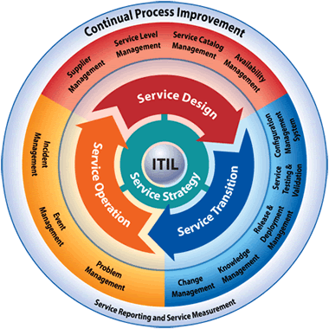

Introduction to the NGDCv3 Services Stack
Focuses on both the Technology and Operations stacks to provide a “top down” Service Oriented Infrastructure
Enablement, integration and seamless operation of Infrastructure as a Service.
Managed by BSM layer which is oriented to business outcomes.
Application Cloud: “Software as a Service” delivers business services from beyond the firewall
Service Oriented
Infrastructure
BSM
Business Services
ITSM
IT Processes
Business Service Management
Management
IT Service Management
Application
Mgmt
Service
Application Services
Process
App
Cloud
Web &
Portal
SOA
Client /
Server
BI
ERP &
CRM
GRID
apps
SaaS
Batch
Release
Mgmt
Availability
Mgmt
Service Level Management
Integration Services
Service Support
IT Asset and Configuration Mgmt
EAI
Ent Service Bus
Broker Middleware
Change
Mgmt
Capacity
Mgmt
Web Services
Service Desk
Service Delivery
Infrastructure Services
Infrastructure Mgmt
Service
Continuity
Tool Integration &
Process Automation
Operations Mgmt
IT Financial
Mgmt
CMDB
Platform
& Facilities
Mgt.
Infrastructure Services
Problem
Mgmt
Integrated
Infra
Cloud
Virtualized
Automated
PaaS
Services
Platform
Services
Storage
Services
Provisioning
Services
DR & BCP
Services
GRID
Services
Incident
Mgmt
Pooled & Virtualized Resources
Shared
Aggregated
Bladed
GRID
Cloud
Infra
Mgmt
Infrastructure Components
Resource
Technology
Server
Storage
Backup &
Archive
Network
Security
Sec Mgmt
Tools & Data
Security Services
Physical Environment
ITIL based framework for Infrastructure Services
NGDC v3 Services Stack
Green IT considerations drive the NGDC facilities
Infrastructure Cloud: “Platform as a Service” provides virtualized infrastructure to the NGDC from beyond the firewall
ITILv3 extends the Service Management framework to include Service Strategy and Service Lifecycle components
Copyright © 2009 Accenture All Rights Reserved.
Notes:
We use this to help our clients set a strategy...
The Accenture NGDC Reference Architecture shows how the layers build to provide the capability for managing business services from top down - from its business processes, enabling applications and their interactions, to the underlying technology.
The core is the Service oriented Infrastructure
Service Oriented Infrastructure (SOI) is a paradigm for provisioning and automation of virtualized and integrated infrastructure components that can be described as a service, and provided to any consuming application requirement, not limited to SOA styles. It is managed by a BSM layer, it is automated by a service level optimizing engine. The tools to implement this may or may not be SOA themselves.
SOA as an Application Style reaches into the NGDC Ref Architecture from top down, as processes implemented as asynchronous, loosely coupled, coarse grained services, communicating via standards-based contract and integration services. The NGDC advantage is the Business Service Management framework, which provides a business view of the services offered, providing a converged view of SOA-based applications as part of an end to end process. As SOA applications emerge, there will be an impact across the NGDC layers

Slide 3
The NGDC Reference Architecture Model
The Architecture Blueprint for the NGDC
Orchestration Engine
Execute automated workflows to assign and deploy technical infrastructure in response to the policy rules, work requests and real time inputs.
Business Service Management (BSM)
Business Service Management (BSM)
Business Service Management enables “service orientated infrastructure” (SOI) and allows IT to be managed from the perspective of the business.
Metering
& Billing
Windows
Linux
UNIX
System Z
Metering & Billing
Infrastructure usage and SLAs are processed to create bills/invoices.
Rules & Requests
The Service Catalogue and Policy Rules define how business applications can and must use the technical infrastructure (e.g. SLA).
Work Requests are new requests for infrastructure services.
DC model contains a logical view of the entire data center.
Policy Rules
Orchestration
&
Provisioning
Virtualization
Predictive
Operations
PLATFORM
Monitoring Outputs
The deployment and usage metrics, alerts and alarms are captured and passed to the Predictive Operations monitor.
DMZs
Red zone
Requests
Yellow zone
Service Catalogue
Green zone
NETWORK
NETWORK
Storage Net
Predictive Operations
Infrastructure usage metrics, alerts and alarms are processed by the Predictive Operations monitor and change requests returned to the Orchestration Engine for action through balancing the requests with policy rules for the IT service and incoming work requests.
DC Model
STORAGE
Virtualization
SAN
NAS
Backup
Archive
IT Automation Requests
Infrastructure components are assigned to specific work requests.
Configuration Management Database (CMDB)
Configuration Management Database (CMDB)
The CMDB contains all of the IT organization’s key parts (Configuration Items), their attributes and their inter-relationships
Workload Requests and Provisioning
Shared Technical Infrastructure
Operations Management
Copyright © 2009 Accenture All Rights Reserved.
Notes:
Define the ref arch -> once set, need to move into projects
Virtualization at center of shared technical infrastructure, but value constrained without the bounding functionality

Slide 4
NGDC Solution Architecture
BMC Mapping
BMC Service
Level
Management
Business Service Mgmt
BMC Remedy IT
Service Management
Suite
Atrium
Orchestrator
Metering
& Billing
BMC Performance
Manager
BladeLogic
Windows
Linux
UNIX
BMC Performance
Assurance
Service
Catalog
Orchestration
&
Provisioning
PLATFORM
Predictive
Operations
Policy Rules
Secret
Restricted
BMC Service
Level
Management
Commercial
Infrastructure Mgmt /
Technical Operations
Availability /
Capacity Mgmt
Work Requests
Unclassified
NETWORK
NETWORK
DC Model
Raw Internet
IT Service
Level Mgmt
Service Desk
BMC Remedy
Service Desk
STORAGE
SAN
NAS
Backup
Archive
IT Asset Mgmt
BMC Remedy
IT Service
Request Mgmt
BMC Remedy
Asset
Management
Configuration Management / CMDB
Workload Requests and Provisioning
Shared Technical Infrastructure
Operations Management
BMC Atrium
CMDB
Copyright © 2009 Accenture All Rights Reserved.

Slide 5
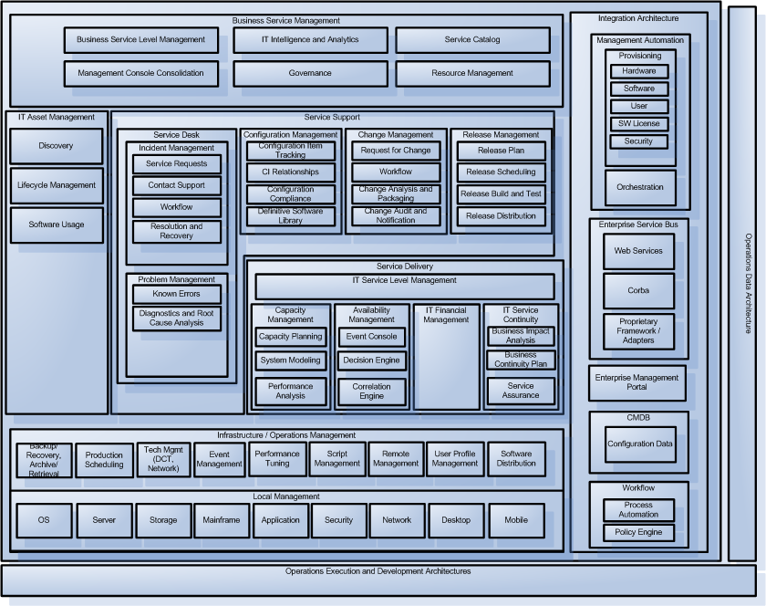
BMC NGDC Framework Mapping
BMC Remedy IT Service
Management Suite
BMC Service Level Management
BMC Analytics for BSM
BMC Discovery for Business Processes
BMC Topology
Discovery
BMC Configuration Manager/ BMC Atrium CMDB Enterprise Manager
BMC Remedy Change Manager
BMC Remedy
Asset
Management
BMC Remedy Service Desk
BMC Remedy IT Service
Management Suite
BMC Service Level Management
BMC Service
Impact Manager
BMC Service Impact Manager
BMC ProactiveNet Analytics
BMC Event Manager
BMC Backup and Recovery Solution for IMS
BMC Performance Analyzer
BMC Patrol Enterprise
Manager
BMC Identity Discovery
BMC Configuration
Manager / BMC Atrium CMDB
Enterprise Manager
BMC Performance Manager
BMC Performance Analyzer
BMC Patrol Reporting for Networks
Copyright © 2009 Accenture All Rights Reserved.

Slide 6
BMC NGDC Framework Mapping
BMC Remedy IT Service
Management Suite
BMC Service Level Management
BMC Analytics for BSM
BMC Discovery for Business Processes
BMC Topology
Discovery
BMC Configuration Manager/ BMC Atrium CMDB Enterprise Manager
BMC Remedy Change Manager
BMC Remedy
Asset
Management
BMC Remedy Service Desk
BMC Remedy IT Service
Management Suite
BMC Service Level Management
BMC Service
Impact Manager
BMC Service Impact Manager
BMC ProactiveNet Analytics
BMC Event Manager
BMC Backup and Recovery Solution for IMS
BMC Performance Analyzer
BMC Patrol Enterprise
Manager
BMC Identity Discovery
BMC Configuration
Manager / BMC Atrium CMDB
Enterprise Manager
BMC Performance Manager
BMC Performance Analyzer
BMC Patrol Reporting for Networks
Copyright © 2009 Accenture All Rights Reserved.

Slide 8
Contents
NGDC Introduction
Functional Specification – Business Scenarios
Solution Architecture Overview
POC Walkthrough
Client Credentials
Copyright © 2009 Accenture All Rights Reserved.

Slide 9
POC Functional Requirements
Below is a re-cap on the functional specifications that were required to be demonstrated for the Proof of Concept which are key elements to the NGDC vision
FS-001 – Basic application server provisioning
FS-002 – Basic Application server De-provisioning
FS-003 – Basic Server Modification
FS-004 – Service Creation and Management
FS-005 – Maintain service through a Platform Failure
FS-006 – Maintain Service through SLA Breach
FS-007 – Service/Server Archival
FS-008 – Short Term Service Request
FS-009 – Manage ‘Scientific Compute Grid’ Capacity
FS-010 – Single Point of Management and Control
FS-011- Usage Report and billing
Copyright © 2009 Accenture All Rights Reserved.

Slide 10
POC Functional Requirements- Grouping
Below is a re-cap on the functional specifications that were required to be demonstrated for the Proof of Concept which are key elements to the NGDC vision
FS-001 – Basic application server provisioning
FS-002 – Basic Application server De-provisioning
FS-003 – Basic Server Modification
FS-004 – Service Creation and Management
FS-005 – Maintain service through a Platform Failure
FS-006 – Maintain Service through SLA Breach
FS-007 – Service/Server Archival
FS-008 – Short Term Service Request
FS-009 – Manage ‘Scientific Compute Grid’ Capacity
FS-010 – Single Point of Management and Control
FS-011- Usage Report and billing
Not part of Phase 1
Copyright © 2009 Accenture All Rights Reserved.

Slide 11
BMC Product Descriptions
BMC Service Request Manager (SRM)
  BMC Service Request Management (SRM) allows IT to define offered services, publish those services in a Service Catalog and automate the fulfillment of those services for their end-users.
BMC Remedy IT Service Management (ITSM)
  The BMC Remedy IT Service Management Suite reduces complexity and makes customer support, change management, and asset management integrated and efficient. With BMC, you gain business transparency, visibility, and control across all of service support with one solution.
BMC Atrium Core (AC)
  BMC Atrium Core activates Business Service Management (BSM) by providing a shared set of enabling technologies that bring business relevance to your BMC and third-party IT solutions by providing a single, federated configuration management database (CMDB), business service model, and common views that provide business relevant views into IT management.
BMC BladeLogic Operations Manager (BLOM)
  The BMC BladeLogic Operations Manager is a leading platform for the management, control and enforcement of configuration changes in the data center. It consists of three modules that address the three most pressing needs in the data center: Configuration, Compliance, and Virtualization.
BMC Atrium Orchestrator (AO)
    BMC Atrium Orchestrator enables IT Operations organizations to automate routine, labor-intensive, error-prone tasks, leveraging systems, applications and tools across silos in the operations environment, from trouble ticketing, fault management, performance monitoring, virtualization management, CMDB, and more.
.
Copyright © 2009 Accenture All Rights Reserved.

Slide 12
BMC Product Descriptions, cont’d
BMC Event and Impact Management (BEIM)
    BMC Event and Impact Management delivers consolidated, automated event management, with event prioritization according to business context.
BMC Performance Manager (BPM)
  BMC Performance Management proactively manages the availability and performance of your distributed systems environment, including your network and a broad range of applications, databases, and operating systems, as well as synthetic and real transaction response times.
BMC Service Level Management (SLM)
  With BMC Service Level Management (SLM), IT can manage the entire range of service level agreement (SLA), from defining SLAs and monitoring compliance to collecting and analyzing KPI data, addressing problem areas, and continually refining the services offered.
BMC Dashboards (Dash)
  BMC Dashboards for BSM enables the linking of critical IT process into a dashboard view that provides aggregated performance indicators within a single pane of glass.
BMC Analytics for BSM (BO)
  BMC Analytics for BSM provides point-and-click analysis and advanced reporting across BMC Remedy Service Desk, BMC Remedy Asset Management, and BMC Atrium CMDB
Copyright © 2009 Accenture All Rights Reserved.

Slide 13

BMC Product Mappings
Use Case | SRM | ITSM | Atrium Core | BL Op Mgr | AO | BEIM | BPM | SLM | BO | Dash
FS-001
FS-002
FS-003
FS-004
FS-005
FS-006
FS-008
FS-010
FS-011
Copyright © 2009 Accenture All Rights Reserved.

Slide 14
Functional Requirement – FS-001: Basic Application Server Provisioning
Function
Parameters
Provision of a new application/server platform according to the selections made from Service Catalog. This process should decide on what physical components to provision the service, secure those resources and provision to the options / parameters provided.
The end result is a single “server”, located on the correct QinetiQ VLAN, providing the requested service characteristics (e.g. operating system and storage).
Key focus here is the correct sequencing of the individual provisioning requests and ensuring that the entire request is completed fully.
Target Network: [Restricted¦Unrestricted¦etc…]
Platform Tier: [Choice]
OS: [Windows 2003 EE¦ Linux]
Storage Volume & Tier: xGB, SAN or NAS, if to archive
Provisioning Orchestration
Server Platform
Predictive Operations
Storage
Manage the end to end provisioning of the service
From the Platform Tier choice determine which Platform to create the service from (i.e. Hp/Dell/IBM Blade; VMware; eGenera
From the Storage parameter determine which storage tier to provision from
Create the necessary provisioning requests – either directly to the “bare-metal” or via a message-broker/interface to a specific provisioning tool
Deliver application server
Return neccesary meta-data to the authorised requester
Provide platform from the pool
Provision the requested operating system onto the platform
Basic operating system configuration completed: administrator accounts, network configurations specific to the VLAN, etc
Provide storage from the storage pool according to tier
Update data archiving polices
Add server to data backup service the relevant backup/recovery policy
Ensure new application server is monitored by Operations
Re-evaluate capacity across the server to identify any limits being reached
Update the client’s Service List to ensure billing records are accurate
BMC Products
Service Request Mgmnt 7.5
ITSM Suite 7.5
Atrium Core 7.5
BladeLogic Operations Mngr
BMC Atrium Orchestrator
Copyright © 2009 Accenture All Rights Reserved.
Notes:
Corrected grammar

Slide 15
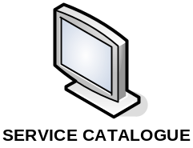
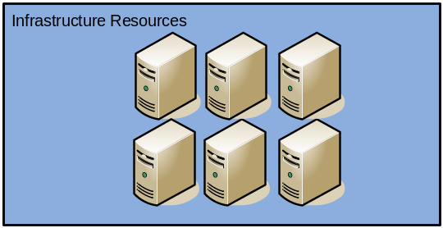


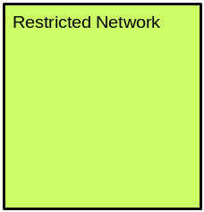
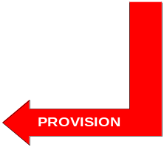

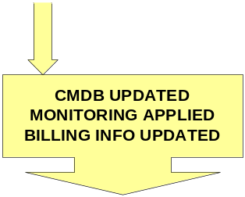
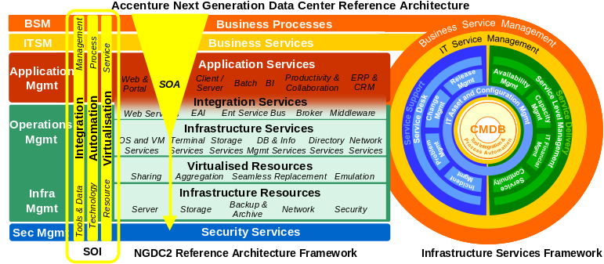
FS-001
Key Functional Specifications include
Provision of a new application/server platform according to the selections made from Service Catalogue. This process should decide on what physical components to provision the service, secure those resources and provision to the options / parameters provided.
The end result is a single “server”, located on the correct QinetiQ VLAN, providing the requested service characteristics (e.g. operating system and storage).
Key focus here is the correct sequencing of the individual provisioning requests and ensuring that the entire request is completed fully.
Copyright © 2009 Accenture All Rights Reserved.
Notes:
Corrected grammar

Slide 16
Functional Requirement – FS-002: Basic Application Server De-provisioning
Function
Parameters
Deprovision an application server in a secure manner and return the components to the resource pools. Data should be backed up.
Key focus here is the correct sequencing of the individual provisioning requests and ensuring that the entire request is completed fully
Application Server Name: [Name]
Provisioning Orchestration
Server Platform
Predictive Operations
Storage
Manage the end to end provisioning of the service
Validate the request and action any due-diligence (e.g. determine if in use; provide a ‘cooling off period)
Determine the infrastructure components being used and construct the necessary provisioning requests
Mark as “Out of Service”
Move to Quarantine VLANS and “clean” accordingly
Deprovision the platform configuration
Return capacity to the pool of available resource
Backup data and mark as archival
“Wipe” data and return storage to the pool
Remove server from active monitoring
Re-evaluate capacity across the infrasturcture
Update the client’s Service List to ensure billing records are accurate
BMC Products
Service Request Mgmnt 7.5
ITSM Suite 7.5
Atrium Core 7.5
BladeLogic Operations Mngr
BMC Atrium Orchestrator
Copyright © 2009 Accenture All Rights Reserved.
Notes:
Corrected grammar

Slide 17
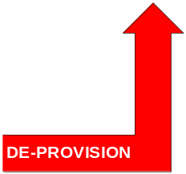
FS-002
Key Functional Specifications Include
De-provision an application server in a secure manner and return the components to the resource pools. Data should be backed up.
Key focus here is the correct sequencing of the individual provisioning requests and ensuring that the entire request is completed fully
Copyright © 2009 Accenture All Rights Reserved.
Notes:
Corrected grammar

Slide 18
Functional Requirement – FS-003: Basic Server Modification
Function
Parameters
Allow an authorised requester to change tiers of service. The changes allowed will be dependant on the current service class/tier
Service Item(s)
Old Service Level/Tier
New Service Level/Tier
Provisioning Orchestration
Server Platform
Predictive Operations
Storage
Manage the end to end change
Validate the change request and action any due diligence
Determine the affected infrastructure components and created the necessary provisioning requests
For VMware this will provide for changes to virtual CPU and allocated memory
For Blades – move operating system to higher/lower class of server
Move operating system between physical and virtual infrastructure
Increase/decrease storage allocated
Move storage allocation: SAN to NAS and vice versa
Change data archiving policies
Update monitoring accordingly
Update client billing records to reflect new tariff
BMC Products
Service Request Mgmnt 7.5
ITSM Suite 7.5
Atrium Core 7.5
BladeLogic Operations Mngr
BMC Atrium Orchestrator
Copyright © 2009 Accenture All Rights Reserved.
Notes:
Corrected grammar

Slide 19
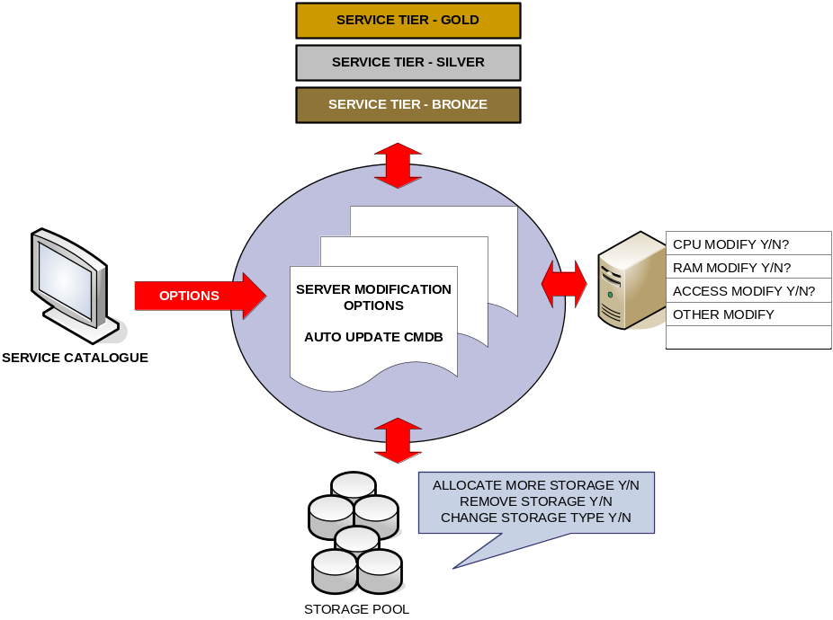
FS-003
Key Functional Specifications include
Ability to modify a servers characteristics after deployment based on business or computing needs
Increase utilization of available resources through improved allocation based on centrally managed infrastructure
Ability to change service tier level in response to business requirements relating to that server
Immediate update of billing instruction based on requested server changes
Copyright © 2009 Accenture All Rights Reserved.
Notes:
Corrected grammar

Slide 20
Functional Requirement – FS-004: Service Creation and Management
Function
Parameters
Allow a “Service” to be created from one or more application servers and define availability and performance characteristics.
Service Name
Service Servers: [List of application servers]
Availability: [High| Standard]
Guarantee Performance: [Yes | No]
Provisioning Orchestration
Server Platform
Predictive Operations
Storage
Create Service in the CMDB
Orchestrate required provisioning request for clustering of operating system, application or database
Action requests for clustering of Operating system and/or application and/or database
None
Create necessary monitoring rules/alerts
Update client billing records
BMC Products
BMC Event and Impact Mgmnt
Atrium Core 7.5
BMC Atrium Orchestrator
BMC Performance Mnger
Copyright © 2009 Accenture All Rights Reserved.
Notes:
Corrected grammar

Slide 21
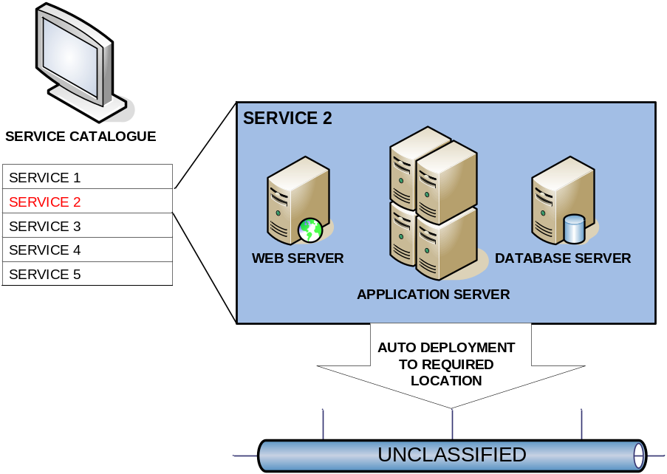
FS-004
Key Functional Specifications Include
Allow a ‘Service’ to be created from one or more application servers and define availability and performance characteristics
Copyright © 2009 Accenture All Rights Reserved.
Notes:
Corrected grammar

Slide 22
Functional Requirement – FS-005: Maintain Service Through a Platform Failure
Function
Parameters
Predictive Operations will detect a platform failure and, depending on the services availability class, will either:
  for ‘Standard’ availability, raise a trouble ticket to have the outage dealt with manually
  For ‘High’ availablity, provide alternate platform for hosting of the application and action automatically
Alert received that Platform in the Service has failed
Provisioning Orchestration
Server Platform
Predictive Operations
Storage
Determine action to take dependent on Availablity class of the Service: “Standard” should raise a trouble ticket; “High” should initiate automatic repositioning
Determine the platform components needed
Create & orchestrate the necessary provisioning requests
Provide new platform from pool and configure accordingly
Move operating system workload
Isolate / take offline failed platform if possible/required
Reallocate storage to new platform pool
Validate data integrity
Perform restore if required
Identify the platform failure and create alert for Orchestration
Update client billing records
BMC Products
BMC Event and Impact Mgmnt
Atrium Core 7.5
ITSM Suite 7.5
BMC Atrium Orchestrator
BMC Performance Mngr
BladeLogic Operations Mngr
Copyright © 2009 Accenture All Rights Reserved.
Notes:
Corrected grammar

Slide 23
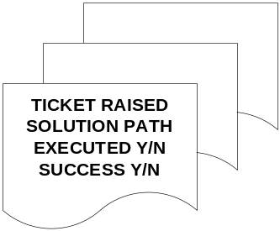





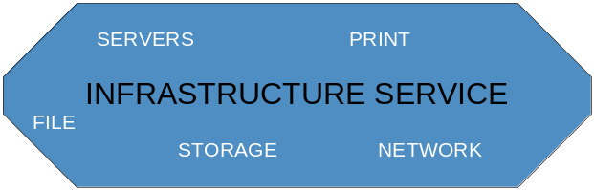
FS-005
Key Functional Specifications include
For a standard availability outage a such as a basic application server outage in development, the infrastructure service is immediately aware and a manual ticket is raised
Solution path is followed in accordance with remedy instructions until service is restored
Copyright © 2009 Accenture All Rights Reserved.
Notes:
Corrected grammar

Slide 24




FS-005 – (cntd)
Key Functional Specifications Include
For a high available service outage such as a server failure, the infrastructure is again notified and the application is automatically transferred to an available resource
Copyright © 2009 Accenture All Rights Reserved.
Notes:
Corrected grammar

Slide 25
Functional Requirement – FS-006: Maintain Service Through Service Level Breach
Function
Parameters
Predictive Operations will predict or detect a breach of a Service Level and alert Orchestration
The base example is that “response time” of a transaction is increasing and approaching/breaching a threshold.
Resources can be added/removed from a service to ensure the provided capacity is a close fit to the application demands
Service Name
SLA Breach
Provisioning Orchestration
Server Platform
Predictive Operations
Storage
Validate the alert and determine action to take:
  Create trouble ticket is “Guarentee Performance” of the Service is “NO”
  Orchestrate required action to be able to address the SLA breach
Determine infrastructure components to add/remove to the service
Options:
Add/removed resources from a Virtual servers
Move operating system onto higher platform tier
Provision and allocate additional platform for application or database layer
Add/remove storage as required
Move storage to higher/lower tier
Service level breach is detected or predicted
Create alert and send to Orchestration
Update client billing records accordingly (e.g. Service credits for period when SLA was not being met)
BMC Products
BMC Event and Impact Mgmnt
Atrium Core 7.5
ITSM Suite 7.5
Remedy SLM
BMC Atrium Orchestrator
BMC Performance Mnger
BladeLogic Operations Mngr
Copyright © 2009 Accenture All Rights Reserved.
Notes:
Corrected grammar

Slide 26
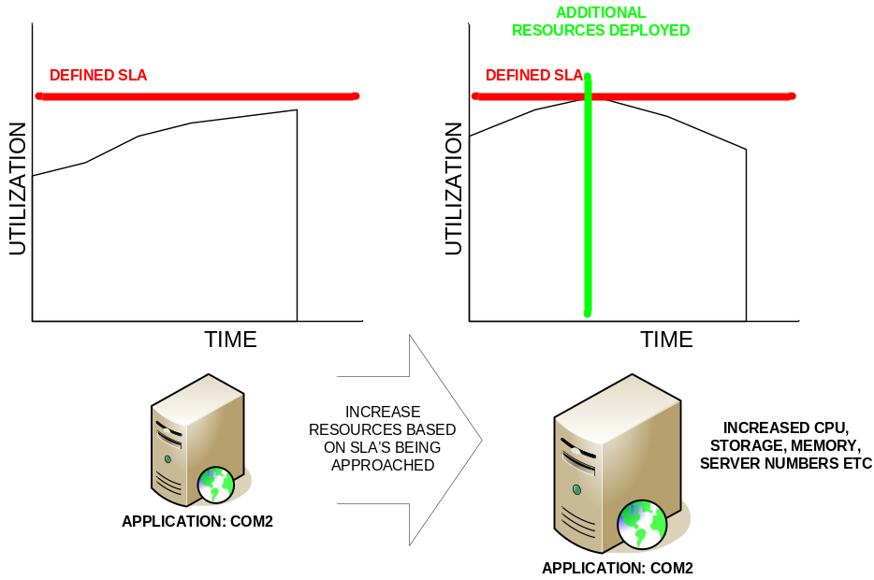
FS-006
Key Functional Specifications Include
Predictive Operations will predict or detect a breach of a Service Level and alert Orchestration
The base example is that “response time” of a transaction is increasing and approaching/breaching a threshold.
Resources can be added/removed from a service to ensure the provided capacity is a close fit to the application demands
Copyright © 2009 Accenture All Rights Reserved.
Notes:
Corrected grammar

Slide 27
Functional Requirement – FS-007: Service/Server Archival
Function
Parameters
Allow an authorised requestor to archive a service/server with the intention it will be retrieved at some point in the future. This allows the underlying infrastructure components to be re-used.
Identifier: Service/Server Name
Provisioning Orchestration
Server Platform
Predictive Operations
Storage
Validate the request and action any due diligence
Identify the infrastructure components
Create & orchestrate the required provisioning workflows
De/re-provision the platform as required
For archive – create operating system image ad archive it
Archive / recover application data
Archive / recover the operatnig system image
Update monitoring framework to reflect the archive/reestablish action
Monitor available capacity in the infrastructure pools
Update client billing records
BMC Products
Copyright © 2009 Accenture All Rights Reserved.
Notes:
Corrected grammar

Slide 28
Functional Requirement – FS-008: Short Term Service Request
Function
Parameters
Similar to FS-001 with the key differentiator being that the service duration is short term (typically less than 12 months).
This function may become just a parameter to the FS-001 function but is described seperately
As for FS-001 plus:
  Service Duration
Provisioning Orchestration
Server Platform
Predictive Operations
Storage
As for FS-001 plus
Handle interaction with service requestor to determine what action to take (continue service; archive; decommission)
Orchestrate required provisioing workflows in support of service requester decision (above)
BMC Notes
Use an advanced interface form within SRM and spawn two change requests, one for provisioning, one for de-provisioning
In lieu of advanced interface form, we could create a drop-down questionnaire that will then create two change requests as described above
As for FS-001
As For FS-001
As for FS-001 plus
Identify services/servers coming to end of service life and create alert
Update client billing records
Monitor capacity of long term and on-demand infrastructure
BMC Products
Service Request Mgmnt 7.5
ITSM Suite 7.5
Atrium Core 7.5
BladeLogic Operations Mngr
BMC Atrium Orchestrator
Copyright © 2009 Accenture All Rights Reserved.
Notes:
Corrected grammar

Slide 29
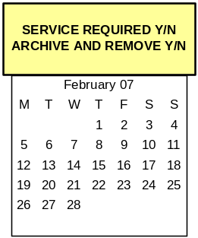
FS-008
Key Functional Specifications Include
Similar to FS-001 with the key differentiator being that the service duration is short term (typically less than 12 months).
This function may become just a parameter to the FS-001 function but is described separately
Copyright © 2009 Accenture All Rights Reserved.
Notes:
Corrected grammar

Slide 30
Functional Requirement – FS-009: Manage ‘Scientific Compute Grid‘ Capacity
Function
Parameters
Many parts of the QinetiQ business require the ability to solve large numerical-based problems. It’s anticipated that a block of the shared service infrastructure will be given over to providing a GRID service.
The GRID will have a base size but will be able to expand / contract according to work load and schedules. Key will be the ability to maker temporary use of unsed servers
N/a
Provisioning Orchestration
Server Platform
Predictive Operations
Storage
GRID will effectively be a Service (see FS004) that will scale up/down using the functions for archive, provisioning and reprovisioning of servers/services FS001/002/007)
Orchestrate the rapid repurposing of platform nodes
Rapid repurposing of platform to enable GRID capability
As per FS001/002/007)
Provide storage to the GRID / reallocate storage to new nodes in the GRID
Monitor GRID service and react to capacity requests (assumed GRID itself will determine capacity needs based on workload demands)
Monitor live services to determine if they can be archived and used in the GRID
Monitor archived services for when they need to come back on line
Create alerts for Orchestration to provision/purpose servers
BMC Products
P
U
A
Copyright © 2009 Accenture All Rights Reserved.
Notes:
Corrected grammar

Slide 31


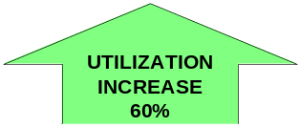
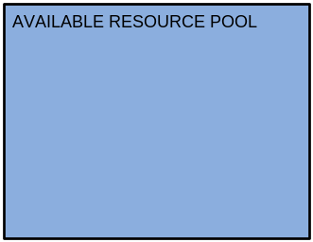

FS-009 – Business Scenario
Key Functional Specifications Include
Many parts of the QinetiQ business require the ability to solve large numerical-based problems. It’s anticipated that a block of the shared service infrastructure will be given over to providing a GRID service.
The GRID will have a base size but will be able to expand / contract according to work load and schedules. Key will be the ability to maker temporary use of unsed servers
Copyright © 2009 Accenture All Rights Reserved.
Notes:
Corrected grammar

Slide 32
Functional Requirement – FS-010: Single Point of Management and Control
Function
Parameters
Provide a single management console for the Utility Data Centre. Provide “overview” and “Drill down” capability across all services and components.
Time-base trigger
Provisioning Orchestration
Server Platform
Predictive Operations
Storage
Provide provisioning metrics to the billing component within Predictive Operations
Provide provisioning metrics to the billing component within Predictive Operations
Provide provisioning metrics to the billing component within Predictive Operations
Ability to accurately bill clients for use of the service
BMC Products
BMC Dashboards
BMC Atrium Core 7.5
ITSM Suite 7.5
BMC Event and Impact Mgmnt
Copyright © 2009 Accenture All Rights Reserved.
Notes:
Corrected grammar

Slide 33
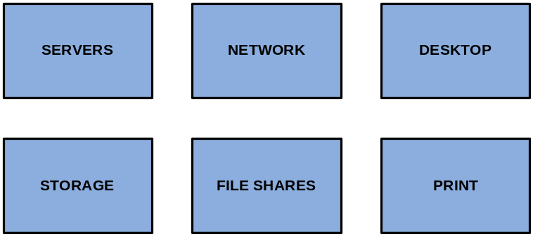


FS-010 – Business Scenario
Key Functional Specifications Include
Provide a single Management console for the Utility Data Centre. Provide ‘Overview’ and ‘Drill-Down’ Capability across all services and components
Copyright © 2009 Accenture All Rights Reserved.
Notes:
Corrected grammar

Slide 34
Functional Requirement – FS-011: Provisioning of File Shares
Function
Parameters
Provide a file-share for a period of time
Tier of storage
Duration required
VLAN required to be deployed to
Provisioning Orchestration
Server Platform
Predictive Operations
Storage
Validate the request and action any due diligence
Identify the infrastructure components
Create & orchestrate the required provisioning workflows
Send access details to requester
None
Provision the storage
Set file/share security options
Ensure file share added to monitoring
Monitor for when expiry dates are approaching
Maintain client billing records
BMC Products
Copyright © 2009 Accenture All Rights Reserved.
Notes:
Corrected grammar

Slide 35
Functional Requirement – FS-012: Usage Reporting/Billing
Function
Parameters
Demonstrate the ability to create a bill for services used during the period
Time-base trigger – e.g. monthly
Provisioning Orchestration
Server Platform
Predictive Operations
Storage
None
None
None
Ability to accurately bill clients for use of the service
Will include charges for ongoing services, on demand services and credits for missed service levels
BMC Products
Atrium Core 7.5
ITSM Suite 7.5
Business Objects/Analytics
Copyright © 2009 Accenture All Rights Reserved.
Notes:
Corrected grammar

Slide 36
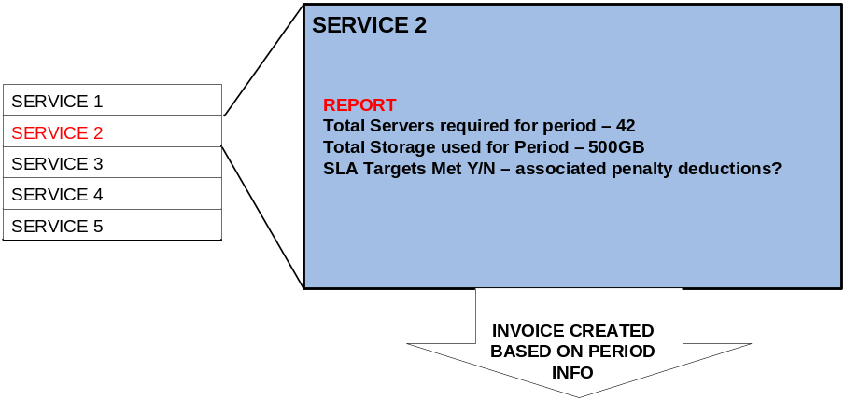
FS-012 – Business Scenario
Key Functional Specifications include
Accurate view of resources used by different business entities
Ability to charge based on resources used during specific time periods
Report on any outages within given time periods
Accurate views on what SLA targets were set and what has been met
Copyright © 2009 Accenture All Rights Reserved.
Notes:
Corrected grammar

Slide 37
Contents
NGDC Introduction
Functional Specification – Business Scenarios
Solution Architecture Overview
POC Walkthrough
Client Credentials
Copyright © 2009 Accenture All Rights Reserved.

Slide 38
Objectives for NGDC Showcase
Demonstrated an Integrated Service Management Solution for
Provisioning
Service Creation and Management
Business Systems Management
Discovery and Mapping
Monitoring
Maintaining Services
Usage and Accounting
Workload Management
Copyright © 2009 Accenture All Rights Reserved.

