Slide 1
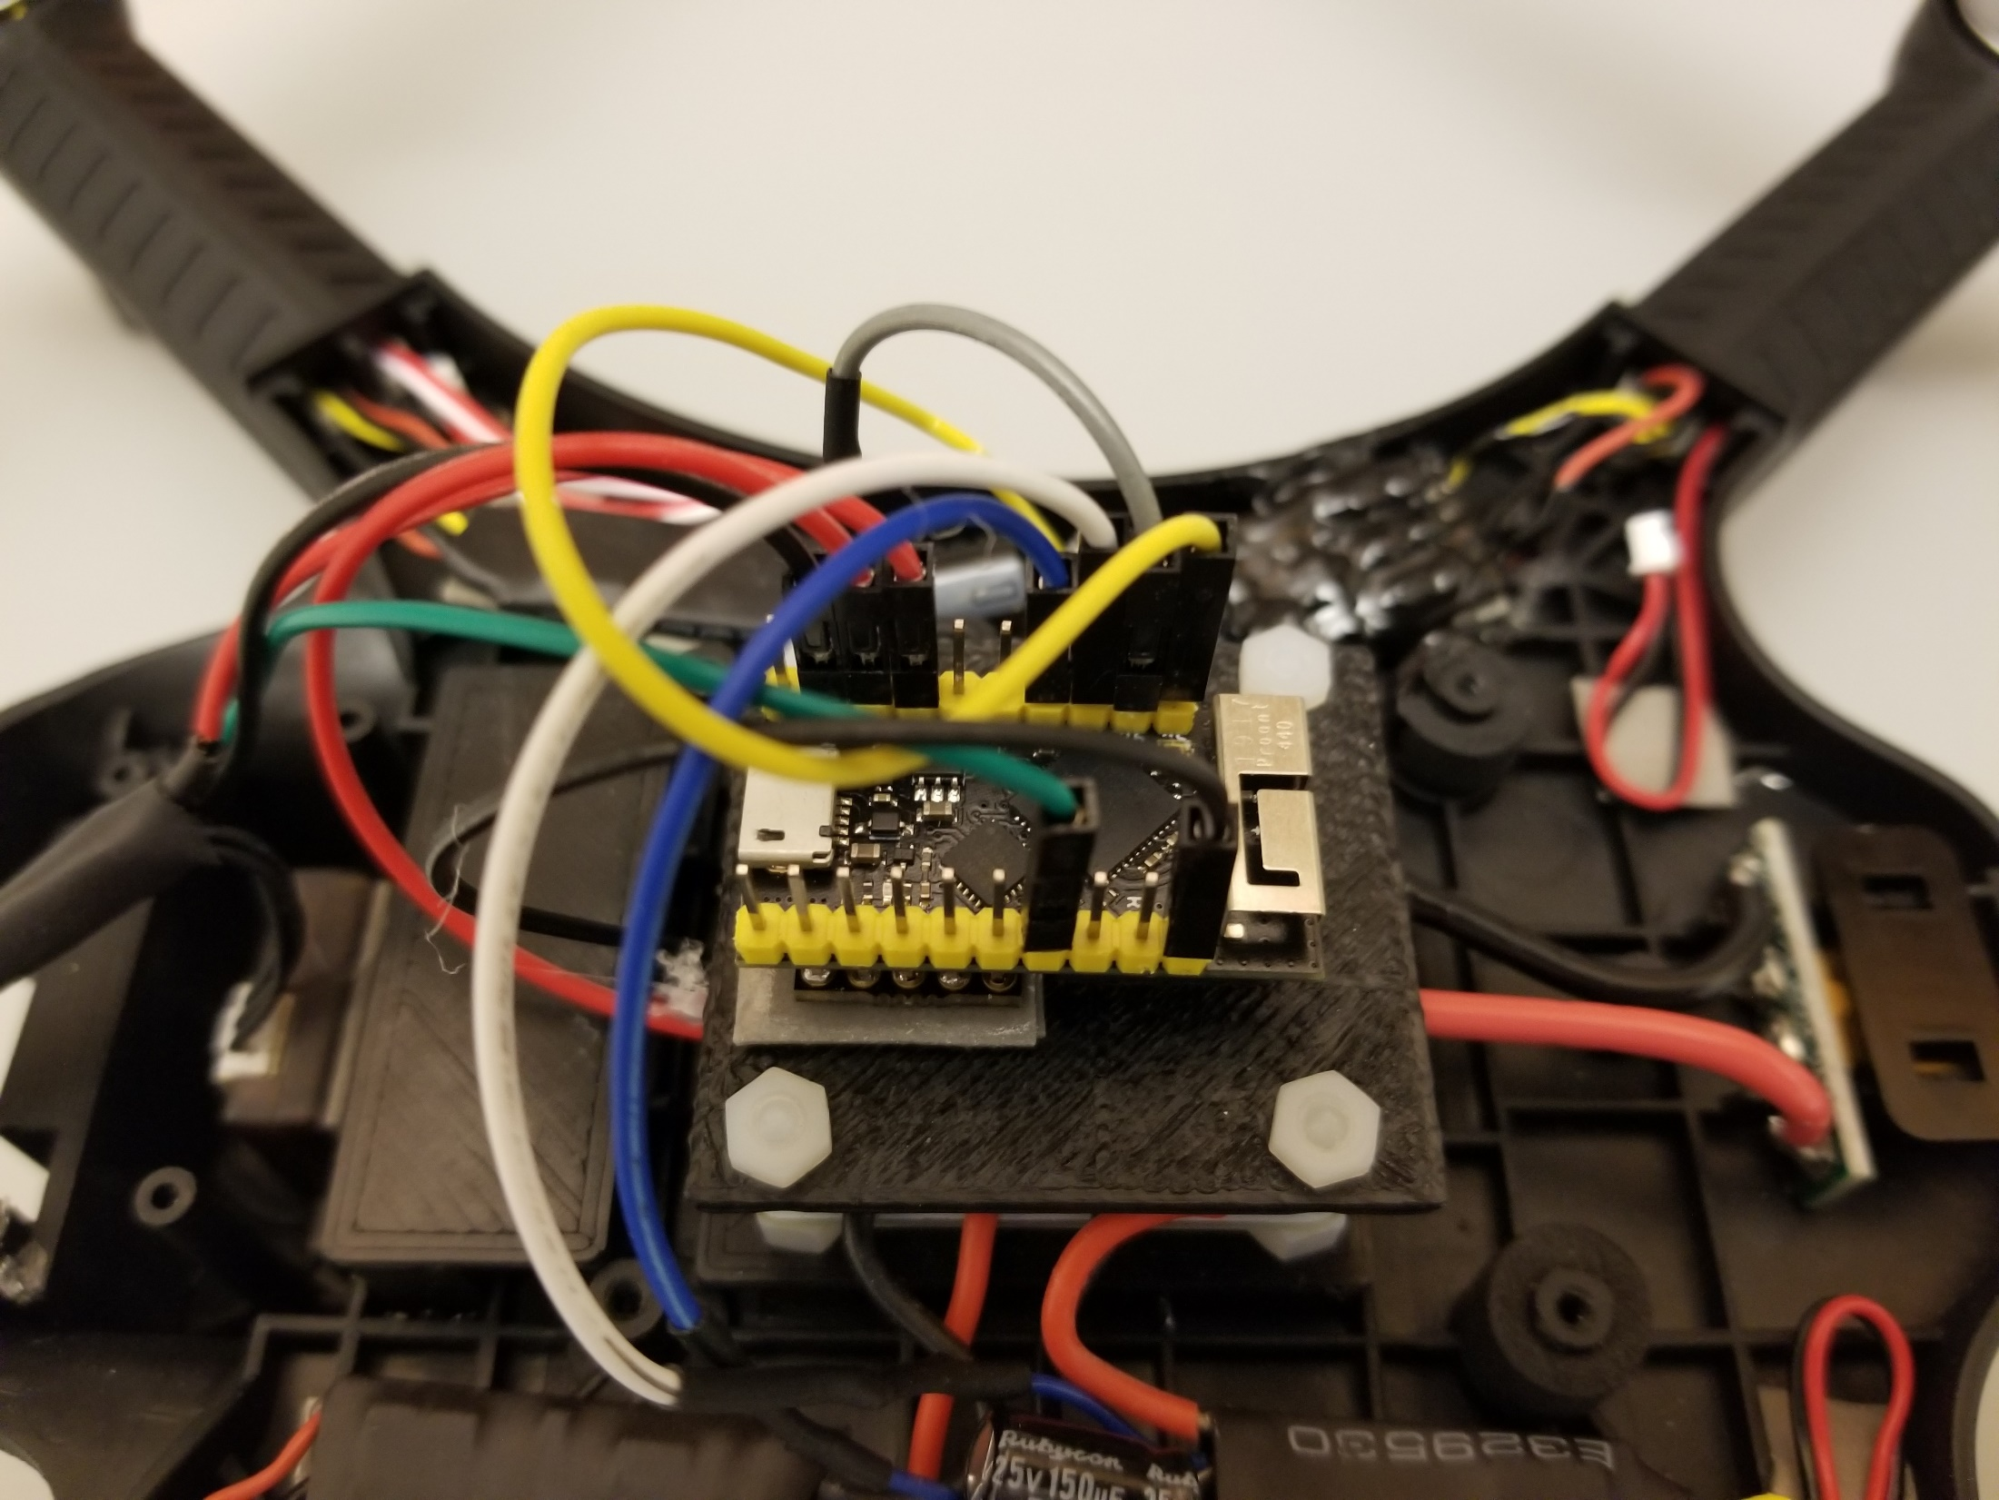
Motor 3, GPIO27
Motor 1, GPIO25
Motor 2, GPIO26
PDB AUX2 -,
GND
RX GND,
GND
RX+, 3.3V
RX Signal,
GPIO32
PDB AUX2 +, 5V
Motor 4, GPIO15

