Slide 1
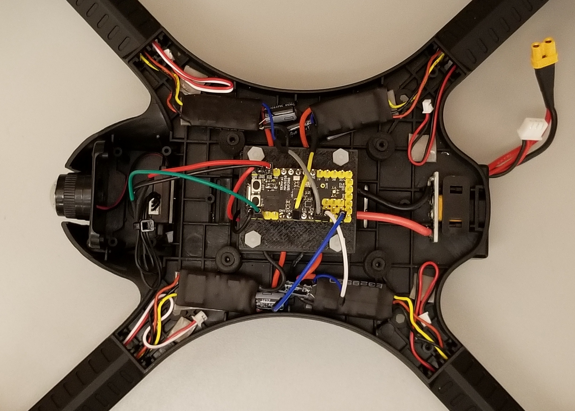
Motor 2, D8
Motor 1, D5
RX+, 3.3V
RX GND,
GND
RX
RX Signal,
D0
PDB AUX2 +,
VIN
Motor 4, D11
PDB AUX -, GND
Motor 3, D9

