Slide 1
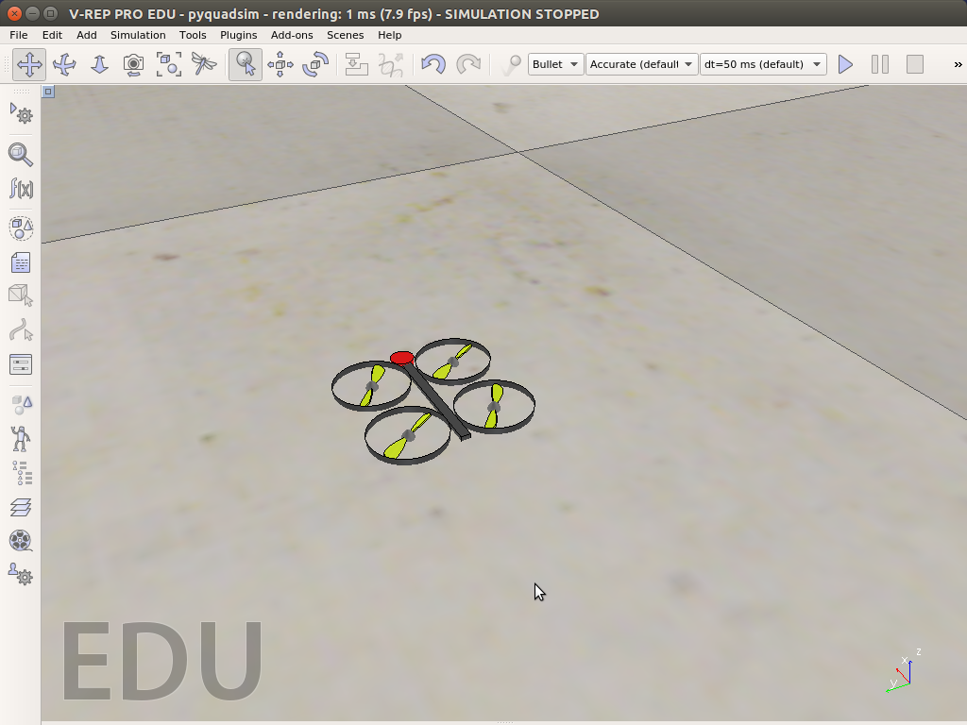
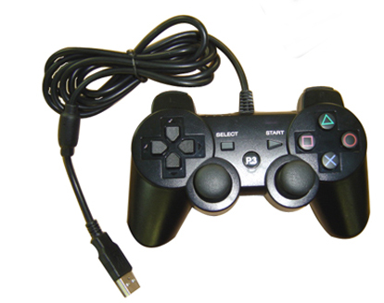
sensors
FMU
demands
PID
Controller
corrections
VREP / pyquadsim.ttt
sensors
demands
motors
motors
sensors
pyquadsim_client.lua
pyquadsim_server.py
demands
PyQuadStick
motors

