Slide 1
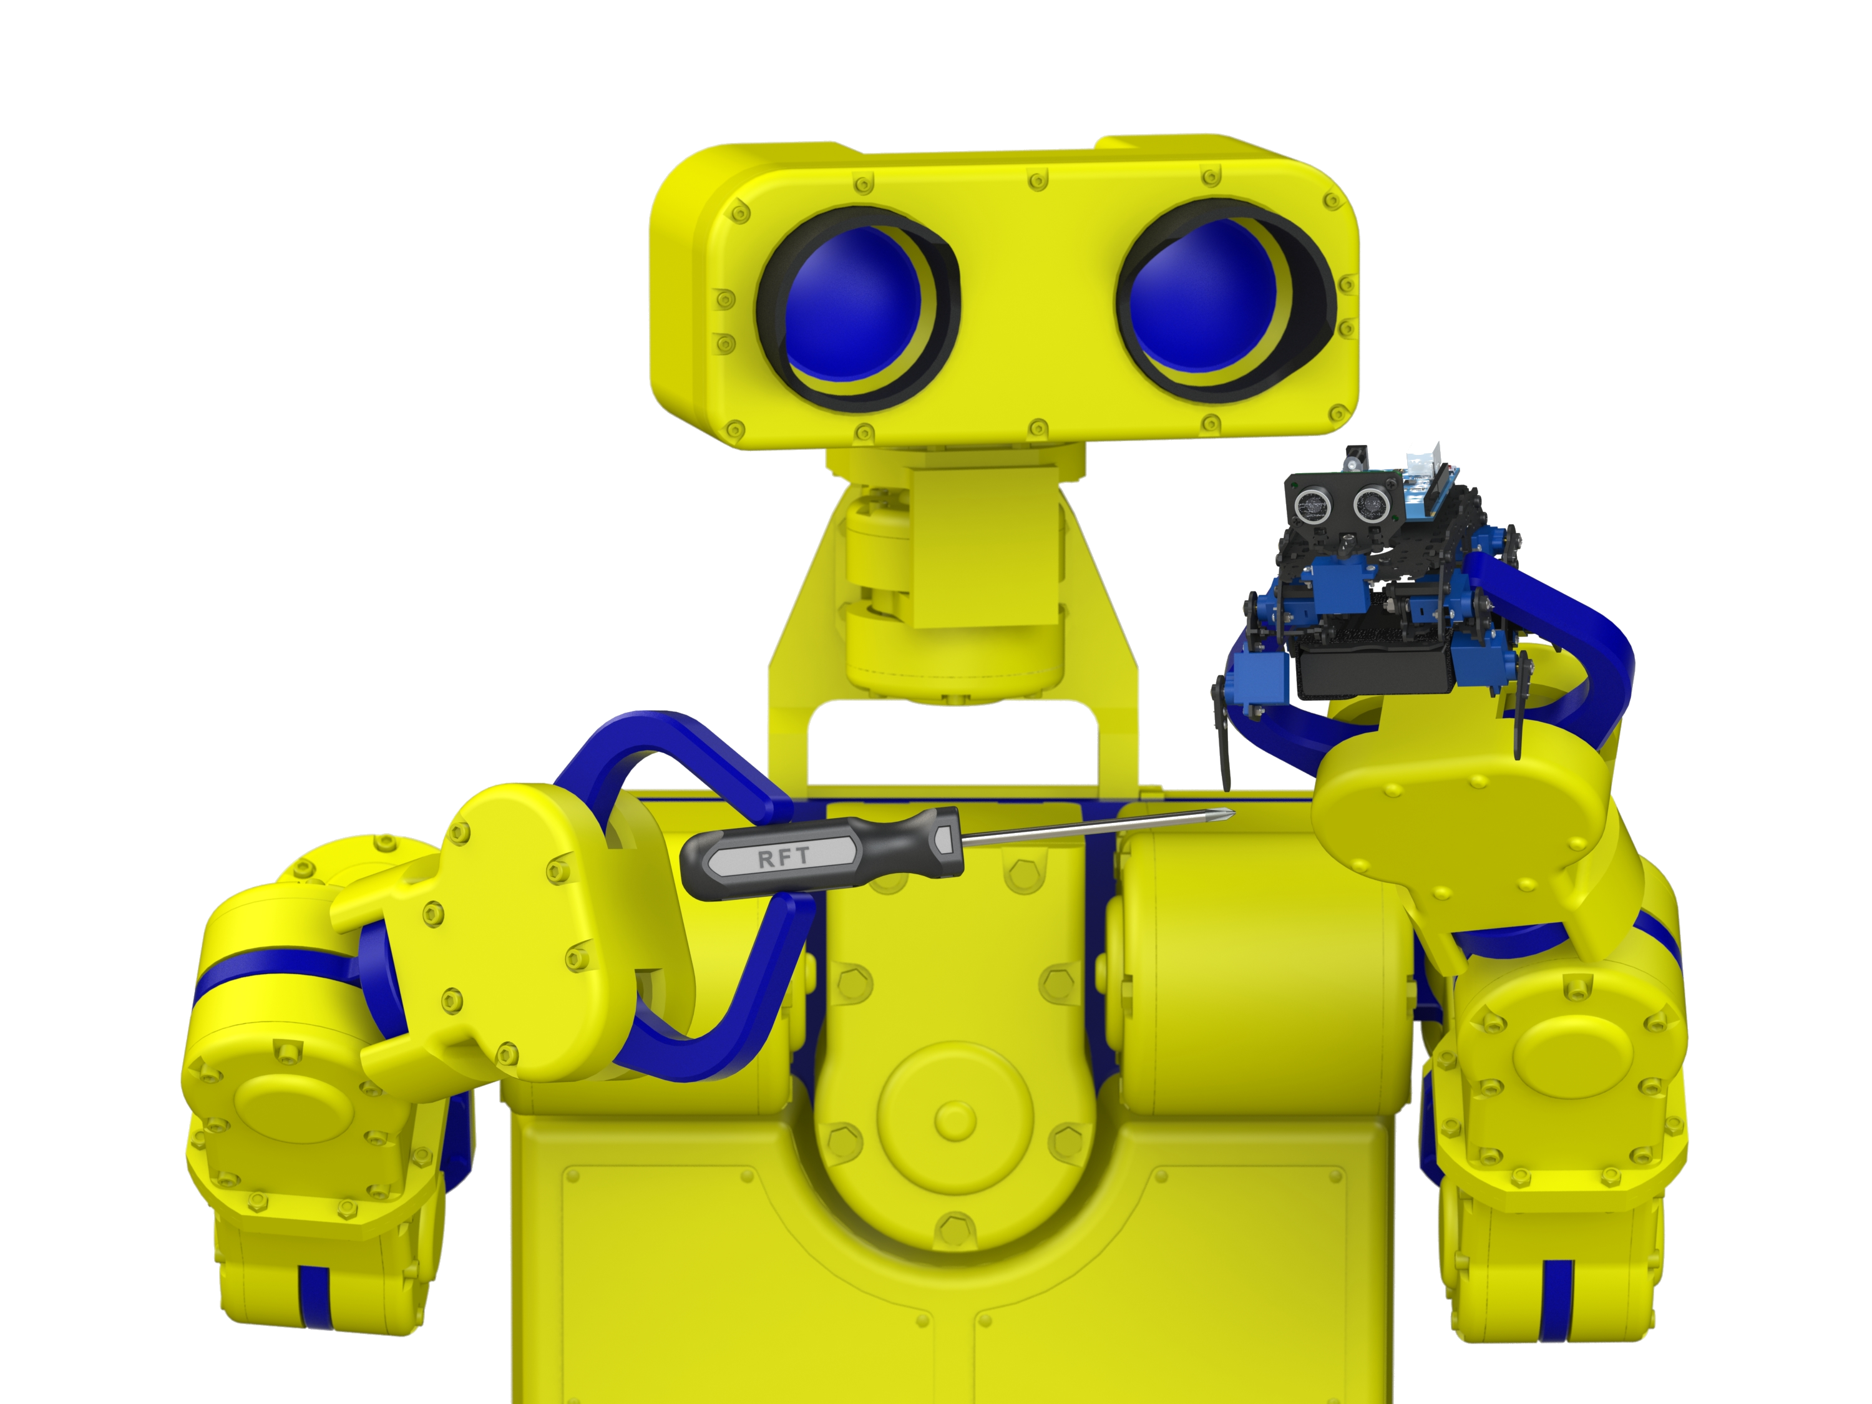
Image courtesy of Bert Wagner, A2USA Inc.

