Slide 1
LISP Project
Justin Hust
Ethan Petuchowski
Simon Doty
LISP Interpreter using JavaCC, to better understand a parser/interpreter complete solution.
SQL Subquery in ReL, to gain familiarity with integrating SQL into another language.

Slide 2
LISP Interpreter
Started from scratch
Ended up using same basic class breakdown as Crono.
Uses Sexpr as abstract base class. Derives Atoms, Expression, Lambda function.
Built AST by hand initially, then developed parser to generate AST-building code.
Eval() on a node performs eval() on recursive sub-nodes to calculate answer.
Class diagram and AST code on next slides.

Slide 3
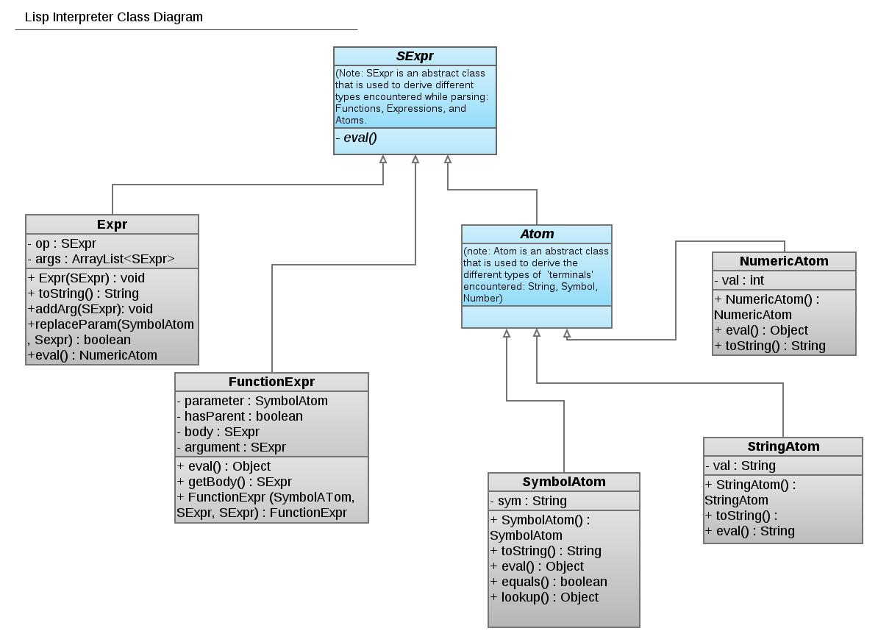
Class Diagram

Slide 4
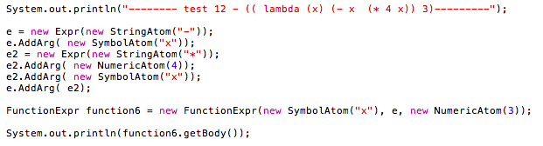
AST Creation

Slide 5
Completed Functionality
> 5
5
> (+ 3 1 2)
6
> ((lambda (x) (- 3 x)) 1)
2
> (let ((x 5)) x)
((lambda (x) (x)) 5)
5

Slide 6
Completed Functionality (Cont')
> ((lambda (x) (* x (+ 3 4 x))) 7)
98
> ((lambda (x) (+ x ((lambda (y) (+ y y)) 3))) 4)
10

Slide 7
On The Radar
Environments. Still need a good method for storage and lookup.
((lambda (x) ((lambda (x) (+ x x)) 3) 4)
Toggle of Static vs. Dynamic scoping
Allow print of AST
SQL Subquery in ReL

