Slide 1
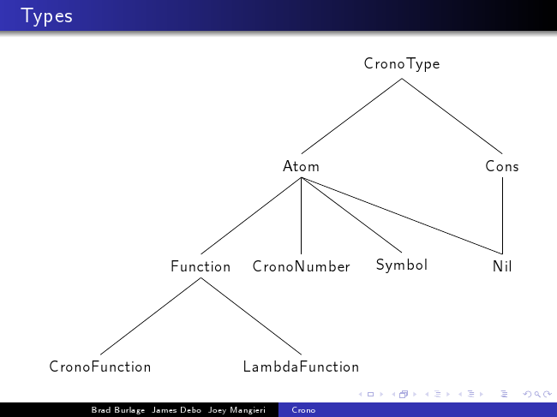

GETCrono
By Graham Benevelli, Tri Nguyen, and Edwin Edge
Insert slide #3 from previous presentation here
[[1]]
number
[x]
boolean
boolean
[[1]] -> [[2]]
[[1]] -> [[2]]

Slide 2
Quick Introduction to Crono & Type Inferencing:
Programming language based on Lisp
Haskell can determine type of functions given no other information whatsoever

Slide 3
Steps of Type Inferencing
CronoTypeConstraint
CronoTypeVar
CronoConstraintCreator
Blindy assign each item (Cons, number, etc.) an identifier that is unique and ambiguous
Build CronoTypeConstraints off of different CronoTypes
a number, symbol, cons, or a known function
Get back a series of constraints
i.e. [[1]] = [y] -> [z]
i.e. [[2]] = number
feed to unification process

Slide 4
The Unification Algorithm
Two stacks
TODO stack, finished stack
Pull constraints off TODO
Substitute constraint into both stacks
Place constraint onto finished stack
Rinse and repeat
Example (define double (x) (* x 2))

Slide 5
Concepts
If Time Other Examples
Type Inferencing
Haskell
Unification
Abstract Syntax Tree
Lisp

Slide 6
Examples
(+ 5 4)
(= 1 2)
(if (= 1 1) 9 8)
(define even (x) (= x (* 2 (/ x 2))))
(define fact (n) (if (= n 1) 1 (* n (fact (- n 1)))))

