Slide 1
RETIMING GRAPH
Simone De Vita
Matricola: 944021

Slide 2
Index
Description of the problem
Description of the solution
Implementation
  CP algorithm
  WD algorithm
  Bellman-Ford algorithm for a system of linear inequalities
  FEAS algorithm
  Step 3 of OPT: Binary Search
Performance
  Time Complexity
  Space Complexity
Testing

Slide 3
Description of the problem
We have a directed graph G = (V, E) with weights associated to both vertices and edges.
We want to minimize the clock period of the graph.
Clock period: the sum of the vertices’s weight on the longest path composed by only zero weight edges.
We are allowed to change the weights on the edges according to a retiming.
Retiming: an integer assignment to vertices.
Problem: find a legal retiming that minimizes the clock period. By legal we mean that the new edges’ weight would still be nonnegative and that there will be no cycles composed by only zero weight edges.

Slide 4
Description of the solution
Step 1: Compute matrices W and D via WD algorithm
Step 2: Sort the elements of D
Step 3: Binary search for the minimun achievable clock period. Test it with:
  OPT1: solve a Systems of linear inequalities using Bellman-Ford algorithm
  OPT2: apply the FEAS procedure
Step 4: Use the retiming found in Step 3 associated to the minimum achievable clock period.

Slide 5
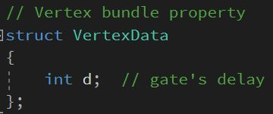
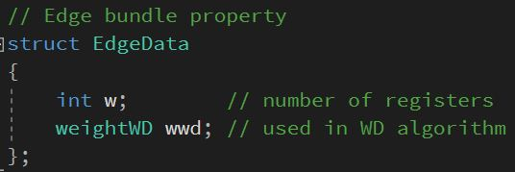
Implementation
C++
Boost Graph Library
Wrapper class RetimingGraph which works on a RGraph
Bundle properties

Slide 6
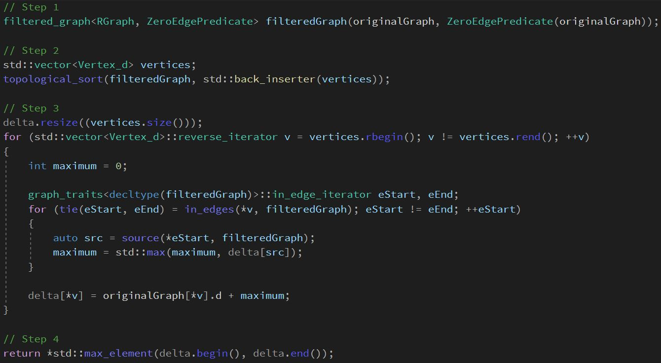
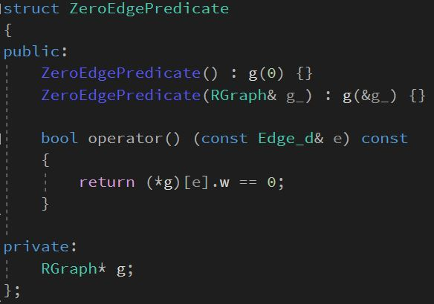
Implementation: CP algorithm
Compute clock period

Slide 7
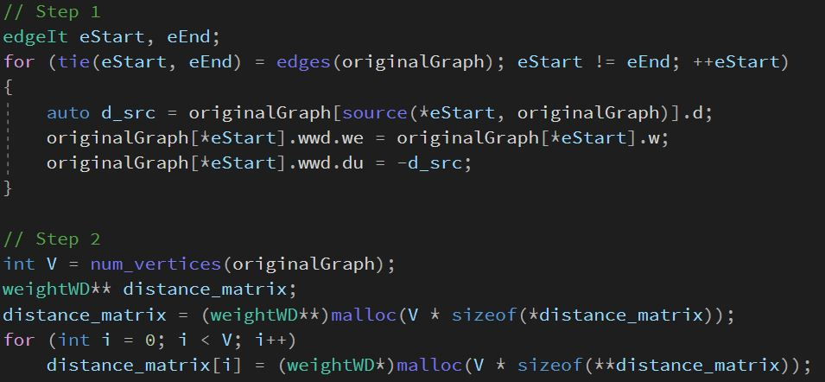
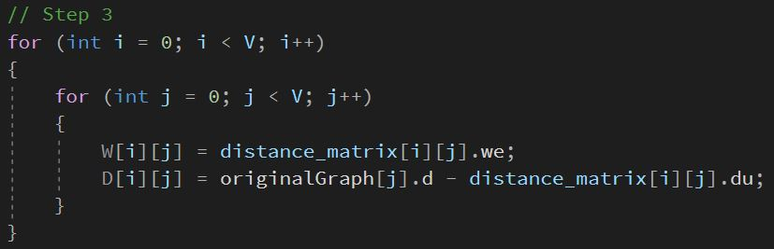
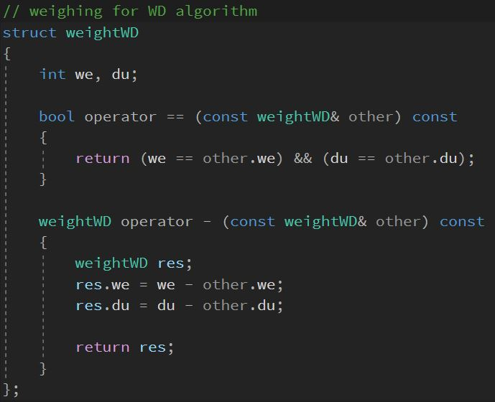
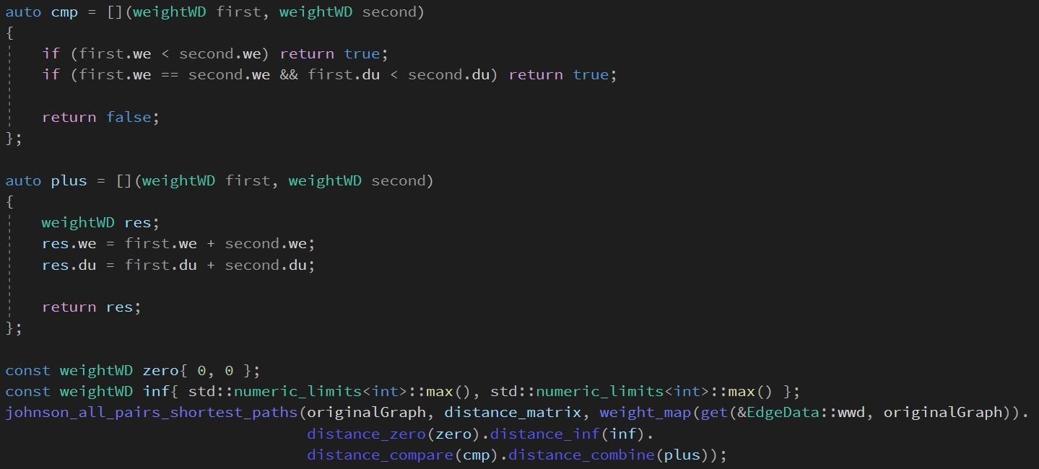
Implementation: WD algorithm
Compute matrices W and D

Slide 8
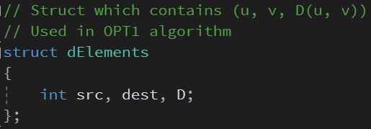
Implementation: Bellman-Ford algorithm
Test a clock period c
Solve a system of inequalities https://www.oreilly.com/library/view/vlsi-digital-signal/9780471241867/sec-4.3.html
Use an auxiliary sorted data structure dElements
Create a constraint graph
  Add edge v -> u with weight W[u][v]-1 if D[u][v] > c (need dElements here)
  Add edge v -> u with the weight of the edge u -> v in the original graph
  Add one last vertex connected to all the other vertices with weight 0. This will be the source vertex of the Bellman-Ford algorithm
The distance vector returned by the Bellman-Ford algorithm is our retiming (discarding the source vertex)

Slide 9
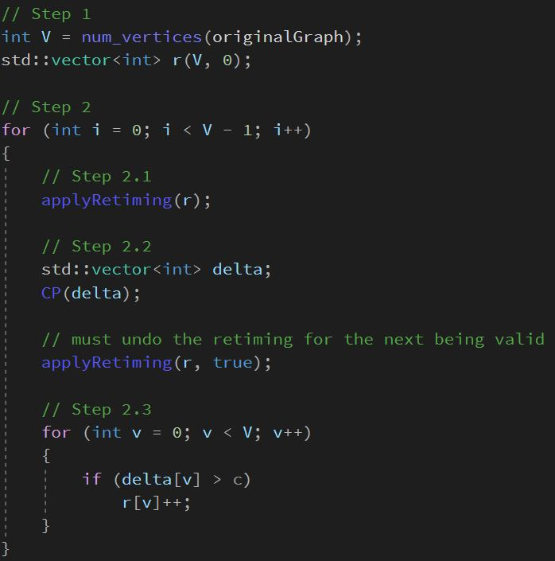
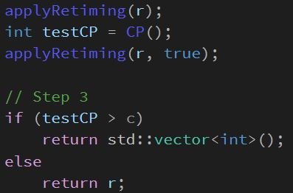
Implementation: FEAS algorithm
Test a clock period c

Slide 10
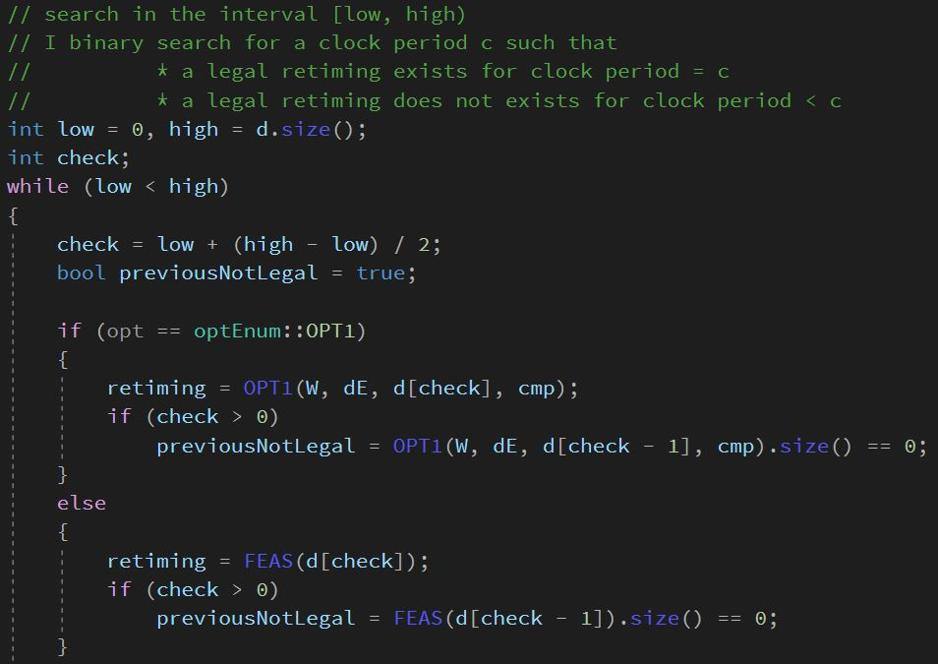
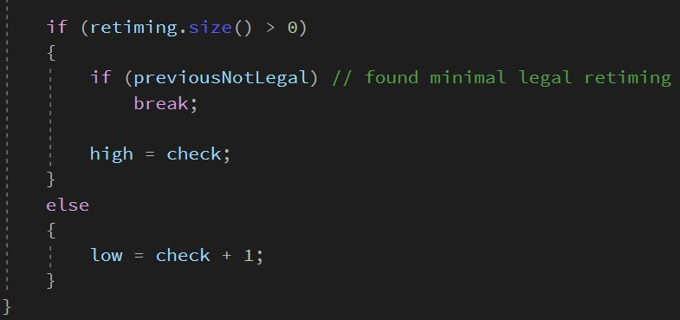
Implementation: Step 3 of OPT
Binary Search for the minimum clock period
d is the sorted vector of possible clock periods

Slide 11
Performance: Time Complexity
CP algorithm: O(|V| + |E|) = O(|E|) (I don’t expect |V| >> |E|)
  Topological Sort: O(|V| + |E|)
  Loop over edges: O(|E|)
WD algorithm: O(|V||E| + |V|^2 log|V|)
  Initialize W and D: O(|V|^2)
  Johnson All Pairs Shortest Paths: O(|V||E| + |V|^2 log|V|)
Bellman-Ford: O(|V_{constraint_graph}||E_{constraint_graph}|) = O(|V||V|^2) = O(|V|^3)
FEAS: O(|V||E|)
  Loop over vertices: O(|V|)
    Apply Retiming / Call to CP: O(|E|)
OPT1: O(|V|^3 log|V|)
OPT2: O(|V||E|log|V|) better than OPT1 for sparse graph (|E| ≈ |V|)

Slide 12
Performance: Space Complexity
CP algorithm: O(|V|)
  Vertices / delta: O(|V|)
WD algorithm: O(|V|^2)
  Distance_matrix: O(|V|^2)
Bellman-Ford: O(|V|^2)
  W / dElements: O(|V|^2)
  Distance: O(|V|)
FEAS: O(|V|)
  Retiming / delta: O(|V|)
OPT1: O(|V|^2)
OPT2: O(|V|^2)

Slide 13
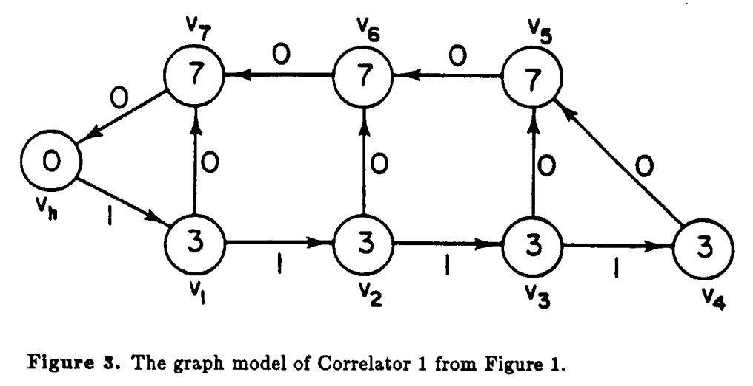
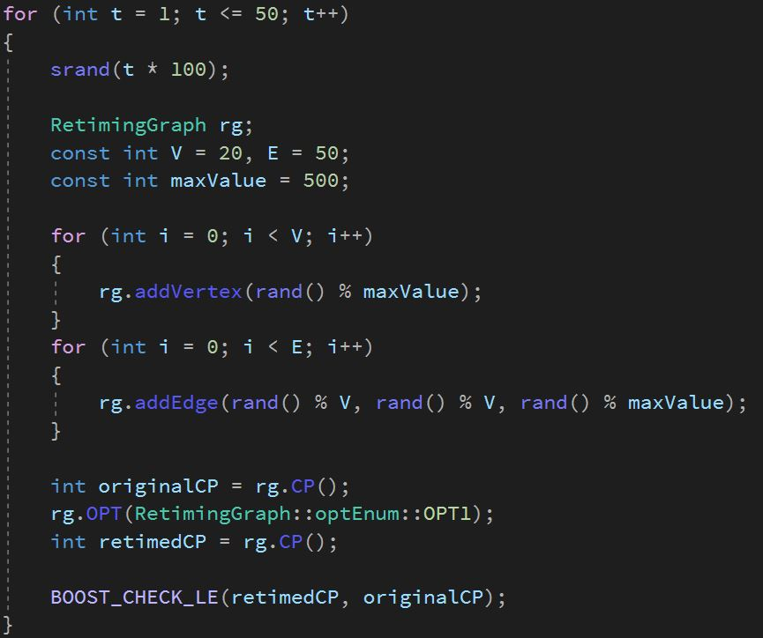
Testing
Correlator 1
  Original CP
  Optimal CP
Random generated graphs
  Test if optimal CP <= original CP

