Slide 1
Numerical Methods for Partial Differential Equations
Navier-Stokes problem – flow past a cylinder
Foderà Simone – Rigamonti Matteo

Slide 2
Approach
Created mesh with stationary Stokes
Implement time-dependency into Stokes problem
Include non linearity in the stationary problem
Develop the final non-linear time-dependent version
Analyze the final version changing the boundary conditions

Slide 3
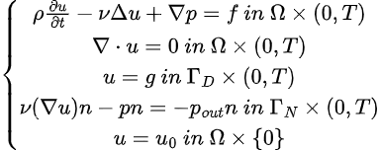

Strong Stokes problem
For the weak formulation we introduce the following spaces:
in which we want to find u in V and p in Q such that (next slide):

Slide 4


Semi-Discrete Weak Formulation
Stokes:
where v is in V and q is in Q, we can rewrite it as:
where a,c are bilinear forms such that:

Slide 5
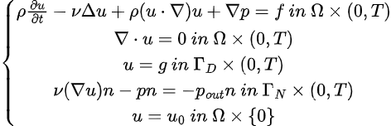
Strong Navier-Stokes problem
For the weak formulation we introduce the same spaces as before, in which we want to find u in V and p in Q such that (next slide):

Slide 6

Weak Formulation
Navier-Stokes:
which we can write as (with v in V and q in Q):
where a,c are defined like before and b is the nonlinear form:

Slide 7

Weak Formulation
We call:
And we compute its Fréchet derivative as:

Slide 8
Galerkin Problem
By choosing:
with basis functions:
we get the Galerkin Problem:
Togliere le n+1, scrivere R = 0

Slide 9
Fully-Discrete Problem
Since the problem is non-linear, we adopt the Newton method for solving it. We split the time domain into N subintervals such that :
Now for each timestep we want to solve the problem (using implicit Euler):
where
NB we call

Slide 10

System Matrices
From the discretization of the problem we derive that we have to solve a linear system at each
Newton iteration, in every time step. The linear system has blocks:
where the whole matrix represents the Jacobian of the system.

Slide 11
Visualization of results
In the next slides we are going to show some results, visualized in Paraview.
The mesh size utilized is h = 0.001 approximately, and the number of nodes (for the long mesh) is 37168 in total. A similar number for the short one.
The cluster has been analyzing a mesh with 180k DoFs approximately.

Slide 12
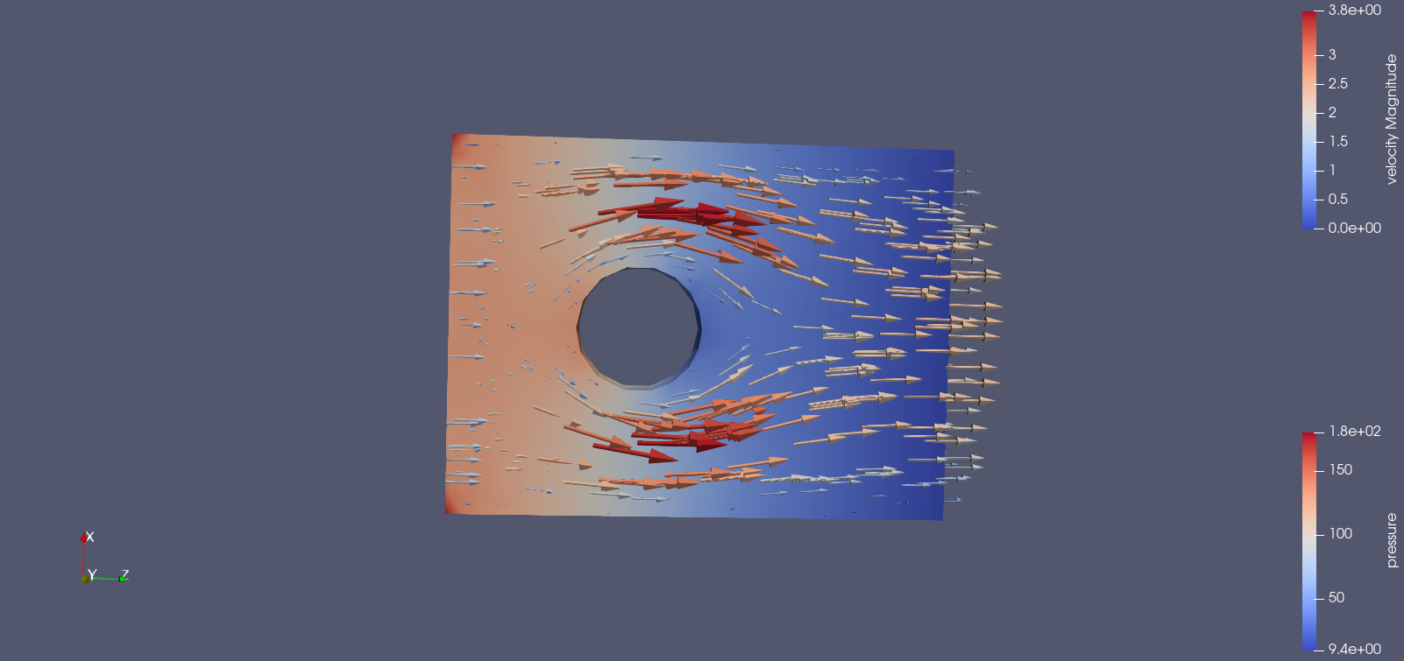
Stationary Stokes

Slide 13
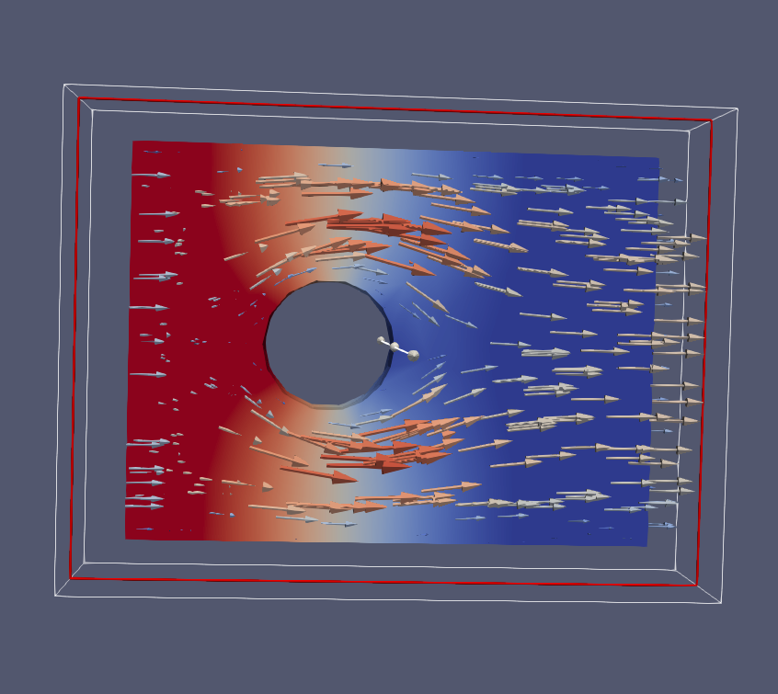
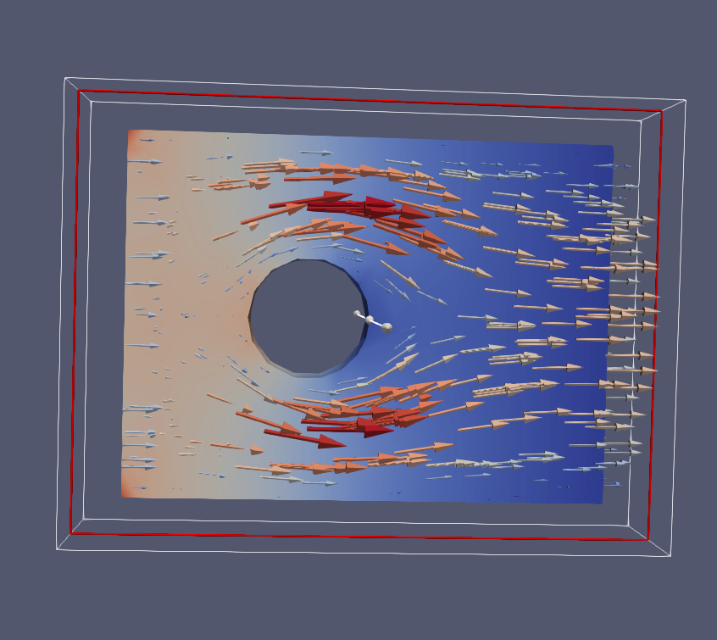
Time-Dependent Stokes

Slide 14
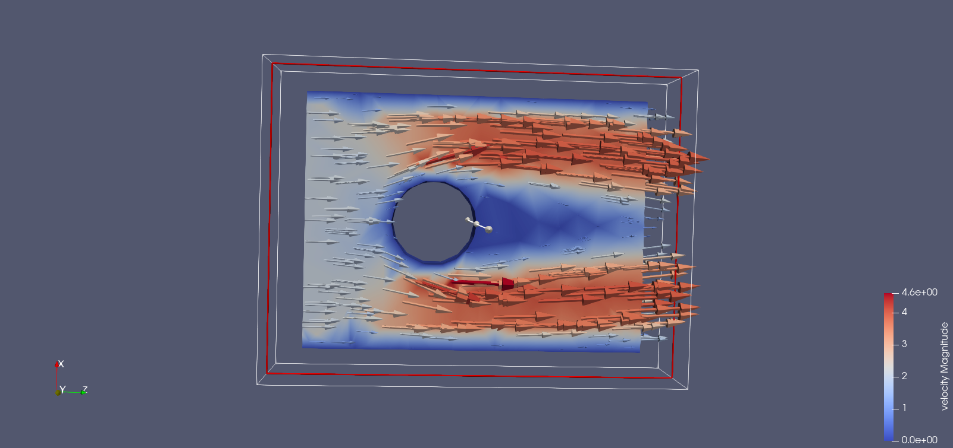
Stationary Navier-Stokes

Slide 15


Time-Dependent Navier Stokes
In the time-dependent version of the problem we have implemented different boundary conditions. Since until now we have simulated the flow inside a pipe with a cylindrical obstacle, now we want to simulate the flow of a section of a large fluid (e.g. the ocean) past a cylindrical object. To do so, we have removed the Dirichlet boundary conditions of u=0 on the wall and substituted them with Neumann conditions, which added a term in the right hand side:

Slide 16
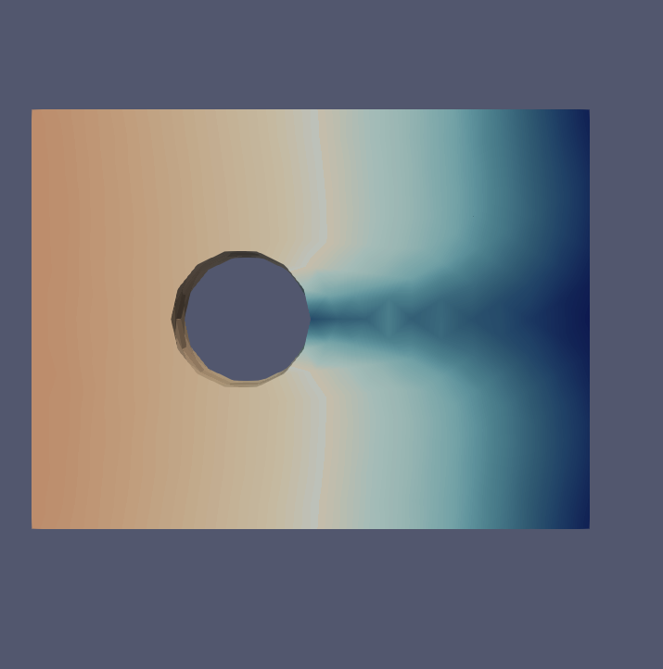
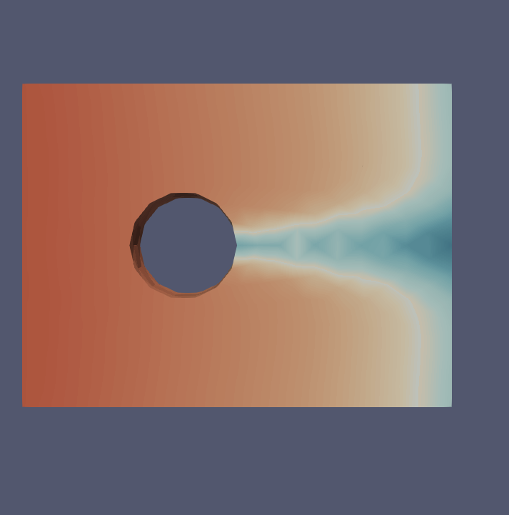
Time-Dependent Navier-Stokes

Slide 17
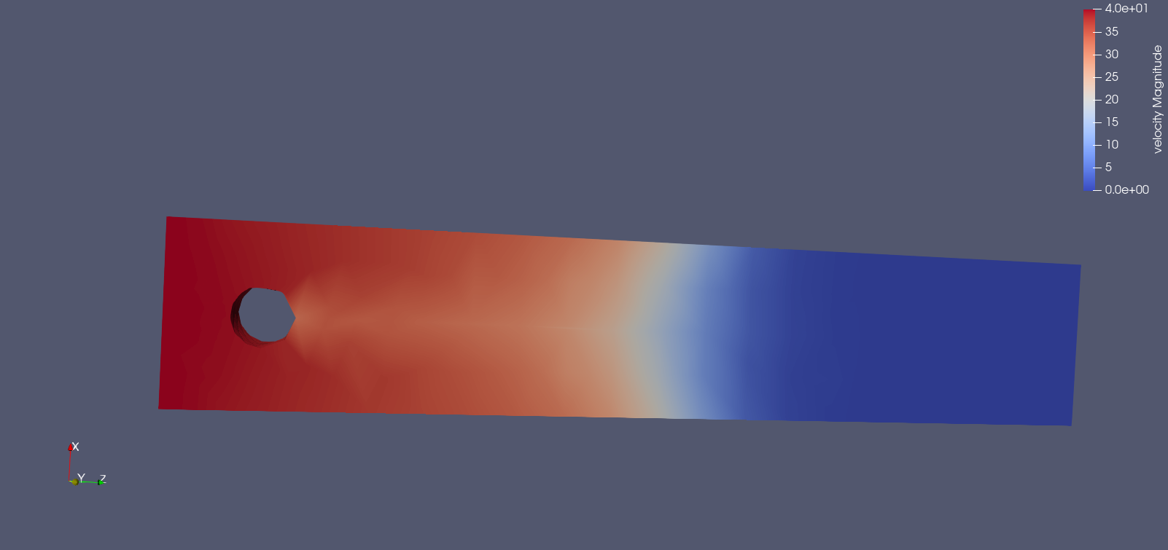
Time-Dependent Navier-Stokes (Re = 1)

Slide 18
Study of Reynolds Number
By keeping fixed the geometry of the structure and the data of the pyisical problem, we changed the fluid’s viscosity to analyze the different behaviour for different Reynold’s numbers.
In some cases we changed the pressure values to analyze the behaviour at a given Reynolds number.
We noticed that increasing Reynolds number produced an increase in the vorticity (curl of the velocity field) of the fluid.
Nb Put here reynolds 20

Slide 19
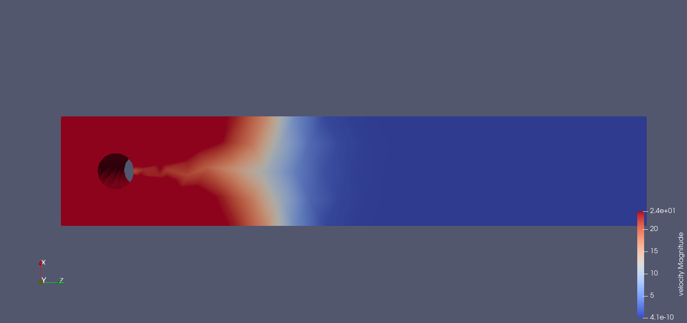
Time-Dependent Navier-Stokes (Re = 4, p=1)

Slide 20
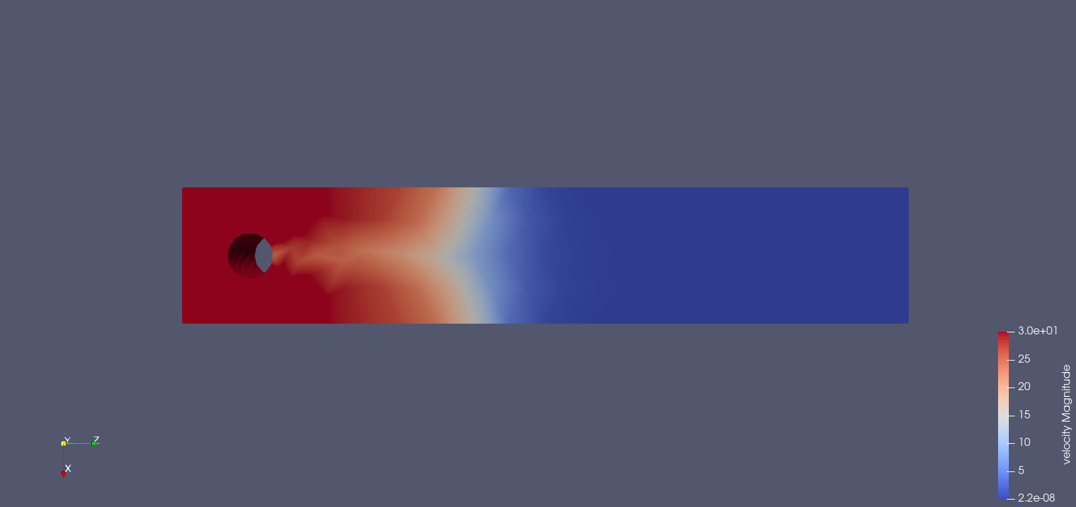
Time-Dependent Navier-Stokes (Re = 4, p=0.1)

Slide 21
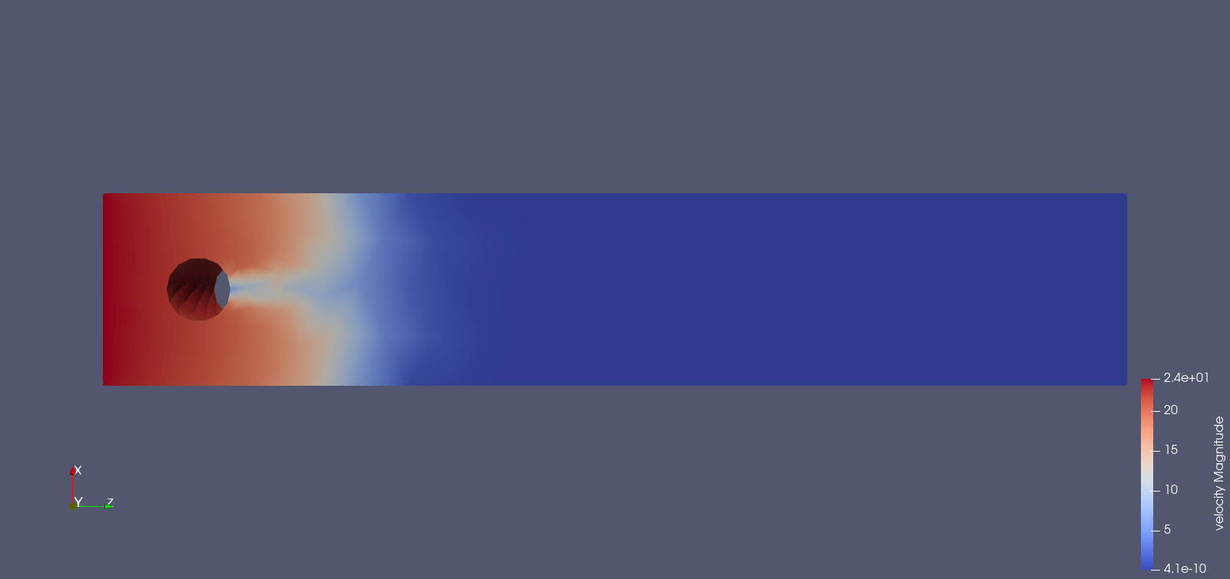
Time-Dependent Navier-Stokes (Re = 10)

Slide 22
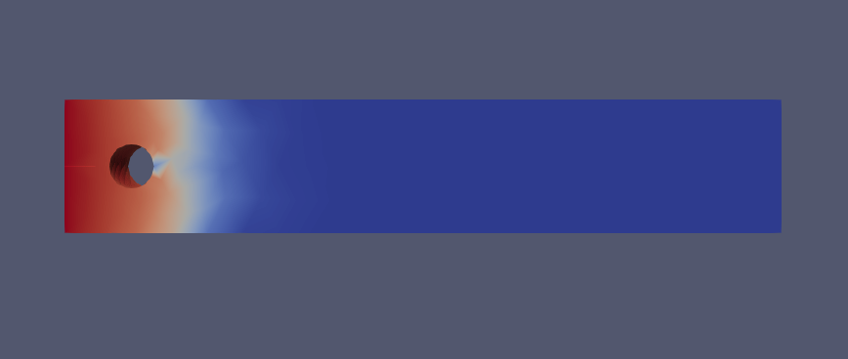
Time-Dependent Navier-Stokes (Re = 20)

Slide 23
Comparison between linear and non-linear problem
To be able to appreciate the difference between the linear and the non-linear problem we decided to plot the magnitude of the velocity along the central line of the problem.
In both problems we will see what happens when the flow goes past the cylinder and we will see the difference between the symmetric and regular Stokes problem and the non-symmetric Navier-Stokes one.

Slide 24
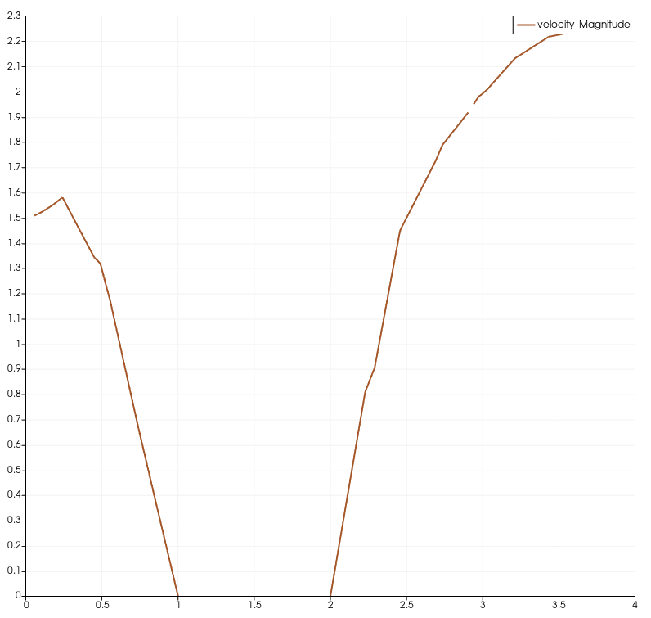
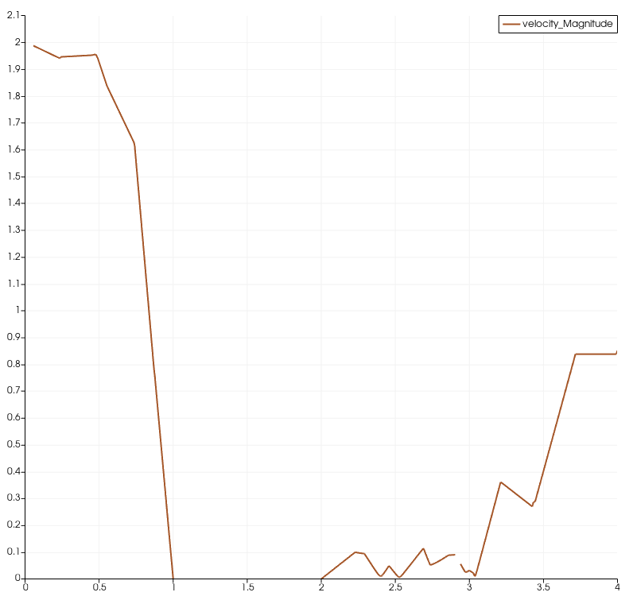
Comparison between linear and non-linear problem
stokes
Navier-stokes

Slide 25
Brief discussion on Preconditioners
stokes
Navier-stokes
Block Diagonal + CG
Block Triangular + GMRES
Block Triangular + GMRES

Slide 26
Thank you for the attention

