Slide 1
Numerical Methods for Partial Differential Equations
Navier-Stokes problem – flow past a cylinder

Slide 2
Approach
Created mesh with stationary Stokes
Implement time-dependency into Stokes problem
Include non linearity in the stationary problem
Develop the final non-linear time-dependent version

Slide 3
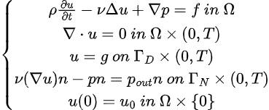
Strong Stokes problem

Slide 4


Semi-Discrete Weak Formulation
Stokes:
which we can write as:
where a,c are bilinear forms such that:

Slide 5
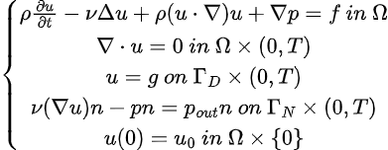
Strong Navier-Stokes problem

Slide 6

Semi-Discrete Weak Formulation
Navier-Stokes:
which we can write as:
where a,c are defined like before and b is the nonlinear form:

Slide 7

Fully-Discrete Weak Formulation
We call:
And we compute its Fréchet derivative as:

Slide 8
Fully-Discrete Problem
Now for each timestep we want to solve the Newton problem:
where we have the approximations of u at each timestep.

Slide 9
Galerkin Problem
By choosing:
with basis functions:
we get the Galerkin Problem:

Slide 10


System Matrices

Slide 11
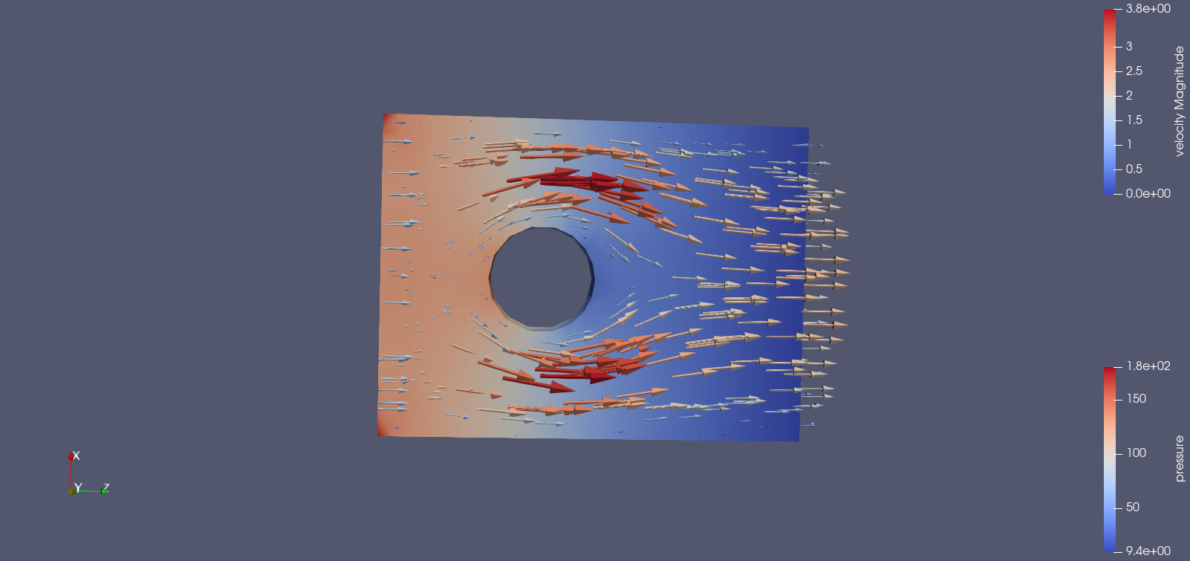
Stationary Stokes

Slide 12
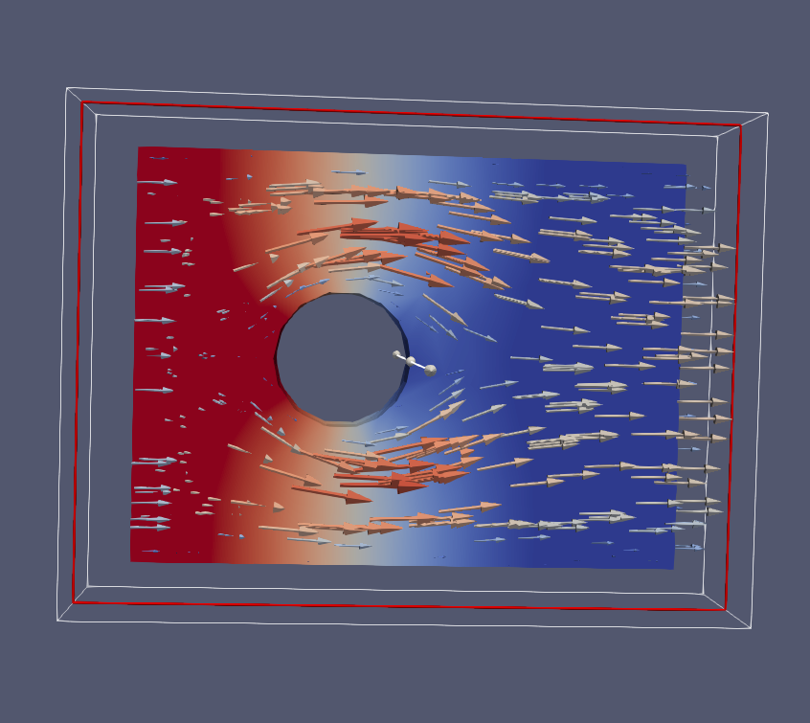
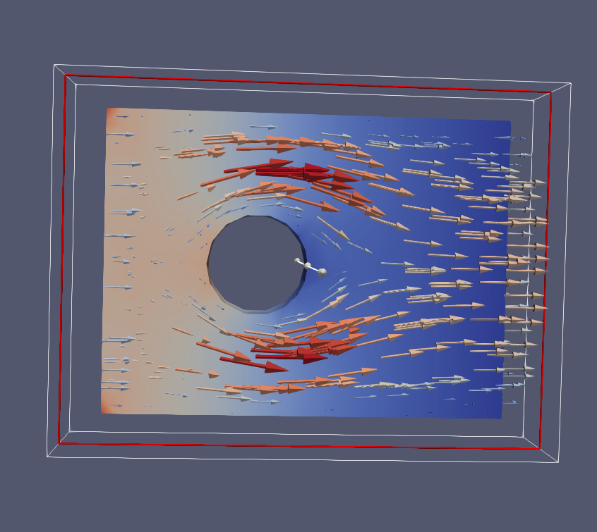
Time-Dependent Stokes

Slide 13
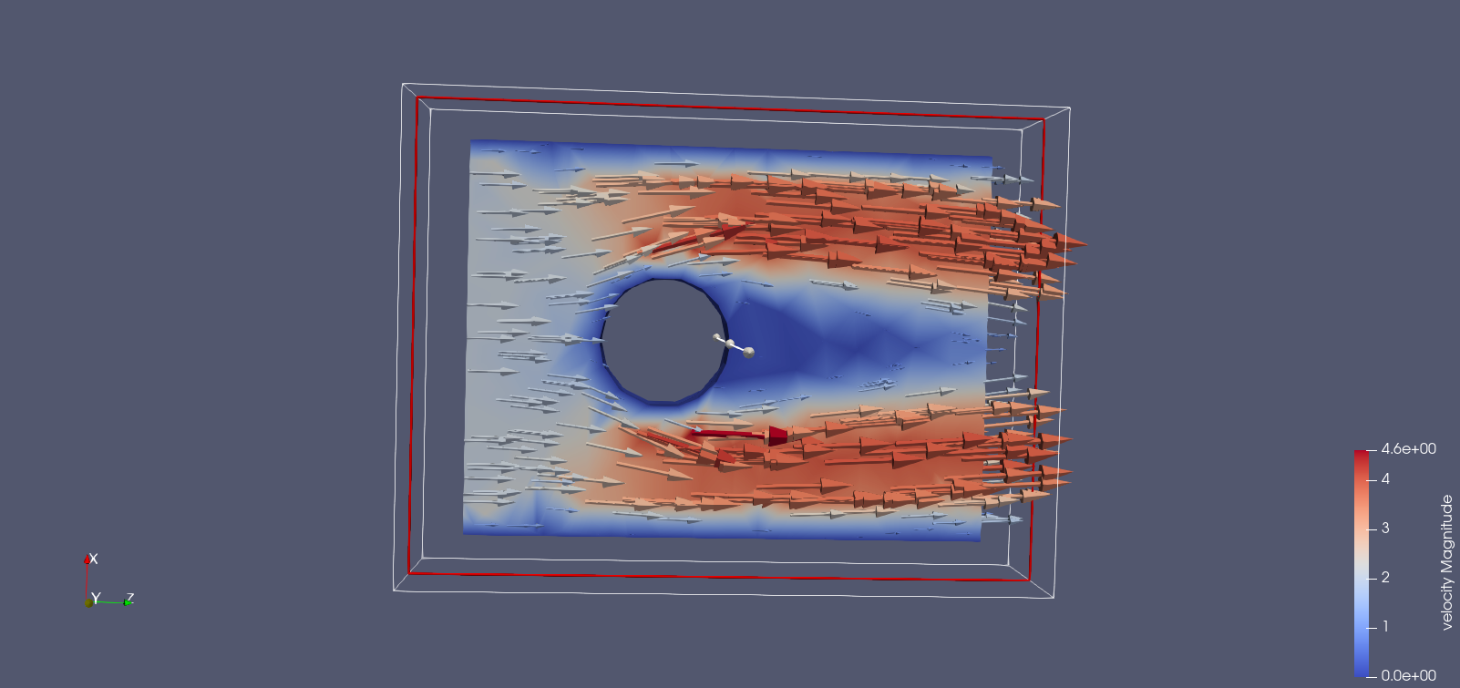
Stationary Navier-Stokes

Slide 14
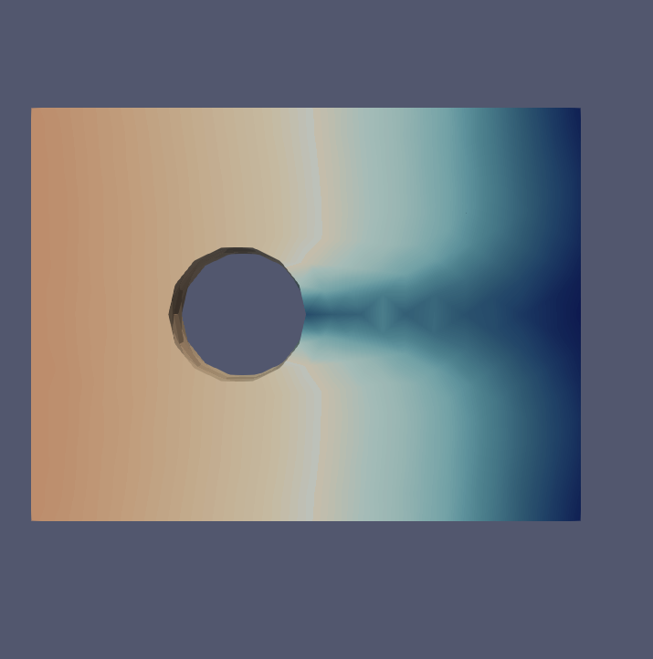
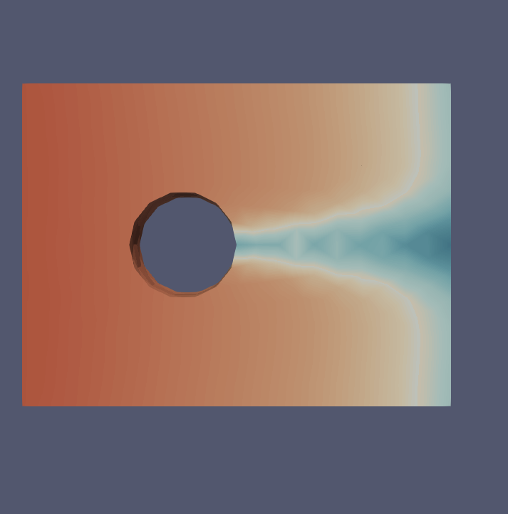
Time-Dependent Navier-Stokes

Slide 15
Study of Reynolds Number

Slide 16
Comparison between linear and non-linear problem
To be able to appreciate the difference between the linear and the non-linear problem we decided to plot the magnitude of the velocity along the central line of the problem.
In both problems we will see what happens when the flow goes past the cylinder and we will see the difference between the symmetric and regular Stokes problem and the non-symmetric Navier-Stokes one.

Slide 17
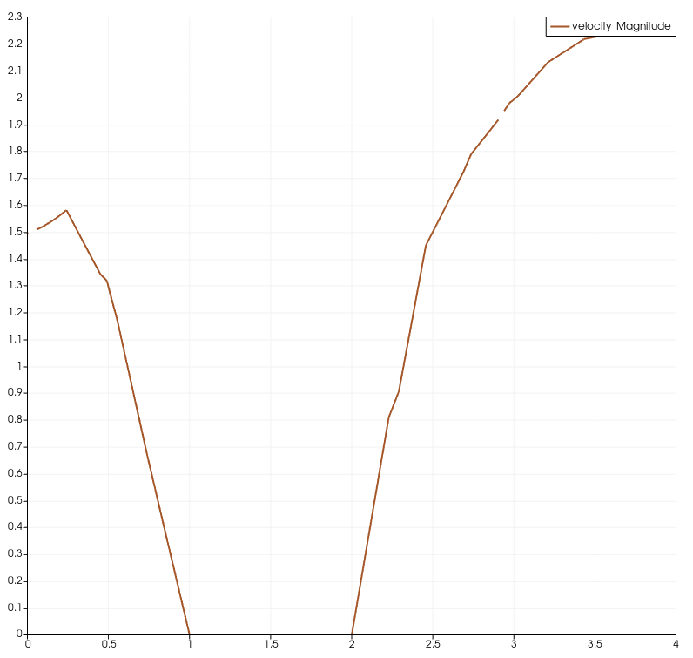
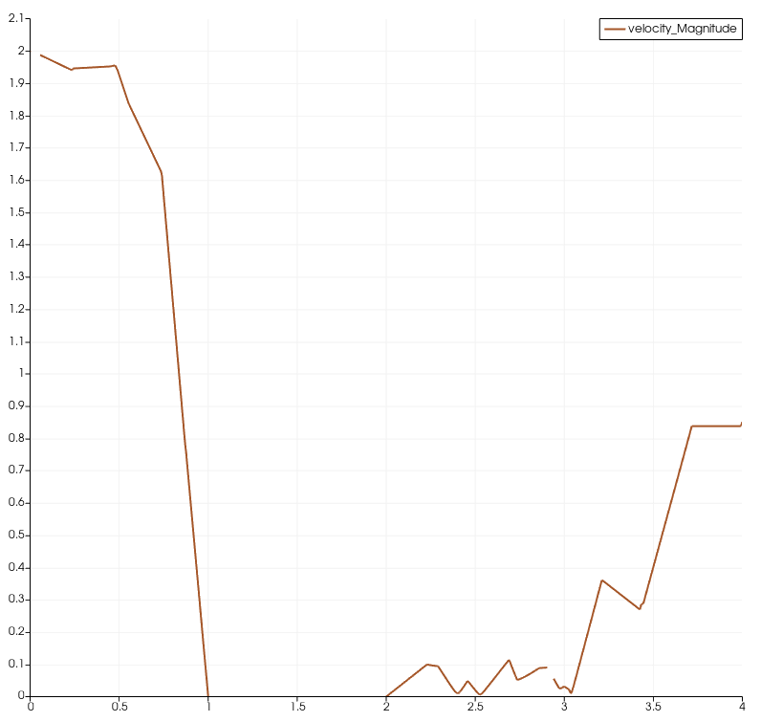
Comparison between linear and non-linear problem
stokes
Navier-stokes

Slide 18
Brief discussion on Preconditioners
stokes
Navier-stokes
Diagonal + CG
Triangular + GMRES
Triangular + GMRES

Slide 19
Thank you for the attention

