Slide 1

Car Sharing model simulation
Simone Rizzo
CMCS 2021

Slide 2
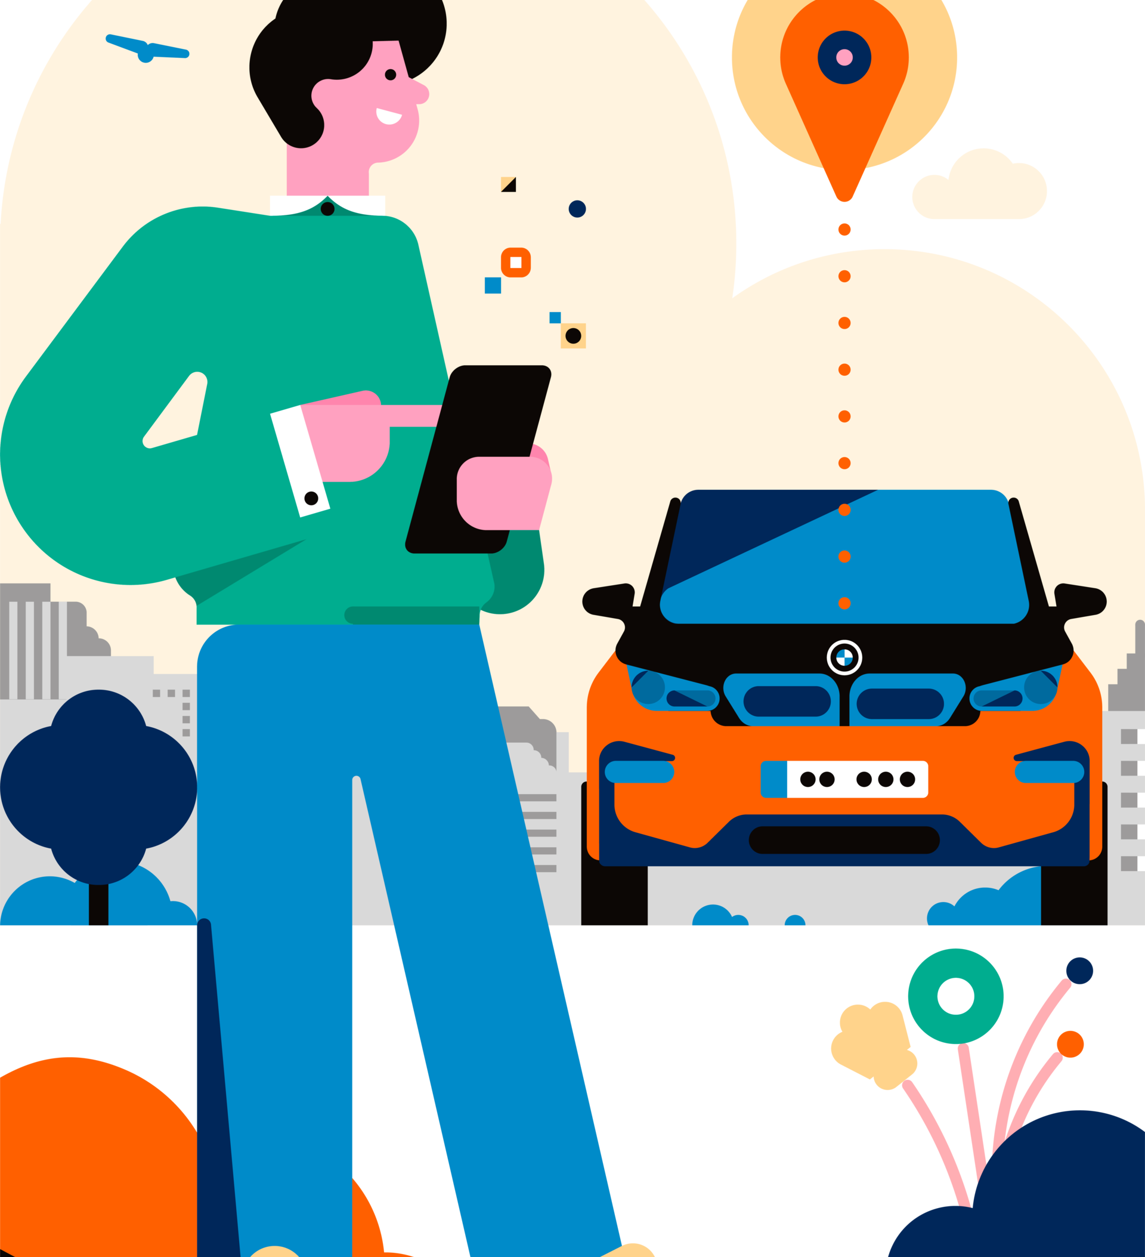

What is car sharing?
Car sharing is a car rental model in which people rent cars for short periods of time, often by the hour.

Slide 3

It is a discrete-event simulation framework based on Python.
Process
Events
Resources
They are used to model active components, they create events in their duration time and wait to be awakened.
Each event occurs at a particular instant in time and may change the state of the system.
there are 3 main types of resources
Resources:
Resources that can be used in a limited number of processes at a time.
Containers: allow the production and consumption of a continuous homogeneous mass (water)or discrete (apples)
Stores: they allow the production and consumption of objects.

Slide 4
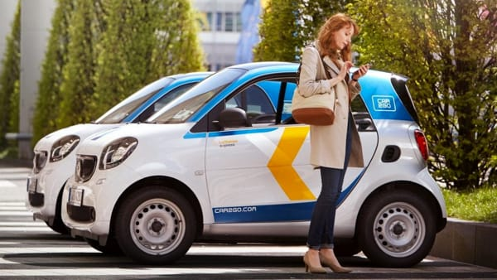
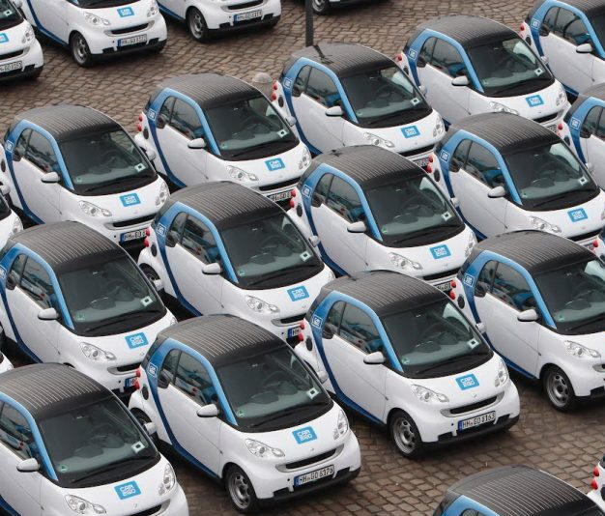
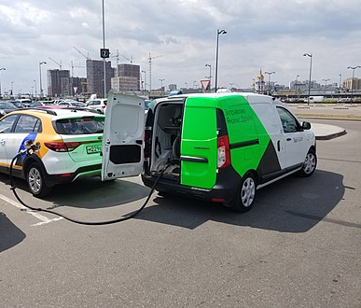
Main components of the domain :
Customers
Automobiles
Operators

Slide 5

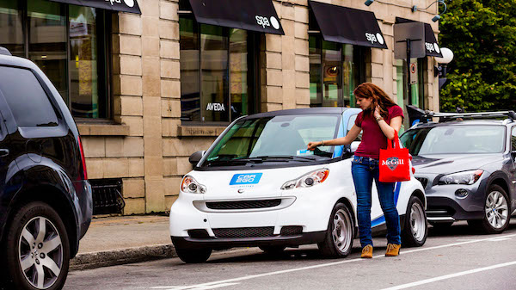

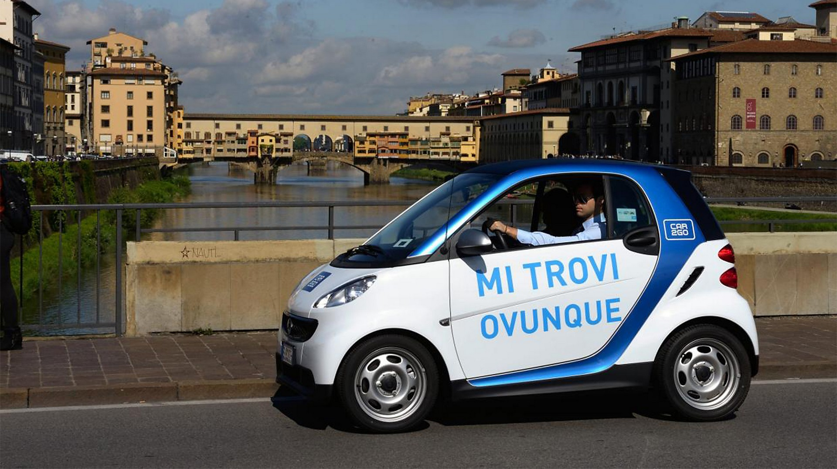
Customer:
New customer
It is a process which: requires a car, makes a journey for a set time and then releases the car. However, if the car is not assigned to him within a certain time (patience) after that he prefers to call a taxi.
Gets a car
Call a taxi
Makes thejourney
Release the car

Slide 6
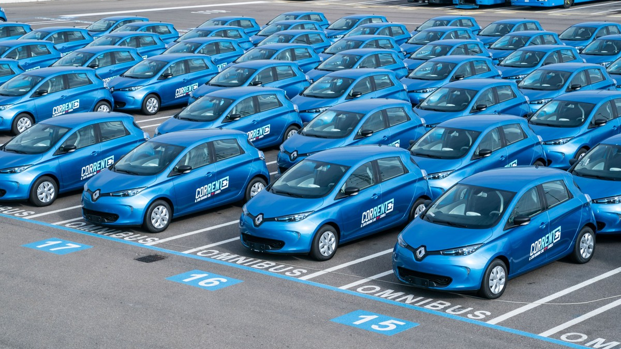
Automobiles:
They are resources to be assigned to users. A car is assigned to a single user. The cars are limited in number and are defined in Simpy as a Resource and therefore a discrete value.

Slide 7
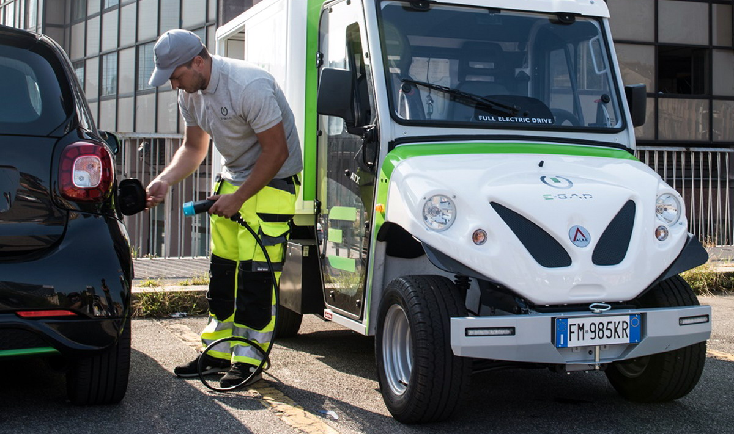
Operators:
An operator is process that is spawned after a certain time to carry out maintenance on the cars or to recharge them. Each operator can work on more cars, sequentially.

