Slide 1

Car Sharing model simulation
Simone Rizzo
CMCS 2021

Slide 2
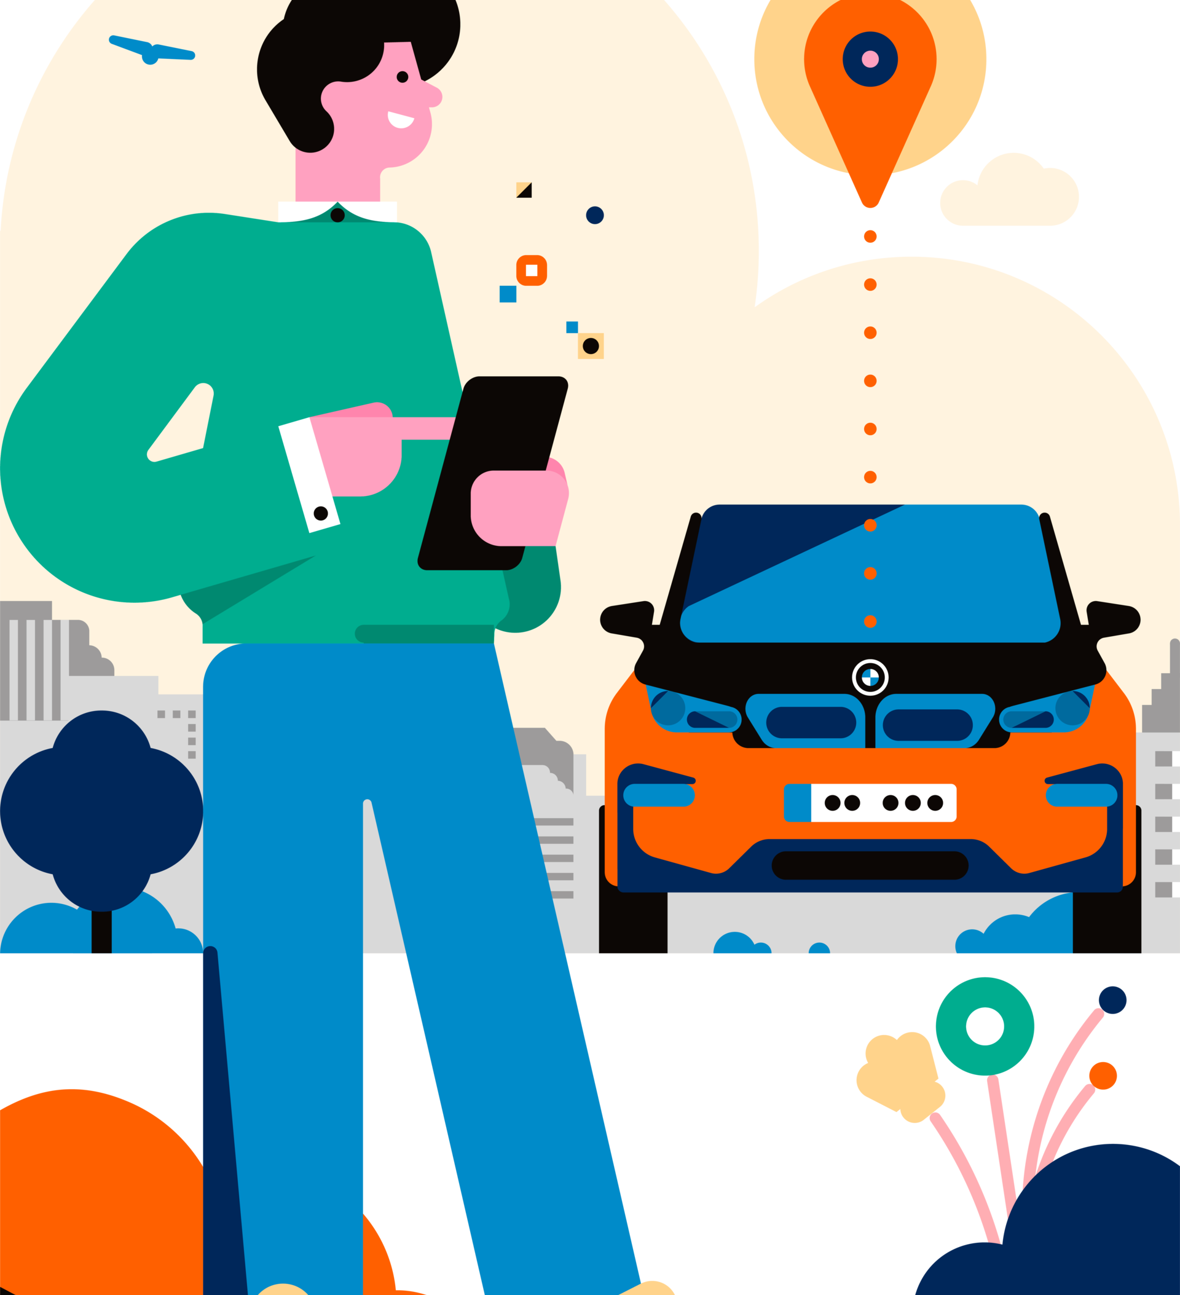

What is car sharing?
Car sharing is a car rental model in which people rent cars for short periods of time, often by the hour.

Slide 3

It is a discrete-event simulation framework based on Python.
Process
Events
Resources
They are used to model active components, they create events in their duration time and wait to be awakened.
Each event occurs at a particular instant in time and may change the state of the system.
there are 3 main types of resources
Resources:
Resources that can be used in a limited number of processes at a time.
Containers: allow the production and consumption of a continuous homogeneous mass (water)or discrete (apples)
Stores: they allow the production and consumption of objects.

Slide 4
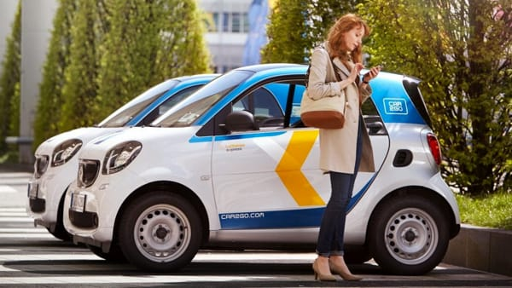
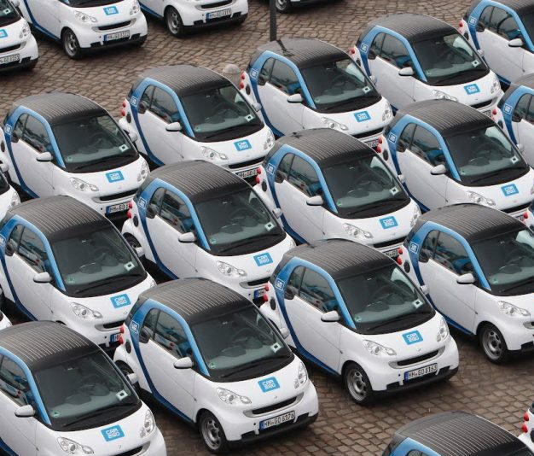
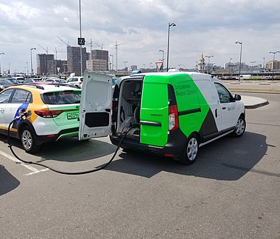
Main components of the domain :
Customers
Automobiles
Operators

Slide 5

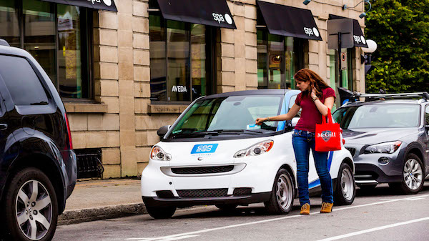

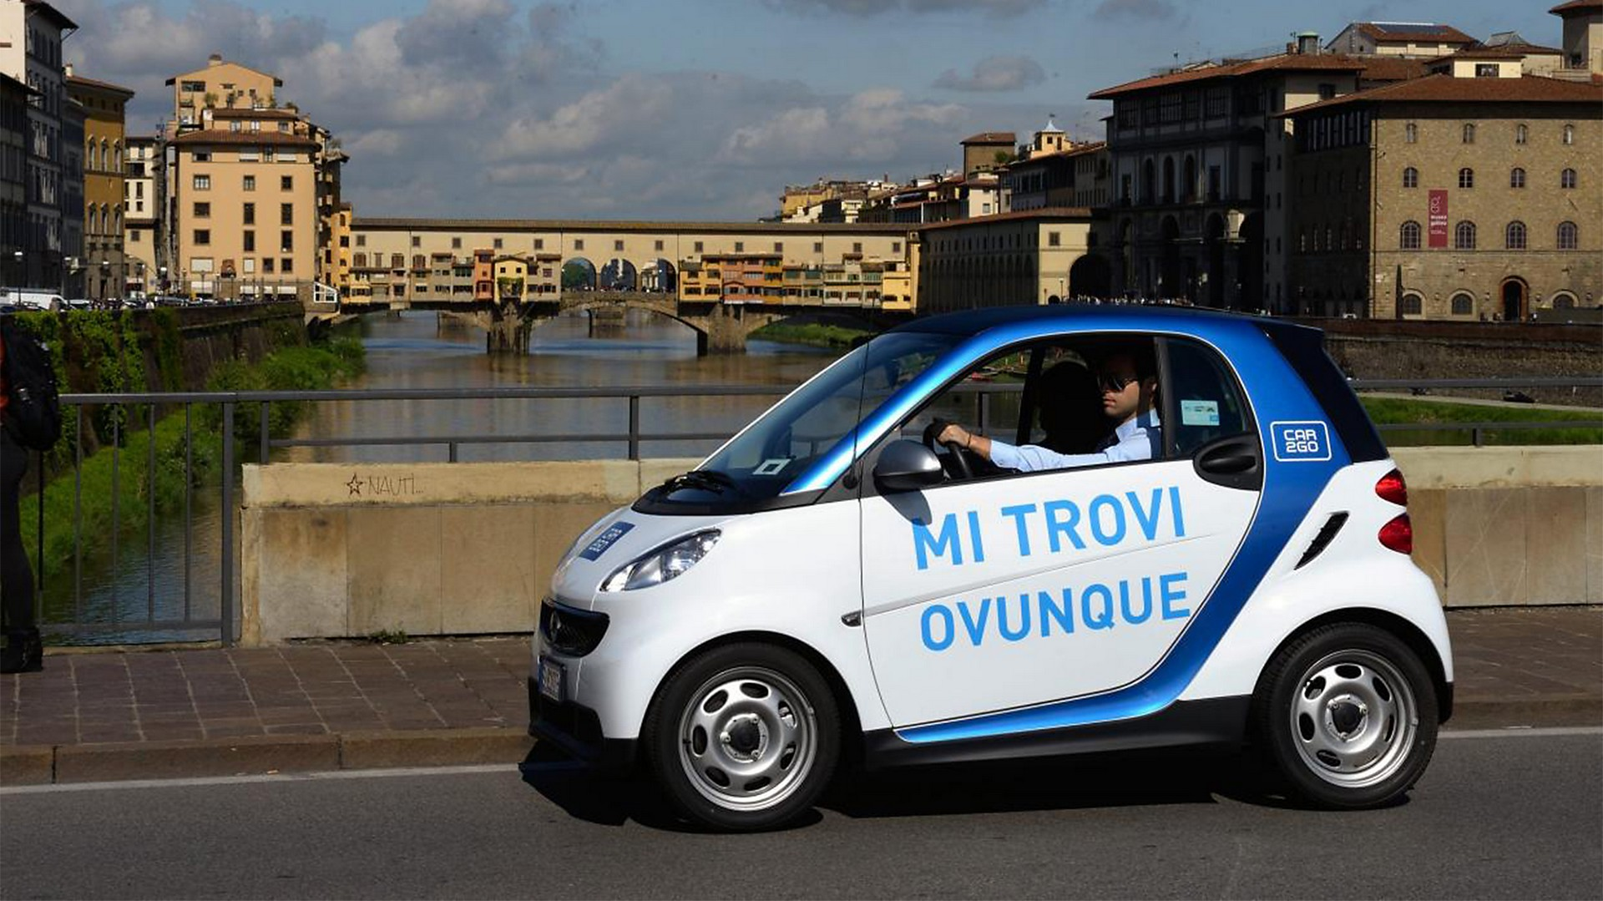
Customer:
New customer
It is a process which: requires a car, makes a journey for a set time and then releases the car. However, if the car is not assigned to him within a certain time (patience) after that he prefers to call a taxi.
Gets a car
Call a taxi
Do the travel
Release the car

Slide 6
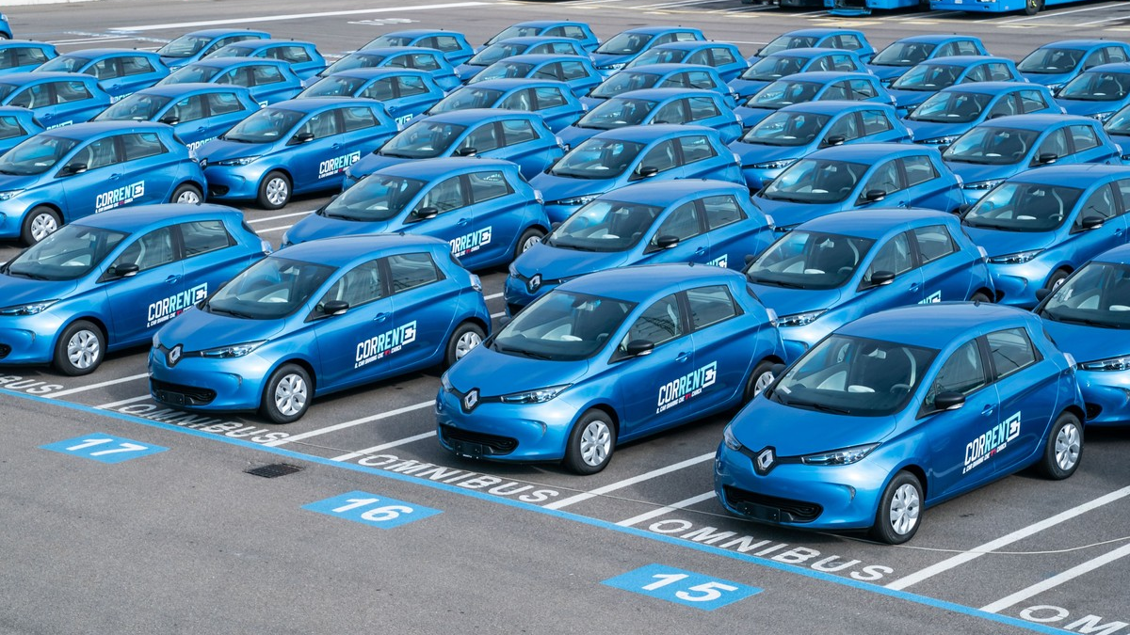
Automobiles:
They are resources to be assigned to users. A car is assigned to a single user. The cars are limited in number and are defined in Simpy as a Store Resource.

Slide 7
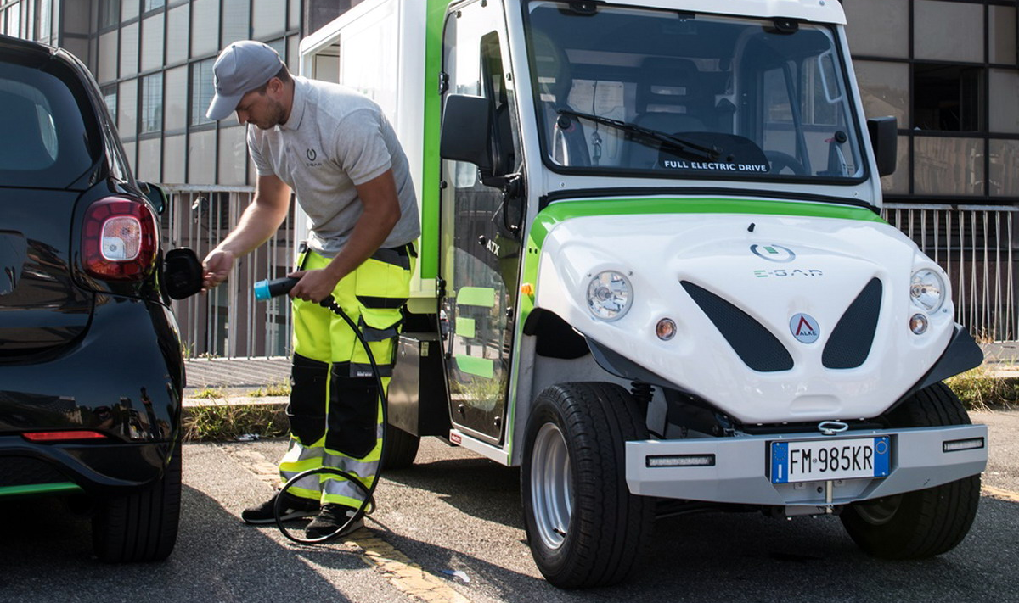
Operators:
An operator is process that is spawned after a certain time to carry out maintenance on the cars or to recharge them. Each operator can work on more cars, sequentially.

Slide 8
Simulation results:
In the next slides we are going so see some simulation results evidencing the most important aspects.
For the simulation the unit time step is equivalent to 1 minutes.
We will change enviroment variable inizialization to see different behaviors.

Slide 9
Simulation Parameters:
VARIABLE NAME | VALUE
CAR_USAGE_TIME | (28,35)
USER_SPAWN_TIME | (1,2)
CARS_NUMBER | 20
MAX_NUMB_USERS | 50
MIN_PATIENCE | -1
MAX_PATIENCE | 18
AUTO_AUTONOMY | 200
CHARGE_TIME | 60
OPERATORS_NUMBER | 20
RUN_UNTIL | -1
Range of time of use of a car
Arrival time range of new users
Number of cars
Max number of users, if -1 it generates infinite users
Min. customer patience, -1 if we would take off patience
Max. customer patience
Autonomy of a car in minutes
Time to recharge the car
Number of Operators who charge the car
Run until this time 0 to let the users end coming

Slide 10
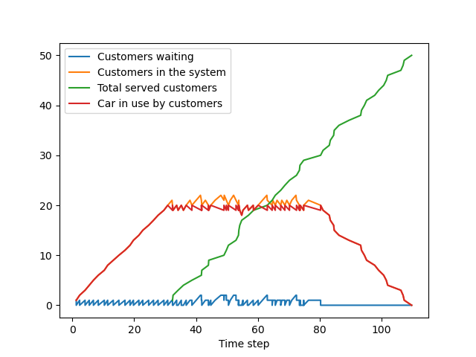
Base case:
No impatient customers, sufficient numer of operators, small ammount of customers, high battery life.
VARIABLE NAME | VALUE
CAR_USAGE_TIME | (28,35)
USER_SPAWN_TIME | (1,2)
CARS_NUMBER | 20
MAX_NUMB_USERS | 50
MIN_PATIENCE | None
MAX_PATIENCE | None
AUTO_AUTONOMY | 200
CHARGE_TIME | 60
OPERATORS_NUMBER | 20
RUN_UNTIL | -1
We can see that all the customers was serverd, small waiting queue and no car battery was charged for this simulation.

Slide 11
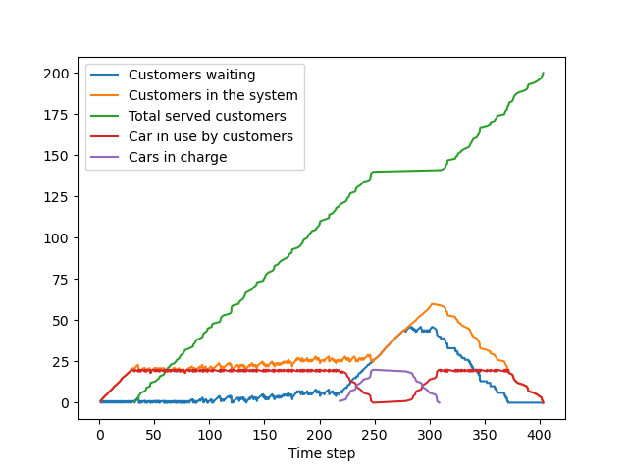
More customers:
By adding more customers to the previous simulation we can see this behaviour.
VARIABLE NAME | VALUE
CAR_USAGE_TIME | (28,35)
USER_SPAWN_TIME | (1,2)
CARS_NUMBER | 20
MAX_NUMB_USERS | 200
MIN_PATIENCE | -1
MAX_PATIENCE | 18
AUTO_AUTONOMY | 200
CHARGE_TIME | 60
OPERATORS_NUMBER | 20
RUN_UNTIL | -1
In this case we can see that the waiting queue is much higher especially at the point where the cars start to be reloaded.

Slide 12
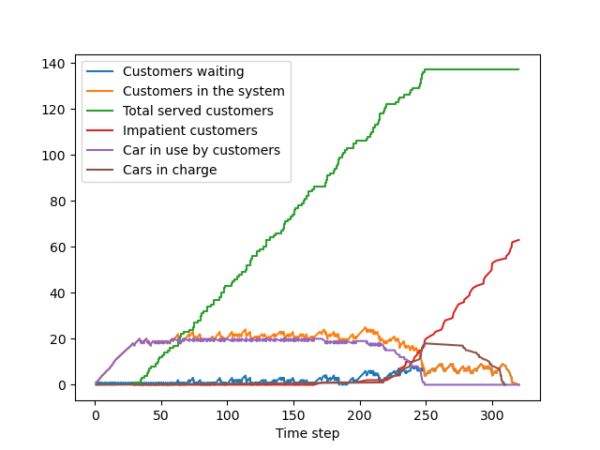
With user patience :
Here a customer can wati at maximum between a range of 5 minutes up to 18 minutes to rent a car.
VARIABLE NAME | VALUE
CAR_USAGE_TIME | (28,35)
USER_SPAWN_TIME | (1,2)
CARS_NUMBER | 20
MAX_NUMB_USERS | 200
MIN_PATIENCE | 5
MAX_PATIENCE | 18
AUTO_AUTONOMY | 200
CHARGE_TIME | 60
OPERATORS_NUMBER | 20
RUN_UNTIL | -1
We can see that users start getting impatient by the time most of the cars are charging.

Slide 13
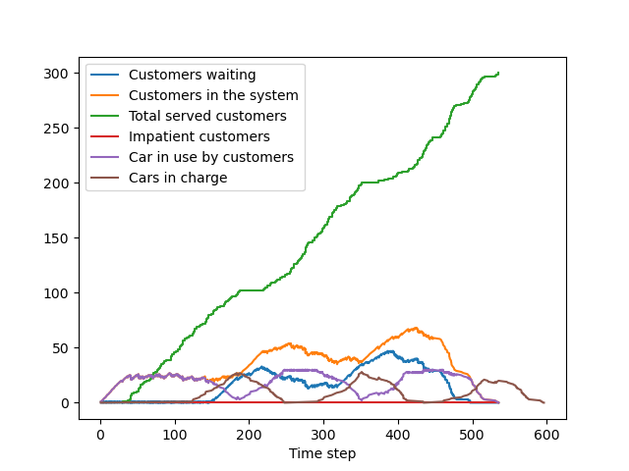
Operators number:
Here we put the number of operators the same as the number of the cars.
VARIABLE NAME | VALUE
CAR_USAGE_TIME | (28,35)
USER_SPAWN_TIME | (1,2)
CARS_NUMBER | 30
MAX_NUMB_USERS | 300
MIN_PATIENCE | -1
MAX_PATIENCE | 18
AUTO_AUTONOMY | 100
CHARGE_TIME | 60
OPERATORS_NUMBER | 30
RUN_UNTIL | 600
We can see the alternating between car in use and car in charge.
This leads to a smaller waiting queue, but peaks when all the cars are charging.

Slide 14
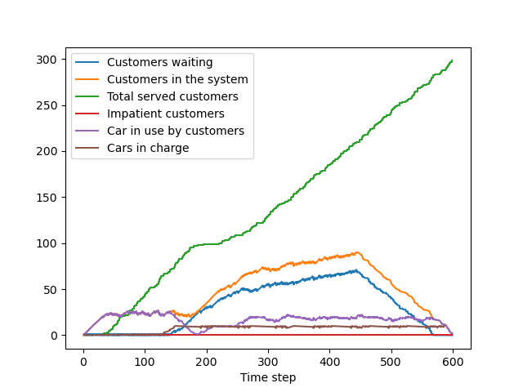
By decreasing the operators :
VARIABLE NAME | VALUE
CAR_USAGE_TIME | (28,35)
USER_SPAWN_TIME | (1,2)
CARS_NUMBER | 30
MAX_NUMB_USERS | 300
MIN_PATIENCE | -1
MAX_PATIENCE | 18
AUTO_AUTONOMY | 100
CHARGE_TIME | 60
OPERATORS_NUMBER | 10
RUN_UNTIL | 600
By decreasing the number of operators in this case to 10. We can see that the cars in use tend to stabilize at 20 instead of 30, this because the 10 operators cannot load more than 10 cars at a time and therefore the usable cars will be CARS_NUMBER - OPERATORS_NUMBER.

Slide 15
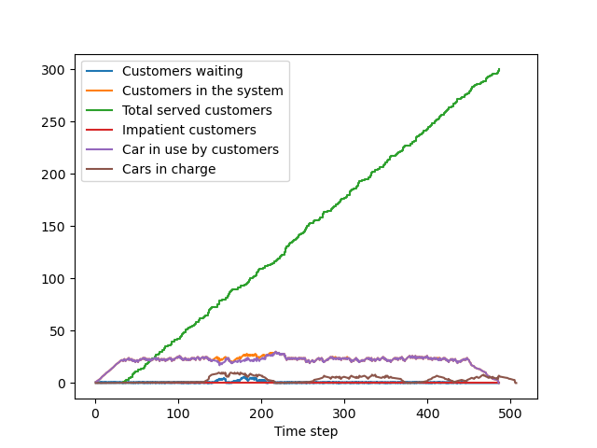
By decreasing the charge time :
VARIABLE NAME | VALUE
CAR_USAGE_TIME | (28,35)
USER_SPAWN_TIME | (1,2)
CARS_NUMBER | 30
MAX_NUMB_USERS | 300
MIN_PATIENCE | -1
MAX_PATIENCE | 18
AUTO_AUTONOMY | 100
CHARGE_TIME | 20
OPERATORS_NUMBER | 10
RUN_UNTIL | 600
By decreasing the charge time, we can see that the operators work for less time and the waiting queue is almost null and all users receive their cars.

Slide 16

Final observations:
These were some of the possible parameter changes to get an idea of how the environment behaves in these cases. Obviously you can see what happens by varying the time of use of the cars, the time of arrival of the users, changing the patience and mixing the various parameters together.

