Slide 1
Question-Answering System with KGs and LMs
Simone Benitozzi 889407
Kevin Pretell 816725

Slide 2
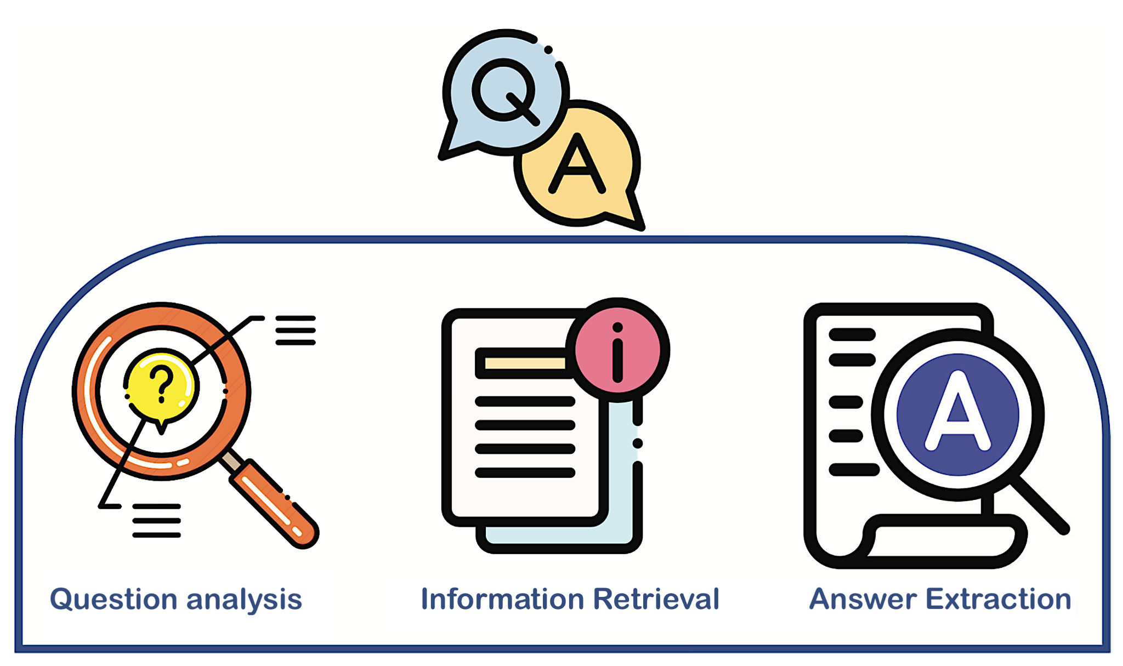
Introduction QA + KG + LM
Question Answering System?

Slide 3
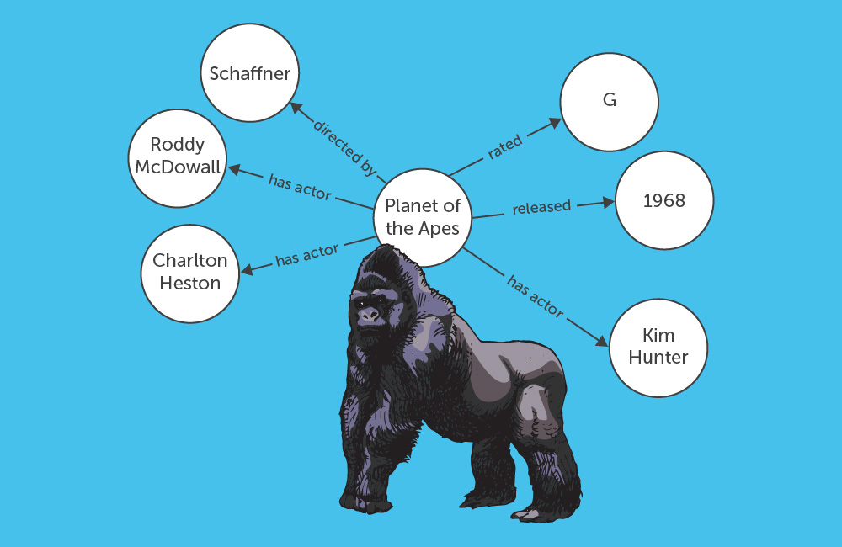
Introduction QA + KG + LM
Where to find the information?
from unstructured to structured
KGs (DBpedia, Wikidata)
graph-based answers
KGQA

Slide 4
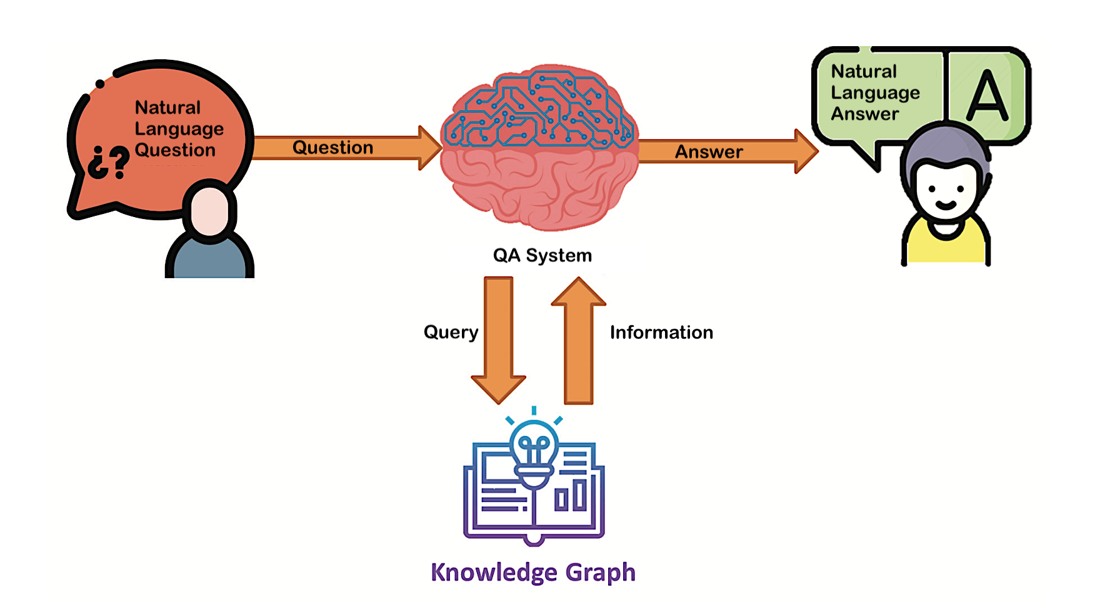
Introduction QA + KG + LM
Progress on QA systems
NLP, AI
Transformers, BERT
text-based answers

Slide 5
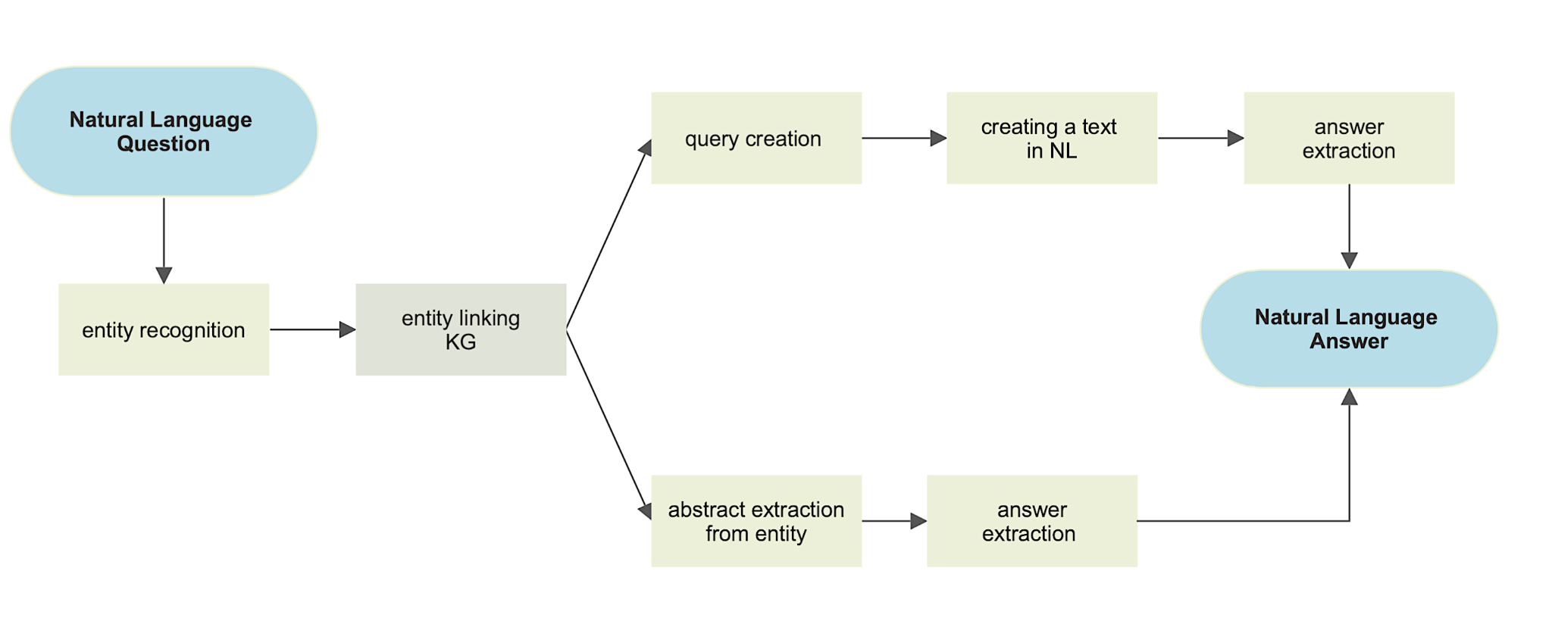
Our QA system (methodology)

Slide 6
Knowledge Graphs Approach

Slide 7
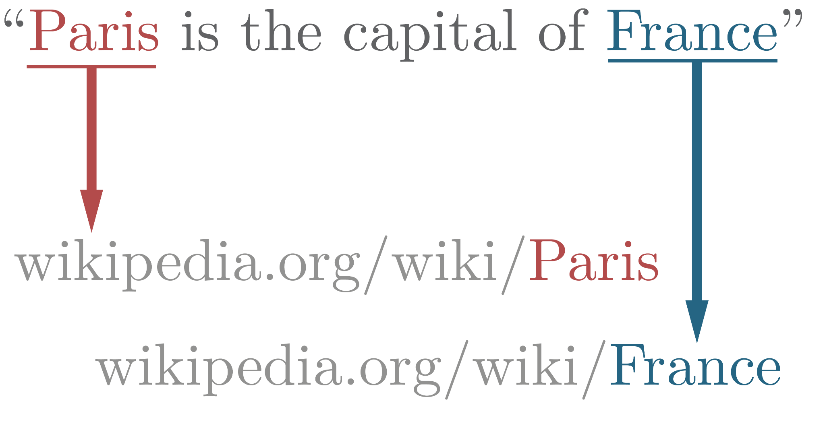
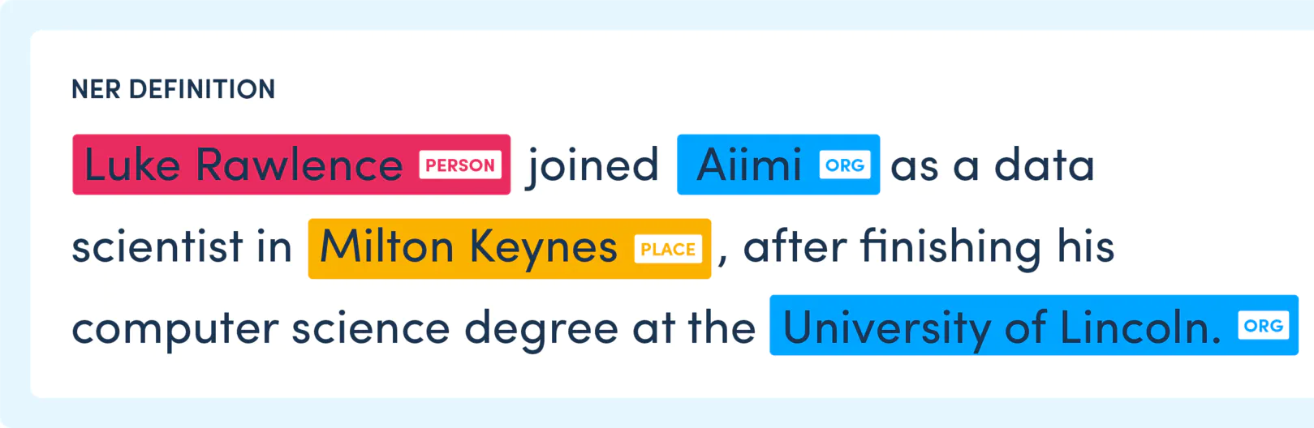
1 & 2) Named Entity Recognition + Entity Linking
What is a NER Task?
What is a NEL Task?
Technology used:
SpaCy
Technology used:
DBpedia Spotlight
* Used in both KG and LM approaches (subject recognition)

Slide 8
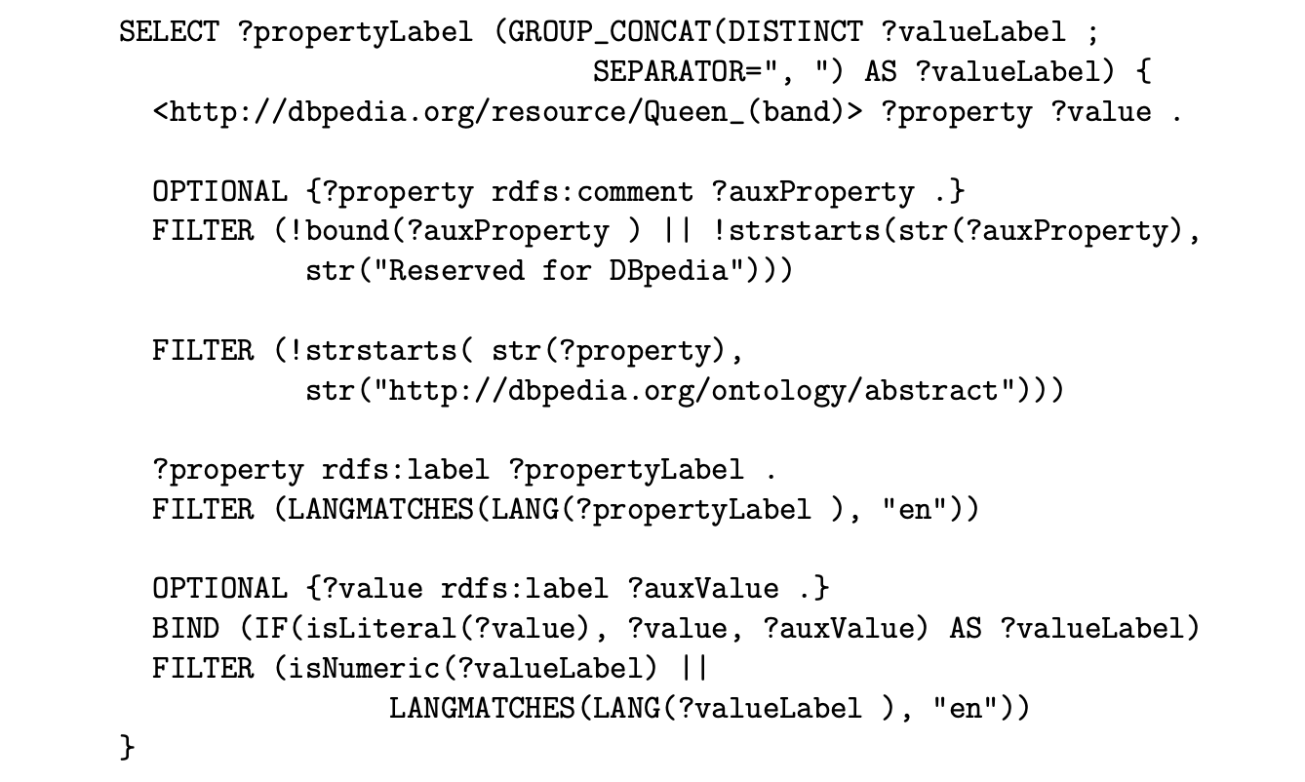
3) Query creation
A query is generated with a standard pattern to extract information from the KG
For the previously retrieved Entity:
all the in-relations
all the out-relations
Technology used:
SPARQL

Slide 9
4) Creation of a corpus in Natural Language
We want to express all the information that an entity has starting from its relationships in the KG with other entities or literals.
We express an entity relationship with the following pattern:
“entity has a relation, that it is literal/s or other/s entity/entities"
for example:
"Fernando Alonso has birth place, that it is Oviedo, Asturias, Spain"
"Queen (band) has hometown, that it is London"
"The Neverending Story has ISBN, that it is 3-522-12800-1”

Slide 10
5) Answer extraction
Input: text generated in natural language in the previous task
Answer is extracted by using question and answer extraction techniques for unstructured data (natural language texts)
Technology used:
BERT (Specifically BERT-Large Uncased Whole Word Masking fine-tuned with the SQuAD dataset for Question-Answering)

Slide 11
Knowledge Graphs Answers - Examples
Where did Barack obama graduate?
"Columbia University, Harvard Law School"
Who founded Google?
"Larry Page, Sergey Brin"
Where is Freddie Mercury from?
Sultanate of Zanzibar

Slide 12
Language Models Approach

Slide 13
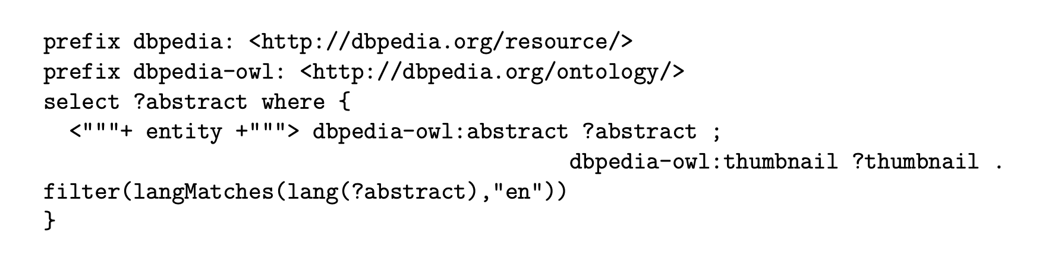
6) KG with textual description of entities
A query is generated with a standard pattern to extract the abstract from the KG
Extract the abstract of the entity: modifying the SPARQL query
Answer extraction (same as for KGs)

Slide 14
6) KG with textual description of entities
Improvements:
more correct answers to more detailed questions
more correct answers to more popular questions
more correct answers to frequently asked questions
Examples:
Q: when max verstappen won his first race? A: 2016 spanish grand prix
Q: How is Michael Jackson known? A: king of pop
Q: who replaced ringo starr as drummer for the beatles? A: pete best
Not a new pipeline but a support to the previous one!

Slide 15
Language Models Answers - Examples
Where did Barack obama graduate?
Columbia University
Who founded Google?
Larry Page and Sergey Brin
Where is Freddie Mercury from?
Zanzibar

Slide 16
KG & LM Integration

Slide 17
KG & LM Integration: Pipeline
Named Entity Recognition
Named Entity Linking
Relations Extraction (from KGs)
Abstract Extraction (from LMs)
Answer Extraction in Natural Language
using both Relations and Abstract as Context

Slide 18
KG + LM Answers - Examples
What instrument does Brad Delson play?
KG: guitar
LM: guitarist (occupation)
KG+LM: guitar
When was Brad Delson born?
KG: 1995 (debut year)
LM: december 1, 1977
KG+LM: december 1, 1977

Slide 19
Results

Slide 20
1) Subject Recognition: SimpleDBPediaQA
SimpleDBPediaQA
Migration of the Freebase SimpleQuestions Dataset to DBpedia
Used for testing the Subject Recognition of the NER and NEL tasks
Test over 4305 questions, labeled with subjects as DBpedia entities
Result: 0.5163 accuracy
results open to improvements
need of recognizable entities for the question-answer benchmark

Slide 21
2) Question-Answer Benchmark
Original goal: find a benchmark of questions with answers as DBpedia entities
didn’t find anything like that
SQuAD (Stanford Question Answering Dataset)
based on articles and not on Knowledge Graphs
Solution: our own Benchmark
50 questions on 10 entities
entities of variable popularity
resulting answers from the 3 models manually labeled:
not_found, wrong, acceptable, correct

Slide 22
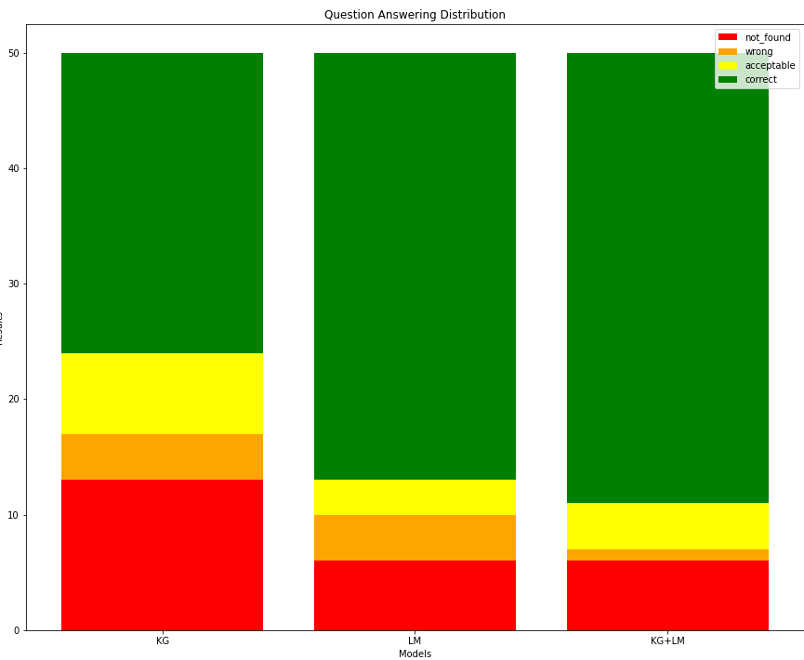
2) Question-Answer Benchmark
Model | not_found | wrong | acceptable | correct
KG | 13 | 4 | 7 | 26
LM | 6 | 4 | 3 | 37
KG+LM | 6 | 1 | 4 | 39

Slide 23
3) Timings and Efficiency
KG | NER | NEL | Relations | Answer | Total
time (s) | 0.5347 | 0.0017 | 1.4519 | 12.1647 | 14.1531
percentage | 3.78% | 0.01% | 10.26% | 85.95% | 100%
LM | NER | NEL | Abstract | Answer | Total
time (s) | 0.5371 | 0.0017 | 0.6589 | 9.2238 | 10.4217
percentage | 5.15% | 0.02% | 6.32% | 88.51% | 100%
KG+LM | NER | NEL | Relations | Abstract | Answer | Total
time (s) | 0.5478 | 0.0018 | 1.6617 | 0.7230 | 12.1333 | 15.0678
percentage | 3.64% | 0.01% | 11.03% | 4.80% | 80.52% | 100%

Slide 24
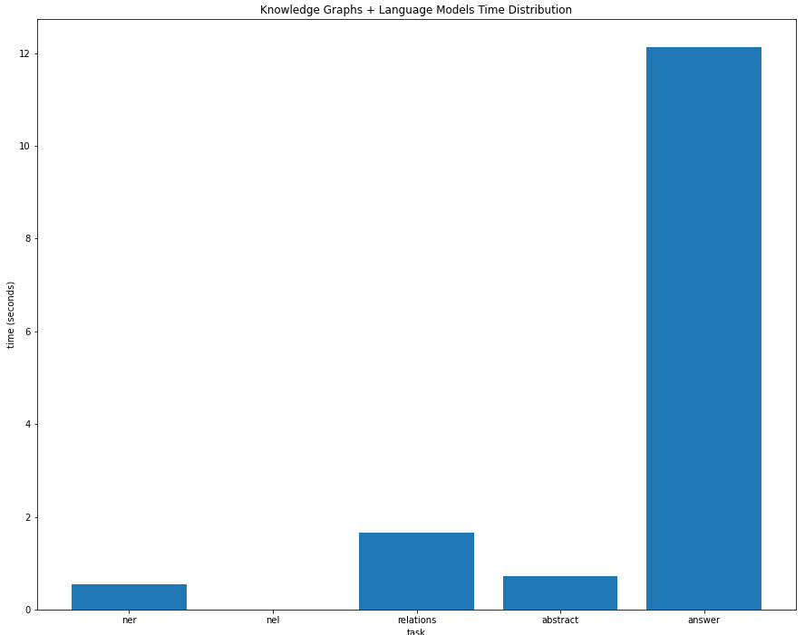
3) Timings and Efficiency

Slide 25
Knowledge Graph Embeddings Attempts

Slide 26
KGE: Original Idea
Starting from a comprehensive Knowledge Base of Embeddings (like DBPedia):
Extract the question Head Subject (with NER and NEL)
Extract the question Predicate
Map the subject and relation to their respective Embedded Representation
from the trained Knowledge Base
Retrieve the Tail Subject from the Knowledge Base (Answer Selection)

Slide 27
KGE: Data Limitations
Different source of data have been tried:
TransE model (https://github.com/ZichaoHuang/TransE)
training on Freebase5M
too expensive and GPU required for training
WikiData5M (PyKeen)
expensive training: 5hrs+ for a single epoch
DBPedia50 (PyKeen)
easily manageable (~25.000 entities)
entities not really relevant and common
very limited subset for an effective QA system

Slide 28
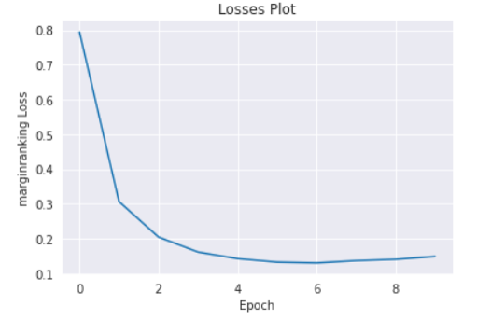
KGE: DBpedia50 Training and Prediction
Training Hyperparameters:
model='TransE',
model_kwargs=dict(embedding_dim=80),
random_seed=256,
optimizer = torch.optim.Adam,
optimizer_kwargs=dict(lr=1.0e-02),
training_kwargs=dict(num_epochs=10),
tail_id | score | tail_label
1887 | -11.233741 | Armenian_language
14980 | -11.454445 | Murtaza_Rakhimov
3912 | -11.521836 | Cataulacus
6630 | -11.626891 | English_language
Prediction Example:
&Me (movie) language

Slide 29
Conclusions

Slide 30
1) Conclusions: Results Summary
A better implementation of NER and NEL would improve the performances
for a more accurate Subject Recognition
something other that Spacy and Spotlight
LMs proved to be better than KG on simple questions
The combination of the 2 approaches is the best one in term of performances
LM is the faster answering model by a 31% gap on KG+LM
the system still needs improvements on the efficiency side
KG+LM seems to get the best answer when KG and LM give a different one

Slide 31
2) Conclusions: Future Improvements
Integration with the Knowledge Graph Embeddings
having more useful and comprehensive data
Improvements on the Knowledge Graph implementation
to answer more complex answers: multi-hop relations
pattern recognition for more sophisticated kind of relations
Indexing of the Knowledge Base for efficiency purpose
having to query directly on DBpedia for every question is too time consuming

