Slide 1


Slide 2


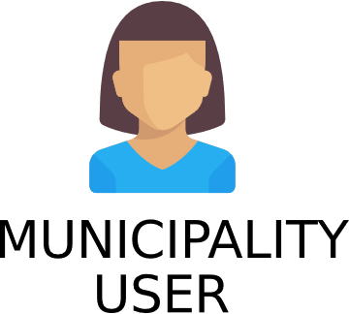
CROWD-SOURCED APPLICATION
Notes:
SafeStreets is a crowd-sourced application whose purpose is to manage traffic violation reports.
There are 3 classes of users that the application has to deal with.
Common users have lowest level of privileges. The registration of a common user does not require any kind of verification.
Authorities can access data without restrictions. They are supposed use the application as a support for their tasks.
Municipality users are supposed to use the application to get suggestion on possible interventions to reduce accidents and violations.
Both authorities and municipality users require a verification for the activation of the account.

Slide 3
SAFEREPORTS
ALLOW COMMON USERS TO SEND VIOLATION REPORTS
SAFEANALYTICS
ALLOW COMMON USERS TO GET ANONYMOUS DATA ON VIOLATIONS
ALLOW AUTHORITIES TO ACCESS TO ALL THE DATA WITHOUT RESTRICTIONS
ALLOW MUNICIPALITY USERS TO GET SUGGESTIONS ON POSSIBLE INTERVENTIONS
SAFESUGGESTIONS
GENERATE TRAFFIC TICKETS FORWARDING RELIABLE DATA
ALLOW AUTHORITIES TO GET STATISTICS ON ISSUED TICKETS
SAFETICKETS
Notes:
The application must provide some functionalities, captured by these goals.
Goal 2 – «Anonymous» because it is illegal to share sensitive information
Goal 4 – «Suggestions» are identified using data analyisis techniques
Goal 5 – By «reliable» we mean that data must not break the chain of custody
Goals can be factored in some groups. We decided to indentify 4 different services, each of which is responsible for one or more goals.
Services are reciprocally independent. This means that every service can be developed without affecting the working of the other ones.
This service-division was not required, but we thought it would be a good idea to split the goals of the application.

Slide 4
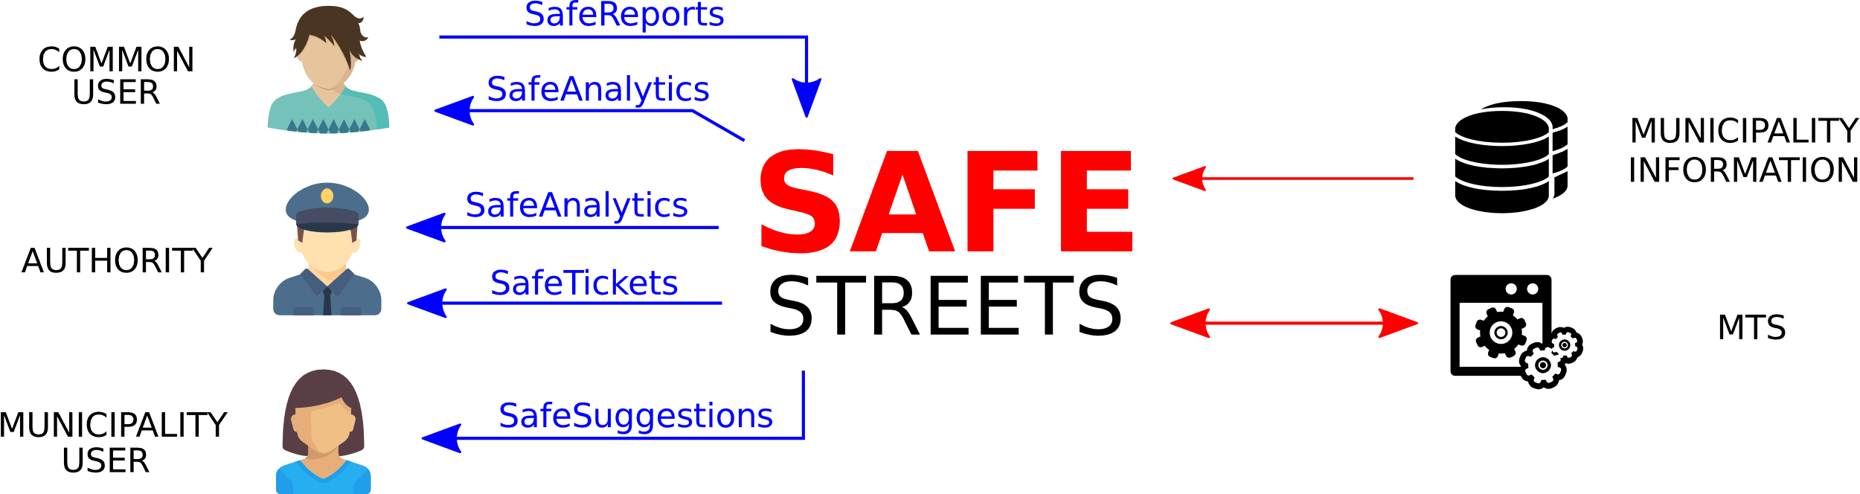
Notes:
This is a diagram that represents the relations between the actors of the scenario in which the application must work.
The diagram also shows which type of user every service is addressed to.
But the most interesting thing in this diagram is the structure, which is similar to the one of the diagram in the next slide.

Slide 5
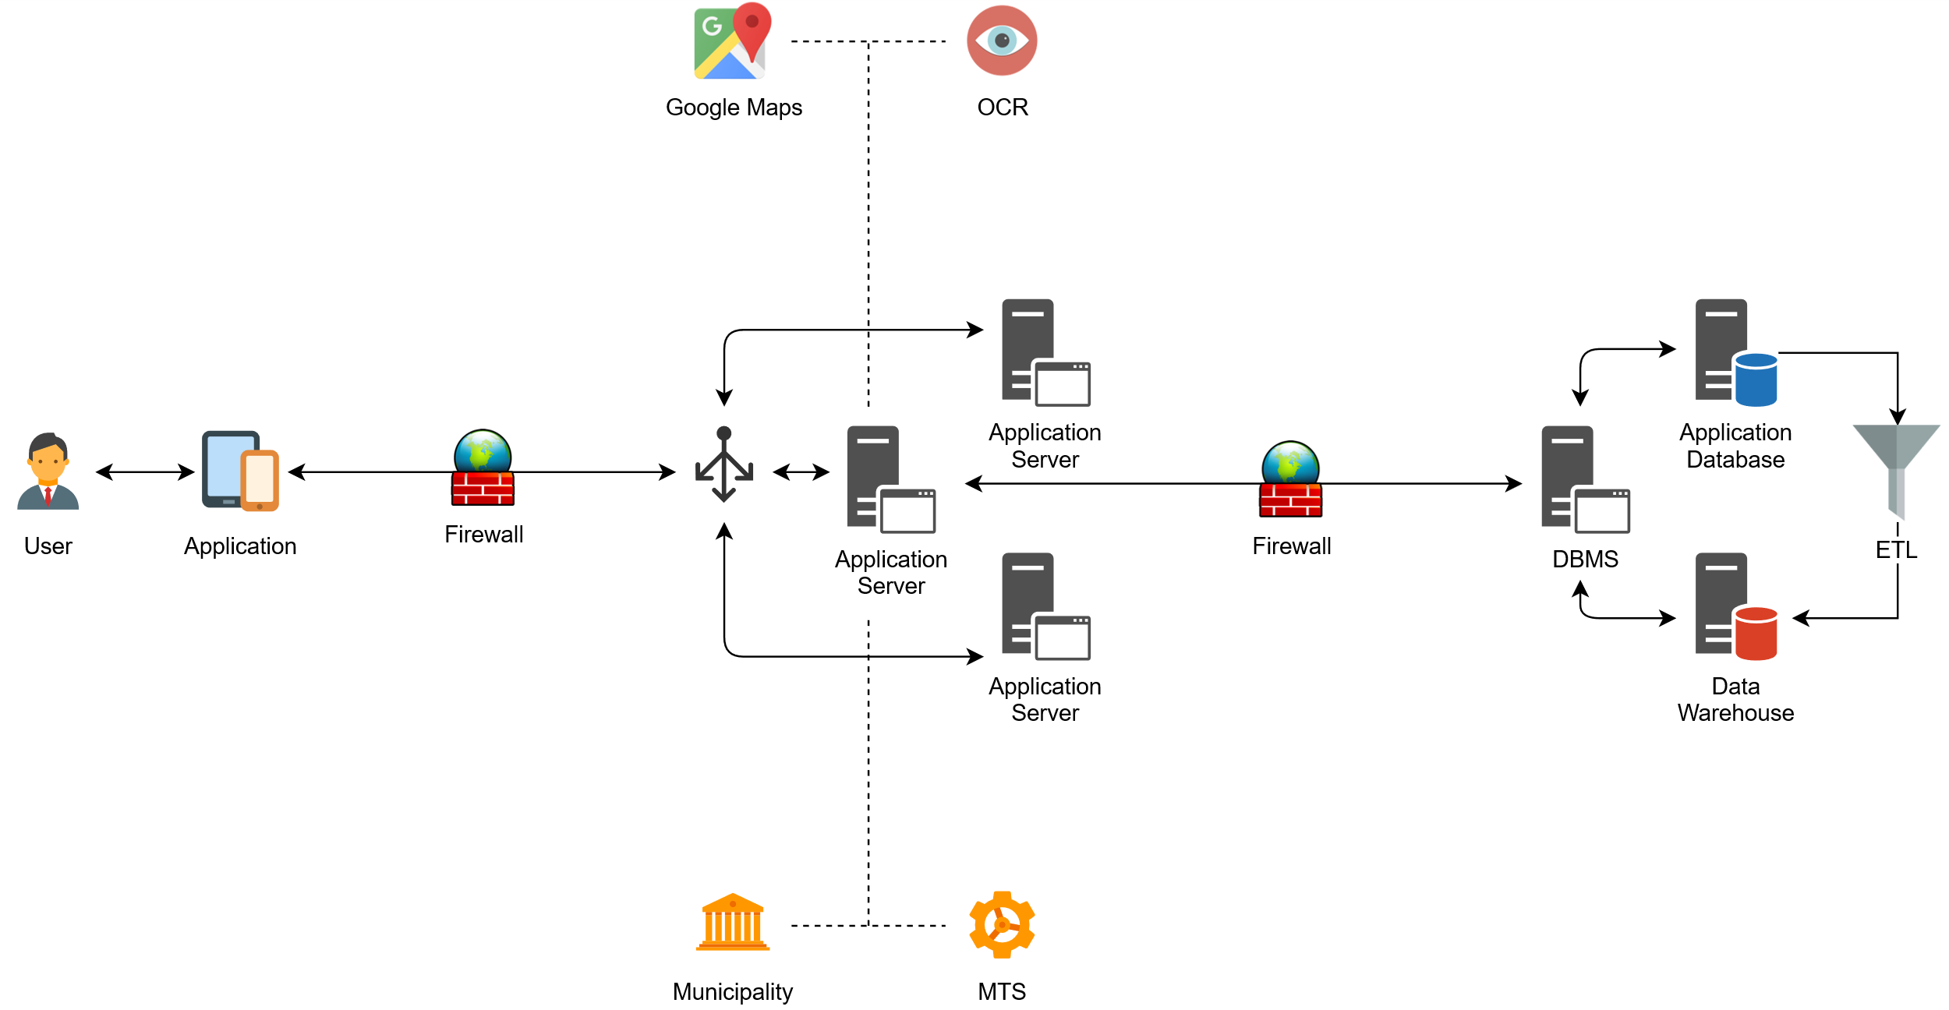
Notes:
This diagram does not represent the actors but the physical nodes of the scenario in which the application works.
The structure is similar to the diagram in the previous slide.
This led us to the most natural choice we could have done for the architecture of the system.

Slide 6



THREE-TIER ARCHITECTURE
VIEW
CONTROLLER
MODEL
MVC PATTERN
Notes:
Indeed, we have choosen a three-tier architecture, where the presentation layer, the application layer and the data layer are separated.
This solution perfectly fits with this linear variant of the mvc-pattern.

Slide 7
SAFEREPORTS

Slide 8
CHAIN OF CUSTODY & SECURITY
PREVENT IMAGE MODIFICATION
TAKE AND SEND THE PICTURES
SAFE CAMERA
HTTPS COMMUNICATION
LOW DATA EXCHANGE

Slide 9
OCR
STRONG ASSUMPTION
USER CONFIRMATION

Slide 10
RESTFUL PROBLEM
STATELESS COMMUNICATION
SERVER SHOULD START COMMUNICATION
«CONFIRMATION REQUEST»
TEMPORARY DATA

Slide 11
DUPLICATED REPORTS
AVOID MULTIPLE NOTIFICATIONS
EQUIVALENCE CHECK

Slide 12
SAFEANALYTICS
SAFETICKETS
SAFESUGGESTIONS

Slide 13
PROVIDE DATA
SERVICES TO ACCESS THE COLLECTED DATA

Slide 14



SAFEANALYTICS
SAFETICKETS
SAFESUGGESTIONS
GET SUGGESTIONS ON POSSIBLE INTERVENTIONS, FROM VIOLATIONS AND ACCIDENTS
ACCESS TO VIOLATIONS’ DATA
GET STATISTICS ON TICKETS

Slide 15
DATABASE & DATA WAREHOUSE
DATABASE SERVER DEVELOPED INDEPENDENTLY FROM THE APPLICATION SERVER
DATABASE
DATA WAREHOUSE
DEALS WITH SIMPLE AND FREQUENT QUERIES
PROVIDES STATISTICS: COMPLEX QUERIES
EASY TO USE
DATA ANALYSIS DOESN’T AFFECT THE APPLICATION
EFFICIENCY
UPGRADES ON DATA ANALYSIS TECHNIQUES DON’T
AFFECT THE OVERALL APPLICATION
IMMEDIATE RESPONSE ON BIG AMOUNT OF DATA

Slide 16

ONE COMMON INTERFACE
REUSABILITY
COHERENCE
HOMOGENEITY

Slide 17
AUTHORS
SIMONE BRAGA
JUAN CALDERON
MARZIA FAVARO

