Slide 1
PROJECT 1
Simulation and Analysis of Noise Level

Slide 2
GOALS
Collect noise data
Simulate when not possible
Clean input data
Analyze and compute metrics

Slide 3




Open MPI

Slide 4
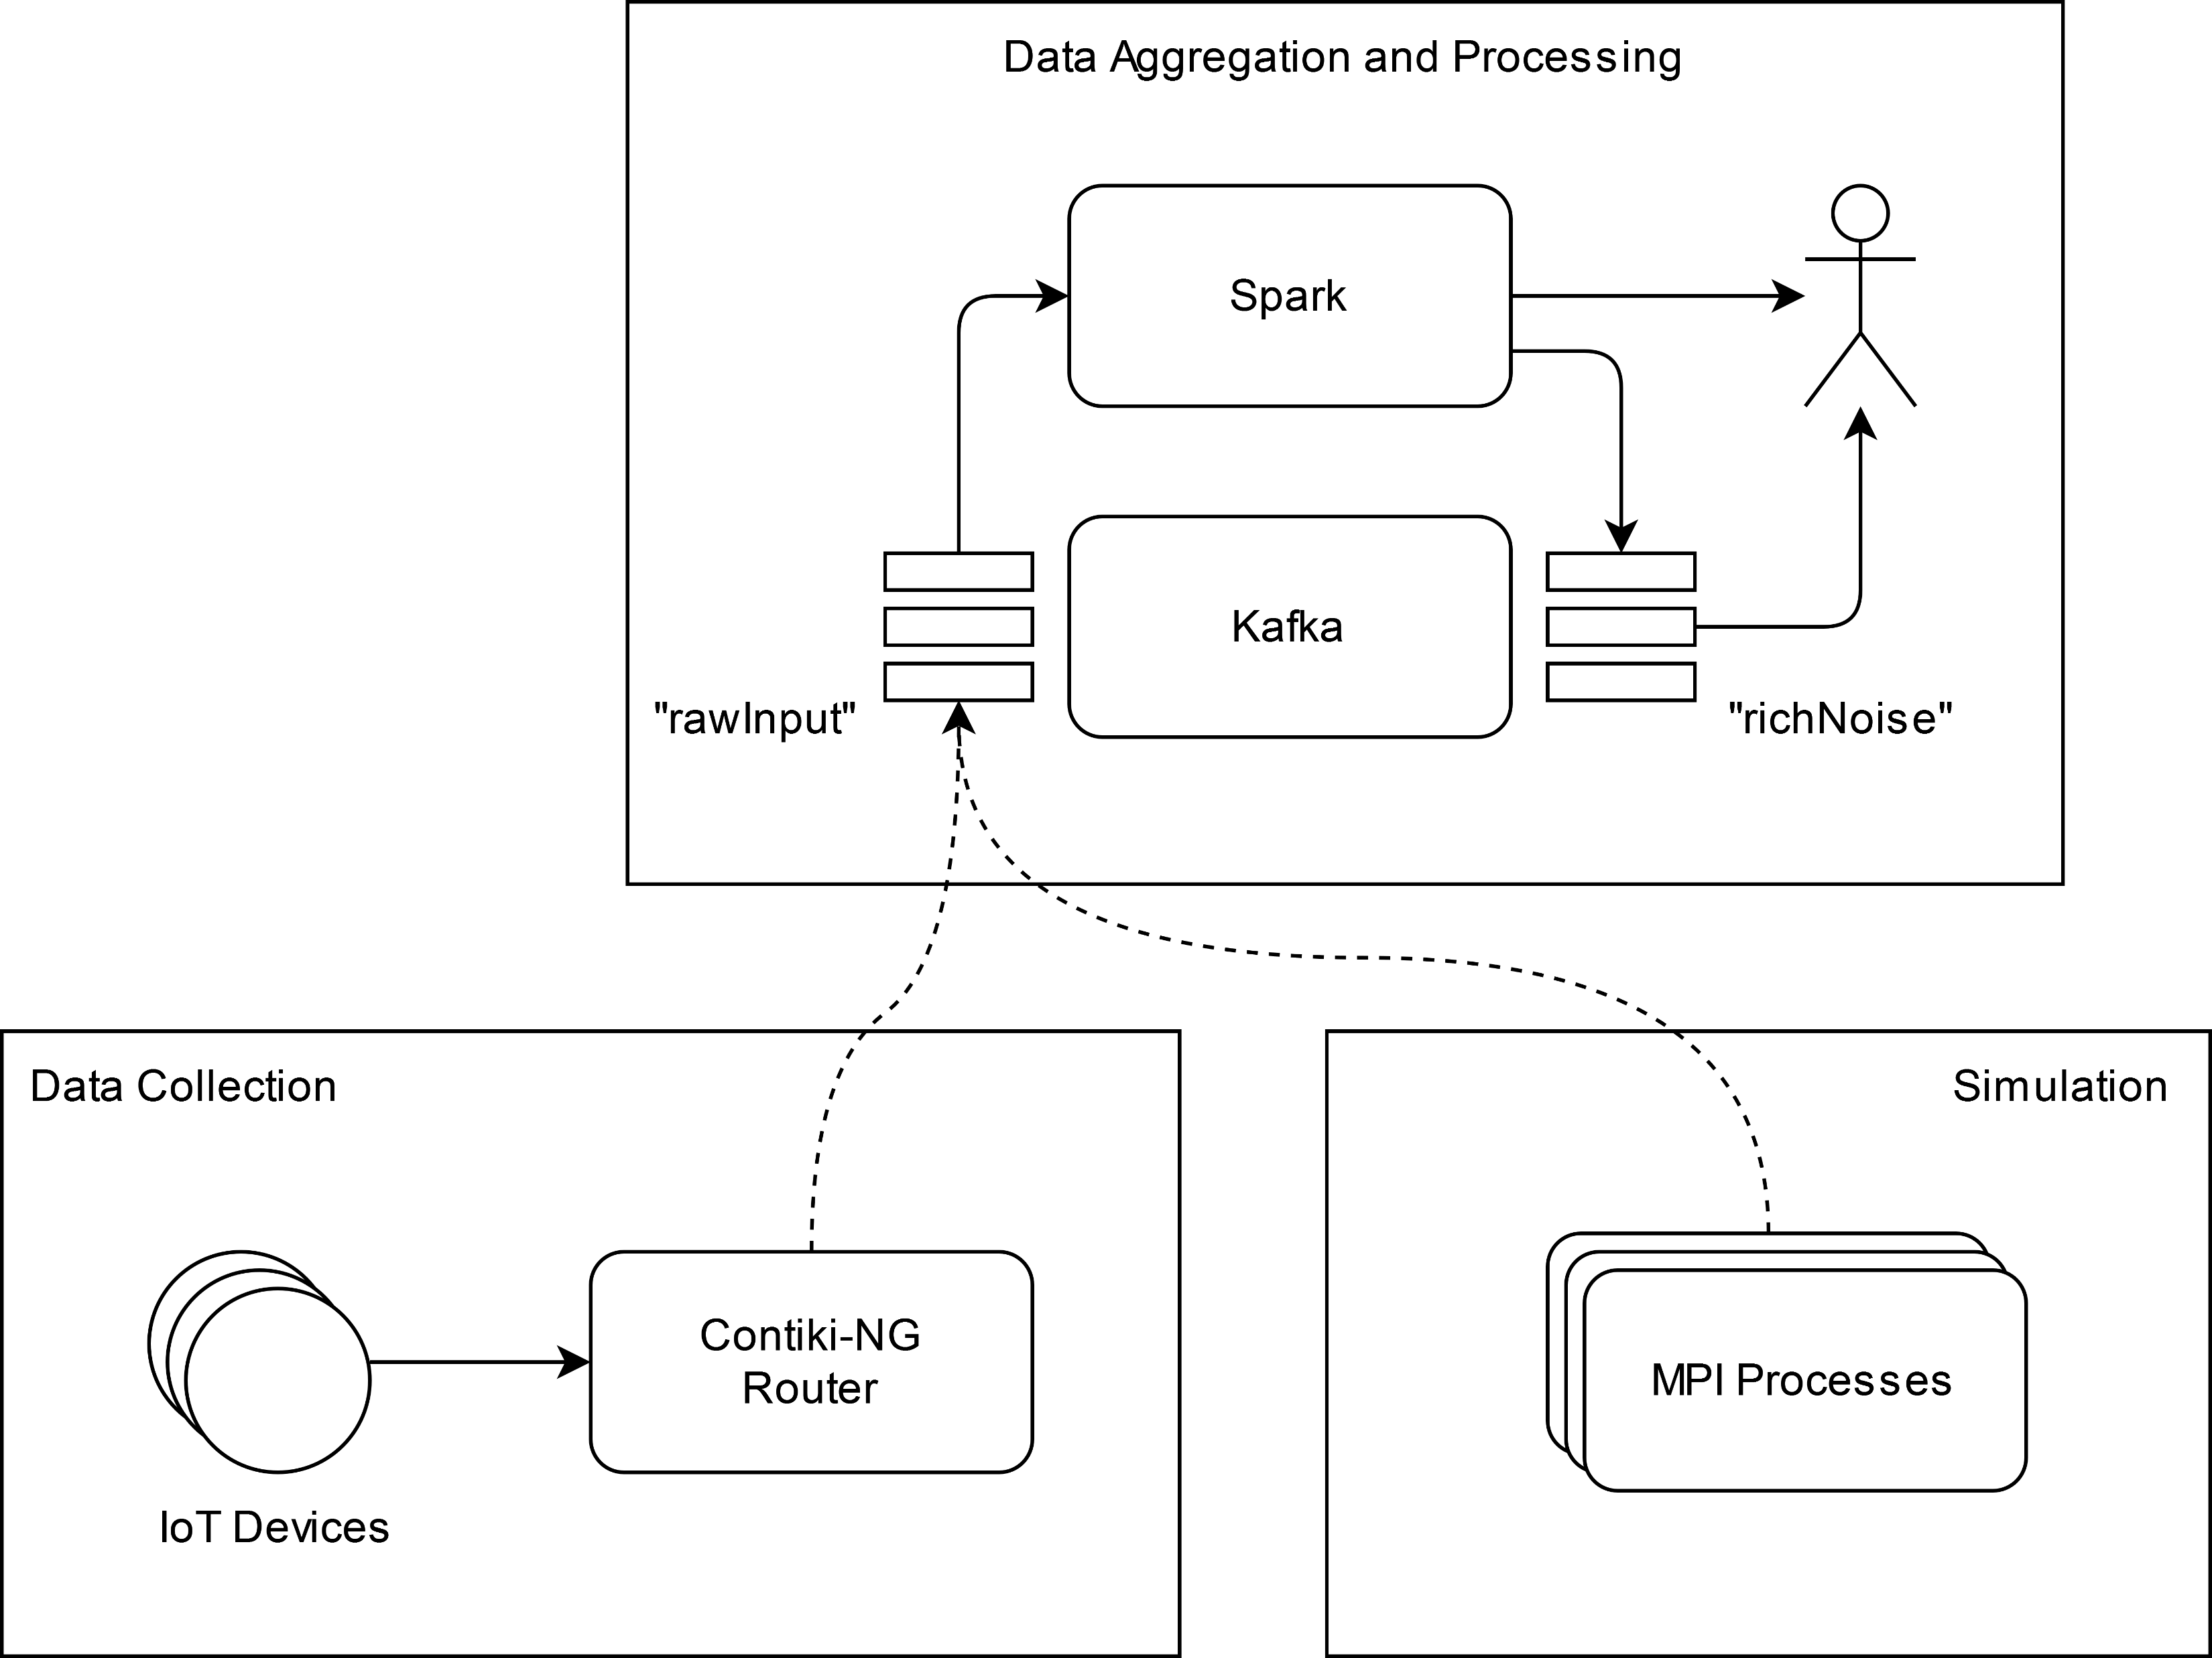

Slide 5
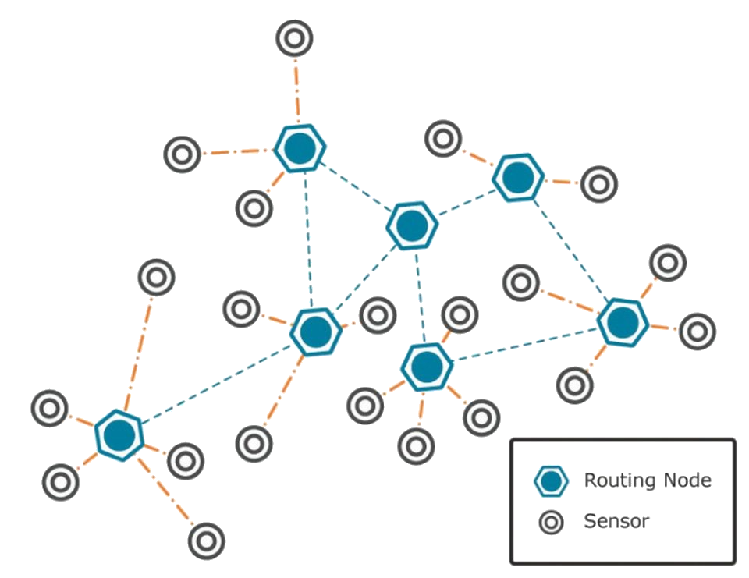

Slide 6
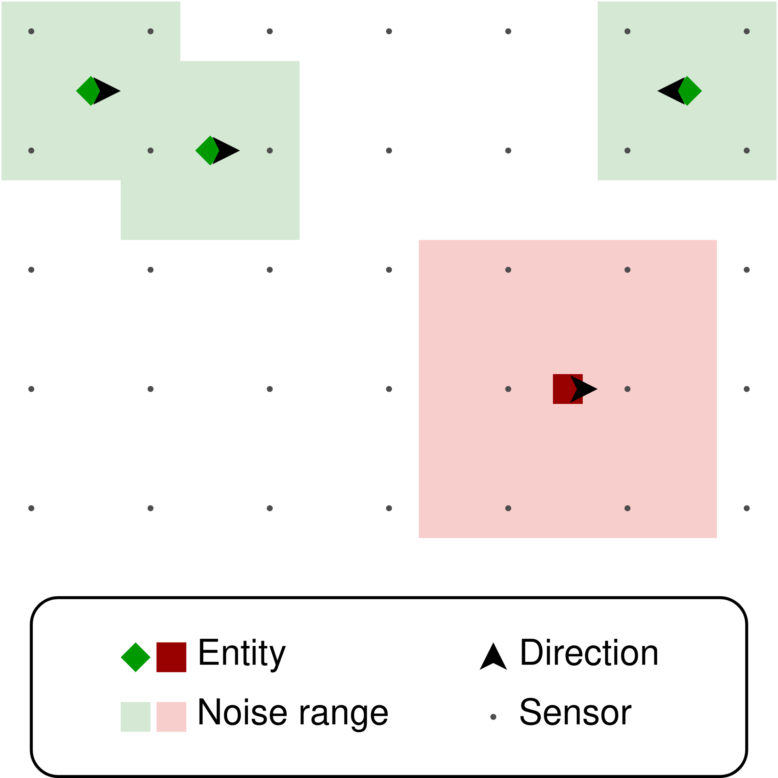

Slide 7
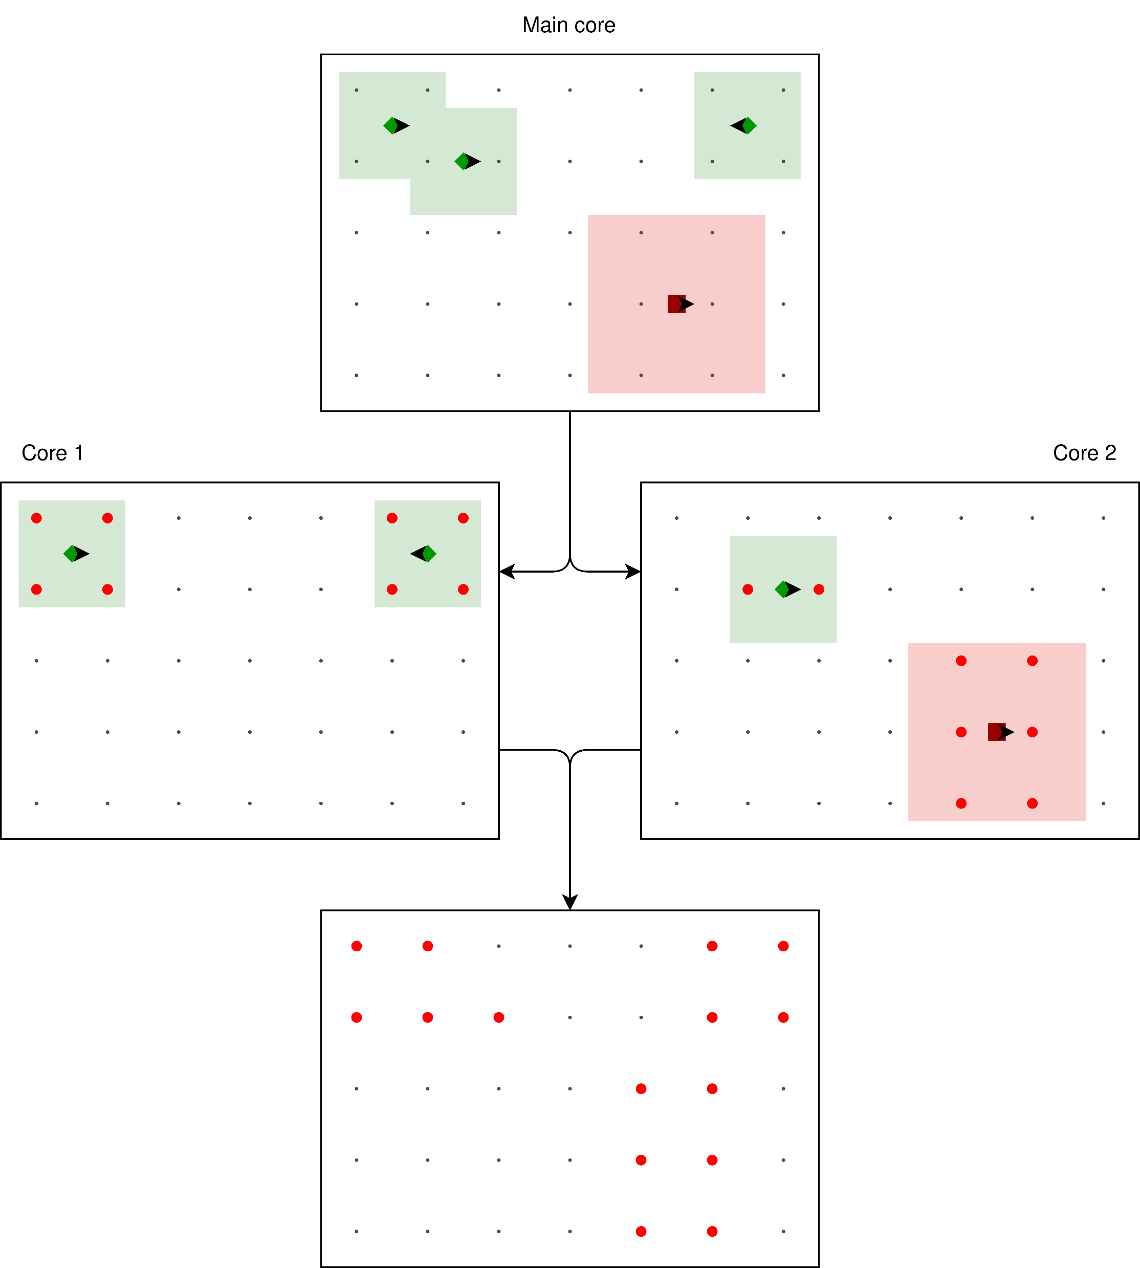

Slide 8
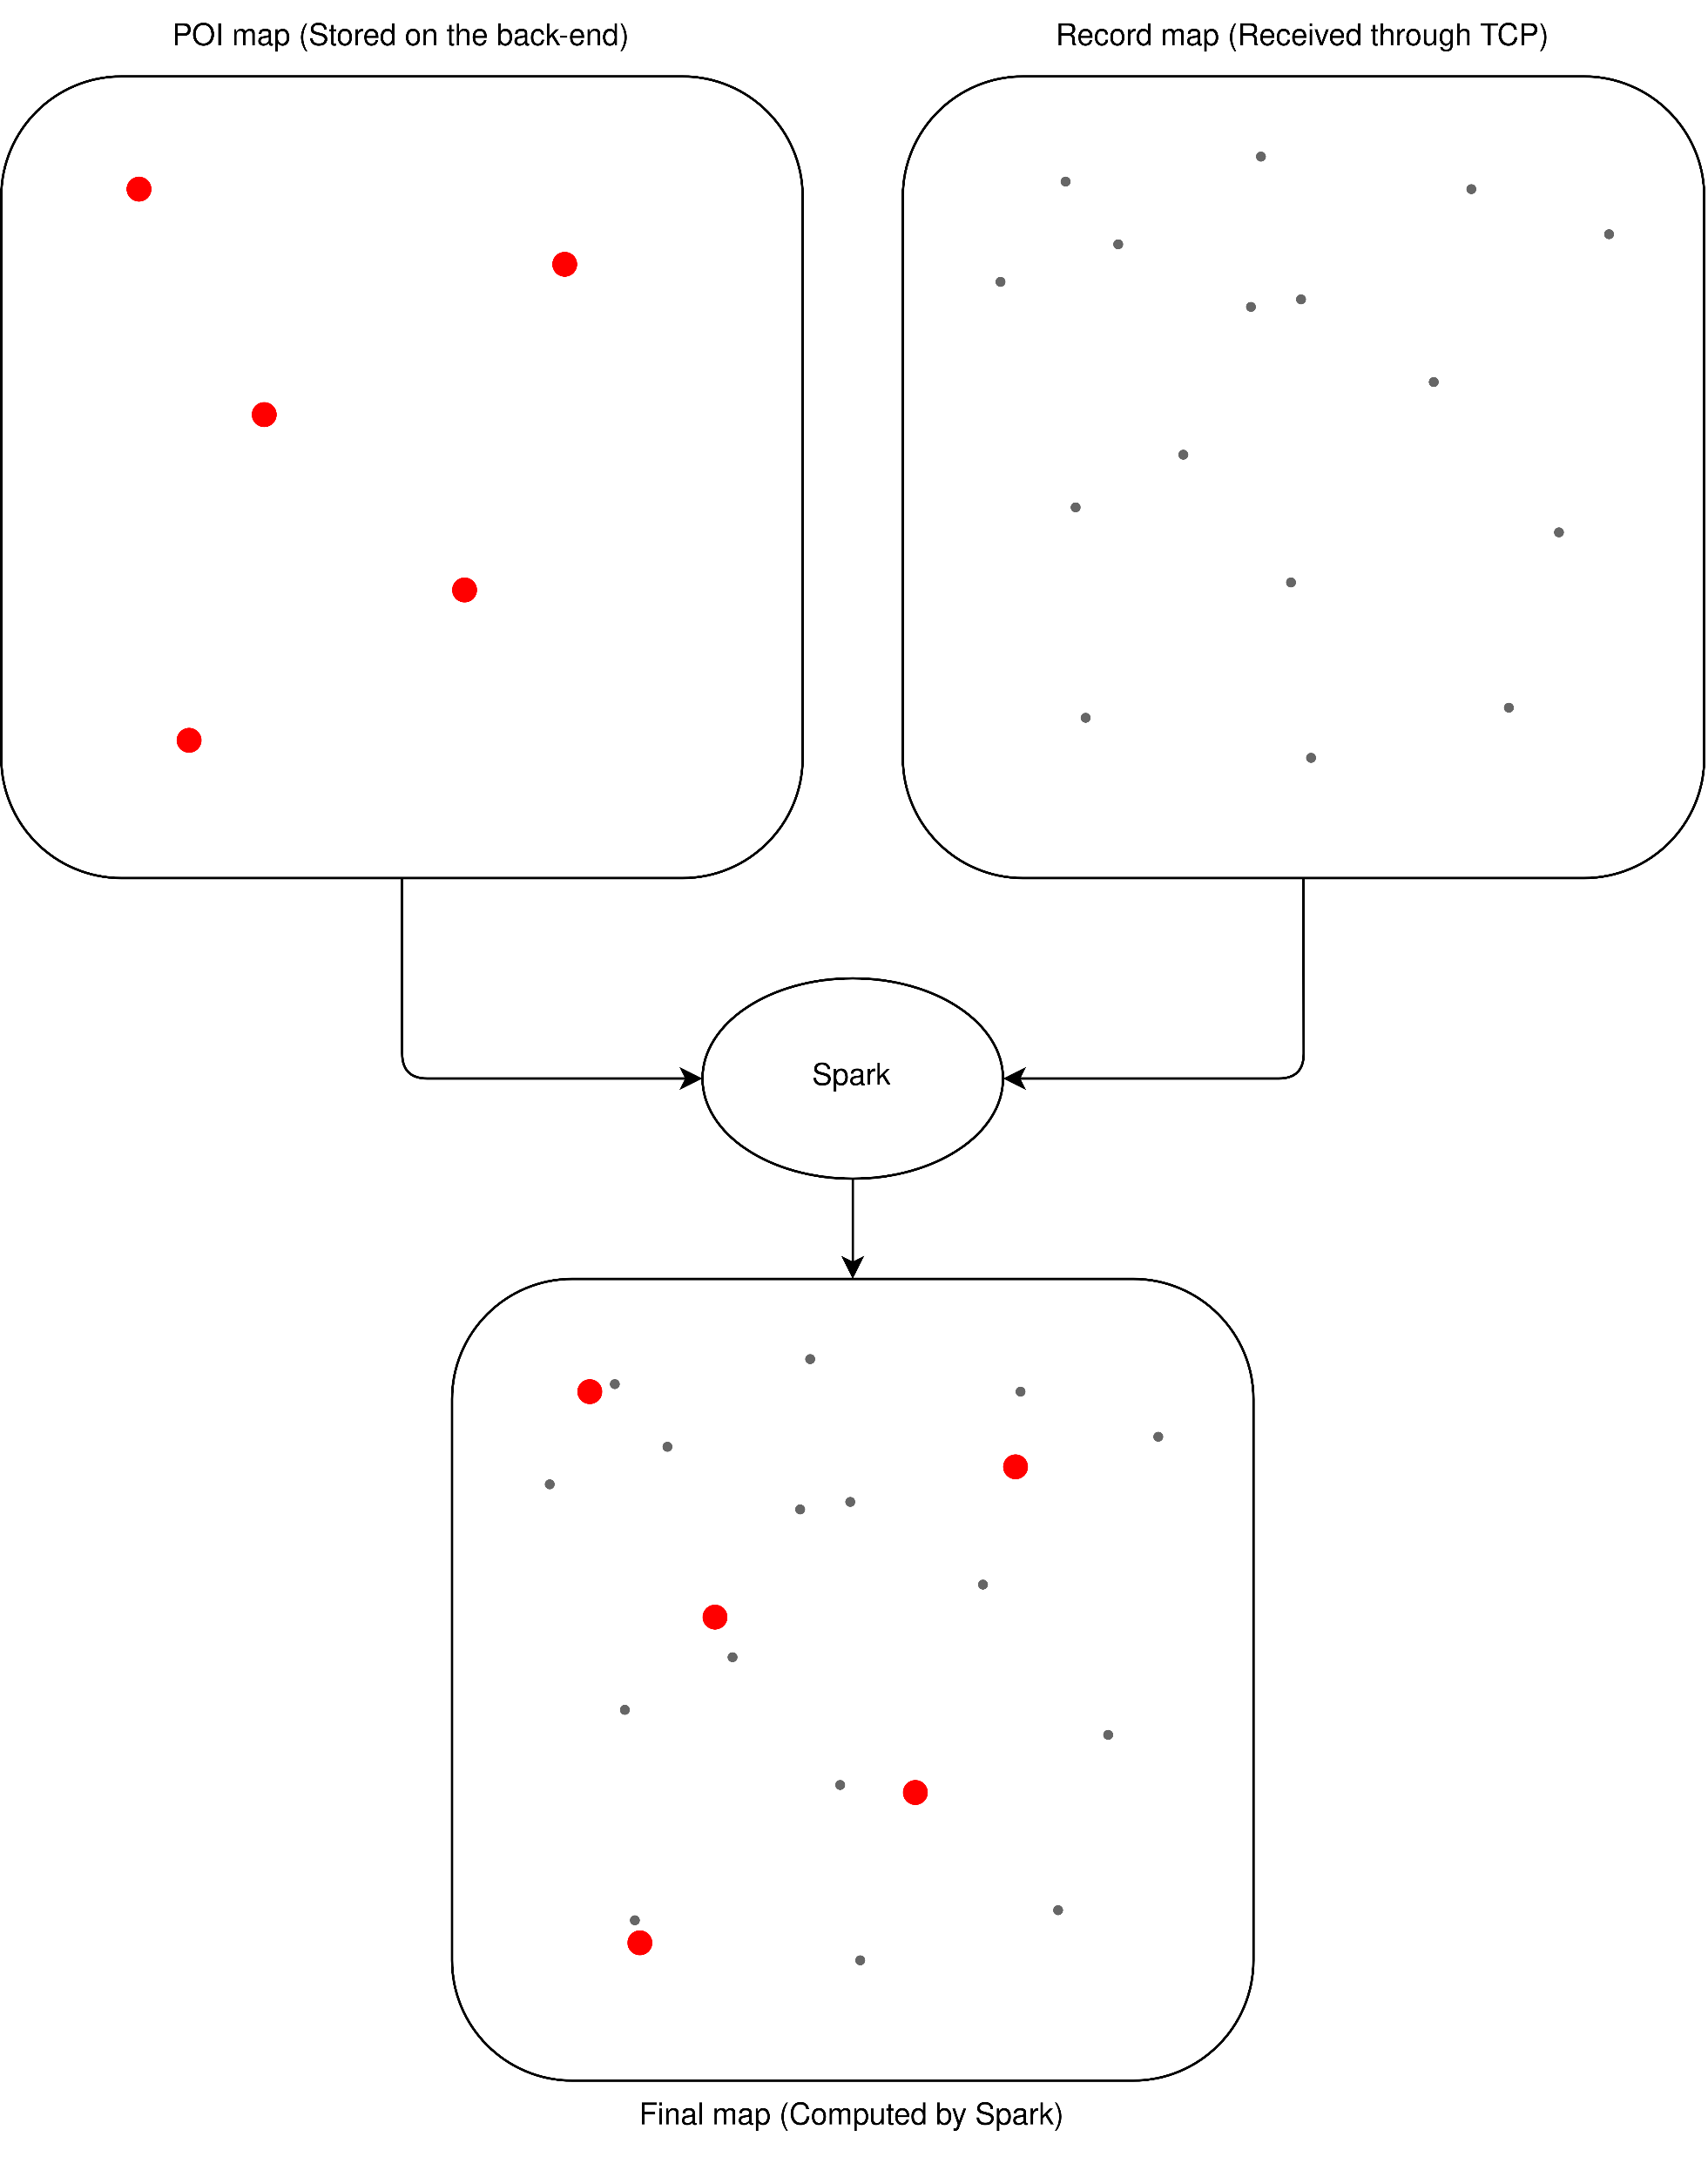

Slide 9
X | Y
VALUE
TIMESTAMP
10.1 | 15.3
52.7
2022-06-11 16:43:24.000

Slide 10


POI
VALUE
TIMESTAMP
milan_cathedral
52.7
2022-06-11 16:43:24.000

Slide 11
POI
VALUE
TIMESTAMP
milan_cathedral
52.7
2022-06-11 16:43:24.000
trevi_fountain
41.2
2022-06-11 16:45:52.000
milan_cathedral
61.5
2022-06-11 16:46:17.000
pisa_tower
31.2
2022-06-11 16:46:25.000
pisa_tower
76.5
2022-06-11 16:47:44.000
colosseum
49.6
2022-06-11 16:51:13.000

Slide 12
hourlyAverage = source .where(col(“TIMESTAMP”) .gt(current_timestamp() .minus(expr(“INTERVAL 1 HOUR”)))) .select(“POI”,“VALUE”) .groupBy(“POI”) .avg(“VALUE”);

Slide 13
top10poi = hourlyAverage .orderBy(desc(“avg(VALUE)”) .limit(10);

Slide 14
noiseStreak = source .where(col(“VALUE”).gt(threshold)) .groupBy(“POI”) .agg(max(“TIMESTAMP”)) .withColumn(“STREAK”,current_timestamp() .minus(col(“max(TIMESTAMP”)))) .orderBy(desc(“STREAK”)) .select(“POI”) .limit(1);

