Slide 1

http://127.0.0.1:5500/mhw1.html

Slide 2
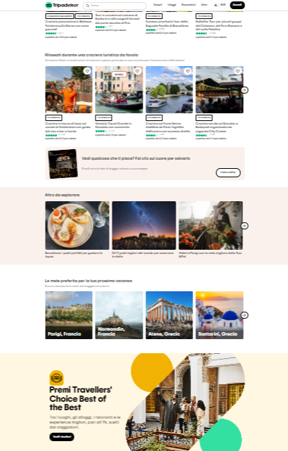

Slide 3


