Slide 1

Progetto Tecnologie Informatiche per il Web PlaylistMusicale
Anno accademico 2022/23
Calzolaro Simone 956298

Slide 2
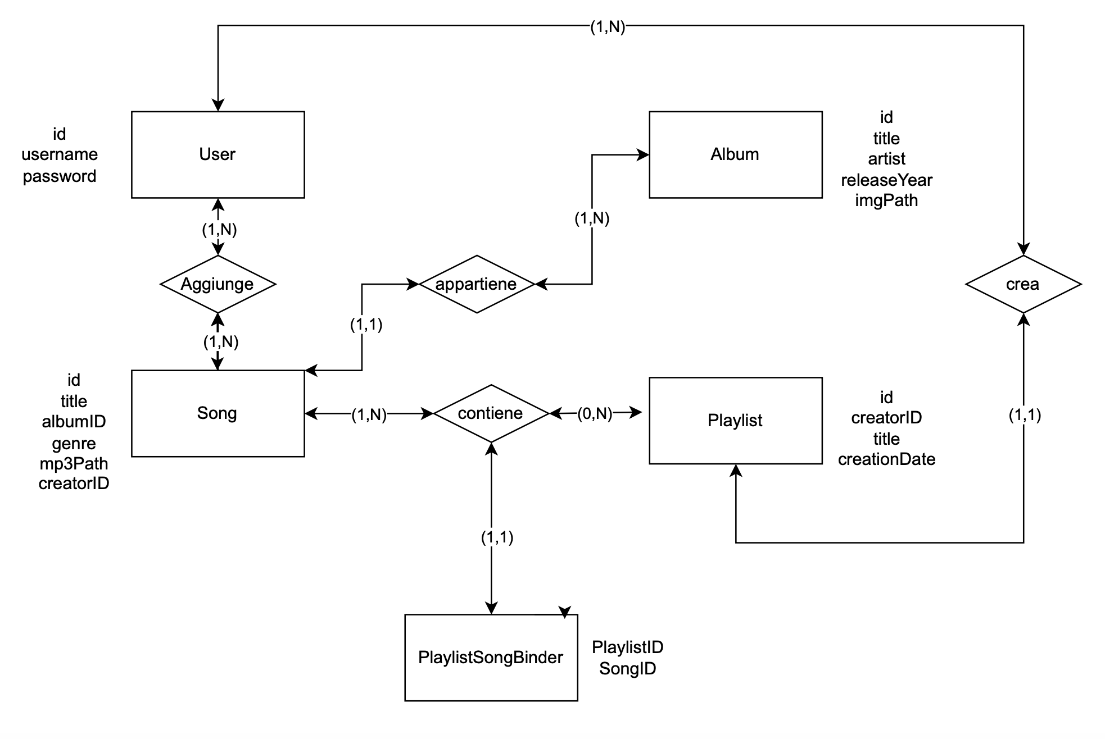
Database Design

Slide 3
NOTA:
La struttura del database per la versione fat client è identica a quella della versione thin client fatta eccezione per la tabella Playlist, la quale contiene un attributo Sorting (varchar) per memorizzare l’ordine delle canzoni nella playlist in maniera permanente

Slide 4
Database Design: Schema Logico
USER (Id, username,password)
PLAYLIST(Id, creatorID, title, creationDate)
ALBUM(Id, title, artist, releaseYear, imgPath)
SONG(Id, title, albumID, genre, mp3Path, creatorId)
PLAYLISTSONGBINDER(PlaylistID,SongID)

Slide 5

Database Design: Foreign Keys
SONG.creatorID REFERENCES USER.Id
SONG.albumID REFERENCES ALBUM.Id
PLAYLIST.creatorId REFERENCES USER.Id
PLAYLISTSONGBINDER.PlaylistID REFERENCES PLAYLIST.Id
PLAYLISTSONGBINDER.SongID REFERENCES SONG.Id

Slide 6

Database Design: Song Table
CREATE TABLE IF NOT EXISTS `Song` (
`id` INT PRIMARY KEY AUTO_INCREMENT,
`title` VARCHAR(50) NOT NULL,
`albumID` INT NOT NULL,
`genre` VARCHAR(50) NOT NULL,
`mp3Path` VARCHAR(255) NOT NULL,
`creatorID` INT,
FOREIGN KEY (`creatorID`) REFERENCES `User`(`id`) ON UPDATE CASCADE ON DELETE CASCADE,
FOREIGN KEY (`albumID`) REFERENCES `Album`(`id`) ON UPDATE CASCADE ON DELETE CASCADE

Slide 7
Database Design: Album Table
CREATE TABLE IF NOT EXISTS `Album`(
`id` INT PRIMARY KEY AUTO_INCREMENT,
`title` VARCHAR(50) NOT NULL,
`artist` VARCHAR(50) NOT NULL,
`releaseYear` INT NOT NULL,
`imgPath` VARCHAR(255) NOT NULL
);

Slide 8

Database Design: Playlist Table
CREATE TABLE IF NOT EXISTS `Playlist` (
`id` INT PRIMARY KEY AUTO_INCREMENT,
`creatorID` INT NOT NULL,
`title` VARCHAR(50) NOT NULL,
`creationDate` DATE NOT NULL,
FOREIGN KEY (`creatorID`) REFERENCES `User`(`id`) ON UPDATE CASCADE ON DELETE CASCADE
);

Slide 9
Database Design: User Table
CREATE TABLE IF NOT EXISTS `User` (
`id` INT PRIMARY KEY AUTO_INCREMENT,
`username` VARCHAR(50) UNIQUE NOT NULL ,
`password` VARCHAR(50) NOT NULL
);

Slide 10

Database Design: PlaylistSongBinder Table
CREATE TABLE IF NOT EXISTS `PlaylistSongBinder` (
`PlaylistID` INT,
`SongID` INT,
PRIMARY KEY (`PlaylistID`, `SongID`),
FOREIGN KEY (`PlaylistID`) REFERENCES `Playlist`(`id`) ON UPDATE CASCADE ON DELETE CASCADE,
FOREIGN KEY (`SongID`) REFERENCES `Song`(`id`) ON UPDATE CASCADE ON DELETE CASCADE
);

Slide 11
Application Design: Thin Client

Slide 12
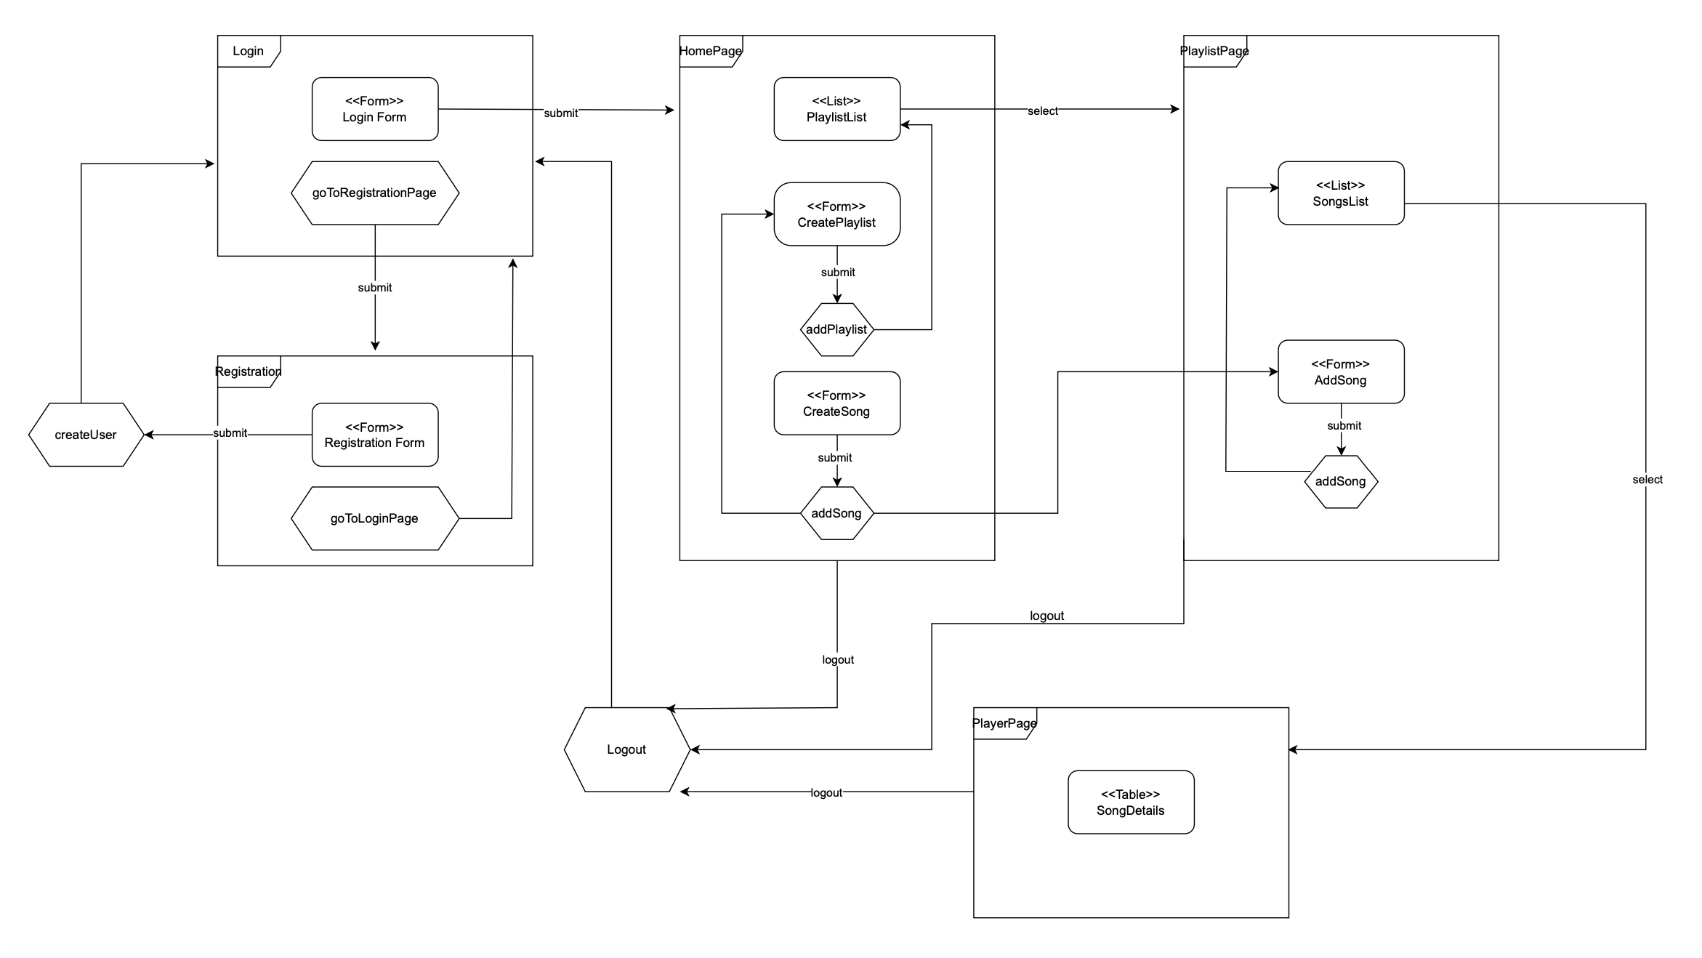
Application Design (vv. Thin Client)

Slide 13
Application Design: Model
User.java:
+get/setId
+get/setUsername
+get/setPassword
Song.java:
+get/setID
+get/setTitle
+get/setGenre
+get/setAlbumID
+get/setMp3Path
+get/setCreatorID
+get/setImgPath
+get/setAlbumTitle
+get/setArtist
+get/setReleaseYear
Playlist.java:
+get/setId
+get/setTitle
+get/setCreationDate
+get/setCreatorId
Album.java:
+get/setId
+get/setTitle
+get/setArtist
+get/setReleaseYear
+getSetReleasePath

Slide 14

Application Design: View
Web Pages:
loginPage.html
registrationPage.html
homePage.html
playerPage.html
playlistPage.html

Slide 15
Application Design: Controller
Controllers:
AddSong.java
CheckLogin.java
CheckRegistration.java
CreatePlaylist.java
CreateSong.java
GetImage.java
GetSong.java
GoToHomePage.java
GoToPlaylistPage.java
GoToSongPage.java
Logout.java

Slide 16
Application Design: DAO
SongDAO.java:
+createSongAndAlbum
-createAlbum
+getAlbum
-createSong_private
+createSong
+getSongTitleAndImg
+getSongsNotInPlaylist
+findSongByUser
+getSongDetails
+findSongByUser
+findSongByUserId
+getSongByUser
PlaylistDAO.java:
+fingUserPlaylists
+findPlaylistByTitle
+createPlaylist
+addSongBefore
+getPlaylistId
+fingPlaylistById
+findPlaylistTitleById
+addSong
+findSongInPlaylist
UserDAO.java:
+existsUser
+checkAuthentication
+addUser

Slide 17
Application Design: Fat Client

Slide 18
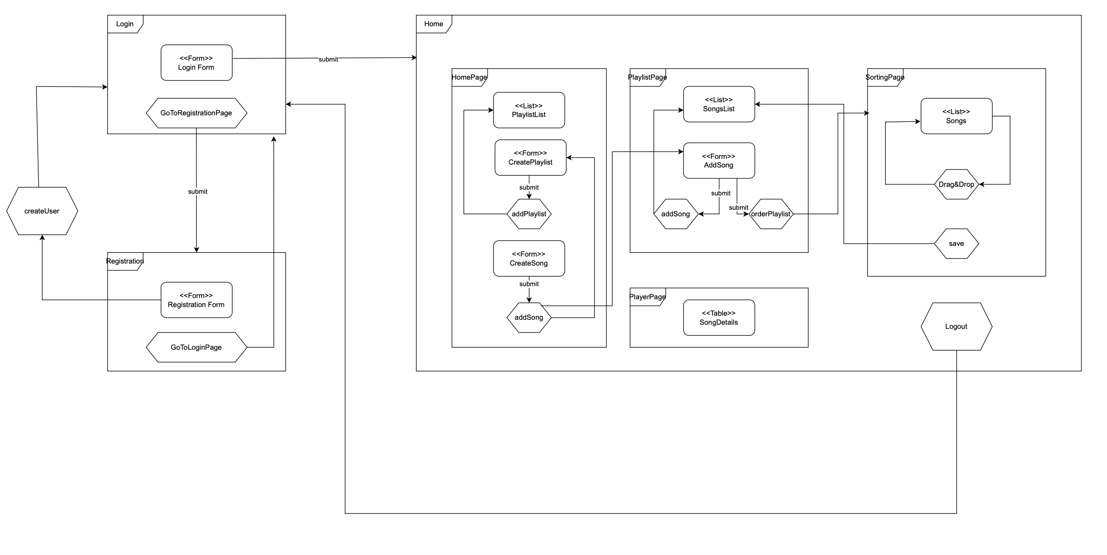
Application Desing (vv. Fat Client)

Slide 19
Application Design: Model
User.java:
+get/setId
+get/setUsername
+get/setPassword
SongDetails.java:
+get/setID
+get/setSongTitle
+get/setKindOf
+get/setAlbumID
+get/setSongFile
+get/setCreatorID
+get/setImgFile
+get/setAlbumTitle
+get/setSInger
+get/setPublicationYear
Playlist.java:
+get/setId
+get/setTitle
+get/setCreationDate

Slide 20
Application Design: View
Web Pages:
home.html
login.html
registration.html

Slide 21
Application Design: Controller (Server Side)
Controllers:
AddSong.java
AddSorting.java
CheckLogin.java
CreatePlaylist.java
CreateSong.java
GetPlaylistList.java
GetSongDetails.java
GetSongsInPlaylist.java
GetSongsNotInPlaylist.java
GetUserSongs.java
Logout.java
Registration.java

Slide 22
Application Design: Controller (Client Side)
Controllers:
playlistManager.js
addSong.js
changePlaylistOrder.js
confirmNewSorting.js
createPlaylist.js
createSong.js
d&dSorting.js
login.js
registration.js
utils.js

Slide 23
Application Design: DAO
SongDAO.java:
+findAlbumId
+createSongAndAlbum
+createAlbum
+getAlbum
-createSong_private
+createSong
+getSongTitleAndImg
+getSongsNotInPlaylist
+findSongByUser
+getSongDetails
+findSongByUser
+findSongByUserId
+getSongByUser
+findImageByUser
+getUserSongs
UserDAO.java:
+findUser
+checkAuthentication
+addUser
PlaylistDAO.java:
+fingUserPlaylists
+findPlaylistByTitle
+createPlaylist
+addSongBefore
+getPlaylistId
+fingPlaylistById
+findPlaylistTitleById
+addSong
+findSongInPlaylist

Slide 24
Events Flow: Thin Client

Slide 25
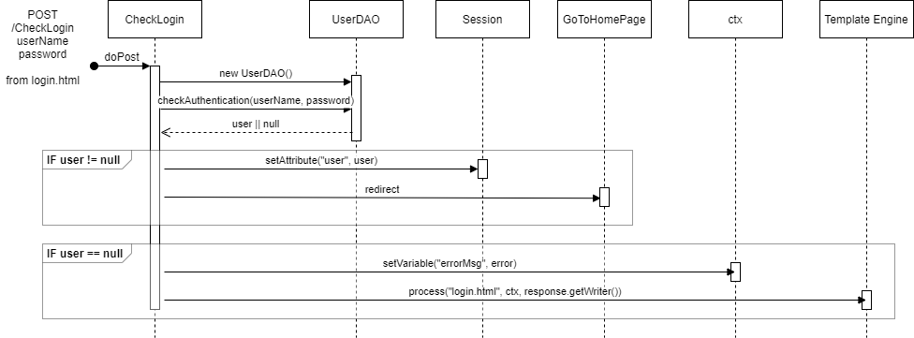
Events: Login

Slide 26
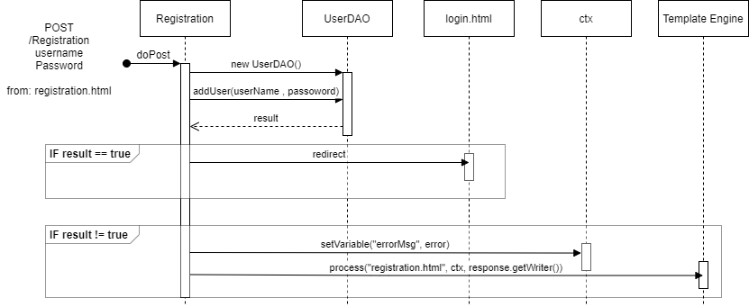
Events: Registration

Slide 27
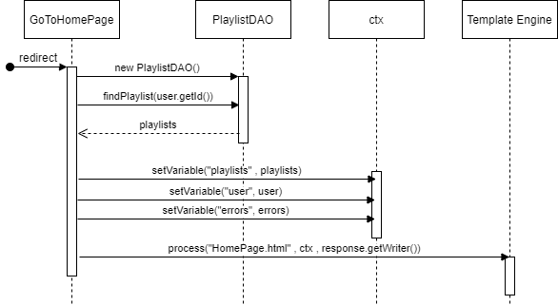
Events: GoToHomePage

Slide 28
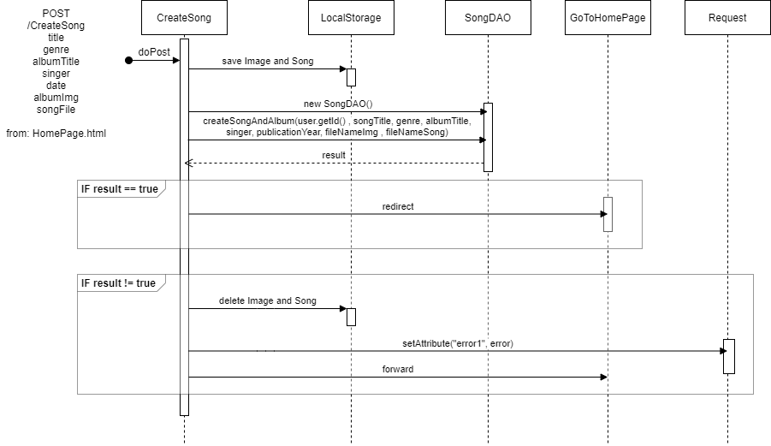
Events: CreateSong

Slide 29
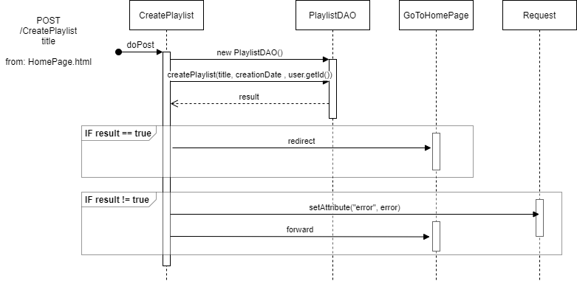
Events: CreatePlaylist

Slide 30
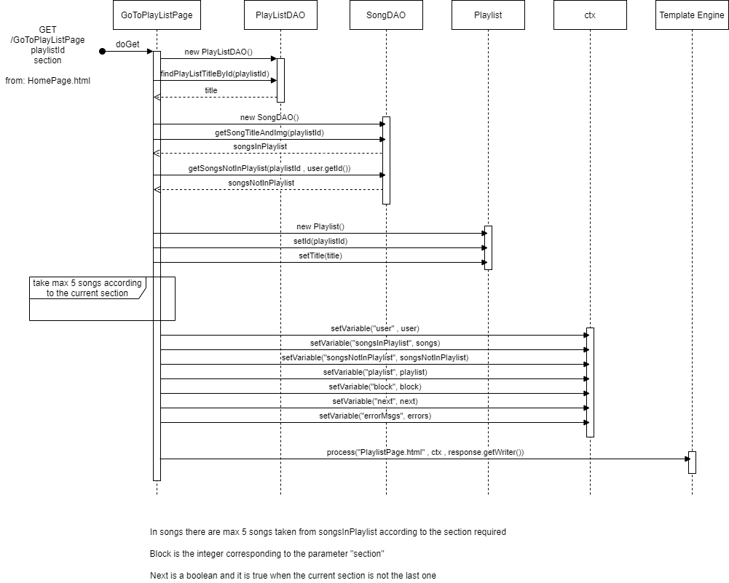
Events: GoToPlaylistPage

Slide 31
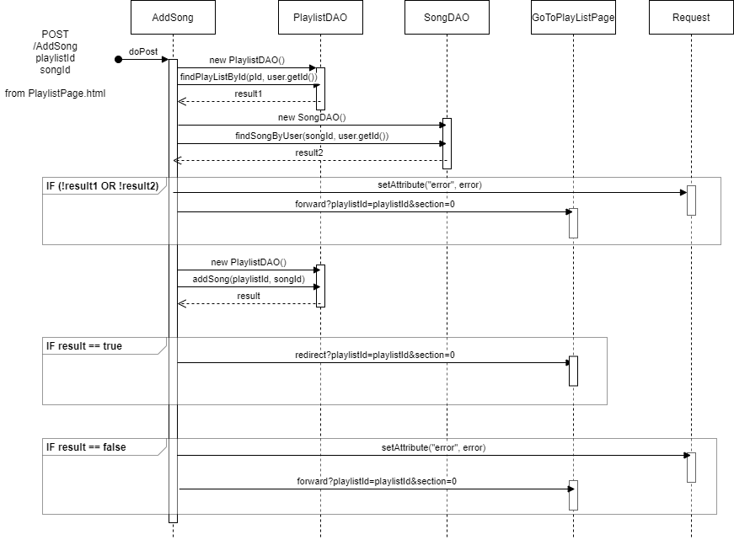
Events: AddSongs

Slide 32
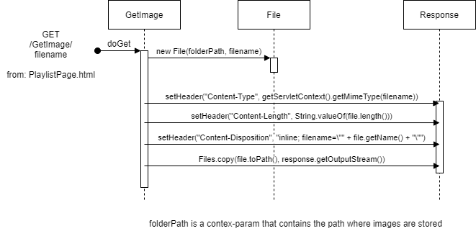
Events: GetImages

Slide 33
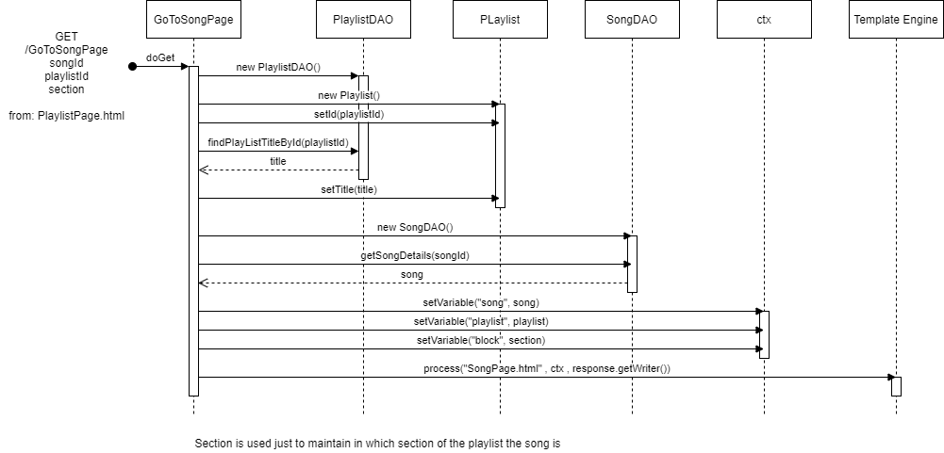
Events: GoToSongPage

Slide 34

Events: GetSongs

Slide 35
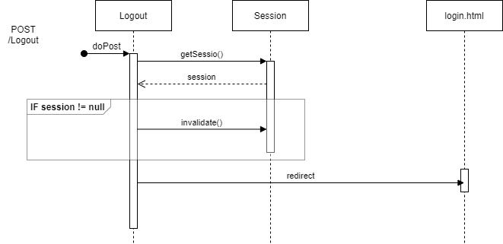
Events: Logout

Slide 36
Events Flow: Fat Client

Slide 37
Events: Login

Slide 38
Events: Registration

Slide 39
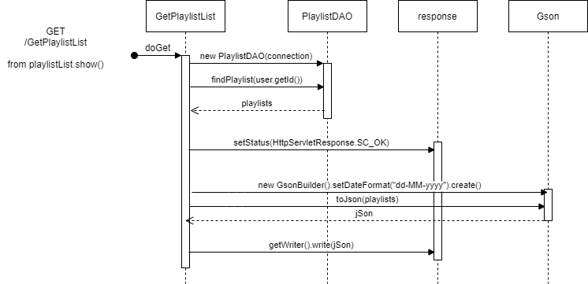
Events: GetPlaylistList

Slide 40
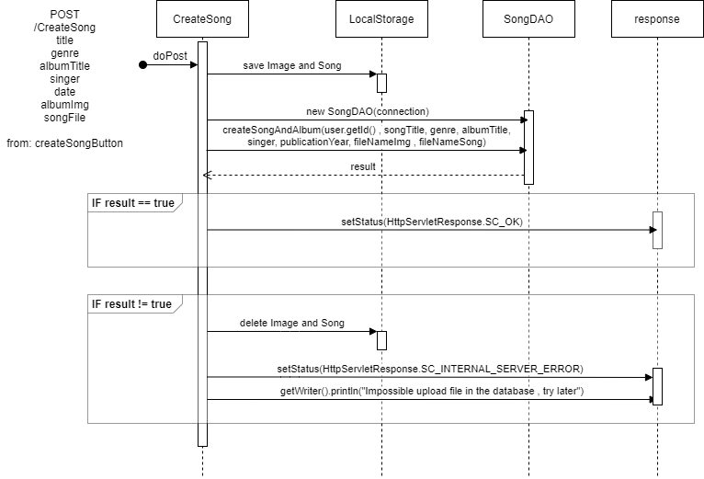
Events: CreateSong

Slide 41
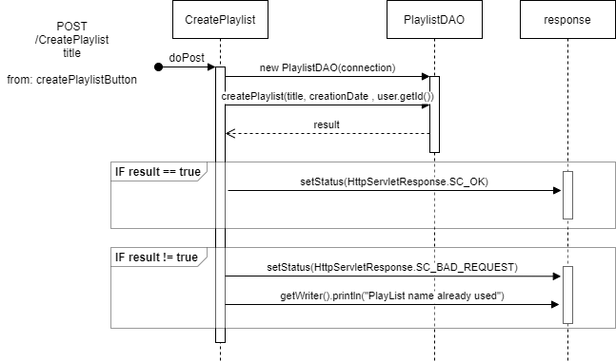
Events: CreatePlaylist

Slide 42
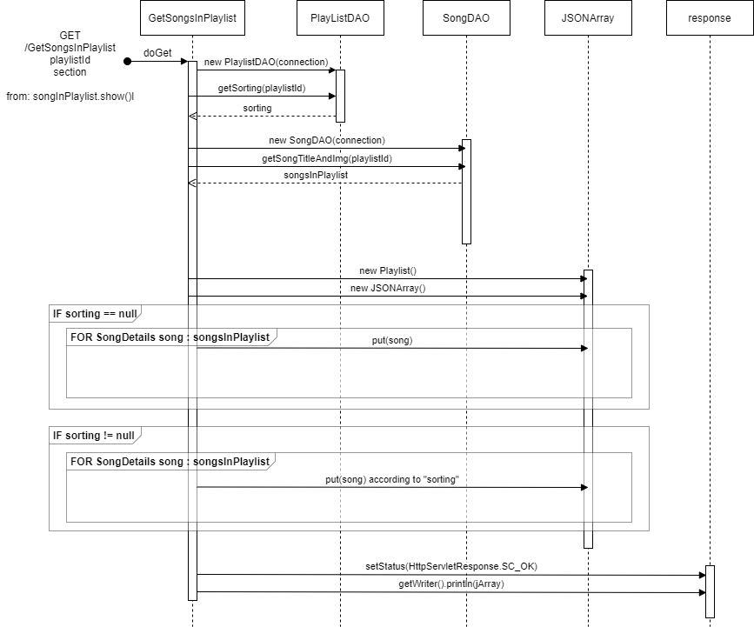
Events: GetSongsInPlaylist

Slide 43
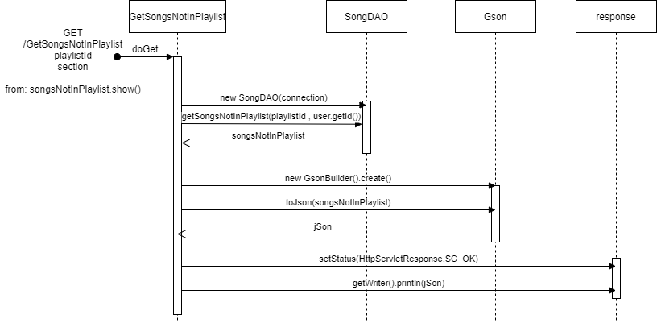
Events: GetSongsNotInPlaylist

Slide 44
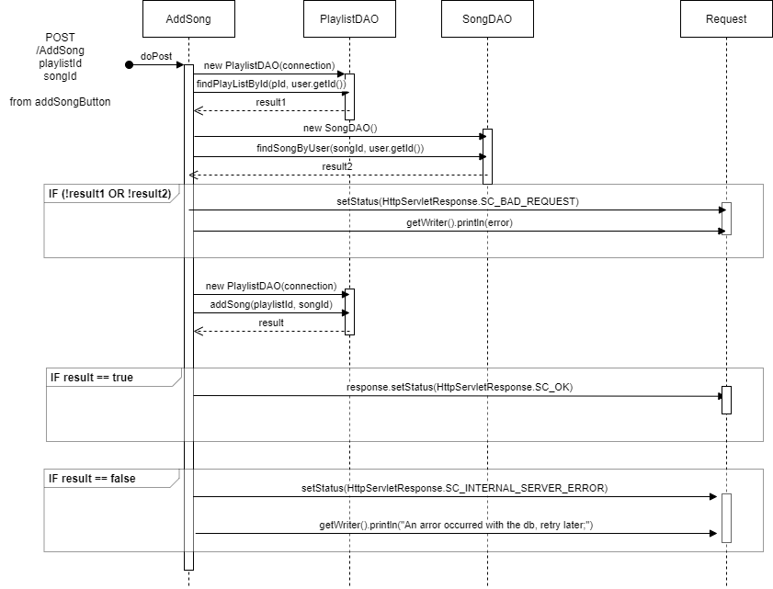
Events: AddSong

Slide 45
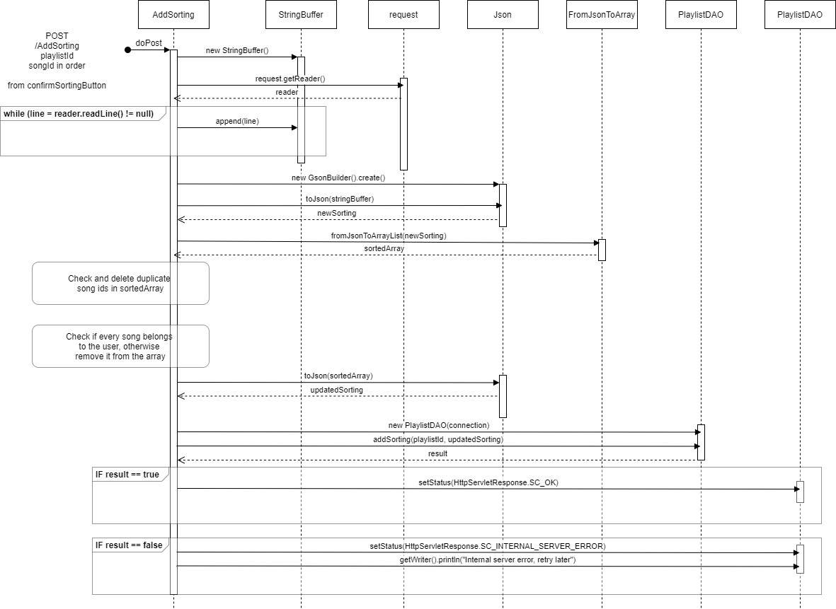
Events: AddSorting

Slide 46
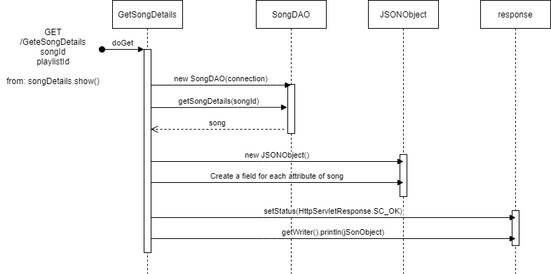
Events: GetSongDetail

Slide 47
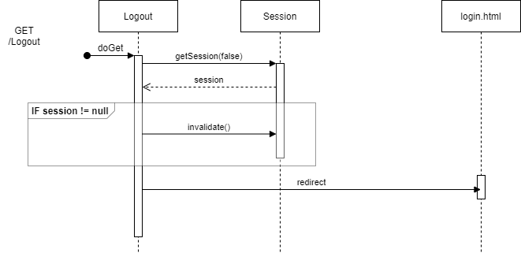
Events: Logout

