Slide 1


Dipartimento di Elettronica, Informazione e Bioingegneria
2025
Unikernel
Milan, 29/08/2025

Slide 2
Unikernel
Unikernel
Analysis of the possibility to map applications and small OS on virtual machine ready for migration/consolidation on edge nodes, when real-time constraints need to be taken into account

Slide 3
Simone Calzolaro
MSc Student
CONTACTS
simone.calzolaro@mail.polimi.it
https://www.deib.polimi.it/eng/home-page

Slide 4
Unikernel
Simone Calzolaro 260121
V1.0
15.03.2022

Slide 5
Introduction
Overview of the main scenarios and related problems

Slide 6
Notes - FAQ
Language: English
Other: include in a zip all the sources of information considered plus the ppt
For each student of the group –at least- 40/50 slides (better more)
Provide general introduction & background, math foundation (if any), standards, techologies, market analysis and current implementation, conclusion with pros 6 cons
Send you candidate work to prof. Fornaciari, receive feedback, provide last version + presentation in one of the designated slots (typ Monday or Friday afternoon)

Slide 7
Cyber-Physical Systems scenario
Virtualization technology consolidates multiple systems as virtual machines (VMs) into the same platform
It allows for:
Cost reduction
Increased efficiency
Enhanced flexibility
Virtualization was initially not designed to cope with strict timing constraints: in CPS like systems timing requirements are as important as functional correctness

Slide 8
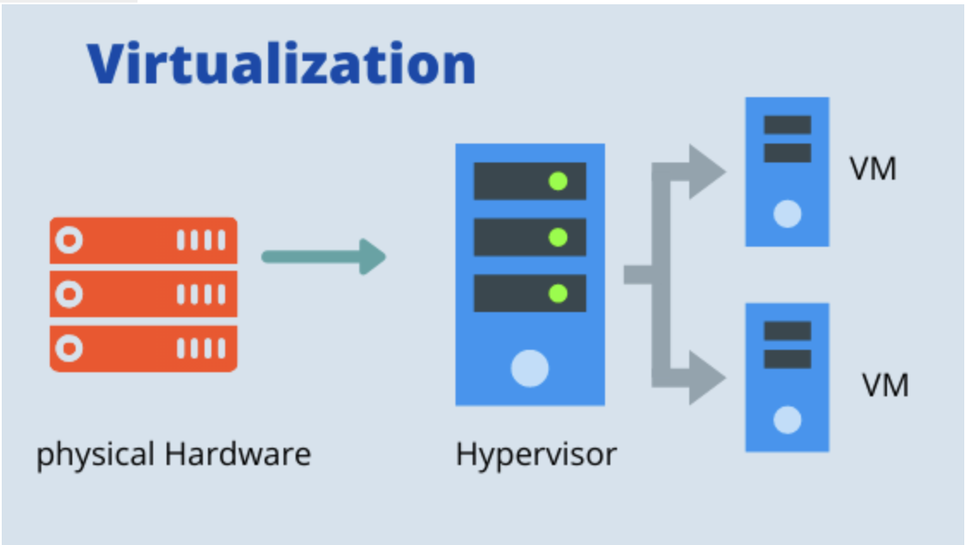
Cyber-Physical Systems scenario
Thus virtualization must be compatible to real-time software stack and satisfy the time constraints by employing hypervisor-level real-time scheduling policies

Slide 9
Cyber-Physical Systems scenario
In data-centers and cloud environments each VM is expected to to host a general purpose operating systems to ease the effort of porting legacy software
Legacy software has a lot of inherent libraries and functionalities
… it can be overkilled in some use cases ☹ …
In fact, most CPS applications are functionally dedicated single purposed, thus not dependent on additional functionalities

Slide 10

Cyber-Physical Systems scenario
Due to the encapsulation of superfluous libraries and the execution of non-essential processes, that are not related to the task of interest, deploying real-time tasks of CPS on a general purpose OS arises various issues:
Resources efficiency
Timing predictability

Slide 11
Embedded Systems scenario
In the era of Big Data, more and more applications of smart devices are computing-intensive
Strong demand for task offloading to cloud data centers
However this gives rise to network delay and privacy data leak issues

Slide 12
Embedded Systems scenario
Edge computing can effectively solve:
Latency
Bandwidth occupation
Data privacy problems
However the deployment of applications are also limited by hardware resources
With the fast development of Internet of Things more and more smart devices are connected to the Internet

Slide 13
Embedded Systems scenario
These devices inevitably produce large amounts of data
Moreover 5G technology can increase network bandwidth and reduce the latency of data transmission
So we face the storage and computing pressure for big data and the geographical limitation of a cloud center
In addition many latency-sensitive applications need milliseconds or even microseconds response time

Slide 14
Title of the slide
Text of the slide
At present it is not clear how
Implementation of the algorithms is envisage only for
1060
1061 A/B
Implementation will be first done for 1060 devices
No significant constraints w.r.t. code size, data size, processing time
Example of table | Count
1059 | 11529
1059 | 6359
1059A/B | 50457
First | 144036
Second | 212443
Other | 11780
Total | 436604

