Slide 1


Meet Project K
Simone Chiaretta
@simonech
http://codeclimber.net.nz

Slide 2
Meet ASP.NET vNext
Simone Chiaretta
@simonech
http://codeclimber.net.nz

Slide 3
Meet ASP.NET 5
Simone Chiaretta
@simonech
http://codeclimber.net.nz

Slide 4

Meet ASP.NET Core
Simone Chiaretta
@simonech
http://codeclimber.net.nz

Slide 5
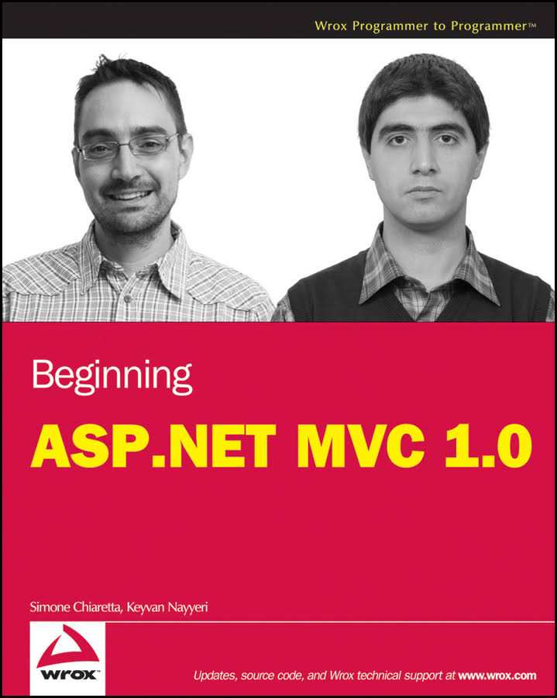
Simone Chiaretta
Umbracian since 2010
Web Developer since 1996
Beginner Triathlete
http://codeclimber.net.nz

Slide 6
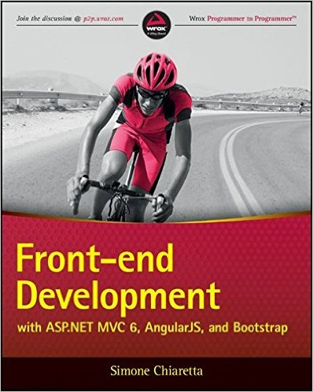
Front-end Development with ASP.NET MVC 6, AngularJS, and Bootstrap

Slide 7
Front-end Development with ASP.NET Core 1 MVC 6, AngularJS, and Bootstrap

Slide 8
Agenda
What’s ASP.NET Core
Getting started with ASP.NET Core
Anatomy of an ASP.NET Core app
Servers
Cross Platform Console Application
dotnet-cli
Project.json

Slide 9
What’s ASP.NET Core
Web Forms
MVC 5
Web Forms
MVC 5
ASP.NET MVC 6
ASP.NET Core MVC
ASP.NET 4.6
ASP.NET Core
.NET Framework 4.6
.NET Core
Windows
Mac
Linux

Slide 10
Getting started the easy way
Install Visual Studio 2015 (any edition) (Win), or install Visual Studio Code (Win, Mac, Linux)
Install ASP.NET Core (Win, Mac, Linux)
http://dot.net

Slide 11
Anatomy of ASP.NET Core app
Inspired by OWIN
Startup
Configure
Middleware
Services

Slide 12

OWIN Succinctly
Open Web Interface for .NET
https://www.syncfusion.com/resources/techportal/details/ebooks/owin

Slide 13
ASP.NET Core app

Slide 14
ASP.NET Core Servers
IIS: runs ASP.NET Core on top of IIS
Kestrel: Cross-Platform web server based on Libuv

Slide 15
Console Application

Slide 16
donet-cli
dotnet new – new project
dotnet restore – restore packages
dotnet run – compiles and runs
dotnet build – compiles as IL
dotnet build – compiles as native app (with correct config)

Slide 17
Project.json
{
"version": "1.0.0-*",
"author": "Simone Chiaretta“,
"dependencies": {
"Microsoft.NETCore.App": {
"version": "1.0.0-rc2-3002702",
"type": "platform"
},
"Microsoft.AspNet.Diagnostics": "1.0.0-rc2-final",
"Microsoft.AspNet.IISPlatformHandler": "1.0.0-rc2-final",
...,
"Microsoft.VisualStudio.Web.BrowserLink.Loader": "14.0.0-rc2-final"
},
"frameworks": {
"netcoreapp1.0": {
"imports": [
"dotnet5.6",
"dnxcore50",
"portable-net45+win8"
]
}
},
"commands": {
"web": "Microsoft.AspNet.Server.Kestrel"
},
"compilationOptions": {
"emitEntryPoint": true
},
"exclude": [
"wwwroot",
"node_modules"
],
"publishExclude": [
"**.user",
"**.vspscc"
],
"scripts": {
"prepublish": [ "npm install", "bower install", "gulp clean", "gulp min" ]
}
}
Metadata
Dependencies
Frameworks
Commands
Configuration
Source files
Scripts

Slide 18
State of play
Framework is RC2
Tooling is Preview 1 (basically an alpha)
Will RTM end of June (probably during July)
Tooling will be Preview 2
Tooling will RTM with Visual Studio v15 (… 2017?)

Slide 19
What you’ve learned
What is ASP.NET Core
The command line tools
How to make:
a command line application
An ASP.NET Core application

Slide 20
Contacts
Simone Chiaretta
@simonech
http://codeclimber.net.nz

