Slide 1



Stadio – Città – Paese
GG MESE ANNO – HH:MM
Serie A 2026/27 – X° giornata
VS
SQUADRA

Slide 2


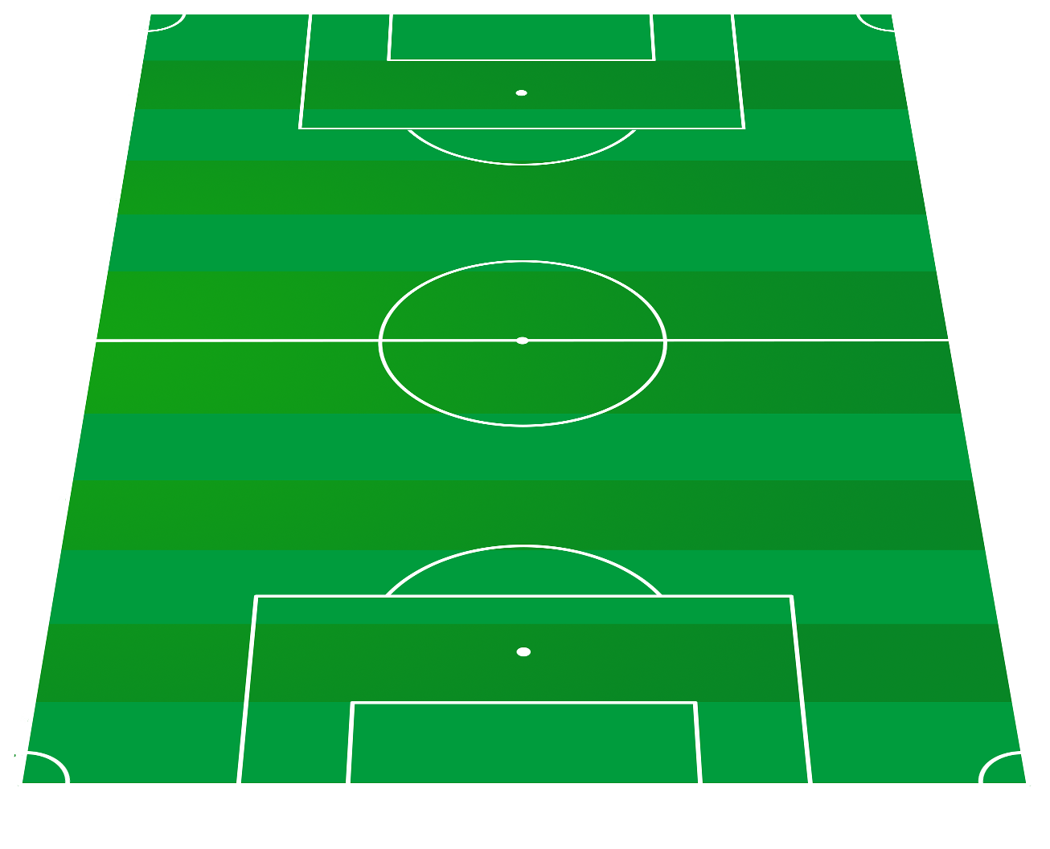

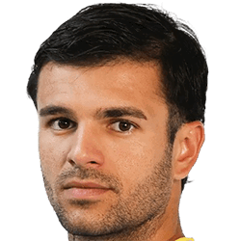









SQUADRA
SISTEMA DI GIOCO 3-5-2
COACH Nome Cognome
1
D
GK1
2
S
GK2
3
D
GK3
4
D
RCB1 184 Cm
7
D
D
CB1 185 Cm
10
LCB1 188 Cm
5
D
D
11
S
RCB2 184 Cm
8
LCB2 182 Cm
CB2 194 Cm
D
D
12
D
6
LCB3 194 Cm
RCB3 184 Cm
9
CB3 194 Cm
16
S
13
D
LFB1 183 Cm
RFB1 178 Cm
17
S
14
D
LFB2 176 Cm
RFB2 183 Cm
19
D
CM1 182 Cm
18
D
15
D
LFB3 185 Cm
RFB3 185 Cm
20
D
CM2 173 Cm
21
D
23
D
CM3 185 Cm
D
RCM1 186 Cm
27
LCM1 172 Cm
22
D
24
D
CM4 185 Cm
28
S
RCM2 181 Cm
LCM2 177 Cm
25
D
29
D
RCM3 185 Cm
LCM3 186 Cm
26
D
30
D
RCM4 185 Cm
LCM4 186 Cm
D
34
D
31
ST1B 185 Cm
ST1 186 Cm
D
35
S
32
ST2B 184 Cm
ST2 179 Cm
D
36
S
33
ST3B 184 Cm
ST3 176 Cm

Slide 3
SQUADRA
SISTEMA DI GIOCO 3-4-3
COACH Nome Cognome
1
D
GK1
2
S
GK2
3
D
GK3
4
D
RCB1 184 Cm
7
D
D
CB1 185 Cm
10
LCB1 188 Cm
5
D
D
11
S
RCB2 184 Cm
8
LCB2 182 Cm
CB2 194 Cm
D
D
12
D
6
LCB3 194 Cm
RCB3 184 Cm
9
CB3 194 Cm
D
16
S
D
23
D
LFB1 183 Cm
13
RCM1 186 Cm
RFB1 178 Cm
27
LCM1 172 Cm
17
S
14
D
24
D
28
S
LFB2 176 Cm
RFB2 183 Cm
RCM2 181 Cm
LCM2 177 Cm
18
D
D
25
D
29
D
LFB3 185 Cm
15
RCM3 185 Cm
LCM3 186 Cm
RFB3 185 Cm
26
D
30
D
RCM4 185 Cm
LCM4 186 Cm
34
D
34
D
RW1 185 Cm
LW1 185 Cm
35
S
35
S
RW2 184 Cm
31
D
LW2 184 Cm
36
S
ST1 186 Cm
36
S
RW3 184 Cm
32
D
LW3 184 Cm
ST2 179 Cm
33
D
ST3 176 Cm

Slide 4
SQUADRA
SISTEMA DI GIOCO 3-4-2-1
COACH Nome Cognome
1
D
GK1
2
S
GK2
3
D
GK3
4
D
RCB1 184 Cm
7
D
D
CB1 185 Cm
10
LCB1 188 Cm
5
D
D
11
S
RCB2 184 Cm
8
LCB2 182 Cm
CB2 194 Cm
D
D
12
D
6
LCB3 194 Cm
RCB3 184 Cm
9
CB3 194 Cm
D
16
S
D
23
D
LFB1 183 Cm
13
RCM1 186 Cm
RFB1 178 Cm
27
LCM1 172 Cm
17
S
14
D
24
D
28
S
LFB2 176 Cm
RFB2 183 Cm
RCM2 181 Cm
LCM2 177 Cm
18
D
D
25
D
29
D
LFB3 185 Cm
15
RCM3 185 Cm
LCM3 186 Cm
RFB3 185 Cm
26
D
30
D
RCM4 185 Cm
LCM4 186 Cm
34
D
RW1 185 Cm
34
D
LW1 185 Cm
35
S
S
RW2 184 Cm
35
LW2 184 Cm
36
S
S
RW3 184 Cm
36
31
D
LW3 184 Cm
ST1 186 Cm
32
D
ST2 179 Cm
33
D
ST3 176 Cm

Slide 5
SQUADRA
SISTEMA DI GIOCO 4-4-2
COACH Nome Cognome
1
D
GK1
2
S
GK2
3
D
GK3
16
S
13
D
D
D
LFB1 183 Cm
RFB1 178 Cm
10
4
LCB1 188 Cm
RCB1 184 Cm
D
11
S
17
S
D
5
LCB2 182 Cm
LFB2 176 Cm
14
RCB2 184 Cm
RFB2 183 Cm
12
D
D
D
LCB3 194 Cm
18
6
LFB3 185 Cm
15
D
RCB3 184 Cm
RFB3 185 Cm
23
D
D
RCM1 186 Cm
27
LCM1 172 Cm
24
D
28
S
34
D
RCM2 181 Cm
LCM2 177 Cm
34
D
RW1 185 Cm
LW1 185 Cm
25
D
29
D
35
S
RCM3 185 Cm
LCM3 186 Cm
35
S
RW2 184 Cm
LW2 184 Cm
26
D
30
D
36
S
RCM4 185 Cm
LCM4 186 Cm
36
S
RW3 184 Cm
LW3 184 Cm
D
34
D
31
ST1B 185 Cm
ST1 186 Cm
D
35
S
32
ST2B 184 Cm
ST2 179 Cm
D
36
S
33
ST3B 184 Cm
ST3 176 Cm

Slide 6
SQUADRA
SISTEMA DI GIOCO 4-3-3
COACH Nome Cognome
1
D
GK1
2
S
GK2
3
D
GK3
16
S
13
D
D
D
LFB1 183 Cm
RFB1 178 Cm
10
4
LCB1 188 Cm
RCB1 184 Cm
D
11
S
17
S
D
5
LCB2 182 Cm
LFB2 176 Cm
14
RCB2 184 Cm
RFB2 183 Cm
12
D
D
D
LCB3 194 Cm
18
6
LFB3 185 Cm
15
D
RCB3 184 Cm
RFB3 185 Cm
19
D
CM1 182 Cm
23
D
D
RCM1 186 Cm
27
20
D
LCM1 172 Cm
CM2 173 Cm
24
D
28
S
RCM2 181 Cm
21
D
LCM2 177 Cm
CM3 185 Cm
25
D
29
D
RCM3 185 Cm
22
D
LCM3 186 Cm
CM4 185 Cm
26
D
30
D
RCM4 185 Cm
LCM4 186 Cm
34
D
34
D
RW1 185 Cm
LW1 185 Cm
35
S
35
S
RW2 184 Cm
31
D
LW2 184 Cm
36
S
ST1 186 Cm
36
S
RW3 184 Cm
32
D
LW3 184 Cm
ST2 179 Cm
33
D
ST3 176 Cm

Slide 7
SQUADRA
SISTEMA DI GIOCO 4-2-3-1
COACH Nome Cognome
1
D
GK1
2
S
GK2
3
D
GK3
16
S
13
D
D
D
LFB1 183 Cm
RFB1 178 Cm
10
4
LCB1 188 Cm
RCB1 184 Cm
D
11
S
17
S
D
5
LCB2 182 Cm
LFB2 176 Cm
14
RCB2 184 Cm
RFB2 183 Cm
12
D
D
D
LCB3 194 Cm
18
6
LFB3 185 Cm
15
D
RCB3 184 Cm
RFB3 185 Cm
D
27
D
23
LCM1 172 Cm
RCM1 186 Cm
24
D
28
S
RCM2 181 Cm
LCM2 177 Cm
25
D
29
D
RCM3 185 Cm
LCM3 186 Cm
26
D
30
D
RCM4 185 Cm
LCM4 186 Cm
34
D
ST1B 185 Cm
34
D
34
D
RW1 185 Cm
35
S
LW1 185 Cm
ST2B 184 Cm
35
S
35
S
RW2 184 Cm
36
S
LW2 184 Cm
ST3B 184 Cm
36
S
36
S
RW3 184 Cm
LW3 184 Cm
31
D
ST1 186 Cm
32
D
ST2 179 Cm
33
D
ST3 176 Cm

Slide 8
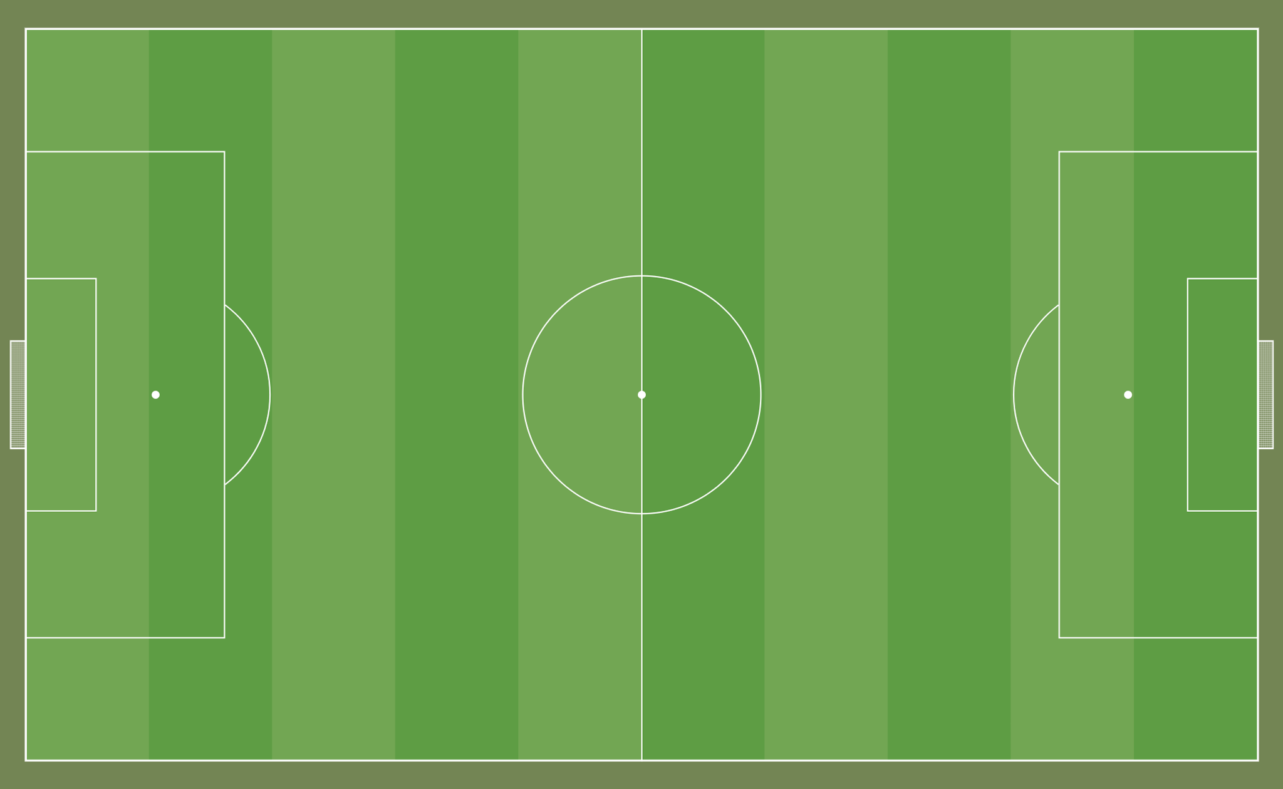
Rfb1
13
Rcb1
TER S
4
3
ALA S
11
DC S
CEN S
Rcm1
St1
6
31
4
23
Cm1
Gk1
POR
TREQ.
19
ATT
Cb1
1
9
1
10
⚽️
7
DC D
CEN D
St1b
5
34
8
Lcm1
27
ALA D
Lcb1
TER D
7
10
2
Lfb1
Pressing
16

