Slide 1
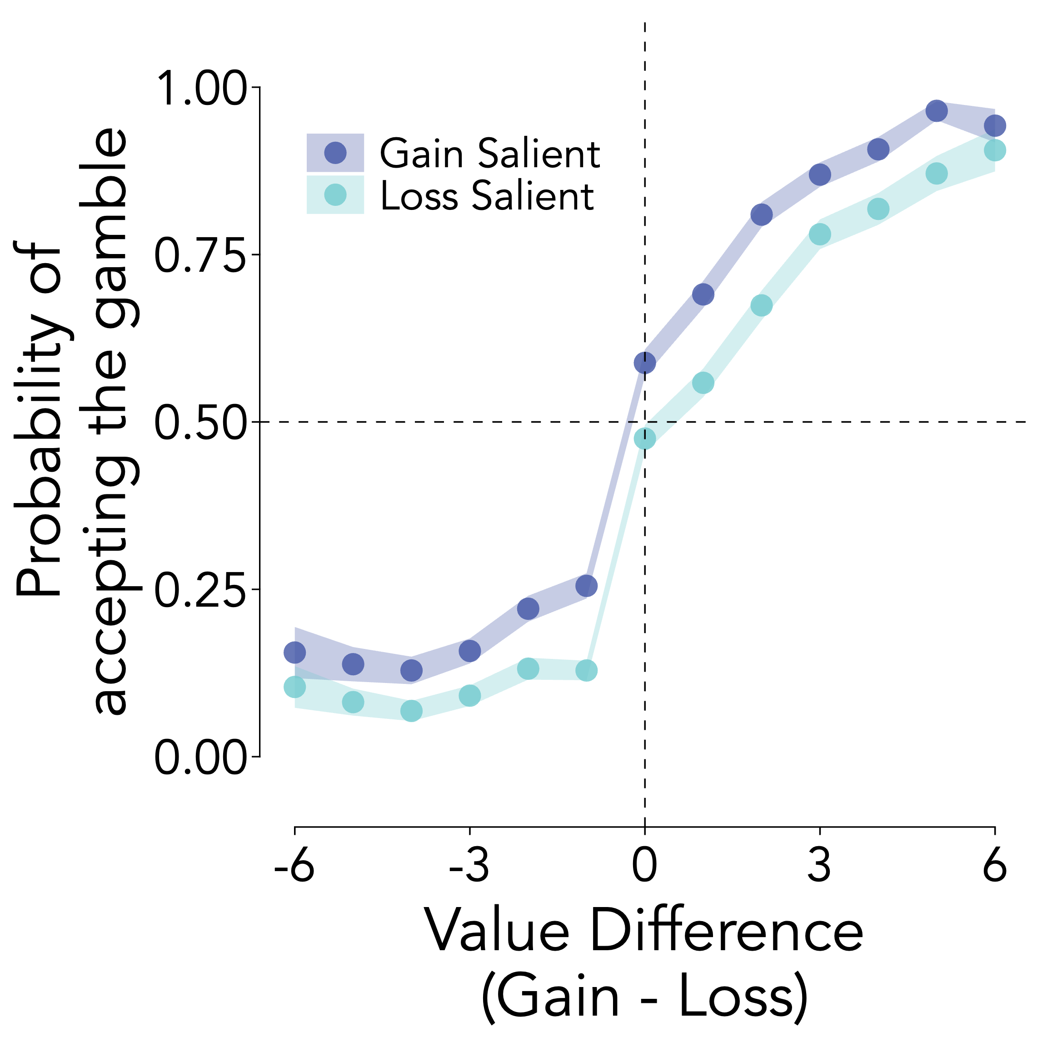
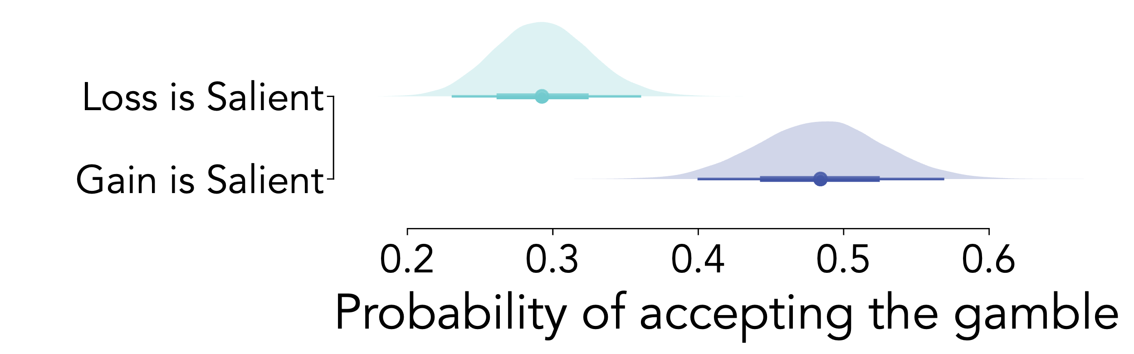
A
B
Gain is Salient
+7
-5
+
Web-based
eye-tracking
+7
-5
C
Loss is Salient
2 – 4 seconds
Until choice

