Slide 1

Analysis and development of a
prompt engineering ontology
Graduating
Simone Gramegna
Advisor
Prof. Claudia d’Amato
Co-advisors
Dr. Roberto Barile
Dr. Andrea Nuzzolese
1/20

Slide 2
What is the context?
2/20

Slide 3

Context
LLMs are advanced AI models, capable of executing different tasks
Most popular LLMs: GPT, Gemini, Mistral and DeepSeek
Prompt engineering involves design and optimization of prompts, producing the best possible response from an LLM
Different prompting techniques have been developed
Main issue
Fragmented resources on prompt engineering and LLMs
Solution: a resource providing a complete perspective
3/20

Slide 4
Prompt Engineering Ontology
Prompt Engineering Ontology (PEO): new resource for prompt engineering and LLMs
PEO represents widely used concepts
Linked Open Terms (LOT) methodology used in the development
PEO is encoded in OWL
PEO is available on Github, W3id and Bioportal
Compliance with FAIR principles in Open science
https://github.com/simonegramegna/peo
http://w3id.org/peo
https://bioportal.bioontology.org/ontologies/PEO_ONTOLOGY?p=summary
4/20

Slide 5
Does PEO provide comprehensive and consistent knowledge on LLMs and prompt engineering?
Can we use PEO to infer additional knowledge?
5/20

Slide 6
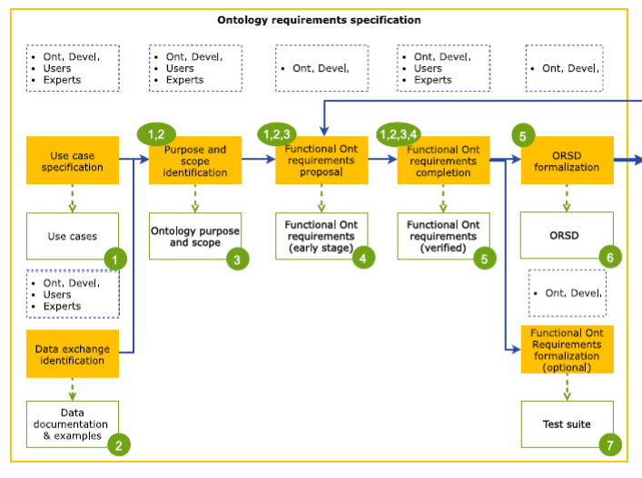
Design
10 use cases defined
10 data sources (papers, websites, repositories) identified
Scope and purpose specification
16 competency questions created
3 non functional requirements identified
What is the output?
Ontology Requirements Specification Document (ORSD)
Ontology requirements specification workflow
6/20

Slide 7
Competency questions
What is prompt engineering?
What is a prompt?
What are prompting techniques?
What are image prompting techniques?
What are code prompting techniques?
Which task does a prompt solve?
Which prompts are generated using a prompting technique?
What are the responses that follow each prompt?
What are possible tasks?
Which tasks are related to the text?
What is a chat?
What is a large language model?
What types of large language models are available?
What are large language models architectures?
What are large language models capabilities?
What companies develop large language models?
Competency questions (CQs) define an ontology from its functional perspective
CQs cover main concepts in the ontology
Good set of CQs responds to user’s real questions
Definition of a conceptual scheme starting from CQs
CQs will be employed during the evaluation
7/20

Slide 8
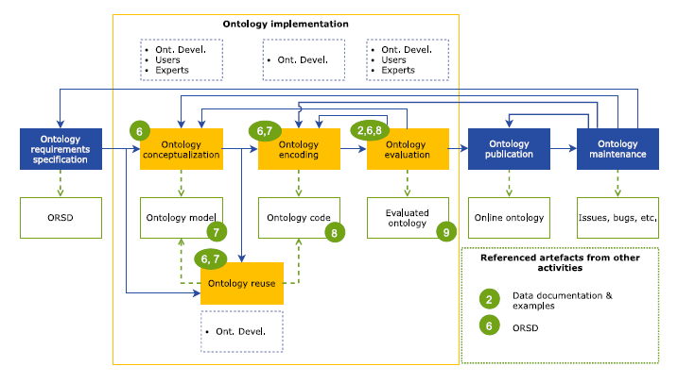
Conceptualization
Conceptualization phase:
Exploration of possible reusable ontologies
Definition of entities and relations
Application of ontology design patterns
Ontology design patterns adopted
Description pattern
Sequence pattern
Task execution pattern
Ontology implementation workflow
8/20

Slide 9
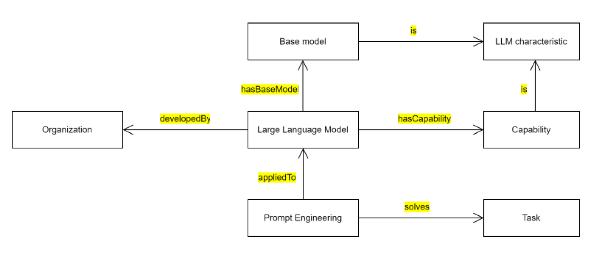
Main concepts
9/20

Slide 10

Implementation
Implementation of the defined scheme
Protegé editor
Definition of every class, object property and data property
Inference rules (SWRL rules), inferring relations between instances
Documentation using OWLDoc
What is the output?
PEO encoded in OWL
10/20

Slide 11
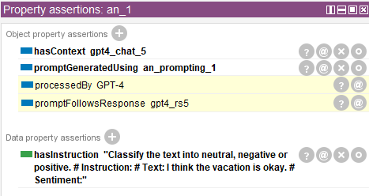
Entities population
Instances creation of Large Language Model and Prompting technique classes
Prompting techniques population: zero-shot prompting, few-shot prompting, emotion prompting, role prompting and analogical prompting
Connection with other entities
Ontology population using GPT-4
Prompt individual with object properties and data properties
Extends the original ontology
Input: competency questions and PEO
Output: new version of PEO
11/20

Slide 12
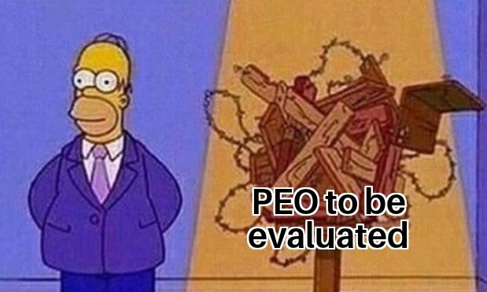
Evaluation setting
Evaluation on four dimensions, ensuring PEO quality.
Ontology consistency check
Standard metrics
Static validation
CQs addressing
What is the target?
PEO evaluation
12/20

Slide 13
Consistency and metrics
Ontology consistency check
HermiT reasoner execution
No inconsistencies found
http://www.hermit-reasoner.com/
https://ontometrics.informatik.uni-rostock.de/ontologymetrics/
OntoMetrics
Base metrics: count elements like classes, properties, and individuals
Schema metrics: evaluate schema structure and hierarchy
Knowledge base metrics: measure knowledge density and quality
Class metrics: analyze class connectivity and detail
Graph metrics: assess graph connectivity and centrality
13/20

Slide 14
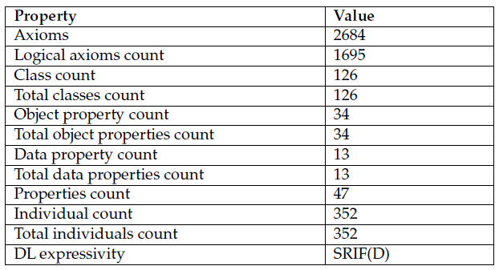
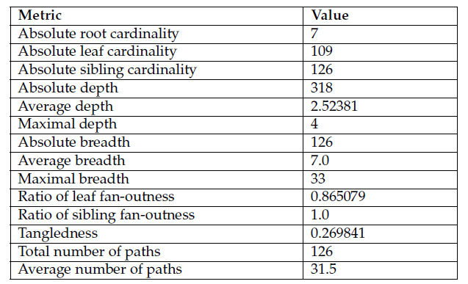
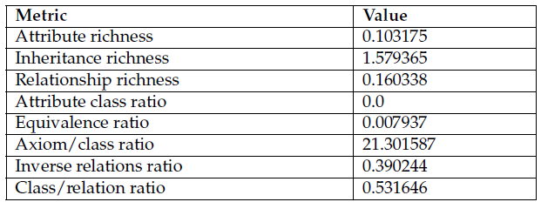
Metrics
14/20

Slide 15
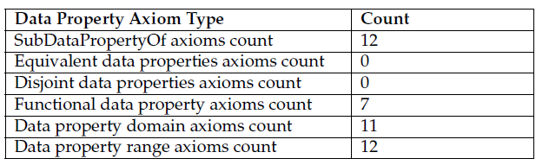
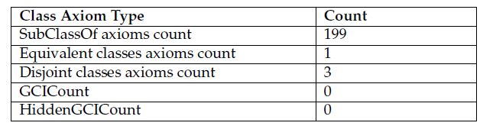
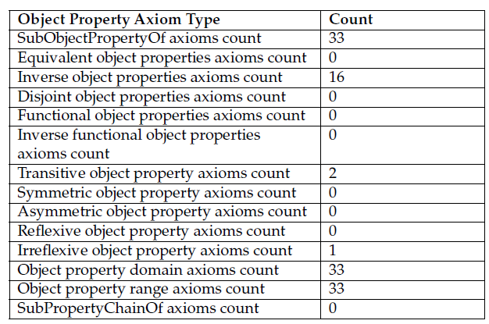
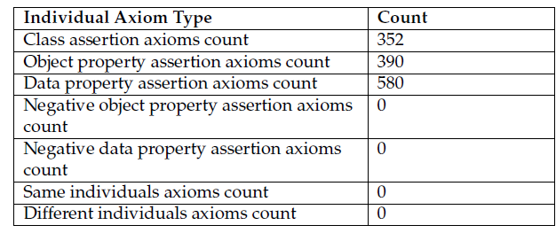
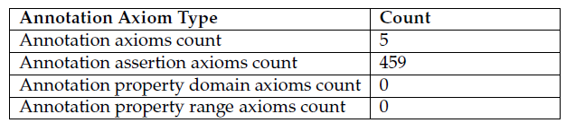
Metrics
15/20

Slide 16
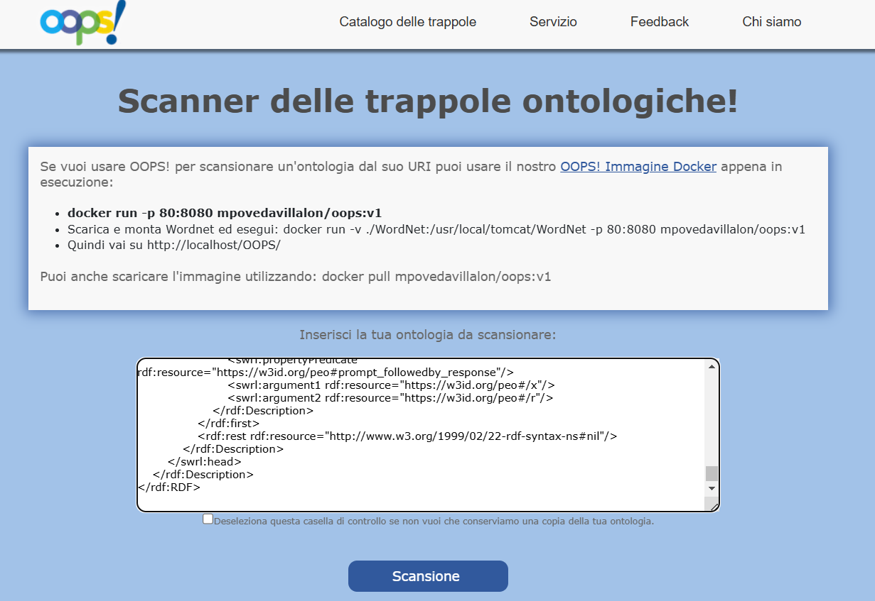
OOPS! validation
Three pitfalls found in PEO:
P04: Unconnected ontology elements
P34: Untyped class
P41: No license declared
OOPS! Pitfalls resolution
P04: connected unconnected classes
P34: Substituted SWRL rules with property chains
P41: Declared license (CC-BY-4.0)
OOPS! main page
16/20

Slide 17
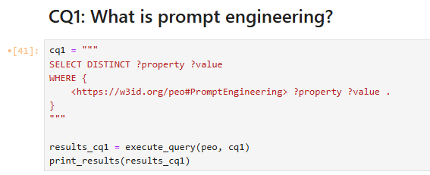
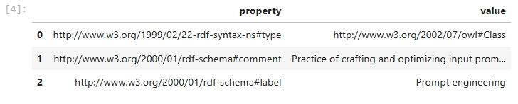
SPARQL queries
Translation of the 16 competency questions into SPARQL queries used as unit test
State-of-art approach to verify whether PEO meets the requirements
Goal: check whether PEO contains the expected content
Execution of SPARQL queries using python and jupyter notebook
Comparison of the output of each SPARQL query with the expected result
CQ1 SPARQL query
CQ1 SPARQL query result
17/20

Slide 18
Research questions
Does PEO provide comprehensive and consistent knowledge on LLMs and prompt engineering?
Yes, PEO formalizes key concepts, relationships and applications of LLMs, prompting techniques and related concepts in a structured ontology.
Can we use PEO to infer additional knowledge?
Yes, PEO allows inferring additional knowledge by reasoning over LLMs and their connections with prompts and prompt engineering techniques.
18/20

Slide 19
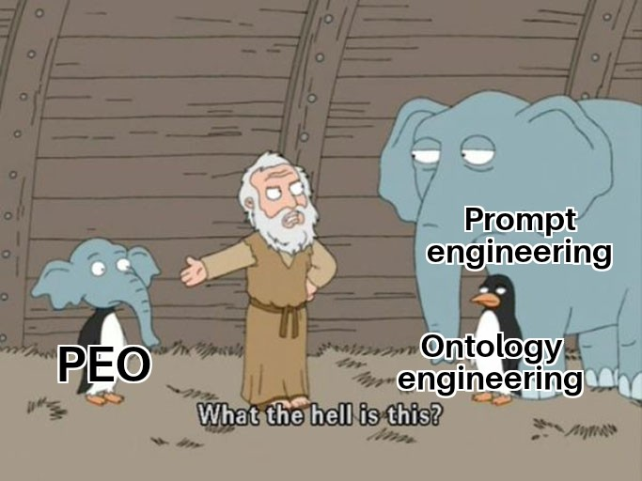
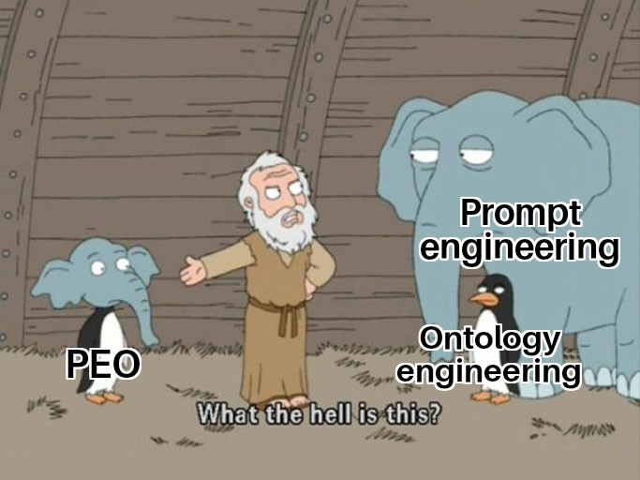
Conclusions
PEO conceptualizes LLMs and prompt engineering
The conceptualization is machine-processable
Future developments
PEO-based AI agent
Automatic population using LLMs
Integration with external ontologies
PEO ontology web application
19/20

Slide 20
Thanks for the attention!
Simone Gramegna
20/20

Slide 21


