Slide 1

Malicious URL detection using
machine Learning techniques
with Apache Spark
Students
Simone Gramegna
Lecturer
Prof. Michelangelo Ceci
Course
Big data

Slide 2
What is a URL?
2/34

Slide 3

What is a URL?
A URL (Uniform Resource Locator) is the address of a given resource on the web (HTML page, CSS document, image ecc..).
Potential web risks
Spreading malware
Phishing
Personal data theft
Redirection to malicious websites
Spread of harmful content
Online scams
3/34

Slide 4
What is the goal?
4/34

Slide 5
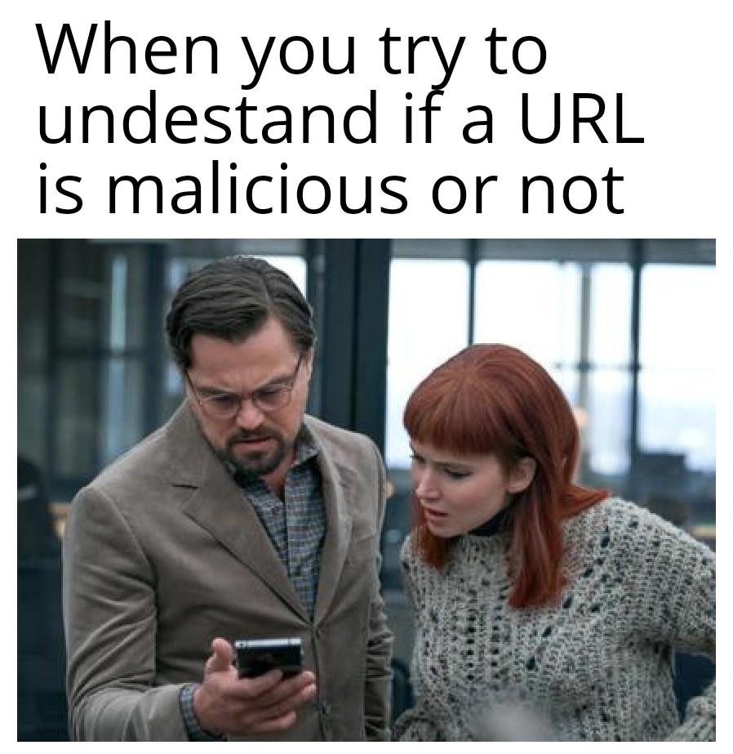
What is the goal?
The goal of this case study is to use machine learning and deep learning techniques to detect malicious URLs from features extracted from the URL itself. Common experience suggests we can recognise a potentially malicious url at glance without visiting the associated resource. So, we wanted to transfer this common experience by comparing different machine learning and deep learning algorithms trained on the features obtained from the URLs.
5/34

Slide 6
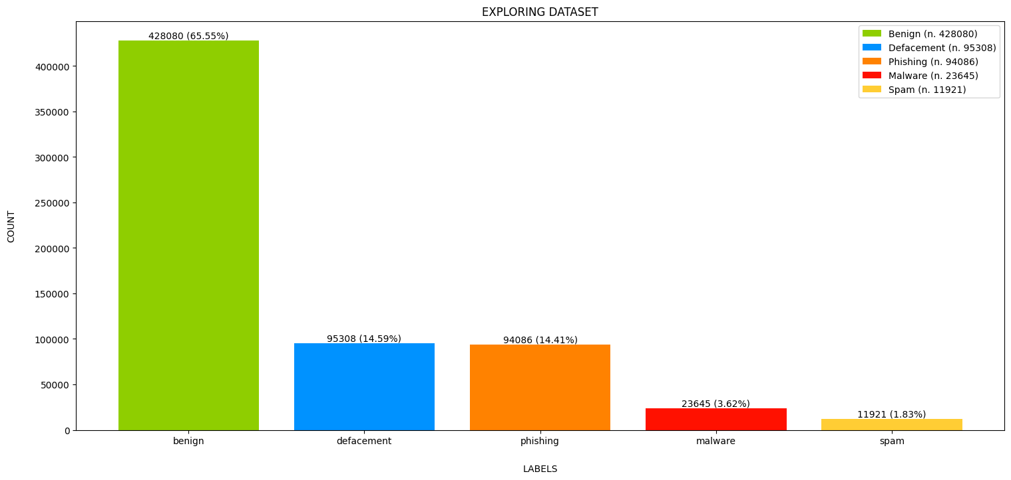
Dataset
The Malicious URLs dataset contains 641.119 URLs divided into to five classes:
Benign (65,55%)
Defacement (14,59%)
Phising (14,41%)
Malware (3,62%)
Spam (1,83%)
6/34

Slide 7
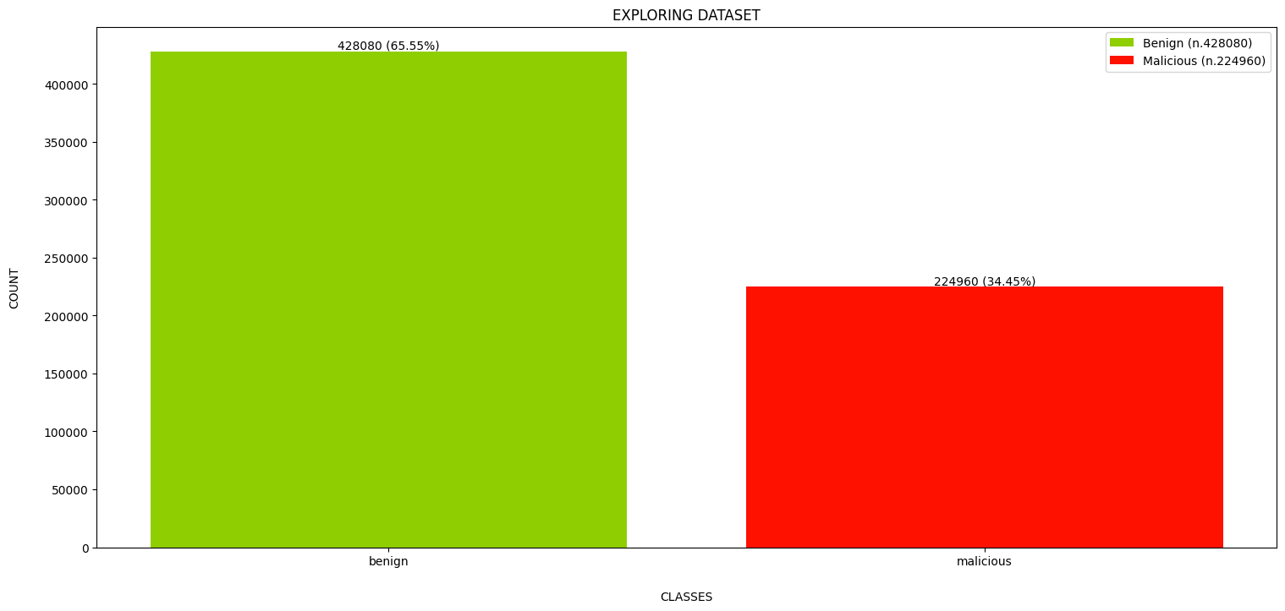
7/34

Slide 8
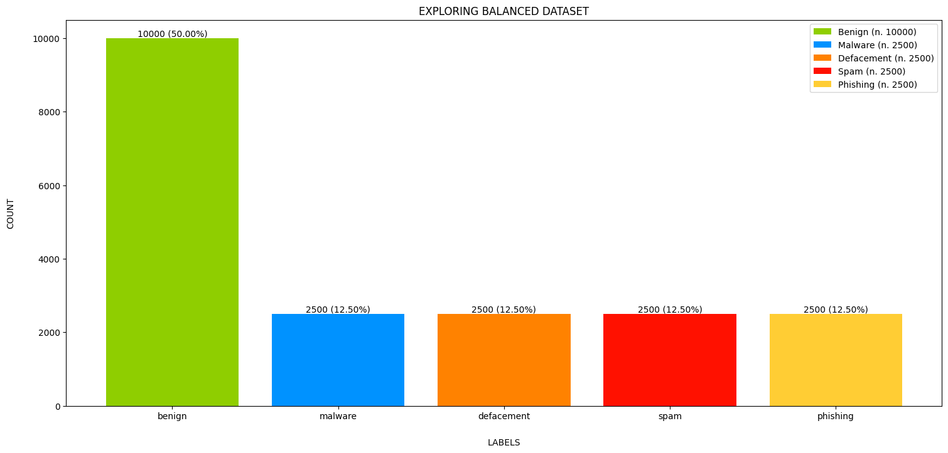
Dataset balancing
By randomly sampling the URLs in the dataset, we obtained a new, more balanced dataset.
Benign (50,00%)
Defacement (12,50%)
Phising (12,50%)
Malware (12,50%)
Spam (12,50%)
8/34

Slide 9
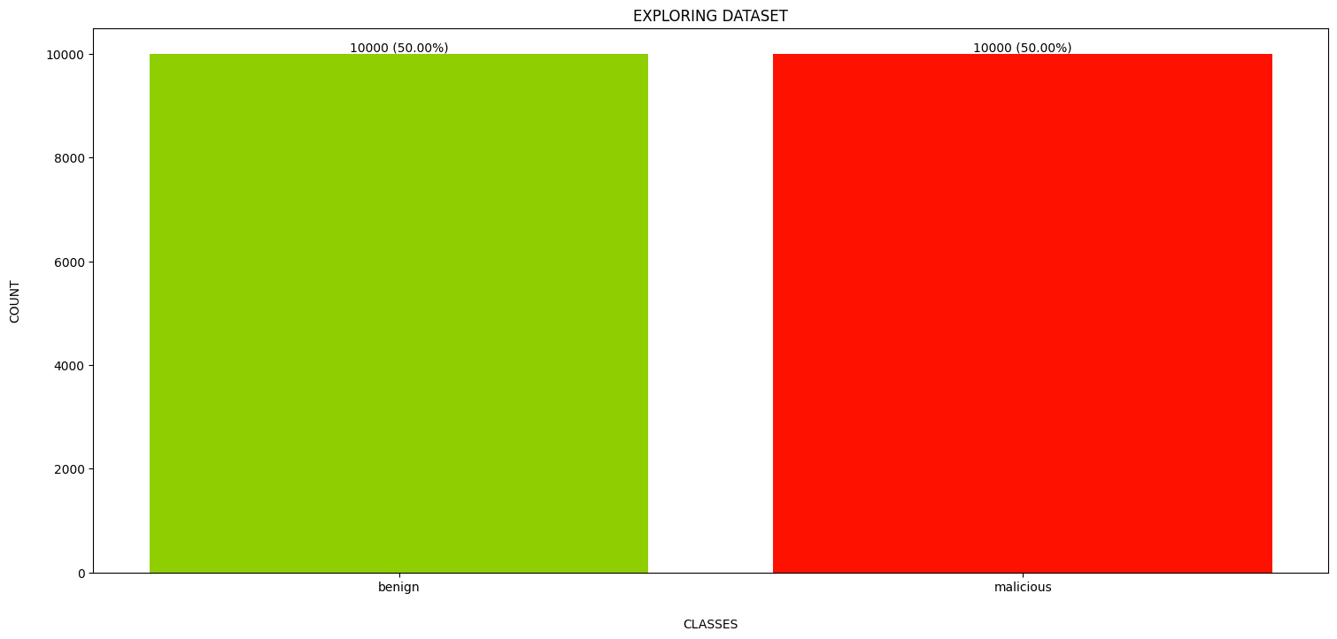
9/34

Slide 10
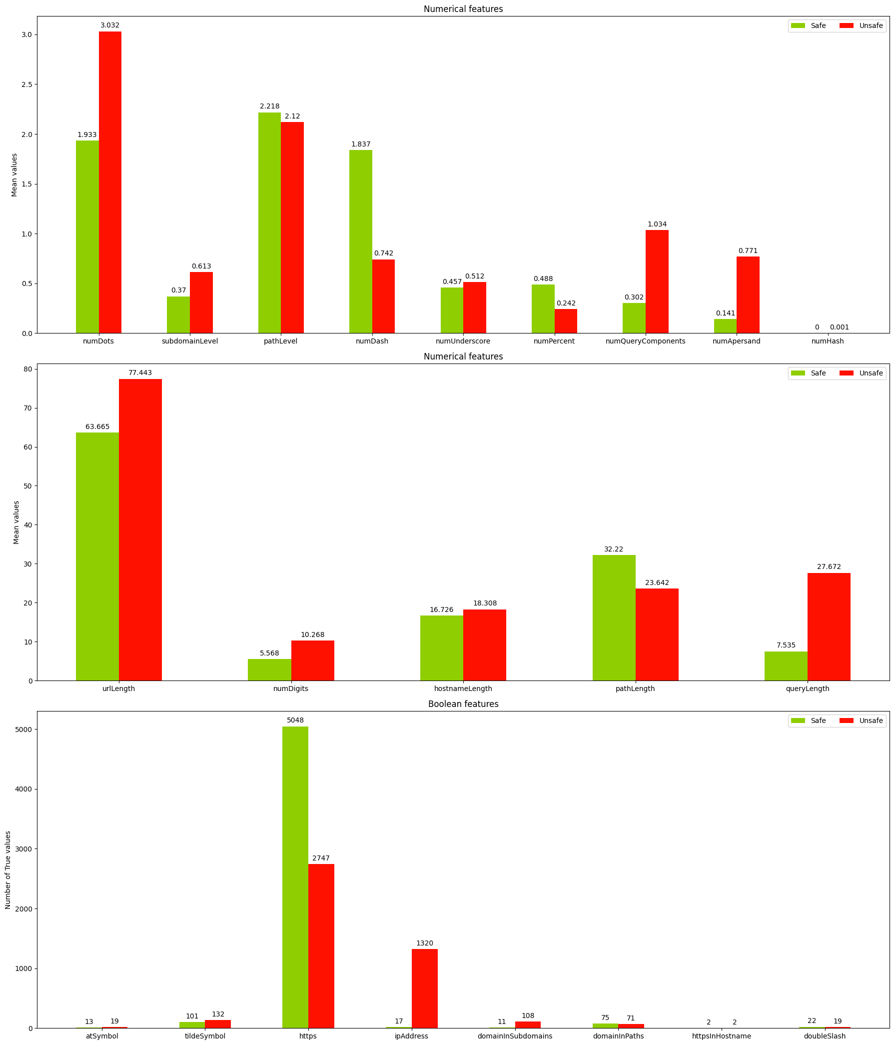
11/34

Slide 11

Features selection
First of all, we remove from the dataset those features that from the explorative data analysis are useless for our purposes, then we apply two separate techniques for feature selection:
Principal Component Analysis
Autoencoder
13/34

Slide 12
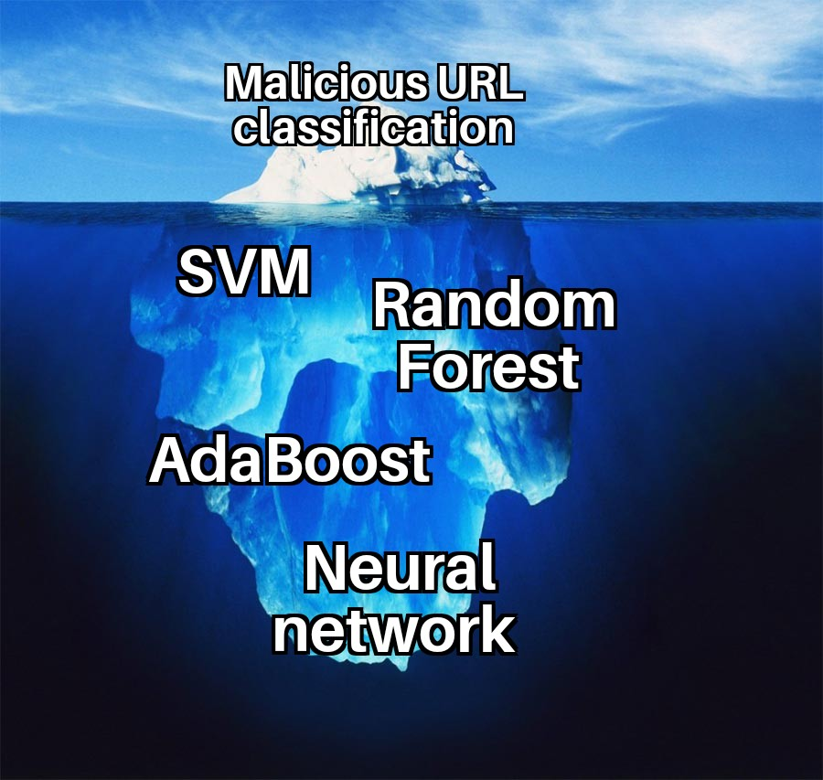
Models definition
We defined four different models to classify URLs starting from features obtained:
Support Vector Machine
AdaBoost
Random Forest
Neural network
First, we train each of these models on our extracted features, on PCA and on Autoencoder features, then we perform hyperparameters tuning, and finally we propose an alternative approach inspired by the Natural Language Processing.
16/34

Slide 13
Conclusions
We compared five machine learning models, and it turned out that the best model to deal with this task is the Random Forest classifier on full set of lexical features, which outperforms all the other models implemented with 89,7% of accuracy. Although, by looking also at execution times, a good trade-off option would be represented by the AdaBoost classifier.
Future developments
Implementation of a more specific neural network for URL2Vec approach, such as any model that keep track of dependencies on sequential data (LSTM, Transformers, etc.).
Applying the models implemented not only on lexical features but also on host-based features.
Building a model that classifies malicious URLs according to the type of possible attack.
Once chosen the best model and the best settings applying them to the whole dataset and not on a small sample as done in this project due to limited hardware resources.
32/34

Slide 14
Thanks for the attention!
Simone Gramegna Alberto G. Valerio
33/34

Slide 15


