Slide 1
PRISM
Precision Room-temperature Instrumentation for high-energy X-ray absorption Spectroscopy Measurements
Responsabile di Progetto: Dr. Simone Manti, INFN - LNF
Referente di Progetto: Dr.ssa Catalina Curceanu, INFN - LNF

Slide 2
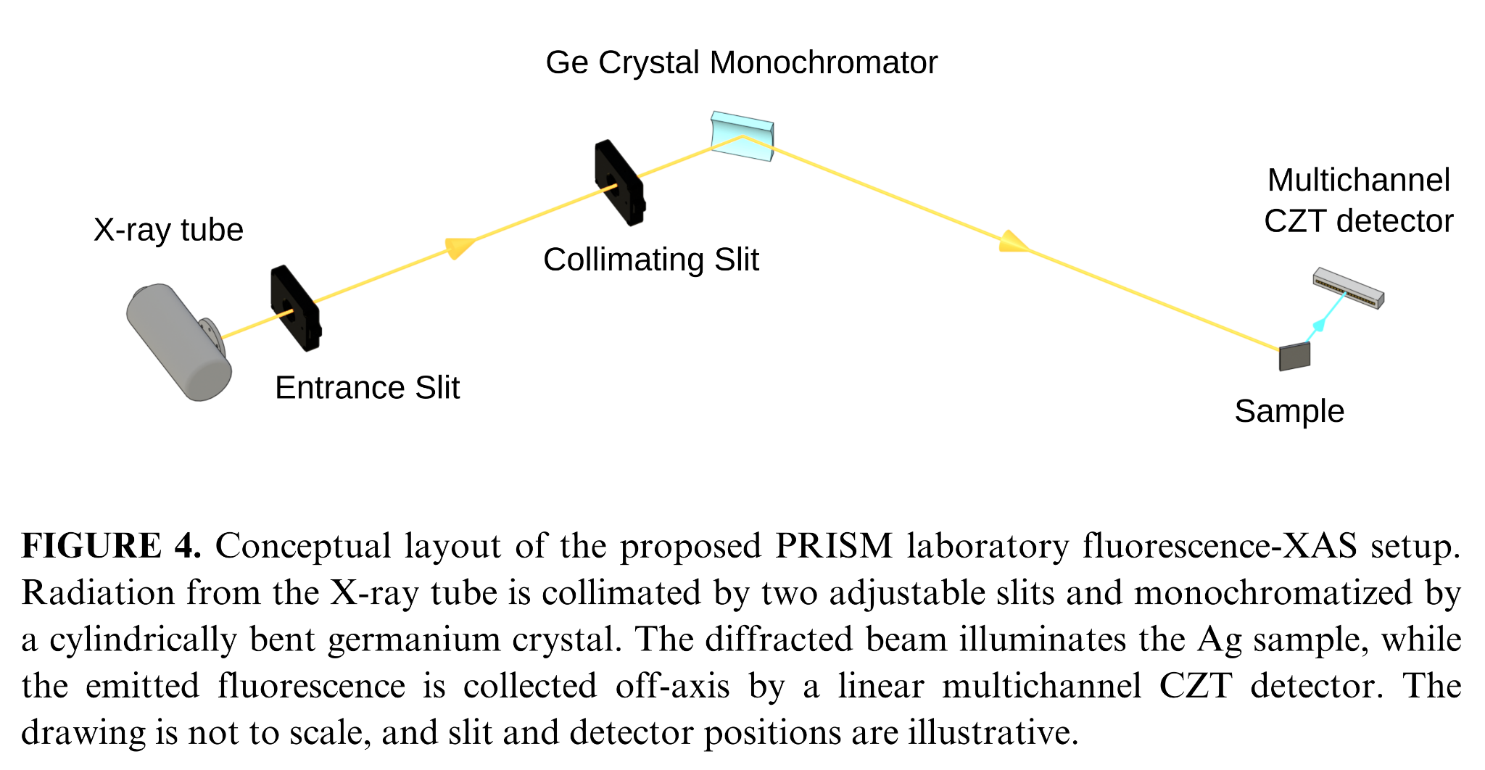
How can we perform laboratory XAS above 20 keV?

Slide 3
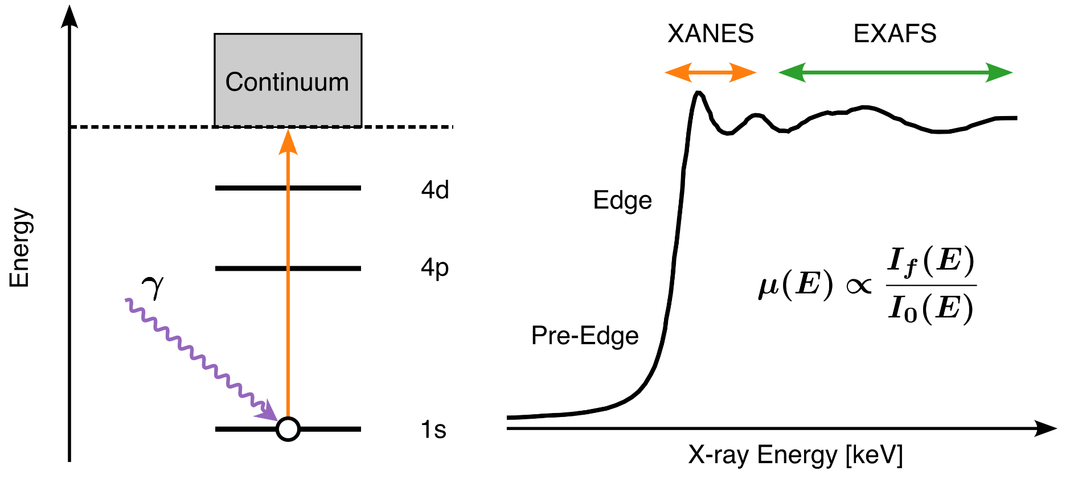
X-ray Absorption Spectroscopy (XAS): Chemical State and Local Structure
XAS probes element-specific Absorption Edges to reveal Chemical State and the Local Atomic Environment.
Element selectivity
Core-level edges identify the absorbing element
Pre-edge
Electronic states and local symmetry
XANES
Oxidation state and coordination geometry
EXAFS
Neighbor distances, coordination and disorder

Slide 4
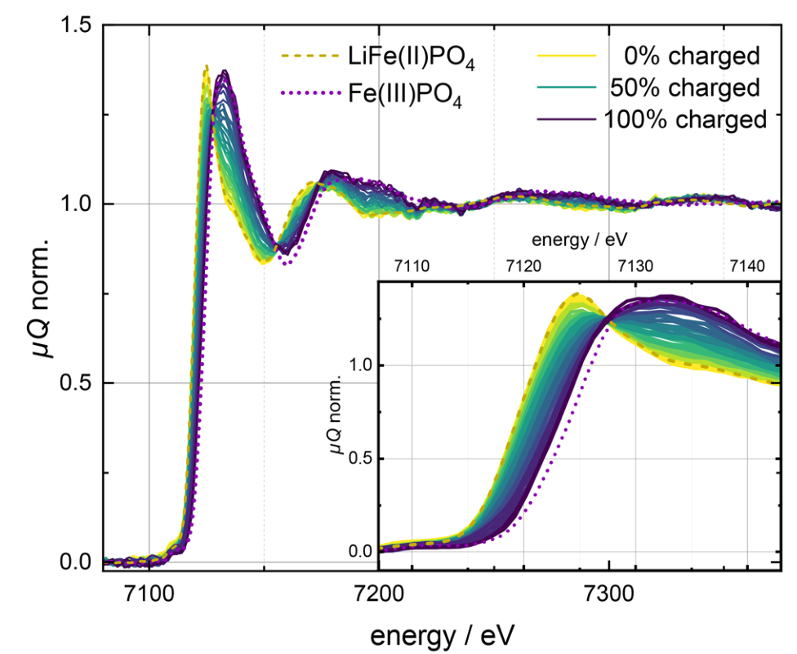
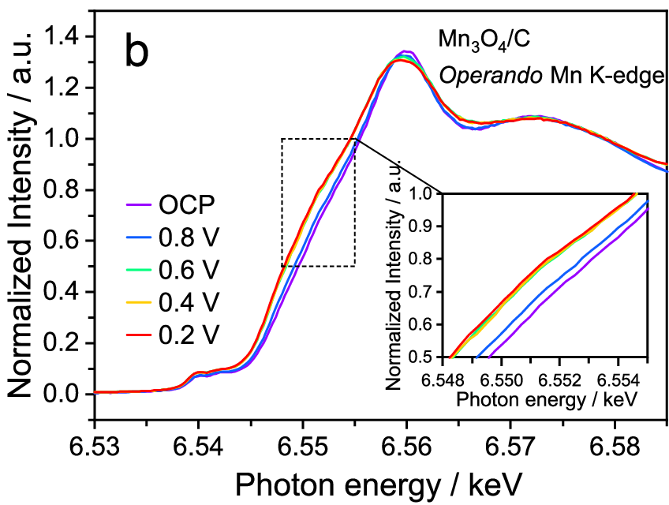
State-of-the-Art XAS under Operating Conditions
Element-specific insight into Electronic State and Local Atomic Structure.
Laboratory Operando XANES
Lab XANES tracks LiFePO₄ conversion
Fe K-edge ~7.1 keV, 15 min per spectrum
Working Catalysts
Operando XANES probes the Mn K-edge ~6.5 keV state under fuel-cell operating conditions
Praetz et al., JAAS 40, 2447–2461 (2025), Fig. 2
Li et al., Nature Communications (2025), Fig. 3b
Notes:
-Milgiori esempi o dire limite

Slide 5
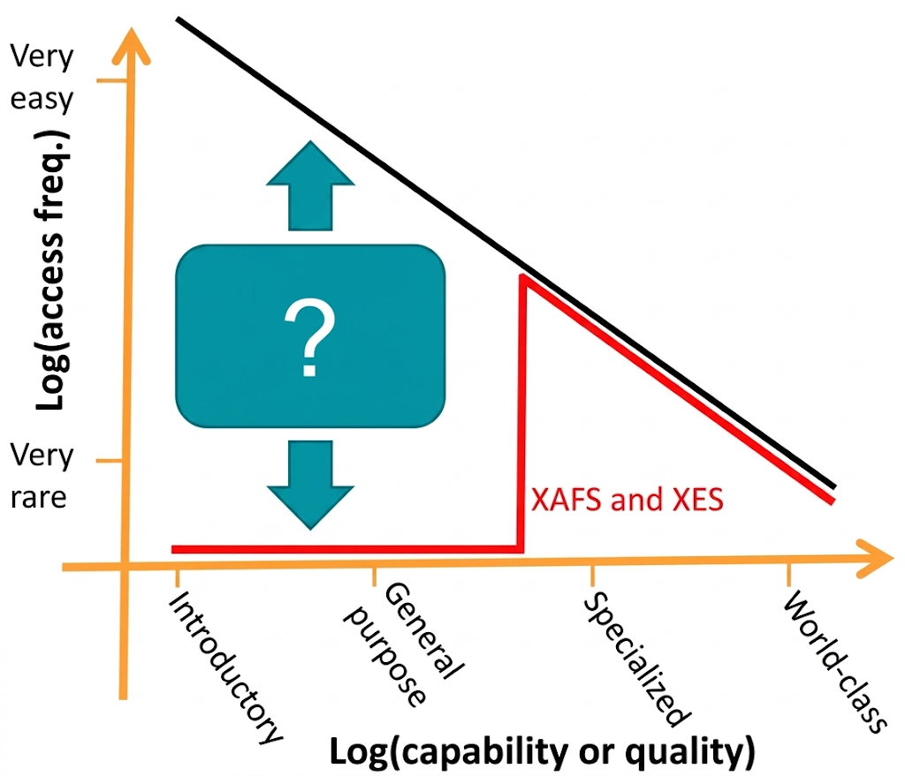
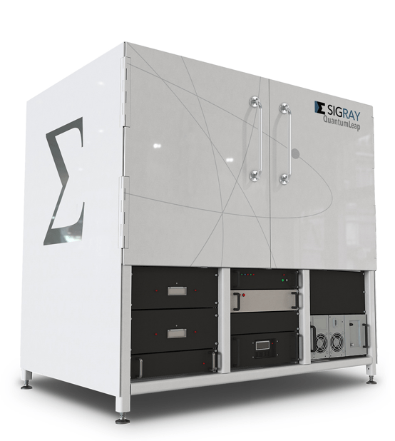
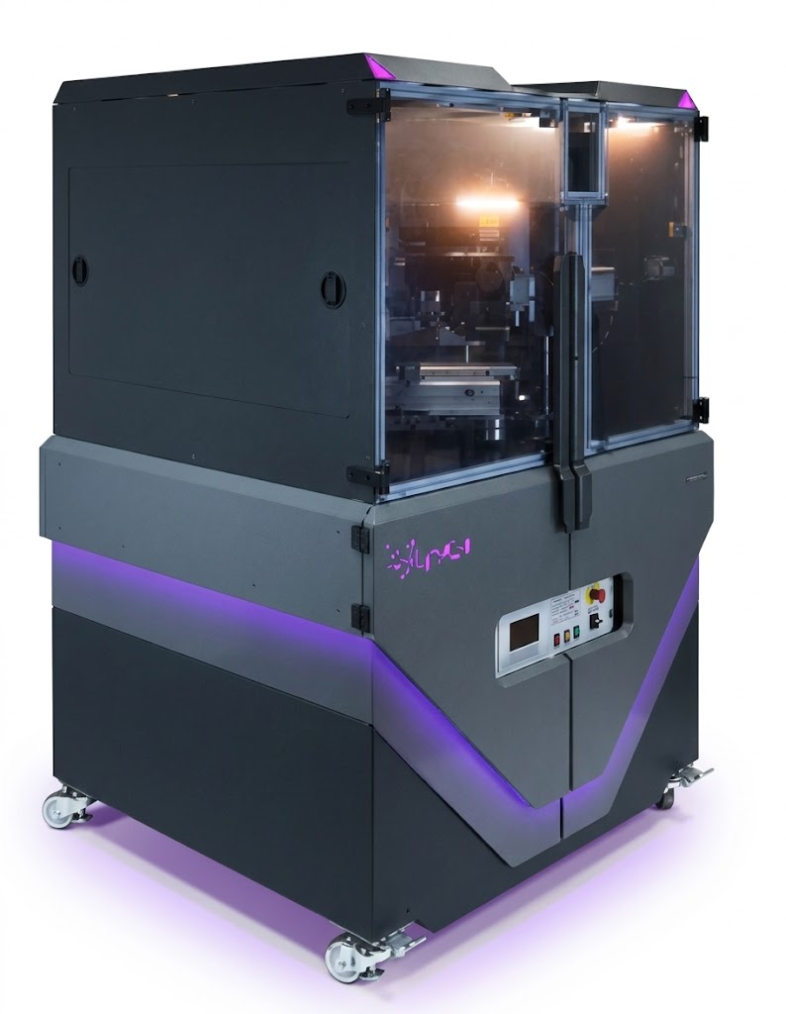
Why bring XAS into the Laboratory?
Synchrotrons and FEL remain the reference for XAS performance.
Laboratory instruments with X-ray tubes offer routine access and flexible measurement times.
Routine screening and repeated measurements
Long In-Situ / Operando campaigns
Sample and protocol optimization for beamtime
Commercial Laboratory XAS already exists,
but elevated cost and up to 20 keV!
Sigray
≈ 1.5 M€
Jerry Seidler, et al. (2024)
Notes:
-Meglio motivazione

Slide 6
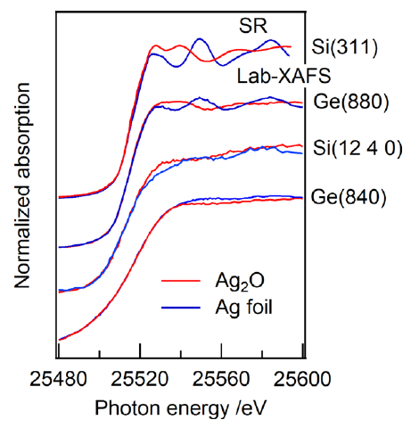
Laboratory XAS above 20 keV: Opportunities and Challenges
K-edges of Mo, Pd, Ag and Sn are relevant to Catalysis and Energy Materials.
Closely spaced L-edges can restrict the accessible EXAFS range.
Yamamoto. "Selection of Monochromator Crystal for Pb L‐ and Ag K‐Edge XANES Using a Laboratory‐Based Spectrometer." X‐Ray Spectrometry (2026).
Feasibility demonstrated in transmission
Ge(880): ≈12 h for Ag K-edge XANES
Ag K-edge EXAFS impractical at this count rate
Spectral purity is also critical
Al filters suppress lower-order reflections (440) and characteristic Ge K lines.
Challenge: quantitative fluorescence XAS with efficient detection and sufficient SNR in a single lab day!

Slide 7
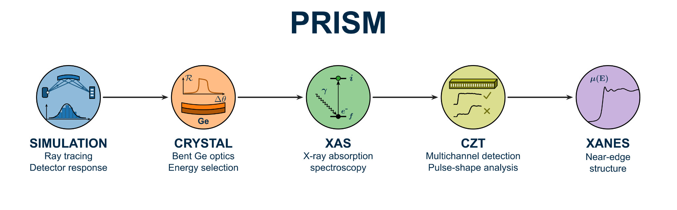
MAIN GOAL:
“To develop and validate a room-temperature laboratory platform for fluorescence-mode XAS above 20 keV, combining a high-resolution crystal monochromator with a custom multichannel CZT detector “
Notes:
-Focusing Area

Slide 8
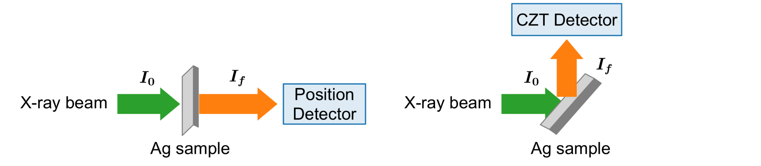
PRISM probes XAS K-edge with the characteristic Fluorescence line
Transmission Mode
Requires sufficient transmission and a uniform sample thickness.
Fluorescence Mode
Enables measurements on dilute samples and samples unsuitable for transmission.
PRISM requires efficient, energy-resolving detection of weak fluorescence above 20 keV!

Slide 9
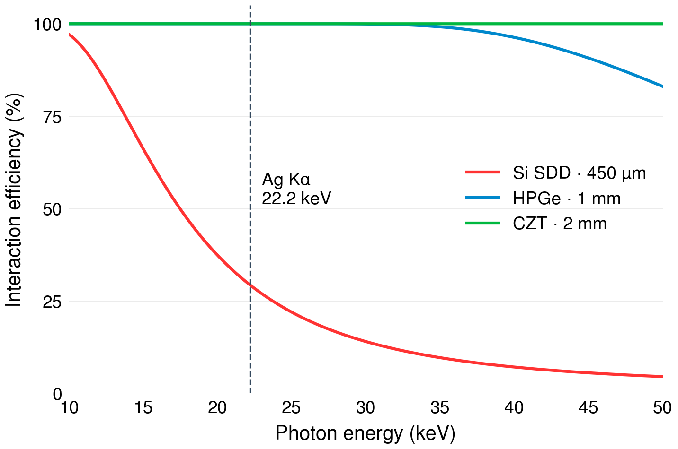
CZT have High Efficiency > 20 keV with Room-Temperature Operation
Fluorescence-Mode XAS above 20 keV requires high detection efficiency
Efficient Fluorescence collection
Higher absorption at Ag Kα (22.2 keV) than Silicon Drift Detectors (SDDs)
Spectroscopy at Room-Temperature
No cryogenic cooling, unlike High-Purity Germanium (HPGe) detectors
My CZT experience at DAΦNE
High-flux Kaonic Atoms Hard-X-ray Spectroscopy with SIDDHARTA-2
Artibani F., Manti S, et al., J. Phys. G (2026)
CZT Detector, Front-End Electronics and Waveform DAQ ~33% of PRISM’s cost

Slide 10
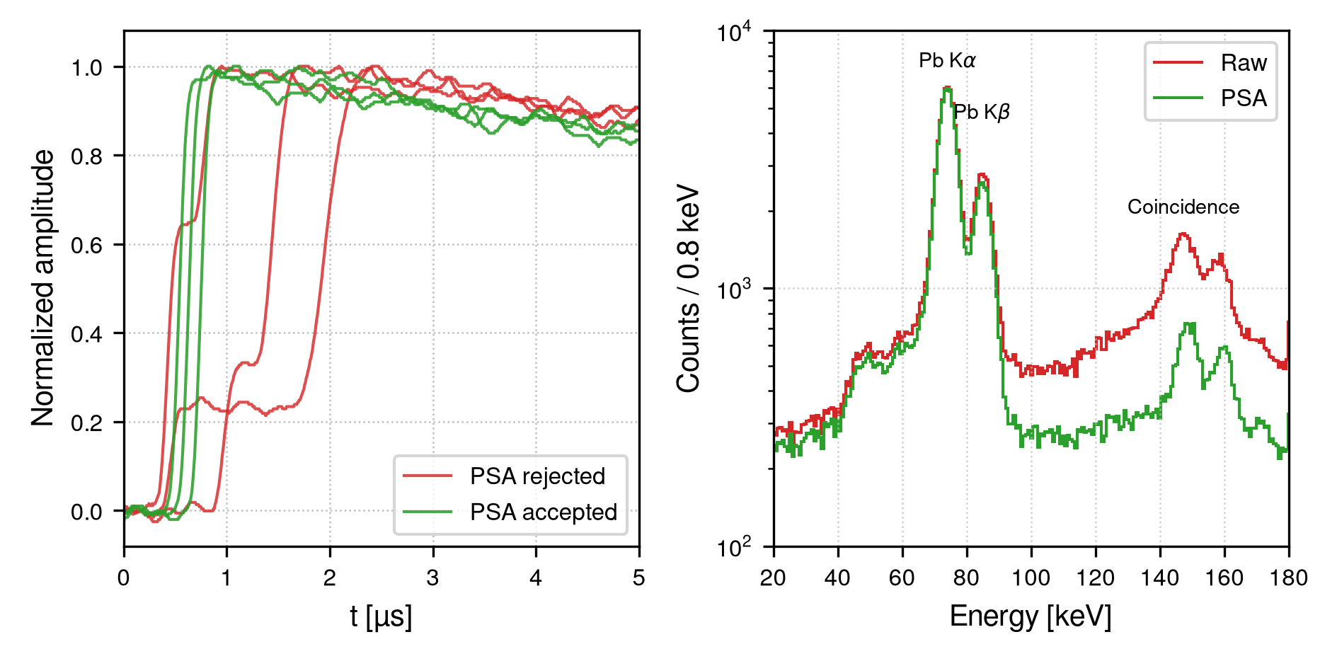
A custom CZT detection chain for fluorescence XAS
Optimize fluorescence collection
A custom 20-pixel linear array with 500 μm
pitch, tailored to the collection geometry.
Custom readout for varying count rates
Below/Above Edge, with /without (I₀) Target
Experience in Pulse Shape Analysis
  High-Flux CZT@BTF: Manti S., et al., Condensed Matter 11, 38 (2026).
  Low-Flux BEGe@LNGS: Manti S., et al. JINST 21.01 (2026): P01036.
Building on prior CZT results at DAΦNE-BTF
Pulse Shape Analysis suppresses Coincidence Structures and maintain Pb Kα and Kβ lines
M15 targets: FWHM/E ≤ 2% at Ag Kα, Dead Time < 10%, Pile-up contamination < 5%
Notes:
-Plot limit 20 keV? 10 keV?
-f-XAS requires measuring fluorescence below/above edge and on/off beam
-Switching dynamically between low/high flux condition

Slide 11
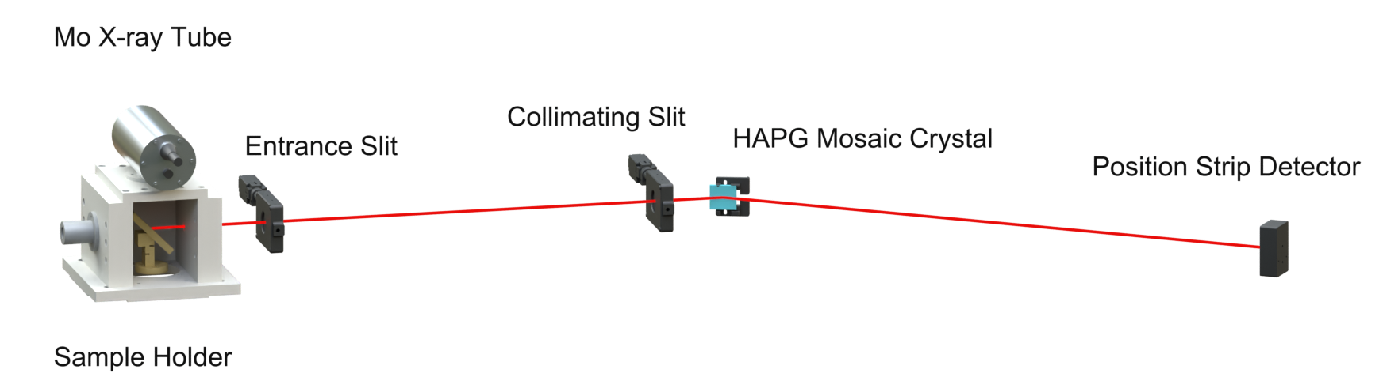
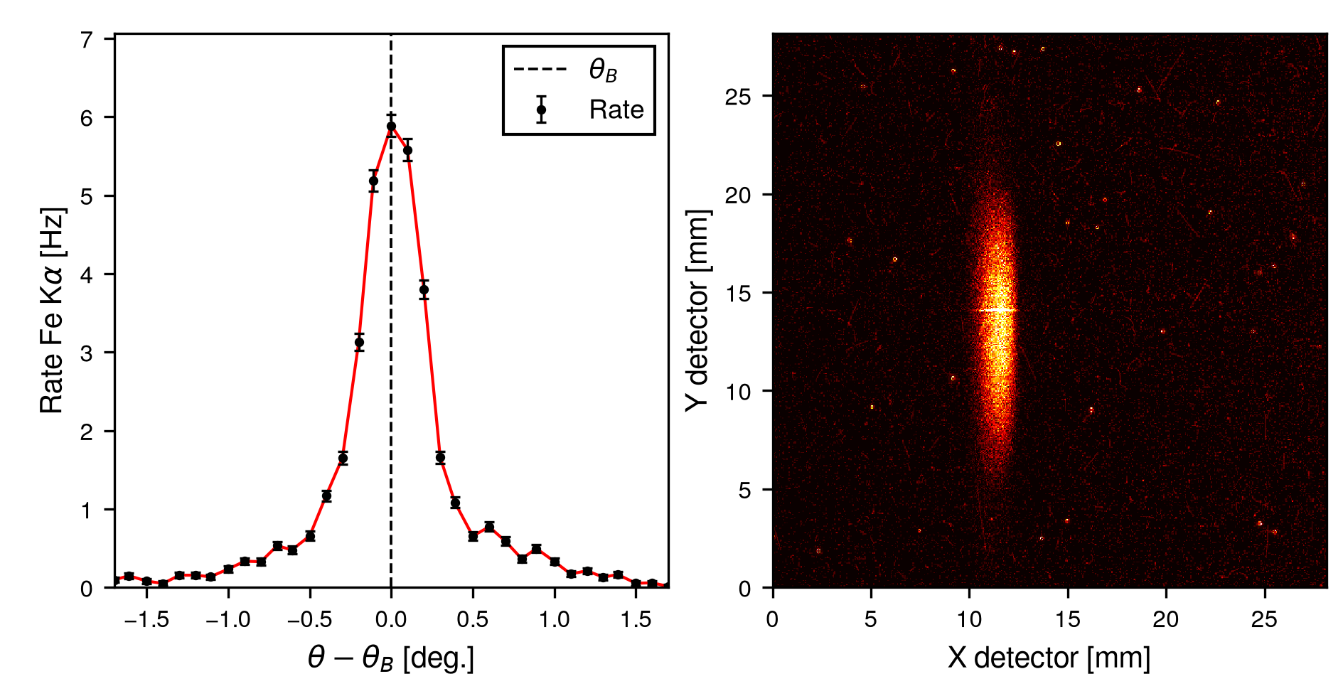
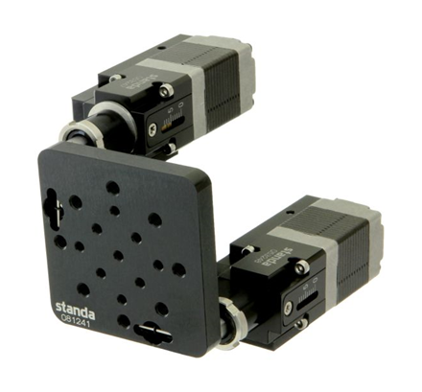
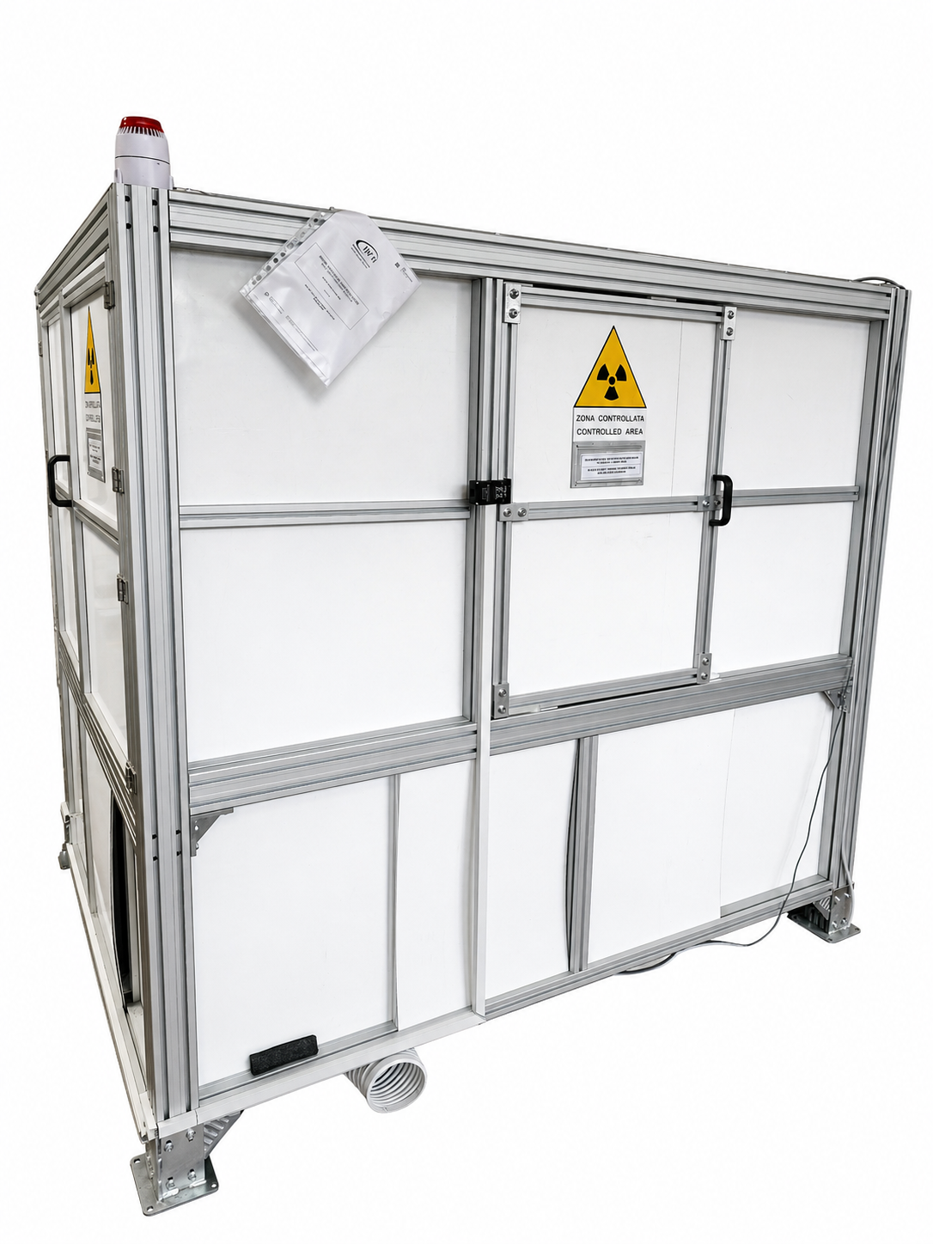
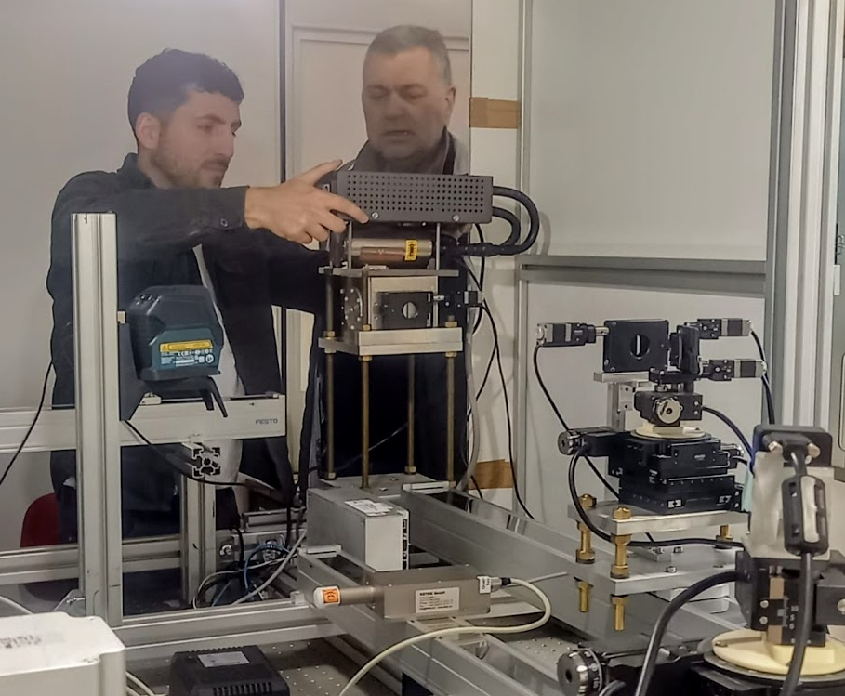
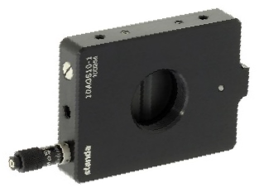
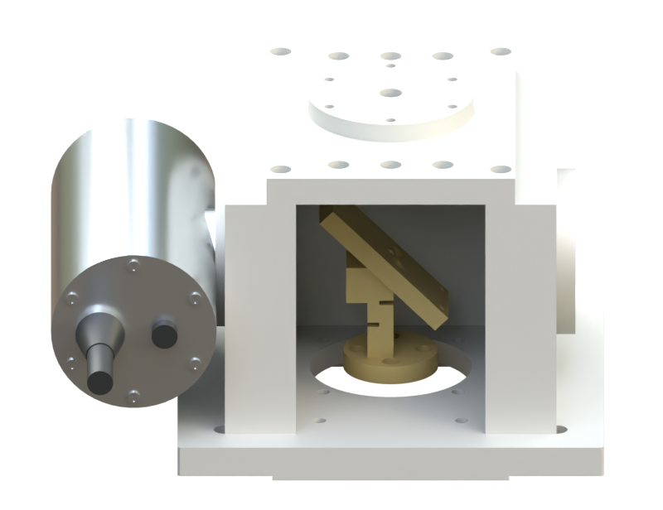
VOXES as the experimental basis for PRISM
Demonstrated Angular Scan and Beam Focusing (e.g. FeKɑ line)
Existing VOXES platform (Scordo CSN5 2015)
Recent upgrades enable Absorption Measurements
Manti et al.. Engineering Innovations 19 (2026): 23-29.
Manti et al., Condensed Matter 9.1 (2024): 19.
Crystal Axis
Bunker
Slits
Notes:
-RIEMPI
-In-kind VOXES

Slide 12
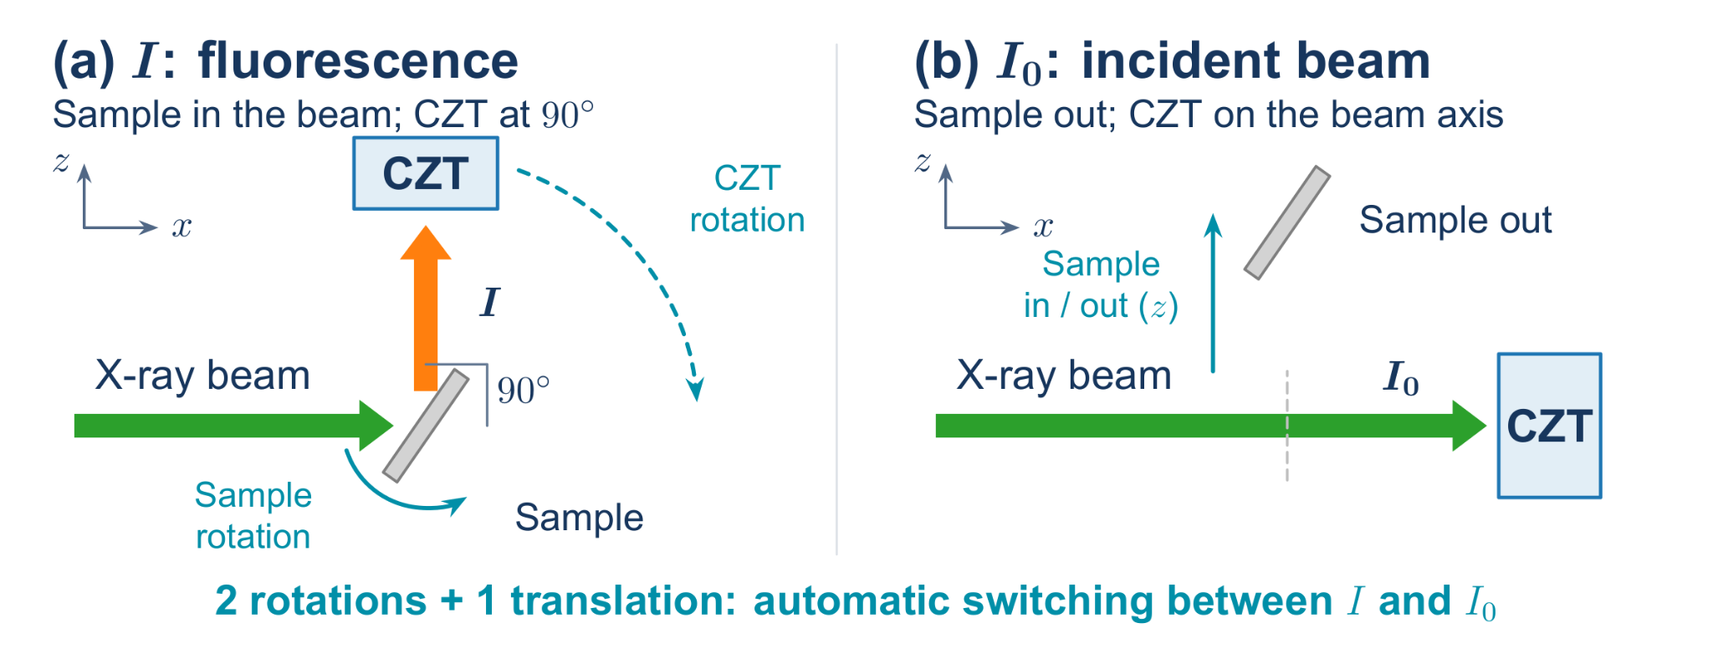
Scanning above 20 keV requires tailored Optics, Source and Motors
Ge Crystal · €20k
Narrow-band incident-energy selection for XANES: target ≤10 eV FWHM at the Ag K-edge. Ge(880) is the baseline candidate.
W-Anode X-ray tube · €17k
Higher continuum flux above 20 keV to provide sufficient photons after monochromatization.
Motorized Stages · €10k
Two rotations and one translation to switch reproducibly between fluorescence I_{f} and incident-flux I₀ measurements at each energy point.
RAY-TRACING + GEANT4 End-End simulations will define the final setup specifications

Slide 13
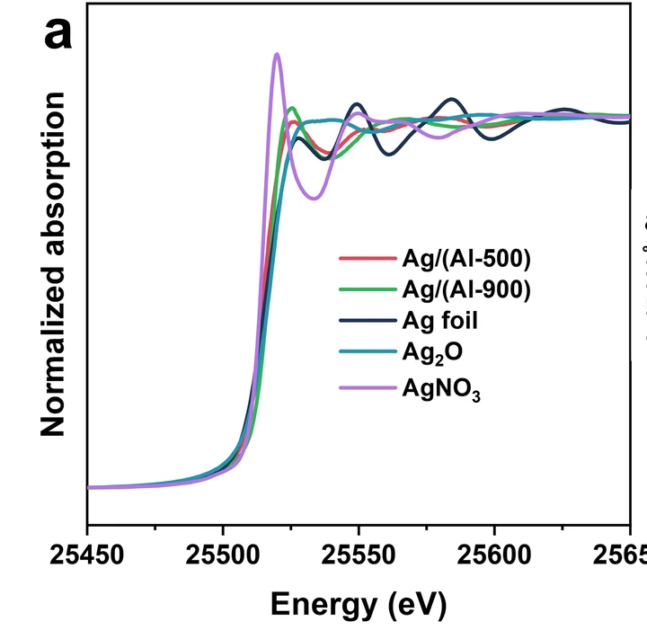
Ag K-edge XANES will be the decisive validation of PRISM
REFERENCE SAMPLES
Ag foil + two Ag(I) compounds
Different local coordination environments
PERFORMANCE TARGETS
≤10 eV FWHM incident-beam bandwidth ≥20 edge-step SNR
VALIDATION
Energy calibration and reproducibility
Comparison with reference XANES spectra
Li, Jiaxin, et al. Comm. 15.1 (2024): 3874.
Notes:
-RIEMPI

Slide 14
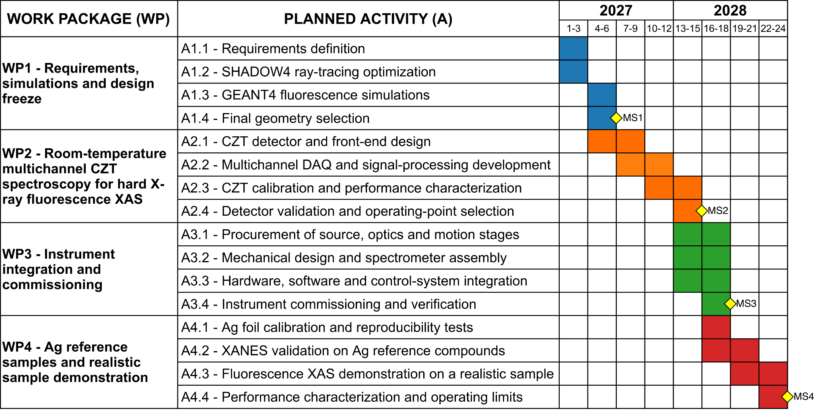
Work Plan and Milestones for PRISM
Work Packages (WP) for Simulation, CZT, Commissioning and Validation and Milestones (MS)
M6 Setup specifications frozen from Simulations
M15 CZT spectroscopic performance demonstrated
M18 Integrated instrument commissioned
M24 Ag XANES demonstration Validated
Notes:
Timeline and milestones: FINAL/Progetto.pdf pp. 7–8. WP1 M1–6, WP2 M4–15, WP3 M10–18, WP4 M16–24. Reference-compound dataset D3 M21, realistic-sample dataset D4 M24. Original Gantt retained. The oral narrative follows scientific concepts; the timeline summarizes delivery.

Slide 15
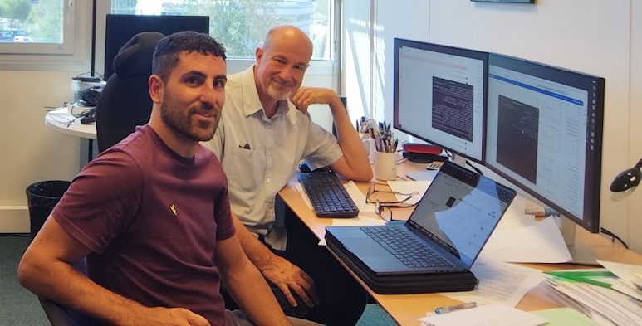



Organization and Synergies supporting PRISM
1.7 FTE at LNF, with specialist expertise for CZT, Crystal Optics and Simulations
Defined Responsibilities across WP1–WP4
ENRICH COST Action
I am co-leader of ENRICH Working Group 3 with M. Sánchez del Río, main developer of the Ray-Tracing software SHADOW4.
Name | Unit | FTE | Responsibility/WP
Simone Manti | INFN-LNF | 1.0 | Project Leader; WP1–WP4
Alessandro Scordo | INFN-LNF | 0.3 | Crystal optics, ray tracing, integration; WP1/WP3
Massimiliano Bazzi | INFN-LNF | 0.3 | Electronics and DAQ; WP2
Catalina Curceanu | INFN-LNF | 0.1 | Scientific Supervisor and application validation; WP4
Total |  | 1.7 | -
VOXES: equipment and test infrastructure.
Palermo/KAONNIS (CSN3): CZT and calibration
VIP (CSN3): pulse-shape analysis.
Further links: SPHINX and EuAPS/AQUA
Mission at ESRF (Grenoble)
Letter of support for PRISM
Potential technical exchanges on CZT sensors and testing (WP2).
Notes:
PRISM assigns 1.7 FTE at INFN-LNF to delivery: Simone Manti 1.0, Alessandro Scordo 0.3, Massimiliano Bazzi 0.3, Catalina Curceanu 0.1. The table maps responsibilities to the work packages.
The existing VOXES equipment and laboratory infrastructure provide the experimental foundation. The established University of Palermo collaboration and SIDDHARTA/KAONNIS experience contribute to CZT geometry, front-end electronics, calibration and reconstruction. VIP shares the challenges of weak hard-X-ray signals and pulse-shape analysis.
ENRICH WG3 (Software Advancement) connects ray tracing with other Monte Carlo tools and integrated-model validation. Manti is co-leader; Manuel Sánchez del Río is WG leader and principal developer of SHADOW4. Direct interaction supports the crystal-optics modelling and SHADOW4–GEANT4 workflow in WP1. The existing photograph shows Manti with Sánchez del Río. This support does not by itself validate PRISM's predictions; benchmark measurements and analytical comparisons remain necessary.
Due2Lab's signed letter expresses support for PRISM and interest in possible future technical exchanges on CZT sensor architectures, detector characterization and application requirements. Specific contributions would be agreed separately. This is documented industrial interest, not a guarantee of delivery, funding or an already contracted development activity.
Further synergies: SPHINX for precision angular scanning and alignment; EuAPS and AQUA for complementary XAS methods and preparation of future experiments after laboratory validation. Rigaku and Quantum Design have also provided letters of support.
Sources: FINAL/Progetto.pdf, PDF pages 8–11 and 13 (printed pages 7–10 and 12); REFERENCES/MoU_ENRICH_COST.pdf, PDF page 14, WG3 tasks T3.1–T3.4; 14_LOI_Due2Lab/LOI_Due2Lab_PRISM.pdf, signed letter dated 28 July 2026. Existing slide photo, table and logos retained.

Slide 16
Budget for the integrated PRISM instrument
Item | Year | Cost (k€)
CZT detector and front-end | 2027 | 30
Digitizer and DAQ | 2027 | 23
Bent Ge crystal optics | 2028 | 20
Motorized stages and controllers | 2027 | 10
Cooled W-anode X-ray tube | 2028 | 10
X-ray tube power supply | 2028 | 7
Oral conference travel | 2028 | 4
Ag reference targets | 2027 | 2
Custom mechanical supports | 2027 | 2
DataCloud CPU and storage | 2027 | 2
Additional reference targets | 2028 | 2
Total Requested | 2027–28 | 112
112 k€
Requested budget
2027: 69 k€
2028: 43 k€
100 k€ in equipment
89% of the request
45 k€
Estimated in-kind value
VOXES tube and bunker
Motion and control systems
Notes:
-Controlla VOXES in-kind

Slide 17
Expected Impact of the PRISM project
Fluorescence XAS for Catalysis and Energy Materials above 20 keV (Mo,Pd,Ag,Sn)
Scientific
Access
Screen Thick or Dilute Samples and track slow changes.
Optimize protocols before Synchrotron Beamtime.
Industrial
Interest
Rigaku and Quantum Design support PRISM (letters)
Quantum Design offers Sigray laboratory XAS systems.
INFN
Capabilities
Reuse CZT readout, simulations and calibration. Future INFN capability (EuAPS,EuPRAXIA@AQUA,VIP, KAONNIS@JPARC)
Notes:
-Aggiungi EuAPS+ AQUA
-Industrial prima di INFN

Slide 18
Main Risks and practical Mitigations
Risk | Activities | Mitigation | PNR
R1. Limited accuracy of the end-to-end simulation | A1.2–A1.4 | Benchmark against analytical calculations and VOXES data. Consult SHADOW4 developer M. Sánchez del Río through ENRICH WG3. | Medium
R2. Extended CZT optimization phase | A2.1–A2.4 | Use the VOXES Si PIN for preliminary calibration at reduced efficiency while CZT optimization continues. | Low
R3. Delayed delivery of critical components | A3.1–A3.4 | Start integration and alignment with compatible VOXES components, including non-optimized crystals. | Medium
R4. Lower than expected fluorescence count rate or SNR | A3.3–A4.4 | Optimize scan steps, dwell time, acceptance and detector shaping. Preserve energy resolution and background rejection. | High
Notes:
Risk names, activity ranges and mitigation mechanisms follow the user-provided table and FINAL/Progetto.pdf, section 8, printed page 12. Mitigation wording is shortened for presentation. Current priority assignments follow the project owner's requested classification: R1 medium/yellow, R2 low/green, R3 medium/yellow, R4 high/red. Proposed initial PNR = P × I, with each factor on a 1–3 scale. P: low, medium, high probability. I: minor local correction, significant rework or delay, threat to the final performance demonstration. Bands: 1–2 low, 3–4 medium, 6–9 high. The corresponding planning scores are R1 P2 I2=4, R2 P1 I2=2, R3 P2 I2=4, R4 P2 I3=6. R2's low classification assumes a low probability of an extended optimization phase and a moderate schedule impact; the Si PIN allows preliminary work at reduced efficiency but does not replace final CZT validation. These are proposed planning estimates, not measured probabilities, established residual risk or scores from the submitted proposal. Reassess at M6 design freeze, M15 detector validation and M18 commissioning.

Slide 19
PRISM: fluorescence XAS above 20 keV at LNF
Goal: quantitative Ag K-edge XANES, building on VOXES
M24
≤10 eV
≥20
112 k€
Ag XANES validation
Target beam FWHM
Target edge-step SNR
Requested budget
Thank you for your Attention!
Notes:
-Meglio

Slide 20
References
[1] Yamamoto. "Selection of Monochromator Crystal for Pb L‐ and Ag K‐Edge XANES Using a Laboratory‐Based Spectrometer." X‐Ray Spectrometry (2026).
[2] Manti, Simone, and Alessandro Scordo. "Recent Developments of the VOXES Von Hamos X-Ray Spectrometer for Laboratory XES and XAS Studies." Engineering Innovations 19 (2026): 23-29.
[3] Scordo, A., et al. "VOXES: a high precision X-ray spectrometer for diffused sources with HAPG crystals in the 2–20 keV range." Journal of Instrumentation 13.04 (2018): C04002-C04002.
[4] Manti, Simone, et al. "Enhancing Performances of the VOXES Bragg Spectrometer for XES Investigations." Condensed Matter 9.1 (2024): 19.
[5] Manti, Simone, et al. "Machine-learning-enhanced event selection for BEGe detectors in the VIP experiment." Journal of Instrumentation 21.01 (2026): P01036.
[6] Manti, Simone, et al. "Pulse-Shape Discrimination with Machine Learning for CZT Detectors at DAΦNE Beam Test Facility." Condensed Matter (2026).
[7] Artibani, Francesco, et al. "Kaonic copper and fluorine absolute yields measurement with a CZT-based detection system at DAΦNE." Journal of Physics G: Nuclear and Particle Physics 53.9 (2026): 095102.
Notes:
Expected outputs and impact, not achieved results: FINAL/Progetto.pdf, objectives, deliverables and impact sections. Emphasize reusable detector/readout, validated simulations and analysis procedures. Laboratory validation establishes the basis for long measurement campaigns and future transfer.

Slide 21
SPARE
Notes:
Expected outputs and impact, not achieved results: FINAL/Progetto.pdf, objectives, deliverables and impact sections. Emphasize reusable detector/readout, validated simulations and analysis procedures. Laboratory validation establishes the basis for long measurement campaigns and future transfer.

Slide 22
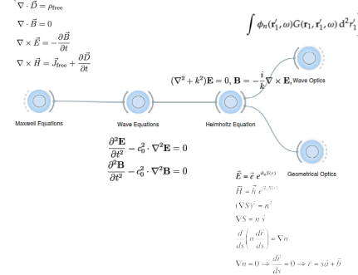
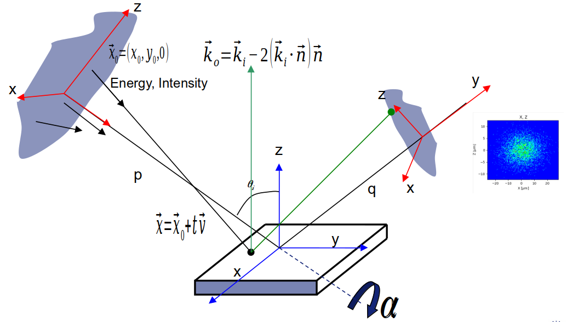
Ray-Tracing Simulations with SHADOW4
Ray tracing in X-ray optics is a simulation method used to model how X-rays propagate and interact with optical components, like mirrors, lenses, and monochromators.
It relies on approximate solutions to Maxwell's equations that are valid as long as the light waves propagate through and around objects whose dimensions are much greater than the light's wavelength.
It's essential for designing and optimizing beamlines at synchrotrons as well as any X-ray optical system.

Slide 23
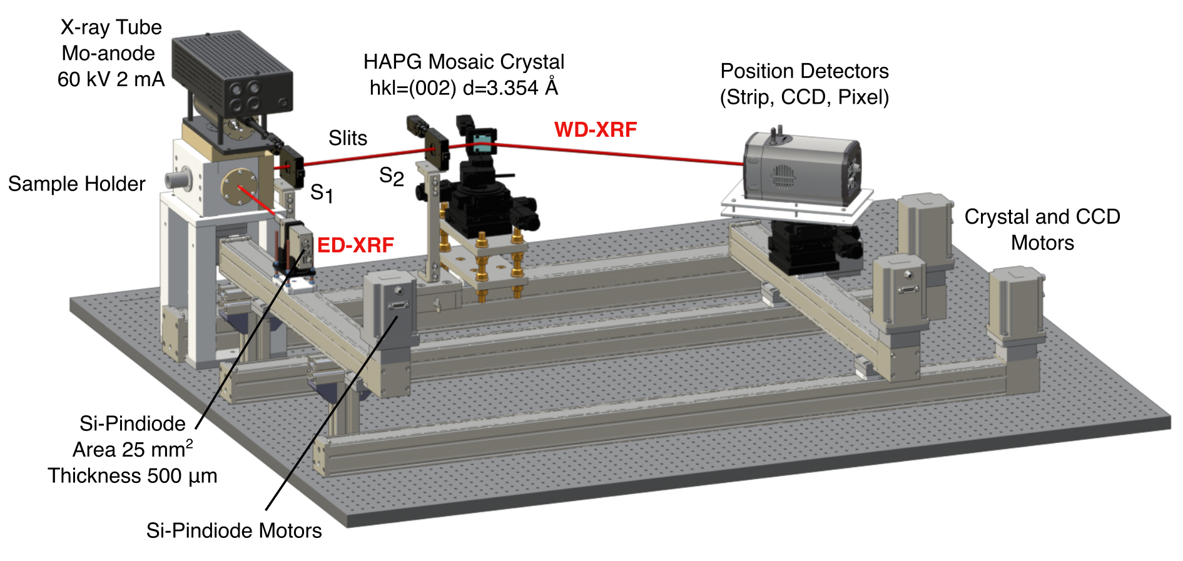
VOXES

