Slide 1




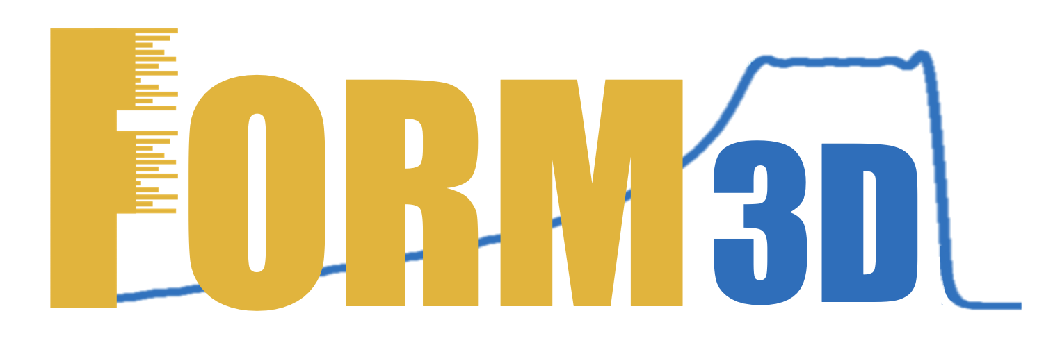
FORM-3D:
Fast Optimization of Range Modulators 3D
Grant Giovani INFN, November, 19th, 2024
Alberto Taffelli
Rome, November, 19th, 2024

Slide 2
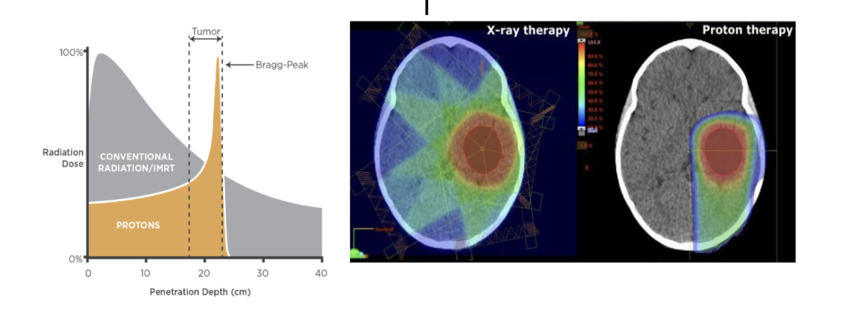
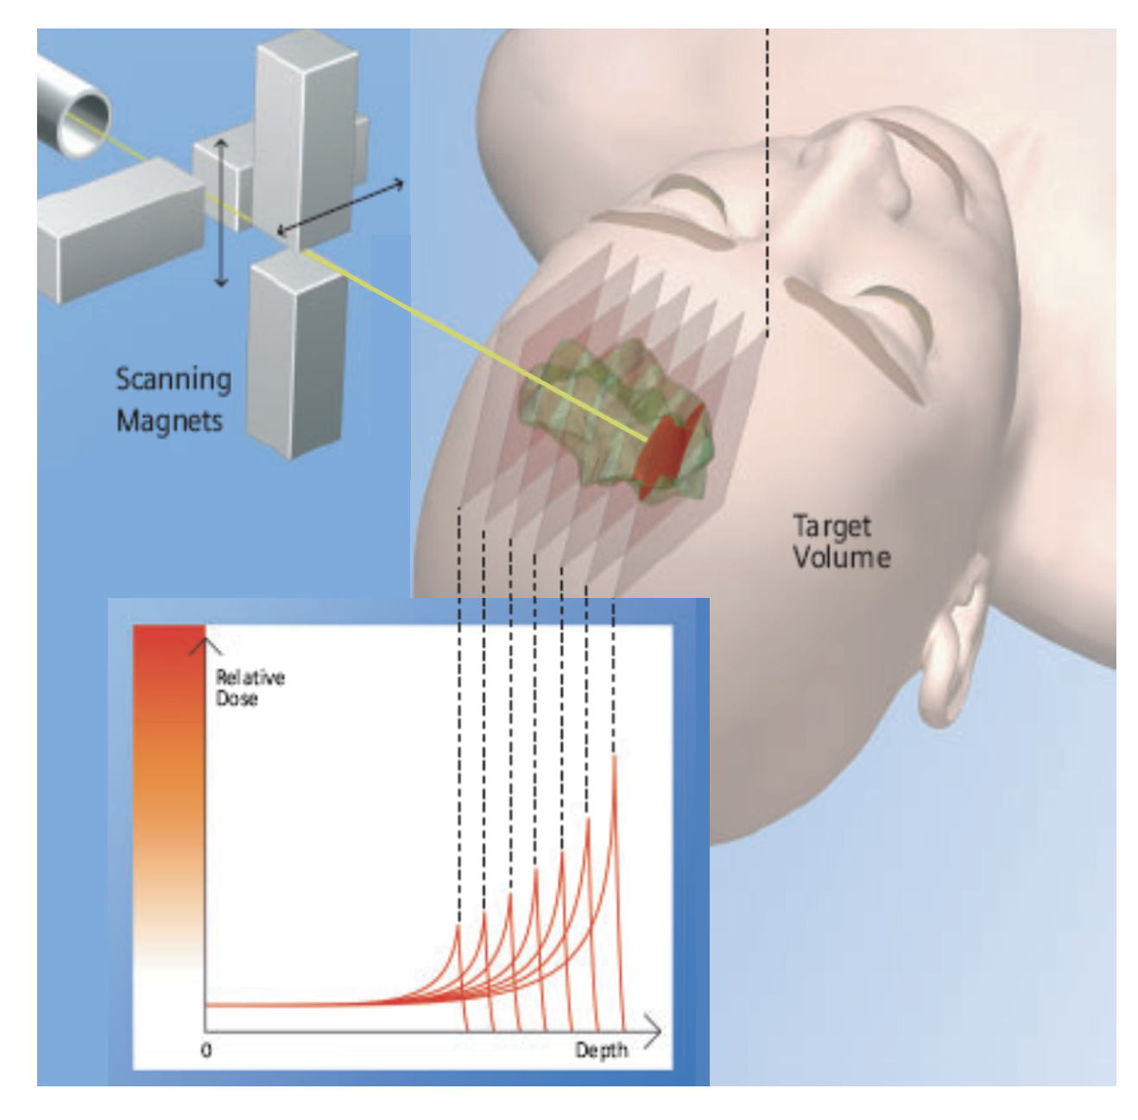
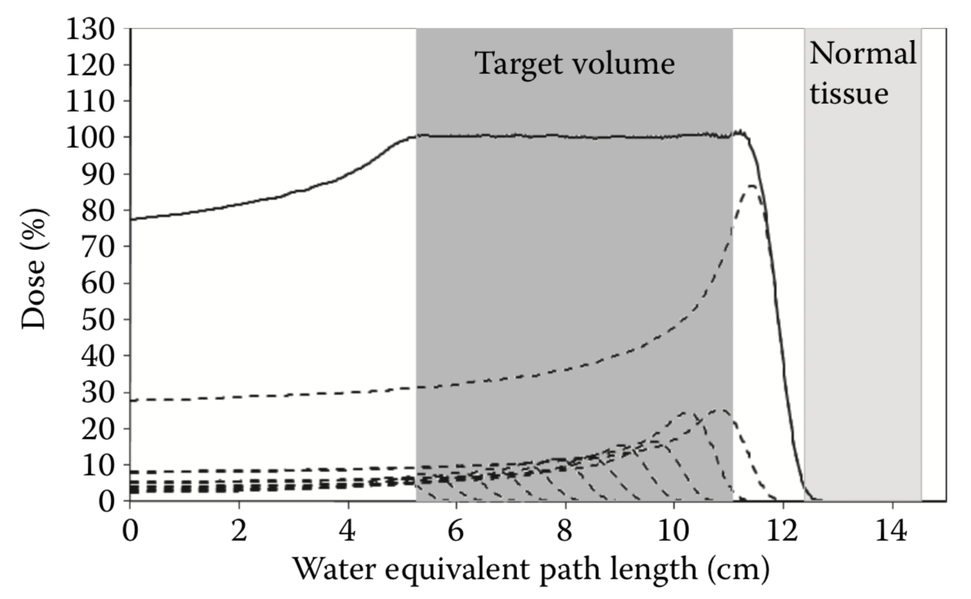

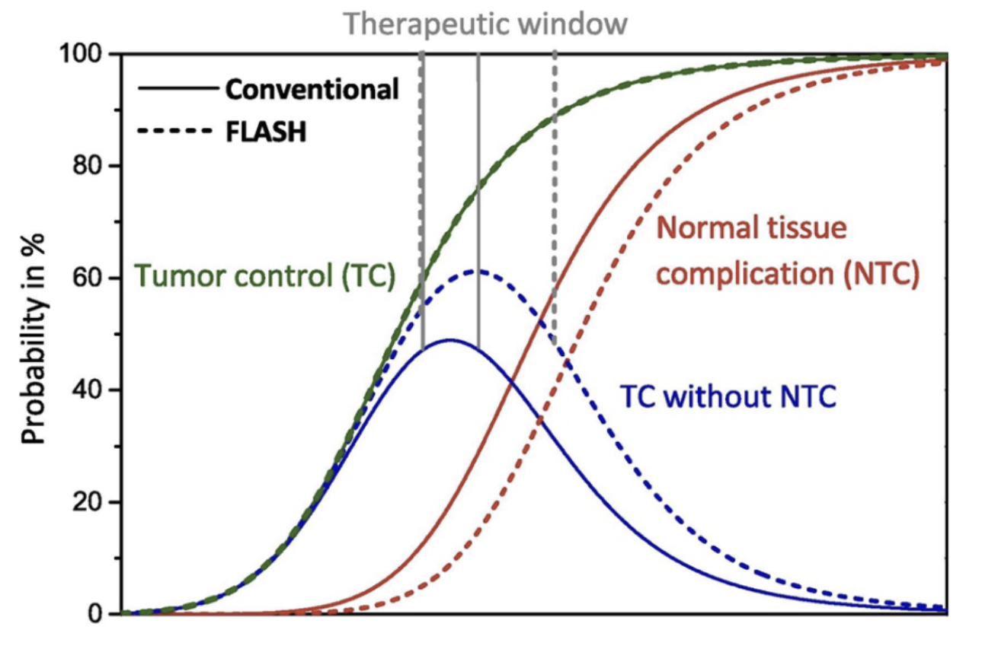
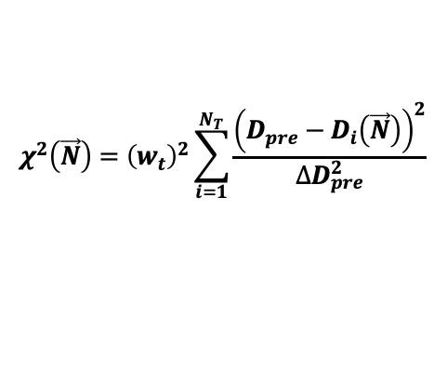
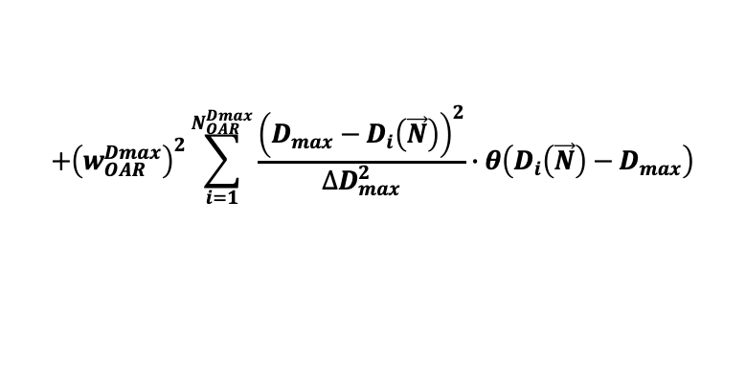
INTRODUCTION
Proton Therapy:
Protons can deliver dose precisely in deep seated tumours thanks to their peaked dose distribution in depth (Bragg peak), thus sparing normal tissues
SOBP
Active Pencil beam scanning (PBS) systems make use of different energy layers to reproduce dose uniformity in the target (SOPB)
Dell’Oro et al., 2021
COST FUNCTION
$$χ^{2}\left(\vec{N}\right)={\left(w_{t}\right)}^{2}\sum_{i=1}^{N_{T}}{\frac{{\left(D_{pre}−D_{i}\left(\vec{N}\right)\right)}^{2}}{∆D_{pre}^{2}}}$$
$$+{\left(w_{OAR}^{Dmax}\right)}^{2}\sum_{i=1}^{N_{OAR}^{Dmax}}{\frac{{\left(D_{max}−D_{i}\left(\vec{N}\right)\right)}^{2}}{∆D_{max}^{2}}}∙θ\left(D_{i}\left(\vec{N}\right)−D_{max}\right)$$
n ∽ 10³-10⁴
FLASH Effect:
Ultra-high dose rates (UHDR) irradiation, i.e. >40 Gy/s, have a protective effect on normal tissues, compared to conventional irradiation (0.01Gy/s), while maintaining the same efficacy against tumours.
Schuller et al., 2020
In RT = increase the therapeutic window
A. Taffelli, PhD
Grant Giovani INFN, Roma, Nov 19th, 2024
Dose (a.u.)

Slide 3
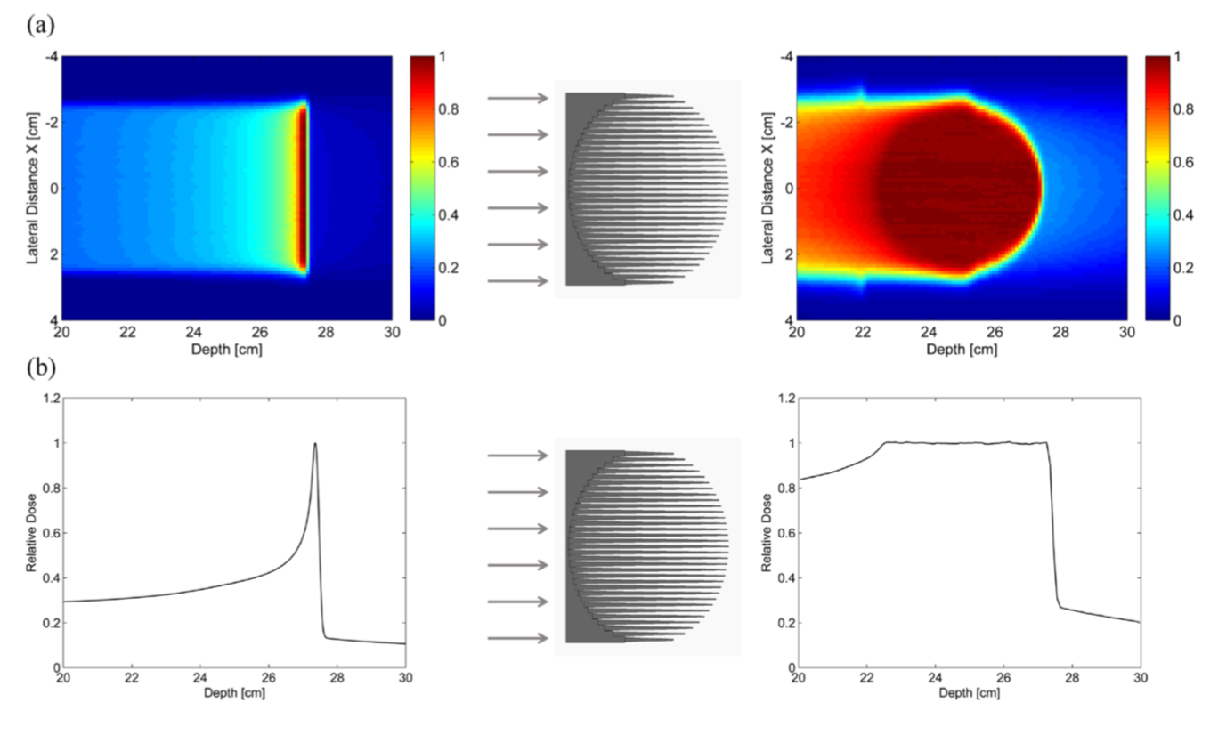
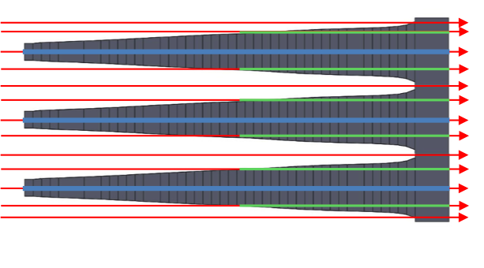

INTRODUCTION
FLASH Effect in proton therapy:
Problem: modern PBS proton therapy centers (PTC) can’t deliver UHDR due to the energy switching time required between different energy layers (0.5-2 s)
The FLASH effect is lost
3D Range Modulators (3DRM)
Solution: 3DRM, objects able to passively modulate the proton pencil beam energy and conformally shape the dose in the target (tumor)
Optimization based on pre-calculated look-up-tables
Each pin is designed to contribute correctly to the final dose distribution (pin’s lengths)
Fluence of each pencil beam needs to be optimized
Simoneov et al. 2017
A. Taffelli, PhD
Grant Giovani INFN, Roma, Nov 19th, 2024

Slide 4
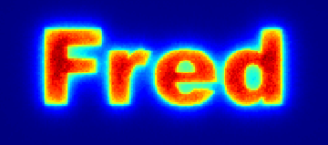
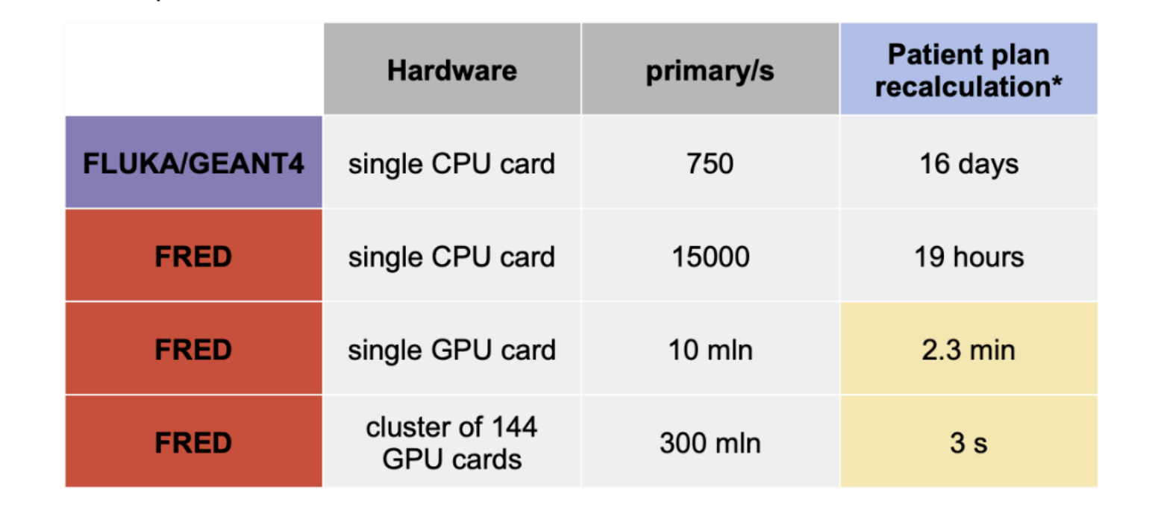
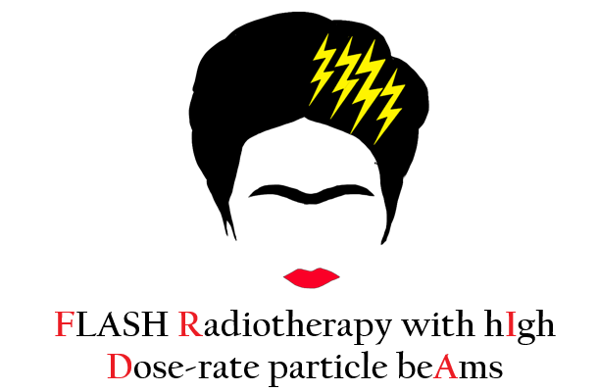

PURPOSE
Fast Optimization of Range Modulators 3D
Copyright © 2015-2023. A. Schiavi and Sapienza university of Rome. All rights reserved
Why?
The design of 3DRM is a non-trivial optimization process, dealing with inaccurate 3D look-up-tables, requiring long computational times, uncompatible with clinical routine (up to days)
A complete workflow to design, print and test the 3DRM is still missing
To speed up the translation of FLASH proton therapy into clinics
How?
Exploiting the superior computational speed of FRED, a GPU-based MC simulation tool, in the optimization process
Creating a dedicated efficient optimization algorithm to design the 3DRM
Developing a complete workflow for the design, printing and testing of patient-specific 3DRM at the PTC of Trento (APSS)
www.fred-mc.org
FRED EXPERTISE:
FRED Commissioning during FRIDA:
APSS beam model implemented in FRED
Tool to recalculate patient’s RT plan developed
Validated on a set of significant patients
A. Taffelli, PhD
Grant Giovani INFN, Roma, Nov 19th, 2024

Slide 5



3DRM DESIGN
1. Acquire and manage TPS data
2. Initial guess of the shape of a 3DRM
ITERATIVE LOOP
3. FRED simulation with the designed 3DRM
correction of the weights w_{l} associated to the pin’s lengths
4. Fluence optimization
NO
5. Check clinical goals
YES
PRINTING PROCESS
A. Taffelli, PhD
Grant Giovani INFN, Roma, Nov 19th, 2024

Slide 6
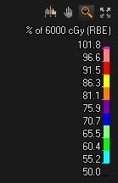
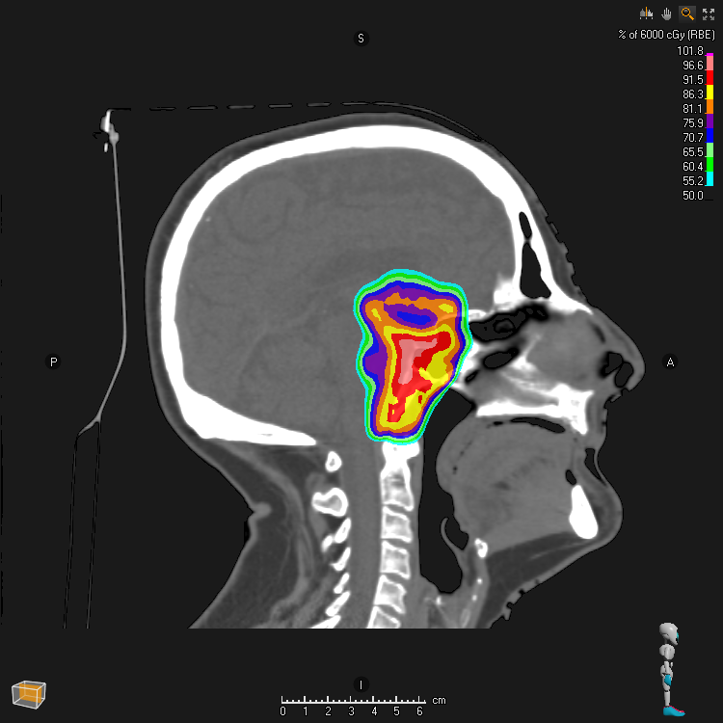
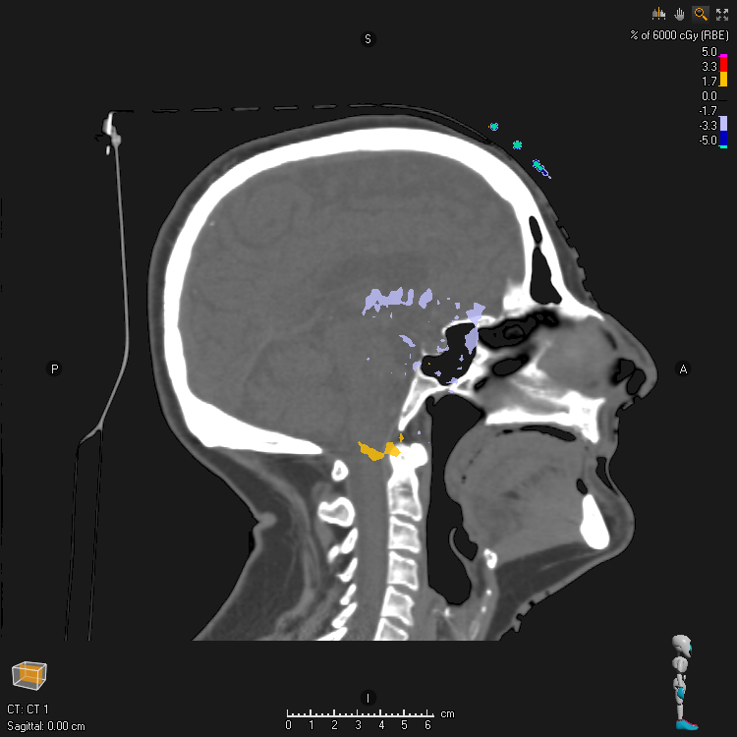

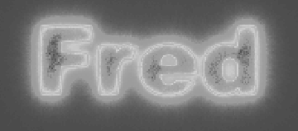
3DRM DESIGN
1. Acquire and manage TPS data
2. Initial guess of the shape of a 3DRM
TPS dicom files:
RT plan
RT dose
CT
Structures
ITERATIVE LOOP
3. FRED simulation with the designed 3DRM
correction of the weights w_{l} associated to the pin’s lengths
4. Fluence optimization
RT original plan
3DRM based plan
NO
pb: 001 1; E=105.6; pb: 001 1; E=105.6;
pb: 002 1; E=105.6; pb: 002 1; E=105.6;
… …
pb: 301 1; E=98.5; pb: 301 1; E=105.6;
pb: 302 1; E=98.5; pb: 302 1; E=105.6;
… …
pb: 701 1; E=78.3; pb: 701 1; E=105.6;
pb: 702 1; E=78.3; pb: 702 1; E=105.6;
… …
5. Check clinical goals
YES
PRINTING PROCESS
A. Taffelli, PhD
Grant Giovani INFN, Roma, Nov 19th, 2024

Slide 7

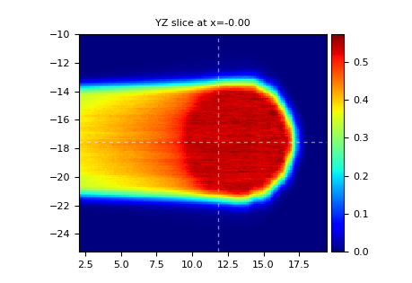
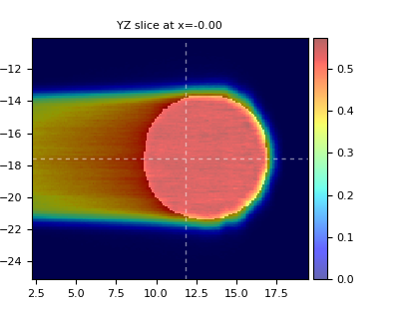
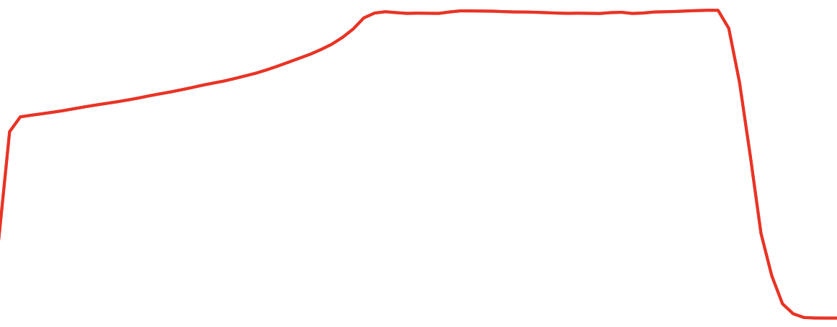
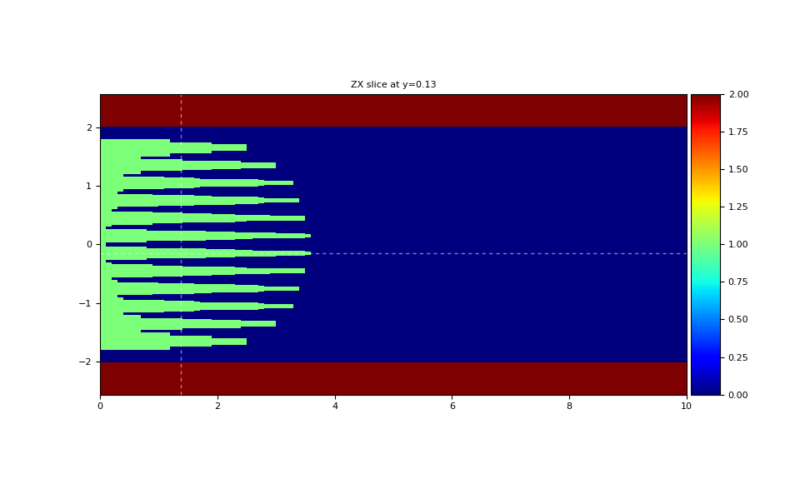
3DRM DESIGN
Starting from simple geometries (e.g. sphere)
1. Acquire and manage TPS data
Gy
TPS dose distribution
2. Initial guess of the shape of a 3DRM
ITERATIVE LOOP
3. FRED simulation with the designed 3DRM
Depth (cm)
Target structure (e.g. PTV)
Gy
correction of the weights w_{l} associated to the pin’s lengths
4. Fluence optimization
NO
Depth (cm)
Raw 3DRM
5. Check clinical goals
Quick guess of the 3DRM based on:
Geometrical considerations on the target
Pre-optimized independent 2D SOPBs
YES
PRINTING PROCESS
A. Taffelli, PhD
Grant Giovani INFN, Roma, Nov 19th, 2024
cm

Slide 8
3DRM DESIGN
1. Acquire and manage TPS data
FRED simulation
p⁺ beam
2. Initial guess of the shape of a 3DRM
cm
Dose (Gy)
ITERATIVE LOOP
3. FRED simulation with the designed 3DRM
Depth (cm)
Time estimate
correction of the weights w_{l} associated to the pin’s lengths
RM #vox | Phantom #vox | nPrim | FRED Time
10⁶ | 10⁶ | 10⁵ | 2 s
10⁶ | 10⁶ | 10⁶ | 2 s
10⁶ | 10⁶ | 10⁷ | 4 s
6.4 x 10⁷ | 10⁶ | 10⁵ | 3 s
6.4 x 10⁷ | 10⁶ | 10⁶ | 3 s
6.4 x 10⁷ | 10⁶ | 10⁷ | 7 s
10⁹ | 10⁶ | 10⁵ | 20 s
10⁹ | 10⁶ | 10⁶ | 15 s
10⁹ | 10⁶ | 10⁷ | 23 s
4. Fluence optimization
NO
5. Check clinical goals
YES
PRINTING PROCESS
Very fast recalculation!
A. Taffelli, PhD
Grant Giovani INFN, Roma, Nov 19th, 2024

Slide 9
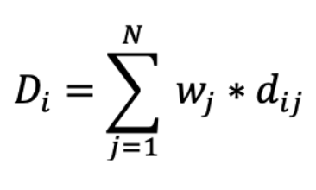
3DRM DESIGN
1. Acquire and manage TPS data
2. Initial guess of the shape of a 3DRM
Fluence Optimization
ITERATIVE LOOP
3. FRED simulation with the designed 3DRM
dose in the i^{th} voxel
dose influence matrix
correction of the weights w_{l} associated to the pin’s lengths
weight of the j^{th} pb (fluence)
4. Fluence optimization
NO
optimize the weights w_{j} to converge to the objective dose distribution D_{i}
e.g. (PTV coverage, OARs sparing)
5. Check clinical goals
YES
PRINTING PROCESS
A. Taffelli, PhD
Grant Giovani INFN, Roma, Nov 19th, 2024

Slide 10
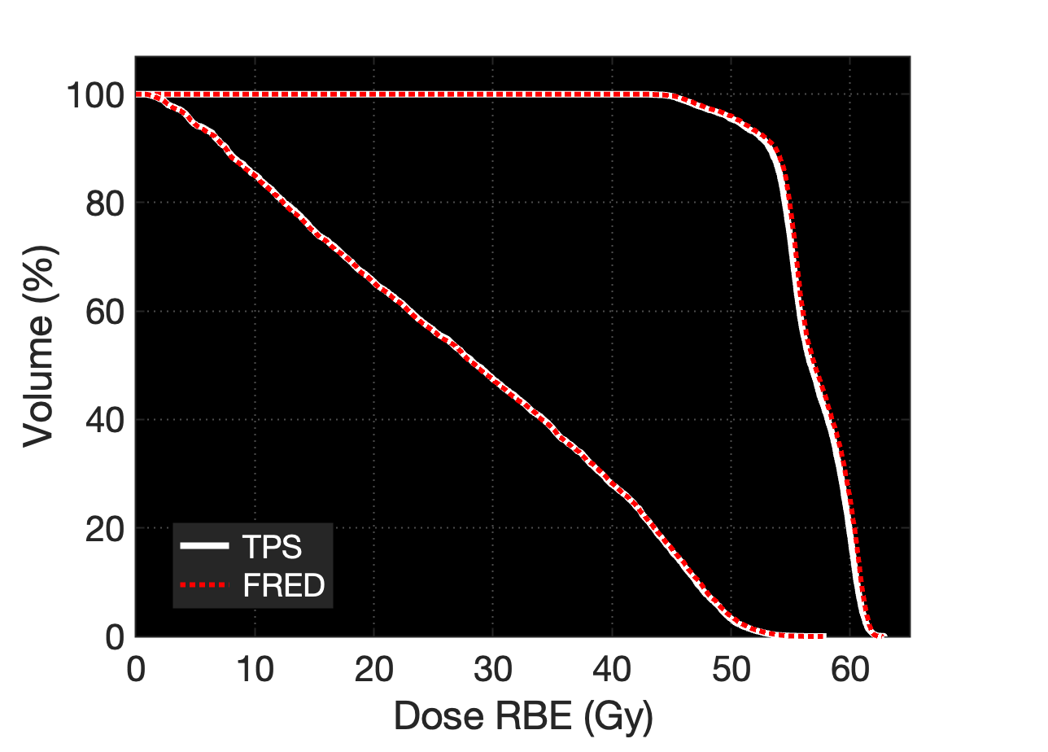
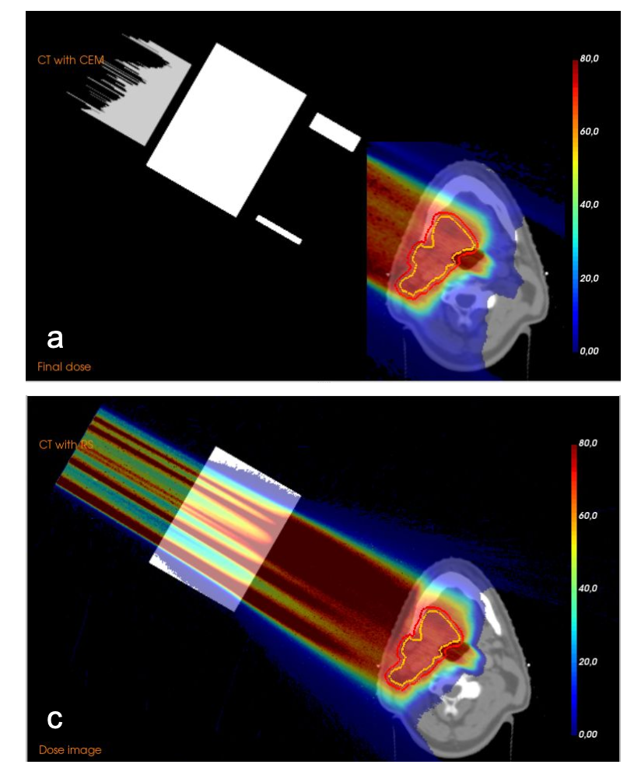
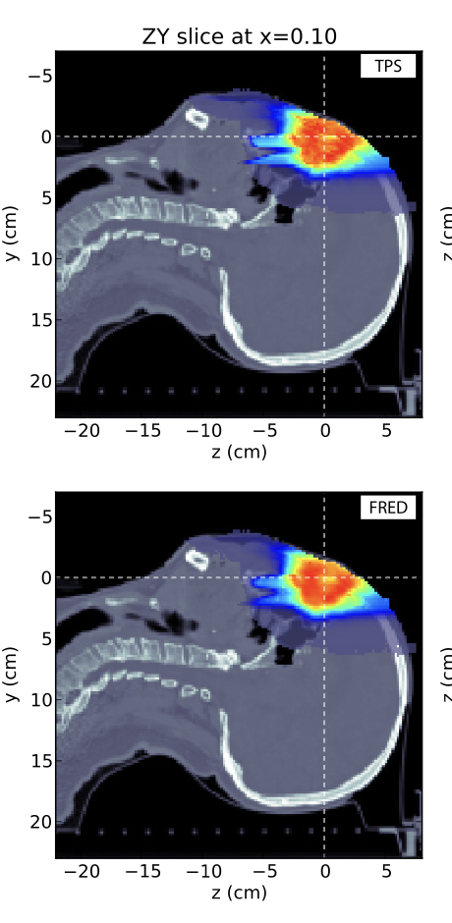
3DRM DESIGN
1. Acquire and manage TPS data
Compare DVH metrics: D98%, D2%, Dmax
2. Initial guess of the shape of a 3DRM
ITERATIVE LOOP
3. FRED simulation with the designed 3DRM
correction of the weights w_{l} associated to the pin’s lengths
4. Fluence optimization
NO
5. Check clinical goals
YES
PRINTING PROCESS
Deffet et al., 2023
A. Taffelli, PhD
Grant Giovani INFN, Roma, Nov 19th, 2024

Slide 11

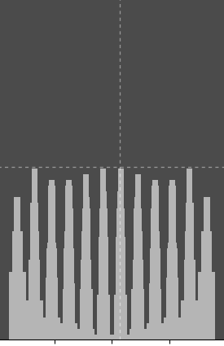
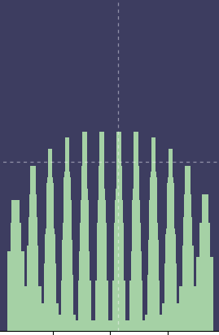
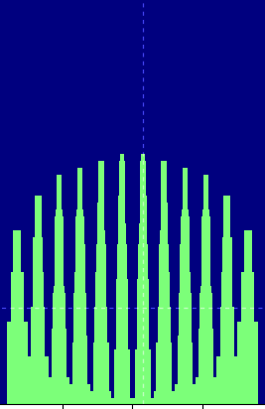
3DRM DESIGN
1. Acquire and manage TPS data
Development of an algorithm to correct the pin’s weights based on the dose distribution
(e.g. matching algorithm)
2. Initial guess of the shape of a 3DRM
ITERATIVE LOOP
3. FRED simulation with the designed 3DRM
correction of the weights w_{l} associated to the pin’s lengths
+
+
4. Fluence optimization
Fluence
Opt
Fluence
Opt
NO
STEP 0
STEP 1
STEP 2
5. Check clinical goals
Time estimate:
(10s (FRED) + 1min (fluence opt)) x 100 iter =
≈ 1-2 hours
YES
PRINTING PROCESS
A. Taffelli, PhD
Grant Giovani INFN, Roma, Nov 19th, 2024

Slide 12
3DRM DESIGN
1. Acquire and manage TPS data
2. Initial guess of the shape of a 3DRM
ITERATIVE LOOP
3. FRED simulation with the designed 3DRM
correction of the weights w_{l} associated to the pin’s lengths
4. Fluence optimization
NO
5. Check clinical goals
YES
PRINTING PROCESS
A. Taffelli, PhD
Grant Giovani INFN, Roma, Nov 19th, 2024

Slide 13


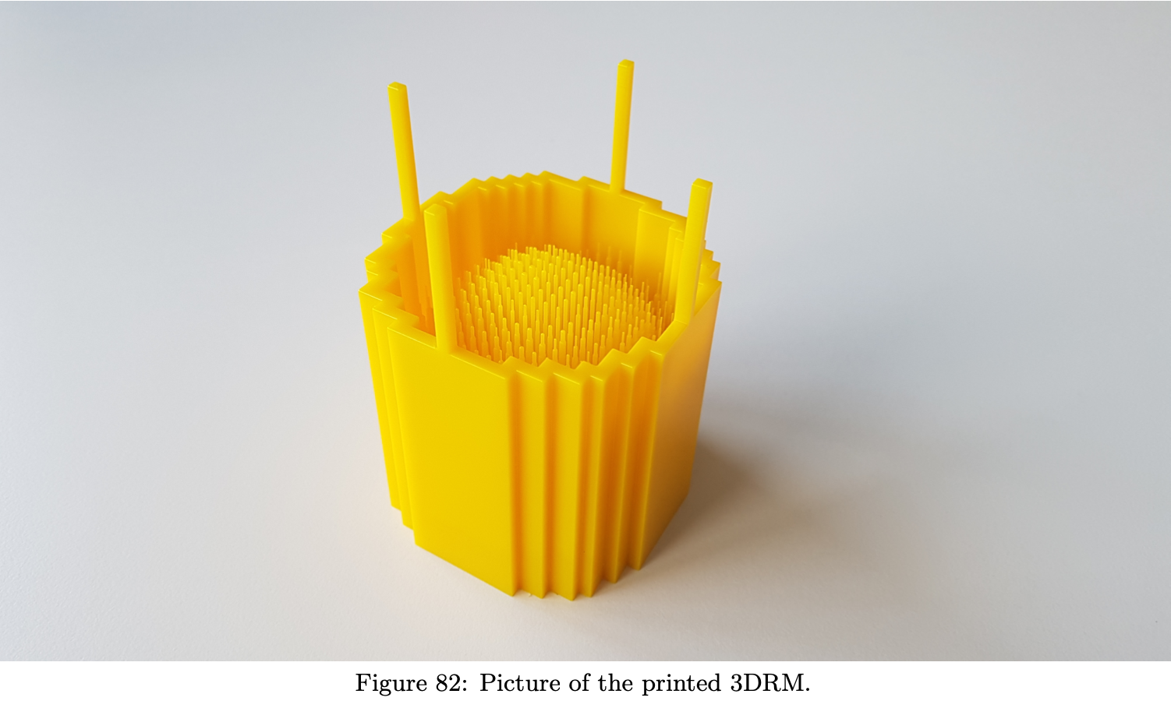
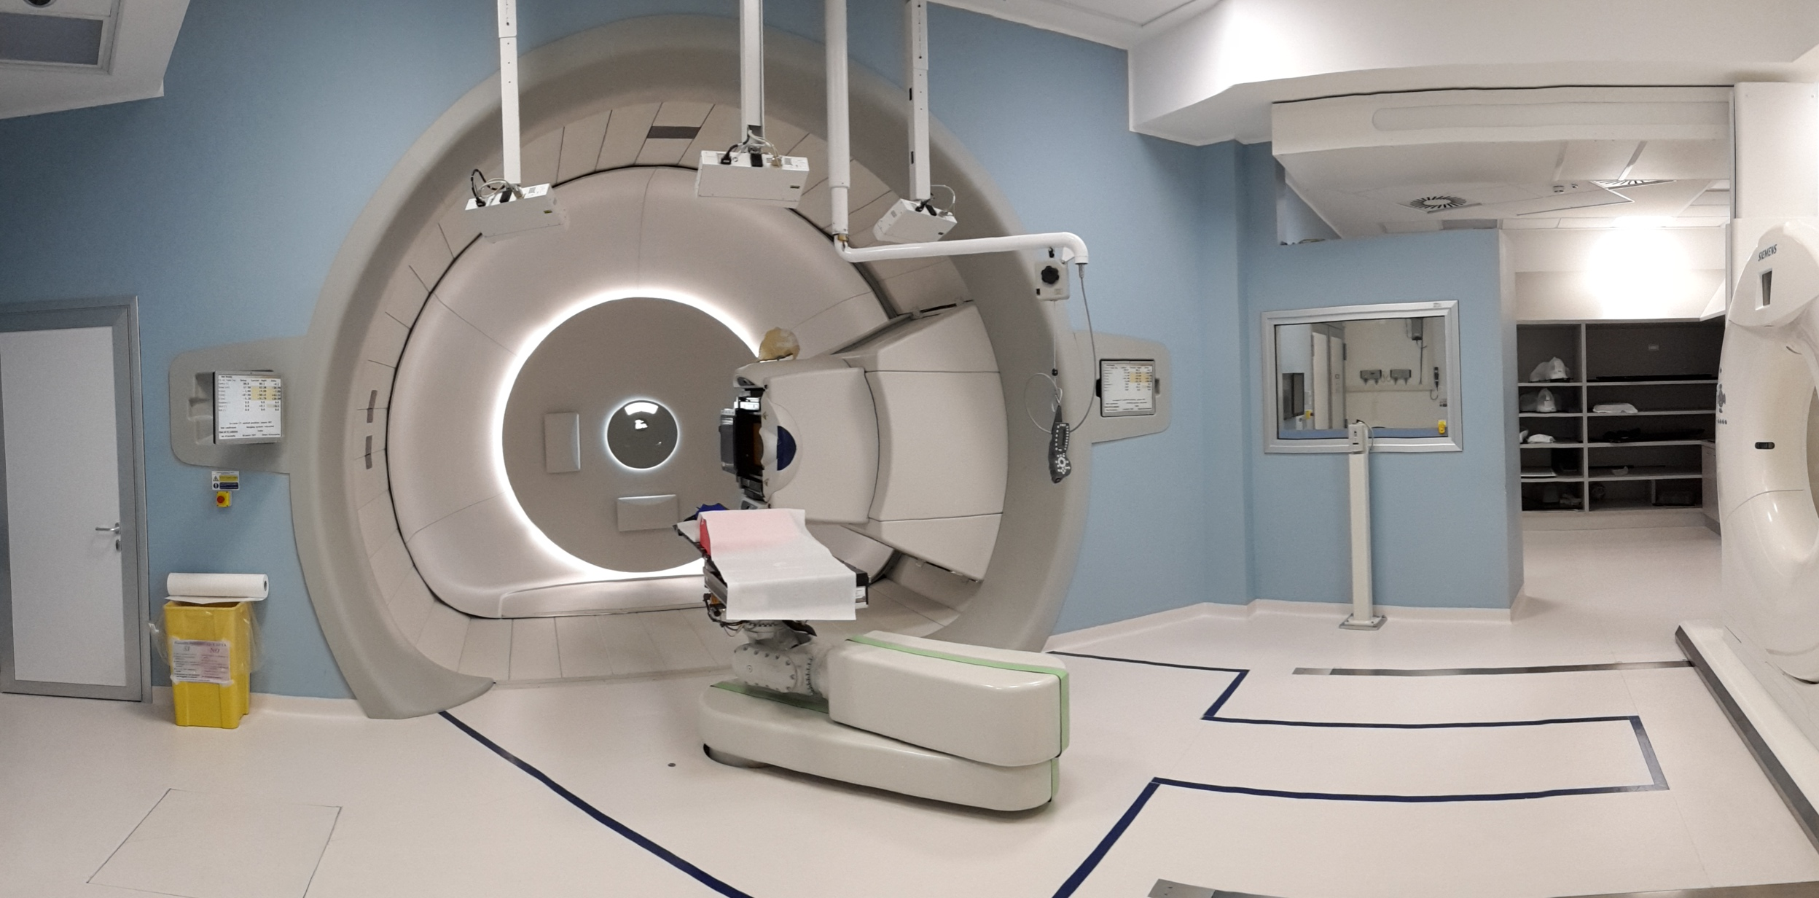
PRINTING & TESTING
PRINTING
TESTING
3D printing performed with a stereolithographic printer in Vero resin (StratasysTM) at UniTN-DICAM
Perfomed at the Proton Therapy Center of Trento (APSS):
Experimental room
  To test first 2DRM prototypes
Gantry
  Through the fabrication of a dedicated support and alignment system for the 3DRM (ProMTM)
  with dosimetric Tests and QA
R. Cristoforetti (M. Thesis), 2022
A. Taffelli, PhD
Grant Giovani INFN, Roma, Nov 19th, 2024

Slide 14
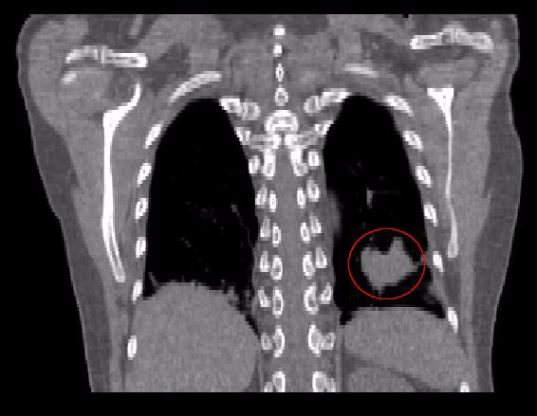
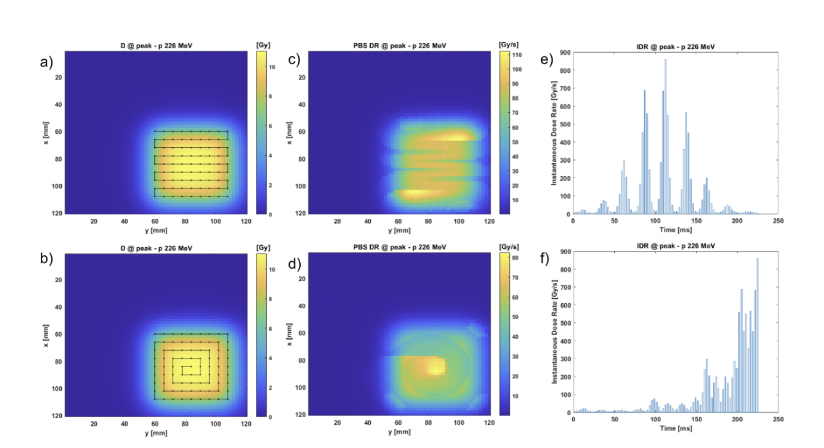
OUTLOOK
FORM-3D aims to make a concrete step towards the translation of FLASH proton therapy into clincs, in the framework of the PTC of Trento, to be possibly extended to other facilities
(but not only)
A part from Flash Radiotherapy, the project will be important also:
To speed up the current PT treatments, with an impact in the treatment of moving targets (e.g. Lung) and to better allocate the PTC resources
Create the basis for the use of FRED as an independent MC tool at the PTC of Trento for further research
Fast calculation of dose rate metrics with biophysical implications
Contribute to the development of FRED, due to a ongoing collaboration
Possible technological transfer
A. Taffelli, PhD
Grant Giovani INFN, Roma, Nov 19th, 2024

Slide 15
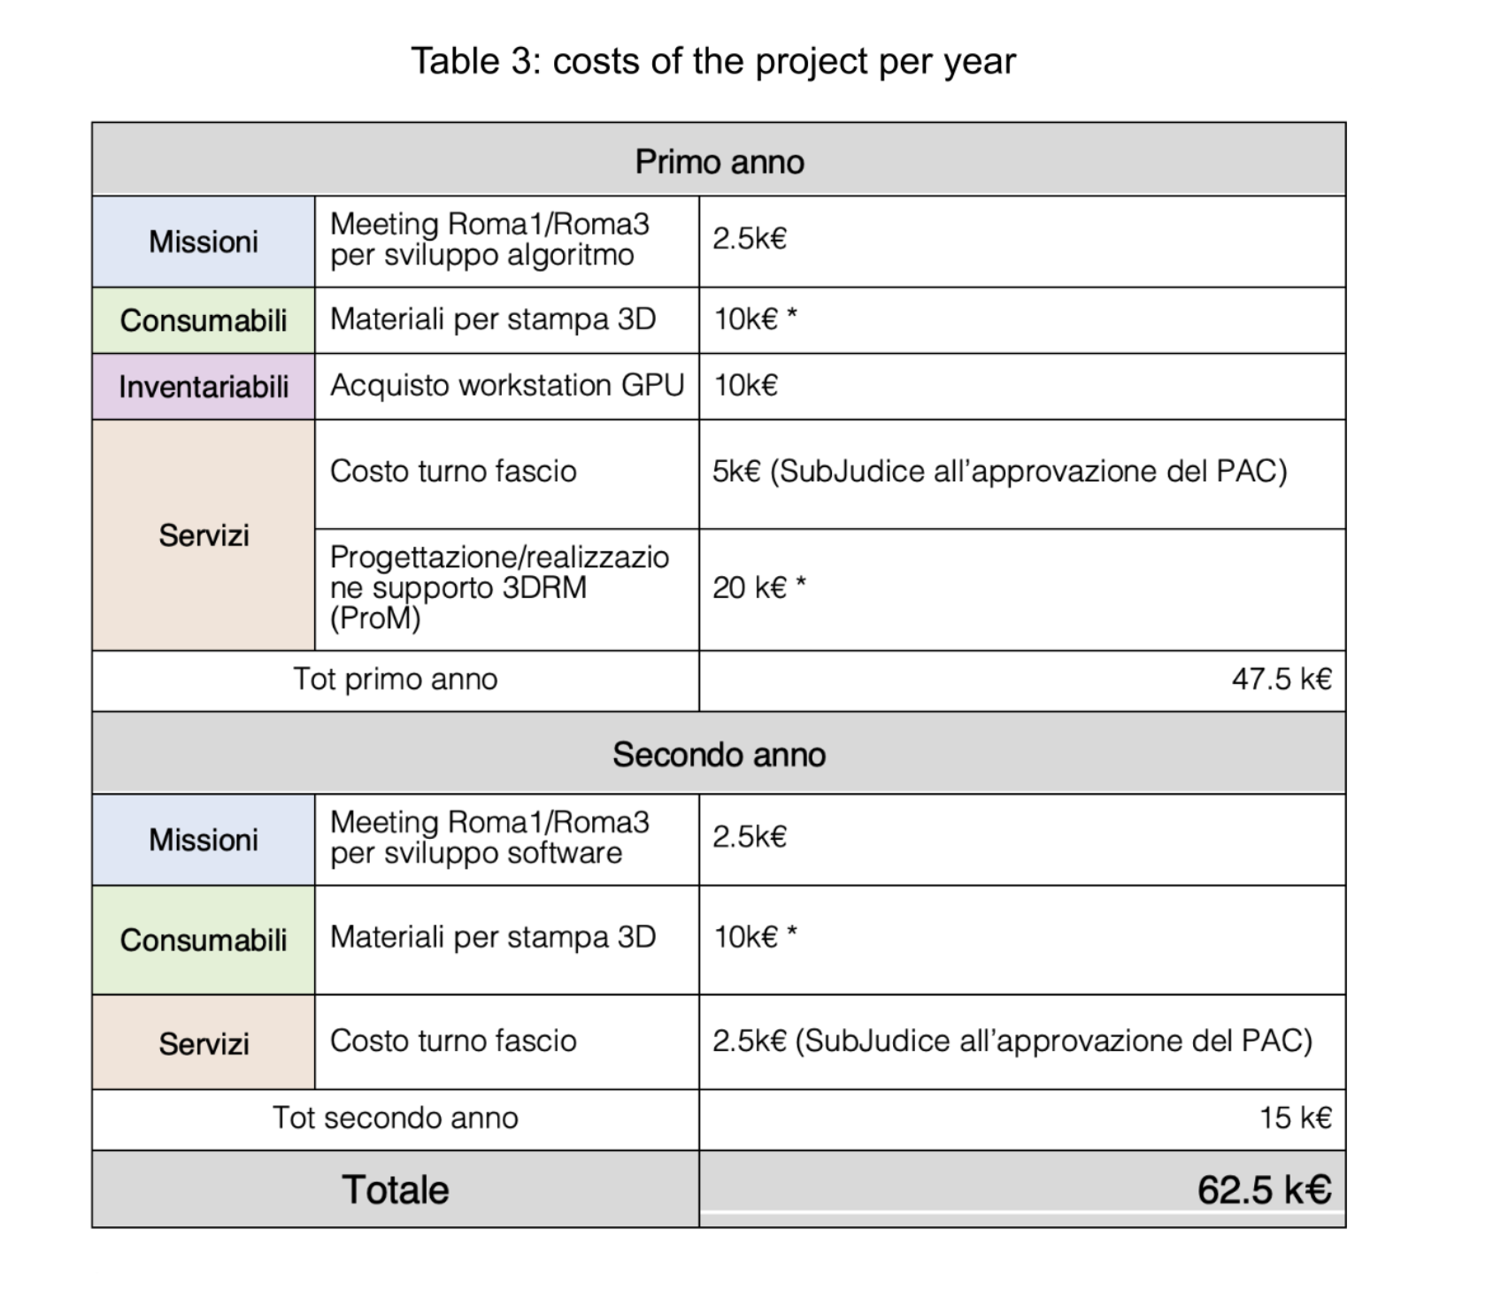
COSTS
A. Taffelli, PhD
Grant Giovani INFN, Roma, Nov 19th, 2024

Slide 16
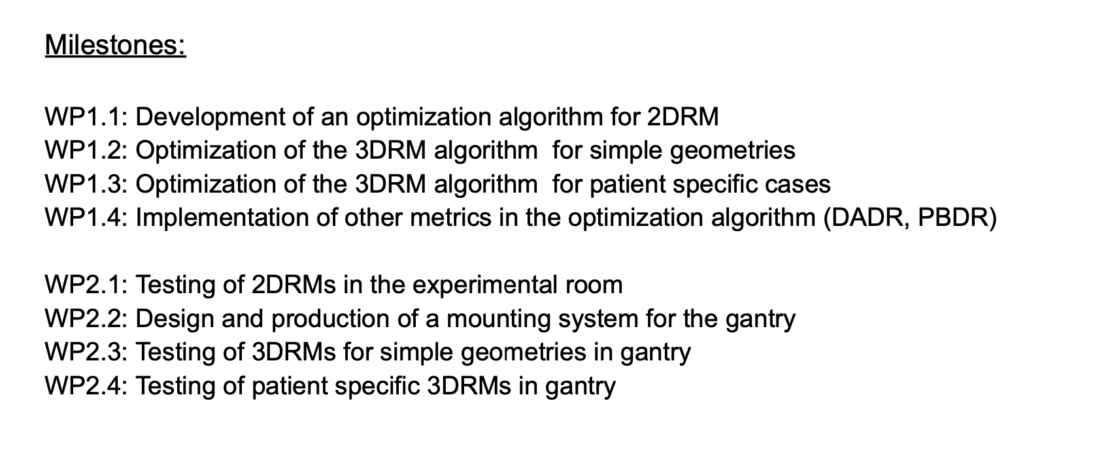
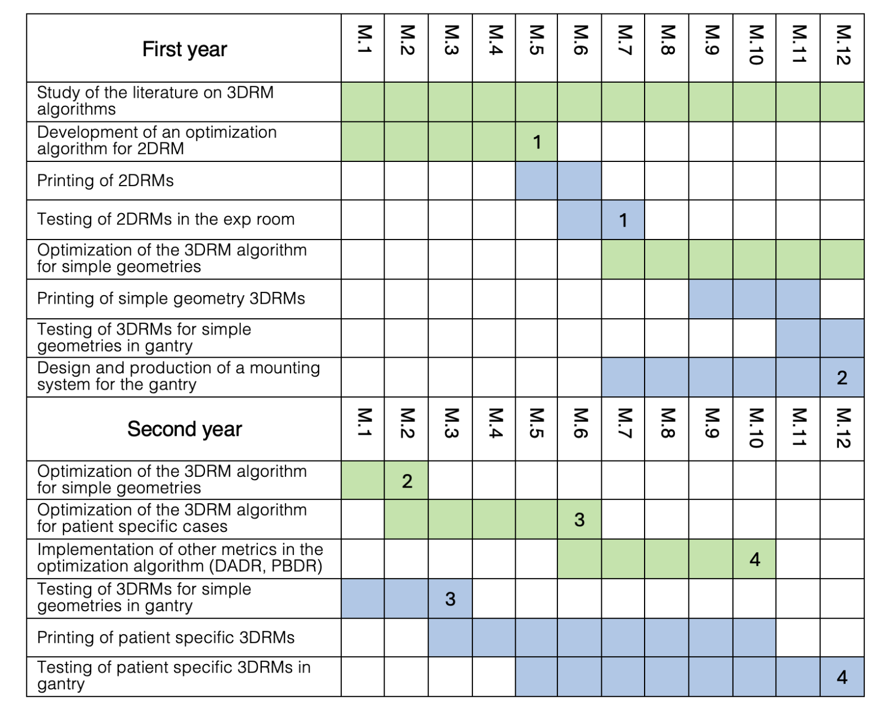
GANTT & WORKPACKAGES
A. Taffelli, PhD
Grant Giovani INFN, Roma, Nov 19th, 2024

Slide 17
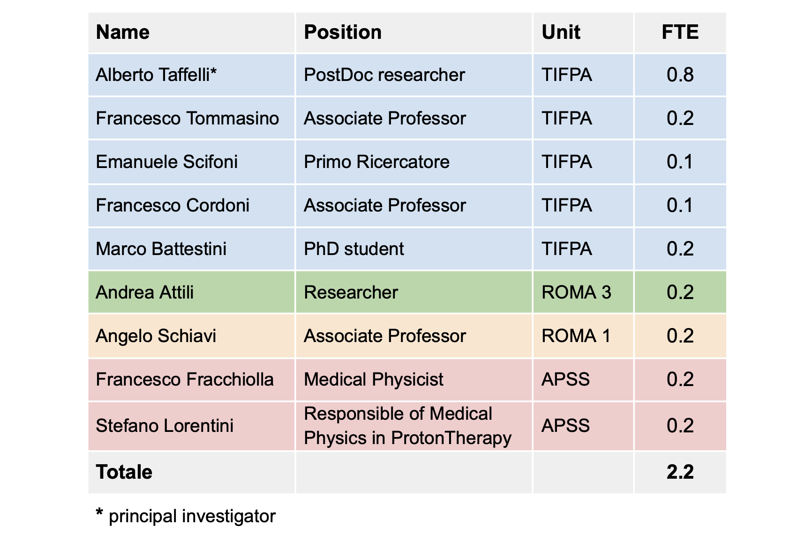
ORGANIZATION
Primo Ricercatore
A. Taffelli, PhD
Grant Giovani INFN, Roma, Nov 19th, 2024

Slide 18
FORM-3D:
Fast Optimization of Range Modulators 3D
Grant Giovani INFN, November, 19th, 2024
Alberto Taffelli
Rome, November, 19th, 2024

Slide 19
BACKUP SLIDES
A. Taffelli, PhD
Grant Giovani INFN, Roma, Nov 19th, 2024

Slide 20
3DRM DESIGN
1. Acquire and manage TPS data
1. Acquire and manage TPS data
2. Computation of 3D look-up-tables (LUTs)
2. Initial guess of the shape of a 3DRM
ITERATIVE LOOP
3. Optimization of Pin lengths and fluences
3. FRED simulation with the designed 3DRM
correction of the weights w_{l} associated to the pin’s lengths
4. MC Simulation
4. Fluence optimization
NO
5. Check clinical goals
5. Check clinical goals
YES
YES
PRINTING PROCESS
PRINTING PROCESS
A. Taffelli, PhD
Grant Giovani INFN, Roma, Nov 19th, 2024

Slide 21
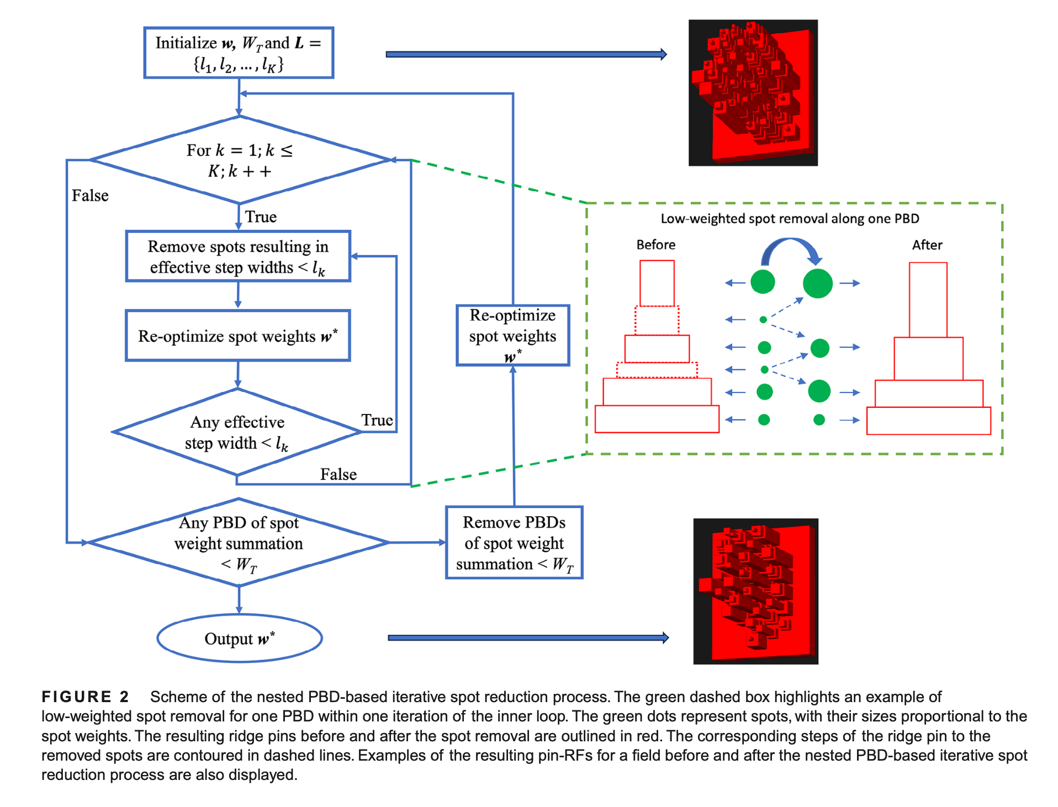
3DRM DESIGN
Ma et al. 2023
A. Taffelli, PhD
Grant Giovani INFN, Roma, Nov 19th, 2024

Slide 22
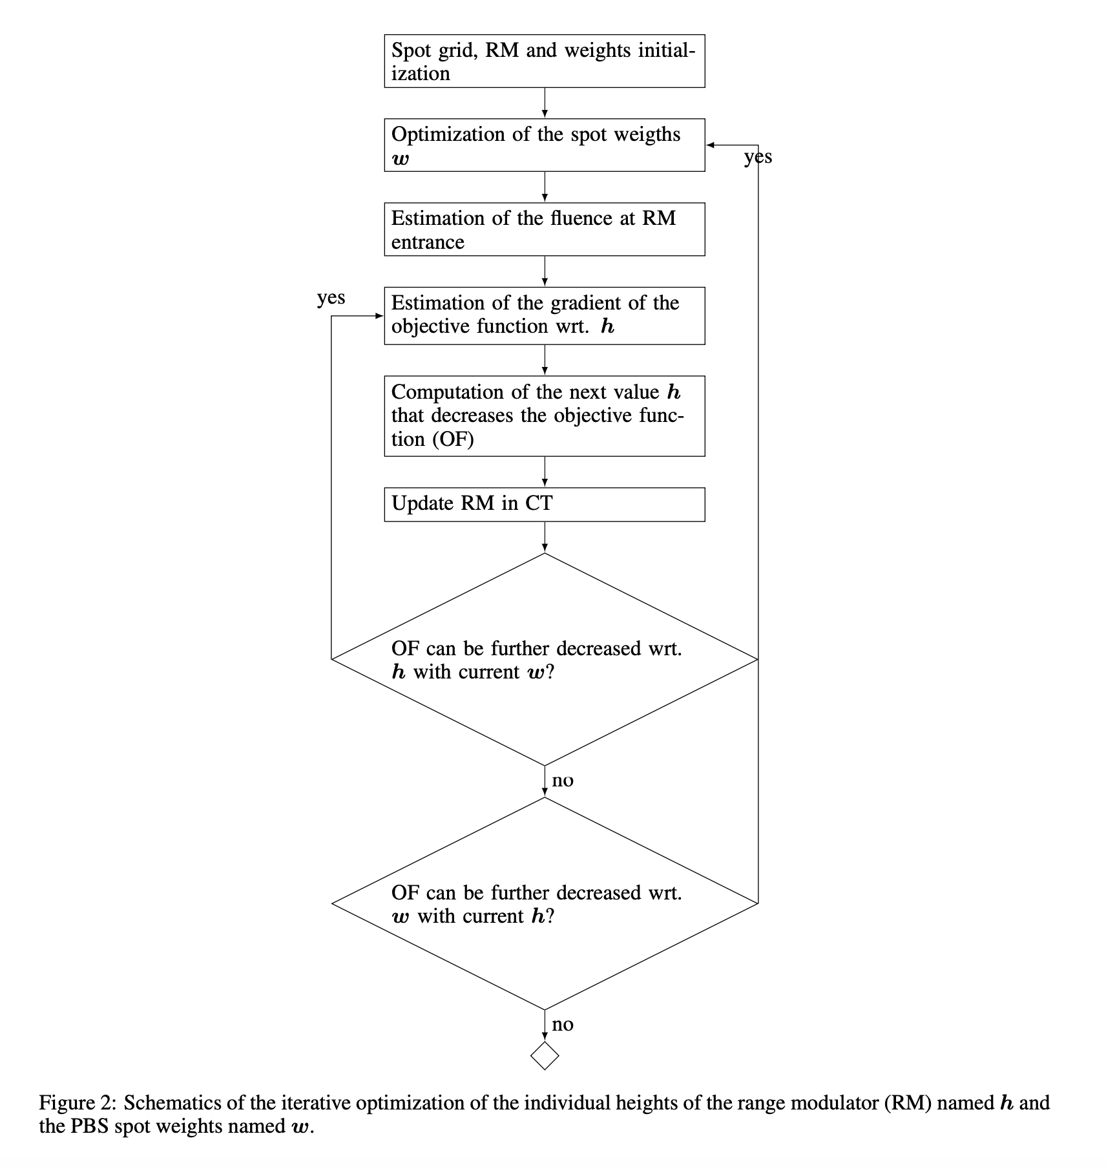
3DRM DESIGN
Deffet et al. 2023
A. Taffelli, PhD
Grant Giovani INFN, Roma, Nov 19th, 2024

Slide 23
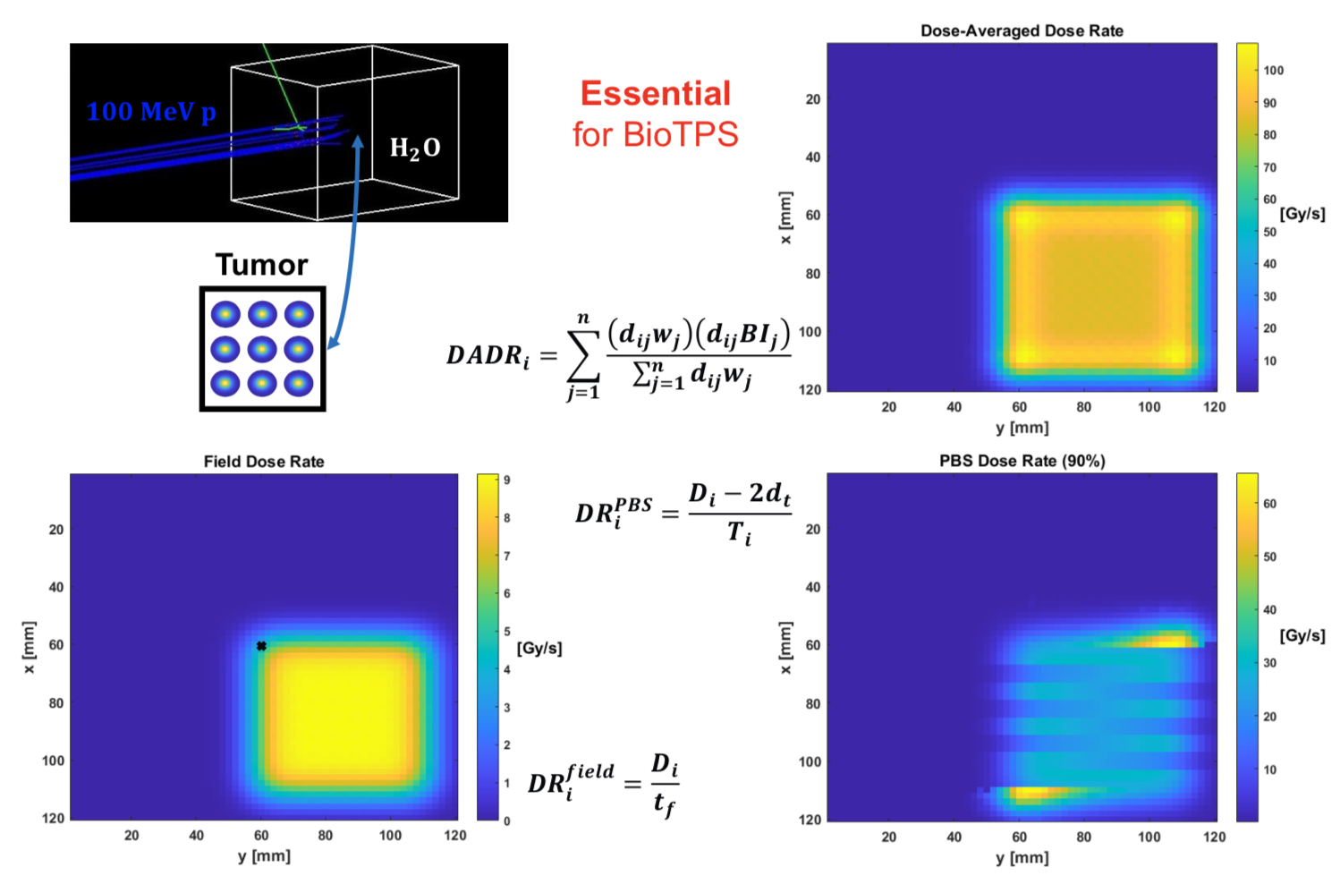
DADR PBDR metrics
A. Taffelli, PhD
Grant Giovani INFN, Roma, Nov 19th, 2024

