Slide 1




CSN 5 - GRANT GIOVANI RICERCATORI 2025
Perovskite-Hybrid Architecture for Spectroscopy and Energy-Counting of γ-Rays
Proposer: L.Margotti
Members: Dr. A. Ciavatti, Dr. I. Fratelli, Dr. S.M. Carturan, Dr. C. Sbarra, Prof. B. Fraboni

Slide 2
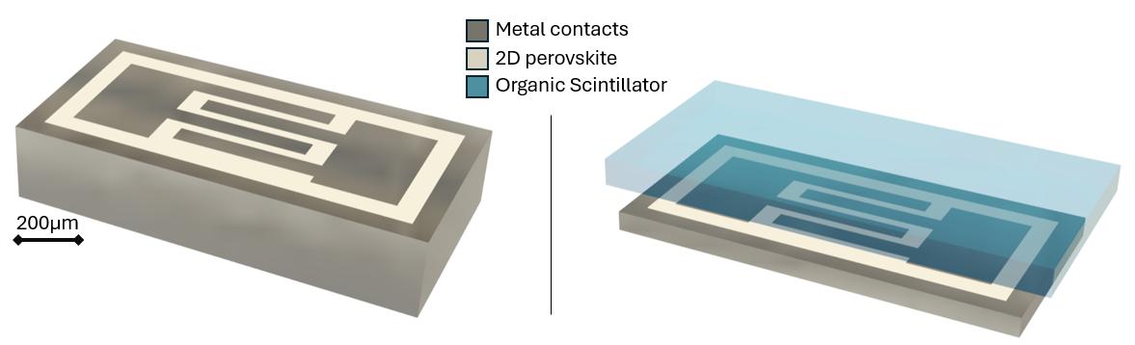
PEROVSKITE-Based γ-DETECTORS
A Proof of Concept towards printable, high-performance devices
Gamma SPECTROSCOPY (GS)
Single Pixel
PHOTON COUNTING Dev (PCD)
Single Pixel
1

Slide 3
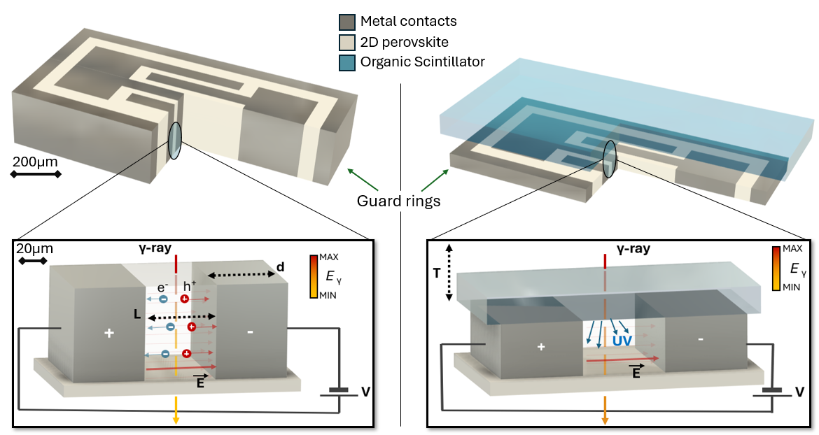
PEROVSKITE-Based γ-DETECTORS
A Proof of Concept towards printable, high-performance devices
Gamma SPECTROSCOPY (GS)
Single Pixel
PHOTON COUNTING Dev (PCD)
Single Pixel
2

Slide 4
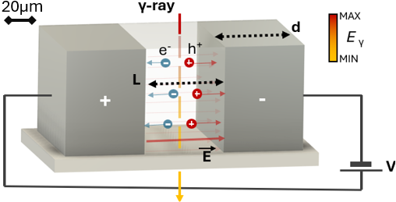
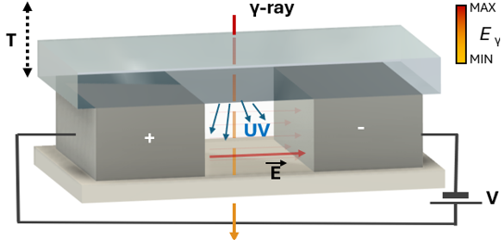
PEROVSKITE-Based γ-DETECTORS
A Proof of Concept towards printable, high-performance devices
Gamma SPECTROSCOPY (GS)
Single Pixel
PHOTON COUNTING Dev (PCD)
Single Pixel
Detector type: DIRECT
Area: A < 1mm²
Target aspect ratio: (10:1)
Key feature: high thickness for enhanced interaction volume
Detector type: INDIRECT/HYBRID
Area: A < 1mm²
Target aspect ratio: (1:1)
Key feature: organic-plastic scintillator on top for UV emission
3

Slide 5
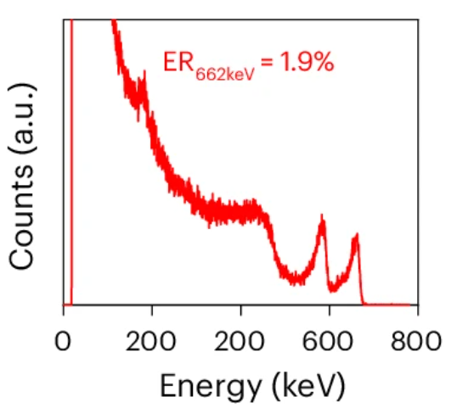
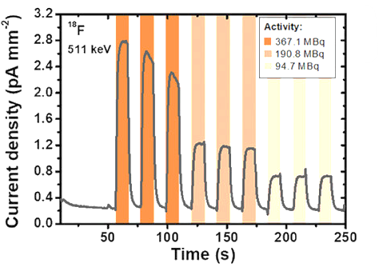
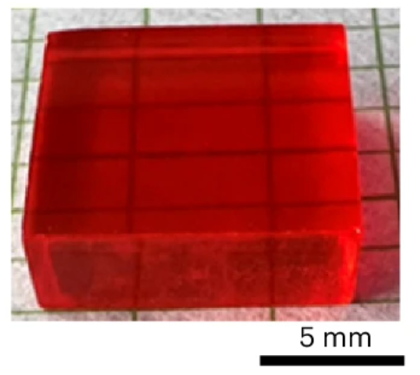
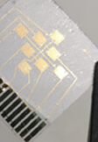
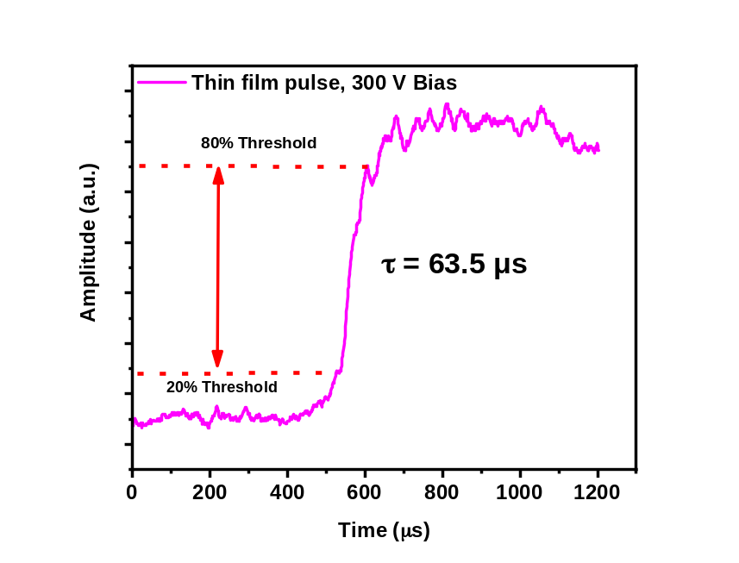
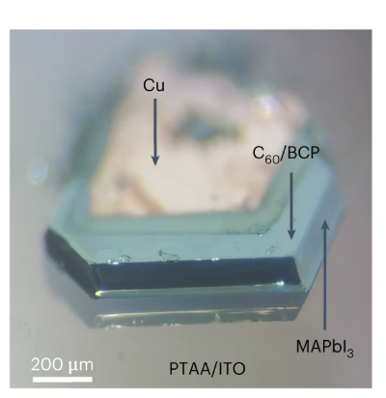
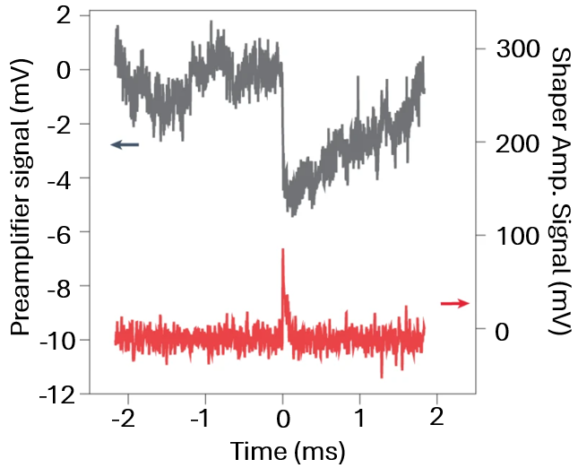
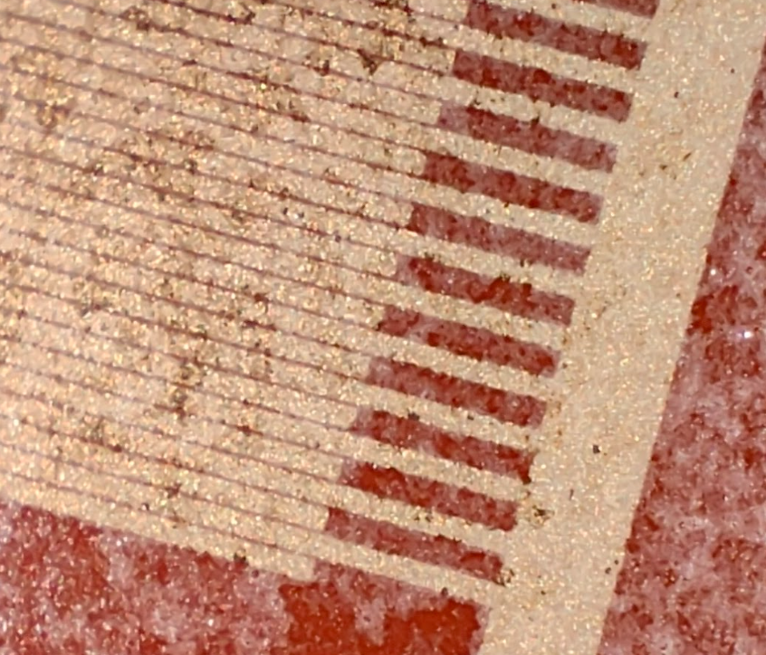
SINGLE CRYSTALS VS THIN FILMS
State of the art: coupling bulk performance with handling features
FAPbBr₃ – 3mm
PEA₂PbBr₄
Li, M., Wang, S., Wood, A. et al.
Nat. Mater. (2025)
400
Basiricò, L. et al.
Adv. Health. Mat. (2024)
MAPbI₃ - 110 µm
α event from ²⁴¹Am (5.48MeV)
PEA₂PbBr₄
γ event
²⁴¹Am (60keV)
300V
Margotti, L. et al.
IEEE NSC, MIC, RTSD 2024
Sakhatskyi, K. et al.
Nat. Photon. (2023)
4

Slide 6
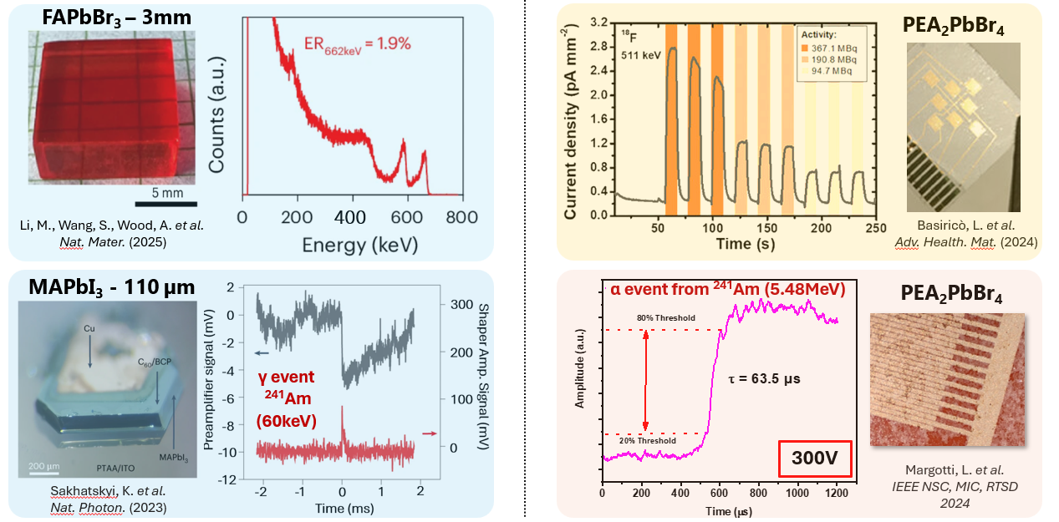
SINGLE CRYSTALS VS THIN FILMS
Coupling bulk performance with handling features
PHASE-g
IDEA
3D-ELECTRODE ARCHITECTURE based on SOLUTION PROCESSED 2D-PEROVSKITE
Device GOALS
LOW COST
SCALABLE
PIXEL DEVICES FOR γ-COUNTING/ ENERGY SPECTROSCOPY
Performance TARGETS
SINGLE-DIGIT ENERGY RESOLUTION
(<2 pcs/mm²) DARK COUNT RATE
FOR CLINICALLY RELEVANT ENERGIES
5

Slide 7
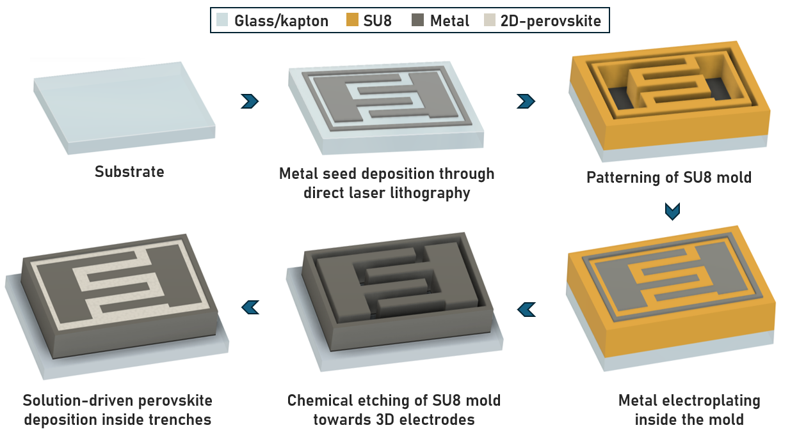

PEROVSKITE-Based DETECTORS
How do we reach bulk-like performance?
Solution processing is a must!
6

Slide 8
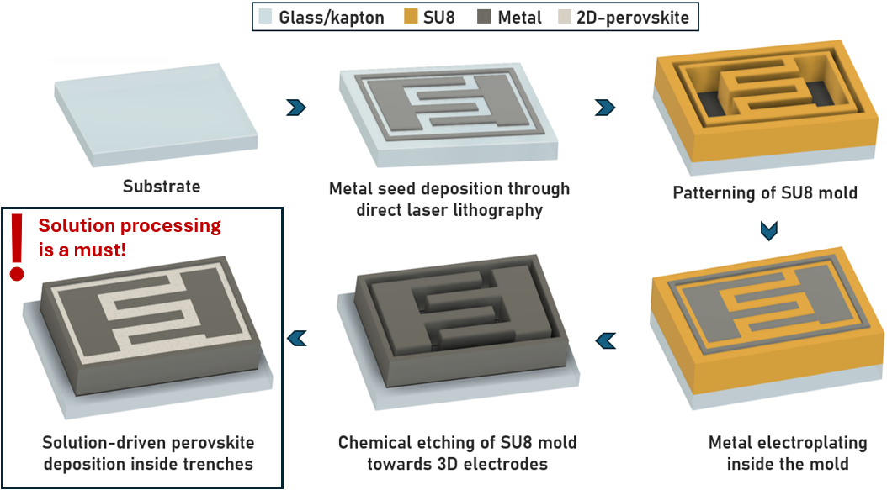
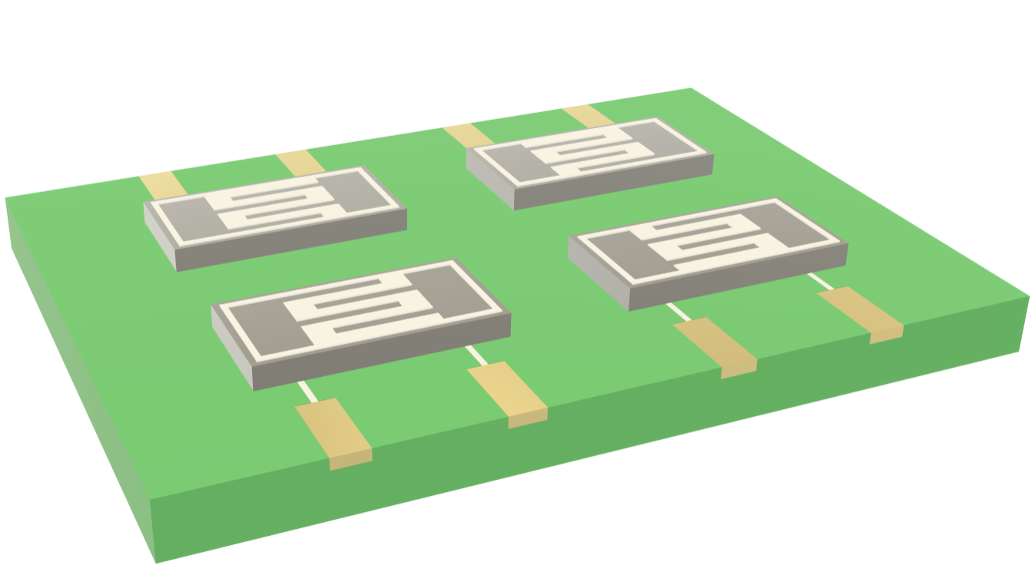
PEROVSKITE-Based DETECTORS
How do we reach bulk-like performance?
Envisioning PCB-printed Multielectrode Arrays…
Commercially available PCB
7

Slide 9
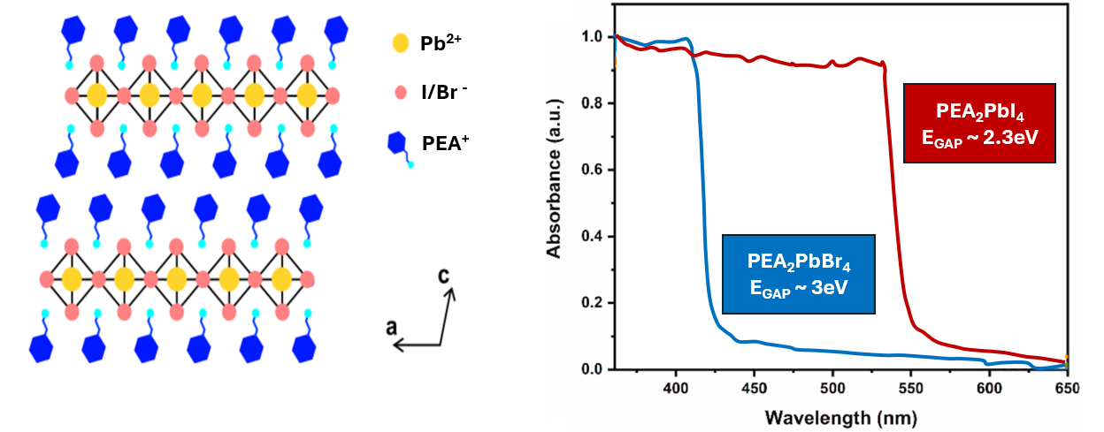
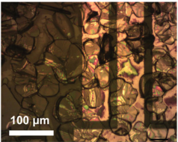
2D PEROVSKITES: PEA₂Pb(Br/I)₄
Featuring highly resistive, more stable structures
Quantum + dielectric confinements
Features of interest compared to 3D perovskites
✅ Larger bandgap → Fewer thermally excited carriers
✅ Lower trap density → Reduced trap-assisted leakage
✅ Dielectric confinement → Less unintentional carrier injection
✅ Reduced ion migration → Limited degradation
Lower dark current (10⁻¹³A @ 1kV/mm)
Higher stability
8

Slide 10
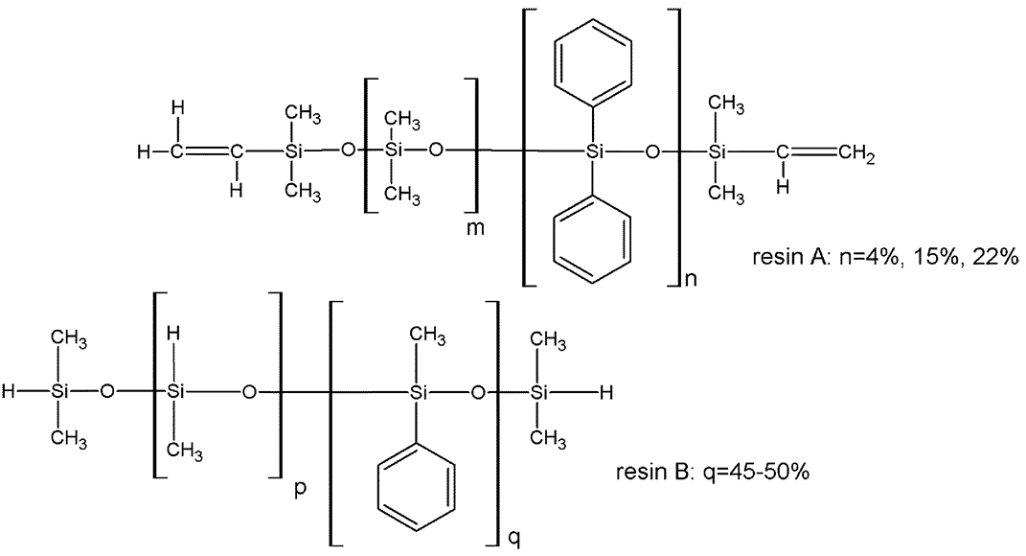
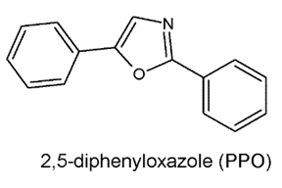
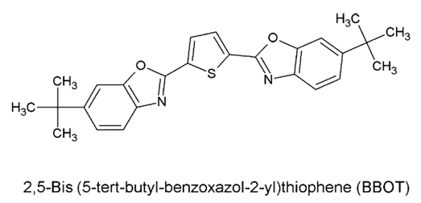
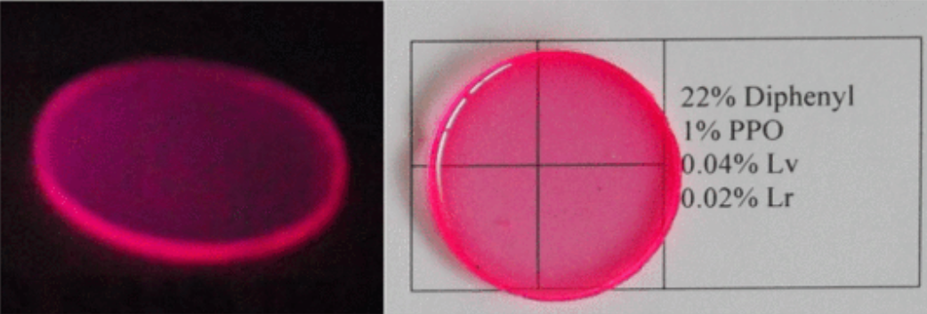
ORGANIC-PLASTIC SCINTILLATOR
Materials and Coupling
PMPS :polydimethyl-co-diphenylsiloxane scintillators
Phenyl groups /dyes: examples
Tunable properties through chemical optimization!
Goals:
✅Peak brilliance in the UV range (320-380nm)
✅Light yield under γ-sources at RT (60% rel. EJ212 under
¹³⁷Cs γ-rays, i.e. 5/7x10³ ph/MeV))
✅Precise optical coupling with 2D perovskites
M. Dalla Palma et al. , 2024,
IEEE Transactions on Nuclear Science
9

Slide 11
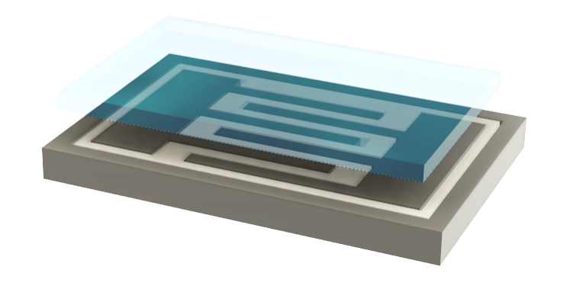



OPTIMIZATION OF GEOMETRICAL PARAMETERS
GEANT4 for feedback-driven analyses
PARAMETERS OF INTEREST
Electric field inside the trenches
Structural features (thickness, width, area)
Optical coupling (emission and absorption matching)
FEEDBACK-DRIVEN SIMULATIONS will provide optimal combination of parameters according to fabrication and desired outcomes.
Required material physical parameters (density, refractive index, charge carriers mobility, μτ product, absorption/transmission coefficients, light yield) have been assessed in previous works or will be determined through dedicated tests onsite.
10

Slide 12
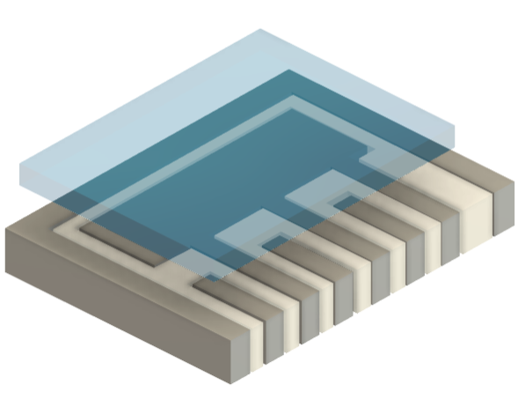
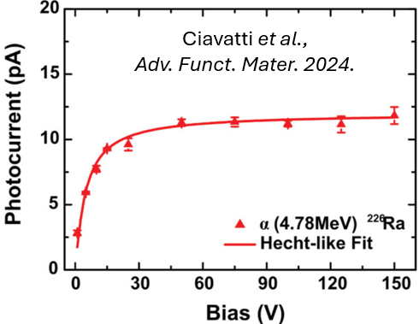
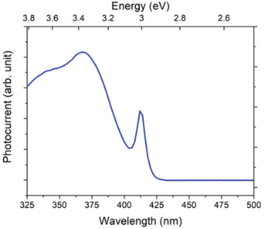
CORE CHARACTERIZATION
Device-level assessments of GS and PCD
  1. STRUCTURAL
  ANALYSIS
  2. BASIC PERFORMANCE ASSESSMENTS
  3. RADIATION DETECTION
J-V and C-V curves, PL and Abs spectra
Pulsed analyses
Scintillator photon yield and spectral distribution.
Cross-section (SEM) for perovskite filling
Surface topography (AFM / 3D profilometry) for excess material.
Ledee et al.
Adv. Optical Mater. 2022
X-rays: sensitivity, time response, dose-rate linearity, LOD, radiation hardness.
α-particles: single pulse detection, μτ product.
PL spectrum of PEA₂PbBr₄ thin film
11

Slide 13
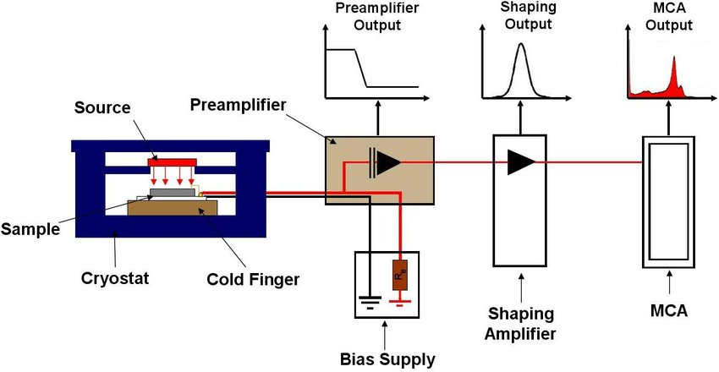
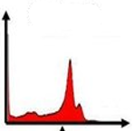

TESTING under GAMMA SOURCES
Performance assessments
PC: FAST CSA (0.16 fC ENC) + 3.2 GS/s DIGITIZER for nanosecond-scale pulse acquisition.
Single-photon detection capability
Sensitivity
Count-rate stability
Impact of hybrid contribution
GS: low-noise CSA + shaper (up to 100μs) + Digital MCA
Tuneable Source-Sample distance
(1-50 mm)
  Charge Collection Efficiency
  Linearity
  Energy resolution
Available Gamma Sources
LOWEST ENERGIES | HIGHEST ENERGIES | MID-RANGE ENERGIES
²⁴¹Am | ¹³⁷Cs - ⁶⁰Co | ¹³³Ba
59.5keV | 662keV – 1.17 & 1.33MeV | 81, 160, 223, 356 keV
Lines in clinically relevant ranges for SPECT (^{99m}Tc, 140keV)!
12

Slide 14


APPLICATIONS AND PROSPECTS
Expected impact
New prospects for γ-cameras:
✅ Reduction in volume and cost
✅ Extension to printable and large area devices
✅ Real-time monitoring of radiotracers and spectroscopic dosimetry
Sinergy with the POR-FESR FORTRESS PROJECT (Fraboni) at IRCSS Reggio Emilia, which is now provided a novel SPECT-CT (source: ⁹⁹mTc, major γ-peak at 140keV).
Compound detectors for nuclear physics
✅ Tiled arrays for localized γ-radiation mapping
✅ Low-dose γ-monitors
Onboard dosimeters
✅ Low-dose γ-monitors
Potential follow-up for the ASI-VUS3 IRIS project (INFN-TTlab) for Wearable Dosimeters for the Crew Members Onboard the ISS.
13

Slide 15






TECHNICAL CONSIDERATIONS
Risk Management and Requests
Possible Issues and Mitigation
COSTS
VOICE | YEAR 1 | YEAR 2
Missions | 5k | 5k
Disposables | 10k | 5k
SMU 4200A-SCS* | 53k
Pulsed Meas. U. |  | 37k
DMCA + CSA |  | 13k
SPC-Module |  | 5k
TOTAL | 68k | 65k
Empty trenches / excess material
Sonication-assisted deposition / lapping techniques
Environmental issues / external light contribution
Deposition of Parylene-C encapsulation layer
Poor γ absorption
SJI / Metal Ink deposition for trenches height increased up to 500μm.
Interface losses between perovskite and scintillator
Dedicated resin / cement of matched refractive index
Delays in electronic instrumentation delivery
* Co-funding with Dip.Fis. Bologna
Analog spectroscopic chain / Electrometer …
14

Slide 16

Conclusions
PHASE-g aims at validating a novel approach to perovskite-based γ-ray detectors, which merges the bulk properties of Single Crystals with the major advantages of interdigitated structures.
It provides:
➡ An Innovative dual structure which relies on 3D interdigitated electrodes
➡ A dedicated study on PMPS-based scintillating device for photon counting
➡ A spectroscopic device for γ-rays of different doses and energies
➡ Tests with clinically relevant radiation energies
It opens up new paradigms for detectors fabrication and thus scalability to large-area, pixelated multielectrode arrays.

