Slide 1




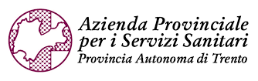



Marco Battestini, Ph.D.
PAVIA
NAPOLI
INFN CSN5 “Grant Giovani” proposal, Rome, 01/12/2025

Slide 2
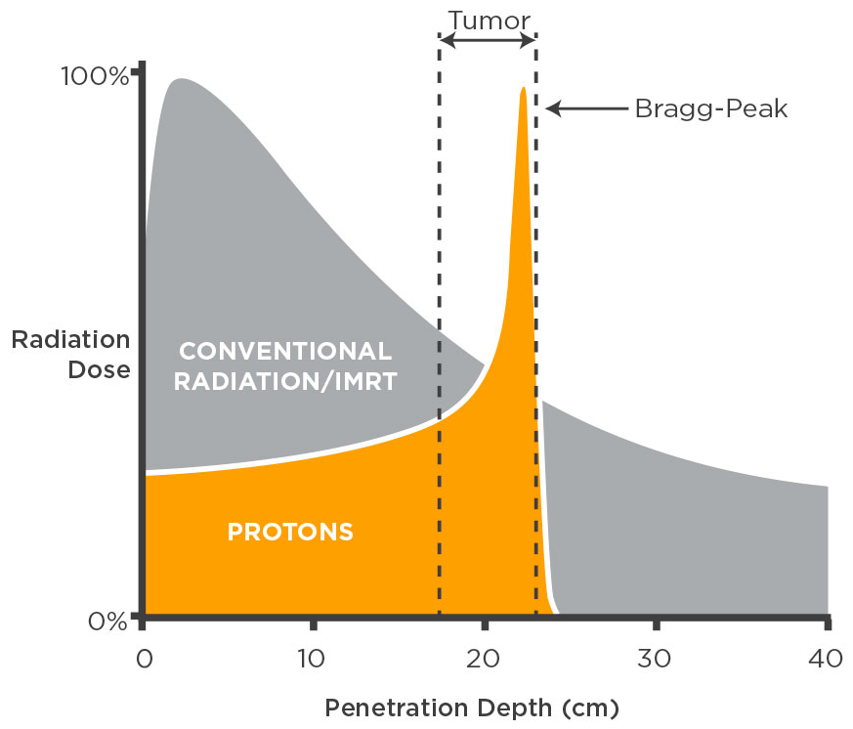
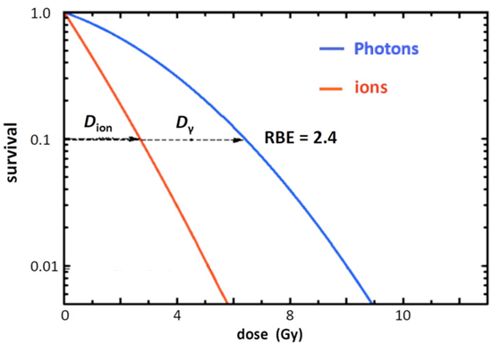
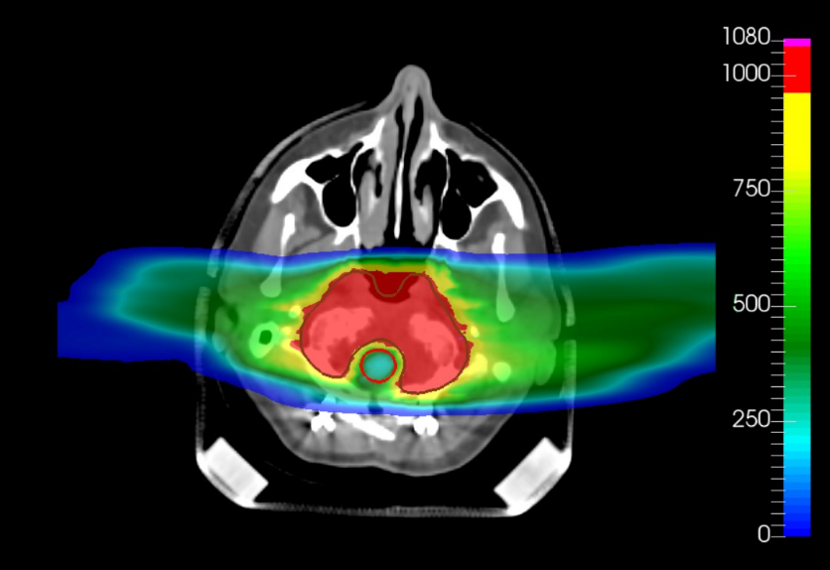


Particle Therapy (PT)
General goals of RadioTherapy (RT):
  Controlling the tumor
  Sparing as much as possible healthy tissues, in order to reduce normal tissue toxicity
PT: physical and biological ($Z>1$) advantages
Map in per mil of dose prescription
Tumor
PHOTONS
IONS
U. Amaldi et al., CERN Yellow Reports (2019)
Organ at risk
Relative Biological Effectiveness $⟶$clinics $⟶$from in-vitro data
$$RBE={\left.\frac{D_{photon}}{D_{ion}}\right|}_{isoeffect}$$
M. Battestini et al., Front. Oncol. (2022)

Slide 3
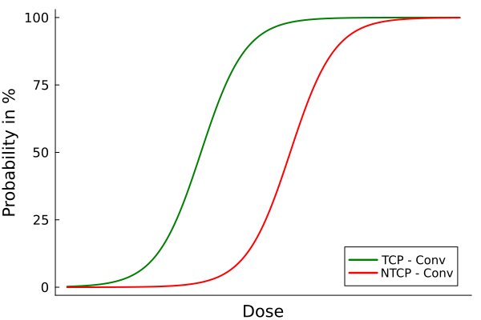
NTCP models in literature for standard RadioTherapy (RT)
Phenomenological models
e.g. Lyman-Kutcher-Burman (LKB) model
Particle Therapy (PT)
Tumor Control Probability (TCP)
Normal Tissue Complication Probability (NTCP)
To quantify the quality of treatment plans
NTCP
Lacking a solid foundation in radiation biophysics
Statistical models
e.g. uni- and multi-variate (MVA) logistic analyses
Mechanistic models
e.g. Relative Seriality model

Slide 4
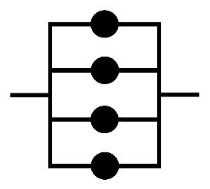
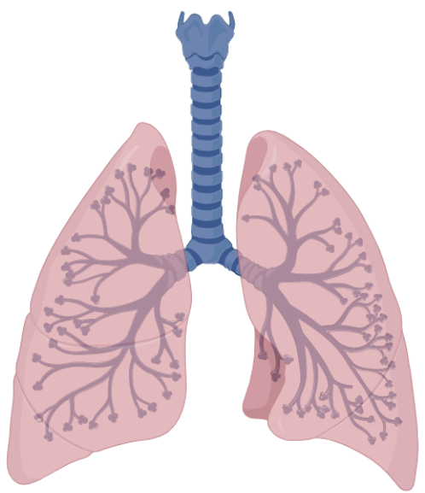
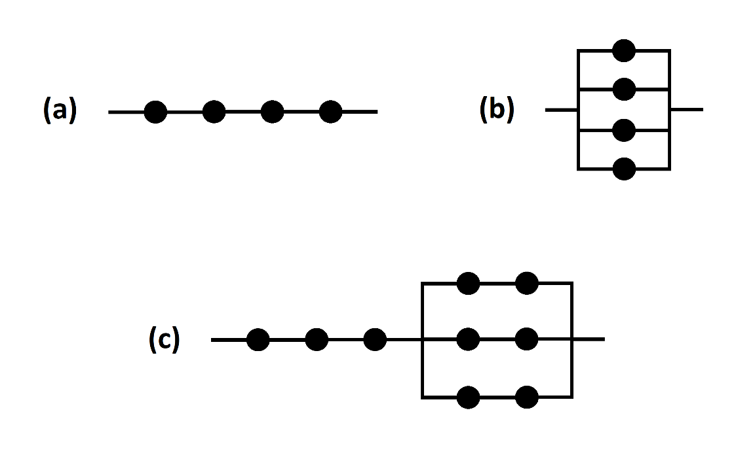
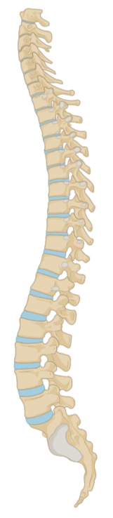
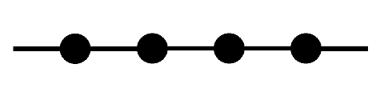
Tissue architecture and volume effect
Parallel organ
Any FSU remaining preserves organ function
Toxicity induction linked to mean dose
Large volume effect
e.g. lung, parotid gland
FSU
Tissue architecture
Functional sub-units (FSUs) arrangement
More realistic scenario
Inactivation of any FSU leads to complication
Toxicity induction linked to maximum dose
Small volume effect
e.g. spinal cord, oesophagus
Volume effect How an organ responds to a damage depending on its tissue architecture
Serial organ
M. Battestini et al., Front. Oncol. (2022)
P. Kallman et al., Int. J. Radiat. Biol. (1992)

Slide 5
Mechanistic NTCP: the Relative Seriality model
Parallel organ
FSU
Tissue architecture
Functional sub-units (FSUs) arrangement
Poisson statistical model
P. Kallman et al., Int. J. Radiat. Biol. (1992)
Physical and biological stochasticities and bio-chemical environmental heterogeneities
Serial organ

Slide 6
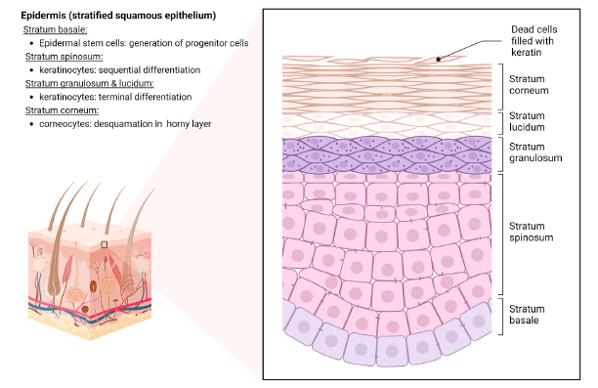






Radiation-induced skin toxicity
Skin toxicity
Common in all radiation treatments
Complex multi-layered architecture with specific bio-chemical properties and functions
NTCP models in literature
$${ O}_{2}$$
ROS
$${ OH}^{∙}$$
Epidermis
Dermis
$${{ O}_{2}^{∙}}^{−}$$
Radiation toxicity influenced by radiation chemistry (free radicals, ROS, XSH, O₂)
XSH
Hypodermis
Rübe et al., Int. J. Mol. Sci. (2024)
Y. Shindo et al., J. Invest. Dermatol. (1994)
N. Chettouh-Hammas et al., Oxid. Med. Cell. Longev. (2024)

Slide 7
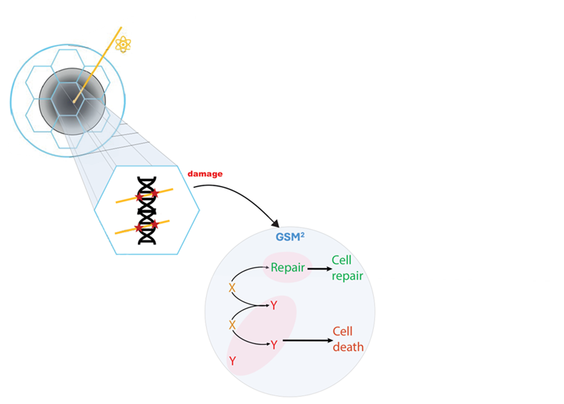
Modeling starting point
The Generalized Stochastic Microdosimetric Model (GSM²)

Slide 8
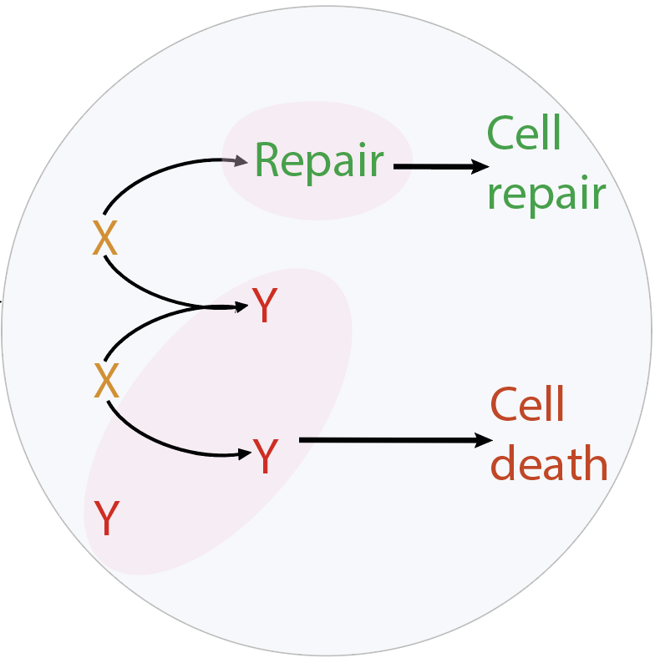

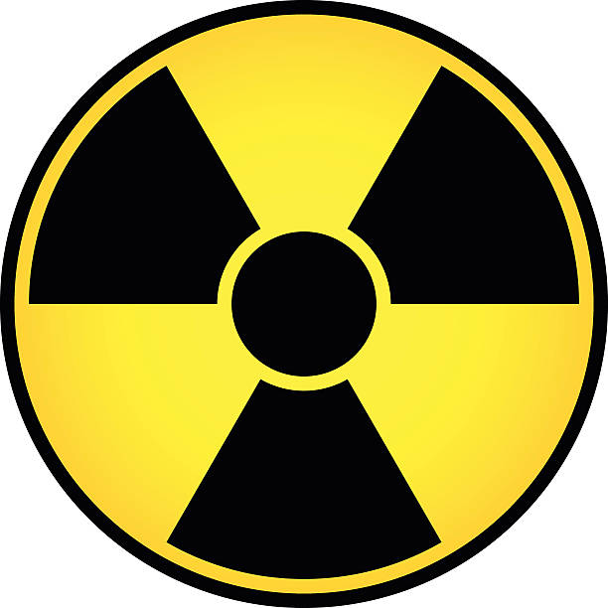
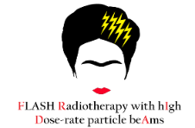




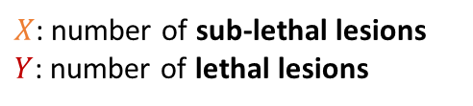




The Generalized Stochastic Microdosimetric Model (GSM²)
1) DNA damage formation
2) DNA damage evolution
3) Biological endpoint
$X$: number of sub-lethal lesions
$Y$: number of lethal lesions
$r, a, b$ depend on cell type
Development and validation
MUSICA
$$r$$
F. G. Cordoni et al., Phys. Rev. E (2021)
F. G. Cordoni et al., Rad. Res. (2022)
F. G. Cordoni et al., Int. J. Radiat. Biol. (2023)
G. Bordieri,…, M. Battestini, et al., Phys. Med. Biol. (2024)
Cell survival
$$b$$
Extensions
$$a$$
M. Battestini et al., Front. Phys. (2023)
M. Battestini et al., Radiother. Oncol. (2025)
GSM²: a fully probabilistic radiation biophysical model
Different levels of spatio-temporal stochasticity in physics and biology

Slide 9
The project

Slide 10
The main goal of the project
MUSICA
ARES
Mechanistic radiation biophysical models
Innovative experimental methods
Treatment planning approaches
Radiation-induced toxicities studies
A novel combined mathematical modeling- experimental approach for PT

Slide 11

Workpackages organization
WP1: NTCP modeling for particle therapy
WP1.2
  Development of a general mechanistic-driven NTCP model
  Systematic analysis of model parameters
  Applications of the NTCP model to in-vivo experimental data from literature
  Model extension towards clinically relevant predictions for simple geometries
PAVIA
NAPOLI
WP1.1
WP1.3
WP2.2
  Irradiation of multi-layer tissues with X-ray and proton beams
  Bio-chemical and histological analyses
  Development of a specific mechanistic-driven model for skin lesions
  Calibration of bio-chemical model parameters on in-house skin data
WP2.1
WP2.3
WP2: Skin toxicity modeling and proton beam experiments

Slide 12
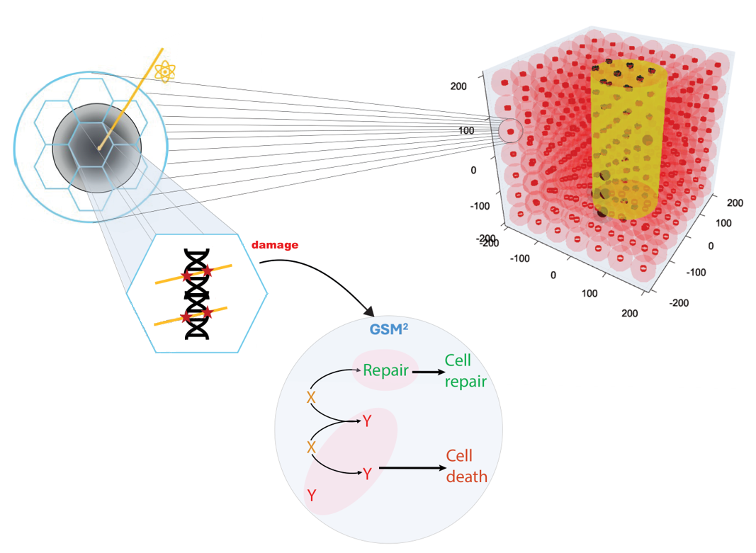




The workflow of the GSM²-based NTCP model
(iv) Whole organ effect
Beam
(i) Energy deposition
  General model development
NTCP/TCP
Relative Seriality model
WP1.1
$$z$$
Cell
P. Kallman et al., Int. J. Radiat. Biol. (1992)
  General model validation
FSU
WP1.2
Functional sub-unit (FSU)
  Model extension to clinic
(ii) DNA damage formation
$$r$$
Cell survival
WP1.3
$$b$$
Main advantage:
inclusion of intra- and inter- cellular effects
$$a$$
(iii) Single-cell response

Slide 13

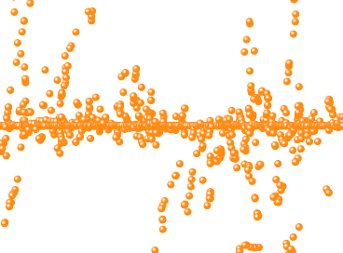

From single cell description to multi-cellular response
Fractionation scheme
Oxygenation level
  General model development
Radiation quality
Cell line
WP1.1
  General model validation
GSM²
WP1.2
Dose prescription
Tissue architecture
  Model extension to clinic
WP1.3
NTCP
Impact of irradiation methods and environmental conditions
Impact of stochastic effects and heterogeneities
GSM²-based NTCP model VS NTCP models from literature

Slide 14
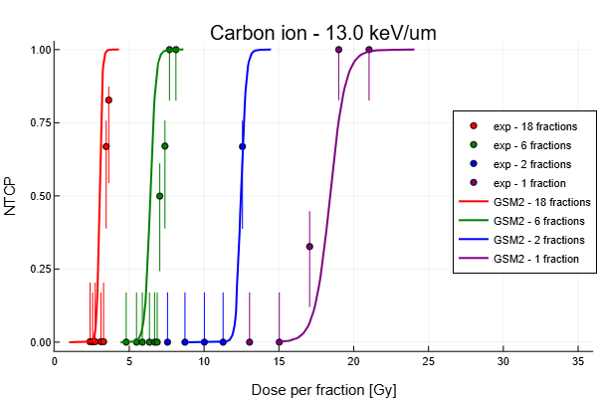

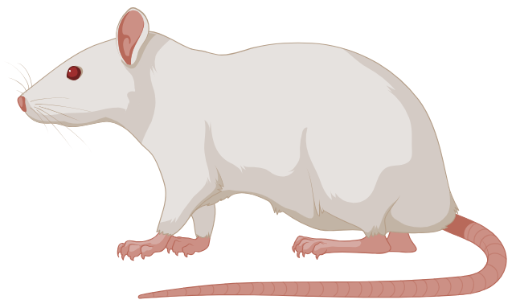
Comparison of model predictions with experimental data
Prof. C. P. Karger (see letter)
  General model development
WP1.1
  General model validation
Rat spinal cord
Conv irradiation
¹²C, ⁴He, p
18, 6, 2, 1 fractions
WP1.2
Preliminary results
Exp: M. Saager et al., Radiother. Oncol. (2018),
L. Hintz et al., Radiother. Oncol. (2022),
C. P. Karger et al., Int. J. Radiation Oncology Biol. Phys. (2006)
  Model extension to clinic
WP1.3
Assumptions: fully serial organ, single cell line, uniform oxygenation
Complex parallel organs (e.g. lung) predictions
Possible interplays among radiation quality, fractionation scheme and biological endpoint
Tumor response predictions

Slide 15
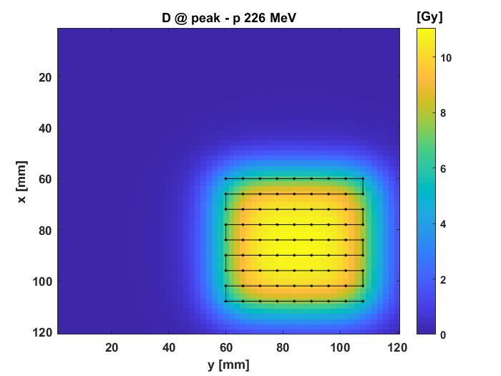







Model extension for clinically relevant applications
Prof. F. Lohr (see letter)
  General model development
WP1.1
$$D_{ij}$$
$${LET}_{ij}$$
$$ij$$
  General model validation
TCP/NTCP
WP1.2
GSM²
Tumor/organ response
$$S_{ij}^{k}$$
$$ij$$
  Model extension to clinic
Healthy organ
WP1.3
Tumor
Cell line
$$ij$$
$$O_{2}$$
Possible spillovers
Biophysics-driven plan optimization methods

Slide 16

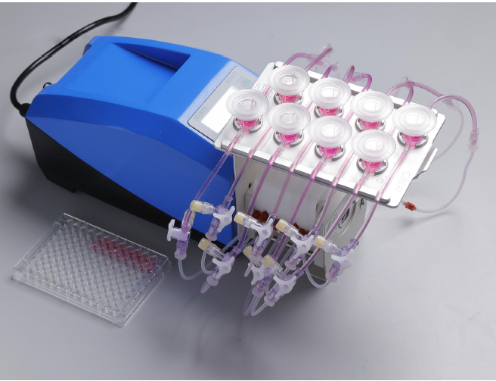
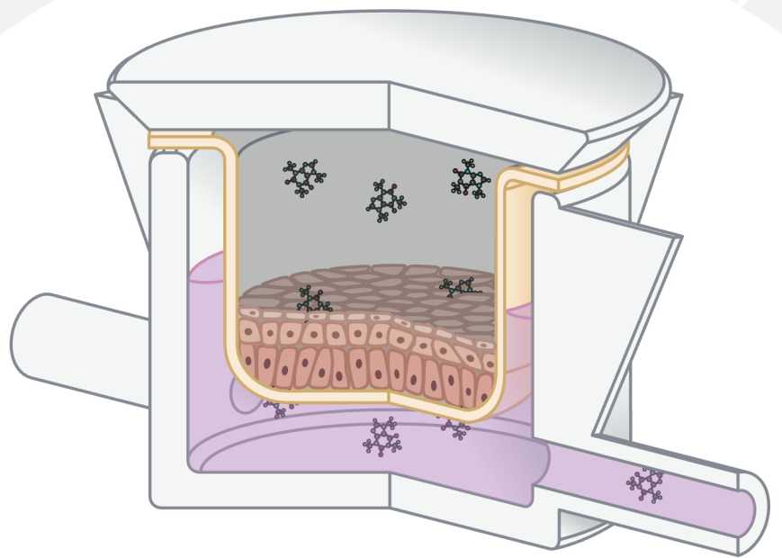
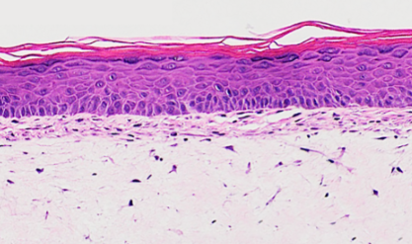
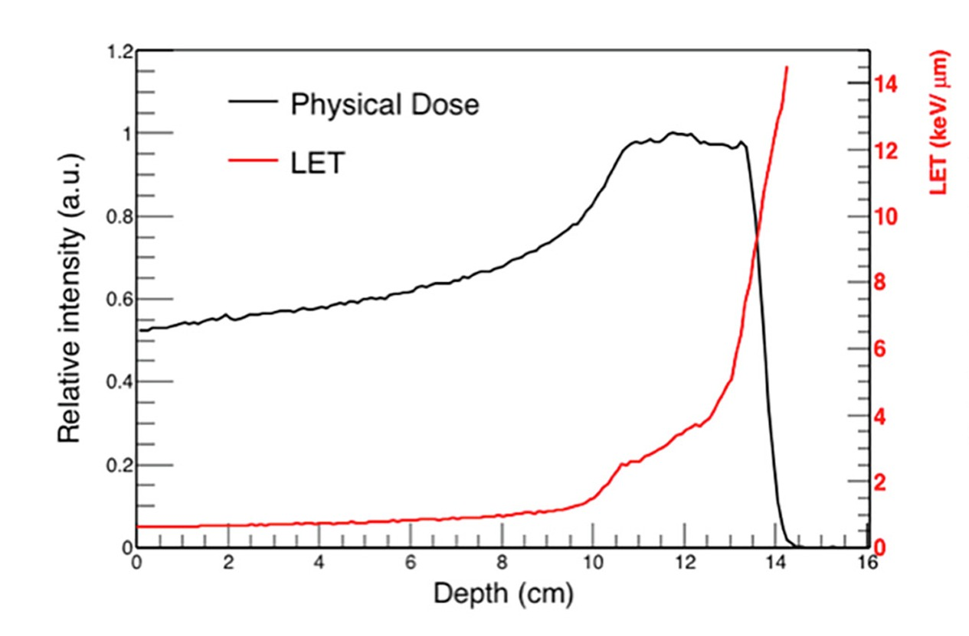
Irradiation of biological multi-layer systems and analyses
Microfluidic bioreactor
Skin-On-Chip
Multi-layer skin tissue
Pumping system
  Irradiation of 3D skin tissue
Epidermis
ARES
WP2.1
Skin tissue
  Skin model development
Independent chambers
Dermis
Physiological conditions
(dynamic environment)
WP2.2
Culture medium (controlled flow)
Experimental proton beam at Trento
Physical properties
Chemical and biological analyses
  Skin model calibration
Radiation quality
DNA damage
Surviving fraction
Histological analyses
Oxidative stress
Cytokines release
WP2.3
Fractionation scheme
PAVIA
Number of fractions
Dose per fraction
Total dose
P. Simoniello et al., Front. Oncol. (2016)
NAPOLI
F. Tommasino et al., Phys. Medica (2019)

Slide 17
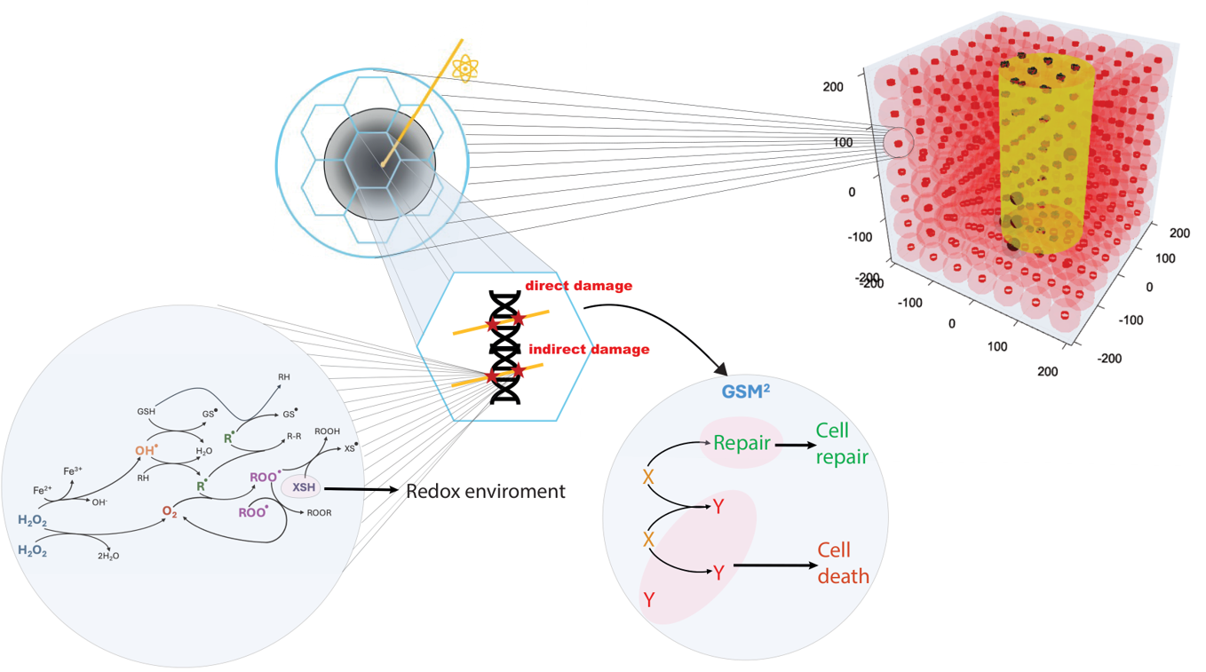

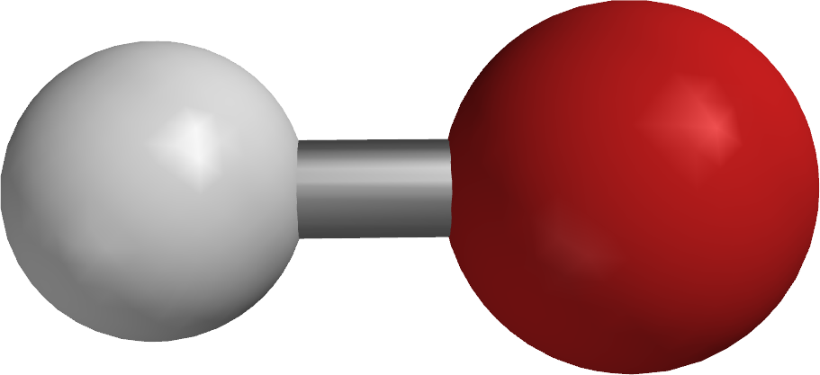







A specific mechanistic-driven NTCP model for skin toxicity
(i) Energy deposition
Beam
Keratinocyte
  Irradiation of 3D skin tissue
Epidermis
MS-GSM²
WP2.1
M. Battestini et al., Front. Phys. (2023)
M. Battestini et al., Radiother. Oncol. (2025)
$$z$$
$XSH$ activity
Dermis
$${[O}_{2}]$$
(iii) DNA damage formation
  Skin model development
(ii) Chemistry evolution
WP2.2
$$LET$$
Fibroblast
(v) Skin response
  Skin model calibration
$$r$$
WP2.3
$$b$$
Cell survival
Antioxidant defense
$$a$$
(iv) Single-cell response

Slide 18
Bio-chemical model parameters calibration for skin lesions
Experiments with multi-layer systems and bioreactor
O₂, XSH
Possible spillovers
  Irradiation of 3D skin tissue
E, LET, D
a, b, r
An integrated modeling-experimental approach to assess skin toxicity with innovative irradiation techniques
WP2.1
Spatially fractionated RT
  Skin model development
MS-GSM²-based NTCP
WP2.2
FLASH RT
  Skin model calibration
WP2.3
A mechanistic radiation biophysical model for skin toxicity in PT
M. Battestini et al., Front. Phys. (2023)
M. Battestini et al., Radiother. Oncol. (2025)

Slide 19
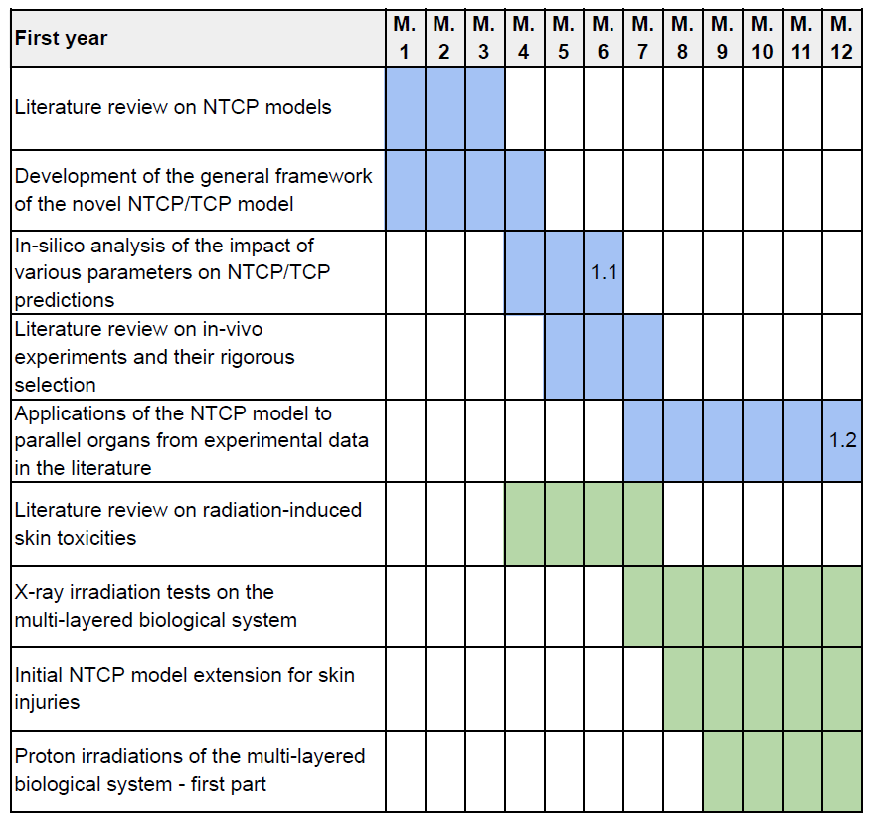
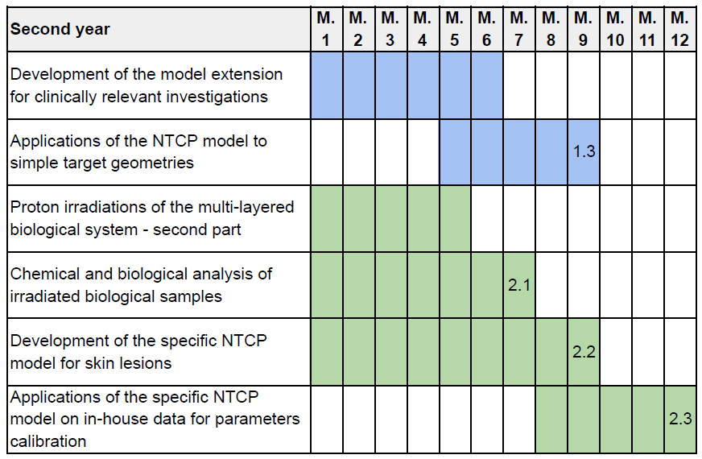
Gantt chart and milestones
WP1.1: Development of a general mechanistic-driven NTCP model and systematic analysis of model parameters
WP1.2: Applications of the NTCP model to in-vivo experimental data from literature
WP1.3: Model extension towards clinically relevant predictions for simple geometries
WP2.1: Proton irradiation of biological multi-layer systems with proton beams and bio-chemical analyses
WP2.2: Development of a specific mechanistic-driven model for skin lesions
WP2.3: Calibrations of bio-chemical model parameters on in-house experiments

Slide 20
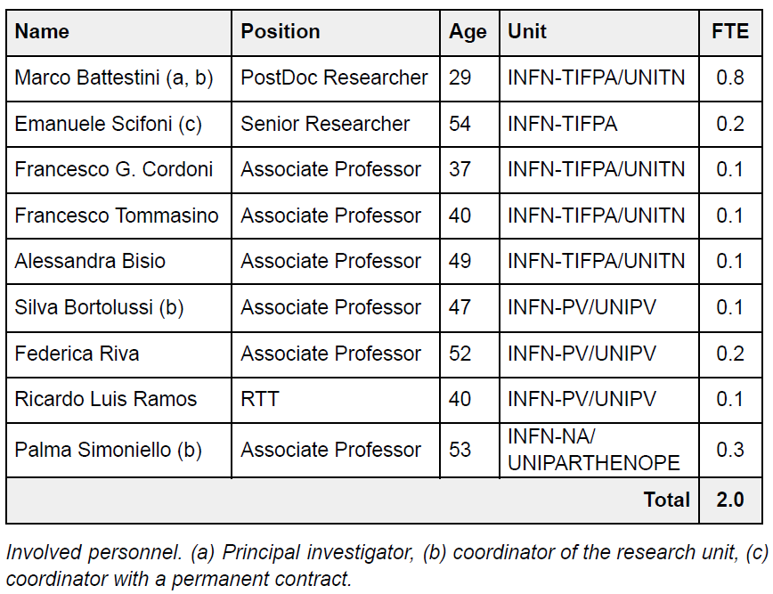
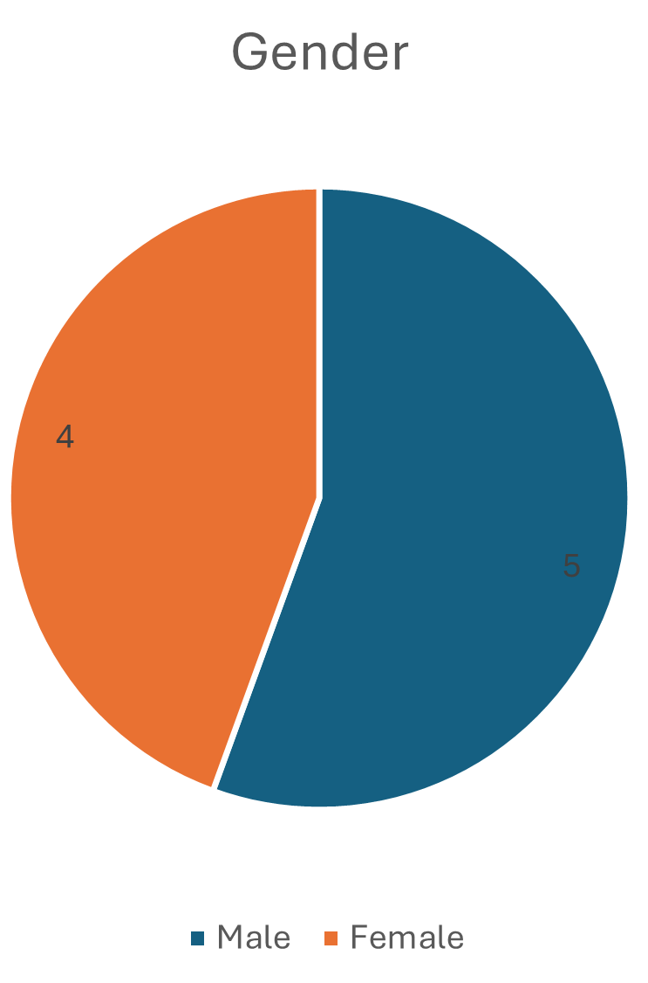
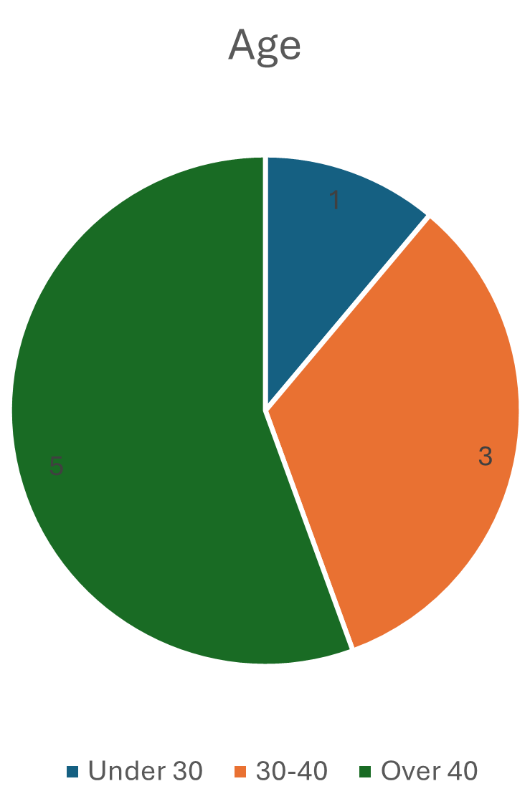
Organization
PAVIA
NAPOLI

Slide 21
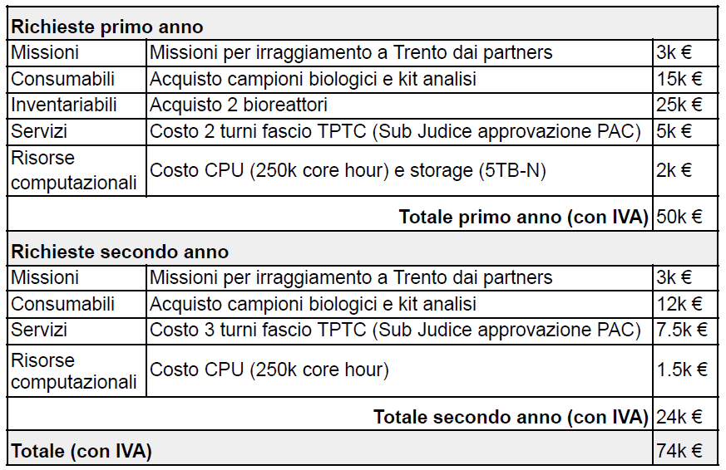
Costs

Slide 22
General model development
General model validation
Model extension to clinic
Irradiation of 3D skin tissue and analyses
Skin model development
Skin model calibration

Slide 23
Backup slides

Slide 24
Risk assessment
Risk
Impact
Solution/mitigation
Delays in procuring the bioreactor and/or its malfunction
Delays in irradiation testing and/or a decreased number of measurement campaigns
We will focus on further model development and its in-silico applications (e.g. additional clinically relevant developments, model extensions for specific PT settings) and/or we will irradiate the multi-cellular system without the bioreactor
Malfunctions in the multi-cellular system and/or in its irradiation
Alternative and/or decreased number of measurement campaigns
We will assess irradiating simpler systems for calibration (e.g., 2D cell cultures) and/or alternative surrogate systems such as spheroids for chemical analyses
Delays in allocation of beamtime slots
Decreased number of measurement campaigns
We will consider involving additional centers for irradiation currently not foreseen in the original project framework (e.g. CNAO)
Malfunctions in the biological and/or chemical analyses of the irradiated tissues
Alternative and/or reduced number of analyses
We will carry out a detailed analysis of the available assays and/or we will assess the feasibility of additional analyses and/or we will focus on further model development and its in-silico applications (e.g. additional clinically relevant developments, model extensions for specific PT settings)
Delays and/or issues in the development and/or calibration of the specific NTCP framework for skin toxicity
Reduced number of biological endpoints available for analysis and incomplete model calibration
We will focus on the study of the available endpoints and/or we will calibrate the model directly on in-vivo data from literature and/or we will focus on further model development and its in-silico applications (e.g. additional clinically relevant developments, model extensions for specific PT settings)

Slide 25
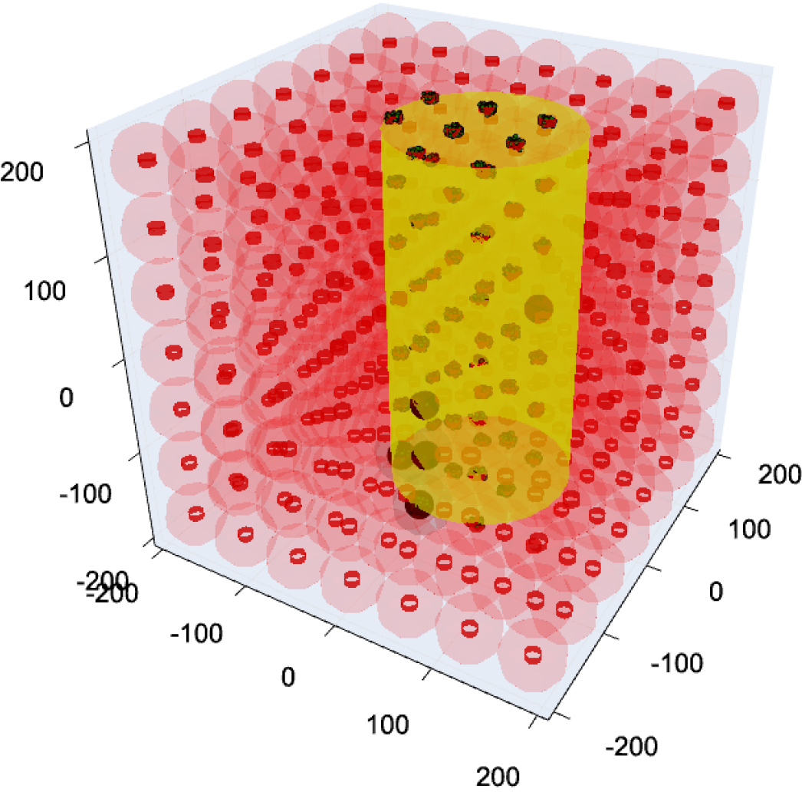
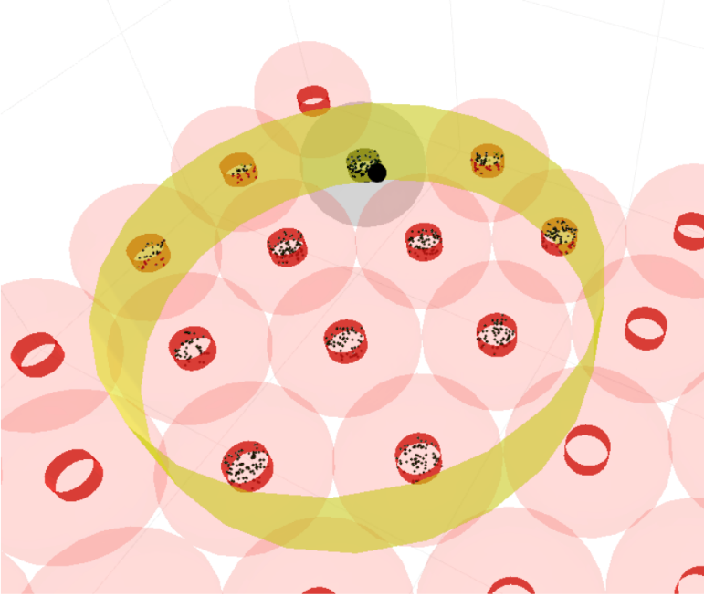






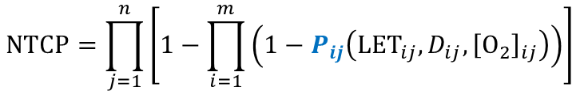
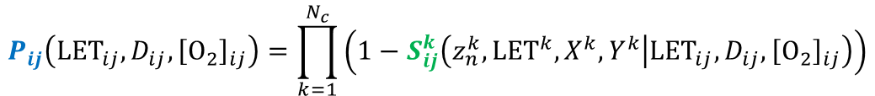


The mathematical workflow of the proposed NTCP model
Organ
Surviving probability of a single cell
FSU response
  General model development
Beam
$$P_{ij}\left({LET}_{ij},D_{ij},{\left[O_{2}\right]}_{ij}\right)=\prod_{k=1}^{N_{c}}{\left(1−S_{ij}^{k}\left(z_{n}^{k},{LET}^{k},X^{k},Y^{k} | {LET}_{ij},D_{ij},{\left[O_{2}\right]}_{ij}\right)\right)}$$
Functional sub-unit (FSU)
WP1.1
Probability that all cells in the FSU die
Cell
  General model validation
$$P_{ij}$$
FSU
Volume effect parameter
WP1.2
ij-th FSU
$$s≔\frac{m}{m∙n}=\frac{1}{n}$$
$$0$$
Parallel organ
GSM²
$$n$$
$$P_{ij}$$
$$1$$
Serial organ
  Model extension to clinic
$$m$$
WP1.3
$$S_{k}$$
Organ response
k-th nucleus
$$NTCP=\prod_{j=1}^{n}{\left[1−\prod_{i=1}^{m}{\left(1−P_{ij}\left({LET}_{ij},D_{ij},{\left[O_{2}\right]}_{ij}\right)\right)}\right]}$$
DNA damages

Slide 26
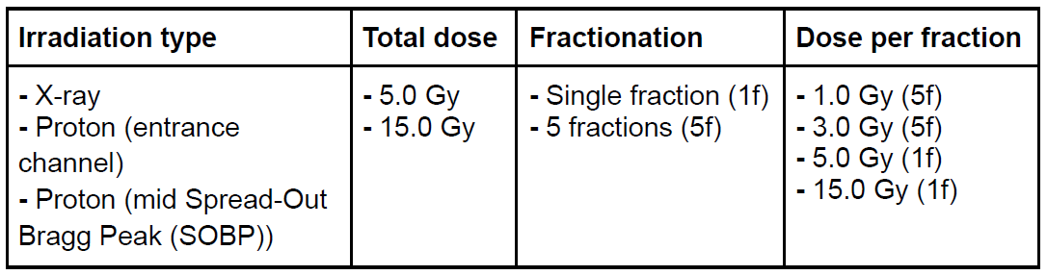
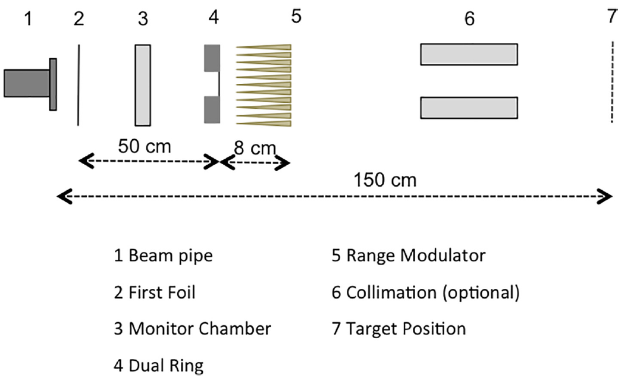
Irradiation scheme of the skin tissue experiment
Goal: investigation of the biological and chemical processes induced by X-ray and proton beam radiation at different irradiation conditions
  Irradiation of 3D skin tissue
WP2.1
  Skin model development
WP2.2
Orthovoltage X-ray @ TIFPA: 195 kVp, 10 mA
  Skin model calibration
Experimental proton beam for radiobiology @ TPTC:
148 MeV nominal energy, dual-ring setup
WP2.3
Radiation quality characterization with microdosimetry:
Benchmark between experiments and MC TOPAS simulations
PAVIA
M. Missiaggia et al., Int. J. Radiat. Oncol. Biol. Phys. (2023)
A. Bianchi et al., Radat. Phys. Chem. (2023)
NAPOLI
F. Tommasino et al., Phys. Medica (2019)

