Slide 1
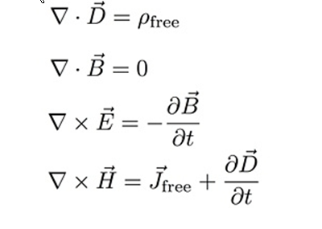
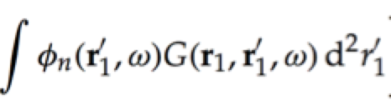
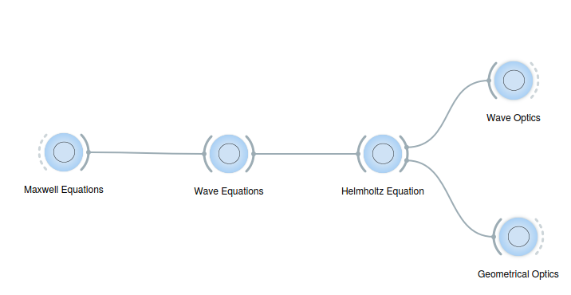

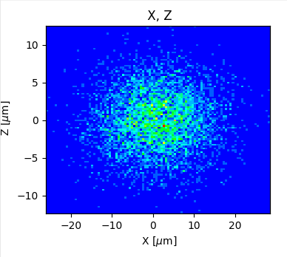

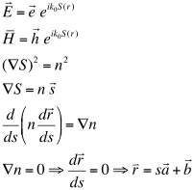



Ray Tracing and Geometrical Optics
Ray tracing in X-ray optics is a simulation method used to model how X-rays propagate and interact with optical components, like mirrors, lenses, and monochromators.
It relies on approximate solutions to Maxwell's equations that are valid as long as the light waves propagate through and around objects whose dimensions are much greater than the light's wavelength.
It's essential for designing and optimizing beamlines at synchrotrons as well as any X-ray optical system.
z
$${\vec{x}}_{0}=(x_{0},y_{0},0) \\ \vec{v}=(v_{x},v_{y}≈1,v_{z})$$
$${\vec{k}}_{o}={\vec{k}}_{i}−2\left({\vec{k}}_{i}⋅\vec{n}\right)\vec{n}$$
x
Energy, Intensity
y
z
z
p
q
x
$$\vec{x}={\vec{x}}_{0}+t\vec{v} \\ z=0$$
y
x

Slide 2
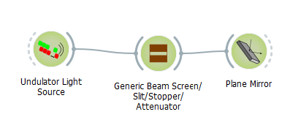
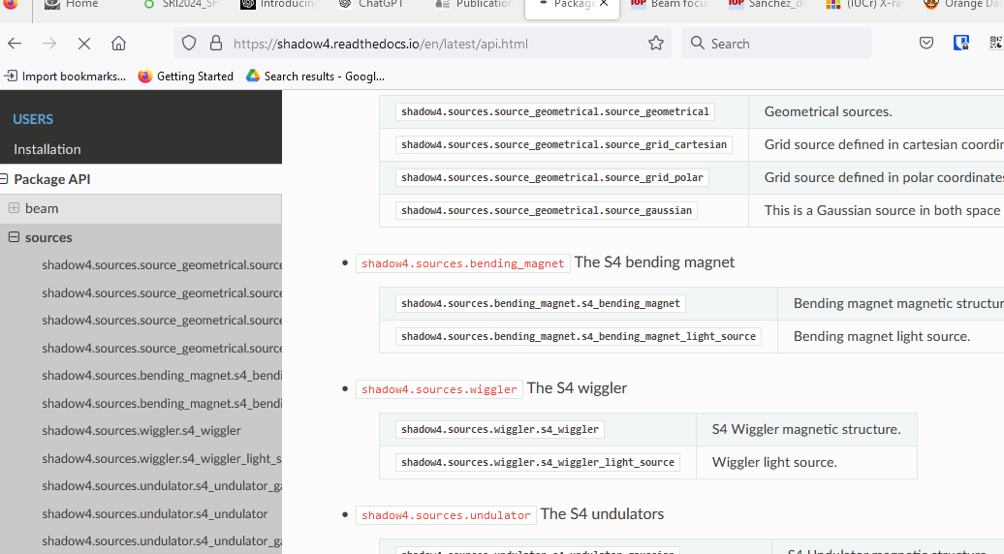
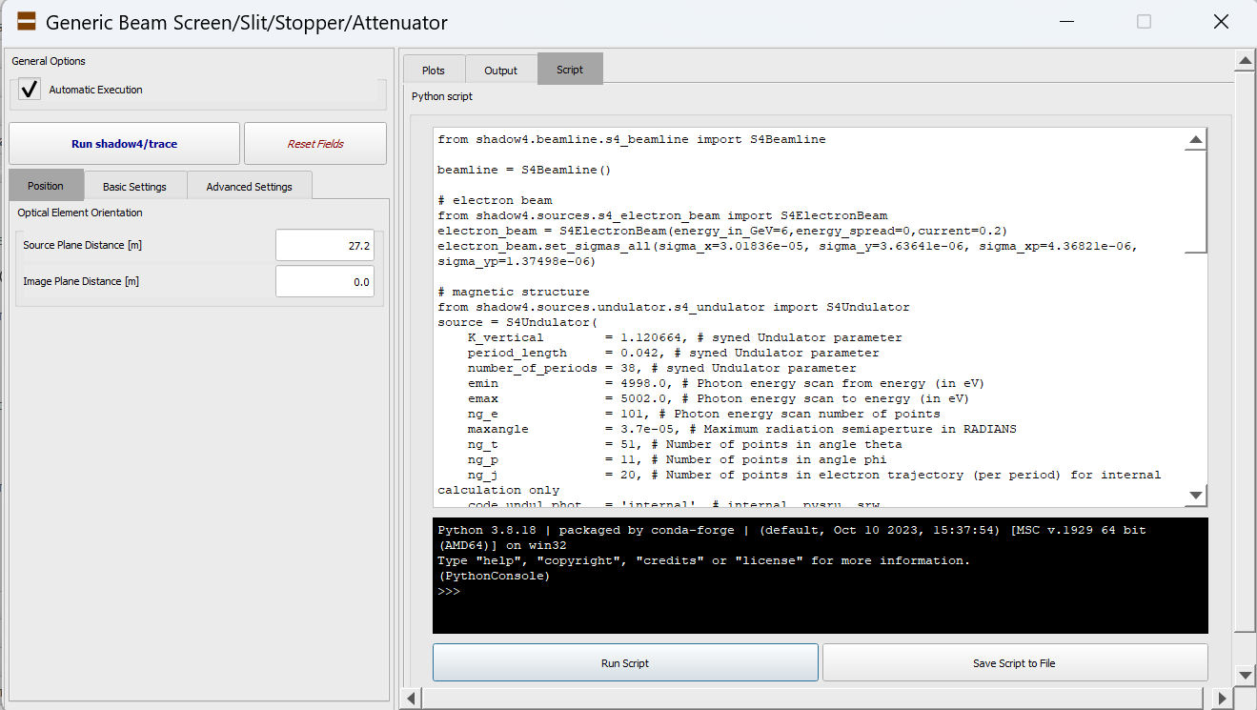
Shadow4 Kernel: Application User Interface
S4Beam: traditional beam data (nrays, 18)
API
S4Beamline
S4LightSource
S4BeamlineElement
…
S4ElectronBeam
S4MagneticStructure
S4OpticalElement
ElementCoordinates
Automated scripts with OASYS
Documentation: https://shadow4.readthedocs.io

Slide 3
Shadow4 Kernel: Application User Interface
Generic: Plane Crystal
Plane Mosaic Crystal
S4Beamline
S4LightSource
S4BeamlineElement
…
S4ElectronBeam
S4MagneticStructure
S4OpticalElement
ElementCoordinates
S4Beamline
S4LightSource
S4PlaneCrystalElement
…
S4PlaneCrystal
ElementCoordinates
trace_beam in: S4CrystalElement
Container (parameters)
trace_beam in: S4MosaicCrystalElement
S4PlaneMosaicCrystalElement
S4PlaneMosaicCrystal
ElementCoordinates

Slide 4
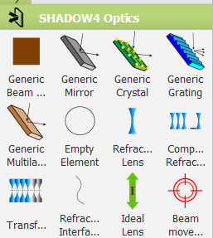
Shadow4: Optical Elements
Optical elements
S4Screen (screens, slits, stops, absorbers)
S4IdealLens, S4Empty,… (ideal elements)
S4PlaneMirror, S4SphereMirror, S4EllipsoidalMirror, …, S4AdditionalNumericalMeshMirror
S4PlaneGrating, … (including VLS)
S4PlaneCrystal, … (undistorted perfect crystals in reflection)
S4PlaneMosaicCrystal, … (mosaic crystals in reflection)
S4PlaneMultilayer, … (also graded, in depth or laterally)
S4Interface, S4Lens, S4CRL, S4Transfocator (refractors)

Slide 5
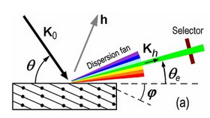
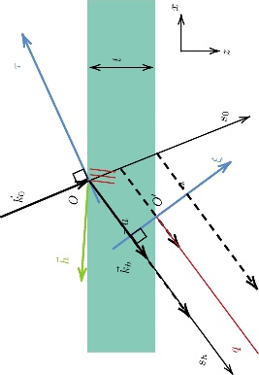
Crystal Optics
Dynamical theory for undistorted crystals (crystalpy)
Bragg:
Flat symmetric (most Double Crystal Monochropmators)
Asymmetric
beam expansion (real or divergence)
high resolution
backscattering (rainbow)
Distorted/bent crystal diffraction profile via external reflectivity (TO DO)
Geometric effect of bending (Johann, Rowland, etc.)
Johansson (TO DO)
Types
Si, Ge, C*
High d-spacing: Quartz, sapphire, ADP, YB66
(any structure)
Laue (TO DO) (Thin undeformed crystals in shadow3)
(TO DO) (symmetric Bragg in shadow3)
Perfect
Mosaic

