Slide 1
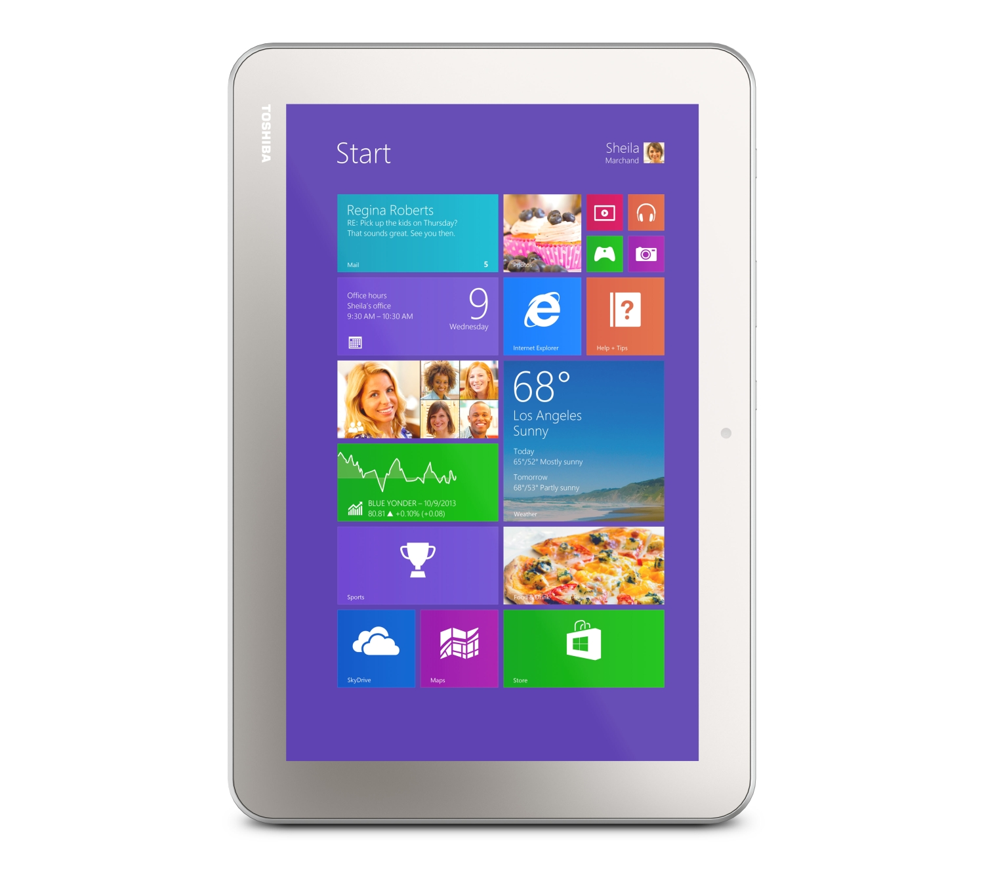
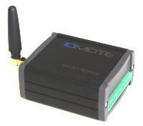
LUIS
Iomote Orchestrator API
Iomote Device Management Web App
IoT Hub
Iomote Device Management API

