Slide 1

Pentode
Power Tree Designer
Pentode simulates,
draws and plots
system-level power distributions
By Simone Pernice

Slide 2
Power tree design tools
A lot of tools are available to simulate analog circuits, power converters, and digital circuits. They are very good at design of every single converter with a lot of details but inconvenient to simulate a whole system power architecture
Very few tools (if any) are available to design and simulate the whole high level power section of a device
Pentode, given a simple high level net list of the device, is able to:
  Simulate the voltage and current from power on to the steady state and then to power off
  Show components working out of specification
  Draw a nice-to-see power tree diagram showing the currents/powers balance
  Plot node transient voltage and gate current waveforms
  Change component parameters interactively to check how they impact the design

Slide 3
Power tree design using Pentode
Pentode takes as input a net list containing:
  A description of the high level power architecture. Usually one line of text is enough to describe one component of the device
  Commands to execute on the power architecture: simulation, draw, plot, ...
Pentode executes commands to:
  Simulate the device reporting any component working out of specification (over voltage at regulator output, diode reverse biased, etc.)
    Simulate stepping parameters looking for their effect to find the best performance
  Draw a (nice to see) power tree diagram on pdf/csv file
  Plot voltage/current versus time (or stepped parameter) waves on png/jpeg file
  Execute loops, iterate though lists, check conditionals and perform basic calculus to automate repetitive task
In the net-list commands or interactively, it is possible to:
  Change the components parameters (enable, quiescent current, etc.)
  Run new simulations to verify the performance of the system for all the use cases
It is possible to change the net-list to describe a different power tree
  It takes few minutes to repeat the tests on all the use cases

Slide 4

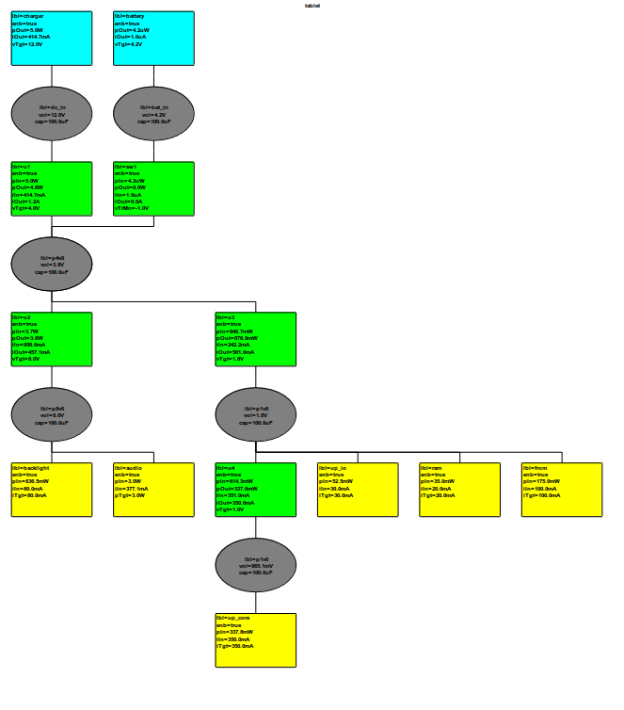
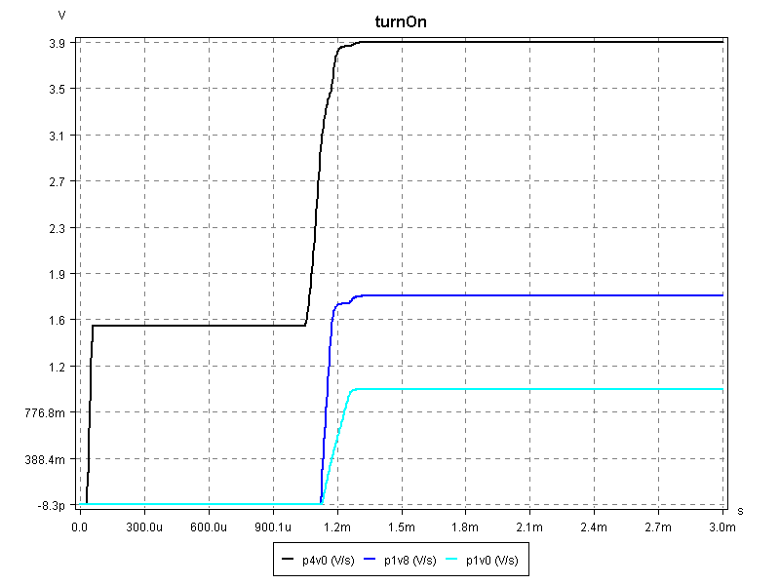
Pentode work flow
Pentode
Components issues
(text)
Device
net-list
simulation
Power tree balance
(pdf or csv file)
V/I waveforms
(png, jpeg, … file)
At the end the updated
net-list can be saved
User interactively changes parameters and
simulate again to improve the design

Slide 5
Power distribution requirements
The main concerns designing the power distribution of a new device are:
Efficiency: it is good to minimize the input power especially on portable devices to provide long battery life. High efficiency can be achieved with:
  Scalability: the capacity to turn off the not used regulators in order to reduce the energy waste
  Standby current: is the special case of scalability where almost all components are turned off and the device has to preserve the battery draining a negligible current drain
Cost: the device has to be the cheapest possible but that goes against efficiency because usually more efficient converters are more expensive
Ratings: every source, converter and drain has to work within its specification
Correct suppliers turn on and off sequence: that is very important when the components linked together use several rails

Slide 6
Traditional power distribution design
Usually the power distribution design requires to:
Define all the user cases:
  Standby, WiFi, Video + WiFi, Video + Ethernet, ...
Define the most suitable power trees
  That is a trial and error procedure which requires to draw on paper the most promising architectures
  Compute the cost of every architecture
For each couple: use case – architecture the designer has to evaluate the efficiency computing the power balance
Choose the best trade off between cost and efficiency
Pentode can automate the procedure above as follow:
The device most promising power distribution is saved on a file as net-list
Pentode load that net-list and simulates it
The user interactively simulate and check pros and cons of the architecture
The user interactively try to improve the architecture and simulate again to validate
When the best solution is found the new net-list is saved
There are few tools available to automate that procedure
  For instance it can be done on a standard spreadsheet. However that requires to rewrite the power balance equations for each architecture evaluated. Moreover it is difficult to use complex mathematical relationship to describe second order effects like the switching converter efficiency which decrease at very low output current or the leakage current on a LDO

Slide 7
Pentode components
Pentode simulates a net of linked electric components
An electric component can be:
  Node, defined by:
    voltage and capacitance
  Black box, defined by:
    gates which are linked to the previous nodes
    the currents flowing through those gates are defined by not-linear time-variant behavioral-equations depending on the voltage of the nodes at which they are linked to
    the user set the behavior of those black-box defining the component characteristic parameters like the output voltage of a voltage regulator

Slide 8
Black boxes
The black boxes can be:
  Sources:
    Have just the output gate
    Provide power to the device like a DC adapter or a battery
    The behavioral model takes into account of parameters like:
      Internal resistance, maximum current, voltage waveform (for time-variant source), etc.
  Converters:
    Have input and output gates and may have also a control gate
    Transfer the power from input to output gate like diodes, switches, LDOs, buck or boost converters
    The behavioral model takes into account of parameters like:
      Load and line regulation, maximum current, minimum input voltage, quiescent and disable current; for switching converters: switching and resistive current loss, working mode (PWM or PFM), etc.
  Drains:
    Have just the input gate
    Use the power provided by sources and converters like LED or resistor
    The behavioral model takes into account of parameters like:
      Minimum operating voltage, equivalent resistance, current or power, etc.

Slide 9
Component definition
The Pentode components are defined in the net-list as follows:
Name Label Node1 ... NodeN Property1 = value1 ... PropertyN = valueN
Name is the type of component like for instance:
  srcVoltage for a voltage source
  cnvLDO for a LDO converter
  drnPower for a constant power drain
Label is the unique name given to this device
Node1 to NodeN are the nodes a which the device is linked to
Propery1 is a property of the device set to value1.
  Devices have a lot of property with default value.
  The not-set properties are kept at their default value.
  The user can just set the property to be modified respect to their default value

Slide 10
Embed branded converters
In order get an accurate simulation the user is required to set the converter parameters. To find those parameters the user has to:
  Look at the data sheet for the basic converter figures
  Simulate the converter on Pentode and tuning its parameters in order to match the data sheet graphs if available or an evaluation board behavior if the data is not reported
That procedure is long and tedious
However it would be possible to store one brand of converters on Pentode
  The user would simply play with them them ignoring most of their behavioral parameters
  That will help the user to design quickly its device based on that brand of components

Slide 11
Commands
The Pentode commands works on the current net-list. Their syntax recall the component definition:
Name Label Property1 = value1 ... PropertyN = valueN
Name is the command name like for instance:
  simulateSteady to simulate the current device up to the steady state
  draw to draw a power tree
  plot to plot a voltage or current
  help to print a command function, properties and syntax
Label is used in some commands, for instance on plot and draw is the output file name
Propery1 is a property of the command, for instance tEnd is the end time of a simulation

Slide 12
Net list example
The following is a simple Pentode net list describing:
  A voltage source labeled charger linked at dc_in node providing 12V
  A buck converter labeled u1 linked from dc_in to p4v0 to provide 4V output and able to sustain 15V reverse
  A voltage source labeled battery linked at bat_in node providing 4.2V
  A boost converter labeled u2 linked from p4v0 to p8v0 to supply back light and audio
  A switch labeled sw1 linked from bat_in to p4v0 active when the node dc_in is between -1 and 4V
  A constant current drain labeled backlight draining 80mA for back light
  The remaining net-list lines are self explaining...
srcVoltage charger dc_in vLow = 12V
cnvBuck u1 dc_in p4v0 vTgt = 4V vRev = 15V
srcVoltage battery bat_in vLow = 4.2V
cnvCntSwitch sw1 bat_in p4v0 dc_in vTrMn = -1V vTrMx=4V
cnvBoost u2 p4v0 p8v0 vTgt = 8V
drnCurrent backlight p8v0 iTgt = 80mA
drnPower audio p8v0 pTgt = 3W
cnvBuck u3 p4v0 p1v8 vTgt = 1.8V vMin = 3V
drnCurrent up_io p1v8 iTgt = 30mA
drnCurrent ram p1v8 iTgt = 20mA
drnCurrent from p1v8 iTgt = 100mA
cnvLDO u4 p1v8 p1v0 vTgt = 1.0V
drnCurrent up_core p1v0 iTgt = 350mA vMin = 0.5V
  The netlist is saved in a text file ending with ptd extension like tablet.ptd
  To load in Pentode run the command java -jar pentode.jar tablet.ptd

Slide 13
Net list draw example
Once Pentode is lunched on
the previous net-list it is possible
to interactively simulate and
draw its results
The previous net-list is simulated
during transient up to 3ms with
following command:
simulateTransient tEnd = 3ms
The power tree is then drawn
and saved on tablet.svg file
with following command:
draw tablet outputFormat = svg

Slide 14
Net list plot example
The turn on sequence is plot on the file turnOn.png with the following command:
plot turnOn TIME, p4v0, p1v8, p1v0
P4v0 is flat for about 1.1ms. P1V8 reaches the final voltage only after p1v0 is ready
That power sequence has to fit the involved components

Slide 15

Net list modify example
It is also possible to interactively
modify components and run
again the simulation.
In the next example the
charger is turned off
modify charger vLow = 0
Then the simulation is run again:
simulateTransient tEnd = 3ms
The new power tree is saved
on the tableBB.pf file:
draw tabletBB outputFormat = pdf
The modifications to that netlists
can be saved on the original file
with the save command:
save

Slide 16
Pentode binary distribution
Pentode is written in Java
It is possible run Pentode on a server and return its output files (power trees and waveforms) to the users
Pentode is based on few GPL libraries to provide output files (pdf, svg, png). Therefore to distribute Pentode binary it is required to provide its source code.
Those libraries are available also with LGPL license paying their royalties. Therefore it is possible distribute Pentode without its source code if needed.

Slide 17
Library dependences
Pentode uses the following external libraries:
  To draw power tree in pdf file:
    Orson PDF
    GPL license can be LGPL paying the royalty
  To draw power tree in svg files:
    jFreeSVG
    GPL license can be LGPL paying the royalty
  To plot diagram in png file:
    simple-java-plot by Yuriy Guskov
    MIT license
  To print figures in engineer notation:
    engNotation by Andrew Greensted
    Free license, just requires to show the library author name

