Slide 1
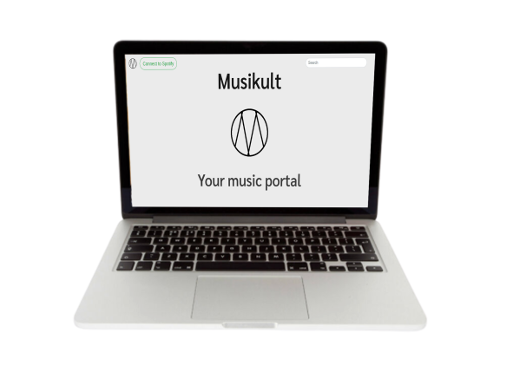
Musikult
Your music portal

Slide 2
INDICE
-Architettura
-Interazione

Slide 3
Database
mySQL
Server
Web-socket
Client-browser
API-Rest

Slide 4
Genius API
Home page
Artist page
Spotify OAuth
Genius API
User page
Spotify/Genius API
Song page
Aggiunta database
Thank page

Slide 5

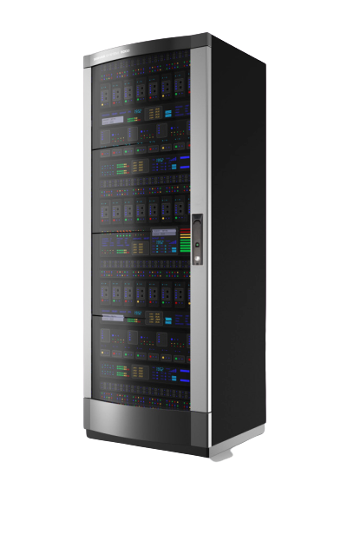

Select from database
Client
Happi api

Slide 6
select
Client
insert
Get testo
Post testo
Get testo

