Slide 1
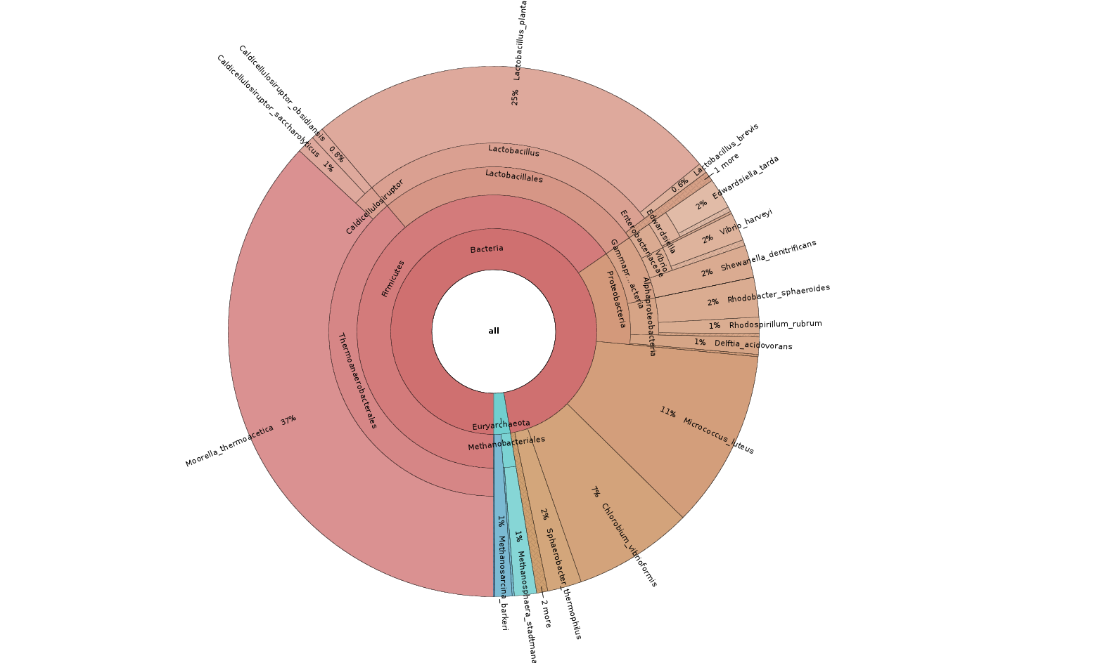


Estimation of abundances in microbial communities from metagenomic data
September 6th 2018
Master 2 Informatique Fondamentale
Université Paris-Est Marne-la-Vallée
Simone Pignotti
Supervised at LIGM by:
Gregory Kucherov
Hosted at HMS by:
Michael Baym
Karel Břinda

Slide 2
Overview
What is Metagenomics
Sequence classification with ProPhyle
Estimation of abundances
Experiments and validation
Conclusions and perspectives

Slide 3

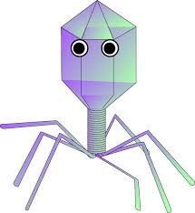







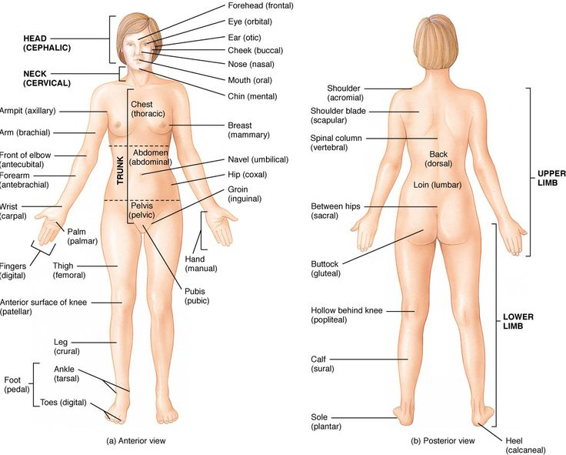


Metagenomic sequencing
Metagenome
(set of DNA reads)
NGS sequencing
Notes:
Stress huge amount of data

Slide 4
Phylogeny-based metagenomic classification
Metagenome reads
(billions)
Phylogenetic tree
Full reference genomes
(thousands)

Slide 5
Phylogeny-based metagenomic classification
Metagenome reads
(billions)
Phylogenetic tree
Full reference genomes
(thousands)
?

Slide 6
Alignment-free methods
Reference genome:
Index of k-mers
“Is this k-mer in the genome?” yes/no
Goal: estimate the “likelihood”
of a read to belong to the genome
(assign a score, e.g. number of hits)
Read:
k-mers
Notes:
pairwise comparison with all reference genomes is too costly

Slide 7
Alignment-free methods
Index of k-mers
Huge
Repeated k-mers
Read:
Same problem, with tree
How to compress it?
k-mers
Notes:
pairwise comparison with all reference genomes is too costly

Slide 8
k-mer propagation - ProPhyle
8
4
7
1
2
3
5
6
AC, GC,
AA, AG
GC, AA,
GA, AG
AA, GA,
AT, AG
AC, AA,
AT, CC
GC, AA,
AT, CC

Slide 9
k-mer propagation - ProPhyle
8
4
7
1
2
3
5
6
AC, GC,
AA, AG
GC, AA,
GA, AG
AA, GA,
AT, AG
AC, AA,
AT, CC
GC, AA,
AT, CC

Slide 10
k-mer propagation - ProPhyle
8
AA, AG
4
7
1
2
3
5
6
AC, GC,
AA, AG
GC, AA,
GA, AG
AA, GA,
AT, AG
AC, AA,
AT, CC
GC, AA,
AT, CC

Slide 11
k-mer propagation - ProPhyle
8
AA, AG
4
7
AA, AT, CC
1
2
3
5
6
AC, GC,
AA, AG
GC, AA,
GA, AG
AA, GA,
AT, AG
AC, AA,
AT, CC
GC, AA,
AT, CC

Slide 12
k-mer propagation - ProPhyle
8
AA
AA, AG
4
7
AA, AT, CC
1
2
3
5
6
AC, GC,
AA, AG
GC, AA,
GA, AG
AA, GA,
AT, AG
AC, AA,
AT, CC
GC, AA,
AT, CC

Slide 13
k-mer propagation - ProPhyle
k-mer forest of AT
8
AA
AA, AG
4
7
AA, AT, CC
1
2
3
5
6
AC, GC,
AA, AG
GC, AA,
GA, AG
AA, GA,
AT, AG
AC, AA,
AT, CC
GC, AA,
AT, CC

Slide 14
Kraken’s LCA
(lowest common ancestors)
False positives
8
AC, GC, AA, AT
AC, GC, AA, GA, AT, AG
AC, GC, AA, AT, CC
4
7
1
2
3
5
6
AC, GC,
AA, GA,
AT, AG
AC, GC,
AA, GA,
AT, AG
AC, GC,
AA, GA,
AT, AG
AC, GC, AA,
AT, CC
AC, GC, AA,
AT, CC

Slide 15
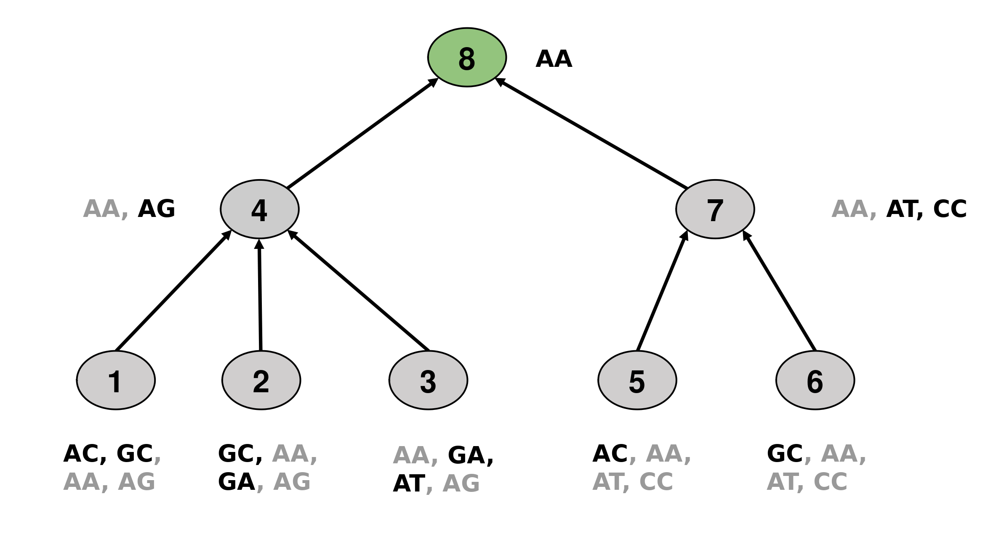
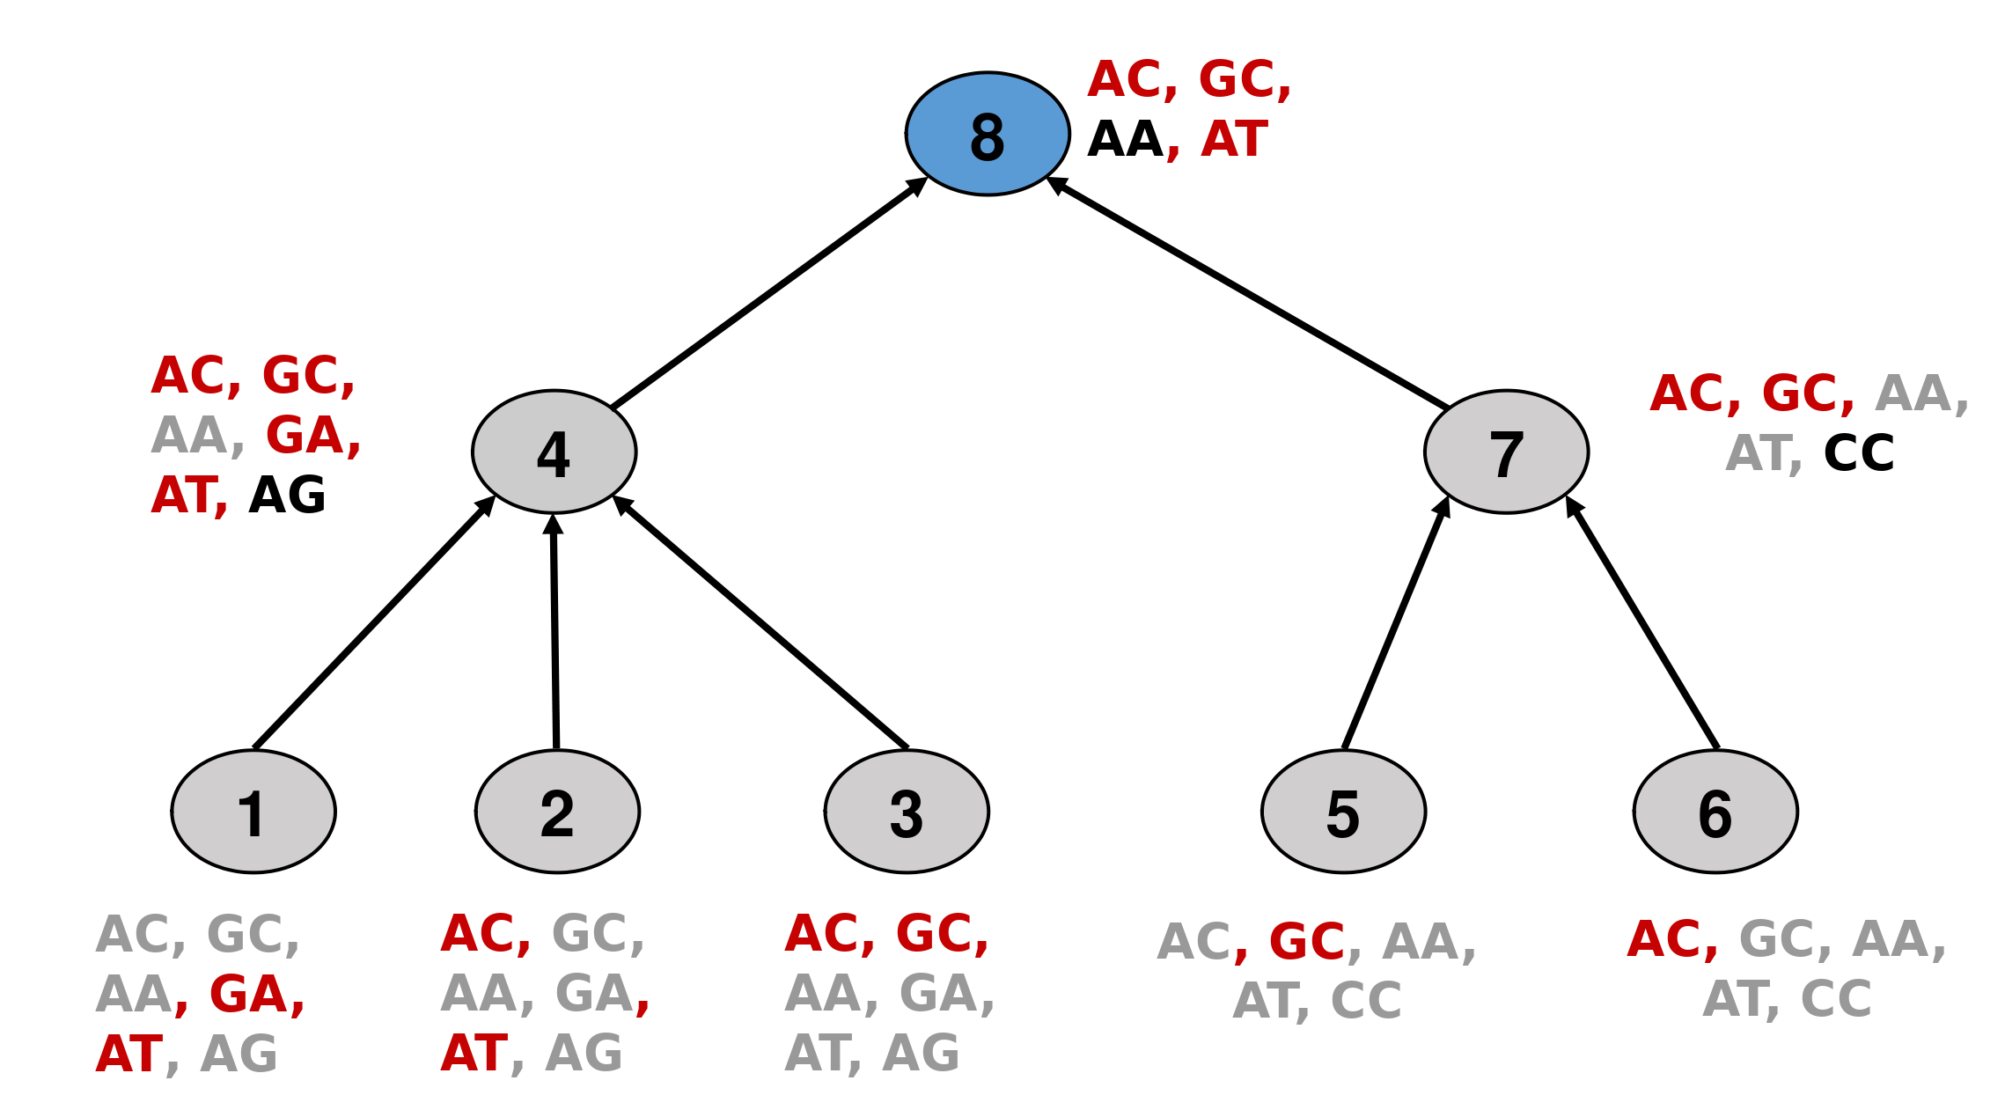
Assignments – ProPhyle vs Kraken
Read:
AGC
k-mers:
AG
GC

Slide 16
Assignments – ProPhyle vs Kraken
Read:
AGC
k-mers:
AG
GC
ProPhyle:
AG → {4} → {1,2,3}
GC → {1,2}

Slide 17
Assignments – ProPhyle vs Kraken
Read:
AGC
k-mers:
AG
GC
ProPhyle:
AG → {4} → {1,2,3}
GC → {1,2,6}
s(1) = 2
s(2) = 2
s(3) = 1
s(6) = 1
s(*) = 0
read → {1,2}

Slide 18
Assignments – ProPhyle vs Kraken
Read:
AGC
k-mers:
AG
GC
Kraken:
AG → 4 → {1,2,3}
GC → 8 → {*}

Slide 19
Assignments – ProPhyle vs Kraken
Read:
AGC
k-mers:
AG
GC
Kraken:
AG → 4 → {1,2,3}
GC → 8 → {*}
s(1) = 2
s(2) = 2
s(3) = 2
S(*) = 1
read → 4
4 = LCA({1,2,3})

Slide 20
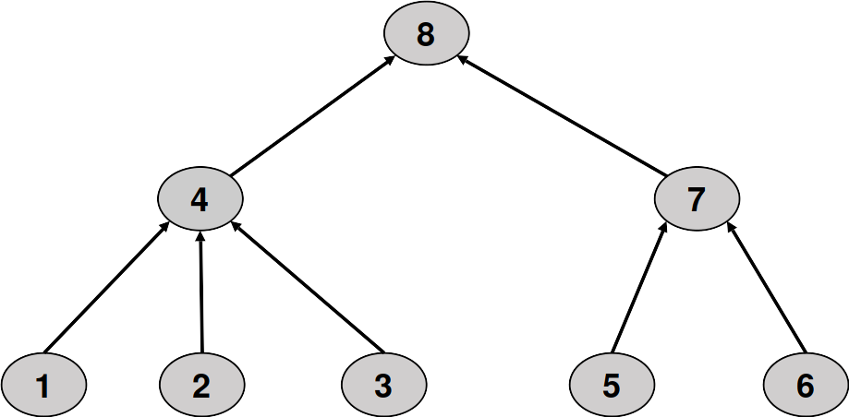
What to do with multiple assignments?
R1 → {1,2}
R2 → {3,7} → {3,5,6}
R3 → {3}
R4 → {1,3,6}

Slide 21
What to do with multiple assignments?
R1 → {1,2}
R2 → {3,7} → {3,5,6}
R3 → {3}
R4 → {1,3,6}
“Redistribute” reads
Consider all 2^{n} - 1
possible combinations
~10³⁰¹ for n = 1000
2
1
3
1
2
∑ = 9 but only 4 reads...

Slide 22

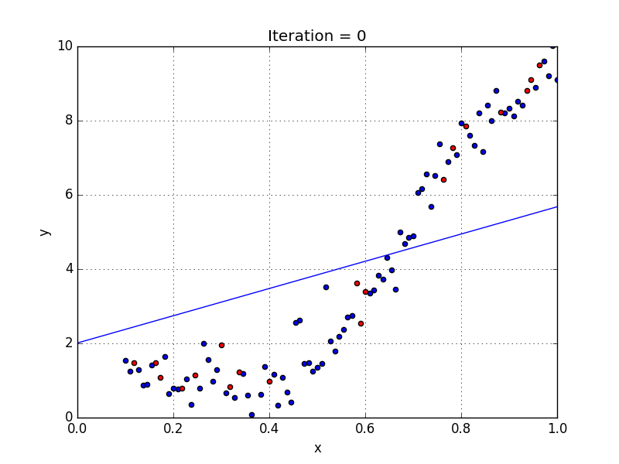
Linear Regression!

Slide 23
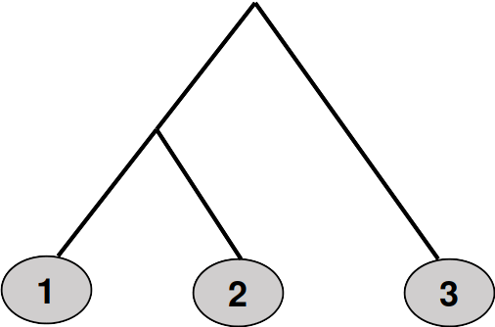
Acquiring statistics about mult. ass.
R1 → {1,2,3}
R2 → {2,3}
R3 → {3}
R[4-10] → {3} (x6)
G₃:
SIM + ASS
S | G₁ | G₂ | G₃
G₁ | 1 | 0.1 | 0.1
G₂ | 0.2 | 1 | 0.2
G₃ | 0 | 0.1 | 1
“10% of reads
simulated from genome 3
were assigned to a set
containing G₁”

Slide 24
“Redistributing” multiple assignments
S | G₁ | G₂ | G₃
G₁ | 1 | 0.1 | 0.1
G₂ | 0.2 | 1 | 0.2
G₃ | 0 | 0.1 | 1
r
m
?
?
?
11
4
10
=

Slide 25
“Redistributing” multiple assignments
S | G₁ | G₂ | G₃
G₁ | 1 | 0.1 | 0.1
G₂ | 0.2 | 1 | 0.2
G₃ | 0 | 0.1 | 1
r
m
10
0
10
11
4
10
=
Same thing in
[#ref.gen.] dimensions

Slide 26

Need regularization
Many assignments are inaccurate
  sequencing errors
  something not in DB
  k-mers only heuristic
10⁹ reads + 10⁵ ref. Genomes → anything could get few assignments
Real scenario: 100s of known organisms in a sample → 1/100 of index
Approximate the system while keeping results sparse
Introduce penalties for “using too many variables”
LASSO regressor

Slide 27
Elastic Net
(Zou & Hastie, 2005)
L₂ regularization does not set regr. coeff. to 0
Lasso (L₁) → among highly correlated variables will choose only 1
(at random)
Combine L₁ and L₂!
The quadratic part of the penalty:
- encourages grouping effect
- stabilize regularization path (selected variables)
Can also simulate LASSO, which has desirable effects

Slide 28
Simulation experiment
(Mende et al, 2012)
~25M 75bp reads simulated from 193 genomes (85 species)
includes multiple strains in the genera Bacillus and Mycobacterium
  notoriously difficult to estimate ab. for (due to high similarity)
Index for ProPhyle, Bracken and DiTASiC containing 1267 genomes
  including simulated ones
  k = 31 → 45 k-mers per read
Residual Sum of Squares (RSS) error measure:

Slide 29
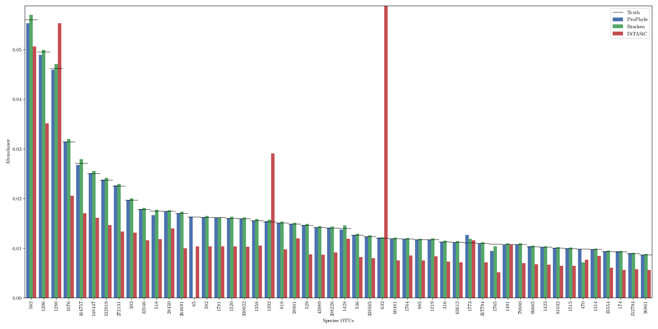

Slide 30
Results - Mende
 |  | LASSO | E-Net | Bracken | DiTASiC
Genome | RSS | 7.52e-4 | 9.32e-4 | NA | 2.26e-02
 | FP# (ab) | 32 (5.60e-02) | 89 (8.57e-2) | NA | 648 (3.22e-01)
 | FN# (ab) | 66 (1.06e-02) | 2 (2.02e-4) | NA | 32 (2.07e-02)
Species | RSS | 3.84e-05 | 6.68e-6 | 2.80e-04 | 4.53e-02
 | FP# (ab) | 1 (1.44e-04) | 26 (1.36e-3) | 170 (9.73e-04) | 381 (6.08e-02)
 | FN# (ab) | 0 (0) | 0 (0) | 1 (1.63e-02) | 0 (0)
Genus | RSS | 1.33e-05 | 1.16e-06 | 2.85e-04 | 5.45e-02
 | FP# (ab) | 0 (0) | 12 (3.62e-5) | 78 (3.23e-04) | 194 (1.06e-02)
 | FN# (ab) | 0 (0) | 0 (0) | 1 (1.63e-02) | 0 (0)

Slide 31
“Stress Test”
10 samples with 500k read pairs of length 150bp
Simulated from ref (250 genomes each, exponential distribution)
Rare genomes (~50) have 10⁻⁵ abundance → 5 reads
Index for all (6171) “reference” and “representative” RefSeq genomes
(Archaea, Bacteria, Fungi, Viruses)
ProPhyle index: ~50GB vs Kraken DB: ~330GB
Kraken running for weeks on a powerful cluster

Slide 32
Results – Stress
OK scalability (~5 days to generate simulation matrix with 0.3 cov)
As for Mende, can effectively use LASSO for FP → 0
Grid-Search for optimal parameters in few minutes (needs ground truth)
Many FN as intended (genomes with <10 reads)
ISSUES:
Parameters choice extremely important
Most samples fit perfectly (Pearson >0.95), 2 of them don’t (<0.4)
Need more statistical info (e.g. P-values or other confidence est.)
Cannot scale to index with ~100k ref

Slide 33
Real – HMP pilot
6.5M reads of length 75bp
Even mixture of DNA from 22 isolates
Same index as stress (6171 RefSeq genomes)
6 out of 22 isolates only have relatives in the index
1 fungus with 18S gene only (assignments suggest low copy number)

Slide 34
Results - HMP
 |  | LASSO
Genome | RSS | 0.15
 | FP# (ab) | 5 (0.01)
 | FN# (ab) | 3 (0.14)
Species | RSS | 0.15
 | FP# (ab) | 3 (6.30e-03)
 | FN# (ab) | 1 (0.05)
Genus | RSS | 0.15
 | FP# (ab) | 1 (5.66e-03)
 | FN# (ab) | 0 (0)

Slide 35
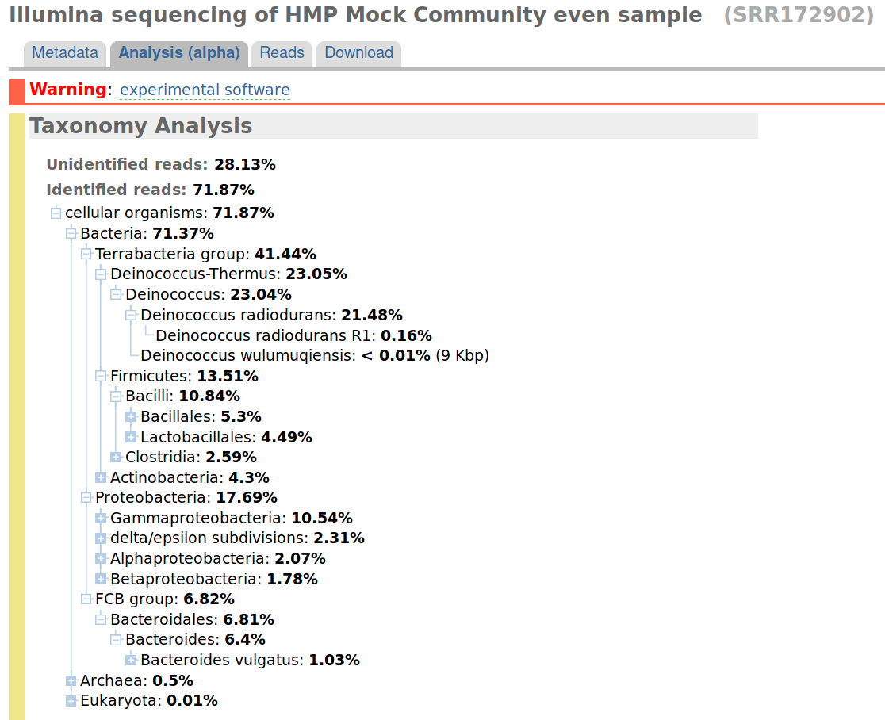
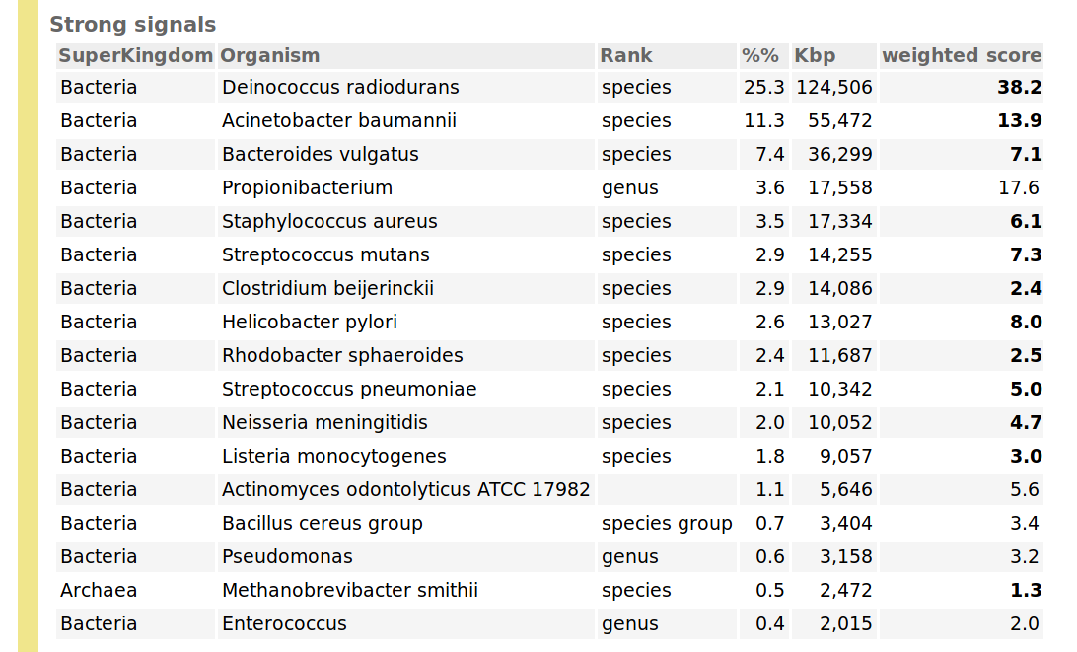
Results - HMP
 |  | LASSO
Genome | RSS | 0.15
 | FP | 5 (0.01)
 | FN | 3 (0.14)
Species | RSS | 0.15
 | FP | 3 (6.30e-03)
 | FN | 1 (0.05)
Genus | RSS | 0.15
 | FP | 1 (5.66e-03)
 | FN | 0 (0)

Slide 36
Adjusted Results - HMP
 |  | LASSO
Genome | RSS | 0.03
 | FP | 5 (0.01)
 | FN | 3 (2.28e-6)
Species | RSS | 0.03
 | FP | 3 (6.30e-03)
 | FN | 1 (7.61e-07)
Genus | RSS | 0.03
 | FP | 1 (5.66e-03)
 | FN | 0 (0)
Suggests problem with:
reference genomes (e.g. contamination)
sample preparation (e.g. not so even mix)
current computational approaches

Slide 37
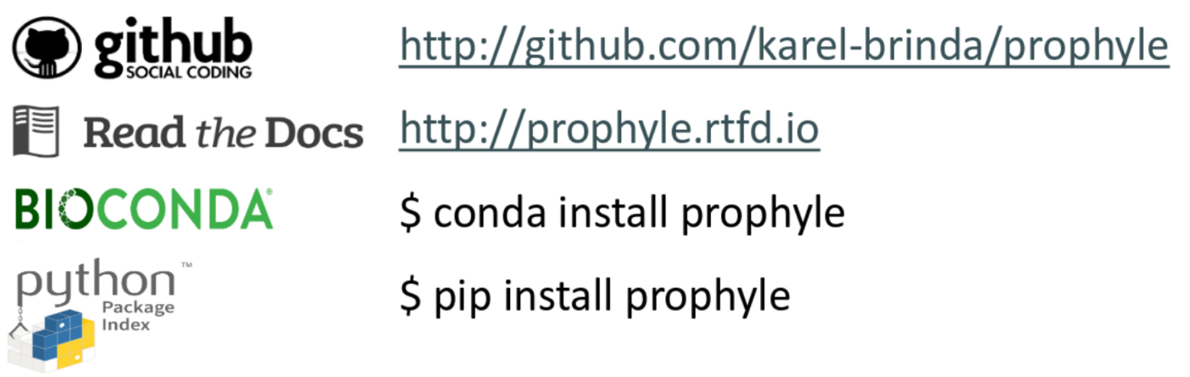
Conclusions and perspectives
ProPhyle is a complete, resource-frugal and easy-to-use
metagenomic classifier
Lossless index, suitable for inaccurate phylogenetic trees
Flexibility and feature richness
(works with any tree, standard bioinformatics formats)
Future directions:
Assignment quality and read/ref.genome length heuristics for abundances
ML framework to estimate optimal reg. parameters based on:
  complexity of sample
  # ref. genomes
  sequencing technology

Slide 38

Thank you!

Slide 39
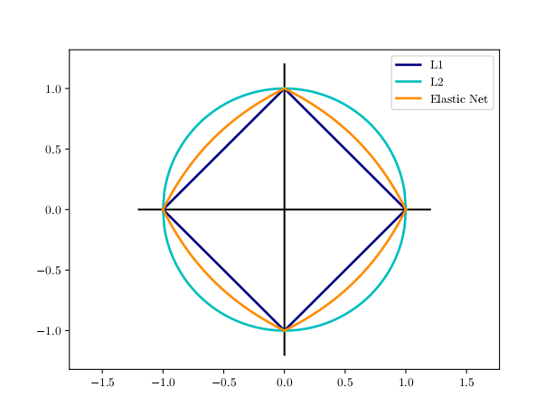

Slide 40


