Slide 1


Two Phase Locking Scheduler
Data Management Project – Simone Scaccia

Slide 2
Two Phase Locking Scheduler
Definition:
Two-phase locking (2PL) is a method for concurrency control that guarantees serializability by using a lock mechanism to ask and perform an operation on a specific element within the database.
Requirements:
  Given a schedule S without lock operations checks if S is in the 2PL class with exclusive lock (or shared and exclusive locks).
  Use the lock anticipation, when possible, to avoid blocking transactions.
  Returns the output lock-extended schedule also for schedules not in the 2PL class. The output schedule can be obtained by resuming blocked transactions. Only when deadlocks are not present.
  For each schedule S in the 2PL class, returns a serial schedule conflict equivalent to S.
Two Phase Locking Scheduler
Pagina <number>

Slide 3
Computing the lock extended schedule
Locking the element
Free object
  Operation: w1(x)
  Input schedule: w1(x)
  Output: xl1(x)
Lock table (Hash table: object -> (xl, sl))
 | Exclusive | Shared
x
 | Exclusive | Shared
x | T1
Two Phase Locking Scheduler
Pagina <number>

Slide 4
Computing the lock extended schedule
Locking the element
Object already locked by the same transaction
  Operation: r1(x)
  Input schedule: w1(x) r1(x)
  Output:
Lock table
 | Exclusive | Shared
x | T1
 | Exclusive | Shared
x | T1
Two Phase Locking Scheduler
Pagina <number>

Slide 5
Computing the lock extended schedule
Locking the element
Object already locked not by the same transaction
  Operation: w1(x)
  Input schedule: w2(x) w1(x)
  Output: u2(x) xl1(x)
Lock table
 | Exclusive | Shared
x | T2
 | Exclusive | Shared
x | T1
Two Phase Locking Scheduler
Pagina <number>

Slide 6
Computing the lock extended schedule
Locking the element
Object already locked not by the same transaction
  Problem 1: Object must be reused by T2
    Operation: w1(x)
    Input schedule: w2(x) w1(x) r2(x)
    T1 blocked
Lock table
 | Exclusive | Shared
x | T2
 | Exclusive | Shared
x | T2
Two Phase Locking Scheduler
Pagina <number>

Slide 7
Computing the lock extended schedule
Locking the element
Object already locked not by the same transaction
  Problem 2.1: the shrinking phase cannot be started, anticipation lock is possible
    Operation: w1(x)
    Input schedule: w2(x) w1(x) w2(y)
    Solution: lock anticipation
    Output: xl2(y) u2(x) xl1(x)
Lock table
 | Exclusive | Shared
x | T1
y | T2
 | Exclusive | Shared
x | T2
Two Phase Locking Scheduler
Pagina <number>

Slide 8
Computing the lock extended schedule
Locking the element
Object already locked not by the same transaction
  Problem 2.2 the shrinking phase cannot be started, anticipation lock is not possible
    Operation: w1(x)
    Input schedule: w2(x) w1(x) w3(y) w2(y)
    T1 blocked
Lock table
 | Exclusive | Shared
x | T2
 | Exclusive | Shared
x | T2
Two Phase Locking Scheduler
Pagina <number>

Slide 9
Computing the lock extended schedule
Locking the element
Lock upgrade
  Operation: w1(x)
  Input schedule: r1(x) w1(x)
  Output: xl1(x)
Lock table
 | Exclusive | Shared
x |  | T1
 | Exclusive | Shared
x | T1
Two Phase Locking Scheduler
Pagina <number>

Slide 10
Computing the lock extended schedule
Locking the element
Lock upgrade
  Problem: shared lock multiple transactions
    Operation: w1(x)
    Input schedule: r1(x) r2(x) w1(x)
    Output: u2(x) xl1(x)
Lock table
 | Exclusive | Shared
x |  | T1,T2
 | Exclusive | Shared
x | T1
Two Phase Locking Scheduler
Pagina <number>

Slide 11
Computing the lock extended schedule
Locking the element
Locking outcomes:
  Successful lock
  Transaction blocked
  Deadlock
Wait-For-Graph:
  Edges are transactions waiting for the unlock of an object by another transaction
  Useful for deadlock recognition, a cycle appear in the graph
  When a transaction is blocked, the scheduler insert them in the Wait-For-Graph
Two Phase Locking Scheduler
Pagina <number>

Slide 12
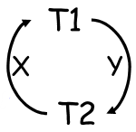
Computing the lock extended schedule
Locking the element
Wait-For-Graph:
  Visual representation:
  Implementation
    Hash table
    Each transaction wait for at most one transaction
Blocked Transaction | Transaction | Object
T1 | T2 | y
T2 | T1 | x
Two Phase Locking Scheduler
Pagina <number>

Slide 13
Computing the lock extended schedule
Executing the operation
Operation: w1(x) or r1(x)
  If successful lock
    Output: w1(x) or r1(x)
  If transaction blocked
    Operation blocked
Operation: c1
  If transaction not blocked
    Output: c1
  If transaction blocked
    Operation blocked
Two Phase Locking Scheduler
Pagina <number>

Slide 14
Computing the lock extended schedule
Unlocking the element
Policy:
  After executing an operation, the scheduler tries to unlock all the objects previously locked by the same transaction
    Input schedule: r1(x) r1(y) w2(z)
    Output: sl1(x) r1(x) sl1(y) r1(y) u1(y) u1(x) xl2(z) w2(z) u2(z)
  We can avoid to check all the unlocks at the end of the execution of the input schedule
Two Phase Locking Scheduler
Pagina <number>

Slide 15
Computing the lock extended schedule
Resuming blocked transactions
Policy:
  After unlocking some object, the scheduler tries to resume blocked transactions
    Input schedule: r1(x) w2(x) w1(x)
    Output: sl1(x) r1(x) xl1(x) w1(x) u1(x) xl2(x) w2(x) u2(x)
    T2 blocked and resumed after w1(x)
  Remove edge from the Wait-For-Graph during resuming blocked transaction
Two Phase Locking Scheduler
Pagina <number>

Slide 16
Computing the data action projection
The scheduler pass through the lock-extended schedule and select only read, write, and commit operations.
  S: input schedule
  S’: lock-extended output schedule
  S’ ∈ Gen(2PL)
  DT(S’): data action projection of S’
  DT(S’) is in the 2PL class
An input schedule S, without lock operations is in the 2PL class with shared and exclusive locks (or exclusive locks) if S = DT(S’) for some S’ ∈ Gen(2PL)
Two Phase Locking Scheduler
Pagina <number>

Slide 17
Computing the data action projection
So, if S’ ∈ Gen(2PL) from an input schedule S by blocking some transaction, then S is not in the 2PL class, since S ≠ DT(S’)
Two Phase Locking Scheduler
Pagina <number>

Slide 18
Computing the serial conflict-equivalent schedule
Theorem:
  If S′ ∈ Gen(2PL), then S = DT(S′) is conflict-serializable.
The theorem states that S is conflict-equivalent to the serial schedule that orders the transactions of S according to the following rule:
  Take as the first transaction the one that executes the first unlock operation.
  Take as the second transaction the one that executes the first unlock operation among the remaining (N-1) transactions in S.
  ...
  Take the last transaction as the N-th transaction.
Two Phase Locking Scheduler
Pagina <number>

Slide 19
Scheduler Logging
The scheduler, in addition to the output schedule, returns a log of the operations performed by the scheduler. The log contains the following information:
  Successful/unsuccessful lock anticipations.
  Blocked transactions.
  Resumed transactions.
  Deadlocks detected, and the transactions involved in the deadlock.
Two Phase Locking Scheduler
Pagina <number>

Slide 20
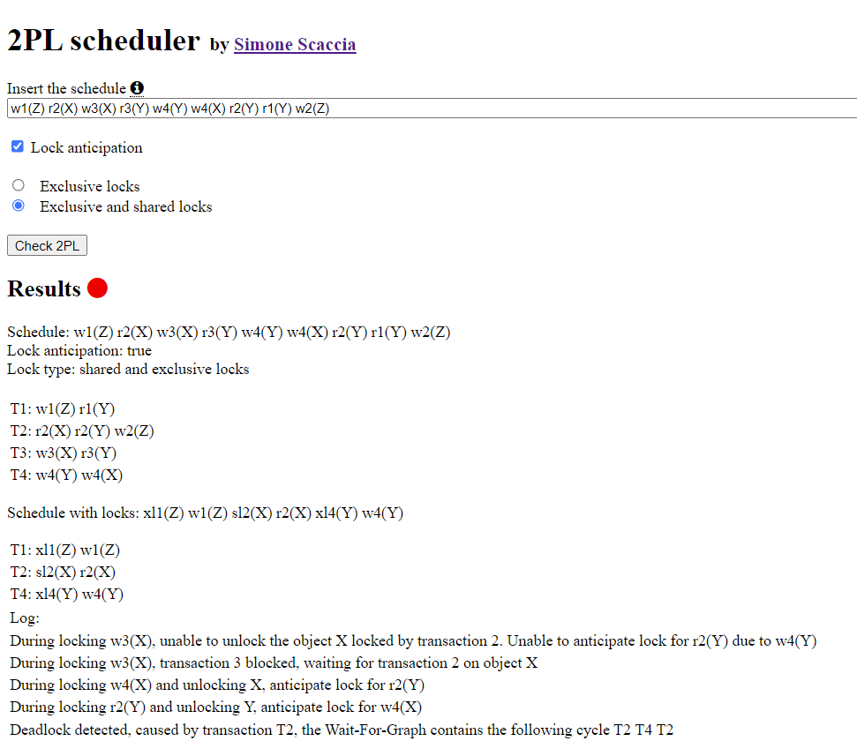
Example from a previous exam
Two Phase Locking Scheduler
Pagina <number>

Slide 21
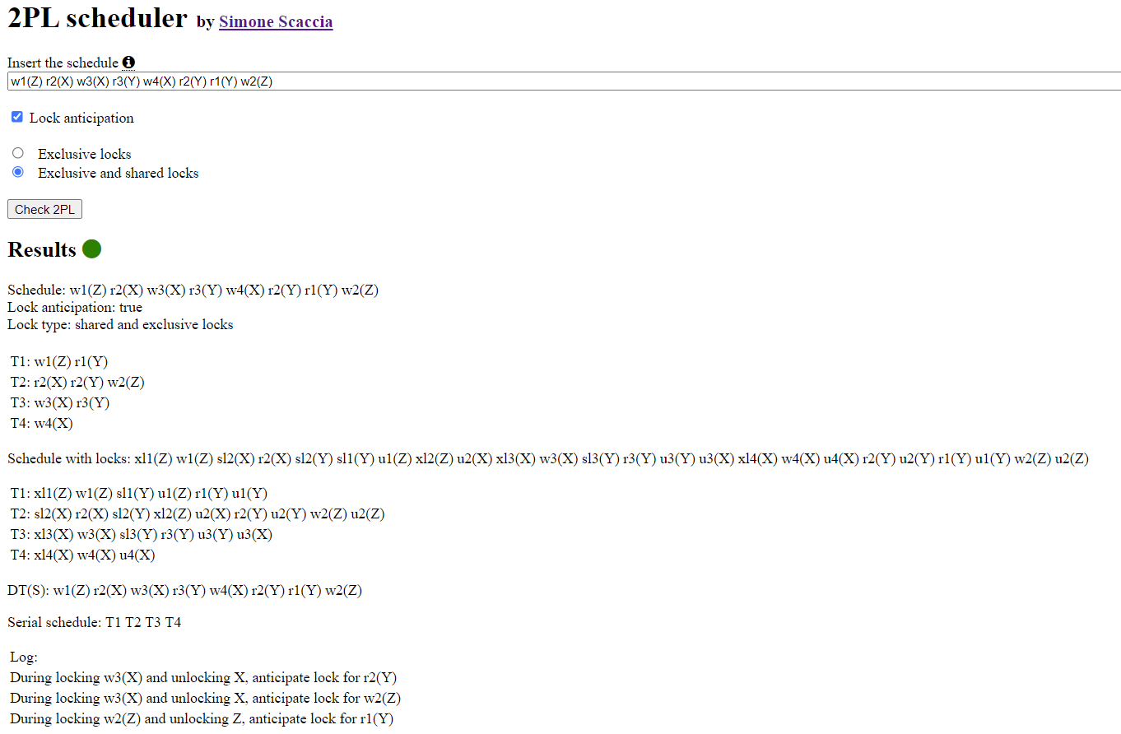
Example from a previous exam
Two Phase Locking Scheduler
Pagina <number>

Slide 22
Thank you
GitHub
Titolo Presentazione
Pagina <number>

