Slide 1


Beyond Metadata for BBC iPlayer
An autoencoder-DRIVEN APPROACH FOR EMBEDDING GENERATION IN CONTENT SIMILARITY RECOMMENDATIONs
Simone spaccarotella
18TH NOVEMBER 2024

Slide 2
Beyond Metadata for BBC iPlayer
An autoencoder-DRIVEN APPROACH FOR EMBEDDING GENERATION IN CONTENT SIMILARITY RECOMMENDATIONs

Slide 3
Introduction

Slide 4



Introduction

Slide 5
Project ideas
Use of Contextual Metadata in personalized recommendations
Play pattern and interaction pattern analysis
Sequential recommender system
Use of Passport tags to improve recommendations
Item representation with Autoencoders
Multi-product recommendations

Slide 6
Project ideas
Use of Contextual Metadata in personalized recommendations
Play pattern and interaction pattern analysis
Sequential recommender system
Use of Passport tags to improve recommendations
Item representation with Autoencoders
Multi-product recommendations

Slide 7
Project ideas
Use of Contextual Metadata in personalized recommendations
Play pattern and interaction pattern analysis
Sequential recommender system
Use of Passport tags to improve recommendations
Item representation with Autoencoders
Multi-product recommendations

Slide 8
Project Overview
a high-level summary of the main aspects of the project

Slide 9

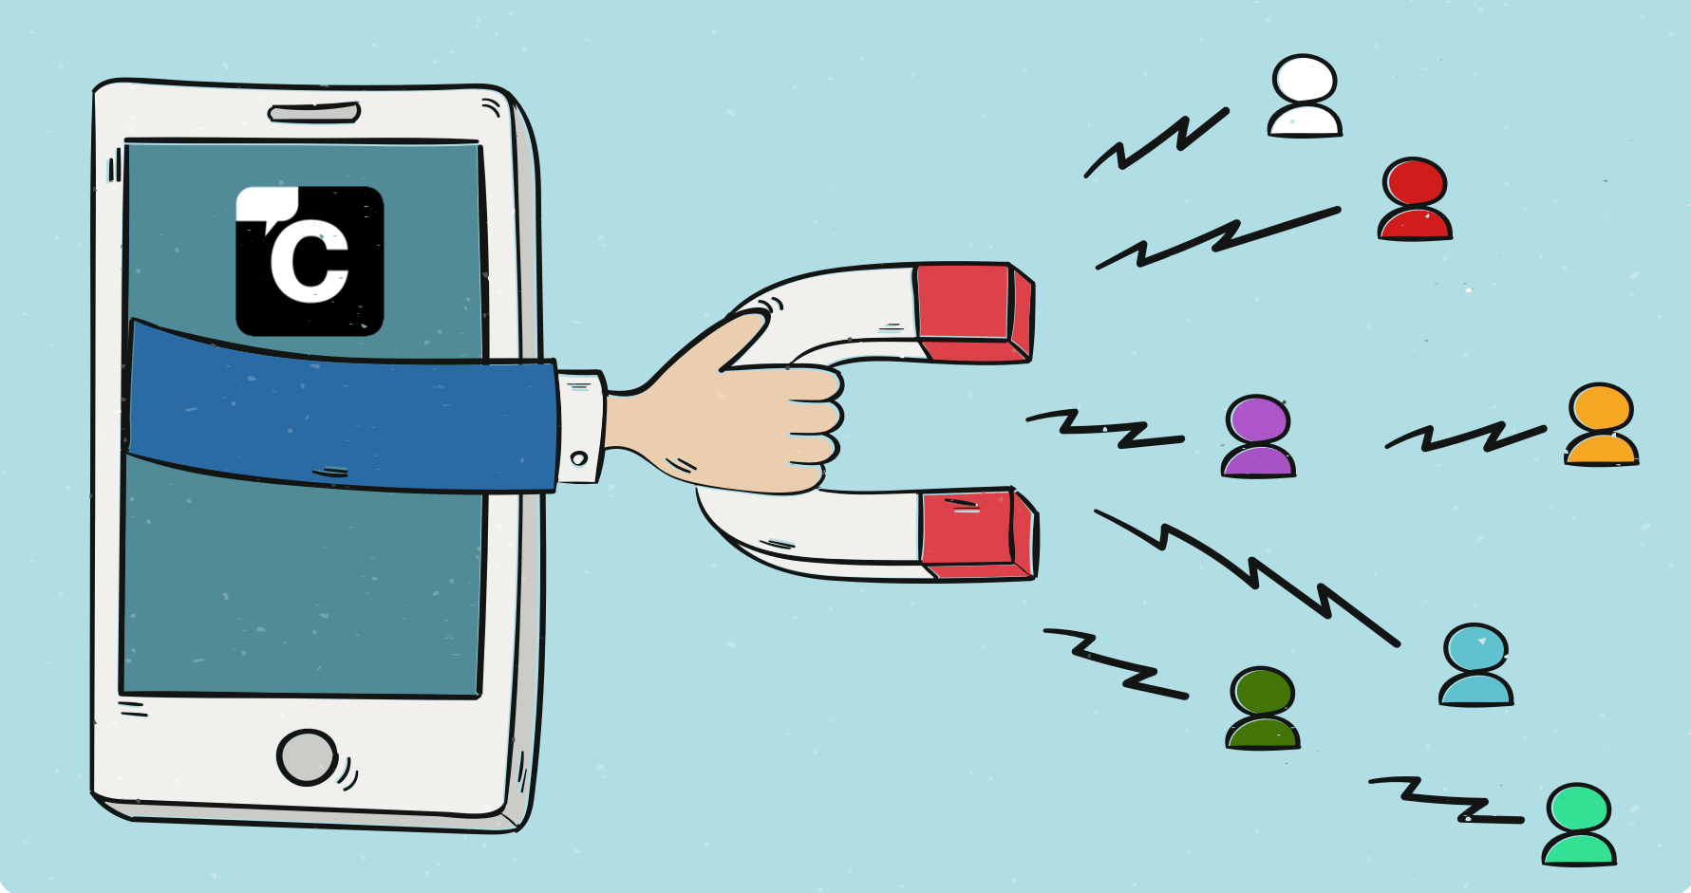
Business needs
Improve User Engagement
Reduce duplication and costs

Slide 10
Improve user engagement

Slide 11
Opportunities

Slide 12
Project Overview
Goal: Develop a non-personalized content-to-content similarity recommendation system for BBC iPlayer.
Solution: A machine learning pipeline leveraging Passport tags as content metadata to generate recommendations.
Outcome: Positive feedback from stakeholders, with potential application across multiple BBC content platforms.
Notes:
Goal: Develop a non-personalized content-to-content similarity recommendation system for BBC iPlayer.
Solution: A machine learning pipeline leveraging one-hot encoding, an autoencoder, and cosine similarity to generate recommendations.
Outcome: Positive feedback from stakeholders, with potential application across multiple BBC content platforms.

Slide 13
Issues and opportunities
a high-level summary of the main aspects of the project report

Slide 14
Context
Problem Statement: Current recommendation systems may require extensive data and specific engineering, which can be resource-intensive and difficult to generalize.
Business Need: A unified approach that reduces code and data redundancy, lowers costs, and aligns with BBC’s strategy of enhancing user engagement through consistent recommendations.

Slide 15
Agenda
Introduction
Project Overview
Context, Implications, and Recommendations
Research and Methodology
Practical Application of Knowledge and Skills
Business Recommendations and Outcomes
Follow-On Actions and Next Steps

Slide 16
Implications and Stakeholder Impact
Implications: Modular and scalable recommendations approach can be applied across BBC products.
Stakeholder Impact: Streamlined engineering, improved efficiency, potential cost savings, and a unified recommendation experience across platforms.
Feedback Summary: Positive reactions from iPlayer and BBC recommendations teams, with interest in A/B testing.

