Slide 1
HR-RIXS Designs for BESSY III
Kick-Off Meeting
Sebastian Malerz
17.09.2025

Slide 2
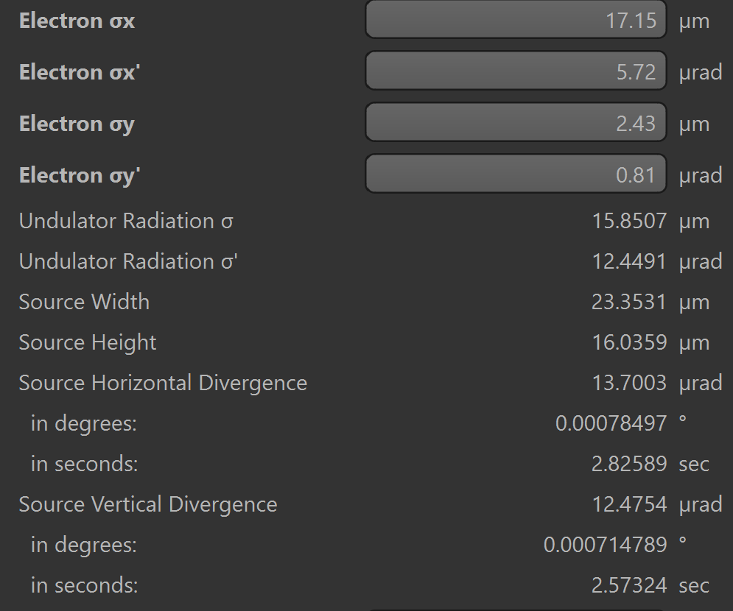
What we know:
Polarization: variable, incl. circular
Energy Range: 250 – 2000 eV
Resolving Power: 1 meV @ 1000 eV (E/dE=1,000,000); what is the scientific reason?
Focus Size: 1 µm (unknown for hor., vert. or both?); is a larger focus acceptable?
Current design and simulation parameter
Undulator: UE-42.5 (calculated by Malerz via SPECTRA)
Energy Range: 150 – 2100 eV, 5 eV steps
Grating: plane grating with 3000 l/mm; efficiency: 1
Diffraction order: 2
c-factor: 25
Optimization energy: 1000 eV
Mirror coating: Pt
Incident angle: 0.75° for all mirrors (except M2)
Errors mirrors: sag=0.05 sec; mer= 0.1 sec (RMS), roughness= 0.1 nm
Errors grating: sag=0.001 sec; mer= 0.002 sec (RMS), roughness= 0.1 nm
Length: 91 m, 100 m, and 108 m
Current BESSY III parameter @ 2% coupling

Slide 3
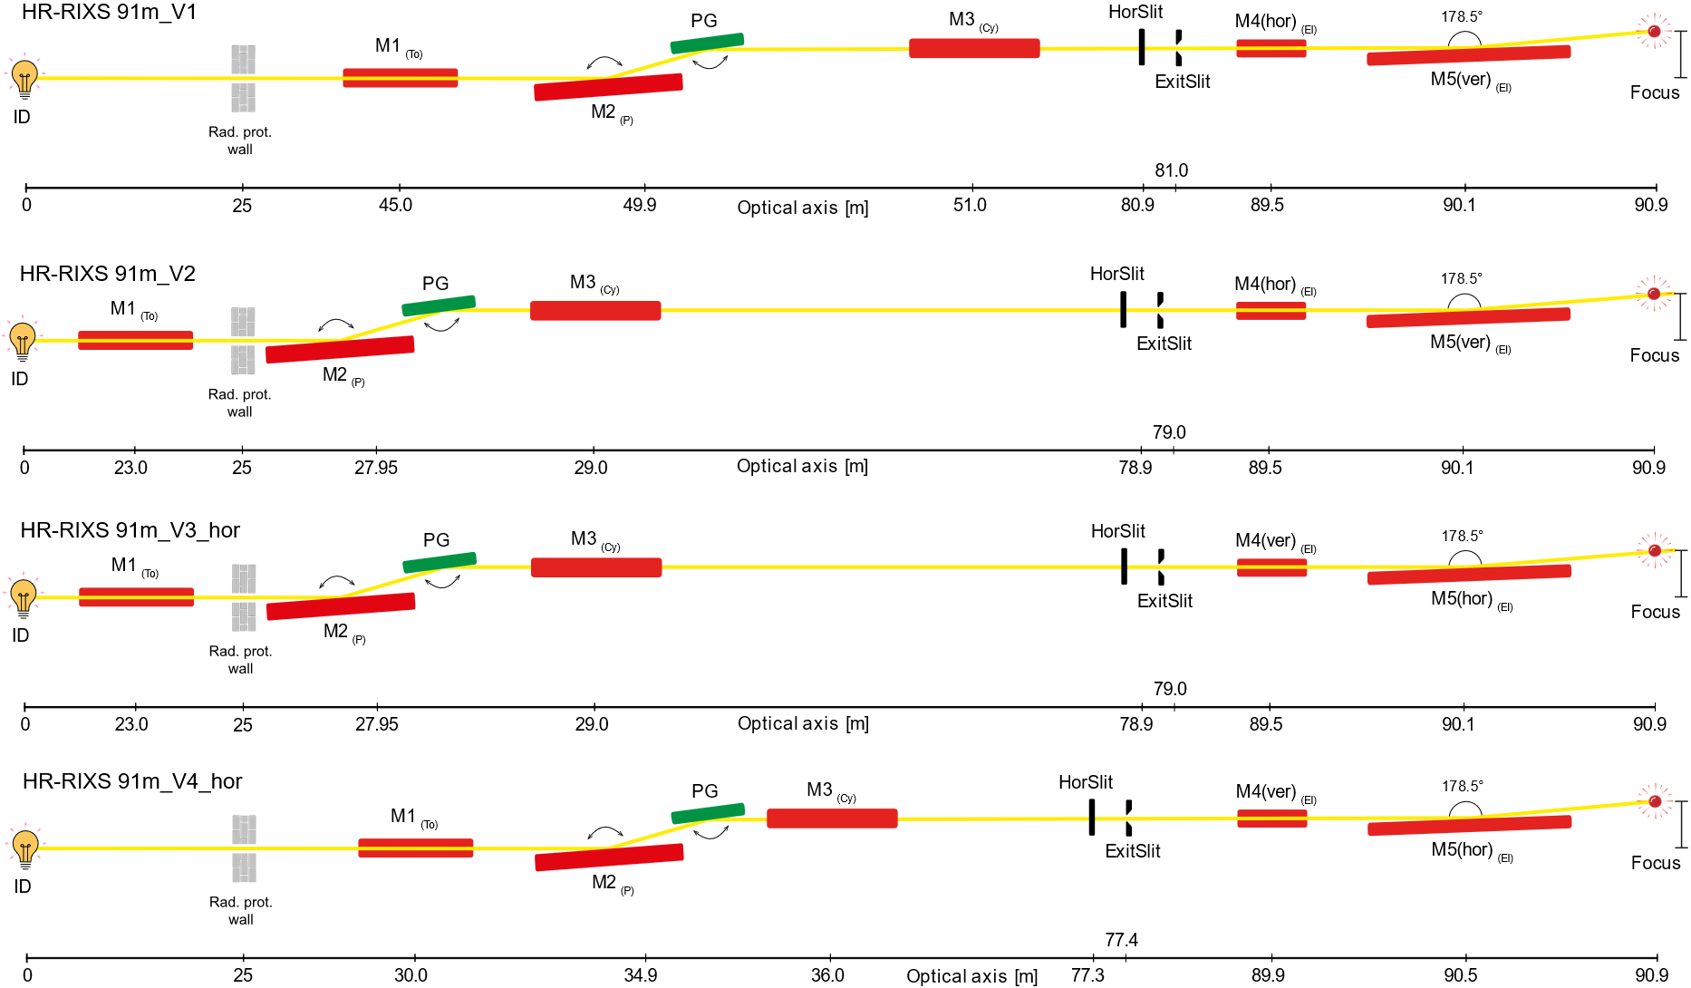
Layouts with 91 m length:
Focus _{(vxh)}: 1.6 x 17.5 µm²
dE_{(@1 keV)} : 1.4 meV
ExitSlit : 2 µm
Focus _{(vxh)}: 1.7 x 15.7 µm²
dE_{(@1 keV)} : 1.7 meV
ExitSlit : 4 µm
good
Focus _{(vxh)}: 3.1 x 8.5 µm²
dE_{(@1 keV)} : 1.6 meV
ExitSlit : 4 µm
Focus _{(vxh)}: 2.2 x 4.1 µm²
dE_{(@1 keV)} : 1.4 meV
ExitSlit : 3 µm

Slide 4
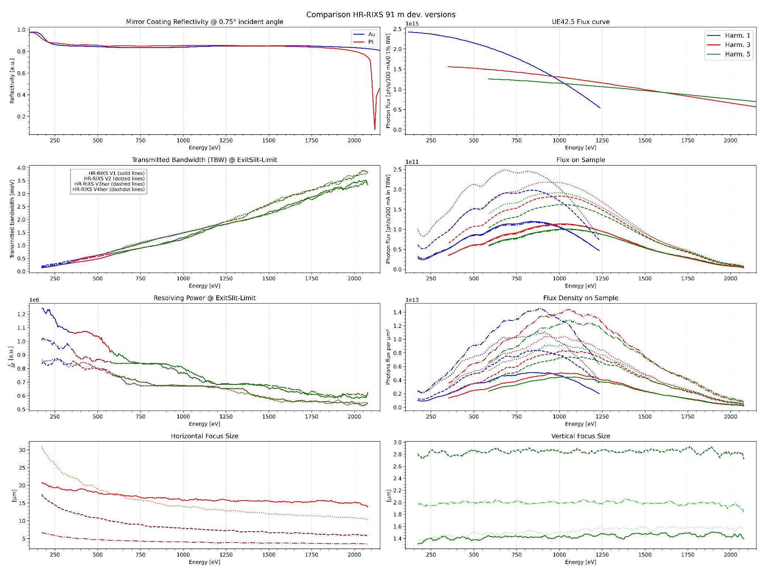

Slide 5
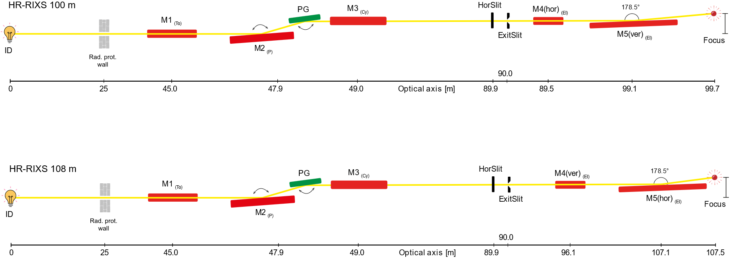
Layout with 100 m and 108 length:
Focus _{(vxh)}: 1.1 x 12.7 µm²
dE_{(@1 keV)} : 1.1 meV
ExitSlit : 1.8 µm
Focus _{(vxh)}: 26.1 x 2.2 µm²
dE_{(@1 keV)} : 1.1 meV
ExitSlit : 1.8 µm

Slide 6
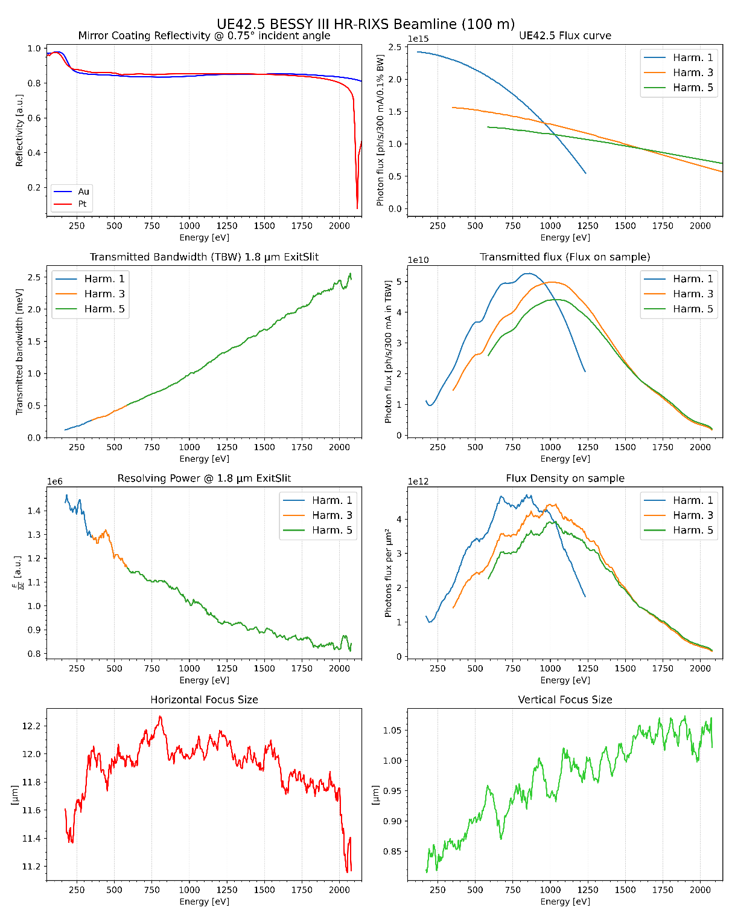
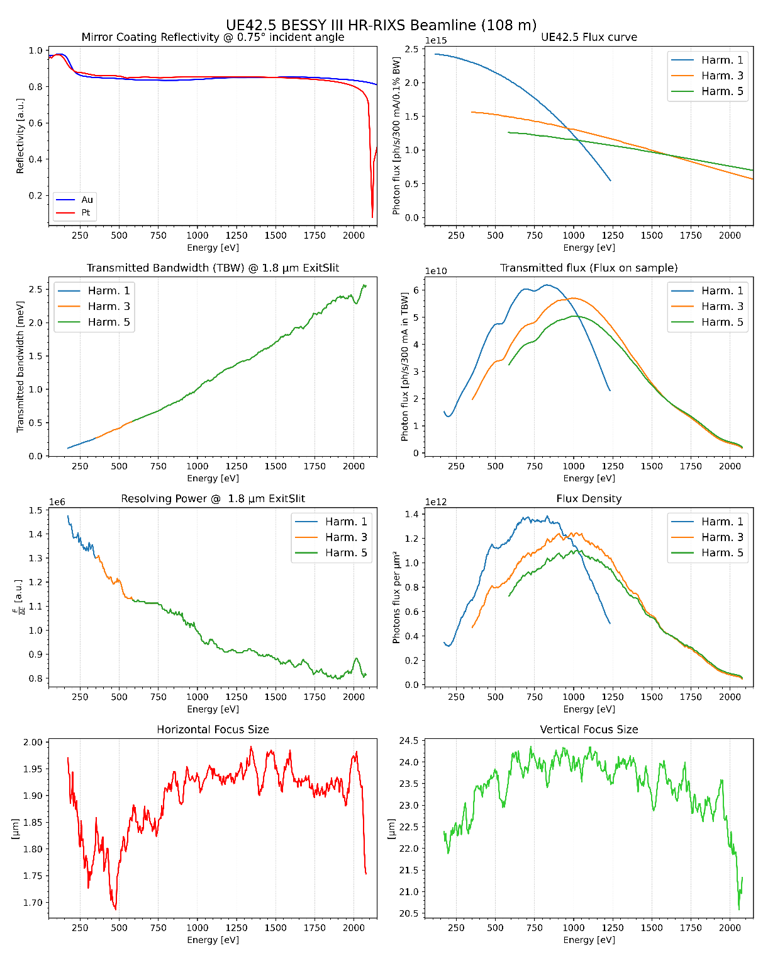

Slide 7
Conclusion
To maintain dE of 1 meV@1keV, longer beamlines up to 100-108 m needed
Focus size still to large (> 1 µm)
ExitSlit opening with ~1 µm maybe challenging
Flux @ high resolution very small (BESSY I niveau)
Long and high precision optics needed
With ExitSlit below ExitSlit-limit, we can gain a bit more RP by loosing flux
Ideas to consider
Advanced KB optics with a Wolter type 1 arrangement to maintain smaller focus
Remove optic elements (hor. or ver. focus) to maintain higher beamline flux
Using VLS-plane grating without ExitSlit (may in combination with a Wolter type1 mirror)
…
good
Technical issues at the first glance
Very high demands on surface quality (rougthness, slope errors)
Delicate grating with high line density (~3000 l/mm, depending on the type) and large dimensions (500 mm)
2. order grating with a high c-factor (~25; leads to a incident angle < 0.4°)
Vibrational stability
…

Slide 8
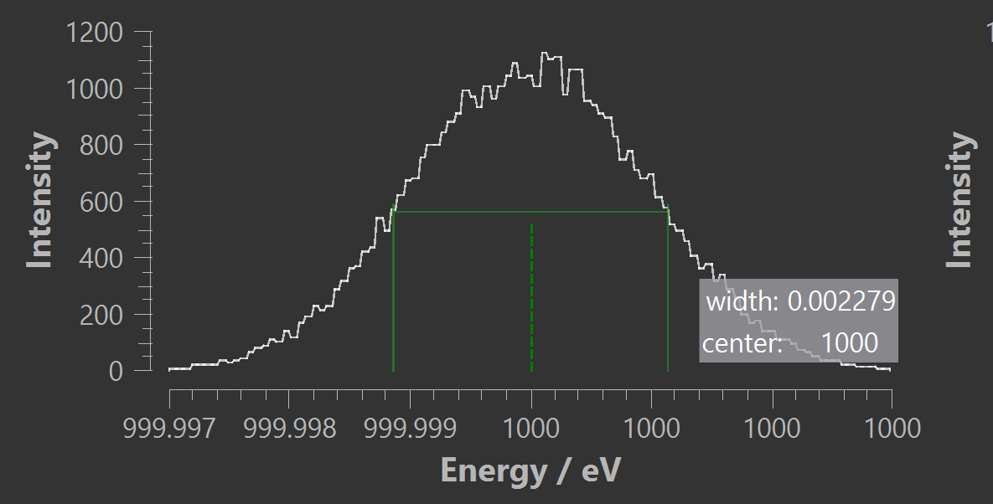
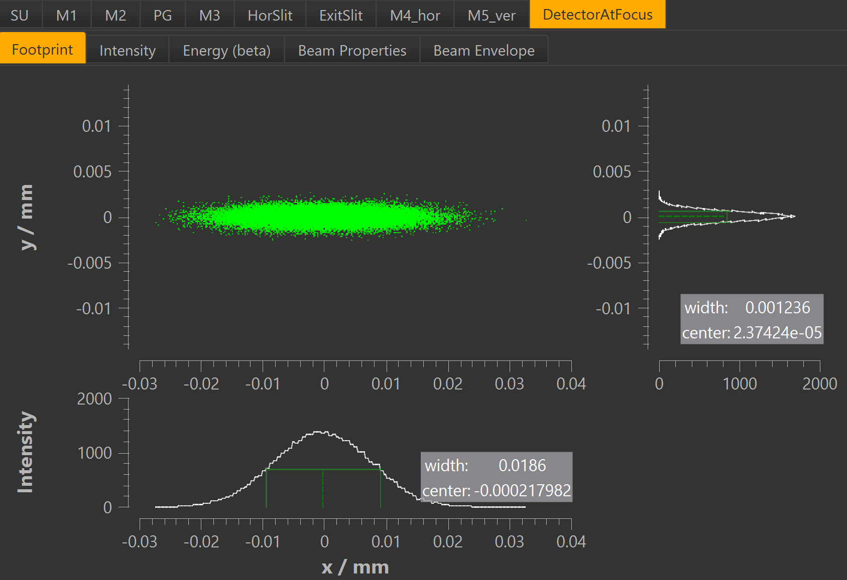
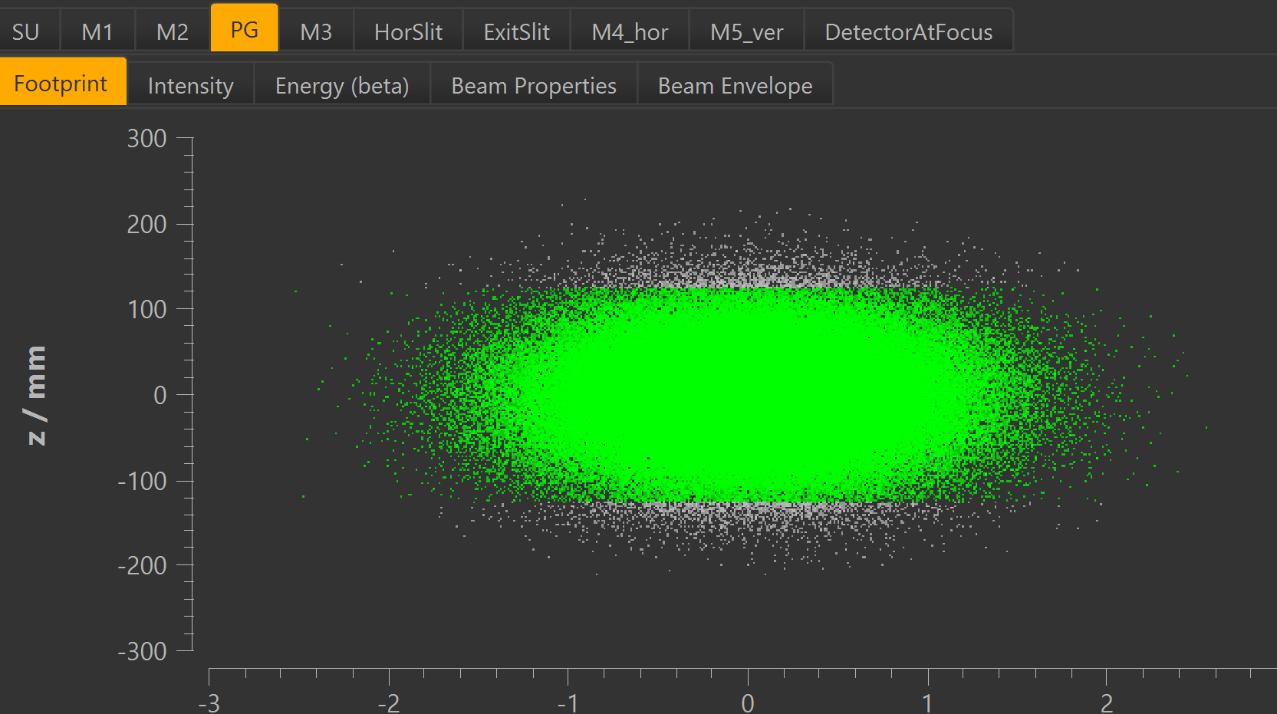
Results with more realistic parameter (state of the art)
c-factor = 10 (incident angle = 0.63°)
linedensity = 2400 l/mm
Grating length = 250 mm
ExitSlit = 4 µm
good
Focus _{(vxh)}: 1.2 x 18.6 µm²
dE_{(@1 keV)} : 2.3 meV
ExitSlit : 4.0 µm
E/dE = ~439,000

Slide 9
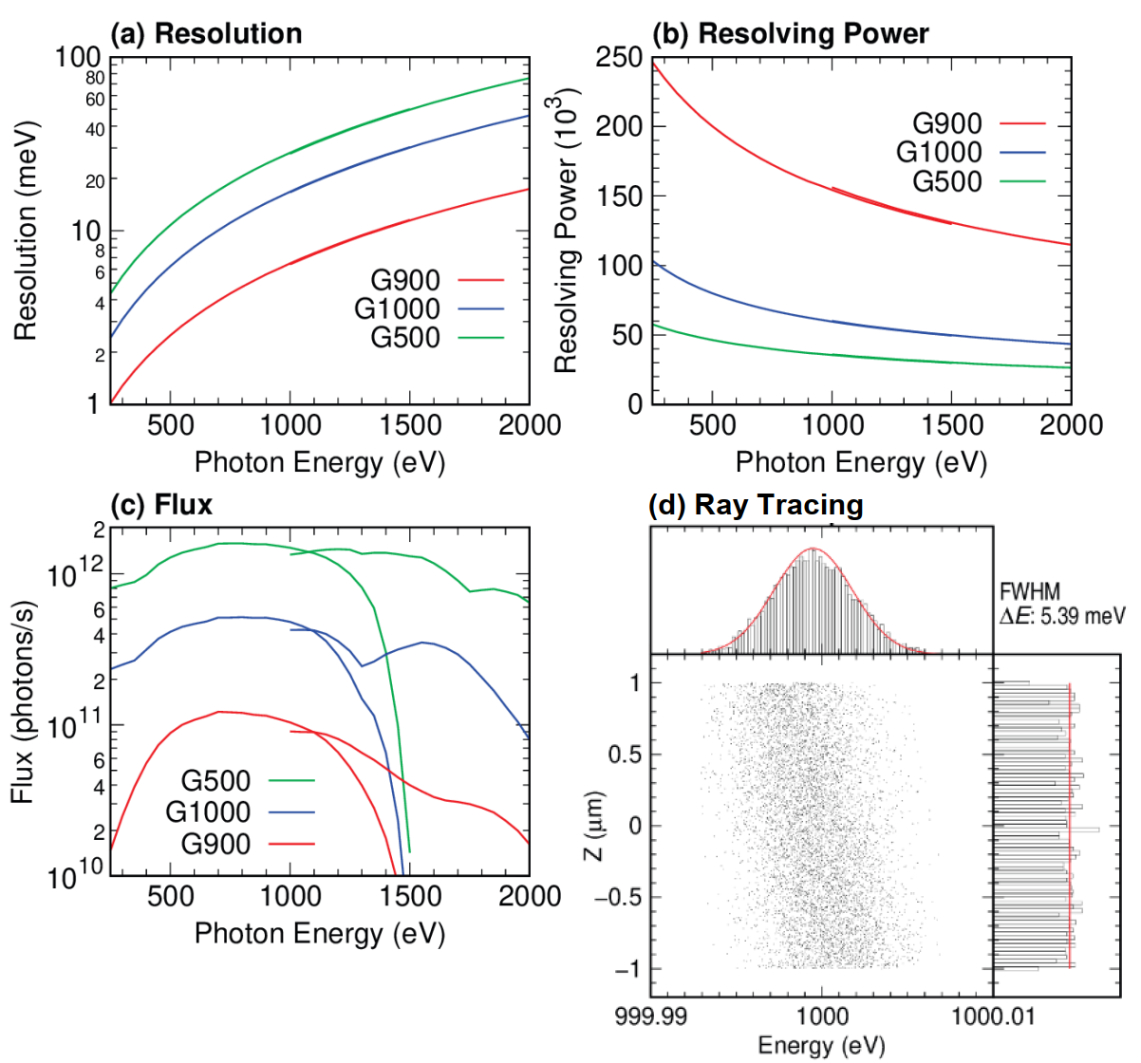
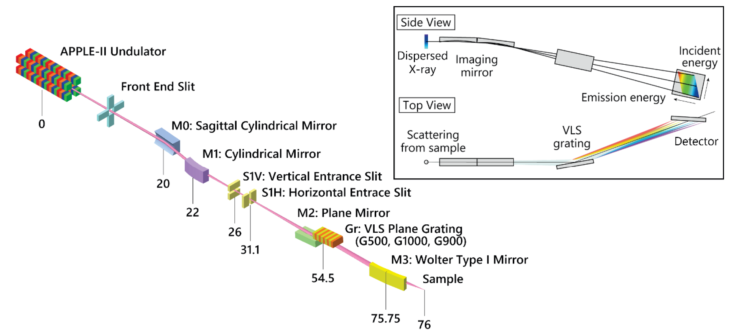
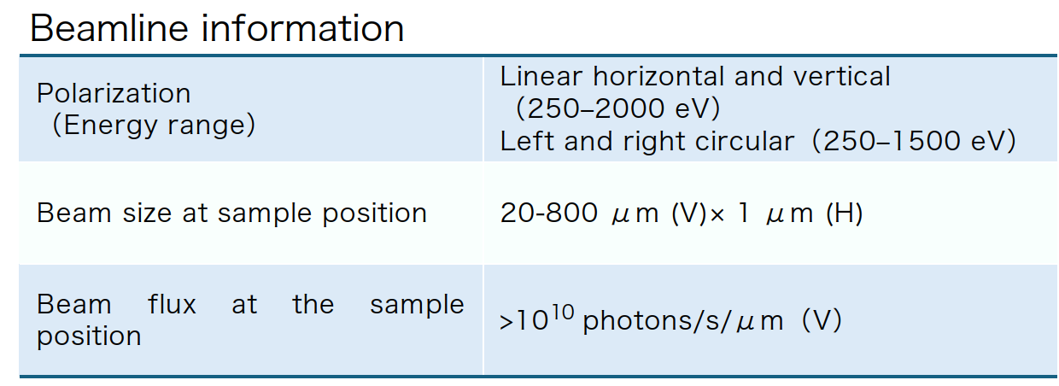
Wolter type 1 mirror – NanoTerasu Beamline:

Slide 10
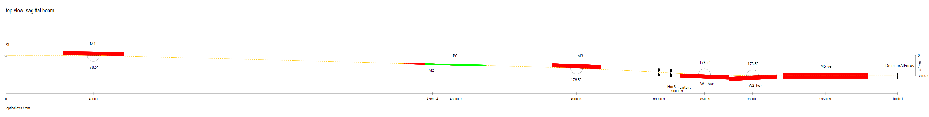
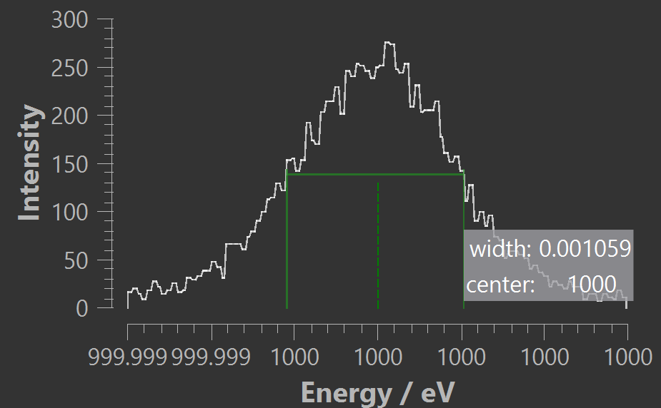
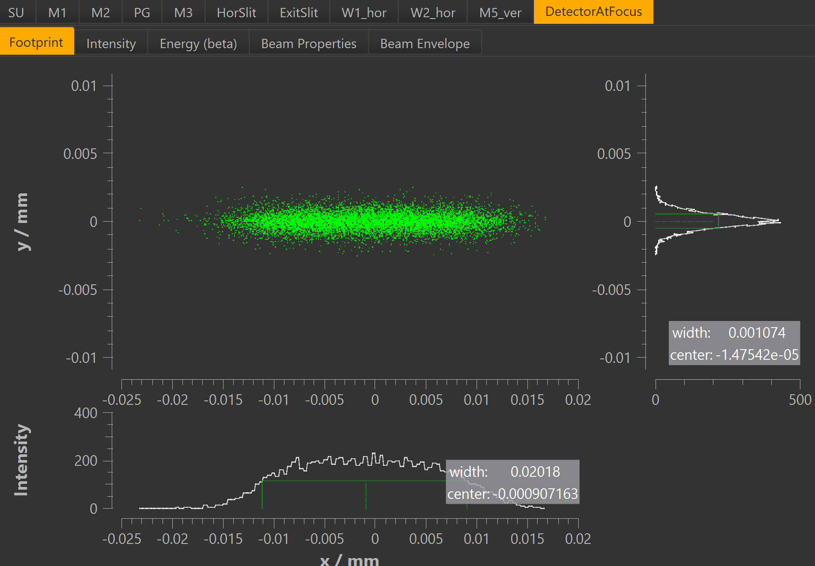
Wolter type 1 mirror – adaption to BESSY III
KB:
Focus _{(vxh)}: 1.1 x 12.7 µm²
dE_{(@1 keV)} : 1.1 meV
ExitSlit : 1.8 µm
AKB
Focus _{(vxh)}: 1.0 x 20.2 µm²
dE_{(@1 keV)} : 1.1 meV
ExitSlit : 1.8 µm

Slide 11
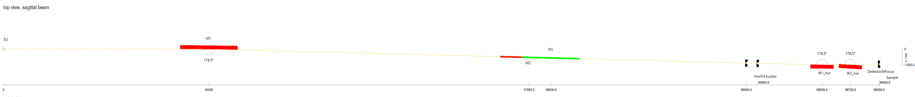
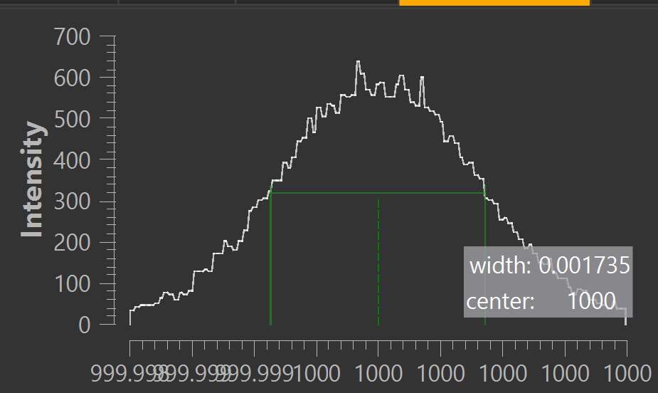
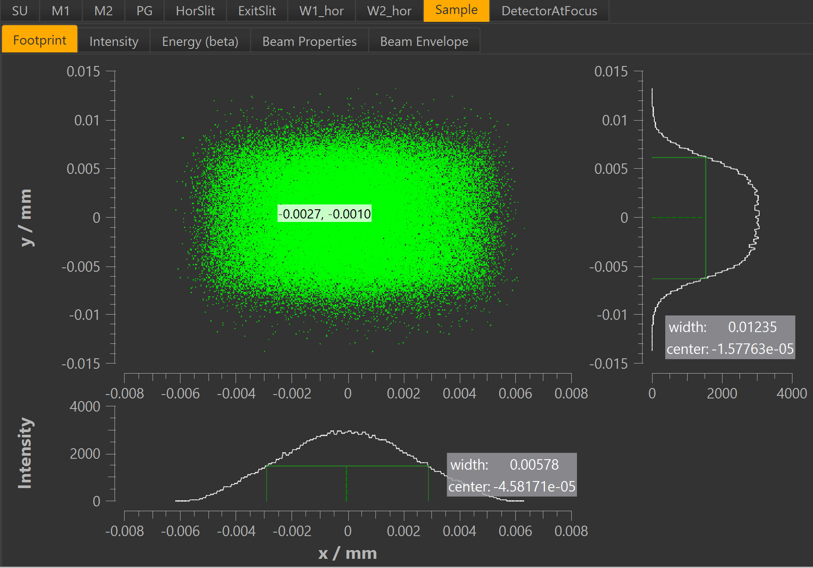
Wolter type 1 mirror – adaption to BESSY III – without vertical refocusing (using VLS plane grating)
Focus _{(vxh)}: 12.4 x 6.8 µm²
dE_{(@1 keV)} : 1.7 meV

Slide 12
Spectrometer specifications
What we know:
Energy Range: 250 – 2000 eV
Resolving Power: ? (amap)
Resolving Power Combined: ? (amap)
Acceptance angle: ?
Collecting mirrors needed?
…
???
Types of RIXS-Spectrometer:
Hettrick-Underwood
Rowland-circle
Von Hamos type
Hybride
…
???

Slide 13
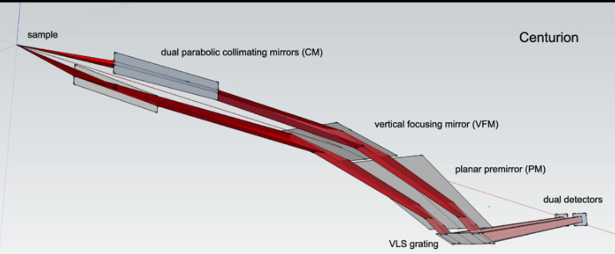
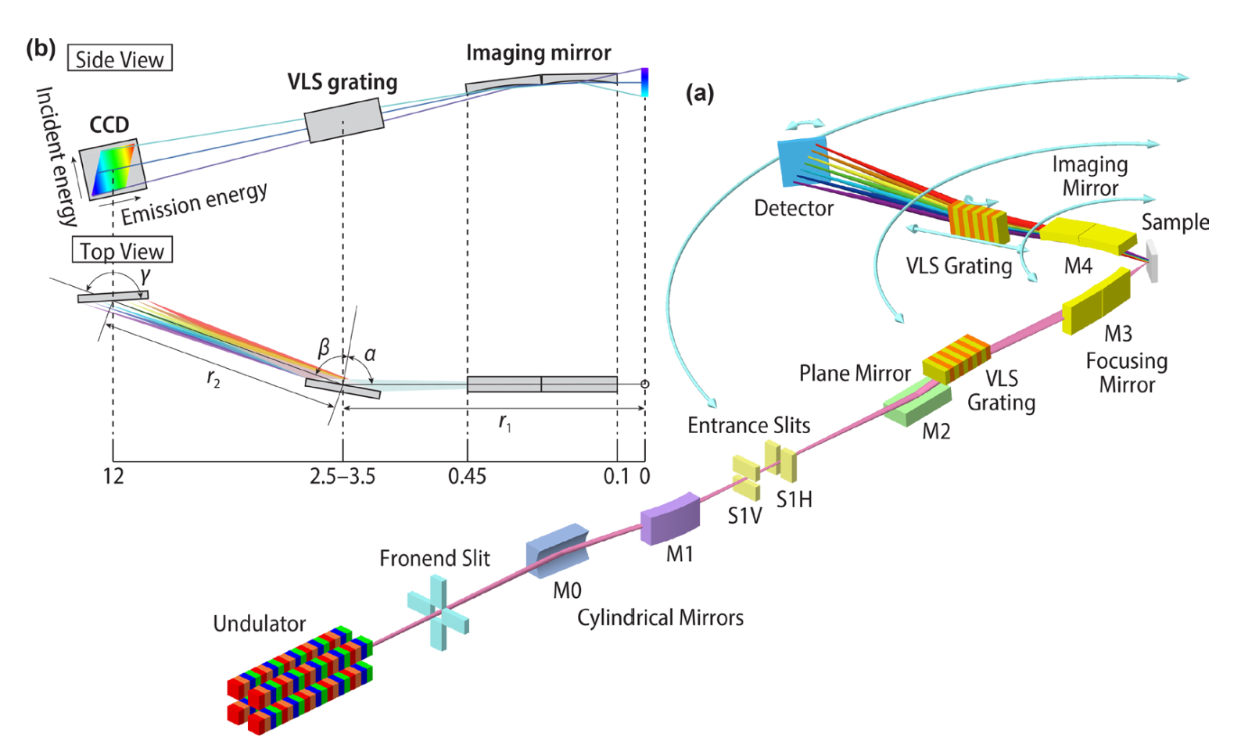
Potential concept from other facilities – competitors
Centurion RIXS @ NSLS-II
RP @ 1000 eV = ~72,000 (combined)
Two parabolic collecting mirrors (hor.)
Length = 15 m
Jarrige, V. Bisogni, Y. Zhu, W. Leonhardt, J. Dvorak, Synchrotron Radiation News 2018, 31, 7-13.
J. Dvorak, I. Jarrige, V. Bisogni, S. Coburn, W. Leonhardt, Rev. Sci. Instrum. 2016, 87, 115109.
High Efficiency 2D-RIXS @ Nano-Teraso
RP @ 1000 eV = up to 50,000 (combined)
Wolter type 1 mirrors in BL and spectrometer
Length = 12 m
J. Miyawaki, K. Yamamoto, H. Kiuchi, Y. Harada, Synchrotron Radiation News 2025, 38, 4-12.
J. Miyawaki, K. Fujii, T. Imazono, NanoTerasu, JASRI NanoTerasu, 2024. (Poster)

Slide 14
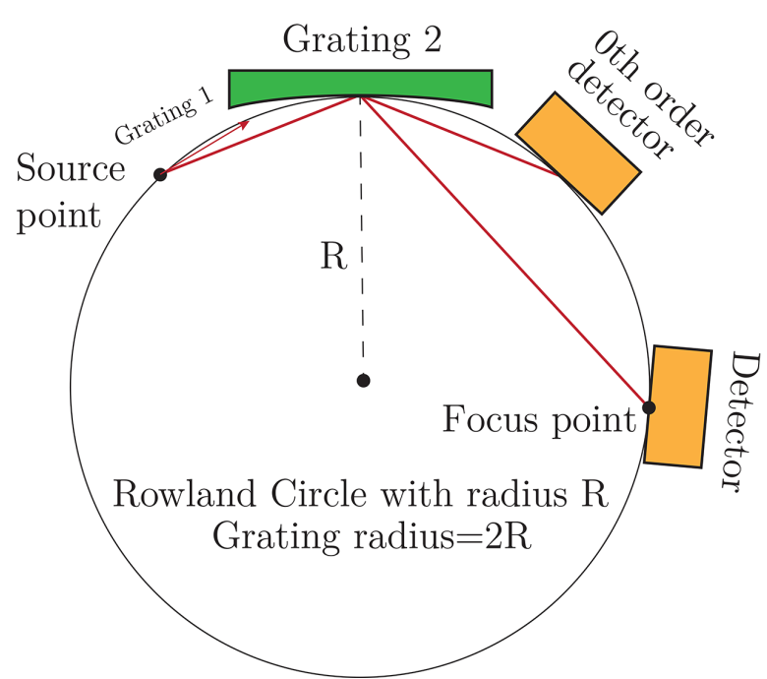
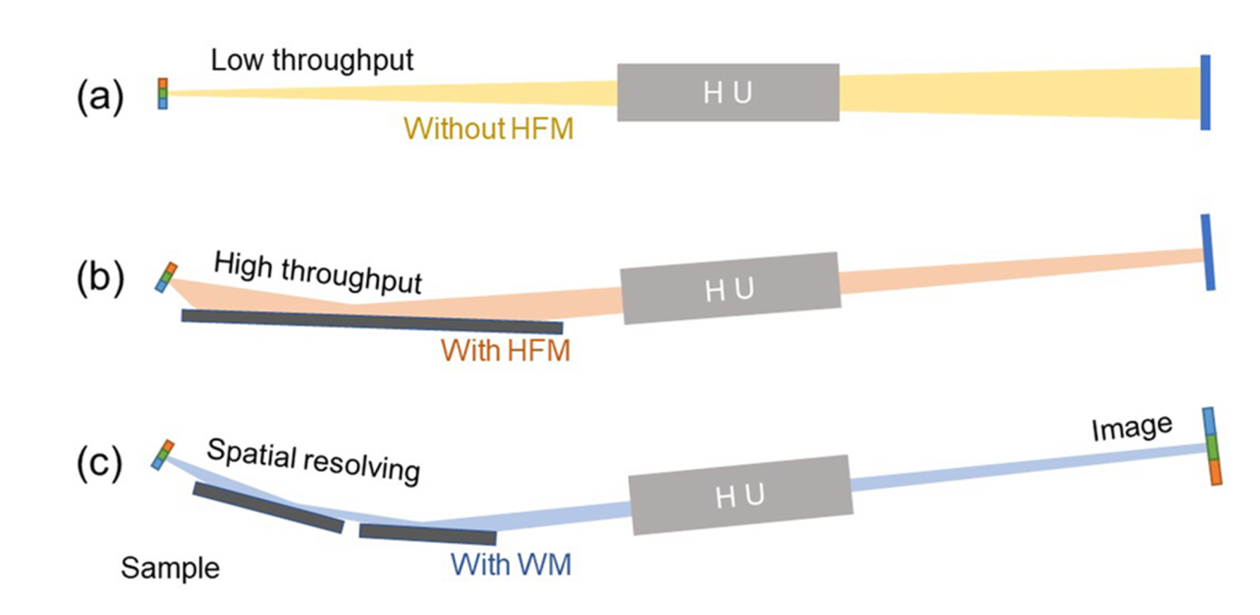
Potential concept from other facilities – competitors
Veritas RIXS @ MAX-IV
RP @ 1000 eV = up to 70,000 (combined, 2. order)
Measured RP only 17,000
No collector
Length = 10 m
M. Agaker, C. J. Englund, V. Ekholm, L. Kjellsson, P. Sjoblom, L. Pickworth, J. Soderstrom, N. Johansson, A. Ghosh, T. Tokushima, M. Caputo, J. Forsberg, G. Felcsuti, P. Fredriksson, S. Malki, N. Wassdahl, C. Sathe, J. E. Rubensson, J Synchrotron Radiat 2025.
RIXS @ NSRL in Hefei
RP @ 1000 eV = up to 12,000 (combined)
Dif. Operation modes
Length = 5 m
R. Wang, P. Zhang, Q. Li, Y. Xia, L. Qian, X. Feng, S. Chen, X. Liu, J Synchrotron Radiat 2025.

Slide 15
Thank you for your kind attention!

