Slide 1

R. Follath: The UE46 X-ray microscopes

Slide 2
X-ray Microscopes
Elliptical Undulator
  130 eV – 2000 eV
  Full polarisation control
Beamline
  Collimated PGM
  Variable magnification
Full Field Microscope
  Condensor with „large“ numerical aperture
  Capillary optics
  Zone plate in objective optic
Scanning Microscope
  Zone plate to produce small spot
  Uniform illumination of zone plate
Fast switching between microscopes by mirror M₃ (1-2 minutes)

Slide 3
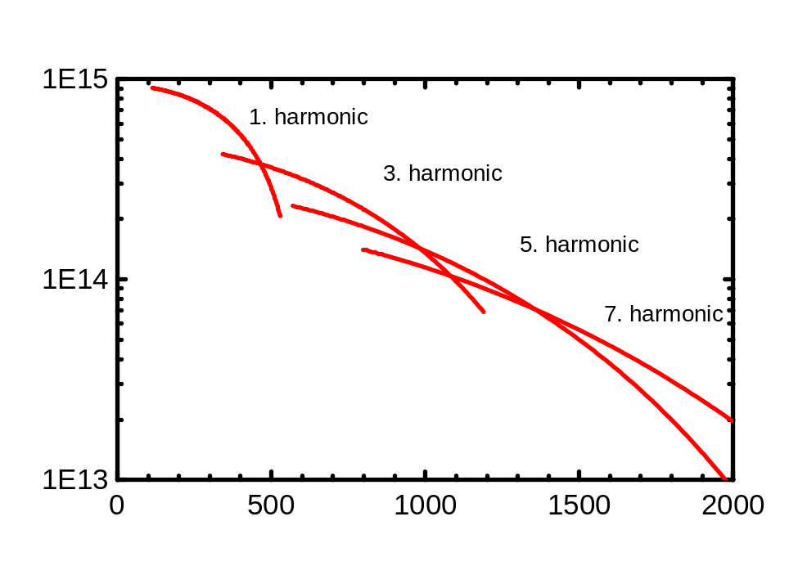
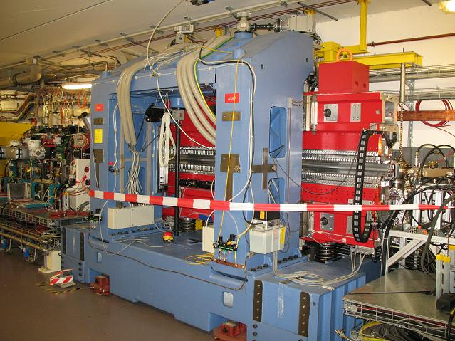
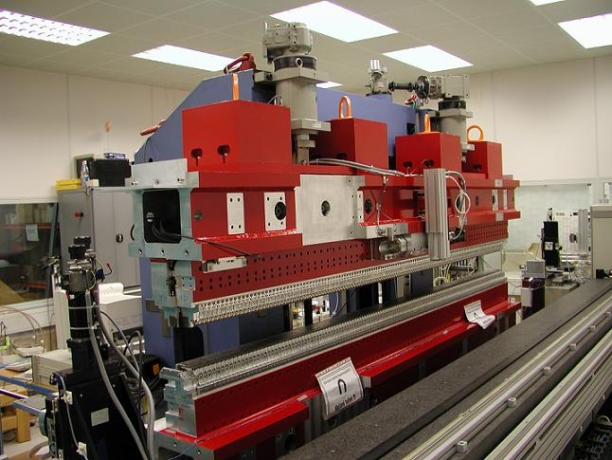
Undulator UE46
Undulator type : APPLE 2
Undulator period : 46 mm
Number of periods : 70
Energy range : 130 eV – 2000 eV
Polarisation : elliptical, linear rotatable
Electron beam parameter
Hor. size σ_{x} : 76 μm
Vert. size σ_{y} : 15 μm
Hor. divergence σ´_{x} : 68 μrad
Vert. divergence σ´_{y} : 10 μrad

Slide 4
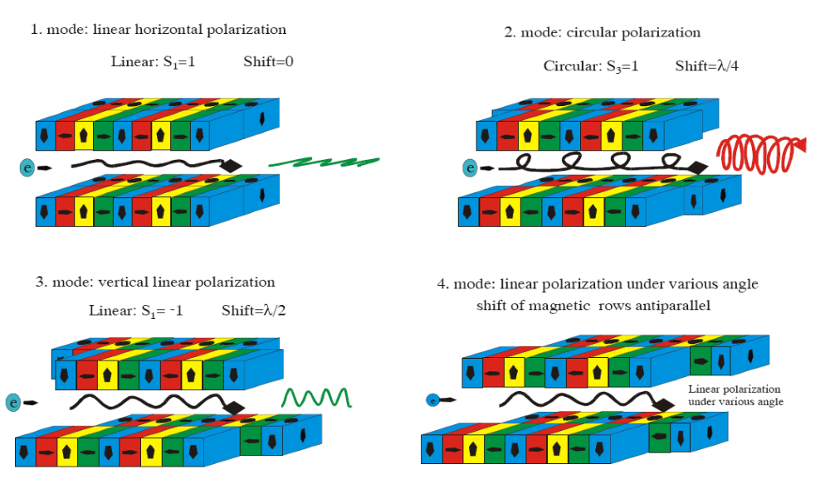
APPLE 2 undulators
Advanced Planar Polarised Light Emmiter

Slide 5
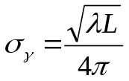

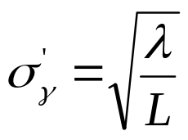


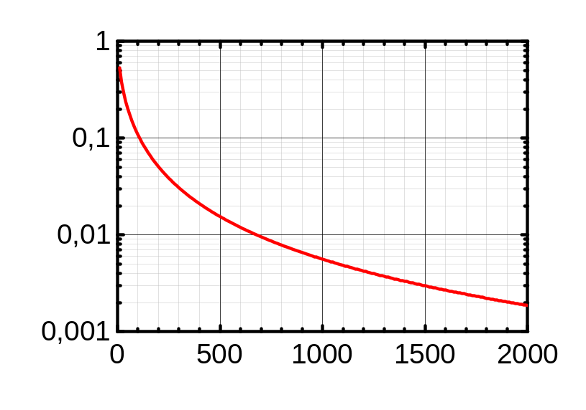
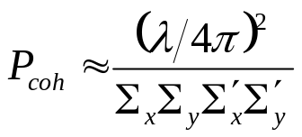
Coherent flux
Photon beam parameters
Electron beam parameter σ_{x,y} ,σ´_{x,y}
(emittance) smears undulator beam
Size
Divergence
Diffraction limited
Effective size
Effective divergence
Coherent fraction
Small coherent fraction at BESSY
L: Undulator length; σ_{γ} ,σ´_{γ} photon beam size and divergence

Slide 6
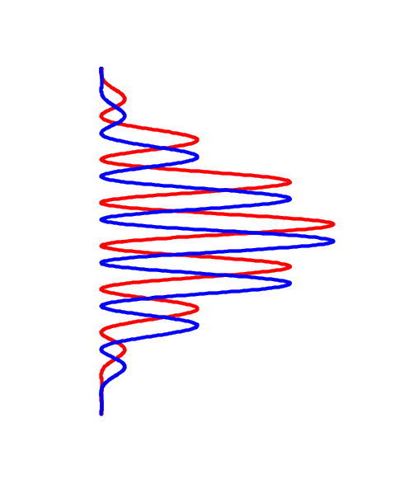
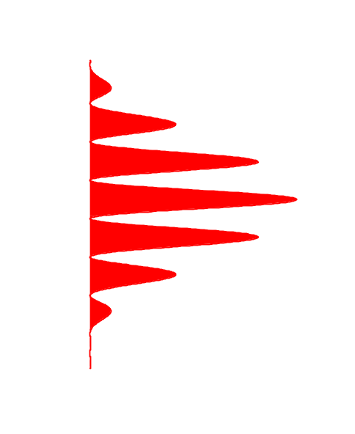
Coherence
Source
Double slit
Screen
L
Q‘
r´₂
r₂
a
s
θ
r´₁
ψ
r₁
Q
θ ≈ s / L
Path differences at slit
Δδ = 2 s sin (ψ/2) ≈ s ψ ≈ s (a / L)
δ = r₂ – r₁
δ´ = r´₂ – r´₁
s (a / L) ≤ λ / 2
a θ ≤ λ / 2
constructive superposition
Δδ = δ´ – δ ≤ λ / 2
a = λ / (2 θ) : Coherence length

Slide 7
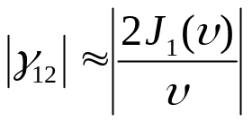
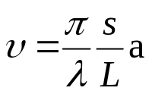
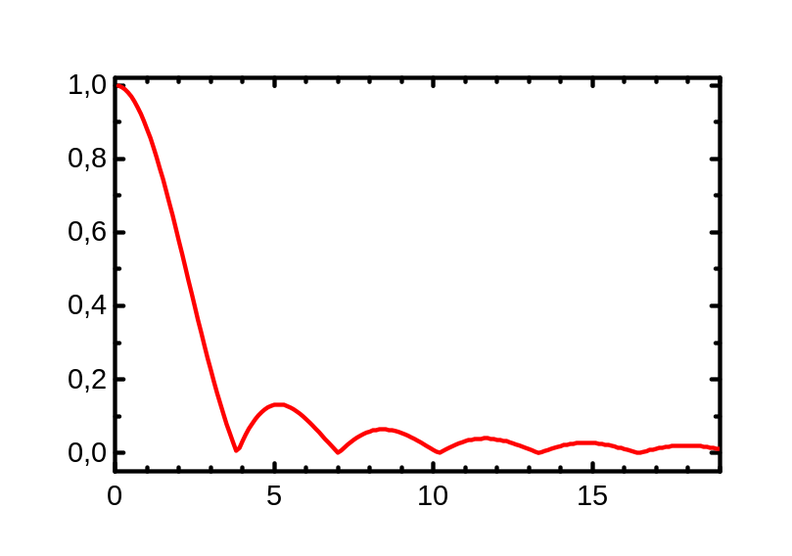
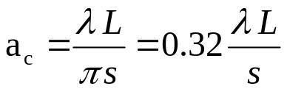
Degree of coherence
Extended source
Uniform disc, diameter s
Degree of coherence
P₁
L
s
a
P₂
J₁ : Besselfunction
Born&Wolf: v=1, (γ₁₂ = 0.88)
Transversal coherence length a_{c}
Sun at 550 nm: a_{c}≈ 19 μm

Slide 8
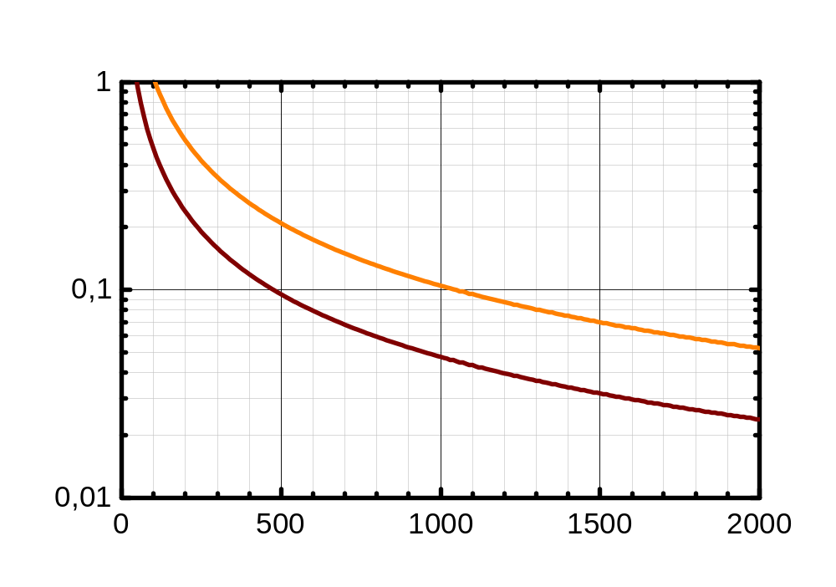
Coherence length
25 μm Pinhole in 3 m distance
partially coherent illumination of
200 μm Zoneplate above 240 eV
70 μm Zoneplate coherently illuminated up to 700 eV
γ₁₂ = 0.5
γ₁₂ = 0.88

Slide 9
Beamline design
Optical design
  Energy range 125 eV –2000 eV
  Collimated plane grating monochromator
  Sagittally focusing mirrors
  3° deflection angles on fixed mirrors
  Stigmatic focussing onto exit slit
  Two microscopes
  3 gratings
Mechanical design
  SX700 mount of premirror
  Fixed exit slit position

Slide 10
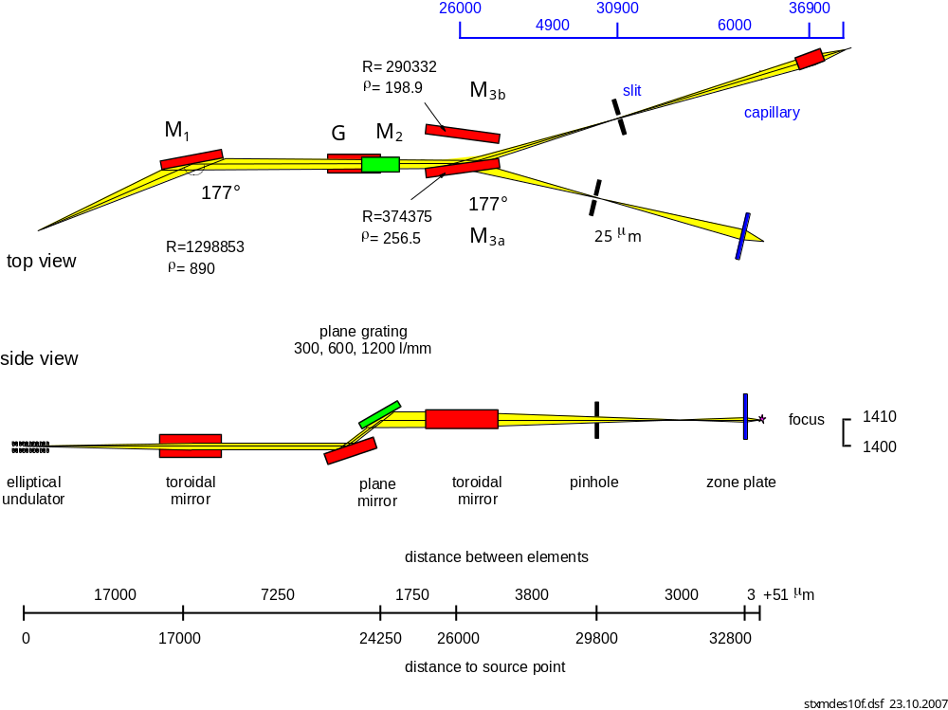
Optical design
Full Field
STXM

Slide 11
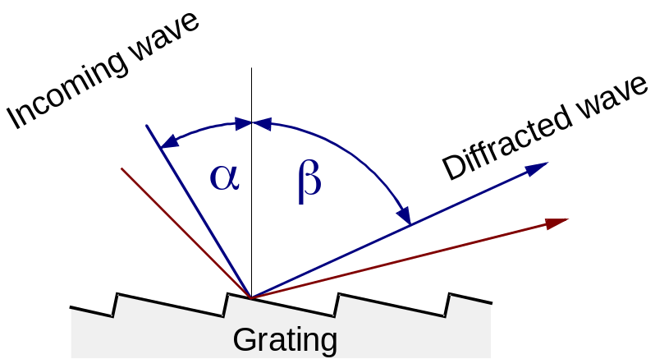
Formulas
grating equation and magnification
Use angular magnification to characterize geometry
N k λ = sin α + sin β
c = cos β / cos α
N: line density, k: diffraction order
λ: wavelength
Large c:
- more grazing incidence
- higher resolution
- longer pulses
Ambiguity in grating equation:
A wavelength λ can be set by an infinite set of pairs (α,β)
Deflection angle 2θ = α - β

Slide 12
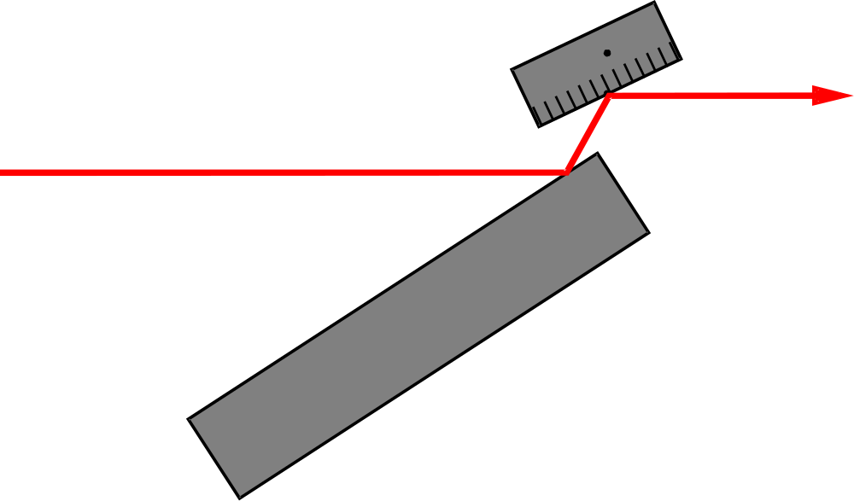

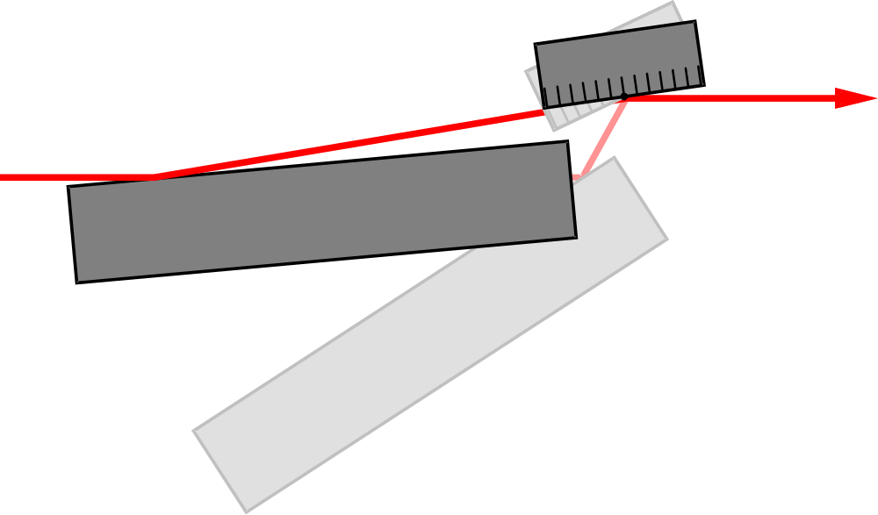
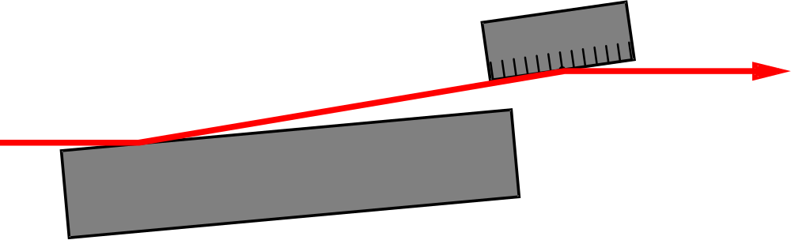
SX700 mechanical design
Grating
Variable deflection angle
Fixed diffracted beam
Plane Mirror
Modes of operation
  Fix focus mode
  On blaze mode
  Grating only
  Mirror only
  Beamsplitter mode

Slide 13
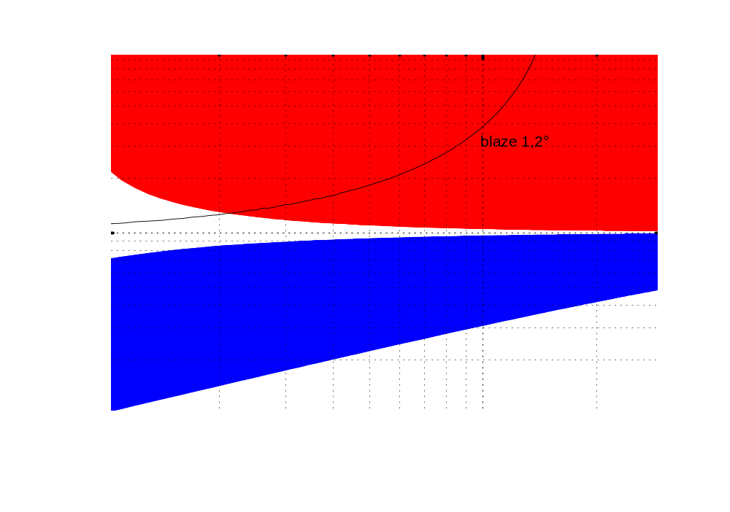
Accessible parameter space
Inside diffraction order
Outside diffraction order
Divide energy scale by factor 2 for 600 l/mm grating and by 4 for 300 l/mm grating

Slide 14
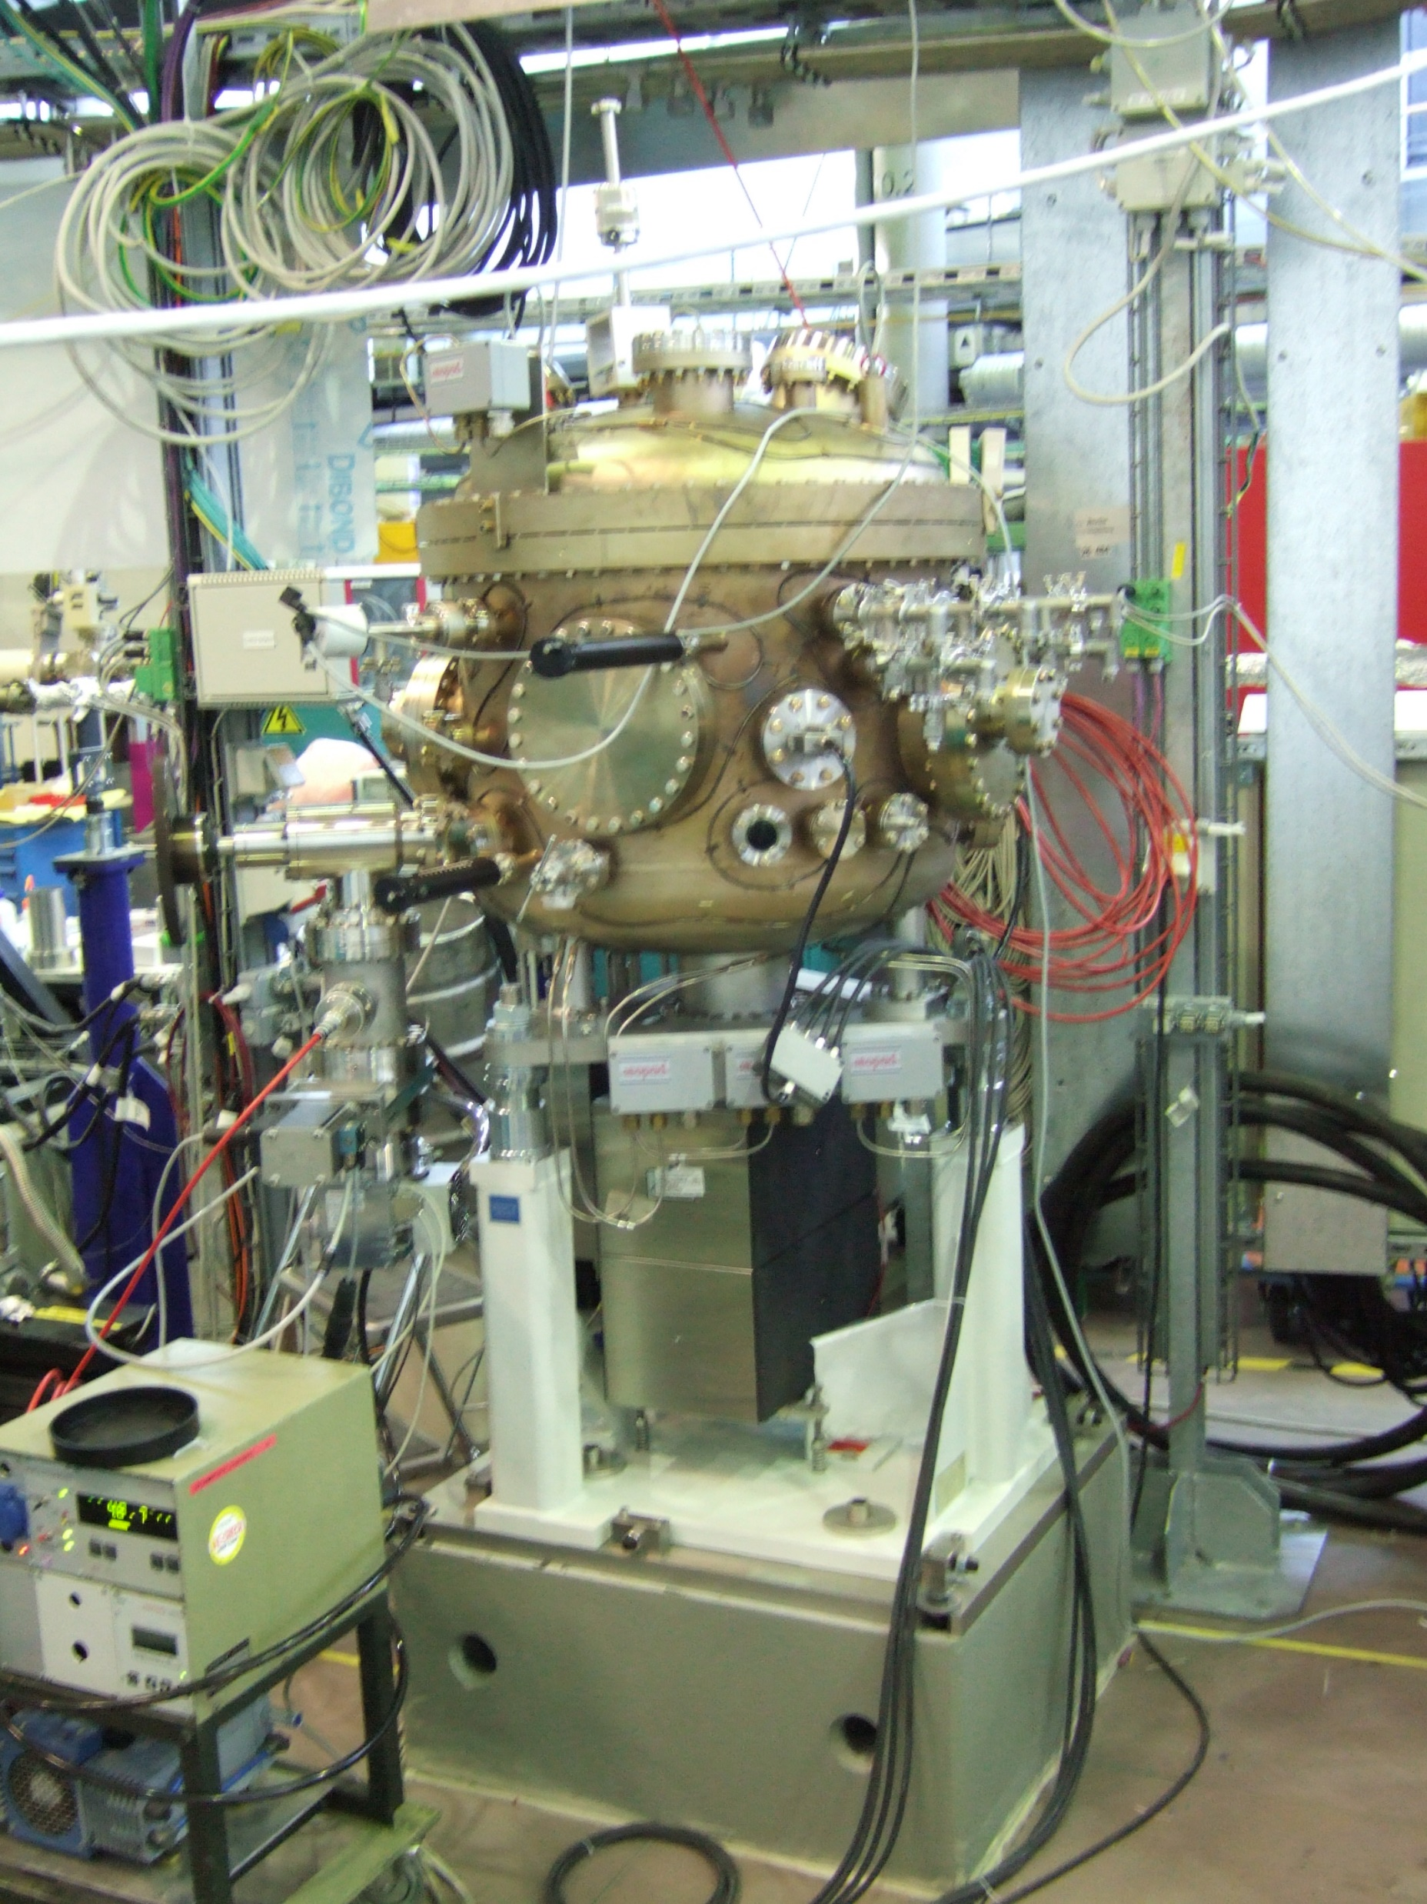
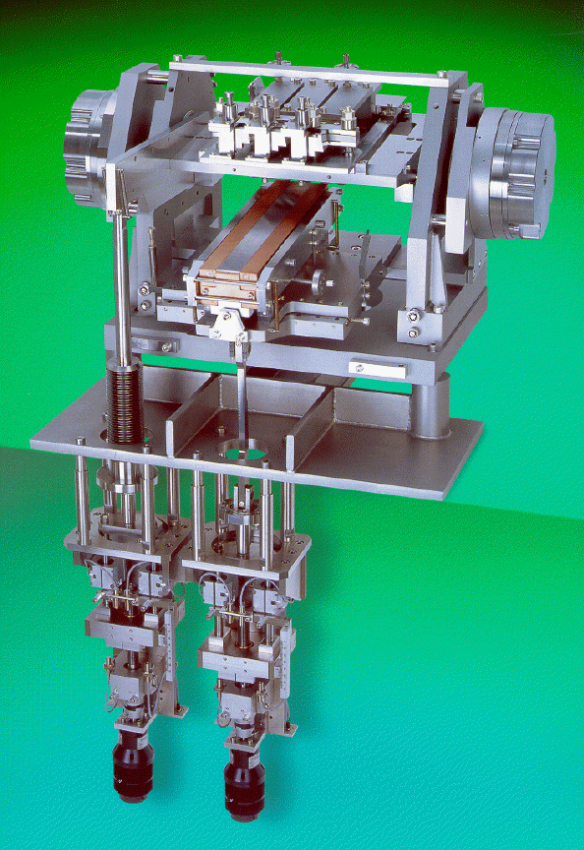
Grating chamber
Angular encoder
3 Gratings (interchangable)
Light
Plane mirror
Drive system
motors

Slide 15
Optical elements
Optical element |  | M1 | M2 | M3a | G1 | G2 | G3
shape |  | toroidal | plane | toroidal | plane
Geom. surface size | [mm²] | 330 x 30 | 310 x 50 | 220 x 40 | 100 x 20
Opt. surface size | [mm²] | 310 x 25 | 300 x 30 | 200 x 35 | 90 x 15
Bulk material |  | Si | Si | Si | Si
Roughness | [nm] | 0.5 nm | 0.5 nm | 0.5 nm | 0.5 nm
Slope error σ (mer/sag) | [arcsec] | 0.5 /0 .9 | 0.08 /0.3 | 0.4 / 1 | 0.1
Source distance (h/v) | [mm] | 17 000 | - | ∞
Image distance (h/v) | [mm] | ∞ | - | 4 900
Mirror parameter | [mm] | R=1 298 800 | R > 20 km | R=374 400 | R > 30 km
 |  | ρ=890 |  | ρ=256.5
Deflection angle |  | 3° | 0.8° - 5° | 3° | 0.8° - 5°
Coating |  | 30 nm Au | 30 nm Pt | 30 nm Au | 50 nm Au
Grating structure |  |  |  |  | blaze
Line density | [1/mm] |  |  |  | 300 | 600 | 1200
Blaze angle |  |  |  |  | 0.6° / 7° | 0.7° / 8° | 1.2° /11°
Already installed
(March 2008)
Delayed
(exp. June 2008)

Slide 16
Raytracing
Parameters
  Include source size and divergence
  With slope errors of optical elements
  Include grating efficiency and reflectivities of mirrors
  Put 25 μm pinhole in exit slit plane
  Calculate flux and resolution
  Calculate illumination of Zoneplates of 200 μm (70 μm) in 3 m distance
  Consider inside order (c=2) versus outside order (c=0.5)
  Consider mode with varying magnification c

Slide 17
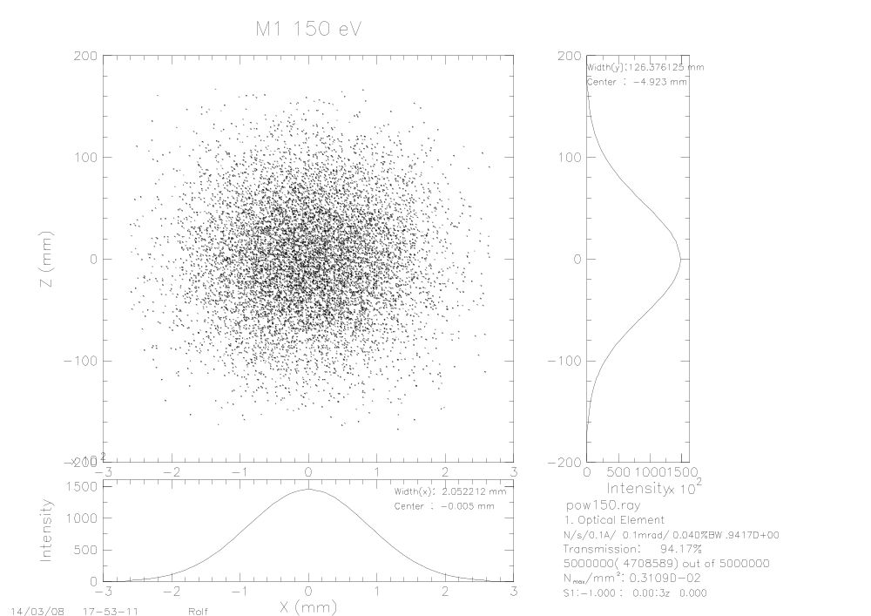

Raytrace: 1200 l/mm, c=2
M1
150 eV
700 eV
2 x 130 μm²
1 x 13 μm²

Slide 18


Raytrace: 1200 l/mm, c=2
M2
150 eV
700 eV
3 x 17 μm²
3 x 18 μm²

Slide 19


Raytrace: 1200 l/mm, c=2
Grating
150 eV
700 eV
3 x 25 μm²
3 x 27 μm²

Slide 20
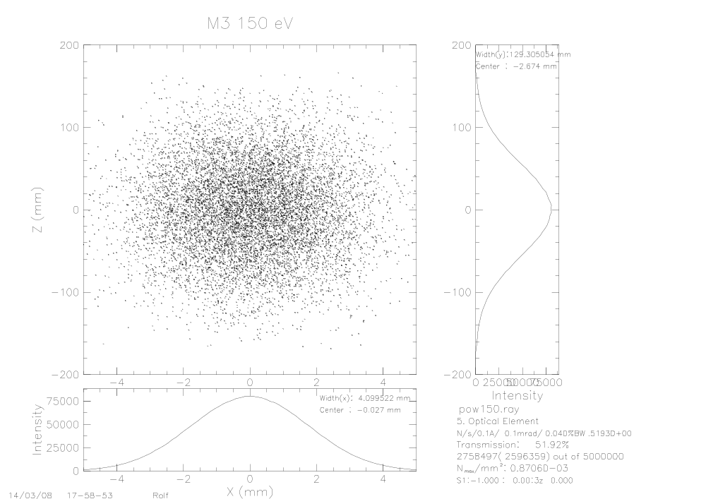

Raytrace: 1200 l/mm, c=2
M3
150 eV
700 eV
130 x 4 μm²
110 x 2 μm²

Slide 21
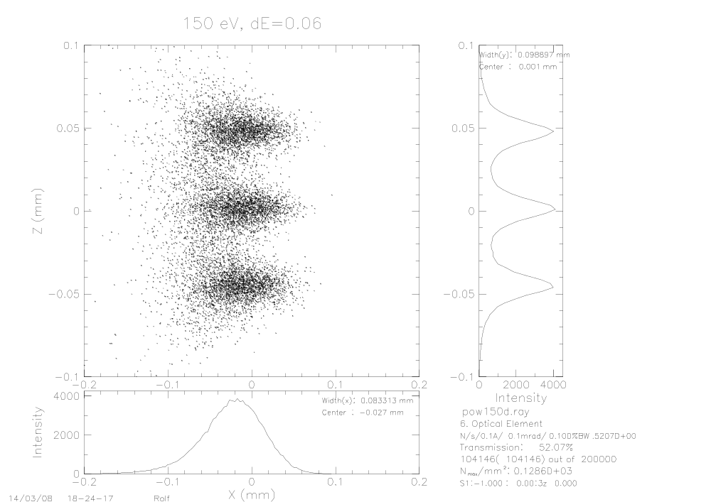
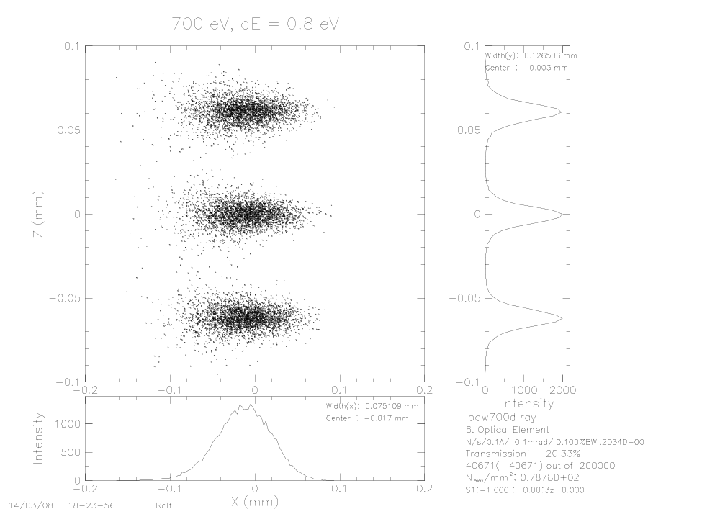
Raytrace: 1200 l/mm, c=2 exit slit
150 eV
700 eV
85 x 25 μm²
75 x 13 μm²

Slide 22

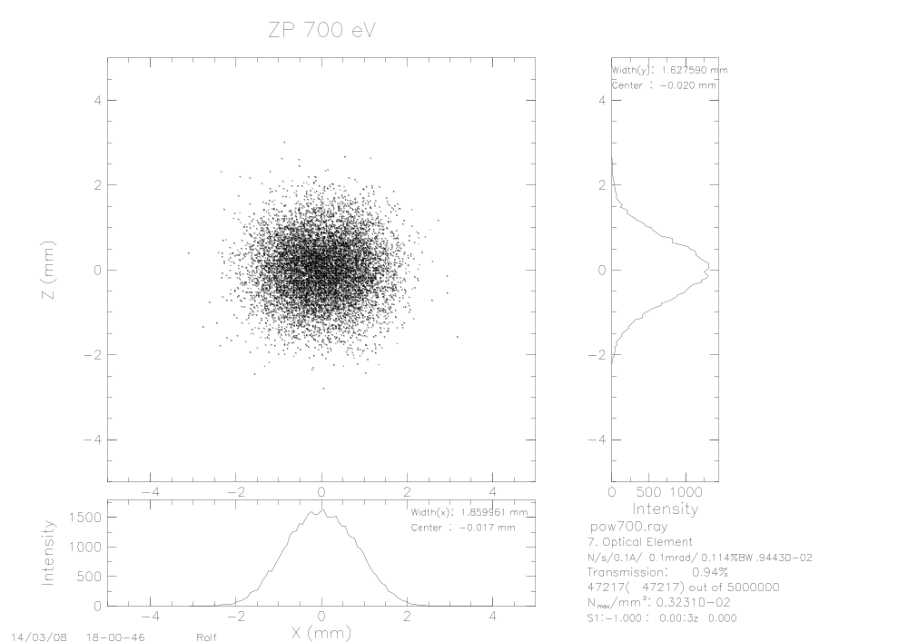
Raytrace: 1200 l/mm, c=2
Zoneplate
150 eV
700 eV
2.6 x 3.4 μm²
1.9 x 1.6 μm²

Slide 23
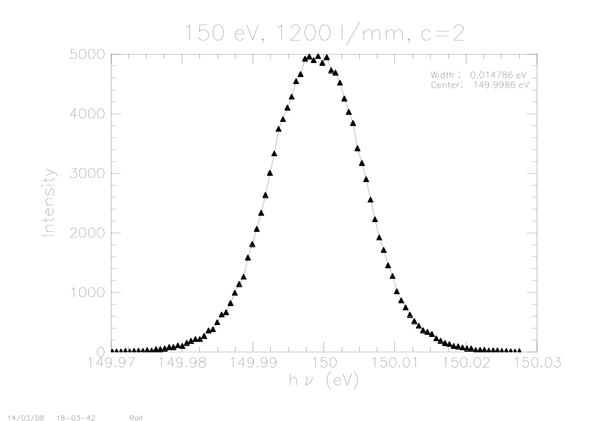
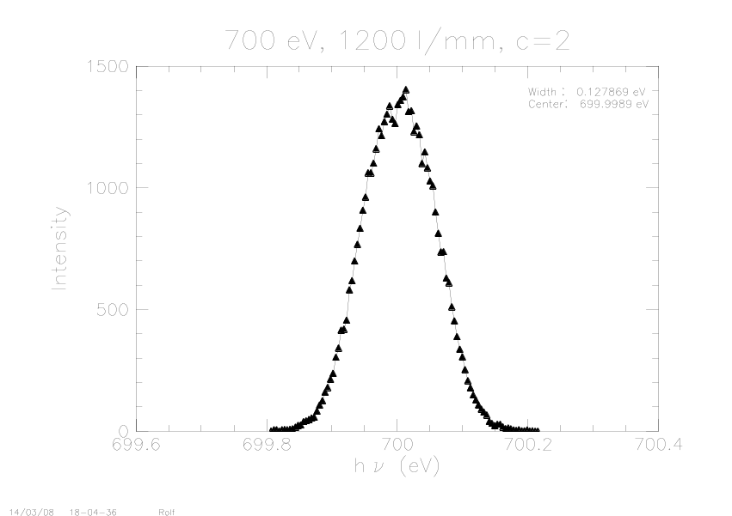
Raytrace: 1200 l/mm, c=2
Energy resolution
150 eV
700 eV
15 meV
130 meV

Slide 24
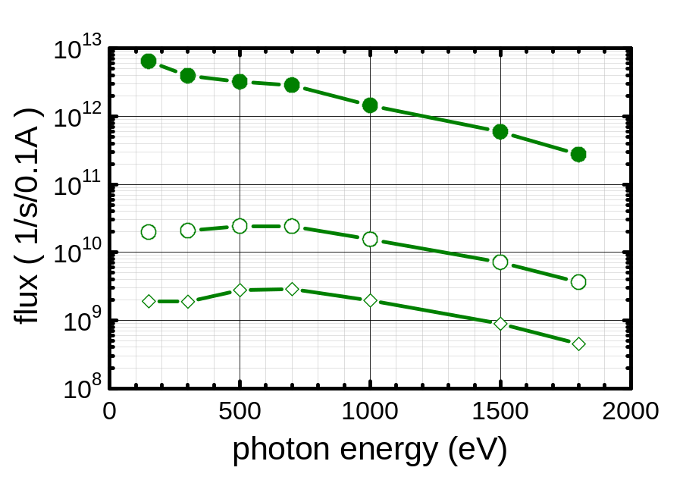
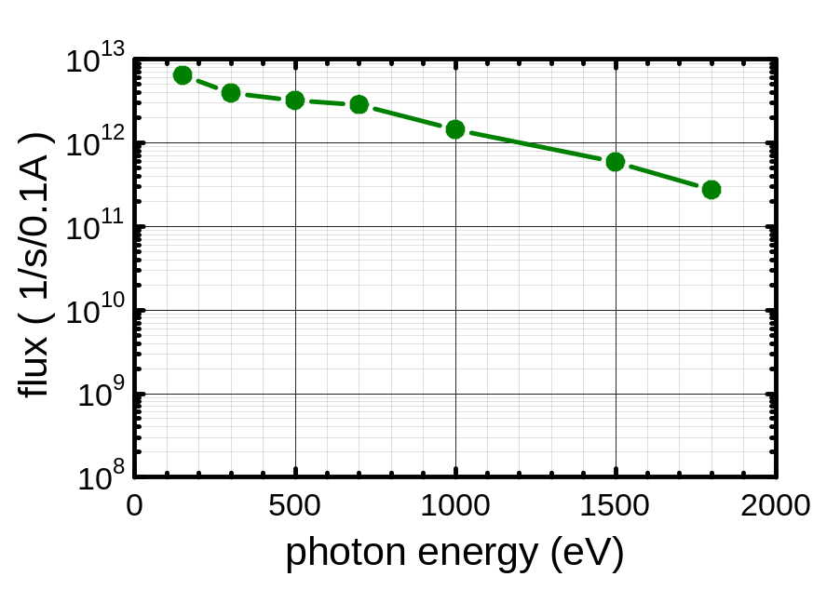
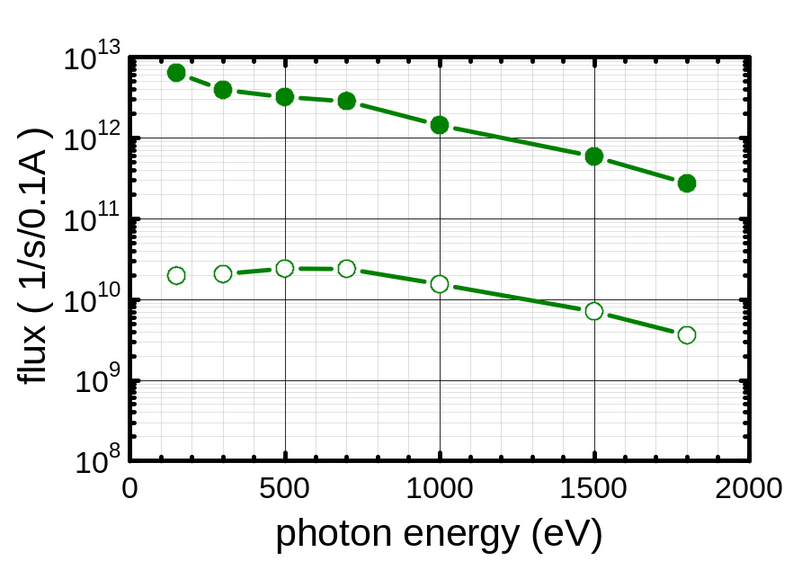
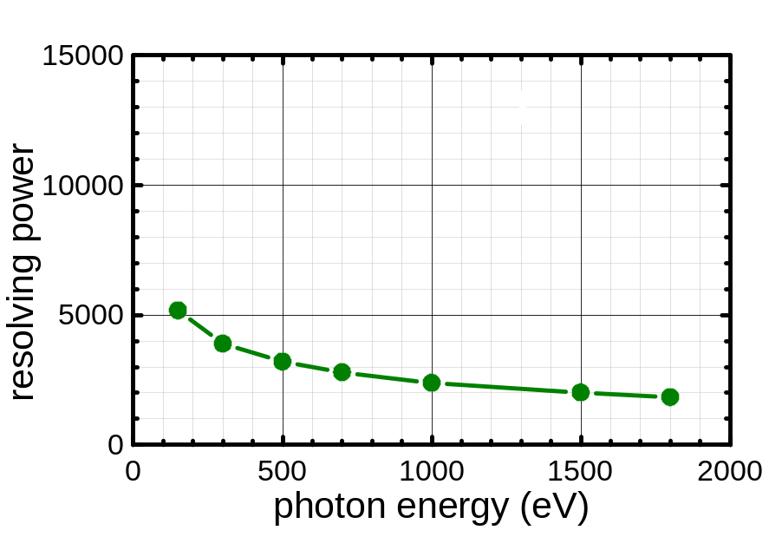
Performance
300 l/mm, c=2
Flux after 25 μm Pinhole
Resolving power
Total
On standard Zoneplate (Ø 200 μm in 3 m distance)
On small Zoneplate (Ø 70 μm in 3 m distance)

Slide 25
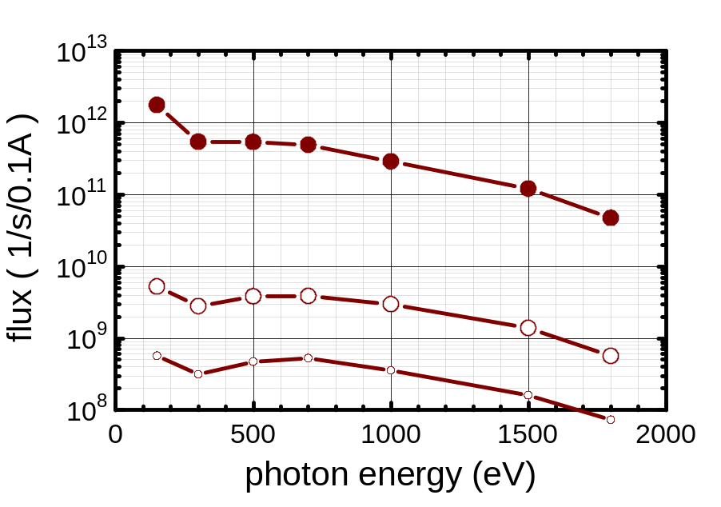
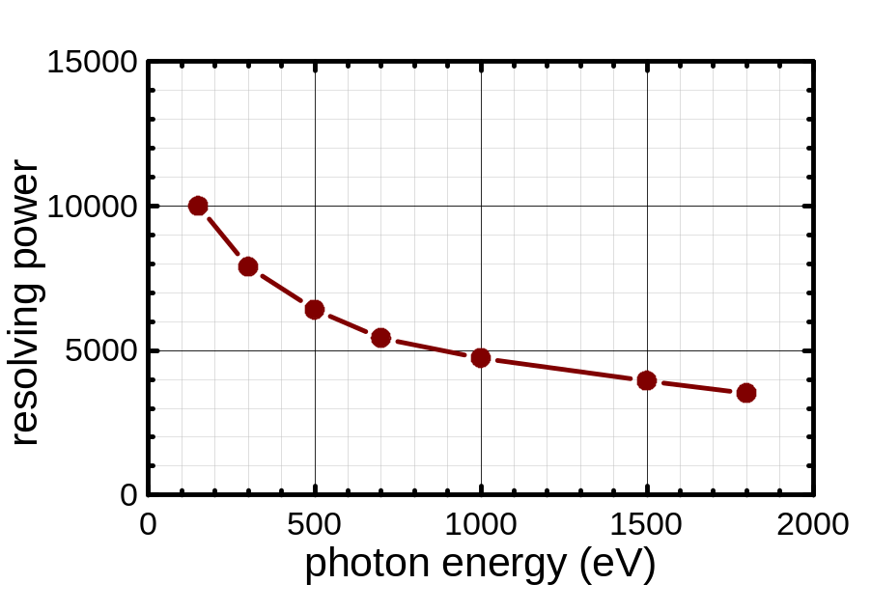
Performance
1200 l/mm, c=2
Flux after 25 μm Pinhole
Resolving power
Total
On standard Zoneplate (Ø 200 μm in 3 m distance)
On small Zoneplate (Ø 70 μm in 3 m distance)

Slide 26
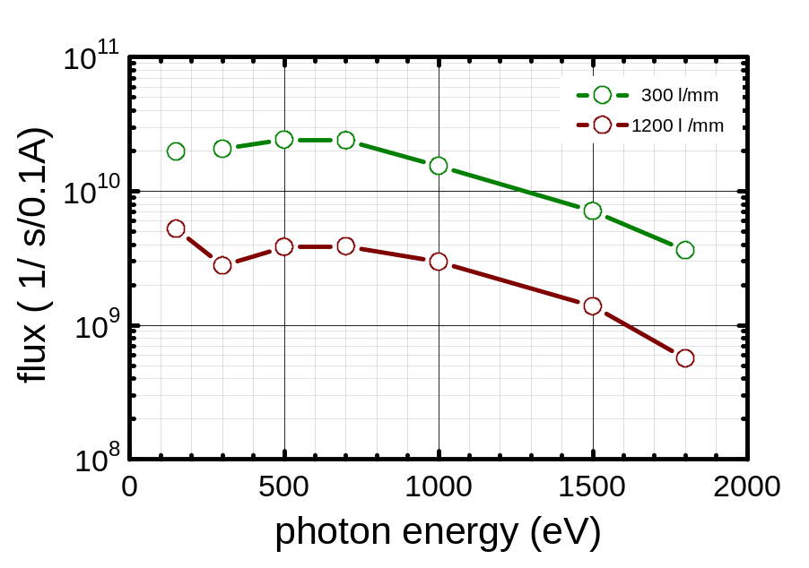
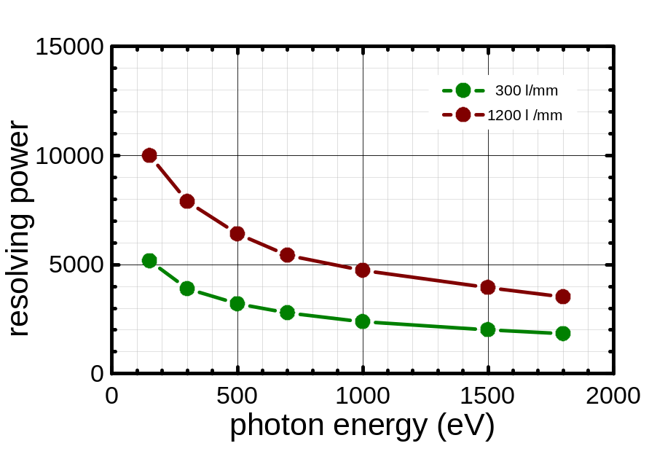
Performance both , c=2
Flux after 25 μm Pinhole
on 200 μm Zoneplate
Resolving power
Standard operation mode

Slide 27
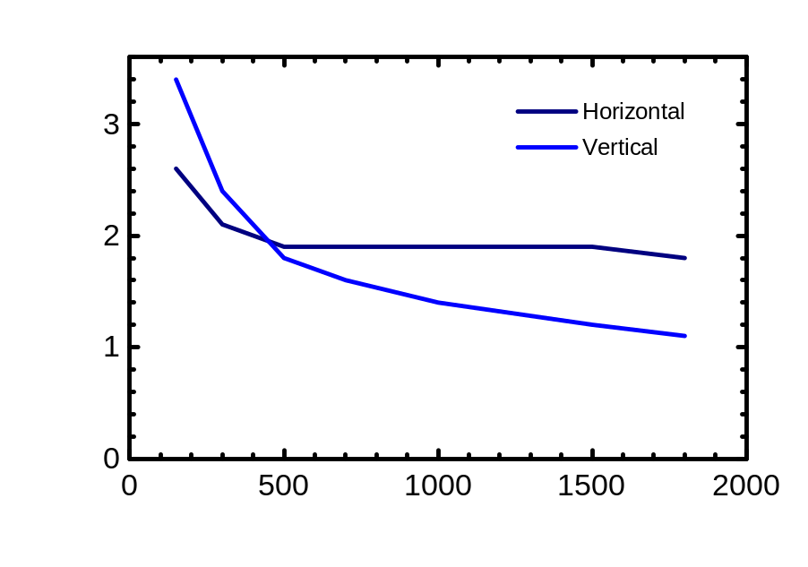
Illumination of Zoneplate
Spotsize on Zoneplate
Horizontal size constant
Spotsize 10 x larger than Zoneplate
Vertical size changes due to
emission of undulator by factor 3
Change vertical magnification of
monochromator

Slide 28
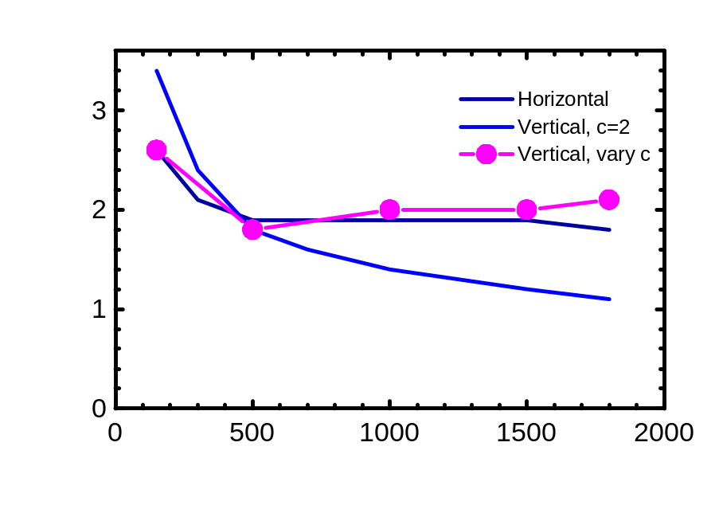
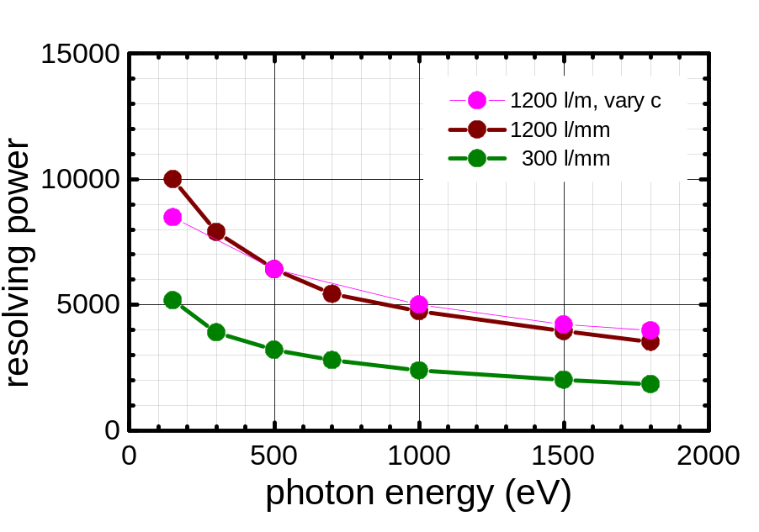
Performance
1200 l/mm, c=2, vary c
Spotsize on Zoneplate
Resolving power
Magnification c=1.4 (150 ev) → c=5 (1800 eV)
Symmetric illumination of Zoneplate
Nearly energy independent
Energy resolution unchanged

Slide 29
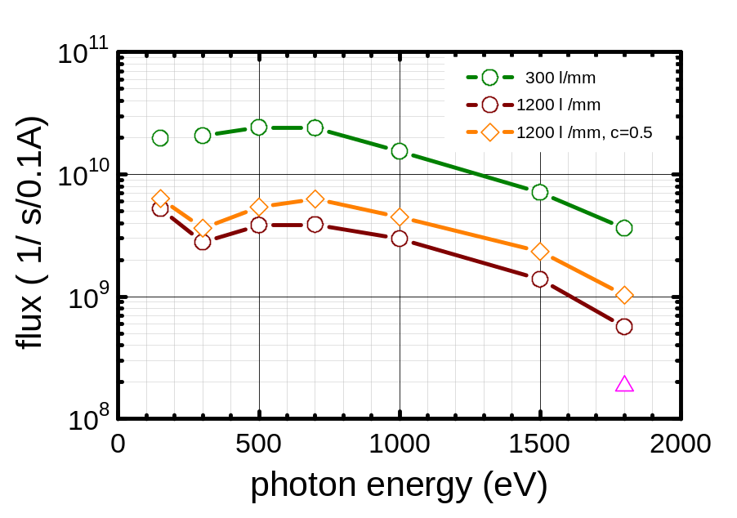
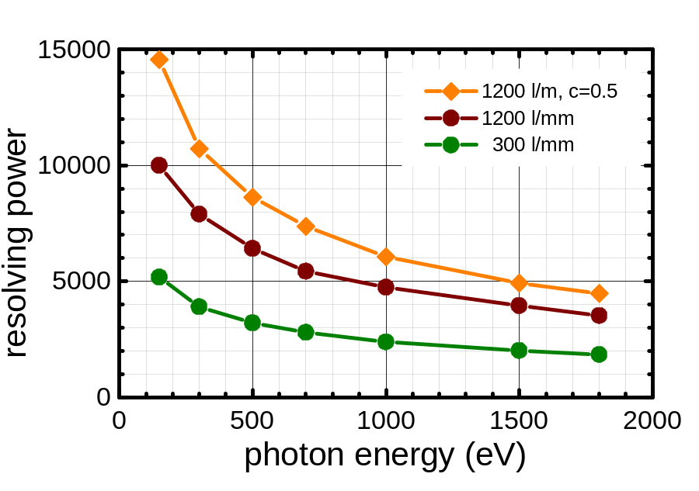
1200 l/mm c=2 versus c=0.5
Flux after 25 μm Pinhole
on 200 μm Zoneplate
Resolving power
outside order
Better performance (Flux , resolution)

Slide 30
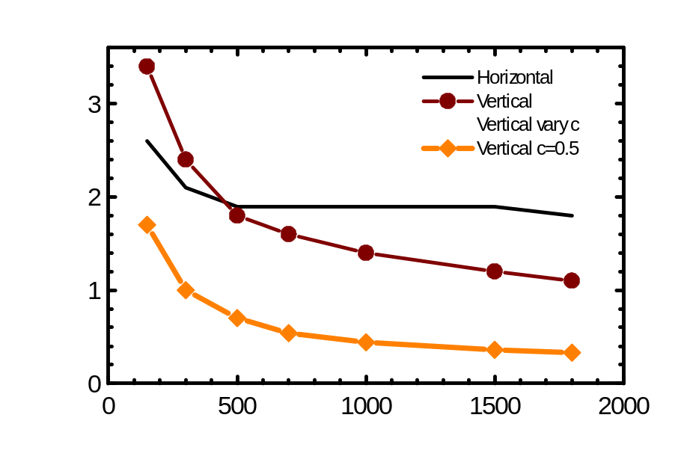
1200 l/mm c=2 versus c=0.5
Spotsize on Zoneplate
outside order
Better performance (Flux , resolution)
Asymmetric illumination of Zoneplate

Slide 31
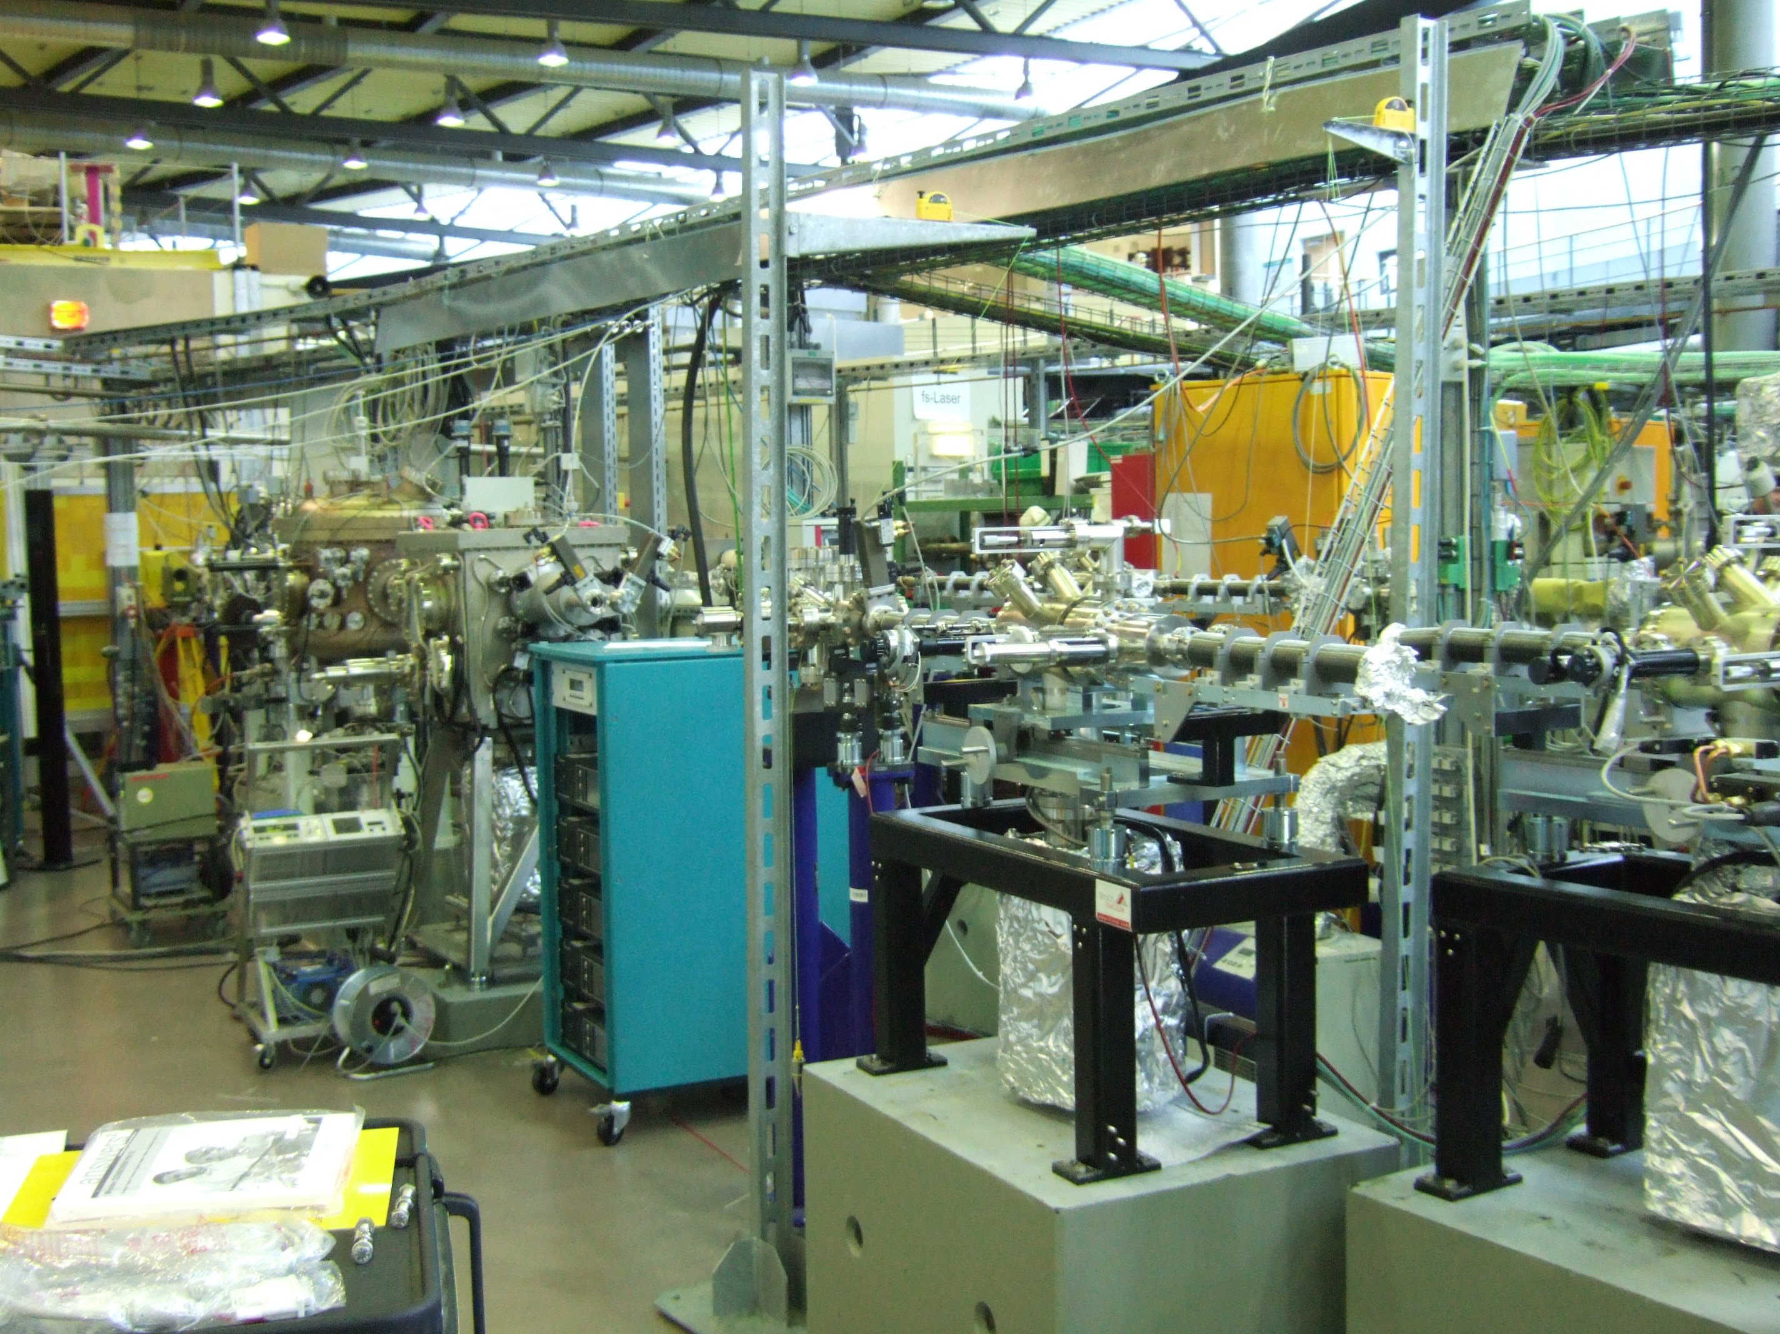
Beamline
Grating
chamber
SMU
Exit slit SM
Exit slit FF

Slide 32
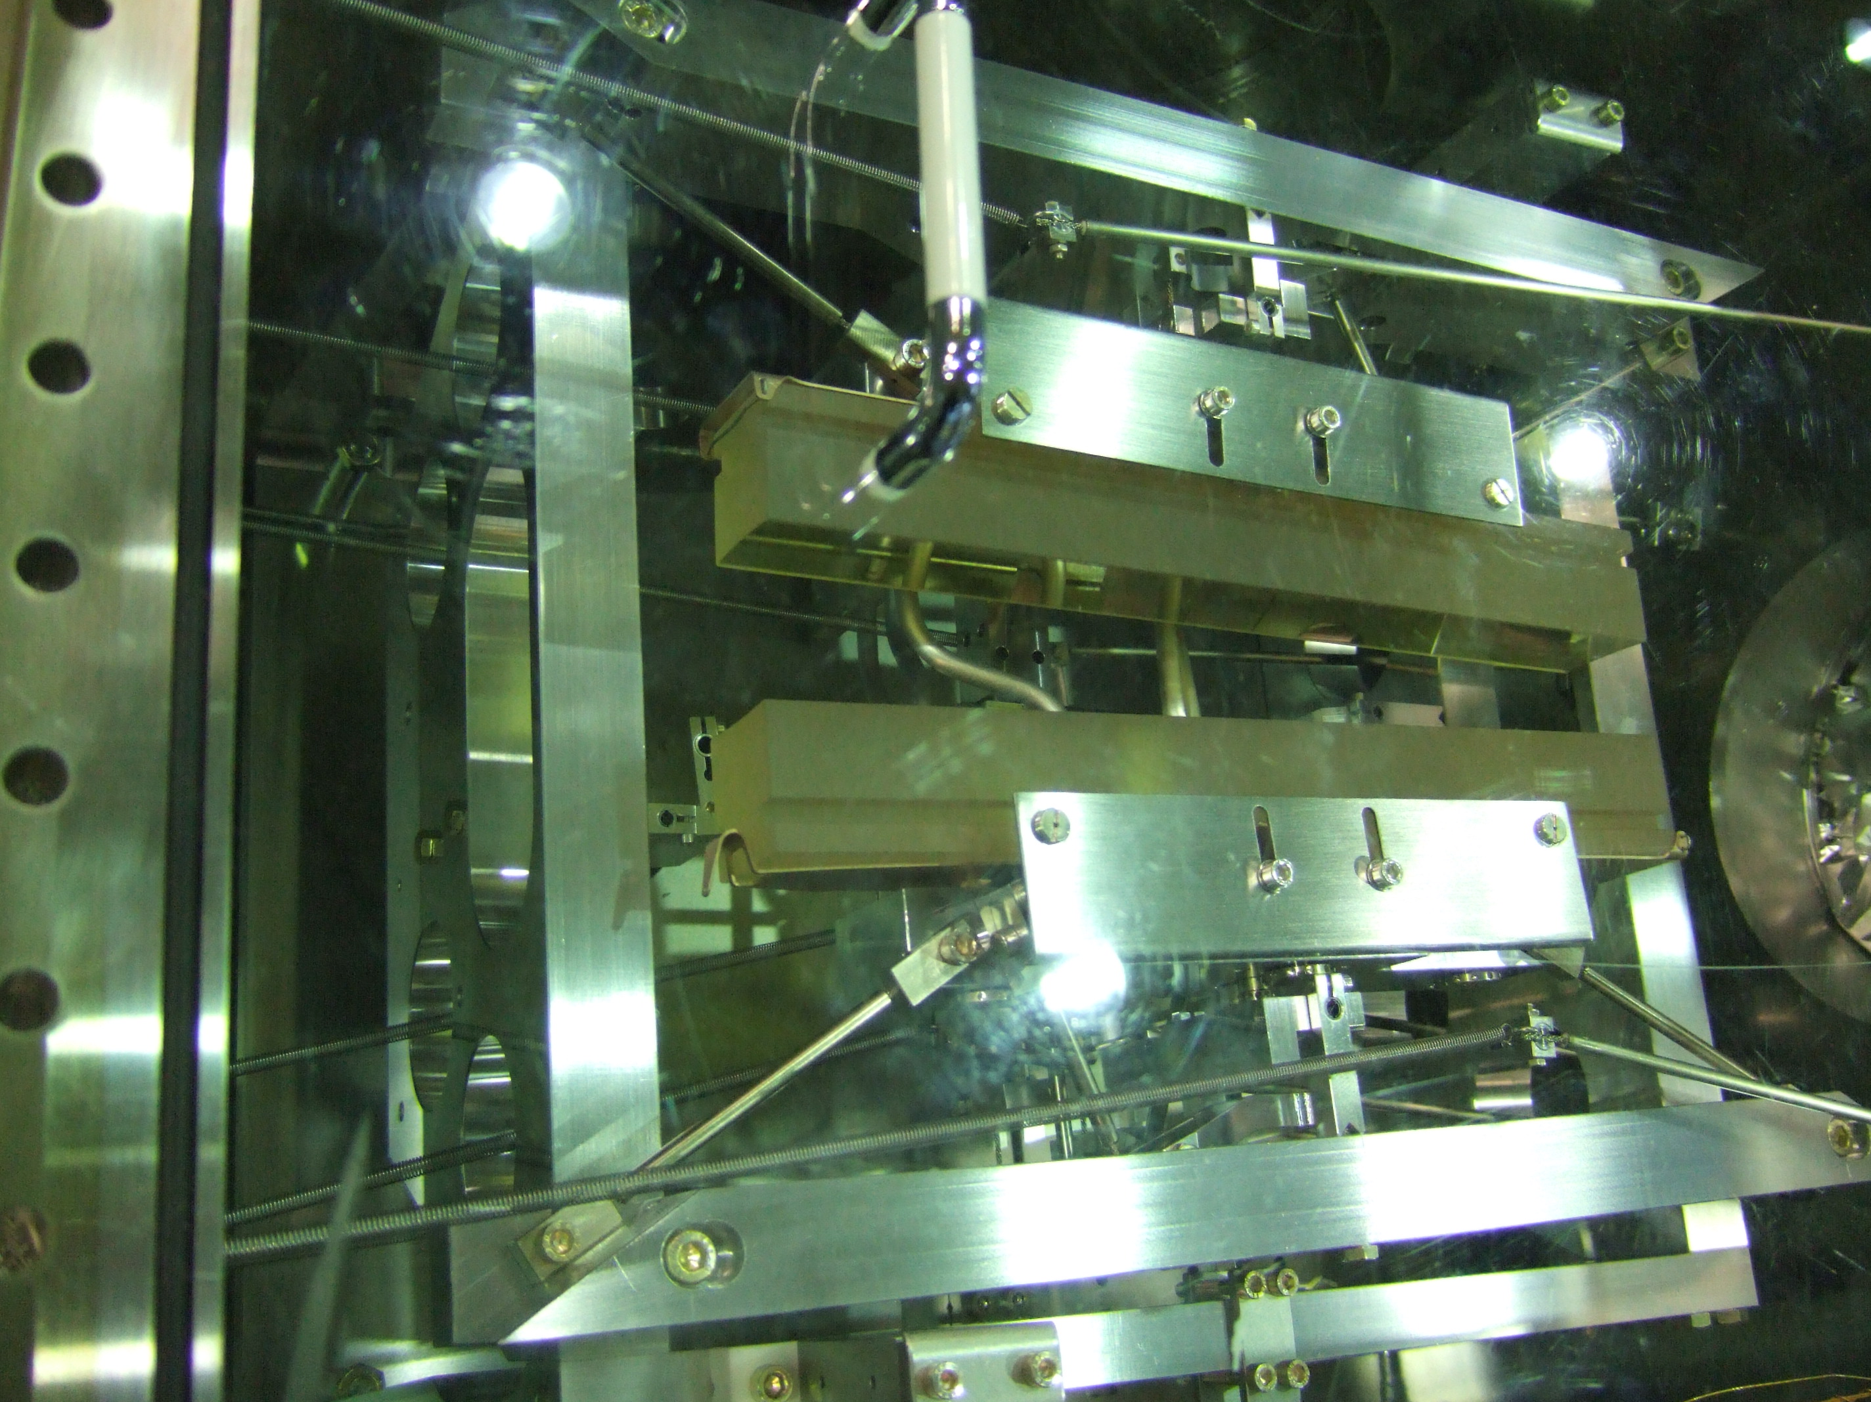
SMU 2
Light
Two mirrors

Slide 33
Exit Slit
Exit Slit unit
  Conventional slit mechanism: 20 mm wide, 0 – 2 mm opening
  Fixed Pinholes 25 μm, 50 μm, 100 μm (moveable)
  Position Sensitive Detector (permanent)
  Viewscreen with CCD for focus inspection (removable)

Slide 34
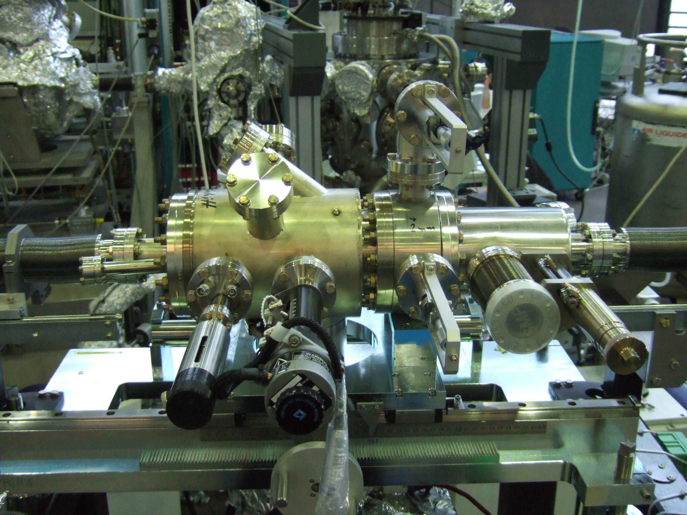
Exit slit unit
Position sensitive detector
(permanent)
Fixed Pinholes (moveable)
25 μm, 50 μm, 100 μm
Viewscreen (moveable)
Inspect focus
Exit slit 0- 2000 μm
(permanent)

Slide 35
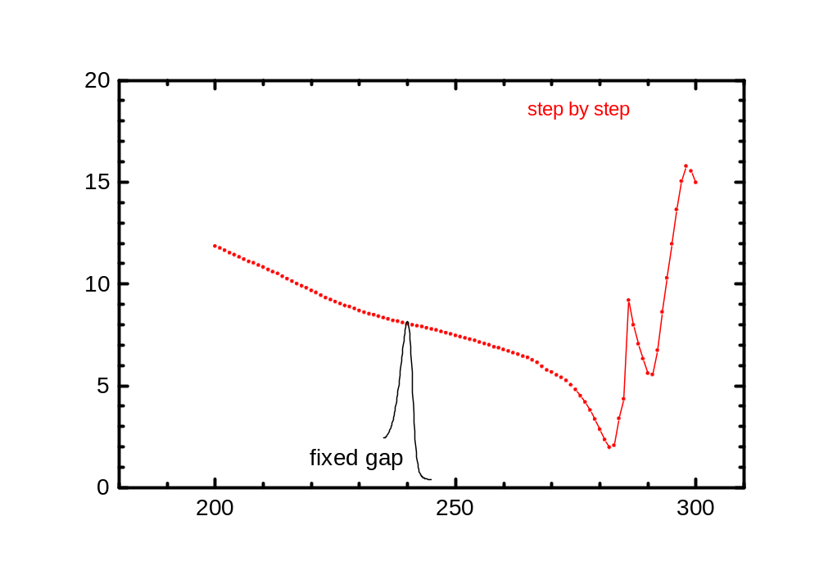
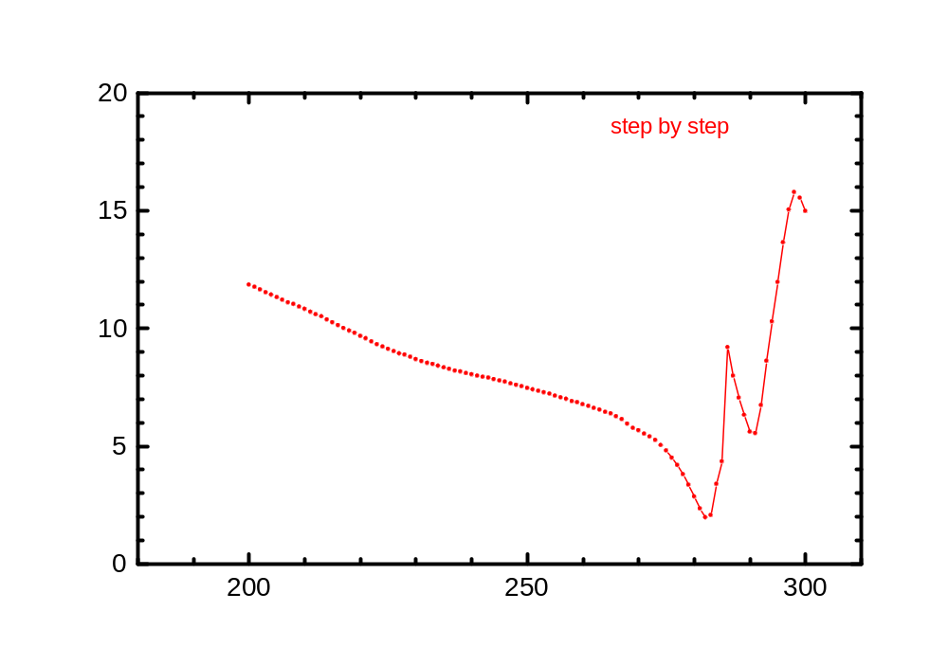
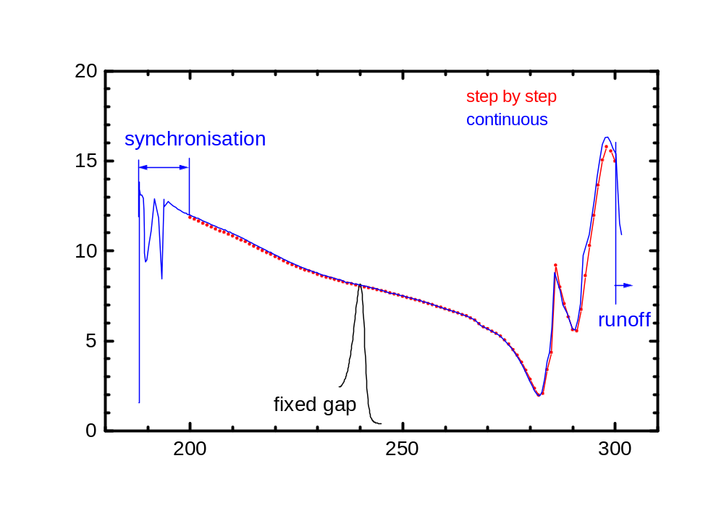
Continuous mode (Id)
  Move undulator from start gap to destination gap (constant velocity)
  Monochromator has to follow the undulator
Keep monochromator
on top of harmonic

Slide 36


Continuous mode (Id)
What is the outcome of 5 minutes beamtime?
XMCD Iron
Step mode : 70 pts, 2*160 s
Cont. Mode : 1300 pts, 2*110 s

Slide 37
Summary
Beamline should be completed in may
Final grating expected for june/july
Comissioning starts with two laminar gratings
Operate in inside and outside diffraction order
Install final gratings for inside or outside diffraction order?

