Slide 1

The UE46 X-ray microscope STXM

Slide 2
X-ray Microscope
Elliptical Undulator
  130 eV – 2000 eV
  Full polarisation control
Beamline
  Collimated PGM
  Variable magnification
Full Field Microscope
  Condensor with „large“ numerical aperture
  Capillary optics
  Zone plate in objective optic
Scanning Microscope
  Zone plate to produce small spot
  Uniform illumination of zone plate
Fast switching between microscopes by mirror M₃ (1-2 minutes)

Slide 3
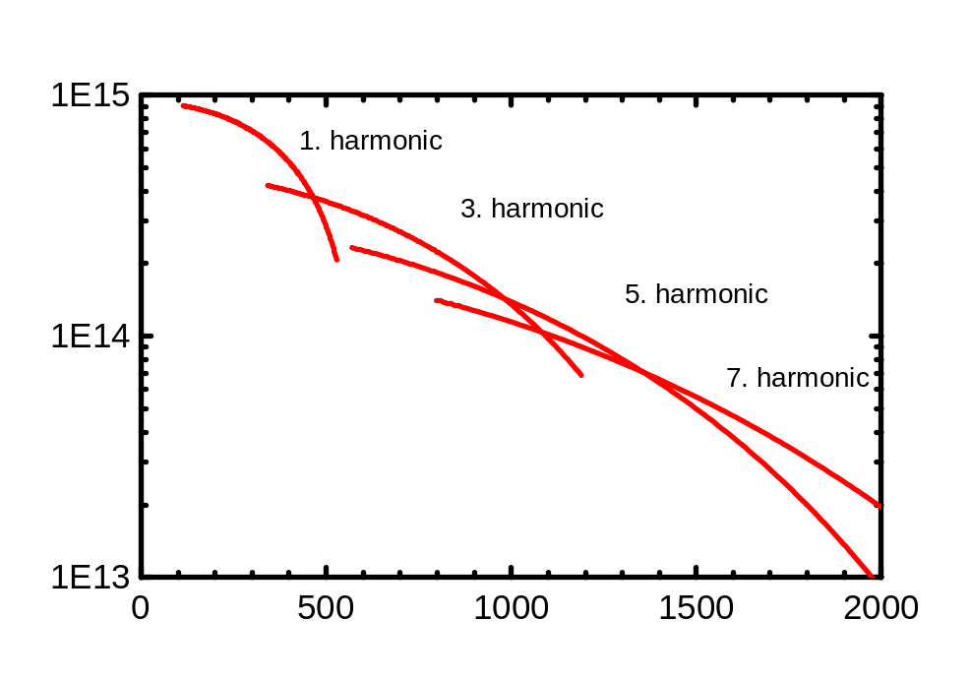
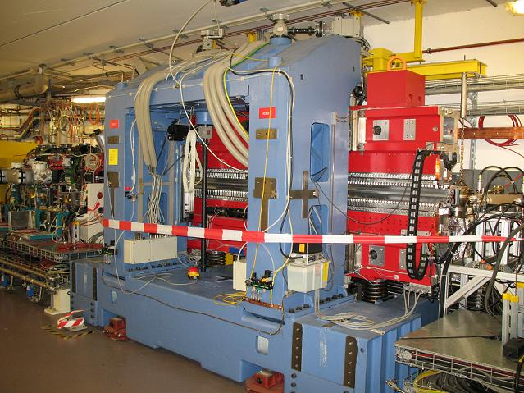
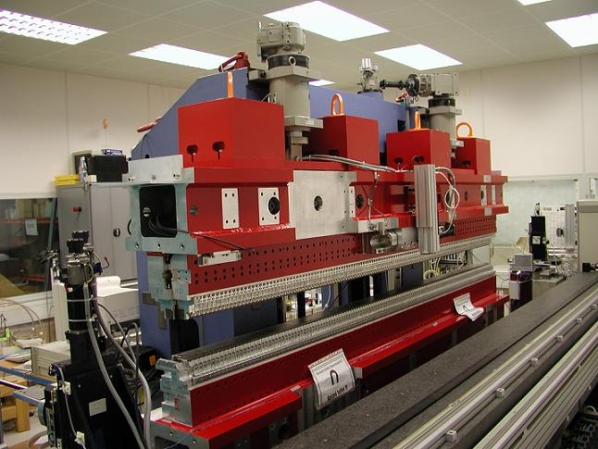
Undulator UE46
Undulator type : APPLE 2
Undulator period : 46 mm
Number of periods : 70
Energy range : 130 eV – 2000 eV
Polarisation : elliptical, linear rotatable
Electron beam parameter
Hor. size σ_{x} : 76 μm
Vert. size σ_{y} : 15 μm
Hor. divergence σ´_{x} : 68 μrad
Vert. divergence σ´_{y} : 10 μrad

Slide 4
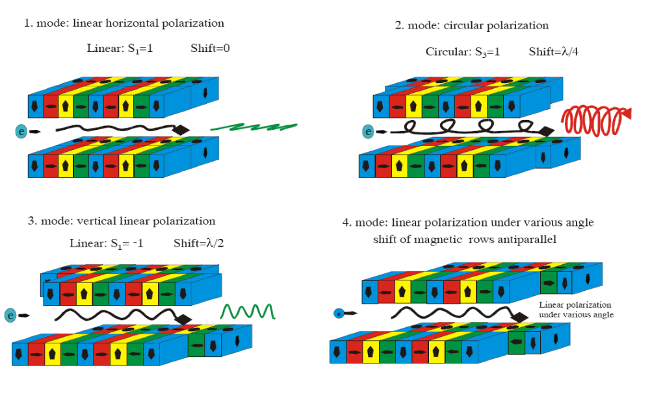
APPLE 2 undulators
Advanced Planar Polarised Light Emmiter

Slide 5
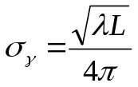

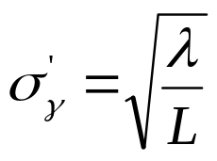


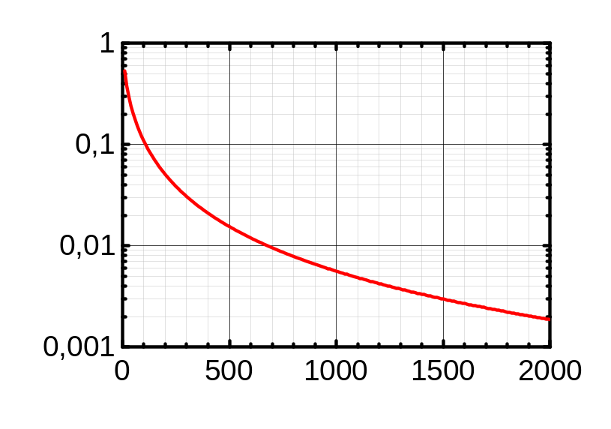
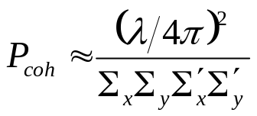
Coherent flux
Photon beam parameters
Electron beam parameter σ_{x,y} ,σ´_{x,y}
(emittance) smears undulator beam
Size
Divergence
Diffraction limited
Effective size
Effective divergence
Coherent fraction
Small coherent fraction at BESSY
L: Undulator length; σ_{γ} ,σ´_{γ} photon beam size and divergence

Slide 6
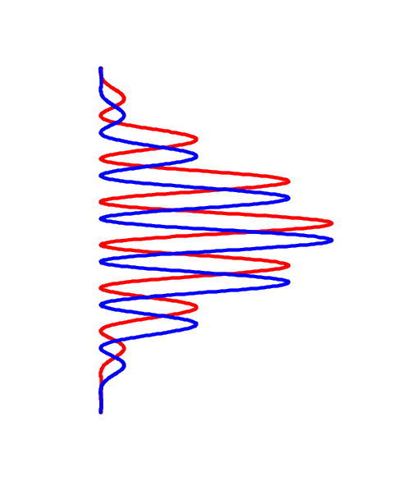
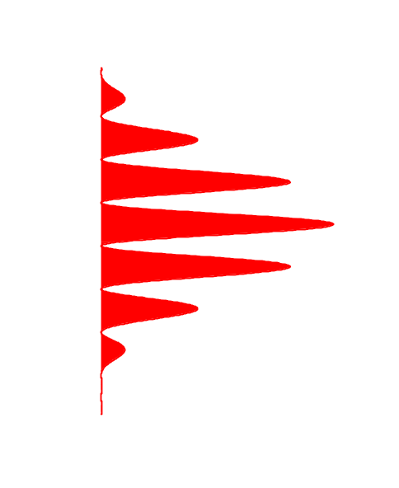
Coherence
Source
Double slit
Screen
L
Q‘
r´₂
r₂
a
s
θ
r´₁
ψ
r₁
Q
θ ≈ s / L
Path differences at slit
Δδ = 2 s sin (ψ/2) ≈ s ψ ≈ s (a / L)
δ = r₂ – r₁
δ´ = r´₂ – r´₁
s (a / L) ≤ λ / 2
a θ ≤ λ / 2
constructive superposition
Δδ = δ´ – δ ≤ λ / 2
a = λ / (2 θ) : Coherence length

Slide 7
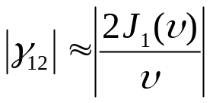
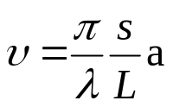
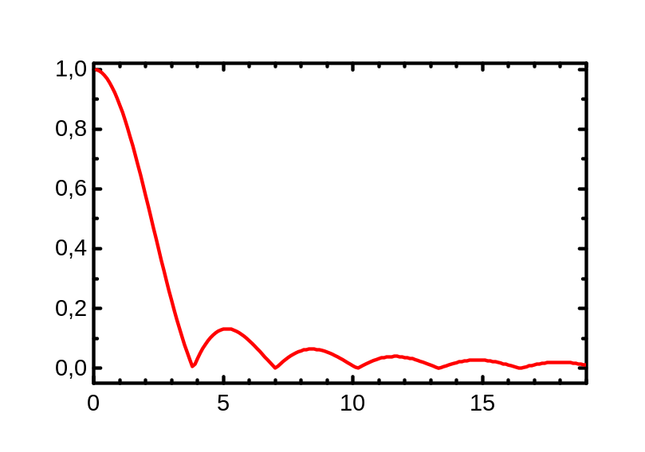
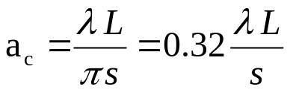
Degree of coherence
Extended source
Uniform disc, diameter s
Degree of coherence
P₁
L
s
a
P₂
J₁ : Besselfunction
Born&Wolf: v=1, (γ₁₂ = 0.88)
Transversal coherence length a_{c}
Sun at 550 nm: a_{c}≈ 19 μm

Slide 8
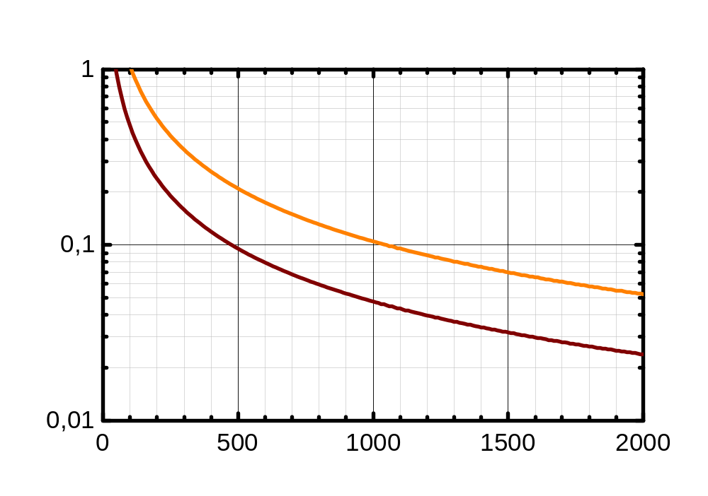
Coherence length
25 μm Pinhole in 3 m distance
partially coherent illumination of
200 μm Zoneplate above 240 eV
70 μm Zoneplate coherently illuminated up to 700 eV
γ₁₂ = 0.5
γ₁₂ = 0.88

Slide 9
Beamline design
Optical design (original)
  Energy range 125 eV –2000 eV
  Collimated plane grating monochromator
  Sagittally focusing mirrors
  3° deflection angles on fixed mirrors
  Stigmatic focussing onto exit slit
  Two microscopes
  3 gratings
Mechanical design
  SX700 mount of premirror
  Fixed exit slit position

Slide 10
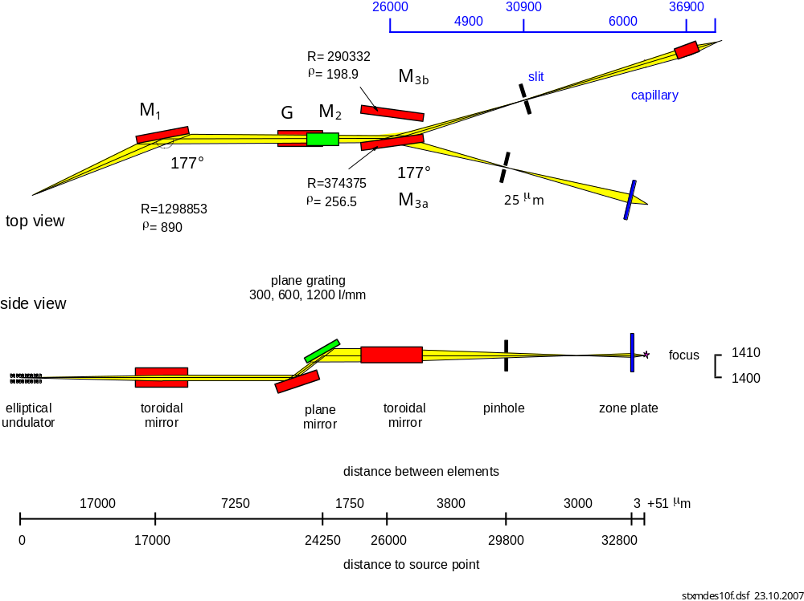
Optical design
Full Field
STXM

Slide 11
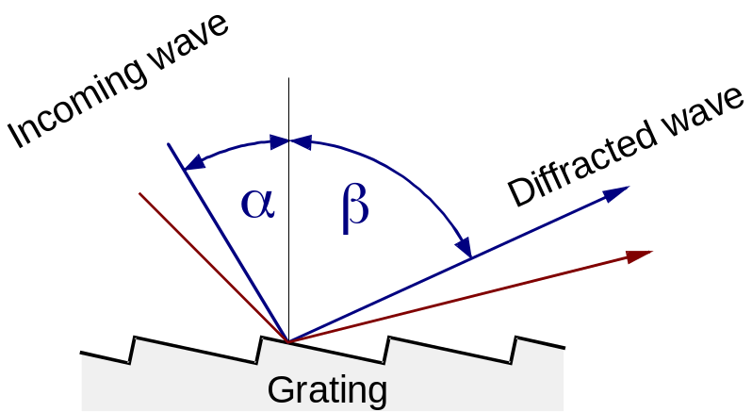
Formulas
grating equation and magnification
Use angular magnification to characterize geometry
N k λ = sin α + sin β
c = cos β / cos α
N: line density, k: diffraction order
λ: wavelength
Large c:
- more grazing incidence
- higher resolution
- longer pulses
Ambiguity in grating equation:
A wavelength λ can be set by an infinite set of pairs (α,β)
Deflection angle 2θ = α - β

Slide 12
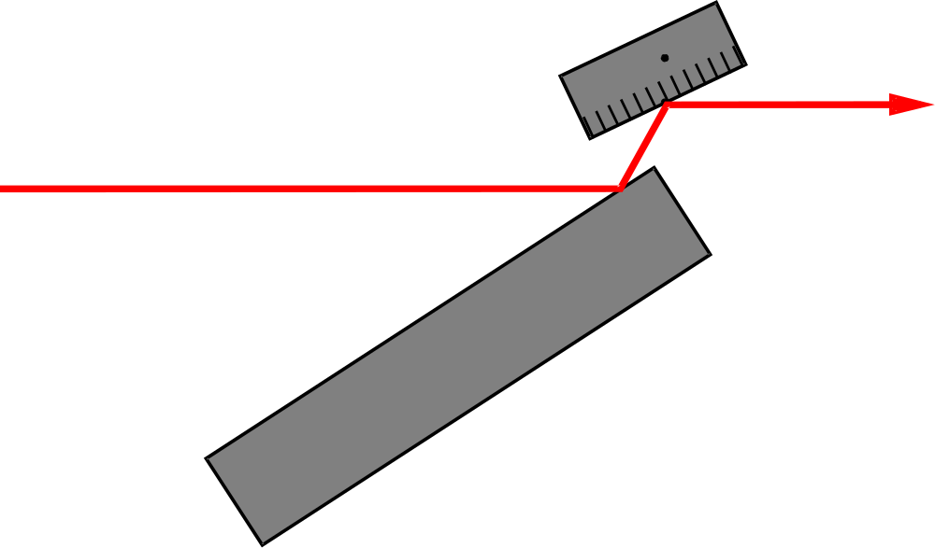

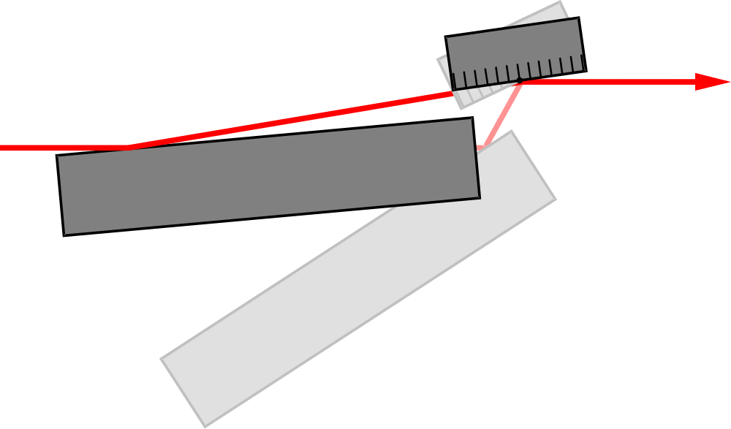
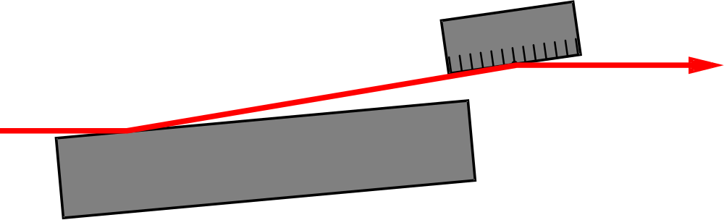
SX700 mechanical design
Grating
Variable deflection angle
Fixed diffracted beam
Plane Mirror
Modes of operation
  Fix focus mode
  On blaze mode
  Grating only
  Mirror only
  Beamsplitter mode

Slide 13
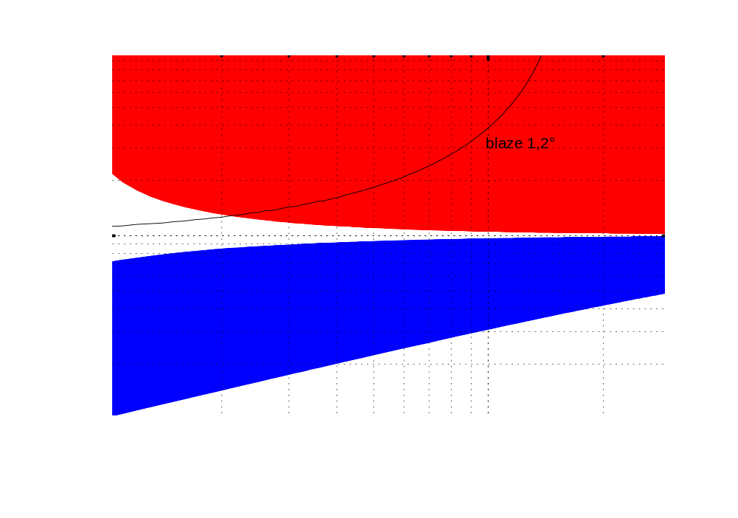
Accessible parameter space
Inside diffraction order
Outside diffraction order
Divide energy scale by factor 2 for 600 l/mm grating and by 4 for 300 l/mm grating

Slide 14
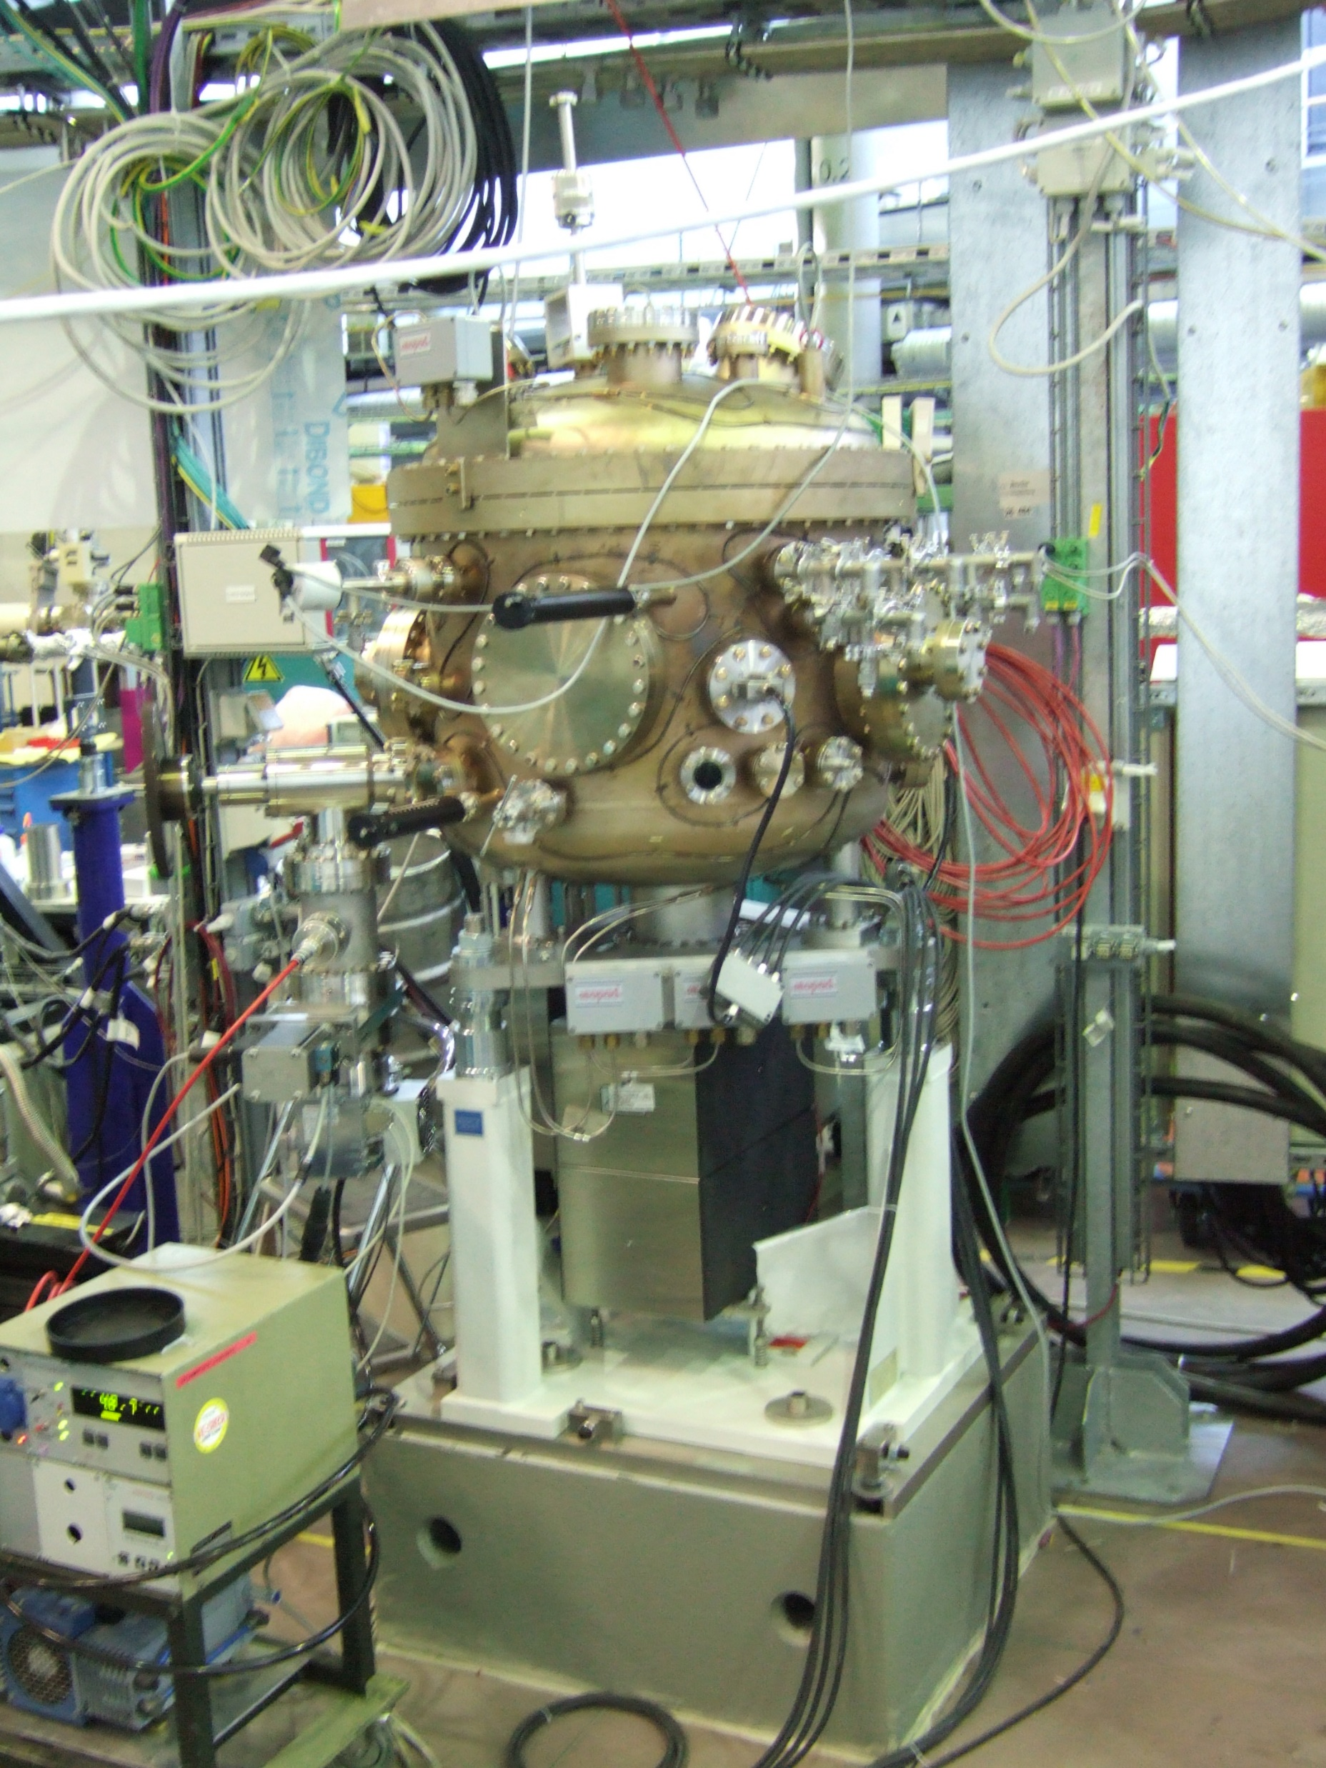
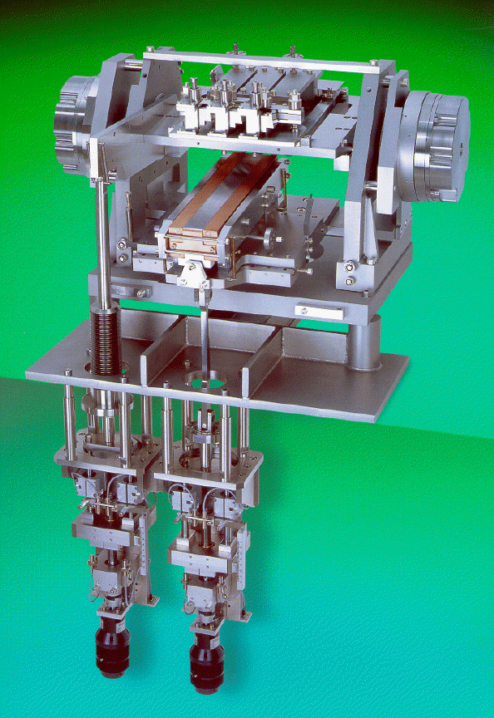
Grating chamber
Angular encoder
3 Gratings (interchangable)
Light
Plane mirror
Drive system
motors

Slide 15
Optical elements by 2025
Optical element |  | M1 | M2 | M3b | G1 | G2 | G3
shape |  | toroidal | plane | toroidal | plane
Geom. surface size | [mm²] | 330 x 30 | 310 x 30 | 320 x 40 | 100 x 20
Opt. surface size | [mm²] | 320 x 20 | 300 x 20 | 310 x 30 | 90 x 15
Bulk material |  | Si | Si | Si | Si
Roughness | [nm] | 0.17 nm | 0.2 nm | 0.5 nm | 1.01
Slope error σ (mer/sag) | [arcsec] | 0.39 / 0 .94 | 0.03 /0.32 | 0.5 / 1 | 0.1 / 0.1
Source distance (h/v) | [mm] | 17 000 | - | ∞
Image distance (h/v) | [mm] | ∞ | - | 4 900
Mirror parameter | [mm] | R=1279852 | R > 20 km | R=290332 | R > 30 km
 |  | ρ=886.1 |  | ρ=198.9
Deflection angle |  | 3° | 0.8° - 5° | 3° | 0.8° - 5°
Coating |  | 30 nm Au | 30 nm Pt | 35 nm Au | 35.8 nm Au
Grating structure |  |  |  |  | blaze
Line density | [1/mm] |  |  |  | 300 | 600 | 1200
Blaze angle |  |  |  |  | 0.6° / 7° | 0.79°/ 8° | 1.2° /11°
Only the 600 l/mm grating was installed

Slide 16
Raytracing
Parameters as known in 2025
(Using Ray-UI)
  Include source size and divergence (from 2025, BESSY II low beta))
  With slope errors of optical elements, include grating efficiency and reflectivities of mirrors (from F. Siewerts protocolls)
  Put 25 μm pinhole in exit slit plane
  Calculate illumination of Zoneplates of 200 μm (70 μm) in 3 m distance
  Grating: c-factor = 2.0, 1200 l/mm (installed 2025: 600 l/mm)
  M2: Premirror sgift by -40 mm, hor_Distanz: 10 mm (derived from old simulation files)
  Comparison of the foortprints and resolving power (using full reflectivity)
  Using SimpleUndulator with 150 / 700 eV, and with 0.04 / 0.114% bw, respectively, 5,000,000 rays

Slide 17
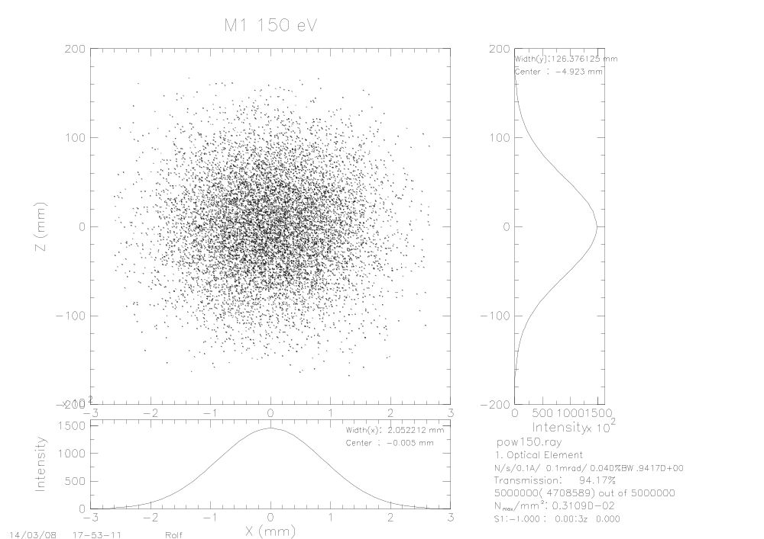

Raytrace: 1200 l/mm, c=2
M1
150 eV
700 eV
2.1 x 126 mm²
1.0 x 109 mm²

Slide 18
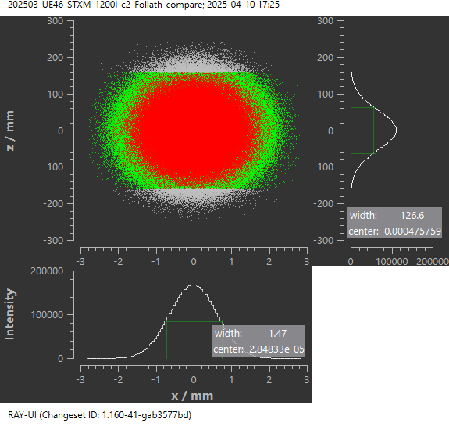
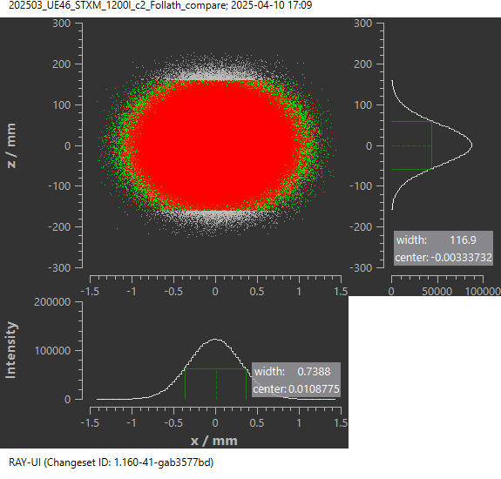
Raytrace: 1200 l/mm, c=2
M1
150 eV
700 eV
1.5 x 127 mm²
0.7 x 117 mm²
2 x 126 mm²
1 x 109 mm²
Transmission: 93.9%
Transmission: 68.8%

Slide 19


Raytrace: 1200 l/mm, c=2
M2
150 eV
700 eV
3.3 x 17 mm²
2.8 x 18 mm²

Slide 20
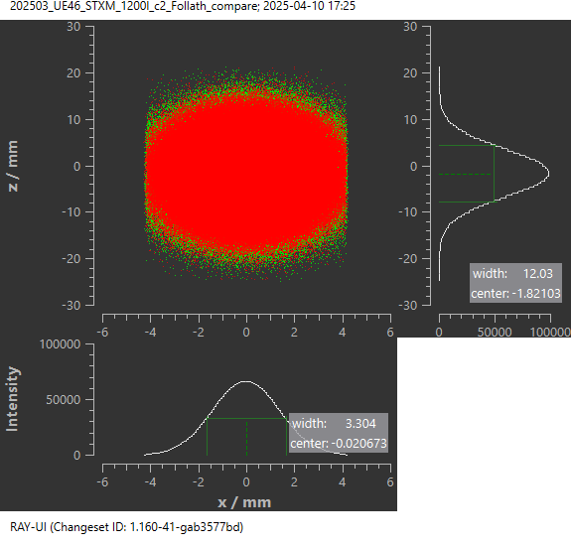
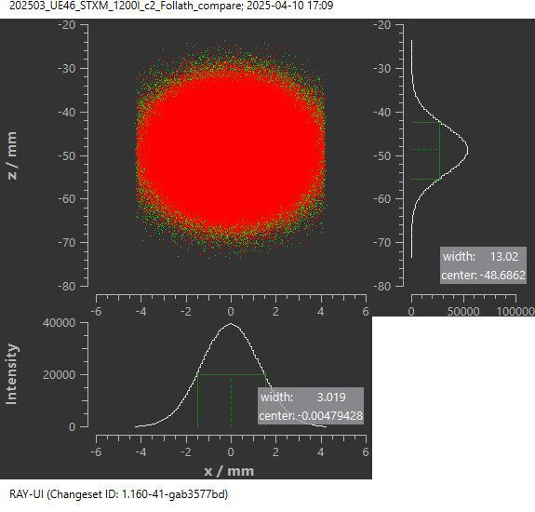
Raytrace: 1200 l/mm, c=2
M2
150 eV
700 eV
3.3 x 12 mm²
3.0 x 13 mm²
3.3 x 17 mm²
2.8 x 18 mm²
Transmission: 55.2%
Transmission: 30.2%

Slide 21


Raytrace: 1200 l/mm, c=2
Grating
150 eV
700 eV
3.3 x 25 mm²
2.9 x 27 mm²

Slide 22


Raytrace: 1200 l/mm, c=2
Grating
150 eV
700 eV
3.3 x 18 mm²
3.0 x 19 mm²
3.3 x 25 mm²
2.9 x 27 mm²
Transmission: 4.96%
Transmission: 4.46%

Slide 23
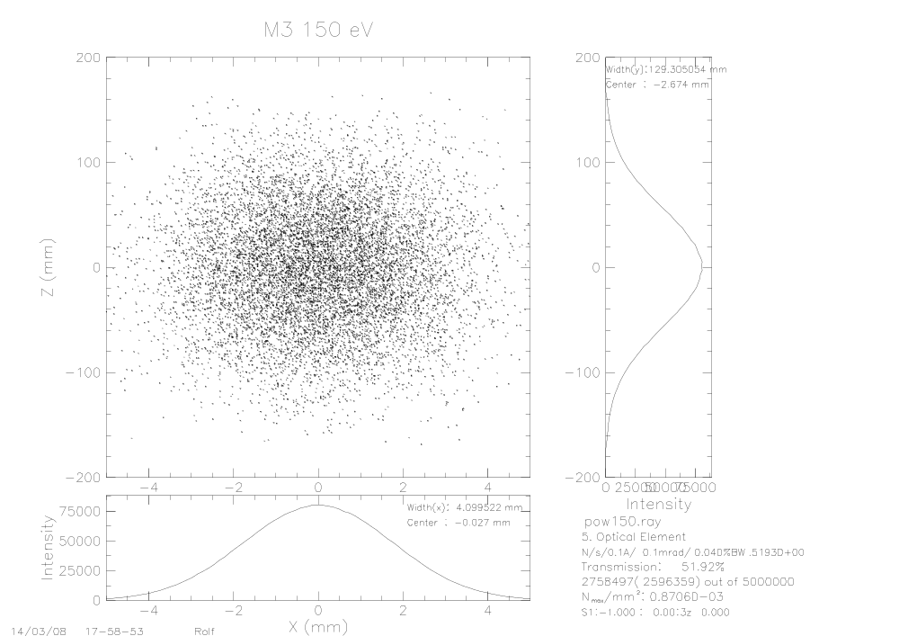

Raytrace: 1200 l/mm, c=2
M3
150 eV
700 eV
4.1 x 129 mm²
2 x 109 mm²

Slide 24
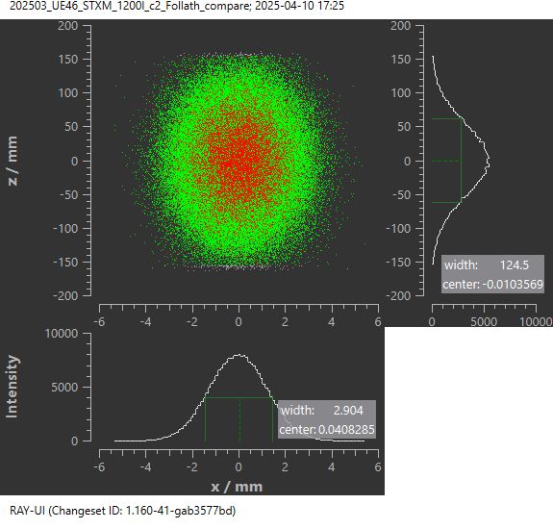
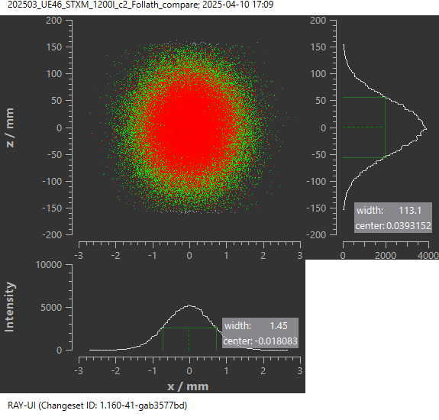
Raytrace: 1200 l/mm, c=2
M3b
150 eV
700 eV
2.9 x 125 mm²
1.5 x 113 mm²
4.1 x 129 mm²
2 x 109 mm²
Transmission: 4.67%
Transmission: 3.05%

Slide 25
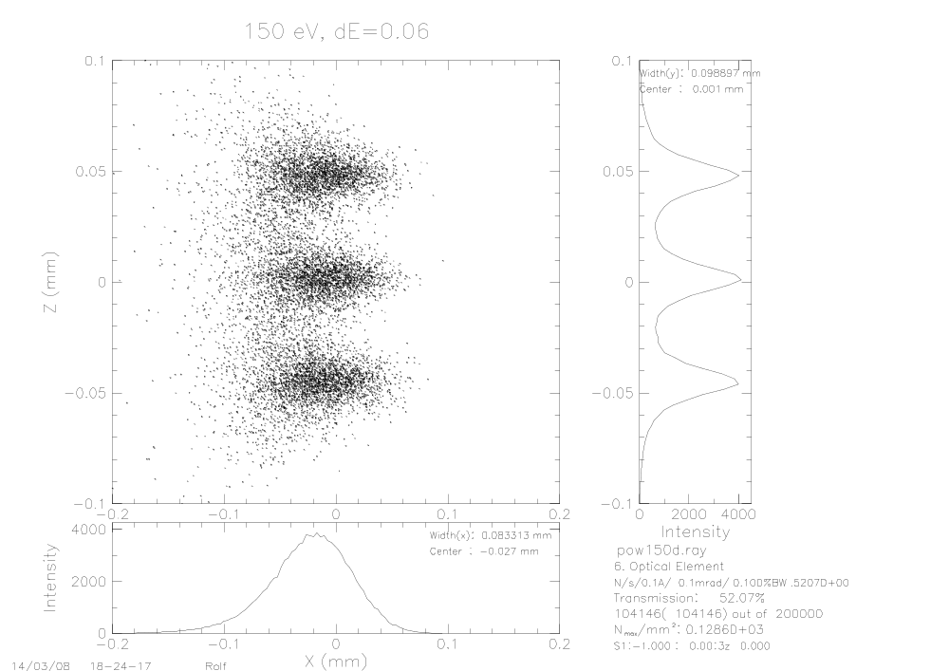
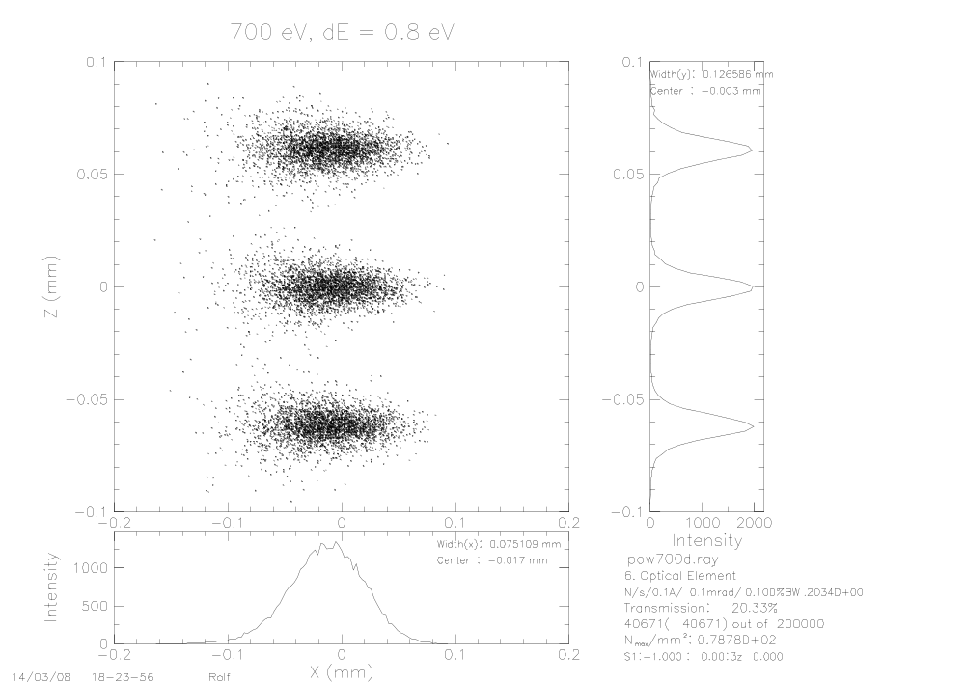
Raytrace: 1200 l/mm, c=2 exit slit
150 eV
700 eV
83 x 99 µm²
75 x 127 µm²

Slide 26
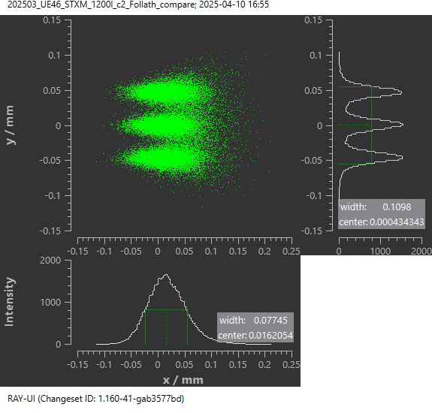
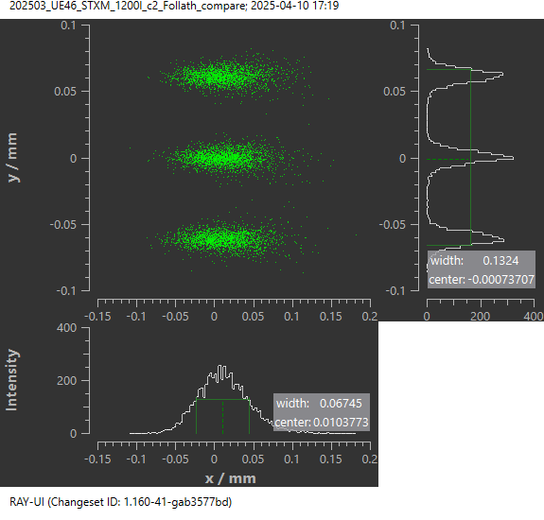
Raytrace: 1200 l/mm, c=2 exit slit
150 eV, dE=0.06
700 eV, dE=0.8 eV
77 x 110 µm²
67 x 132 µm²
83 x 99 mm²
75 x 127 µm²

Slide 27

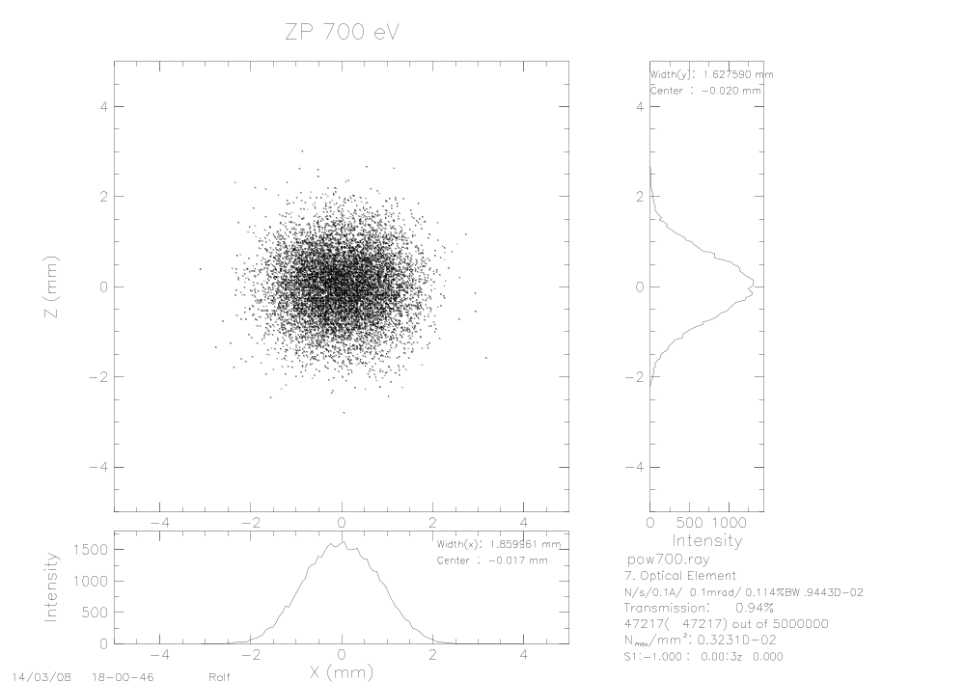
Raytrace: 1200 l/mm, c=2
Zoneplate
150 eV
700 eV
2.6 x 3.4 mm²
1.9 x 1.6 mm²

Slide 28
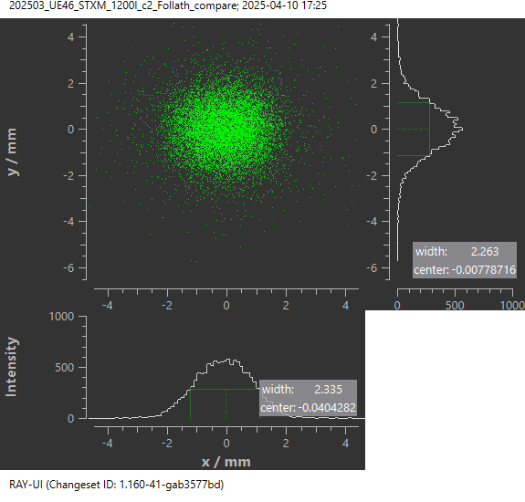
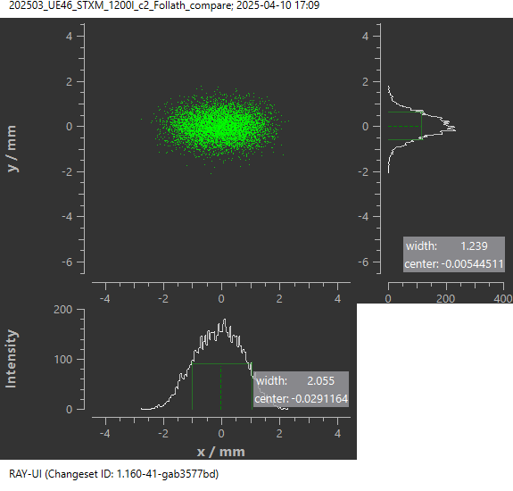
Raytrace: 1200 l/mm, c=2
Zoneplate
150 eV
700 eV
2.3 x 2.3 mm²
2.1 x 1.2 mm²
2.6 x 3.4 mm²
1.9 x 1.6 mm²
Transmission: 0.26%
Transmission: 0.14%

Slide 29
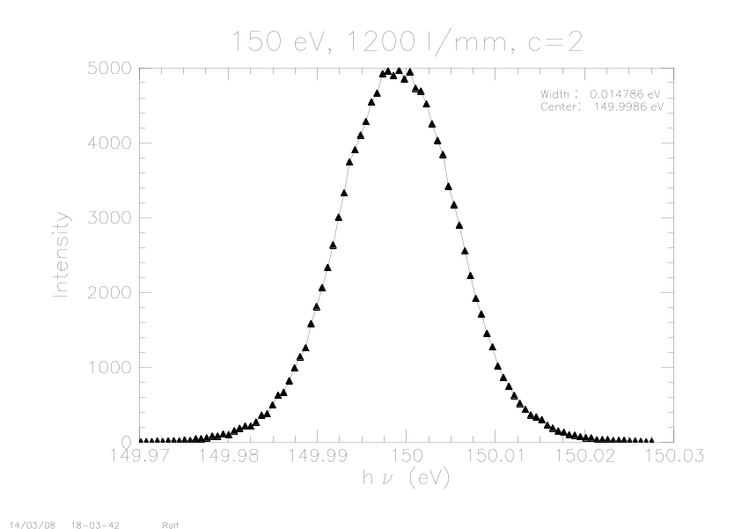
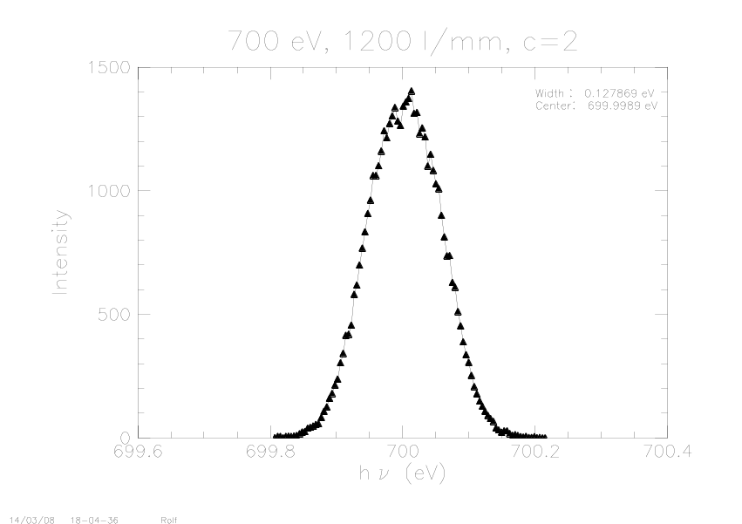
Raytrace: 1200 l/mm, c=2
Energy resolution
150 eV
700 eV
14.8 meV
128 meV
E/dE~10,000
E/dE~5,500

Slide 30
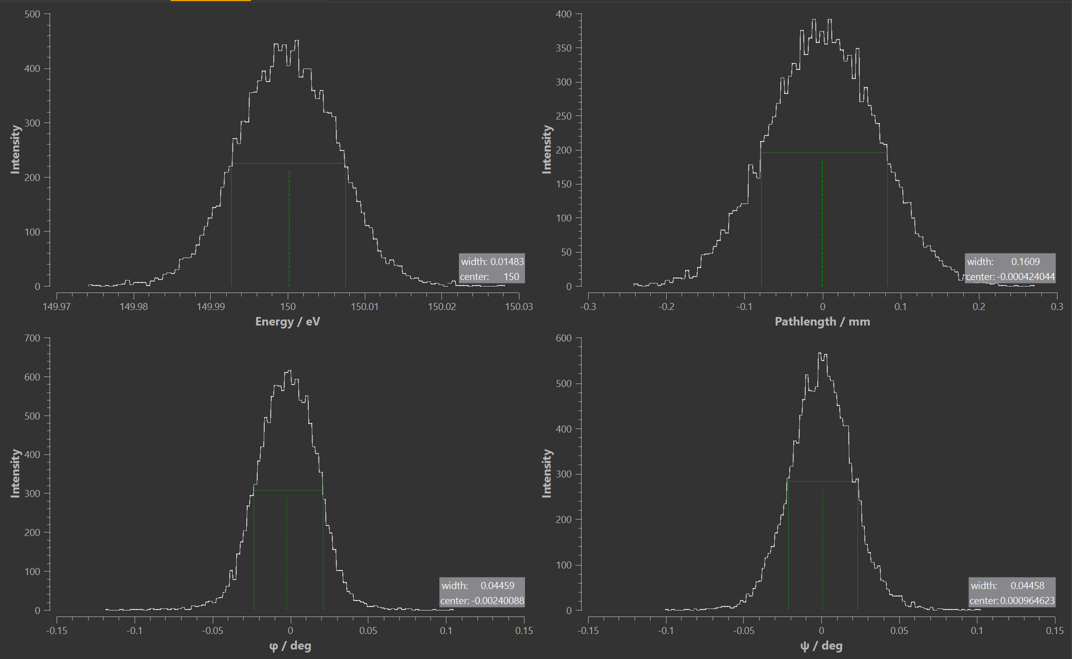
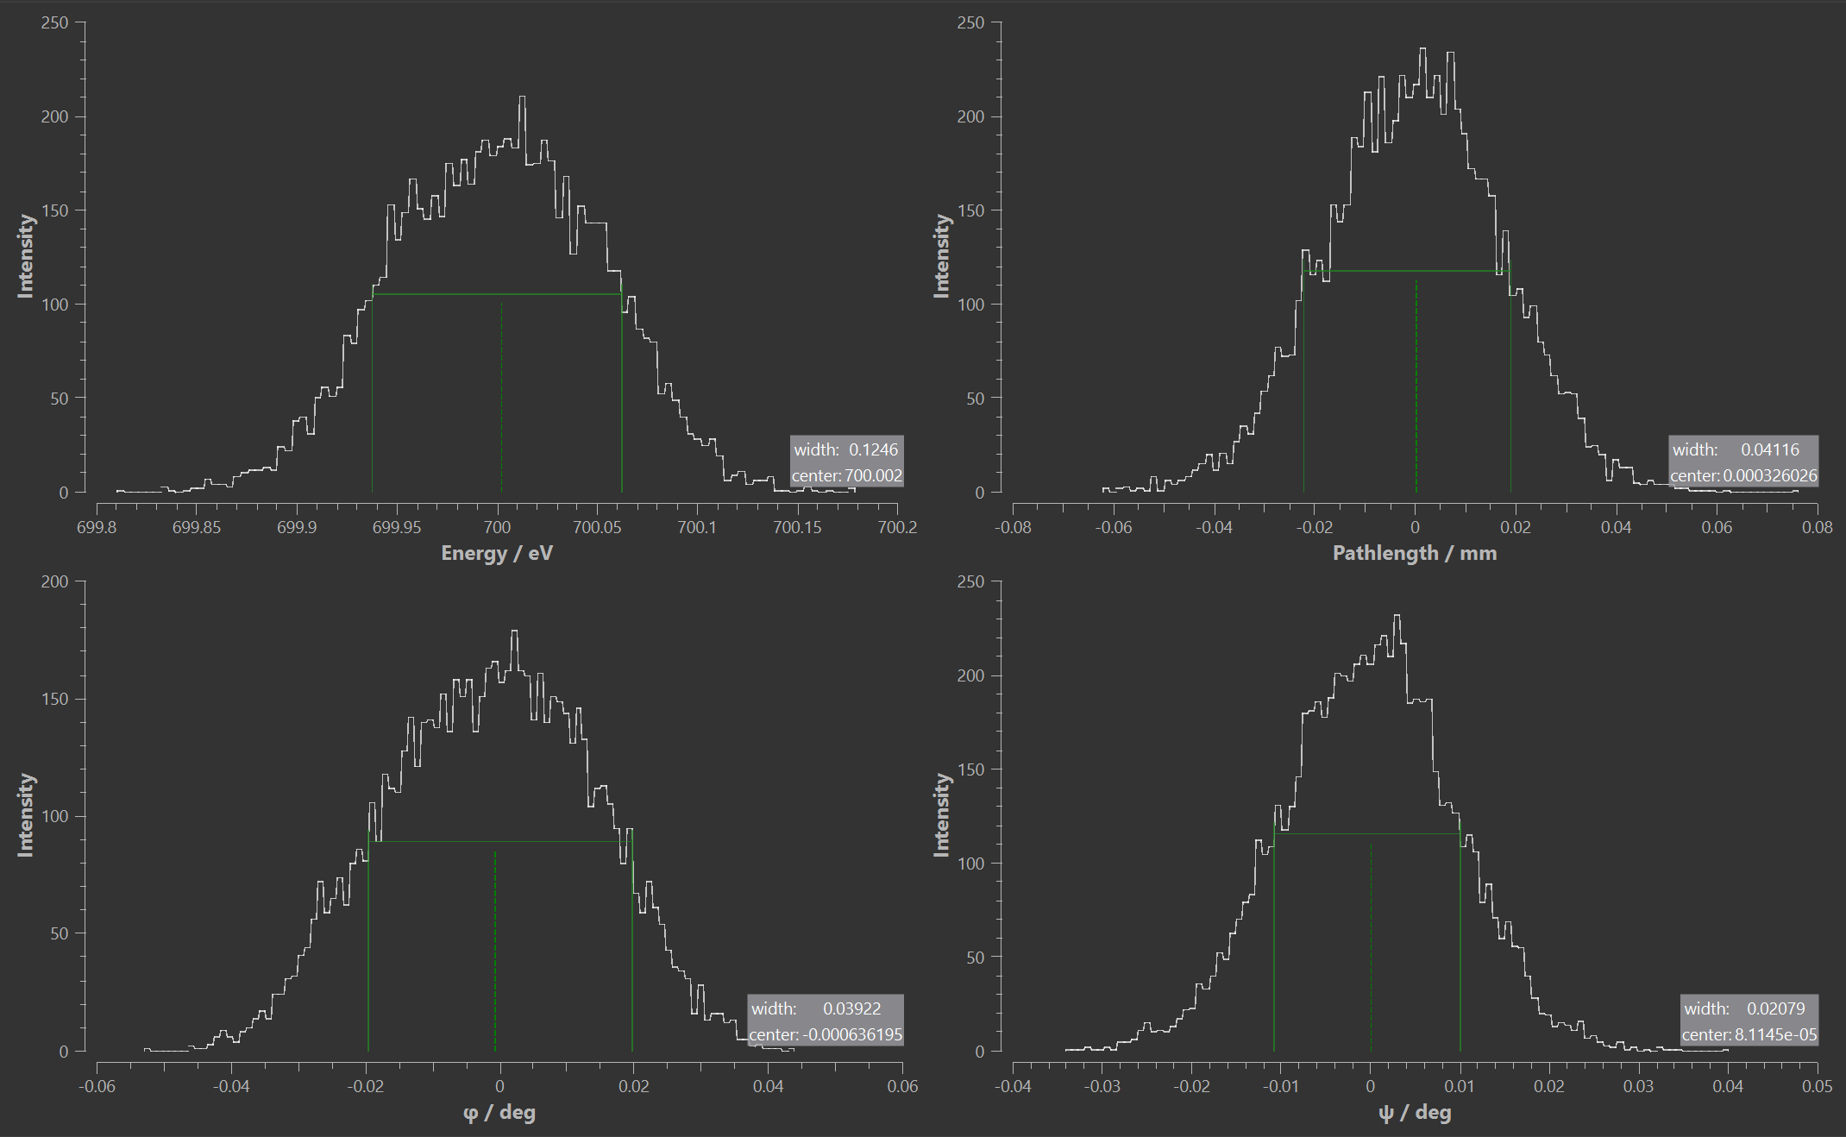
Raytrace: 1200 l/mm, c=2
Energy resolution
150 eV
700 eV
14.8 meV
125 meV
15 meV
130 meV
E/dE~10,000
E/dE~5,600

Slide 31
Sims of the current beamline
Energy spread 0.1 % for all simulations

Slide 32

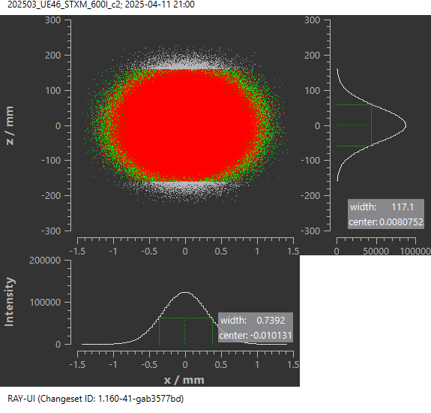
Raytrace: 600 l/mm, c=2
M1
150 eV
700 eV
1.5 x 127 mm²
0.7 x 117 mm²
Transmission: 93.9%
Transmission: 68.8%

Slide 33

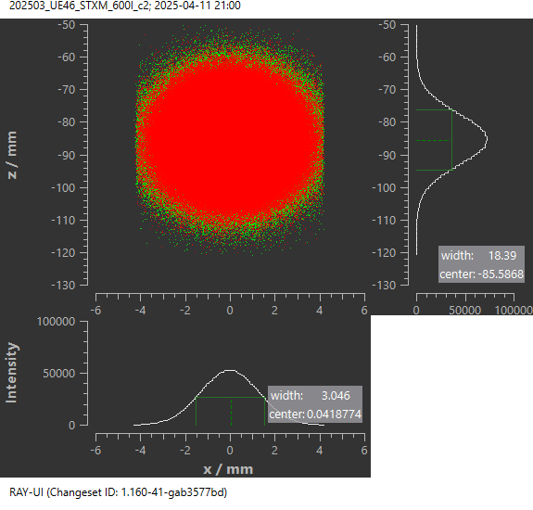
Raytrace: 600 l/mm, c=2
M2
150 eV
700 eV
3.3 x 17 mm²
3.0 x 18 μm²
Transmission: 66.1%
Transmission: 40.5%

Slide 34


Raytrace: 600 l/mm, c=2
Grating
150 eV
700 eV
3.3 x 25 mm²
3.0 x 28 mm²
Transmission: 13.8%
Transmission: 10.3%

Slide 35
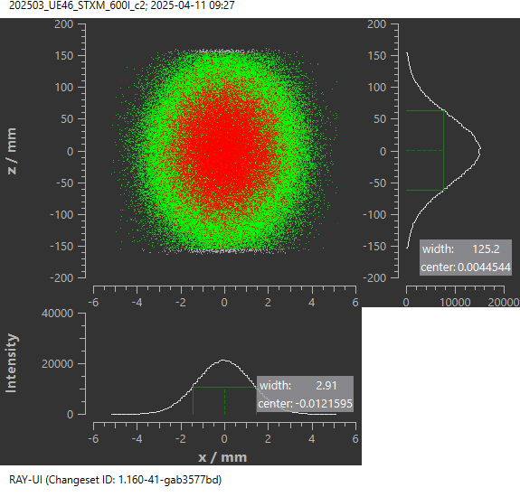
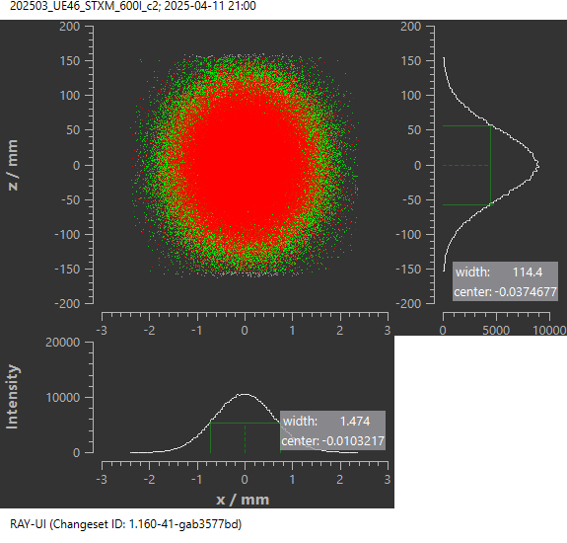
Raytrace: 600 l/mm, c=2
M3b
150 eV
700 eV
2.9 x 125 mm²
1.5 x 114 mm²
Transmission: 13.0%
Transmission: 7.06%

Slide 36
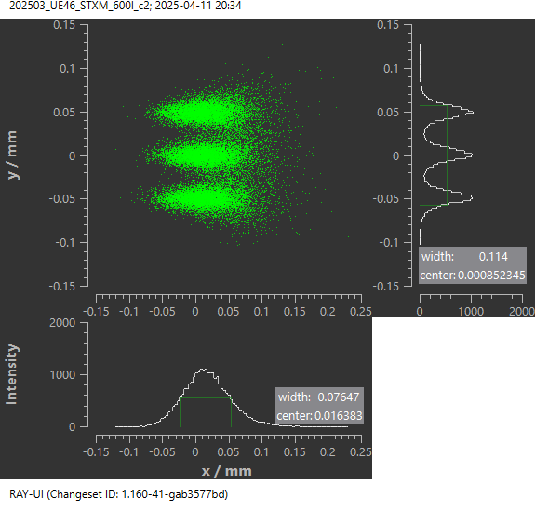
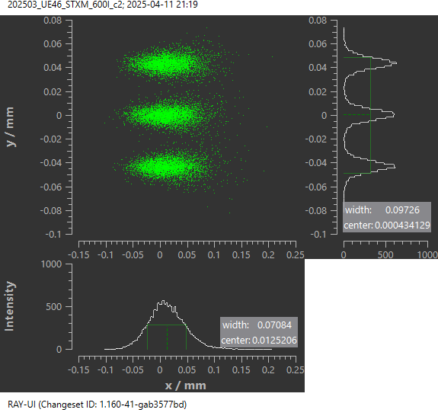
Raytrace: 600 l/mm, c=2 exit slit
150 eV, dE = 0.06
700 eV, dE = 0.08
76 x 114 µm²
71 x 97 µm²

Slide 37
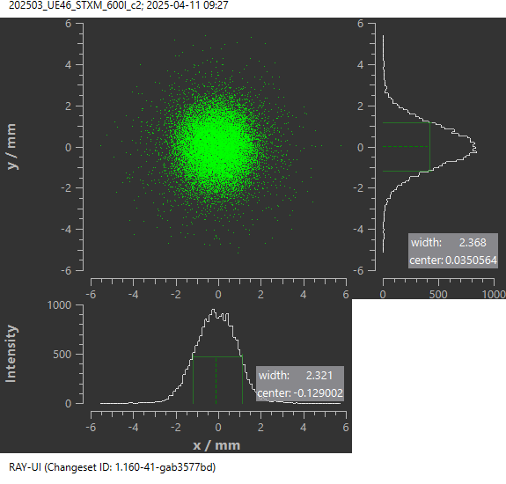
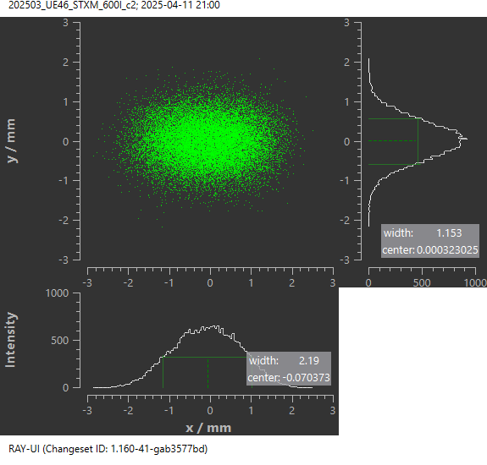
Raytrace: 600 l/mm, c=2
Zoneplate
150 eV
700 eV
2.3 x 2.3 mm²
2.2 x 1.2 mm²
Transmission: 0.41%
Transmission: 0.53%

Slide 38


Raytrace: 600 l/mm, c=2
Energy resolution
150 eV
700 eV
20.8 meV
186 meV
E/dE~7,200
E/dE~3,800

Slide 39
150 eV
Element | R. Follath |  | S.Malerz |  | Current (2025)
 | Footprint (h x v) [mm²] | Transmission [%] | Footprint (h x v) [mm²] | Transmission [%] | Footprint (h x v) [mm²] | Transmission [%]
M1 | 2.1 x 126 | 94.2 | 1.5 x 127 | 93.9 | 1.5 x 127 | 93.9
M2 | 3.3 x 17 | 55.2 | 3.3 x 12 | 55.2 | 3.3 x 17 | 66.1
PG 1200 l/mm | 3.3 x 25 | 55.2 (@100% eff.) | 3.3 x 18 | 4.96 (@100%: 55.2) | - | -
PG 600 l/mm | - | - | - | - | 3.3 x 25 | 13.8
M3b | 4.1 x 129 | 51.9 | 2.9 x 125 | 4.67 | 2.9 x 125 | 13.0
Pinhole (ExitSlit) | 0.083 x 0.099 | 2.66 | 0.077 x 0.110 | 0.26 | 0.076 x 0.114 | 0.41
@ TZP | 2.6 x 3.4 | - | 2.3 x 2.3 | - | 2.3 x 2.3 | -

Slide 40
700 eV
Element | R. Follath |  | S.Malerz |  | Current (2025)
 | Footprint (h x v) [mm²] | Transmission [%] | Footprint (h x v) [mm²] | Transmission [%] | Footprint (h x v) [mm²] | Transmission [%]
M1 | 1.0 x 109 | 69.0 | 0.7 x 117 | 68.8 | 0.7 x 117 | 68.8
M2 | 2.8 x 18 | 29.7 | 3.0 x 13 | 30.2 | 3.0 x 18 | 40.5
PG 1200 l/mm | 2.9 x 27 | 29.7 (@100% eff.) | 3.0 x 19 | 4.46 (@100%: 29.7) | - | -
PG 600 l/mm | - | - | - | - | 3.0 x 28 | 10.3
M3b | 2.0 x 109 | 20.3 | 1.5 x 113 | 3.05 | 1.5 x 114 | 7.06
Pinhole (ExitSlit) | 0.075 x 0.127 | 0.94 | 0.067 x 0.132 | 0.14 | 0.071 x 0.097 | 0.53
@ TZP | 1.9 x 1.6 | - | 2.1 x 1.2 | - | 2.2 x 1.2 | -

Slide 41




Performance
300 l/mm, c=2
Flux after 25 μm Pinhole
Resolving power
Total
On standard Zoneplate (Ø 200 μm in 3 m distance)
On small Zoneplate (Ø 70 μm in 3 m distance)

Slide 42


Performance
1200 l/mm, c=2
Flux after 25 μm Pinhole
Resolving power
Total
On standard Zoneplate (Ø 200 μm in 3 m distance)
On small Zoneplate (Ø 70 μm in 3 m distance)

Slide 43


Performance both , c=2
Flux after 25 μm Pinhole
on 200 μm Zoneplate
Resolving power
Standard operation mode

Slide 44

Illumination of Zoneplate
Spotsize on Zoneplate
Horizontal size constant
Spotsize 10 x larger than Zoneplate
Vertical size changes due to
emission of undulator by factor 3
Change vertical magnification of
monochromator

Slide 45


Performance
1200 l/mm, c=2, vary c
Spotsize on Zoneplate
Resolving power
Magnification c=1.4 (150 ev) → c=5 (1800 eV)
Symmetric illumination of Zoneplate
Nearly energy independent
Energy resolution unchanged

Slide 46


1200 l/mm c=2 versus c=0.5
Flux after 25 μm Pinhole
on 200 μm Zoneplate
Resolving power
outside order
Better performance (Flux , resolution)

Slide 47

1200 l/mm c=2 versus c=0.5
Spotsize on Zoneplate
outside order
Better performance (Flux , resolution)
Asymmetric illumination of Zoneplate

