Slide 1
You’ve got reads! Now what?
A guide on processing paired-end reads to count tables
and subsequent differential expression analysis

Slide 2


Get right document structure
raw_data
ref
run.sh
RNA-seq.sh
Contains your read files:
S1_F
S1_R
S2_F
S2_R
…
</>
Contains your genome reference:
ref.fa
ref.gff
</>
NOTE: other folders will be automatically created by the scripts

Slide 3
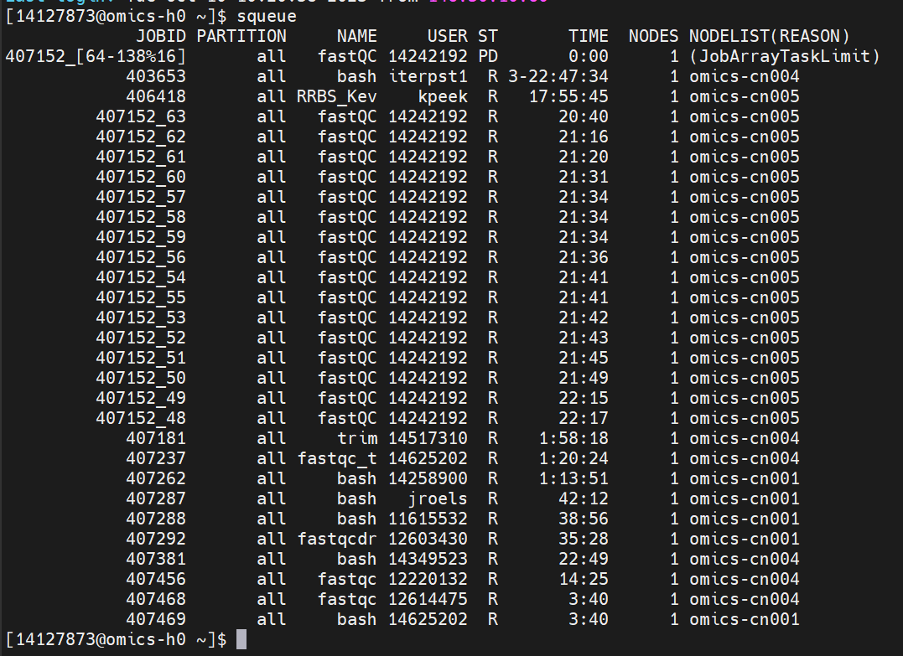
How to run the script on the server
Run by using:
bash run.sh #N
To check the status of your jobs on the server:
squeue

Slide 4
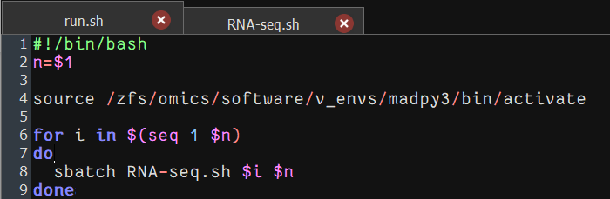
run.sh
1: bash file denottaion
2: variable n (given by the 1st command line input)
4: load environment containing necessary packages
6: loops over all samples 1 till n
8: run RNA-seq script for sample i out of n

Slide 5
Inside the RNA-seq script
Header
Global parameters
Coding chunks

Slide 6
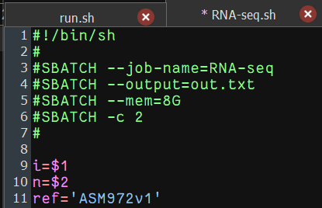
Script header and parameters
1: bash file denotion
3: job name displayed on the server
4: file to write command line output to
5: assign allowed working memory
6: assign cores
9: 1st command line input variable I denoting the sample number
10: 2nd command line input variable denoting number of samples
11: name of the reference files in the ref/ directory

Slide 7
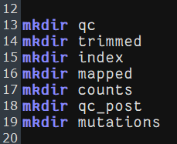
Create directories

Slide 8
Overview of coding chunks
Quality control of the reads
fastqc
Determine trimming parameters
trimmomatic
Post trimming quality control
fastqc
Map and quantify
Map to reference genome
bowtie2
Quantify reads
Htseq
Inspect mutations
NOTE: this script was made to be run on the crunchomics server meaning it will require modification if run locally

Slide 9
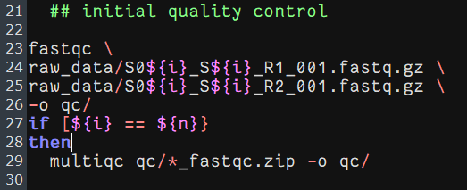
1. Quality control
NOTE: backslash (\) allows you to use a new line where the code will be read as a single line
Example of a single sample, forward reads
23: run fastqc
24: input file containing forward reads
25: input file containing reverse reads
26: point to output directory
27: check if all samples have been run
29: run a multiqc report on all samples

Slide 10
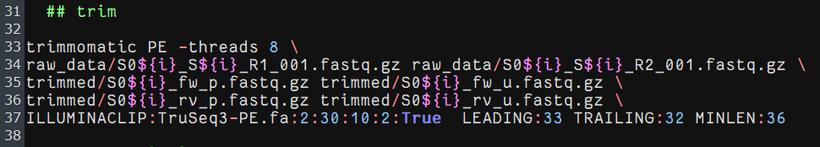
2. Trimming
33: run trimmomatic and assign a number of threads
34: define forward (R1) and reverse (R2) input reads
35: forward output files, respectively paired and unpaired reads
36: reverse output files, respectively paired and unpaired reads
37: remove remaining traces of illumine adapters and set quality restrictions
Notes:
-threads 8
Specifies the number of threads made available for trimming. 8 is usually sufficient.
raw_data/S0${i}_S${i}_R1_001.fastq.gz raw_data/S0${i}_S${i}_R2_001.fastq.gz
Since we specified a sample number, this will pull the forward (R1) and reverse (R2) read files for sample ${i} from the ‘raw_data’ directory
ILLUMINACLIP:TruSeq3-PE.fa:2:30:10:2:True
To remove remaining traces of illumina adapters
LEADING:33 TRAILING:32 MINLEN:36
These parameters allow quality restrictions to be set. The quality of the reads in the beginning are set to 33, whereas those at the end are set to 32 (feel free to play around with this). The minimum length for the remaining read is set to be 36 bases, any reads ending up shorter than this will be removed.

Slide 11
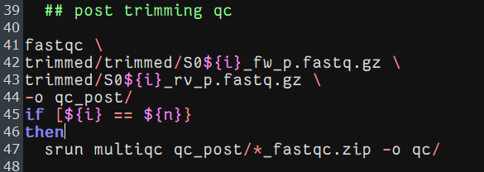
3. Quality control – post trimming
Example of a single sample, forward reads
23: run fastqc
24: input file containing forward trimmed reads
25: input file containing reverse trimmed reads
26: point to output directory
27: check if all samples have been run
29: run a multiqc report on all samples

Slide 12
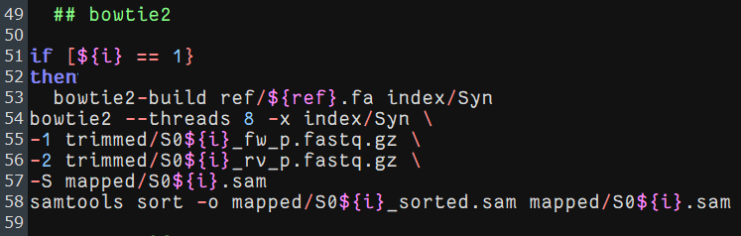
4. Mapping
51: only perform indexing once, at the first sample
53: build bowtie index using reference genome and save in index/ folder
54: run bowtie with indicated amount of threads and point to index
55: forward trimmed reads
56 reverse trimmed reads
57: identify output file
58: sort output file

Slide 13
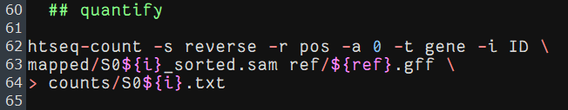
4. quantification
62: run htseq with identified parameters (for more etails see notes)
63: identify sam file with mapped reads and supply a reference
64: define output file
Notes:
htseq-count (Counting reads in features with htseq-count — HTSeq 0.11.1 documentation)
-s
whether the data is from a strand-specific assay. For paired-end data use ‘reverse’
-r
Order. For paired-end data, the alignment have to be sorted either by read name or by alignment position.
-a
skip all reads with alignment quality lower than the given minimum value
-t
feature type (3rd column in GFF file) to be used, all features of other type are ignored.
-i
GFF attribute to be used as feature ID.

Slide 14
Congrats! You now have count tables
Now we move to R-studio

Slide 15
Differential expression analysis
Load count- and meta- data
Perform quality control
DESeq2
Gene set enrichment

Slide 16
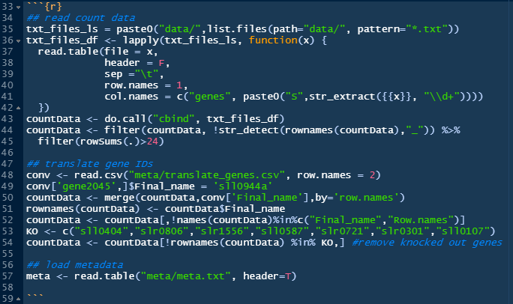
Load data
Notes:
35: create list of filenames
36: use list of filenames to load all into a list of dataframes
43: combine the individual sample dataframes into a single dataframe
44: filter out any lines that are not genes as well as genes with counts below 24 for any of the instances
48: load ID translation file
49: rename the duplicate ID
50-52: change rownames into gene IDs
53-54: list and remove knockouts
57: load metadata

Slide 17
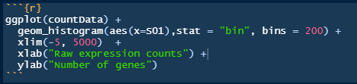
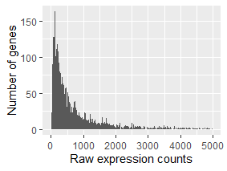
2. Quality control
Count distribution

Slide 18
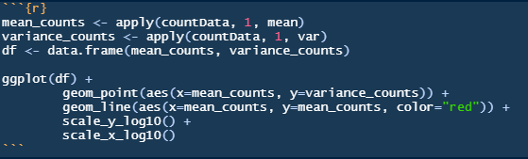
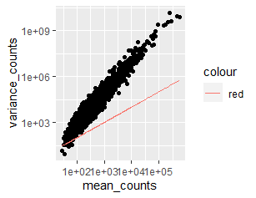
2. Quality control
Mean vs variance

Slide 19
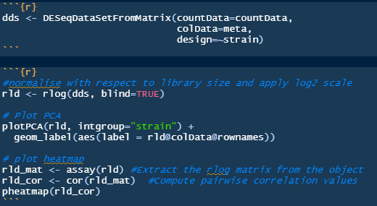
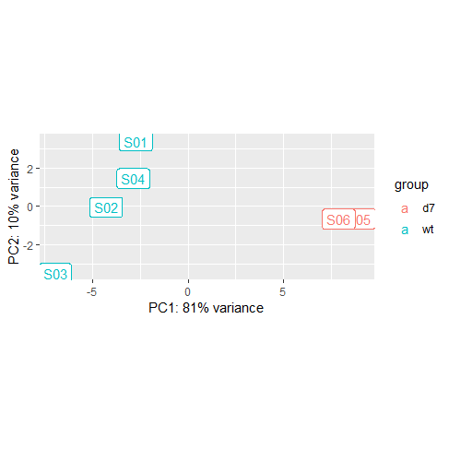
3. DESeq2 - dataset

Slide 20
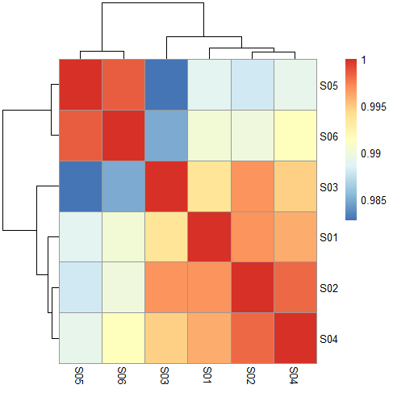
3. DESeq2 - dataset

Slide 21
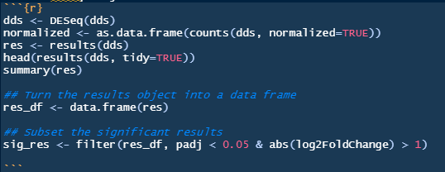
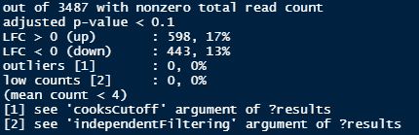
3. DESeq2 - object

Slide 22

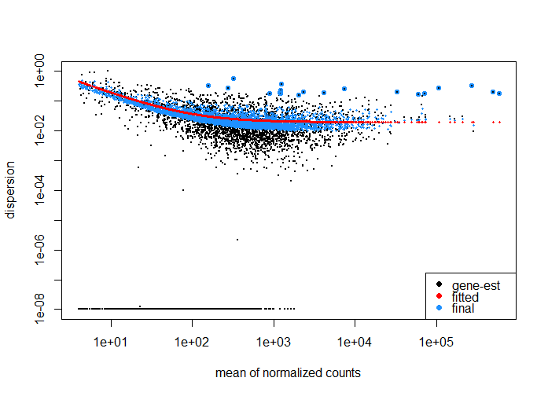
3. DESeq2 - object

Slide 23
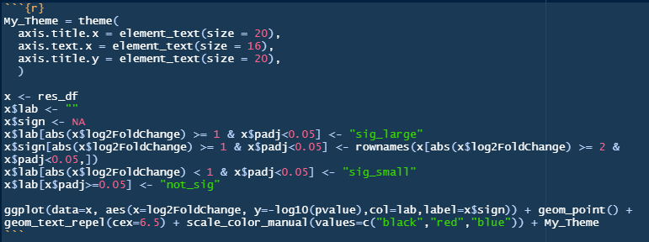
3. DESeq2 - vulcanoplot

Slide 24
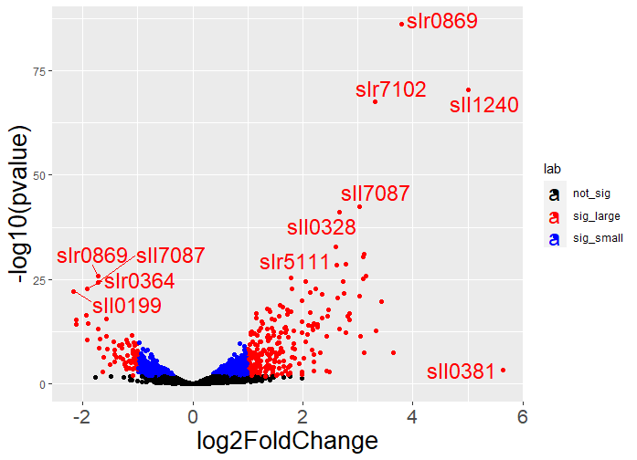
3. DESeq2 - vulcanoplot

Slide 25
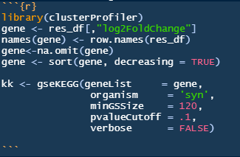
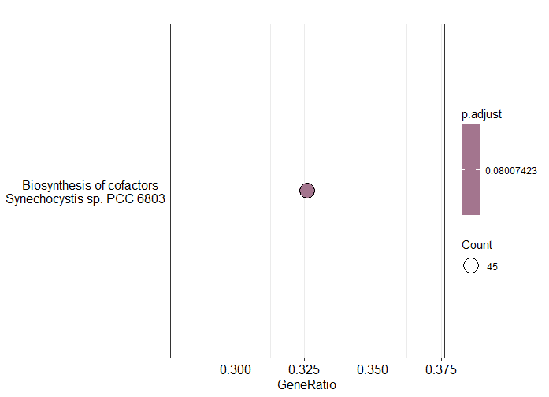
4. Gene set enrichment
Notes:
In this case only one geneset was found to be enriched with p-value 0.08

Slide 26
You’re done!
Of course feel free to run additional analysis ;)

