Slide 1
Homework Assignment #3 Threads & Concurrency

Slide 2
Outline
Thread
Application Programming Interface
Exercise 3.20 API
Pthreads API
Other API
Homework Assignment #2
Race Condition
Reference

Slide 3
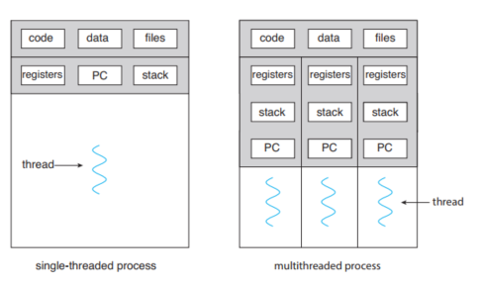
Thread
A thread is a basic unit of CPU utilization; it comprises a thread ID, a program counter (PC), a register set, and a stack.
A traditional process has a single thread of control. If a process has multiple threads of control, it can perform more than one task at a time.
3
Notes:
3244
3

Slide 4
Outline
Thread
Application Programming Interface
Exercise 3.20 API
Pthreads API
Other API
Homework Assignment #2
Race Condition
Reference

Slide 5
Exercise 3.20 API
We have created three APIs in homework#1.
int allocate_map(void)
Creates and initializes a data structure for representing pids;
returns −1 if unsuccessful, 1 if successful.
int allocate_pid(void)
Allocates and returns a pid;
returns −1 if unable to allocate a pid (all pids are in use).
void release_pid(int pid)
Releases a pid
5

Slide 6
The Pthreads API
There is a whole set of library calls associated with threads, most of whose names start with pthread_
To use these library calls, we must include the file pthread.h, and link with the pthread library using –pthread
We will use the following APIs
pthread_create()
Create a thread
pthread_join()
Wait for a thread
pthread_exit()
Exit a thread without exiting process
6

Slide 7
The Pthreads API (cont.)
pthread_create
creates a thread
#include<pthread.h>
int pthread_create(pthread_t *thread, const pthread_att_t *attr,
void *(*start_routine)(void *), void *arg);
EX: pthread_create(&thread,NULL,PrintHello,(void*)t);
thread: Points to the ID of the newly created thread.
attr: An attribute object that encapsulates the attributes of a thread. NULL for the default values.
start_routine: The C routine that the thread calls when it begins execution
arg: The argument that is to be passed to start_routine. NULL may be used if no argument is to be passed.
7
Notes:
7

Slide 8
The Pthreads API (cont.)
pthread_join
causes the caller to wait for the specified thread to exit
#include<pthread.h>
int pthread_join(pthread_t thread, void **value_ptr);
EX: pthread_join(thread,NULL);
thread: The ID of the terminating thread.
value_ptr: Provides a location for a pointer to the return status that the target thread passes to pthread_exit. NULL is used if the caller does not retrieve the target thread return status.
8

Slide 9
The Pthreads API (cont.)
pthread_exit
terminates the calling thread
#include<pthread.h>
int pthread_exit(void *value_ptr);
EX: pthread_exit(NULL);
value_ptr: makes the value value_ptr available to any successful join with the terminating thread
We can use pthread_exit(NULL)to terminate a thread.
9

Slide 10
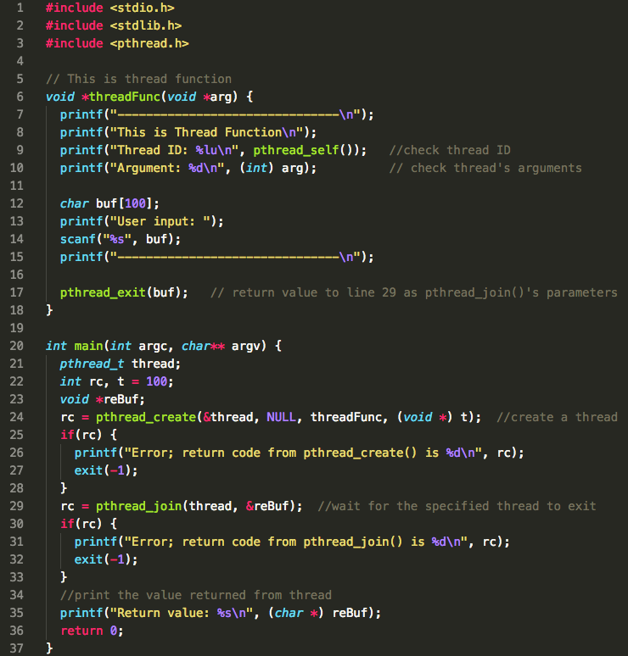
Thread Example

Slide 11
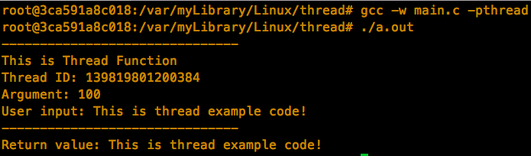
Thread Example (cont.)
While making pthread program, ensure to add “-pthread” option to command line. (Link libpthread.a library)

Slide 12
Other API
sleep()
sleep() function is provided by unistd.h library which is short cut of Unix standard library.
sleep() function will cause the current executable (a thread or process) to sleep for a period of specified time.
#include<unistd.h>
unsigned int sleep(unsigned int time);
EX: sleep(10);
time: how long do you want to sleep the thread. (unit: second)
12

Slide 13
Other API
rand()
rand() function is provided by stdlib.h library.
Returns a pseudo-random number in the range of 0 to RAND_MAX.
#include<stdlib.h>
int rand(void);
EX: rand();
13

Slide 14
Other API
srand()
srand() function is provided by stdlib.h library.
This function seeds the random number generator used by the function rand().
#include<stdlib.h>
void srand(unsigned int seed);
EX: srand(1000);
14

Slide 15
Other API
time()
time() function is provided by time.h library.
Calculates the current calender time and encodes it into time_t format.
#include<time.h>
time_t time(time_t *t);
EX: time(NULL);
15

Slide 16
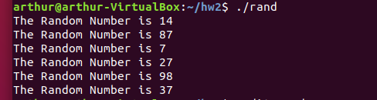
Random number example
#include <stdio.h>
#include <stdlib.h>
#include <time.h>
void main()
{
int a;
srand(time(NULL));
for(int i=0; i<=5; i++){
a=(rand()%100)+1;
printf("The Random Number is %d \n", a);
}
}
16

Slide 17
Outline
Thread
Application Programming Interface
Exercise 3.20 API
Pthreads API
Other API
Homework Assignment #3
Race Condition
Reference

Slide 18
Homework Assignments #3
Create 100 threads.
For each thread, perform the following steps in the start routine
First step: Assign PID for the thread.
Second step: Print out the PID of the thread.
Third step: Let thread sleep for a random period by using sleep() function.
Fourth step: Release the PID of the thread, when the thread wake up.
Fifth step: Terminate the thread.
18

Slide 19
Thread Flowchart
Create
thread
pthread_create()
Get PID
allocate_pid()
Thread
sleep
sleep()
Thread
wake up
start routine
Release
PID
release_pid()
Terminate
thread
pthread_exit()

Slide 20
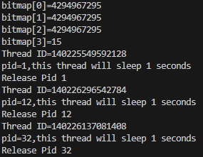
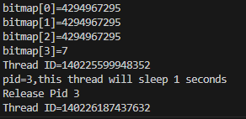
Result
20

Slide 21
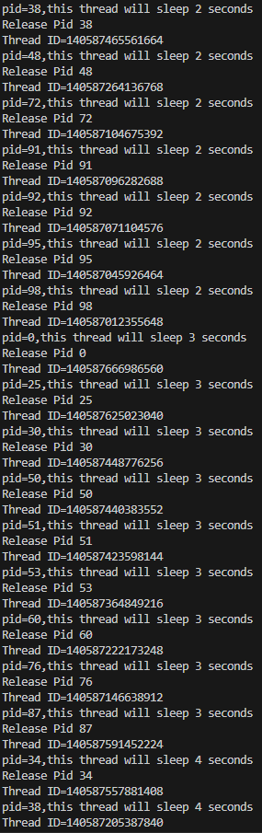
Race Condition
21
Notes:
21

Slide 22
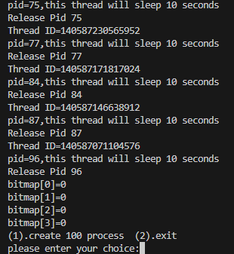
Result
22

Slide 23
Turn in
Deadline
2023/12/05 PM.11:59:59
Upload to ilearning
File name
HW3_ID.zip (e.g. HW3_7105056035.zip)
Source code
.c file
Word
If you don’t hand in your homework on time, your score will be deducted 10 points every day.
23

Slide 24
Rules
No cheat work is acceptable
You get zero if you copy other people’s version
Only single job is accepted
24

Slide 25
Reference
https://www.tutorialspoint.com/c_standard_library/index.htm
http://tw.gitbook.net/c_standard_library/20130920395.html
https://blog.gtwang.org/programming/pthread-multithreading-programming-in-c-tutorial/
Operating System Concepts, 10th Edition
25

Slide 26
TA
Name：Tzu-Han Chen
Email：a877635@gmail.com
Lab: OSNET(1001)
26

