Slide 1
Lab 3 Setuid
TA：Tzu-Han Chen
Professor：Hsung-Pin Chang
Operating System Lab
Notes:
1

Slide 2
Outline
Introduction
Example
Exercises
References

Slide 3
Privilege escalation (上升）
In Chapter 1.9, you learn the privilege escalation (特權提升）
Allows user to change to effective ID
Example: SUID(setuid) in UNIX
Notes:
3

Slide 4
What is SUID?
SUID means Set UID.
The SUID attribute on a program causes that program to run with the user ID of the owner of the file rather than the current user’s ID
The process runs with this effective UID until it turns off the extra privileges or terminates.
Notes:
4

Slide 5
Why we need SUID?
An user sometimes needs to change privileges to gain extra permissions for an activity.
For example, if root creates a file and hope other user can modify it through a restricted way, root can achieve this by :
Set this file writable only with root.
Design a program to write this file, and also give a SUID attribute on this program.
To make other users get a temporary root privilege to write file successfully through executing the program.
In Linux, a scenario is passwd and shadow file
Discuss later.
Notes:
5

Slide 6
Background – file’s permission
Octal notation
4 2 1 4 2 1 4 2 1 = 755
d r w x r w x r w x 2 root root Name
User
Group
Other
User
Group
Three Classes
Owner
To indicate what type it is:
: not a directory
d: directory
Notes:
6

Slide 7
How to set SUID attribute on executable file
-r-x--x--x 1 root root 19336 Mar 15 2008 /usr/bin/exec
$ chmod 4755 /usr/bin/exec
file
-rwsr-xr-x 1 root root 19336 Mar 15 2008 /usr/bin/exec
Notes:
7

Slide 8
What is SUID? (cont.)
Example with SUID：Passwd
Because the new password must be written to the /etc/shadow file and that file is writable only by root.
we can let other users to modify shadow by “SUID attribute”.
Set “SUID attribute” on Passwd.
Other users can run Passwd as a root ID.
Passwd can change password file - shadow.
-r-s--x--x 1 root root 19336 Mar 15 2008 /usr/bin/passwd
-rw-r--r-- 1 root root 1529 Mar 15 2008 /etc/shadow
Notes:
8

Slide 9
Effective user ID vs. Real user ID
Assume an user kevin executes the /usr/bin/passwd file
If the /user/bin/passwd is a setuid program
real user ID : 500 (kevin).
effective user ID : 0 (root).
Here, effective user ID means a temporary privileges of ID 0 (root).
In this example, user kevin execute passwd with a temporary privileges of ID 0 (root) for modifying shadow file.
Notes:
9

Slide 10
Data Types and Functions (cont.)
Two header files are required in C:
sys/types.h
unistd.h
Data type:
uid_t: used to represent the user ID

Slide 11
Data Types and Functions (cont.)
Functions:
uid_t getuid(void):
get the real user ID
uid_t geteuid(void):
get the effective ID
int setuid(uid_t uid):
set the user ID to uid
Return value:
0: set successfully
1: error
Notes:
11

Slide 12
Data Types and Functions (cont.)
int seteuid(uid_t uid):
set the effective user ID to uid
note: Older system (those without the _POSIX_SAVED_IDS feature) don’t have this function
Return value:
0: set successfully
1: error
Example with setuid()
Disabling
setuid (real_user_id)
Enabling after disabling
setuid(effective_user_id)
Notes:
12

Slide 13
Example
Use getuid ( ) and geteuid ( ) to get the real user ID and the effective user ID
You must have two users
user1
Design a program to get the real user ID and the effective user ID of the process
Switch your current user account to new created user
user2
Execute the program to print the result
Notes:
13

Slide 14
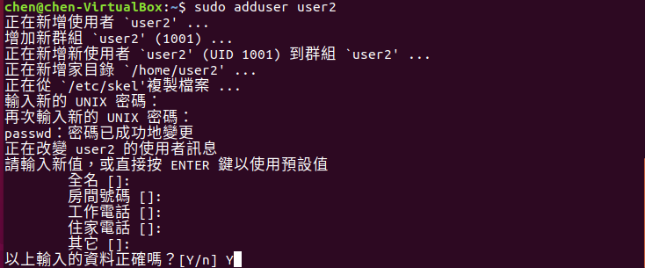
Example
Step 1. Add a new user
sudo adduser user2
Notes:
14

Slide 15
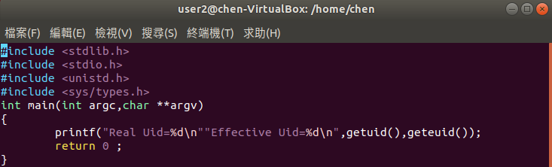
Example
#include<stdlib.h>
#include<stdio.h>
#include<unistd.h>
#include<sys/types.h>
int main(int argc,char **argv){
printf("Real Uid=%d\n""effective Uid=%d\n",getuid(),geteuid());
return 0;
}
Step 2. Write the program to print user ID(test.c)
Notes:
15

Slide 16

Example
Step 3. User1 runs the program to print the ID
Notes:
16

Slide 17

Example
Step 4. User2 runs the program, and we can see the different outputs
Notes:
17

Slide 18

Example
Write a program “printid.c” with the authority of superuser to print the real user ID and the effective user ID
Create a new user
Add the setuid attribute
Change to the new user
Execute the “printid” to print the real user ID and the effective user ID
The result should be as follow:
Real user id: 1001
Effective user id: 0
Notes:
18

Slide 19
Exercise
You must create these as a root identity
Another user
An empty file for writing data
vim datafile, and quit with “:wq!”.
Should be writable only by the root.
chmod 644 datafile
An executable file
gcc changefile.c –o changefile
changefile.c is introduced in next slide.
chmod 755 changefile
-rw-r--r-- 1 root root 0 July 15 2008 datafile
-rwxr-xr-x 1 root root 15365 July 15 2008 changefile
Notes:
19

Slide 20
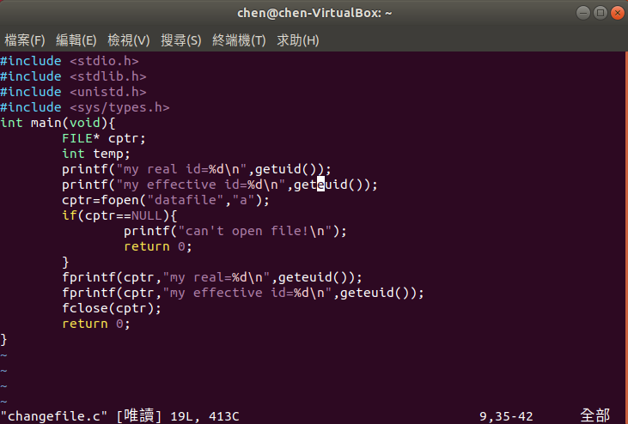
Exercise (cont.)
changefile.c

Slide 21


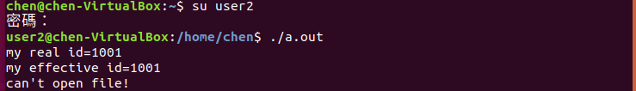
Exercise (cont.)
Execute changefile with the authority “root”
You’ll find the file is executed successfully
Switch to another user and execute changefile
E.g. su user2
Execute changefile
Then an error message will be shown.
You can verifying datafile.
You should try to find out the reason why this error occurred in other user’s execution!
Notes:
21

Slide 22
Exercise
Your job is to make a solution to the problem
You can try two methods as follows:
By setting changefile with a SUID attribute.
Modify SourceCode.c with seteuid() function.
Notes:
22

Slide 23
References
Operating System Concepts, 10th Edition (Chapter 7.4)
http://linux.vbird.org/
https://en.wikipedia.org/wiki/File-system_permissions
https://en.wikipedia.org/wiki/Setuid
https://www.gnu.org/software/libc/manual/html_node/Setuid-Program-Example.html
https://www.gnu.org/software/libc/manual/html_node/Setting-User-ID.html
https://www.computerhope.com/unix/uchmod.htm
Notes:
23

