Slide 1
Lab 9 Thread Management
TA:Yung-Hsu Chu
Professor: Hsung-Pin Chang
Operating System Lab

Slide 2
Outline
Thread Overview
Pthreads
Creating threads
Exit threads
Join threads
Java Thread
Install the Java Virtual Machine
Creating Threads
Excuting Threads
Join threads
Exercise

Slide 3
Thread Overview

Slide 4
Why We Need Threads?
A traditional process
Needs a fair amount of "overhead“
Has a single thread of control
If the process has multiple threads of control, it can do more than one task at a time.
Threads
Run as independent entities because they duplicate only the bare essential resources that enable them to run code

Slide 5
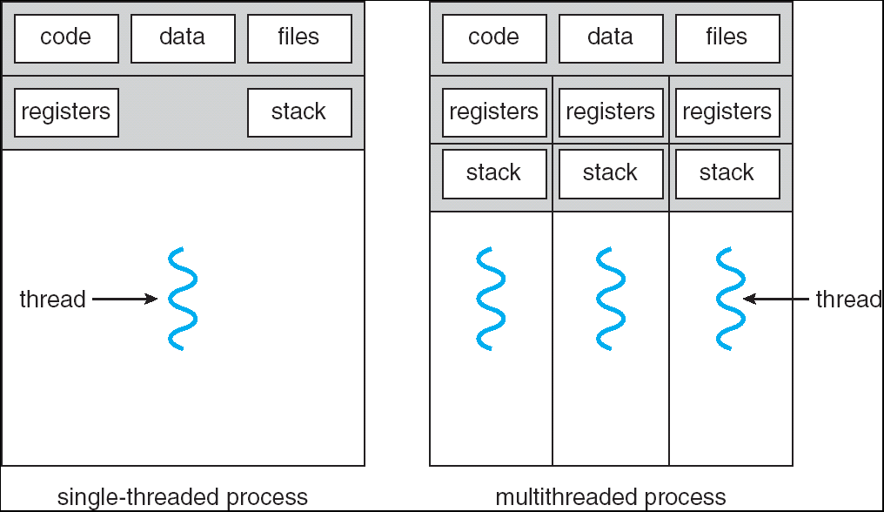
What Is a Thread?

Slide 6
What Is a Thread? (cont.)
A thread is a flow of control within a process.
A multithreaded process contains several different flows of control within the same address space.
A thread has a thread ID, a program counter, a register set, and a stack, and is similar to a process has.
However, a thread shares with other threads in the same process its code section, data section, and other OS resources.
Thus, thread is lightweight

Slide 7
The Benefits of Multithreaded Programming
Responsiveness
A process can execute even if some part of process is paused or taking a long time.
Resource sharing
Share resources of the process to which they belong.
Economy
Allocating memory and resources for process creation is costly.
Threads that share resources of the process to which they belong is more economical to create and context switch threads.
Great on multiprocessor architectures
Be greatly increased in a multiprocessor architecture.

Slide 8
Challenges When Using Thread
Because threads within the same process share resources:
Changes mode by one thread to shared system resources will be seen by all other threads.
Reading and writing to the same memory locations at the same time by two different thread is possible
Race condition
Therefore, thread needs explicit synchronization by the programmer.

Slide 9
POSIX Thread

Slide 10
What Are Pthreads?
Historically, hardware vendors have implemented their own proprietary versions of threads .
Difficult for programmers to develop portable threaded applications.
For UNIX systems, a standardized programming interface has been specified by the IEEE POSIX 1003.1c standard (1995).
Implementations which adhere to this standard are referred to as POSIX threads, or Pthreads.
Pthreads are defined as a set of C language programming types and procedure calls, implemented with a pthread.h header/include file and a thread library.

Slide 11
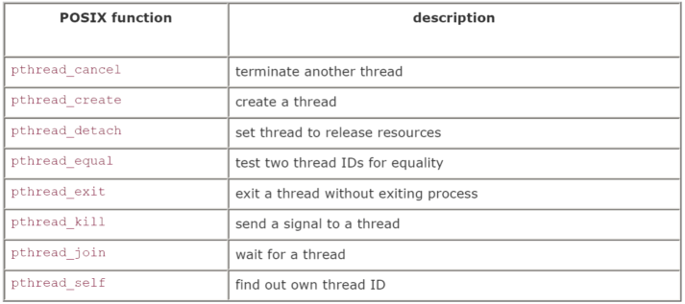
The Pthreads API
There is a whole set of library calls associated with threads, most of whose names start with pthread_.
To use these library calls, we must include the file pthread.h, and link with the pthread library using -pthread.

Slide 12
Referencing Threads by ID
pthread_self: A thread can find out its ID.
pthread_equal: To compare thread IDs for equality.
#include<pthread.h>
pthread_t pthread_self(void);
#include<pthread.h>
int pthread_equal(pthread_t t1,pthread_t t2);
/*Return a nonzero value if t1 equals t2,
0 if the thread IDs are not equal*/
Notes:
self 是 獲得 此thread 自己的ID
euqal 是 判斷兩個thread 是否相等(因為參數類型是pthread_t)

Slide 13
Creating a Thread
pthread_create: creates a thread.
#include<pthread.h>
int pthread_create(pthread_t *thread,
const pthread_att_t *attr,
void *(*start_routine)(void *), void *arg);
/*Return 0 if successful*/
thread: Point to the ID of the newly created thread.
attr: An attribute object that encapsulates the attributes of a thread. NULL for the default values.
start_routine: The C routine that the thread calls when it begins execution
arg: The argument that is to be passed to start_routine. NULL may be used if no argument is to be passed.

Slide 14
Exiting
If the main thread has no work to do after creating other threads, it should either block until all threads have completed or call pthread_exit().
#include<pthread.h>
pthread_t pthread_exit(void *value_ptr);

Slide 15
Joining
pthread_join: causes the caller to wait for the specified thread to exit.
#include<pthread.h>
pthread_t pthread_join(pthread_t thread,
void **value_ptr);
/*Return 0 if successful*/
thread: The ID of the terminating thread.
value_ptr: Provides a location for a pointer to the return status that the target thread passes to pthread_exit. The caller does not retrieve the target thread return status if NULL.

Slide 16
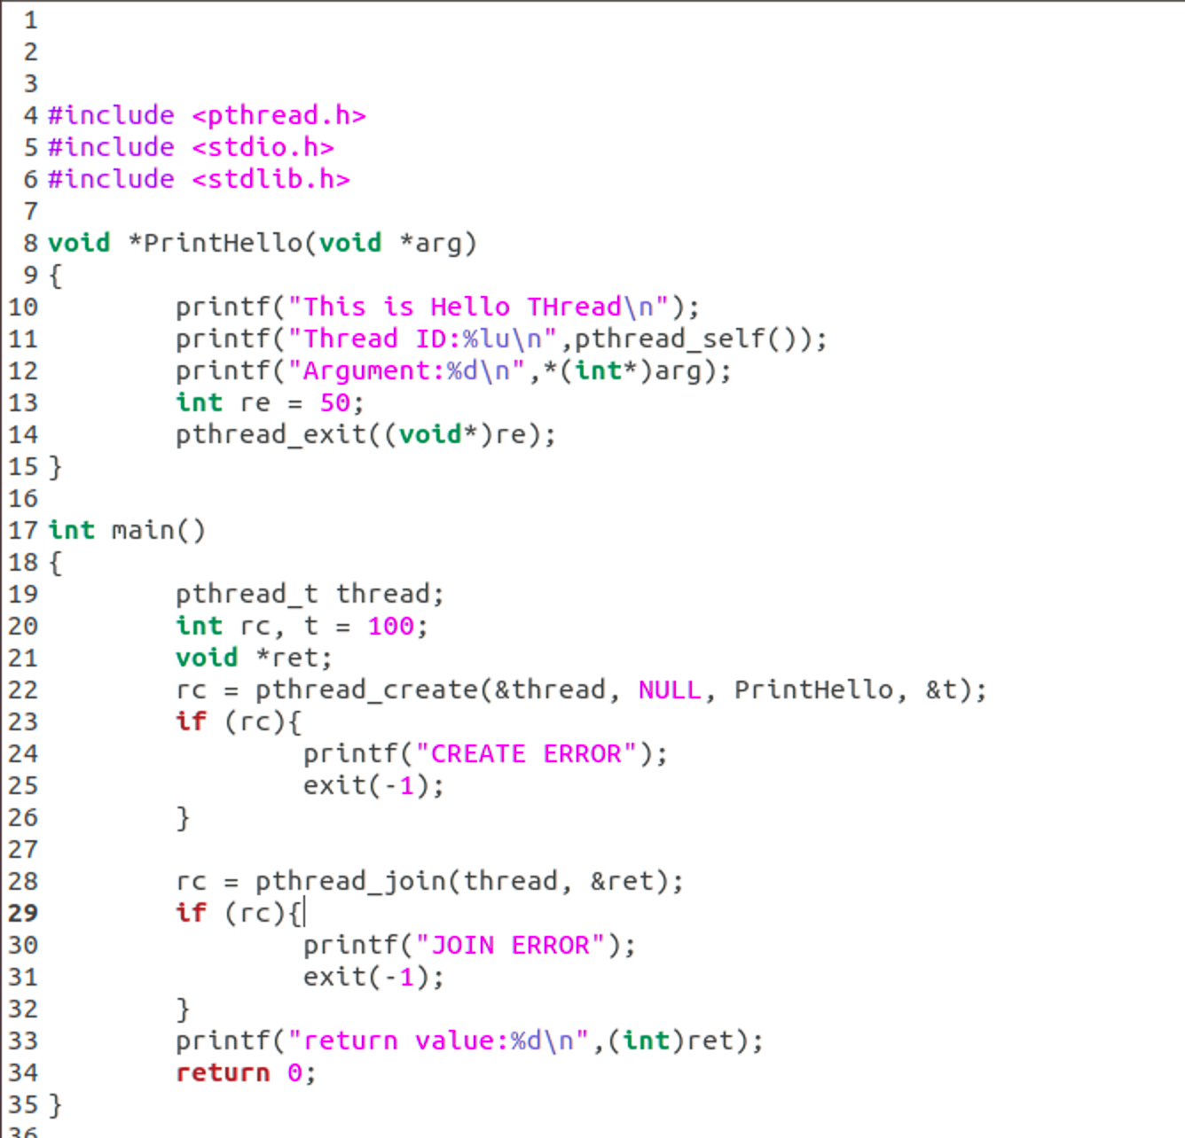
Example

Slide 17
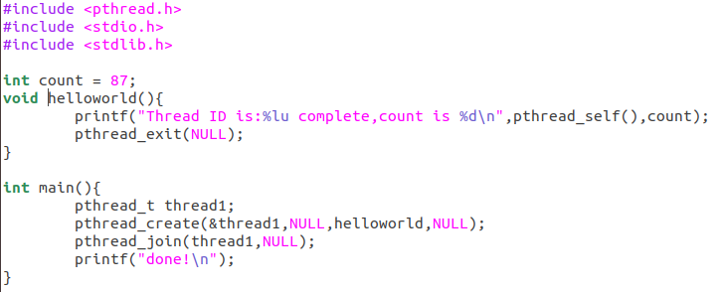

Example

Slide 18
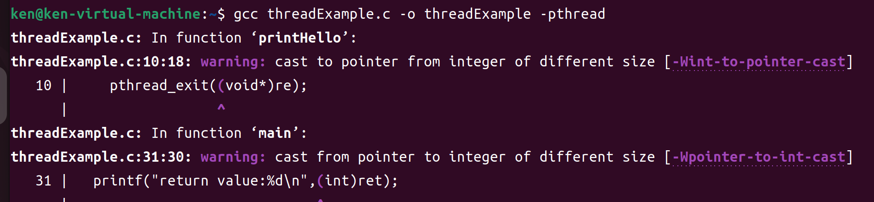
Compile
While compiling pthread program, ensure to add “-pthread” option to command line. (Link libpthread.a library)

Slide 19
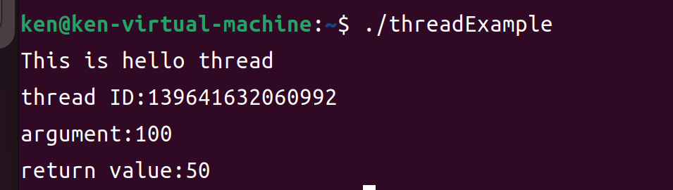
Example (cont.)

Slide 20
Lab1(40pts.)
Using Pthreads to create four identical threads
Also declare a global variable count = 0.
The main program passes a value containing the number of iterations to the threads.
Each thread increments the same global variable 25,000,000 times
Each thread prints the number of iterations from argument and its thread ID.
So count is incremented a total of 100,000,000 times.

Slide 21
Lab1 (cont.)
The main program waits for the four threads to complete
Then print out the global count variable at last.

Slide 22
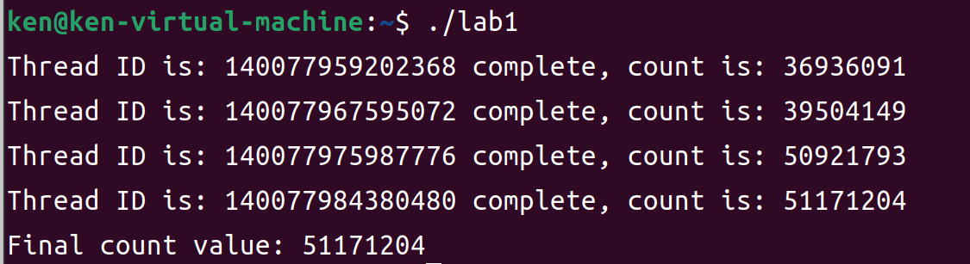
Lab1 (cont.)
Example:

Slide 23
Java Thread

Slide 24
Lab 1-1
Run your Lab1 program several times
Questions:
Observe all of the results you got, and think about what problem does it have?
Compare to fork() process by doing all the same thing to the global variable, can you figure out what’s the difference between them?

Slide 25
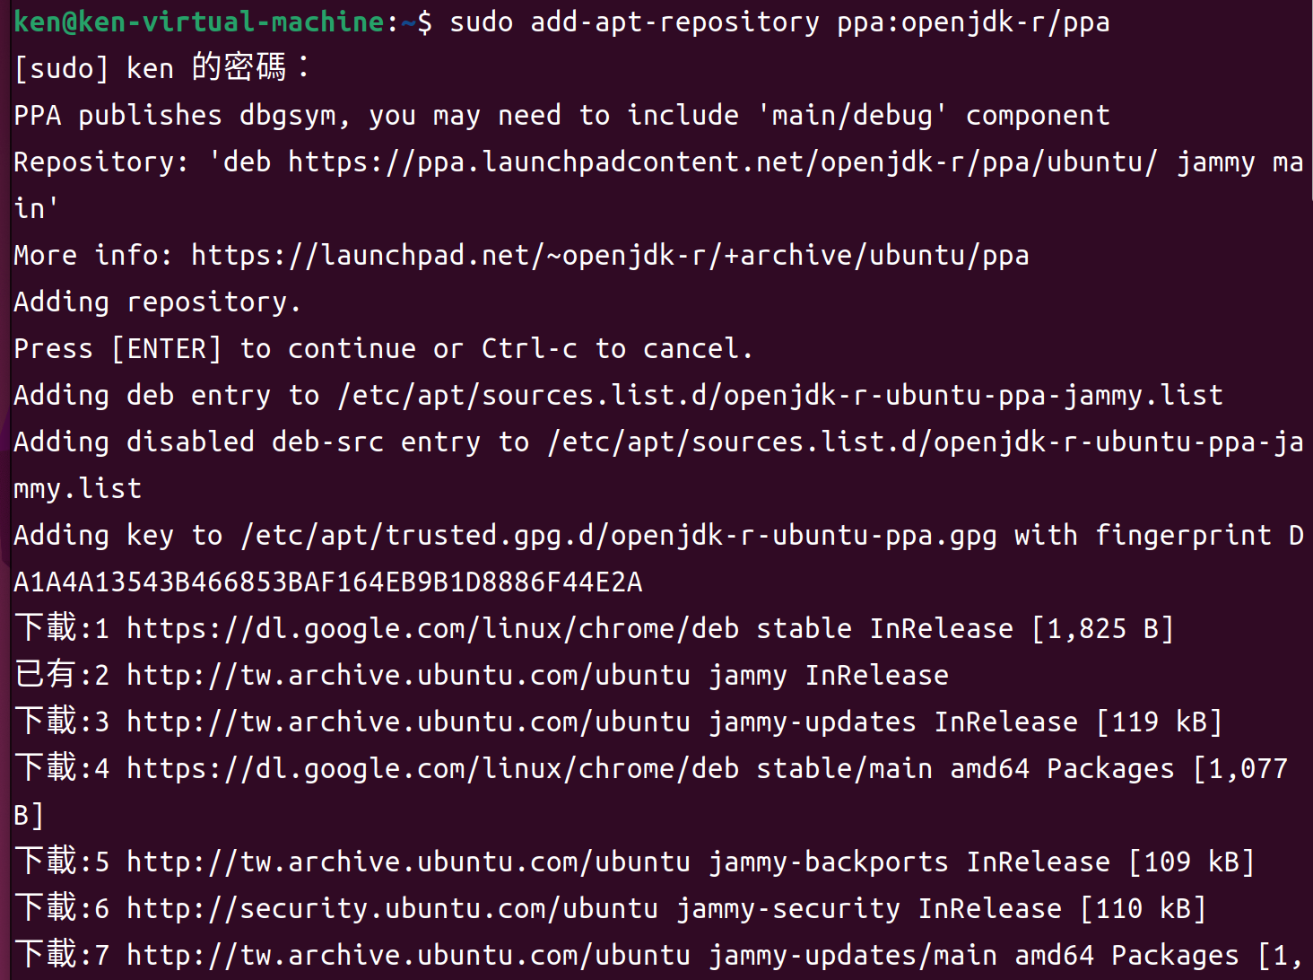
Install the Java Virtual Machine
sudo add-apt-repository ppa:openjdk-r/ppa

Slide 26
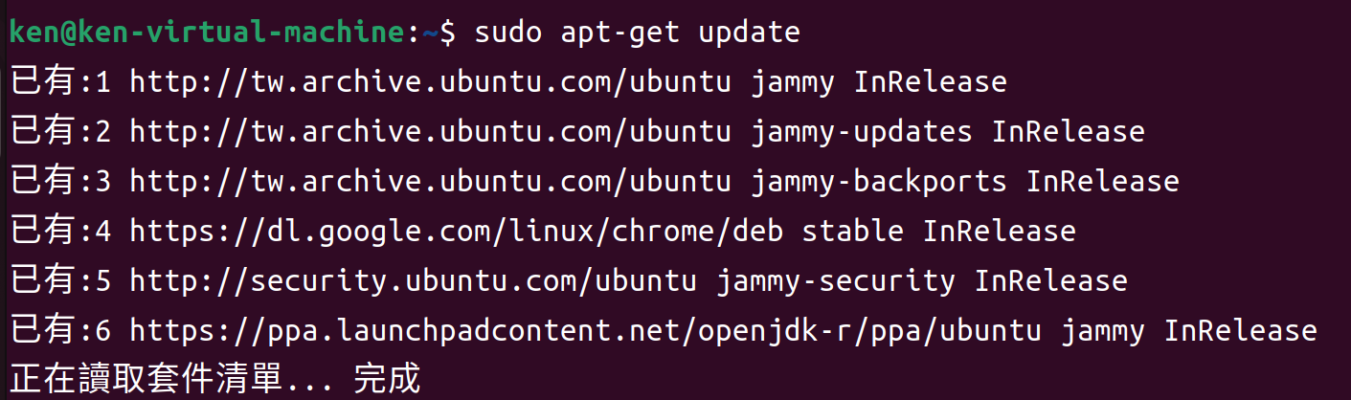
Install the Java Virtual Machine (Cont.)
sudo apt-get update

Slide 27
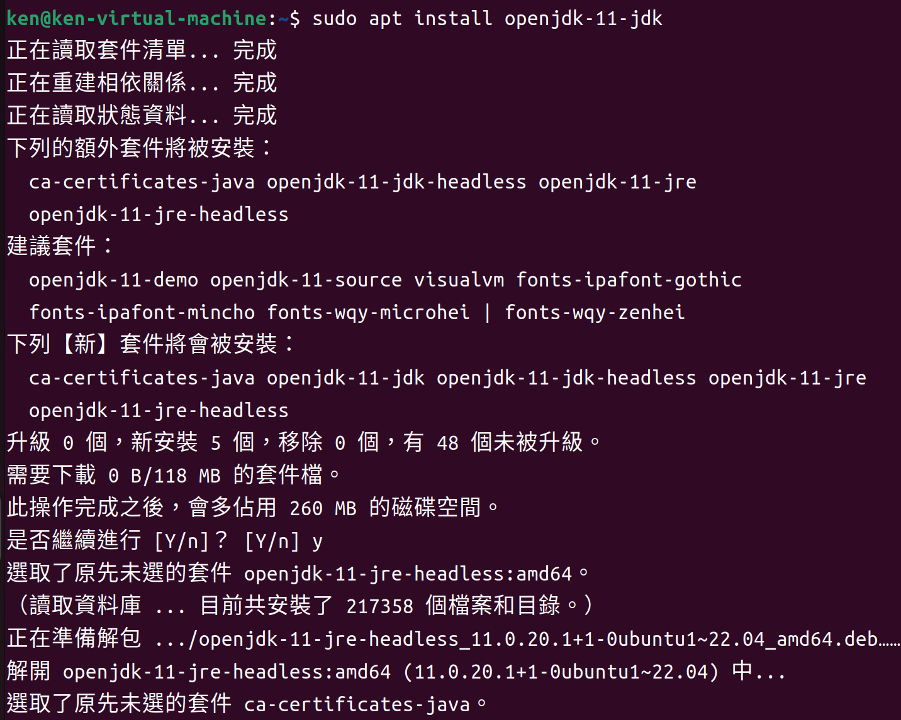
Install the Java Virtual Machine (Cont.)
sudo apt install openjdk-11-jdk

Slide 28
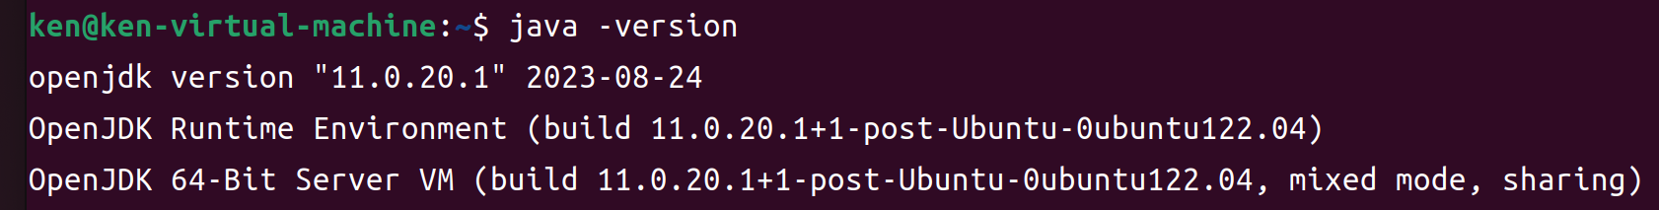
Install the Java Virtual Machine (Cont.)

Slide 29
Creating Thread
There are two techniques for explicitly creating threads in a Java program.
To Extend from the Thread class and to override its run() method.
To define a class that implements the Runnable interface.

Slide 30
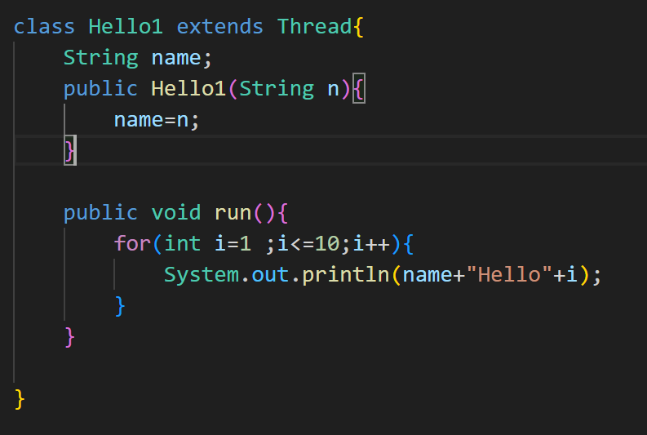
Creating Thread(cont.)
Method 1:extends Thread class.

Slide 31
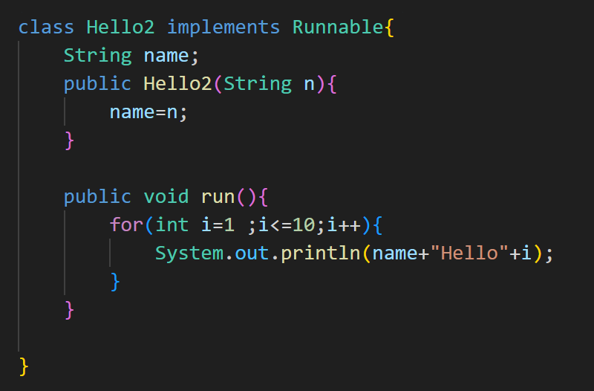
Creating Thread(cont.)
Method 2: Implements the Runnable interface

Slide 32
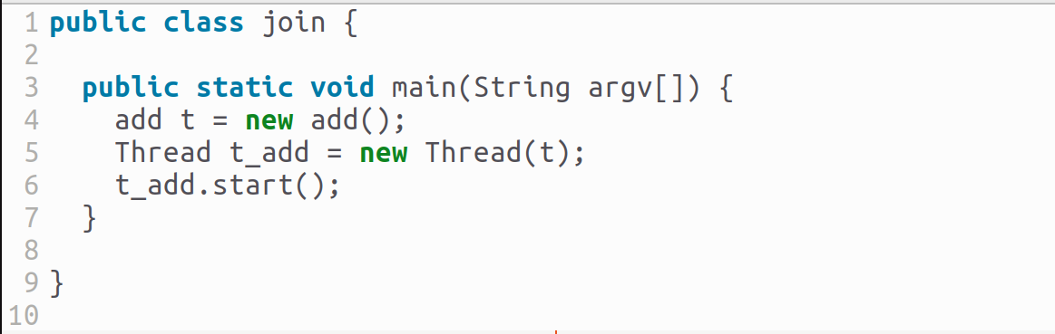
Excuting Thread
(Thread name).start
Join.java

Slide 33
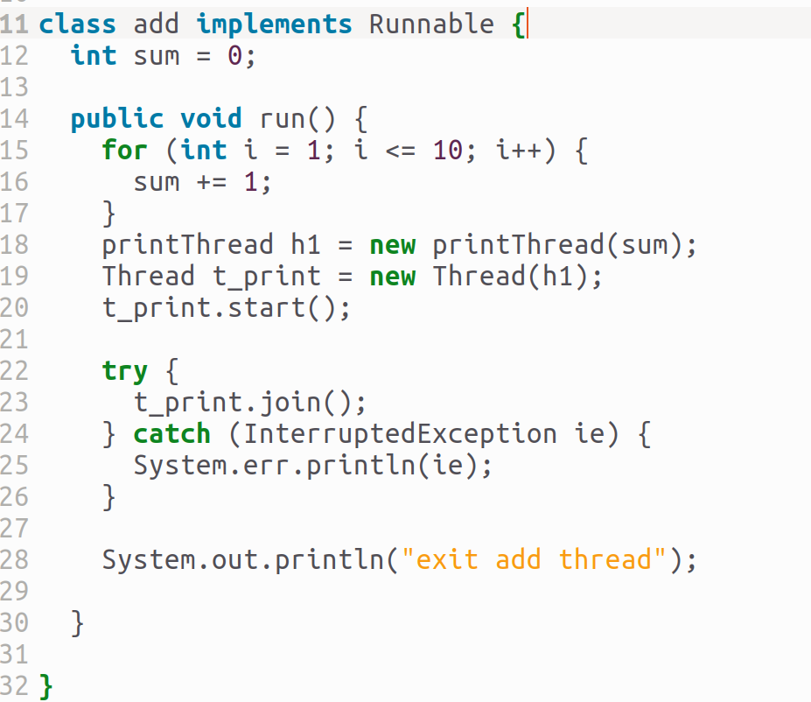
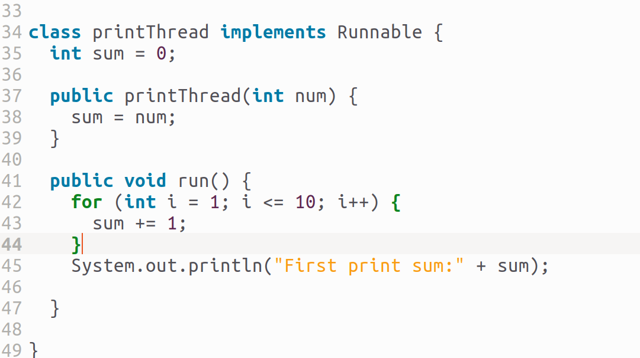
Joining
(Thread name).join
Join.java

Slide 34

Compiler & Excute
Compiler
Excute java

Slide 35
Thread state diagram
New
Dead
Blocked pool
unblocking
Blocking event
call .start
run done
Runnable
Running
CPU
Schedule

Slide 36
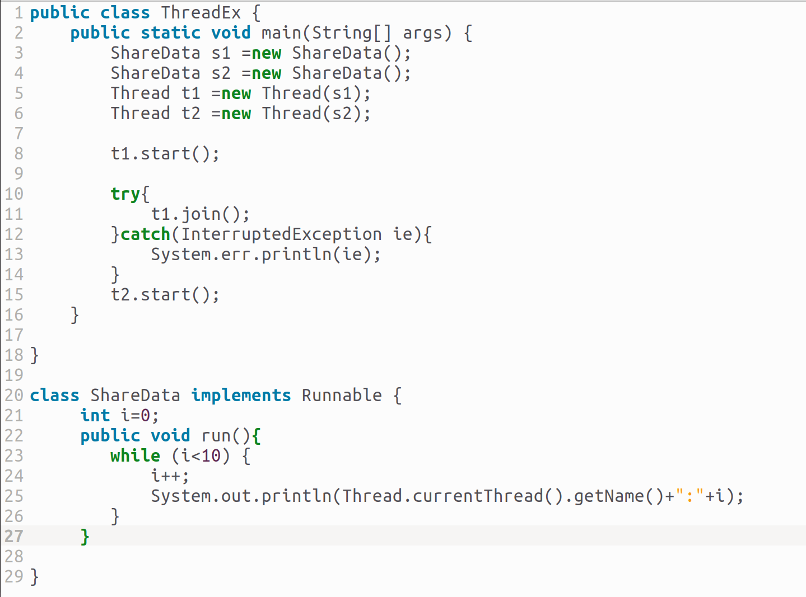
Example
ThreadEx.java

Slide 37
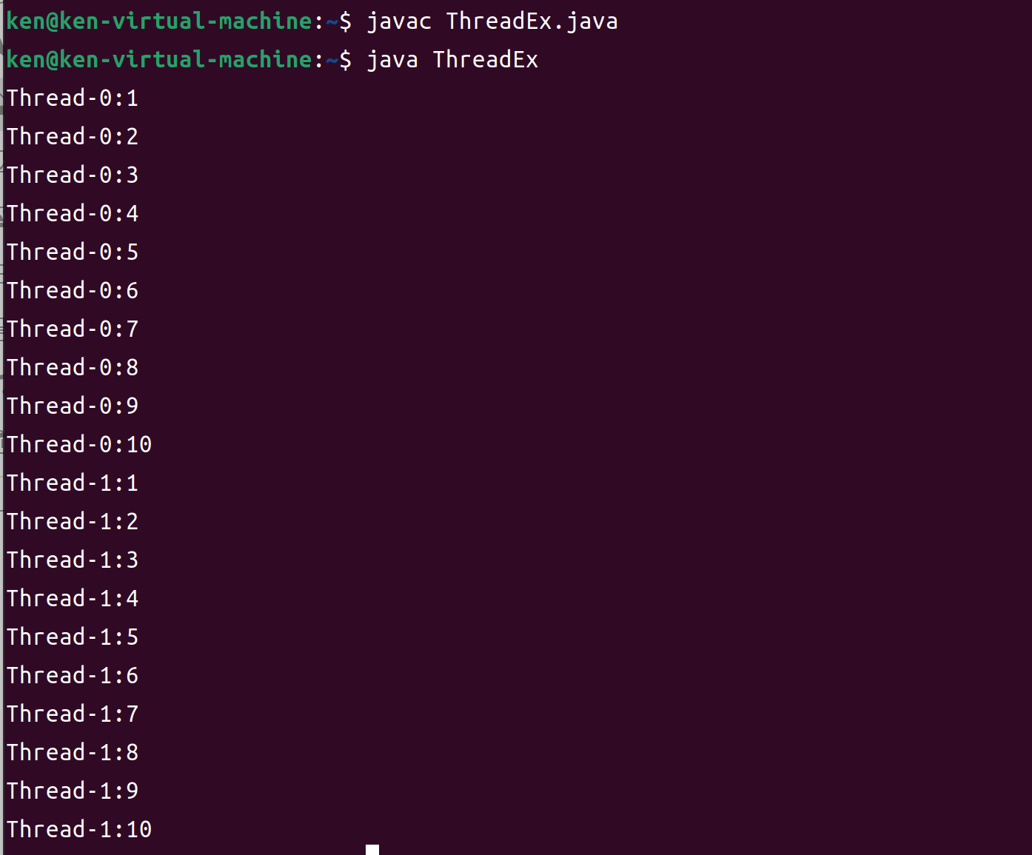
Example(cont.)

Slide 38
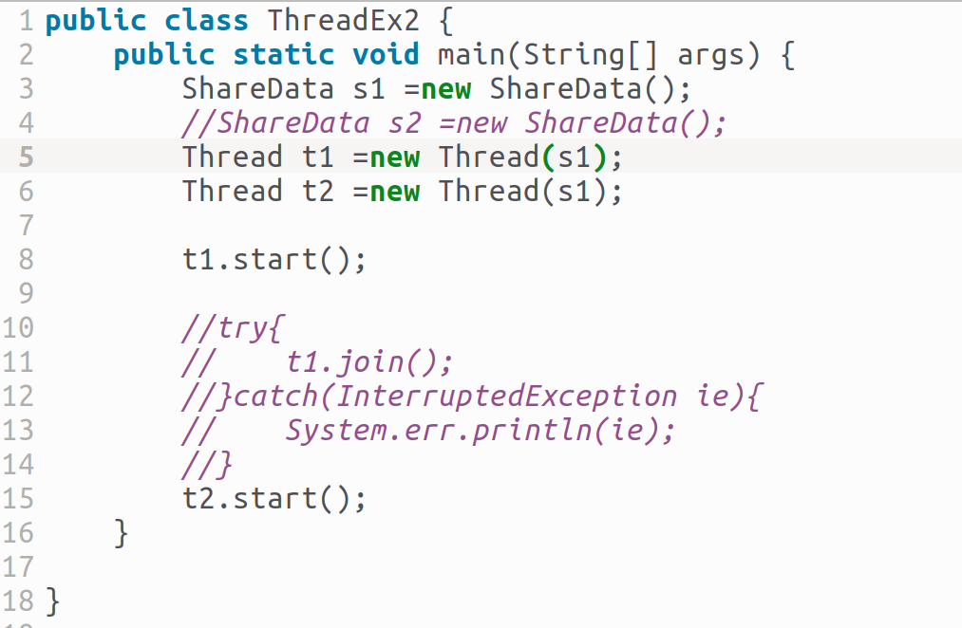
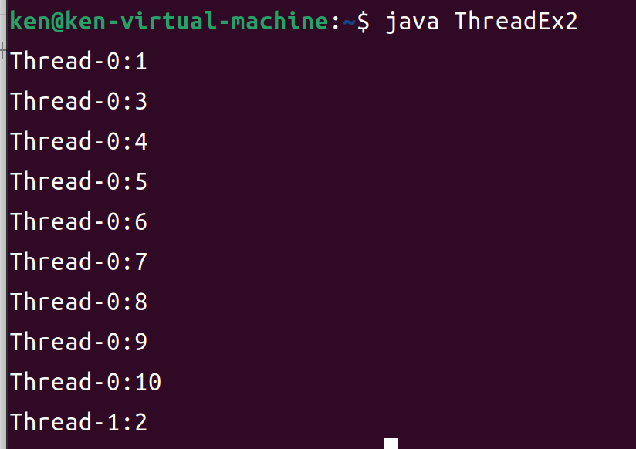
Example(cont.)

Slide 39
Exercise

Slide 40
Lab2(40pts.)
Using Java thread to create four identical threads
Also declare a global variable count = 0.
The main program passes a value containing the number of iterations to the threads.
Each thread increments the same global variable 250,000 times
Each thread prints the number of iterations from argument and its thread name.
So count is incremented a total of 1,000,000 times.

Slide 41
Lab2 (cont.)
The main program waits for the four threads to complete
Then print out the global count variable at last.

Slide 42
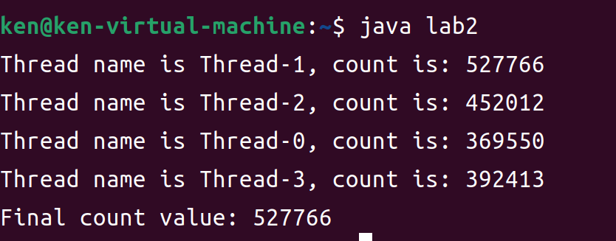
Lab2 (cont.)
Example:

Slide 43
Lab 3 (20pts.)
Using the message queue which we learned last week
Create two processes, each of them has two threads
One thread can allow user type messages iteratively and send those messages to a queue.
The other one can receive the messages which be sent to the queue by the other process and print on screen.
The two processes use the same message queue, but assign different message type to distinguish each other

Slide 44
Lab3 (cont.)
Process A
Message Queue
Process B

Slide 45
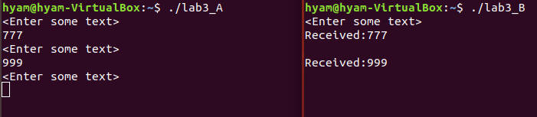
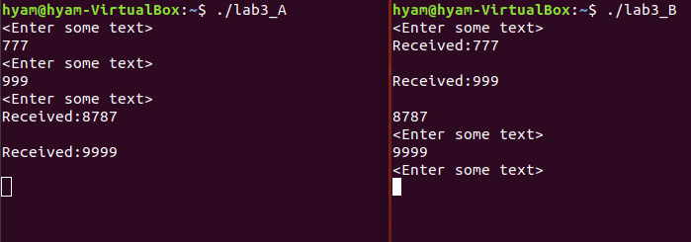
Lab3 Result Example
A send message to B
And then, B send message to A

Slide 46
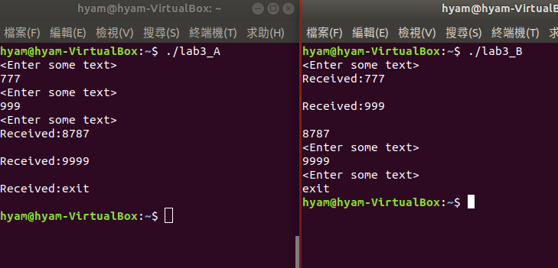
Lab3 Result Example
One of them type “exit”

Slide 47
References
Avi Silberschatz, Peter Baer Galvin and Greg Gagne, “Operating System Concepts,” John Wiley & Sons, 10th Edition
“Unix Systems Programming: Communication, Concurrency, and Threads” by Kay A. Robbins, Steven Robbins
Neil Matthew and Richard Stones, “Beginning Linux Programming,” Wiley publishing, 3rd Edition, 2004
W. Richard Stevens, “Advanced Programming in the UNIX Environment,” Addison-Wesley, 1992

Slide 48
References (cont.)
Marshall Brain, “Win32 System Services: The Heart of Windows 95 and Windows NT,” Prentice Hall PTR, 2nd Edition, 1996
https://stackoverflow.com/questions/52504825/how-to-install-jdk-11-under-ubuntu
Message queue
https://yayaya6d.pixnet.net/blog/post/350095123-linus%E5%90%84%E7%A8%AE%E9%9B%9C%E8%AB%87--process%E9%96%93%E7%9A%84%E6%BA%9D%E9%80%9A%EF%BC%9Amsg-queue

