Slide 1
Lab 6 Process Control
Professor: Dr. Hsung-Pin Chang
TA: Gang Yang
Operating System Lab
Notes:
1

Slide 2
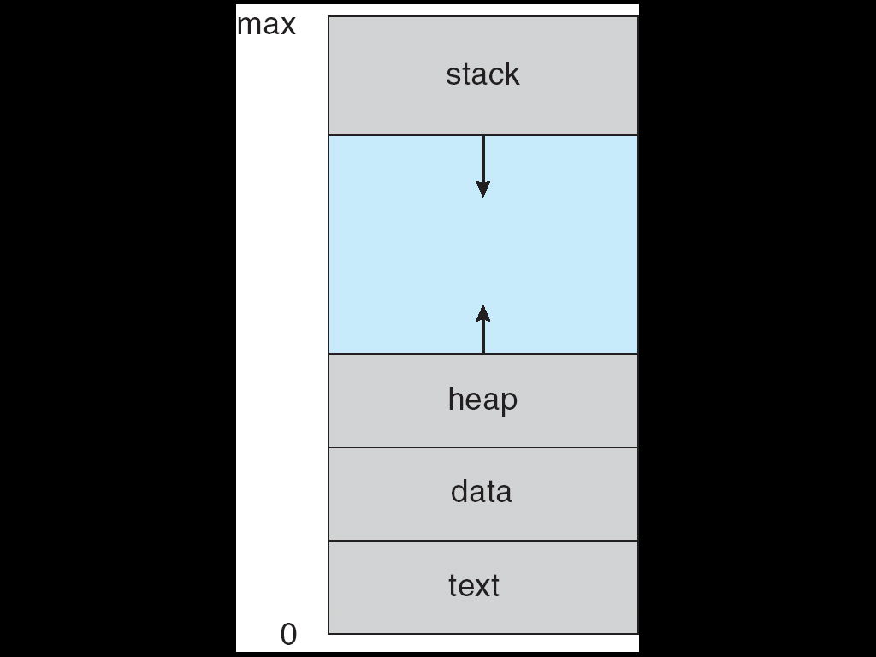
What is a process?
Informally, a process is a program in execution.
A process includes
data section, which contains global variables
text section, which contains the program code
stack section, which contains temporary data
heap section, which contains dynamically allocated memory
A process is more than the program code, it also includes the current activity
Represented by the value of the program counter and the contents of the processor’s registers.
NCHU System & Network Lab

Slide 3
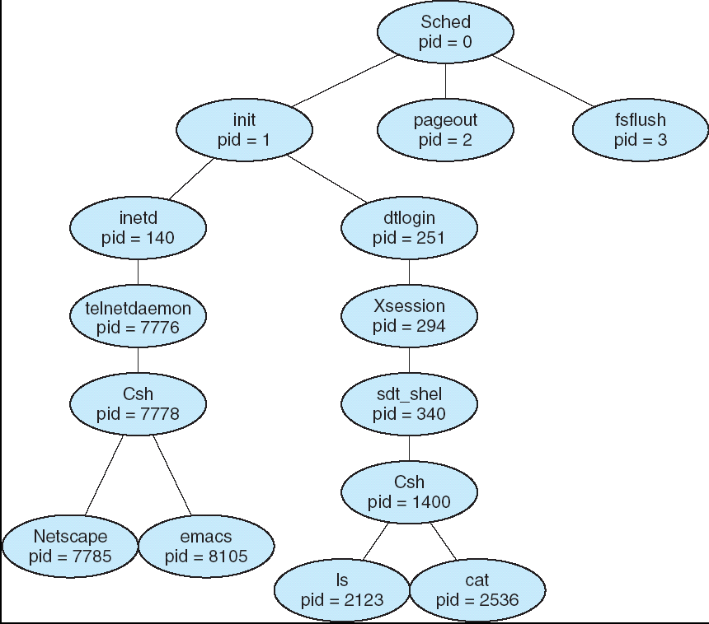
Process Creation
Parent process create children processes, which, in turn create other processes, forming a tree of processes.
NCHU System & Network Lab

Slide 4
Process Identification
UNIX identifies processes by a unique integral value called the process ID.
Each process also has a parent process ID, which is initially the process ID of the process that created it.
SYNOPSIS
#include <unistd.h>
pid_t getpid(void); //return the process ID
pid_t getppid(void); //return the parent process ID
NCHU System & Network Lab

Slide 5
The fork() Function
UNIX examples
fork() system call creates new process
The fork() copies the parent's memory image so that the new process receives a copy of the address space of the parent.
Both processes continue at the instruction after the fork statement (executing in their respective memory images).
SYNOPSIS
#include <unistd.h>
pid_t fork(void);
NCHU System & Network Lab

Slide 6
The fork() Function (cont.)
Memory
Copy from original image
Original image
fork()
Parent
Child
NCHU System & Network Lab

Slide 7
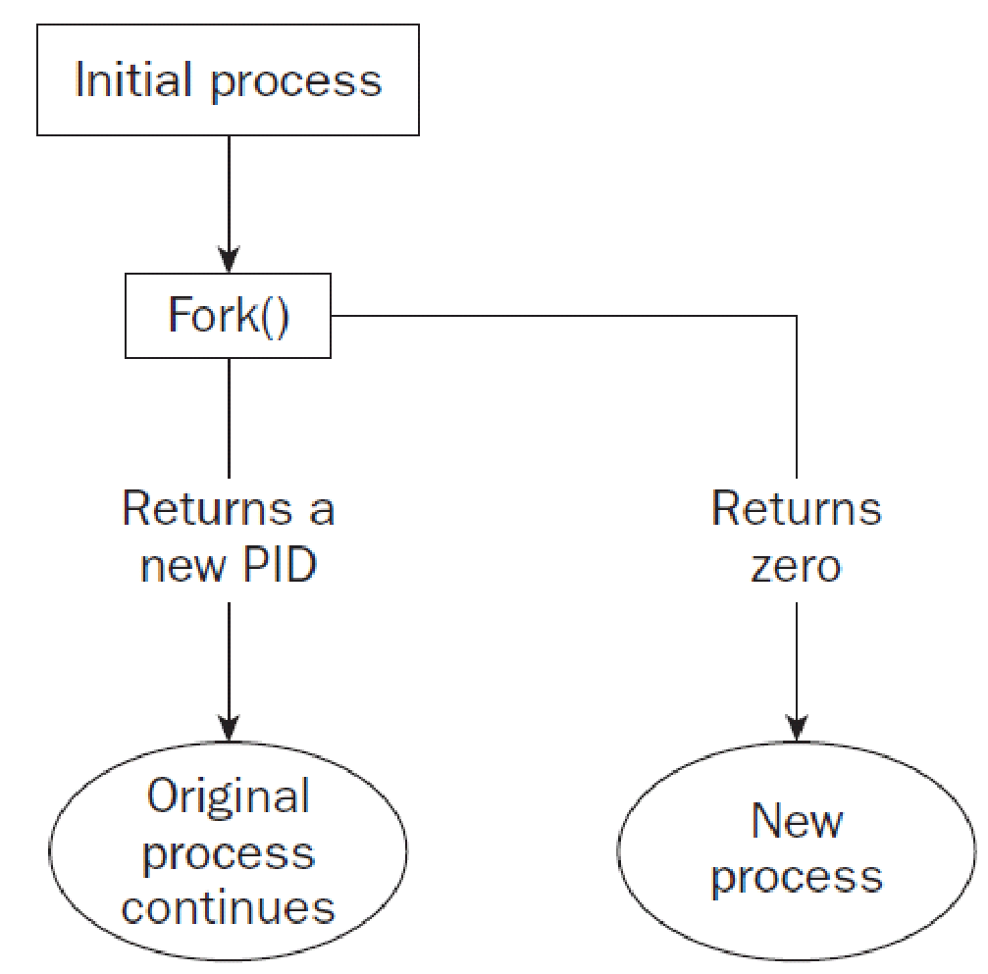
The fork() Function (cont.)
NCHU System & Network Lab

Slide 8
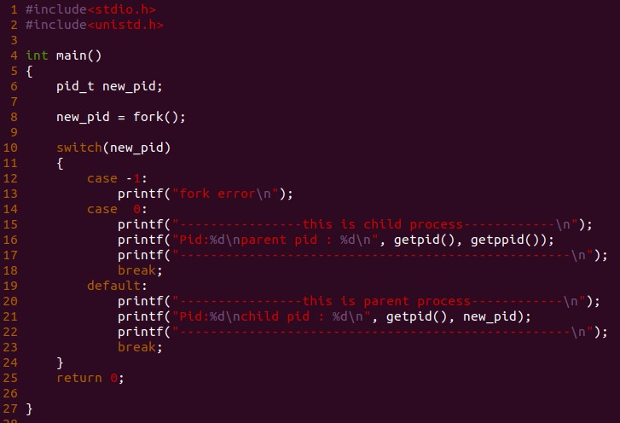
Example (switch)
NCHU System & Network Lab
Notes:
8

Slide 9
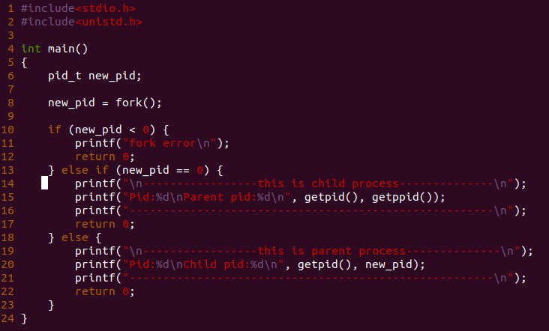
Example (if)
NCHU System & Network Lab

Slide 10
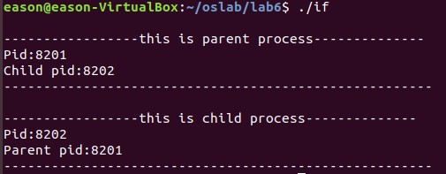
Result
NCHU System & Network Lab

Slide 11
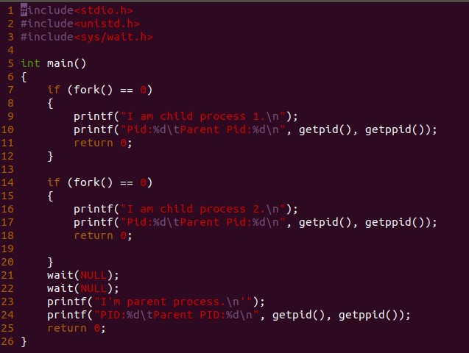
Example 2: fork() multiple times
NCHU System & Network Lab
Notes:
Process 1 和process 2
11

Slide 12
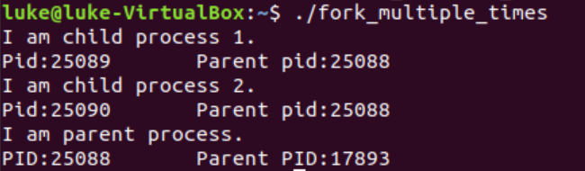
Result
NCHU System & Network Lab
Notes:
12

Slide 13
The wait() Function
The parent can execute wait() to block until the child finishes.
If wait() returns because the status of a child is reported, it returns the process ID of that child.
Else if an error occurs, it returns –1.
SYNOPSIS
#include <sys/wait.h>
pid_t wait(int *stat_loc);
NCHU System & Network Lab

Slide 14
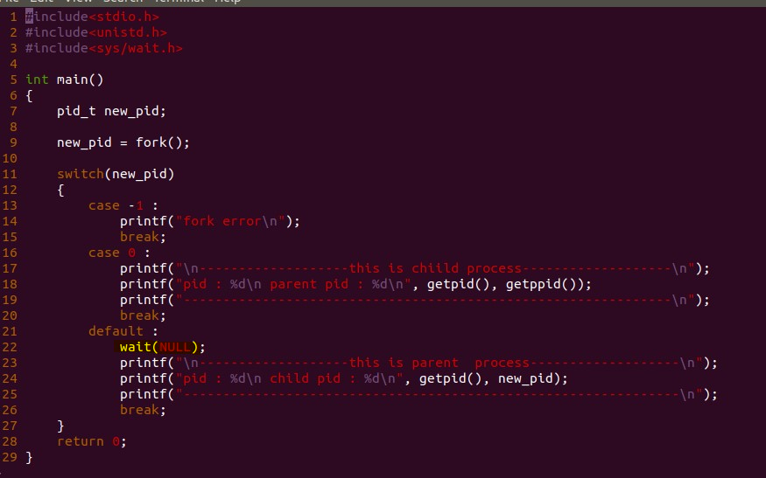
Example
NCHU System & Network Lab

Slide 15
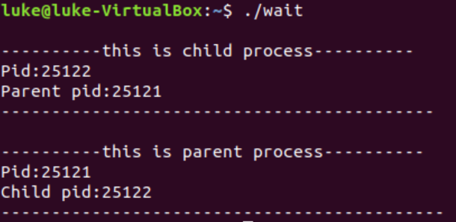
Example (cont.)
Parent process always waits for child and executes last.
NCHU System & Network Lab

Slide 16
The exec() Family
The fork() function creates a copy of the calling process, but many applications require the child process to execute code that is different from that of the parent.
The exec() family provides a facility for overlaying the process image of the calling process with a new image.
Use the fork()–exec() combination for the child to execute the new program while the parent continues to execute the original code.
NCHU System & Network Lab

Slide 17
The exec() Family (cont.)
Copy from original image
Original image
fork()
Parent
Load another image
exec()
Child
NCHU System & Network Lab

Slide 18
The exec() Family (cont.)
Execlp
passes the command-line arguments in an explicit list and are useful if you know the number of command-line arguments at compile time.
SYNOPSIS
#include <unistd.h>
int execlp (const char *filename, const char *arg0, ... /*(char *)0 */);
NCHU System & Network Lab

Slide 19
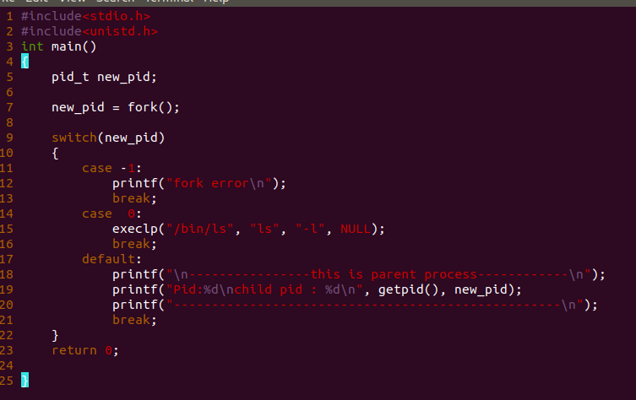
Example
NCHU System & Network Lab

Slide 20
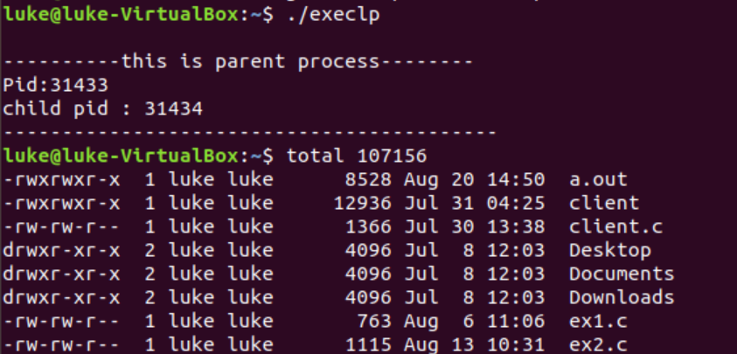
Example (cont.)
NCHU System & Network Lab

Slide 21
Lab I (40 pts.)
Declare a global variable and a local variable
Note that, both the global and local variables are initialized to the same value (=10)
Print both the values of global and local variables in screen
With the process id and parent’s id.
Create a child process
Print both the values of global and local variables in screen
Then, increases both the values of the global variable and local variable
NCHU System & Network Lab
Notes:
21

Slide 22
Lab I (40 pts.)
(40p)Finally, both processes print the values of the global and local variables
With their process id and parent’s id.
NCHU System & Network Lab

Slide 23
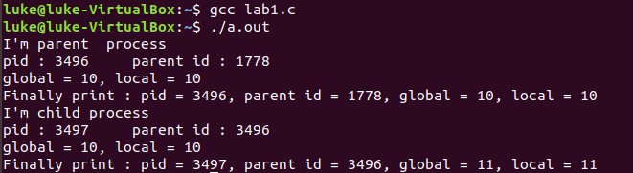
Lab I Result
NCHU System & Network Lab

Slide 24
Lab II (50 pts.)
Write a program that creates 5 processes, forming a tree configuration illustrated in the figure.
Each process print the following report
Its’ process id and the parent’s process id
Each process, if it is a parent, must make a number of wait() system calls to wait until all of it’s children exit.
The number of wait() system calls
depend on the number of children
A
B
D
E
C
NCHU System & Network Lab

Slide 25
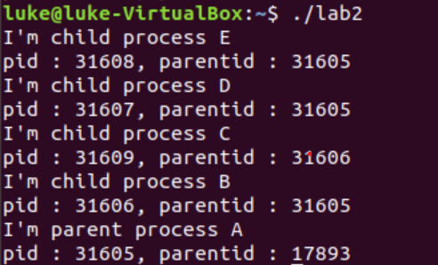
Lab II Result

Slide 26
References
Avi Silberschatz, Peter Baer Galvin and Greg Gagne, “Operating System Concepts,” John Wiley & Sons, 6th Edition, 2001
“Unix Systems Programming: Communication, Concurrency, and Threads” by Kay A. Robbins, Steven Robbins
Neil Matthew and Richard Stones, “Beginning Linux Programming,” Wiley publishing, 3rd Edition, 2004
W. Richard Stevens, “Advanced Programming in the UNIX Environment,” Addison-Wesley, 1992
NCHU System & Network Lab

