Slide 1
Lab 11 Signals
TA:Tzu-Han Chen
Professor: Hsung-Pin Chang
Operating System Lab

Slide 2
What Are Signals?
A signal is used by the OS to notify a process that a particular event has occurred.
Every signal may be handled by one of two possible handlers:
A default signal handler
A user-defined signal handler
Notes:
signal 是 OS 用來通知 process 一個特殊的事件發生了
每一個 signal 可能被兩種 signal handler 處理
1. default signal handler : 預設的 signal handler，kernel 處理的
2. user-defined : 使用者自訂，可以覆蓋 default

Slide 3
Linux Signals
Every signal has a symbolic name starting with SIG.
The signal names are defined in signal.h
Each signal is represented by small integers greater than 0.
Notes:
signal 開頭都是 SIG
被定義在 signal.h 裡面 所以要 include
signal number(signal 代號) 都大於0

Slide 4
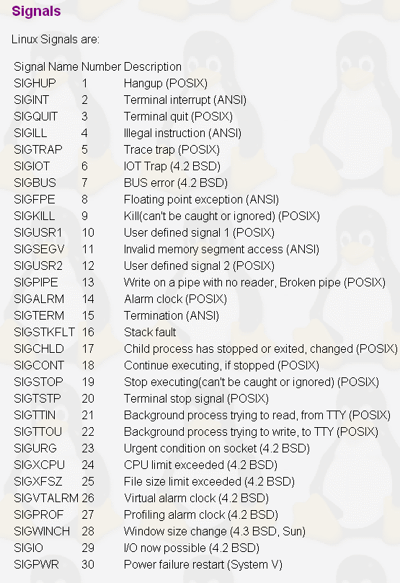
Linux Signals
Notes:
linux signal 的名稱與代號
指令 : kill -l

Slide 5
Sending Signals
Using the keyboard
There are certain key presses that are interpreted by the system as requests to send signals to the process.
Ctrl+C
The interrupt signal, sends SIGINT to the job running in the foreground.
Ctrl+Y
The delayed suspend character.
Ctrl+Z
The suspend signal, sends a SIGTSTP to a running program, thus stopping it and returning control to the shell.
Notes:
Ctrl+C : 發送 SIGINT signal，預設是結束process
Ctrl+Y : 在 Linux 下好像沒功用
VDSUSP (not in POSIX; not supported under Linux; 031, EM, Ctrl-Y) Delayed suspend character (DSUSP): send SIGTSTP signal when the character is read by the user program. Recognized when IEXTEN and ISIG are set, and the system supports job control, and then not passed as input.
Ctrl+Z : 暫停 process 回復 : fg

Slide 6
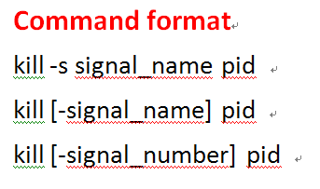
Sending Signals
Using command line
signal_name
By omitting the leading SIG from the corresponding symbolic signal name.
If no signal_name is specified, the TERM signal is sent.
Notes:
利用 command line 送 signal
三種方式
1. kill -s signal_number pid ex : kill –s KILL pid
signal_name : SIG可忽略

Slide 7
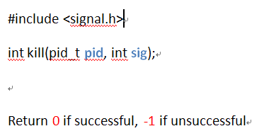
Sending Signals
Using system calls
This is the normal way of sending a signal from one process to another.
Example: A child process sends the SIGTERM signal to its parent process.
kill(getppid(), SIGTERM);
Notes:
使用 system call 傳送 signal
int kill() : 送一個 signal 給另一個 process ，pid : 要送的 process, sig : 要送的 signal，成功回傳 0 失敗回傳 -1
以 kill 為例 : 子 process 可以發送 SIGTERM 到 parent process 殺掉 parent prcoess

Slide 8
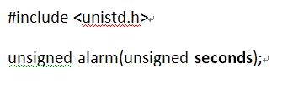
Sending Signals
alarm() Function
Causes a SIGALRM signal to be sent to the calling process after a specified number of real seconds has elapsed.
Notes:
alarm() 會在 seconds 之後產生 SIGALARM signal 到呼叫 alarm() 這個 function 的 process

Slide 9
Exercise 1.1
Step1: Using the fork() function to create a new process.
Step2: Using command line to kill the process.[+30pt.]

Slide 10
Exercise 1.2
Step1: Using the fork() function to create a new process.
Step2: use system calls to kill process.
[+30pt.]

Slide 11
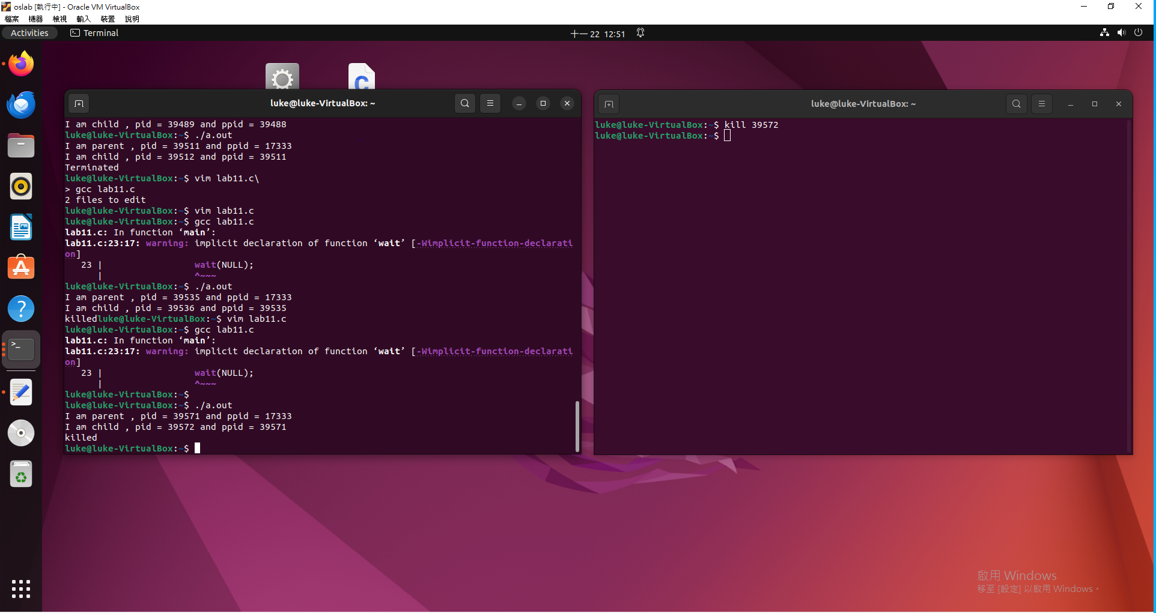
Result
Exercise 1.1

Slide 12
Result
Exercise 1.2

Slide 13
Handling Signals
Default Signal Handlers
If you install no signal handlers of your own, the runtime environment sets up a set of default signal handlers for your program.
For example, the default signal handler for the TERM signal calls the exit()system call.
NCHU System & Network Lab
Notes:
如果沒有註冊 signal handler 的話系統會使用預設 default signal handler
例如 : 預設的 signal handler 接收到 TERM signal 的話會呼叫 exit() system call
或者 ctrl+c 就會殺掉正在執行的 process

Slide 14
Handling Signals (cont.)
Installing signal handlers
signal(), sigaction()
signal(): used to set a signal handler for a single signal type.
pause(): causes the process to halt execution, until a signal is received. It is surely better than a 'busy wait' infinite loop.
SYNOPSIS
#include <signal.h>
void (*signal(int sig, void (*func)(int)))(int);
SYNOPSIS
#include <unistd.h>
int pause(void);
Notes:
設定自己的 signal handler
有兩種方式
signal() : 參數 : sig : 接收到的 signal, void (*func)(int) : 要執行的 signal handler
sigaction()
signal(int sig, void func(int ))(int) : 參數是 要傳送的 signal 還有一個 signal handler
pause() : 暫停 process 直到接收到 signal，其效果會比 busy wait 的無窮迴圈好

Slide 15
Handling Signals (cont.)
Example
/* here is the signal handler */
void catch_int(int sig_num) /* the argument is signal number */
{
/* re-set the signal handler again to catch_int, for next time */
signal(SIGINT, catch_int);
printf(“Ouch! – I got signal %d\n“,sig_num);
}
int main(int argc, char* argv[])
{
/* set the INT (Ctrl-C) signal handler to 'catch_int' */
signal(SIGINT, catch_int);
/* now, lets get into an infinite loop of doing nothing. */
for ( ;; )
pause();
}
NCHU System & Network Lab
Notes:
signal 的執行方式
SIGINT : 接收到 ctrl+c 後呼叫 catch_int() (自己定義的 signal handler)

Slide 16
Handling Signals (cont.)
Pre-defined signal handlers: we can use two pre-defined signal handler functions, instead of writing our own.
SIG_IGN: Ignore the specified signal.
SIG_DFL: Restore default behavior.
NCHU System & Network Lab
Notes:
預先定義的 signal handler
SIG_IGN : 忽略註冊的 signal，除了 SIGKILL 跟 SIGSTOP
SIG_DFL : 預設的 signal 行為

Slide 17
Handling Signals(cont.)
sigaction(): allows the caller to examine or specify the action associated with a specific signal.
The sigaction structure: used to define the actions to be taken on receipt of the signal specified by sig.
SYNOPSIS
#include <signal.h>
int sigaction(int sig, const struct sigaction *act, struct sigaction *oact);
Return 0 if successful, -1 if unsuccessful
struct sigaction {
void (*) (int) sa_handler; /* pointer to function, SIG_DFL or SIG_IGN */
sigset_t sa_mask; /* additional signals to be blocked during execution of handler */
int sa_flags; /* signal action modifiers */
}
NCHU System & Network Lab
Notes:
用 sigaction 自訂義 signal handler (SIGKILL and SIGSTOP 無法改寫)，成功回傳 0 失敗回傳 -1
參數 : sig : 要處理的signal ，*act : 不為 NULL 的話就是新的要執行的 signal handler，*oact : 若非 NULL，系統回傳舊的 signal handler
struct
sa_handler : 欲執行的 signal handler，也可以指定給 SIG_IGN or SIG_DFL，預設是 SIG_DFL
sa_mask : 可以在處理 signal 的過程中遮蔽掉其他的 signal
sa_flags : 當使用 sa_handler 時設為 0 即可

Slide 18
Handling Signals(cont.)
sig: specifies the signal number for the action
act: a pointer to a struct sigaction structure that specifies the action to be taken
If act is NULL, the call to sigaction() does not change the action associated with the signal.
oact: a pointer to a struct sigaction structure that receives the previous action associated with the signal
If oact is NULL, the call to sigaction() does not return the previous action associated with the signal.
NCHU System & Network Lab
Notes:
sig : 要處理的信號
act : 新的信號處理函數
oact : 非NULL 的話回傳原本(舊的 改動前)的 signal handler，

Slide 19
Examples
1. The following code segment sets the signal handler for SIGINT to mysighand.
struct sigaction newact;
newact.sa_handler = mysighand; /* set the new handler */
sigemptyset(&newact.sa_mask); /* initialize the signal mask */
newact.sa_flags = 0; /* no special options */
sigaction(SIGINT, &newact, NULL);
2. The following code segment causes the process to ignore SIGINT if the default action is in effect for this signal.
struct sigaction act;
sigaction(SIGINT, NULL, &act); /* Find current SIGINT handler */
if (act.sa_handler == SIG_DFL) { /* if SIGINT handler is default */
act.sa_handler = SIG_IGN; /* set new SIGINT handler to ignore */
sigaction(SIGINT, &act, NULL);
}
NCHU System & Network Lab
Notes:
Segment1 : 收到 SIGINT 時呼叫 mysighand
建立一個 sigaction 的 struct, 設定 sa_handler 給自己寫的函數
sa_mask : 處理信號時擱置其他信號
sigempty : 初始化傳入的信號集然後清空
sa_flags = 0 : sa_flags 可以用來影響 signal 的行為 ，不特別做甚麼的話設為0
Segment2 : 忽略 SIGINT 信號
若 oldact != NULL 則會把舊的 action 存進 oldact
sa_handler 的 default 值是 SIG_DFL
接著把 sa_handler 改成 SIG_IGN
再重新註冊成新的 action 所以這時候 SIGINT 被換成 SIG_IGN ctrl+c 不再有用

Slide 20
Exercise 2 – Dynamically change your handler
Writing handler1 : show “How are you?” message.
Writing handler2 : show ”I am fine!” message.
In the first 3 seconds, you have to maintain handler1 as your SIGINT handler.
Next 3 seconds, you have to maintain handler2 as your SIGINT handler.
Then you set SIGINT handler to “default” handler.[+30pt.]
Note: you should use alarm()!!![+10pt.]
NCHU System & Network Lab
Notes:
寫一個 handler print
再寫一個 handler pirnt 出 I am fine
前三秒發送 SIGINT 時要呼叫 handler1
下個三秒 SIGINT 要發送給 handler2
然後把你的 SIGINT handler 設定成 default

Slide 21
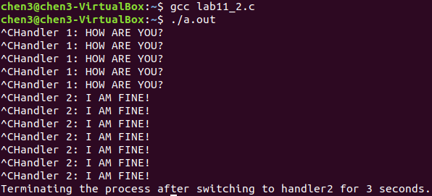
Result

Slide 22
References
Avi Silberschatz, Peter Baer Galvin and Greg Gagne, “Operating System Concepts,” John Wiley & Sons, 10th Edition, 2001
“Unix Systems Programming: Communication, Concurrency, and Threads” by Kay A. Robbins, Steven Robbins
Neil Matthew and Richard Stones, “Beginning Linux Programming,” Wiley publishing, 3rd Edition, 2004
W. Richard Stevens, “Advanced Programming in the UNIX Environment,” Addison-Wesley, 1992
Notes:
https://people.cs.nctu.edu.tw/~yslin/library/linuxc/function/13.html

