Slide 1
Lab16 Paging
TA: YUNG-HSU CHU
Professor: Hsung-Pin Chang
Operating System Lab

Slide 2
Address Translation Scheme
Address generated by CPU is divided into:
Page number (p) – used as an index into a page table which contains base address of each page in physical memory
Page offset (d) – combined with base address to define the physical memory address that is sent to the memory unit
page number
page offset
p
d
m - n
n

Slide 3
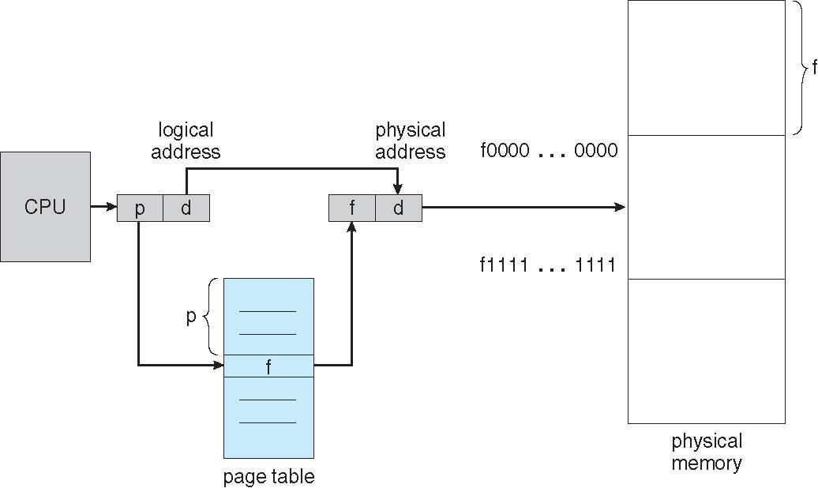
Paging Hardware

Slide 4
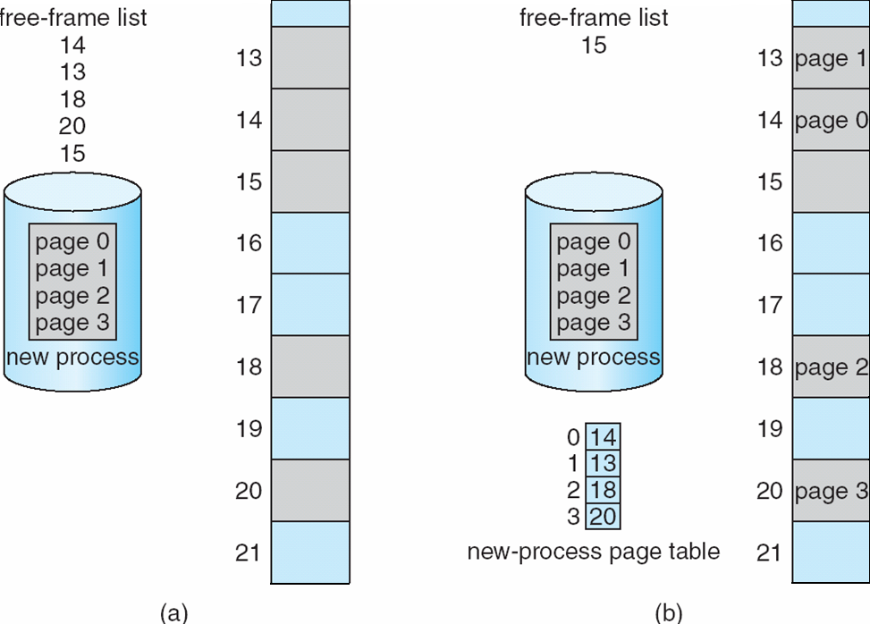
Free-frame list

Slide 5
Paging Hardware Example
Physical Address
Frame No. Offset:value
Page No. Frame No.
0 | Used
1
2 | Used
3 | Used
4
5
6 | used
7
Logical Address
Page No.
Logical memory
1:0
0:A
1:B
0
1
2
3
1
offset | value
0 1 | A B
0 1 | C D
0 1 | E F
0 1 | G H
1:1
0:0
7
0
0:1
1:0
5
1
CPU
4
2:0
0:G
1:H
2
4:1
Page table
5:0
0:E
1:F
3
3:1
7:0
0:C
1:D
Free frame list
1(001)
5(101)
1(001)
4
5
1
7
4
5
1
Physical memory

Slide 6
Exercise(100)
Write a simulate paging program
There are 2 processes(see next page).
Paging them into physical memory by using free-frame list and page table.
Please show
logical memory list + page table (60%)
physical memory list + free frame list (40%)
Non-contiguous memory allocation(use random)

Slide 7
Random
#include <stdlib.h>
#include <time.h>
srand(time(NULL));
a = (rand()%5)+1
a will get values in range 1~5。

Slide 8
Exercise(cont.)
Physical memory
0
1 | zz
2
3
4
5
6 | cd
7
8
9 | yy
10
11
12 | ab
13
14 | ef
15 | rx
Free frame list
A’s Logical memory
0 | ab
1 | ef
2 | cd
0 | 12
1 | 14
2 | 6
11
2
0
13
8
3
10
5
4
7
Page table A
B’s Logical memory
0 | rx
1 | yy
2 | zz
0 | 15
1 | 9
2 | 1
Page table B

Slide 9
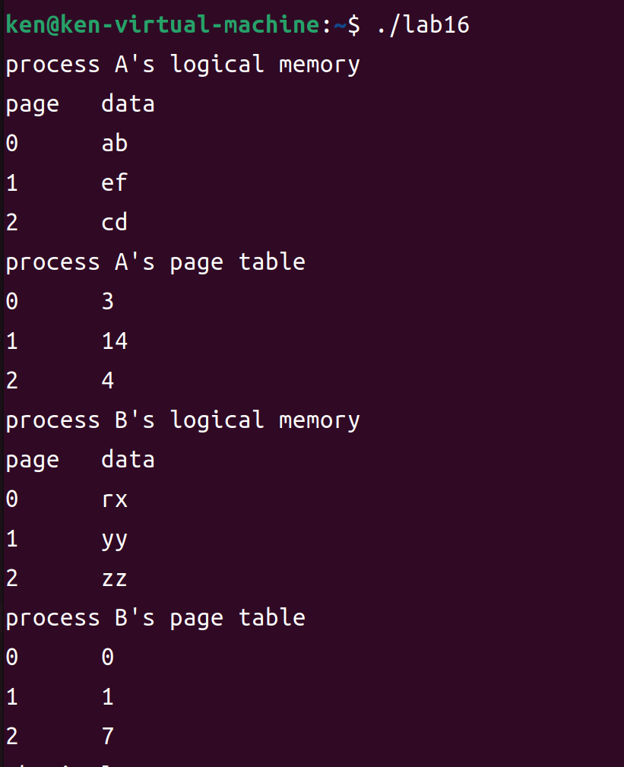
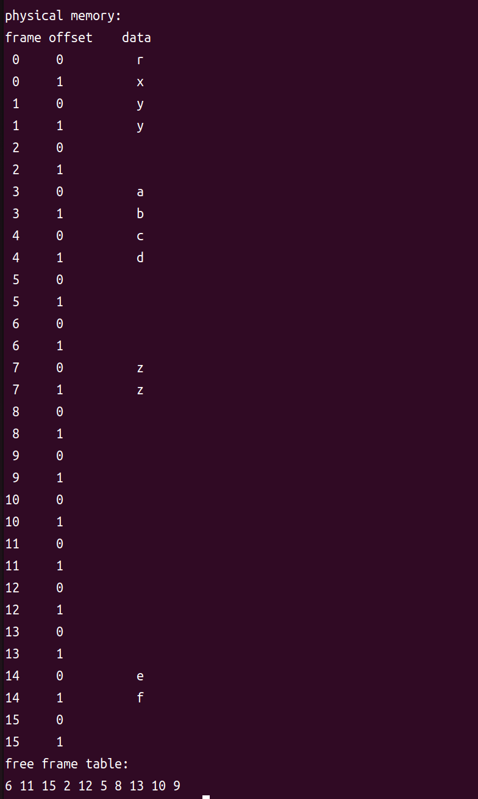
Exercise(cont.)

Slide 10
Reference
Operating System Concepts Tenth Edition
Ch9 main memory
https://www.os-book.com/OS10/slide-dir/PPTX-dir/ch9.pptx

