Slide 1
Katas
#kata on Slack

Slide 2
Getting started
C#
Open the solution file for the kata
JavaScript
Run npm i –g gulp-cli
From the kata’s js folder, run the following: npm install
To run tests: gulp
To stop tests, press Ctrl+C

Slide 3

Roman Numeral Kata
Convert any numeric value to a roman numeral sequence and any roman numeral sequence to a numeric value

Slide 4
Roman Numeral Kata
Feature 1: Converting Arabic to Roman
1 => I, 5 => V, etc
Feature 2: Converting Roman to Arabic
I => 1, V => 5, etc
Advanced rules:
The symbols 'I', 'X', 'C', and 'M' can be repeated at most 3 times in a row.
The symbols 'V', 'L', and 'D' can never be repeated.
The '1' symbols ('I', 'X', and 'C') can only be subtracted from the 2 next highest values ('IV' and 'IX', 'XL' and 'XC', 'CD' and 'CM').
Only one subtraction can be made per numeral ('XC' is allowed, 'XXC' is not).
The '5' symbols ('V', 'L', and 'D') can never be subtracted.
http://agilekatas.co.uk/katas/romannumerals-kata

Slide 5
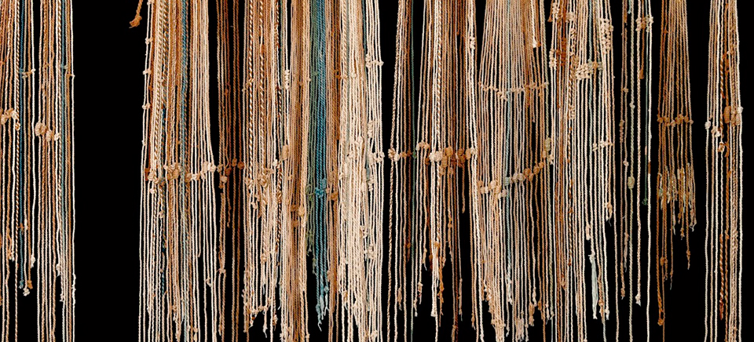
String Calculator Kata
Pass in a string of delimited numbers and add them together

Slide 6
String Calculator
Take 0, 1 or 2 numbers within a string and return their sum
“” => 0, “1” => 1, “1,2” => 3, etc
Add any amount of numbers together
“1,2,3,4” => 10, etc
Handle new line delimiter instead of commas
Support specifying delimiter within string
“//;\n1;2” => 3, “//+\n1+4” => 5, etc
Potential improvements:
Numbers over 1000 should be ignored (“2,1001” => 2)
Delimiters of any length (“//[***]\n1***2***3” => 6)
Multiple delimiters (“//[,][++]\n1,2++3” => 6)
http://osherove.com/tdd-kata-1/

Slide 7

Bowling Kata
A game of bowling lasts ten frames.

Slide 8
Bowling Kata
A game of bowling lasts ten frames.
In each frame, the bowler makes one or two attempts to knock down ten pins.
If they get a strike, they score ten pins plus the number of pins knocked down on their next two rolls.
If they get a spare, they scores ten pins plus the number of pins knocked down on their next roll.
If the bowler fails to knock down all ten pins they score the number of pins knocked down.
The scores accumulate through all ten frames.
At the last frame, if necessary, the pins are reset for one or two additional rolls to count the final bonus.
http://www.butunclebob.com/ArticleS.UncleBob.TheBowlingGameKata

Slide 9
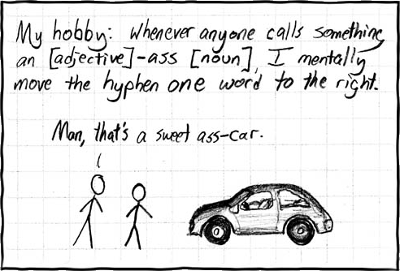
Sweet Ass-Kata
Convert text from [adjective]-ass [noun] to [adjective] ass-[noun]

Slide 10
Sweet Ass-Kata
Convert text from [adjective]-ass [noun] to [adjective] ass-[noun]
“Man, that’s a sweet-ass car.” => “Man, that’s a sweet ass-car.”
Potential improvements:
Ensure it won’t swap if the noun exists but the pattern doesn’t
Ability to define the noun to be swapped
Automatically detect the pattern and swap for any noun
https://xkcd.com/37/

