Slide 1
IoT Protocols
HTTP
CoAP
MQTT
WebSockets
STOMP
Sockets (own protocol)

Slide 2
Overall Informations
Tests made with USB to Ethernet adapter
  2 extra bytes in each direction
Publish topic: vat_test_setup/PRODTOOL/MODULE_ID/PROD_ID/BASIC/v1
  Extra 50 bytes

Slide 3
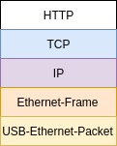
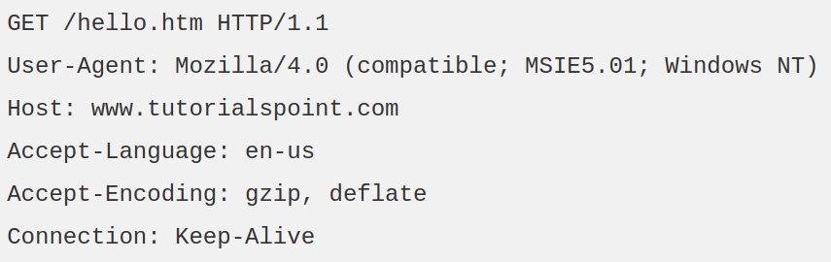
HTTP
plaintext
request/response model
RabbitMQ Plugin available
Reliable through TCP
Lots of overhead

Slide 4
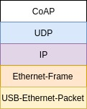
CoAP
HTTP in binary
RabbitMQ Plugin available (3.6)

